Slide 1


FPGA Applications on Nautilus
Mohammad Sada and Elham Khoda
Sixth National Research Platform (6NRP) Workshop
San Diego Supercomputer Center
January 28th, 2025

Slide 2

The Slides can be found at:
https://github.com/nrp-nautilus/6nrp-fpga
2

Slide 3
FPGAs
3

Slide 4
FPGAs
- Field-Programmable Gate Arrays
- Unlike CPUs/GPUs (general-purpose), FPGAs are programmed for specific applications.
- Analogy: CPU = Swiss Army knife, handles variety of tasks, but not optimized. FPGA = Custom-rebuilt machinery, designed for a specific job.
- High Throughput, Low Latency, Energy Efficiency, Flexibility
4

Slide 5
How Are FPGAs Programmable?
- HDL (Hardware Description Language): FPGAs are programmed using languages like Verilog or VHDL (low-level hardware description).
These languages describe the circuit’s behavior at the logic level, such as AND, OR gates, or complex logic circuits.
- HLS (High-Level Synthesis): Use C/C++ for FPGA programming (via tools like Vitis HLS).
Converts high-level code into hardware designs, making FPGA programming more accessible.
HLS C/C++
Vitis/Vitis HLS
Verilog/VHDL
5

Slide 6
How Are FPGAs Programmable?
module uart_tx_hello_world (
input clk, // Clock signal (100 MHz)
input rst, // Reset signal
output tx, // UART transmit pin
output reg [7:0] led_out // Optional: To indicate transmission progress
);
// UART settings
parameter BAUD_RATE = 115200;
parameter CLOCK_FREQ = 100_000_000; // 100 MHz clock
// Baud rate generator (generate 115200 baud)
reg [15:0] baud_counter;
reg baud_tick;
// State machine for transmitting UART data
reg [3:0] state; // FSM states (Idle, Start, Data, Stop)
reg [7:0] data_byte; // Byte to be transmitted
reg [3:0] bit_index; // Index of current bit in the byte
reg transmitting; // Indicates if data is being transmitted
// String "Hello World!" (as 8-bit characters)
reg [7:0] message [11:0];
integer i;
// Baud rate counter
always @(posedge clk or posedge rst) begin
if (rst) begin
baud_counter <= 0;
baud_tick <= 0;
end else begin
if (baud_counter == (CLOCK_FREQ / BAUD_RATE - 1)) begin
baud_counter <= 0;
baud_tick <= 1; // Generate baud tick every 1 clock cycle
end else begin
baud_counter <= baud_counter + 1;
baud_tick <= 0;
end
end
end
// State machine to handle transmission
always @(posedge clk or posedge rst) begin
if (rst) begin
state <= 0;
transmitting <= 0;
bit_index <= 0;
data_byte <= 0;
i <= 0;
led_out <= 0;
end else if (baud_tick) begin
case (state)
0: begin // Idle state
if (i < 12) begin
state <= 1; // Start transmission
transmitting <= 1;
data_byte <= message[i]; // Load next character
bit_index <= 0;
led_out <= 1; // Indicate activity on the LED
end
end
1: begin // Start bit
tx <= 0; // Start bit (low)
state <= 2;
end
2: begin // Data bits (8 bits)
tx <= data_byte[bit_index]; // Send each bit
if (bit_index == 7) begin
state <= 3; // After 8 bits, go to stop bit
end else begin
bit_index <= bit_index + 1;
end
end
3: begin // Stop bit (high)
tx <= 1; // Stop bit (high)
state <= 0; // Back to idle
if (transmitting) begin
i <= i + 1; // Move to next character in the string
end
transmitting <= 0;
end
endcase
end
end
// Initialize "Hello World!" message
initial begin
message[0] = "H";
message[1] = "e";
message[2] = "l";
message[3] = "l";
message[4] = "o";
message[5] = " ";
message[6] = "W";
message[7] = "o";
message[8] = "r";
message[9] = "l";
message[10] = "d";
message[11] = "!";
end
endmodule
6

Slide 7
AMD/Xilinx Alveo U55C
7

Slide 8
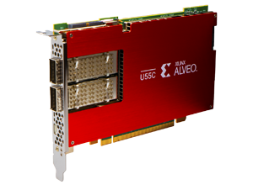
AMD/Xilinx Alveo U55C
PCI Express Interface
Gen3 x16 or 2 x Gen4 x8
Networking
2 x QSFP28 connectors (100 Gb/s each)
Memory
16 GB High-Bandwidth Memory (HBM2)
HBM2 Bandwidth
460 GB/s
Internal SRAM Capacity
43 MB
Internal SRAM Bandwidth
35 TB/s
LUTs
1,304,000
Registers
2,607,000
DSP Slices
9,024
Dimensions
Full Height, Half Length, Single Slot
Power
Maximum: 150W, Typical: 115W
8

Slide 9
FPGAs and HPC – Use Cases
9

Slide 10
FPGAs and HPC – Use Cases
1- Machine Learning and AI Acceleration:
- Vitis AI enables using Alveo Versal FPGAs for both inference and fine-tuning.
Converts TensorFlow and PyTorch models into Verilog for FPGA deployment.
- hls4ml converts machine learning models into FPGA-ready HLS designs.
Optimizes machine learning algorithms for FPGA deployment.
Is open-source.
Free and Open-Source and Supported on Nautilus.
10

Slide 11
FPGAs and HPC – Use Cases
2- FPGAs as SmartNICs
- FPGAs are used as SmartNICs for customizable packet processing at high bandwidth (2x100Gbps).
- Supports P4 programming for custom network processing.
Ideal for high-bandwidth, low-latency networking.
11

Slide 12
FPGAs on Nautilus
12

Slide 13
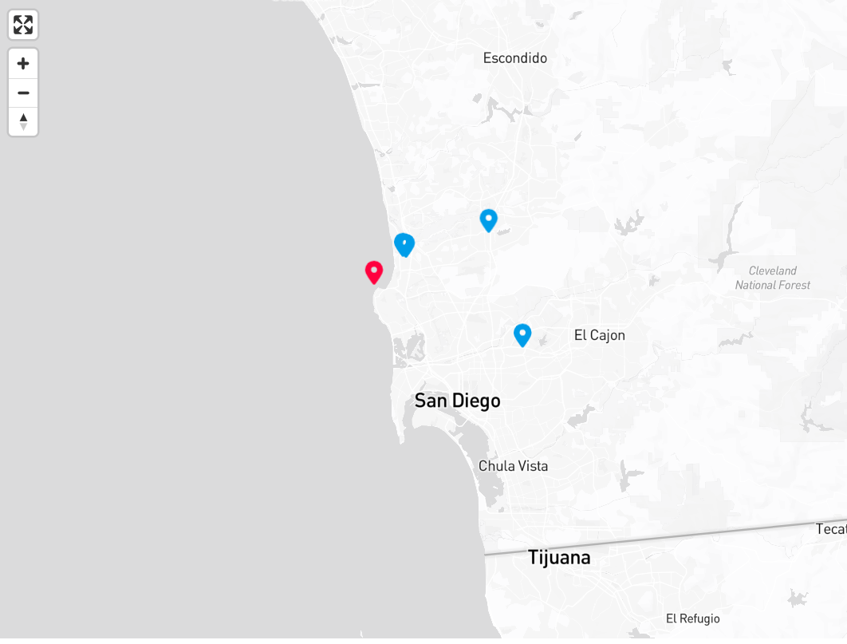
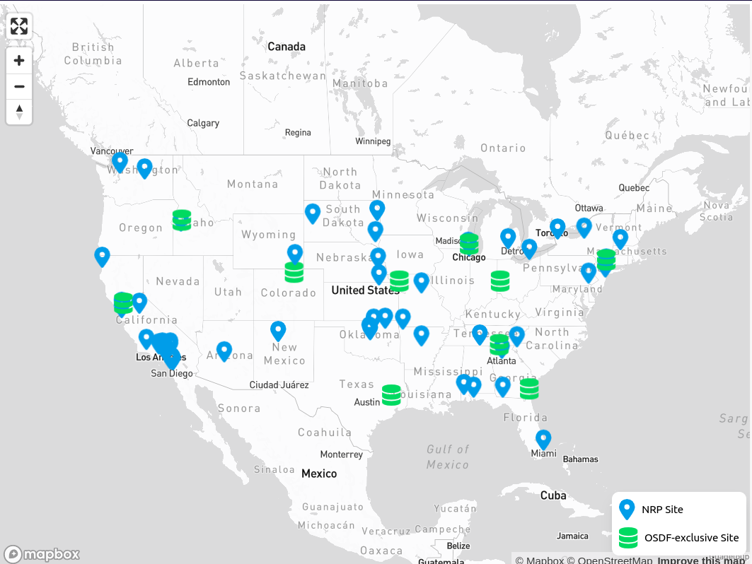
FPGAs on Nautilus
13

Slide 14
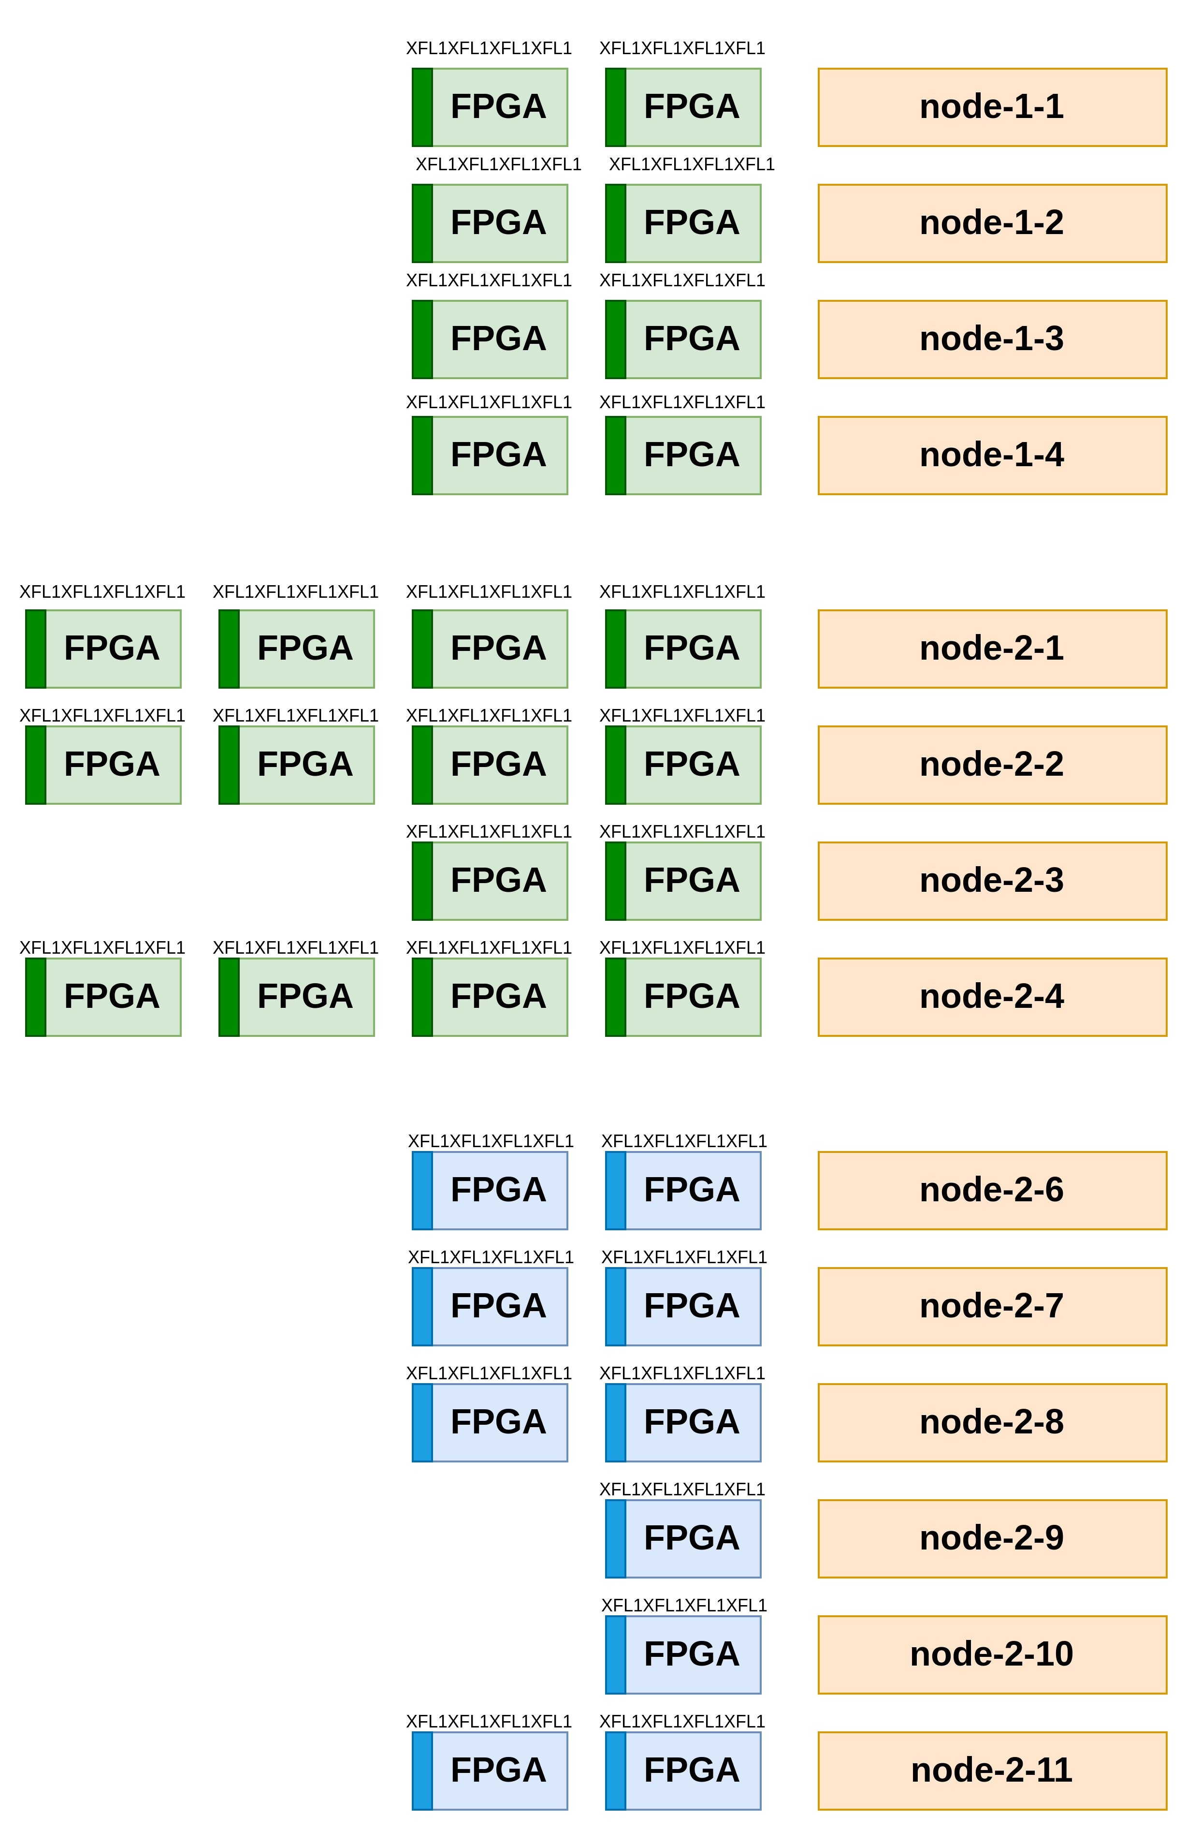
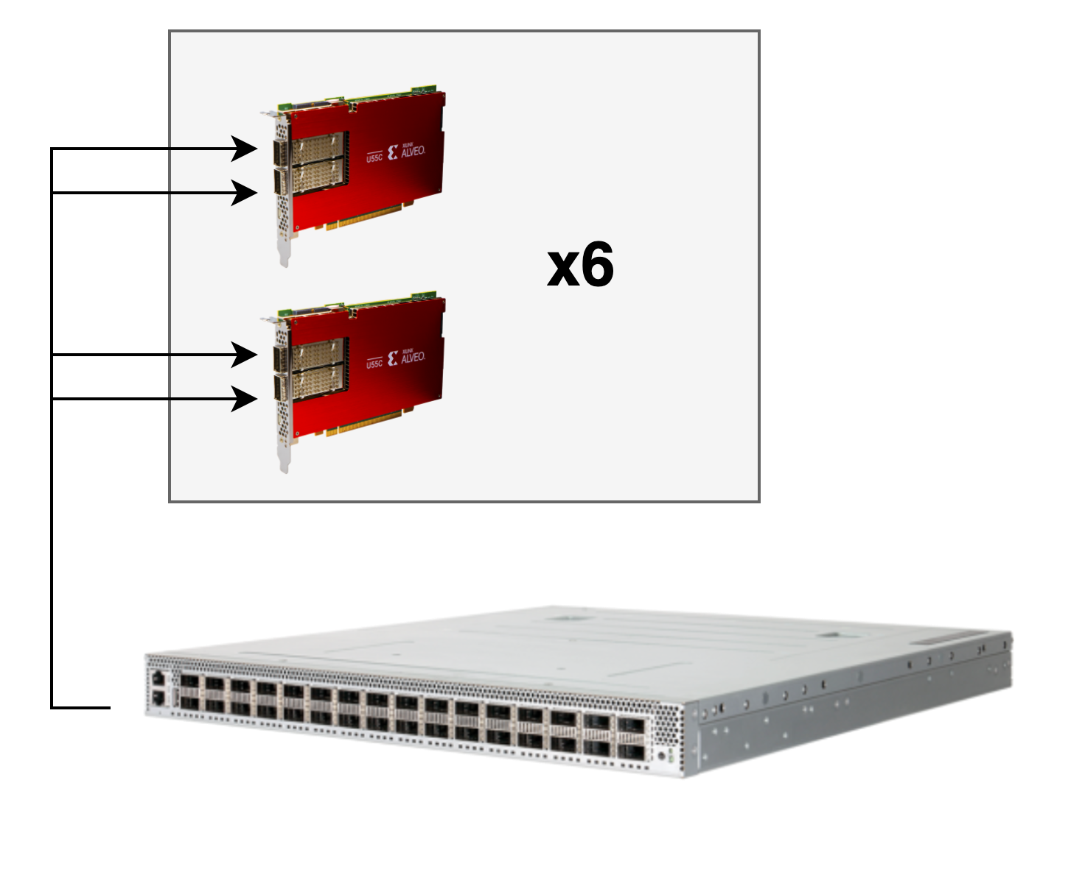
FPGAs on Nautilus
32 FPGAs
14

Slide 15



FPGAs on Nautilus
HLS Code
Allocated resources: (Total limits may be over 100 percent, i.e., overcommitted.) Resource Requests Limits -------- -------- ------ amd.com/xilinx_u55c_gen3x16_xdma_base_3-0 4 4
HDL
Bitstream
resources:
requests:
amd.com/xilinx_u55c_gen3x16_xdma_base_3-0: 1
limits:
amd.com/xilinx_u55c_gen3x16_xdma_base_3-0: 1
15

Slide 16
Hands-On Examples
16

Slide 17
Hands-On Examples
Please go to:
https://github.com/nrp-nautilus/6nrp-fpga
17

