Slide 1


ESnet SmartNIC Tutorial
Mohammad Firas Sada
Wed, March 5th, 2025
We will be starting shortly...

Slide 2
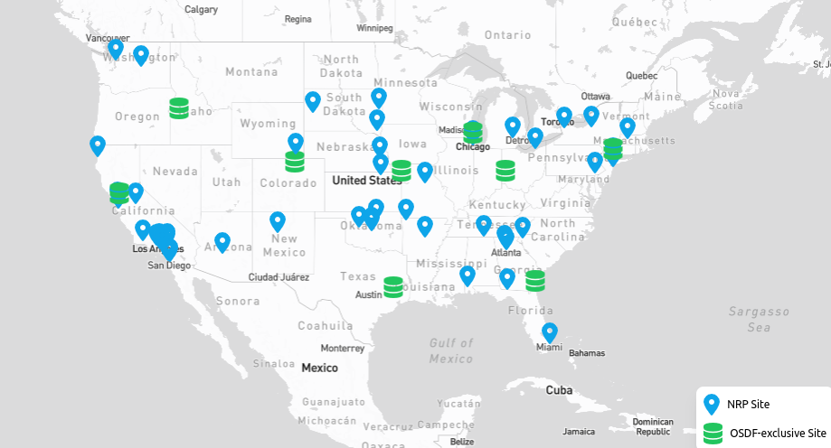
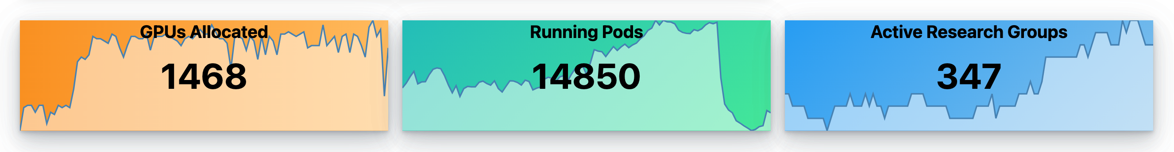
The National Research Platform
The National Research Platform is a partnership of more than 50 institutions.
Led by researchers at UC San Diego, University of Nebraska-Lincoln, and MGHPCC.
Includes contributions by the National Science Foundation, the Department of Energy, the Department of Defense, and many research universities and R&E networking organizations in the US and around the world.
NRP operates a primary Kubernetes distribution cluster with hardware spanning across 3 continents, called Nautilus.

Slide 3
Xilinx Alveo U55C FPGAs
FPGAs: Field-Programmable Gate Arrays
Fully programmable hardware.
Reconfigurable hardware devices that can be programmed to perform specific tasks at high speed.
High Throughput, Low Latency, Energy Efficiency, Flexibility
For Network Engineers:
Hardware-accelerated packet processing.
Custom routing, switching, and telemetry functions.
FPGAs can be linked to other FPGAs or other resources.

Slide 4
Xilinx Alveo U55C FPGAs
1- Machine Learning and AI Acceleration:
- hls4ml converts machine learning models into FPGA-ready HLS designs.
- Optimizes machine learning algorithms for FPGA deployment.
- Is open-source.
2- FPGAs as SmartNICs
- FPGAs are used as SmartNICs for customizable packet processing at high bandwidth (2x100Gbps).
- Supports P4 programming for custom network processing.
- Ideal for high-bandwidth, low-latency networking.

Slide 5
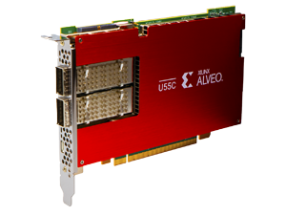
Xilinx Alveo U55C FPGAs
PCI Express Interface
Gen3 x16 or 2 x Gen4 x8
Networking
2 x QSFP28 connectors (100 Gb/s each)
Memory
16 GB High-Bandwidth Memory (HBM2)
HBM2 Bandwidth
460 GB/s
Internal SRAM Capacity
43 MB
Internal SRAM Bandwidth
35 TB/s
LUTs
1,304,000
Registers
2,607,000
DSP Slices
9,024
Dimensions
Full Height, Half Length, Single Slot
Power
Maximum: 150W, Typical: 115W

Slide 6
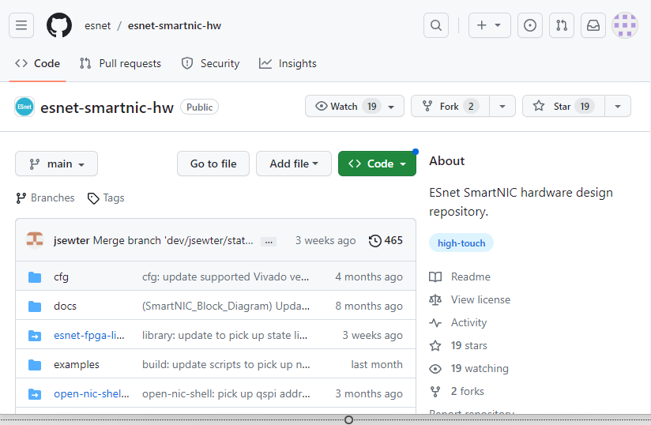
ESnet P4 SmartNIC
- ESnet SmartNIC framework provides an entire workflow for Xilinx Alveo FPGAs.
- It is open-source (on github).
- It seamlessly integrates Xilinx tools along with various tools like DPDK to provide an easy way of programming Alveo FPGAs as SmartNICs.
- Various debugging, testing and simulating tools.
- Containerized environment that makes it as easy as plug-and-play for P4 on FPGAs.
6

Slide 7
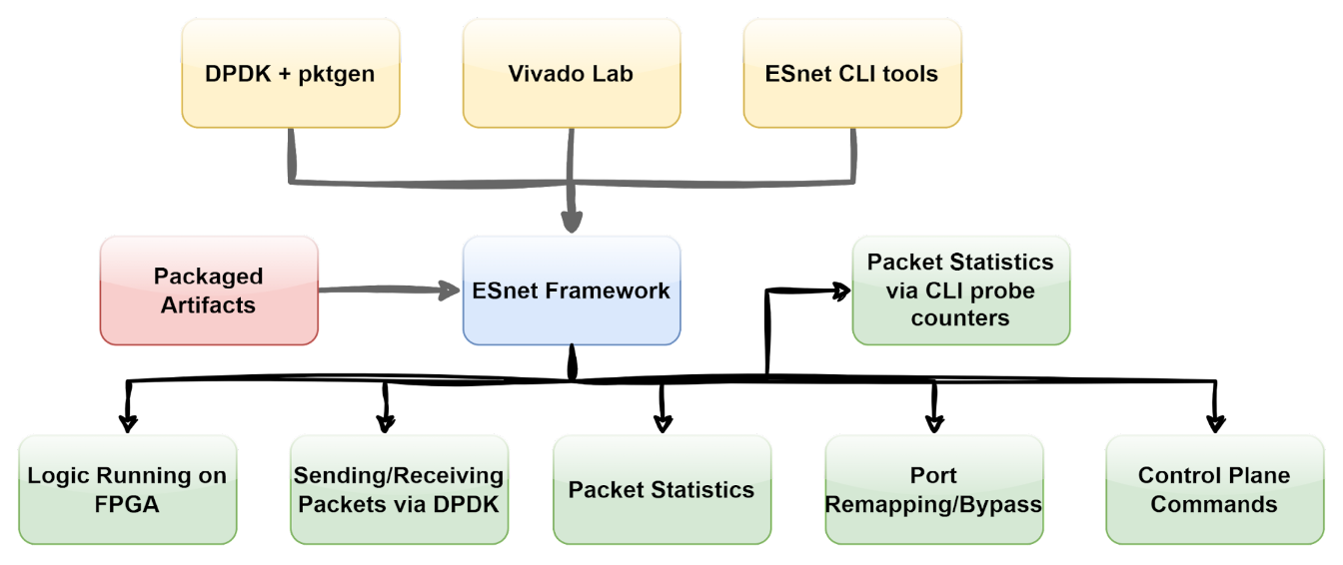
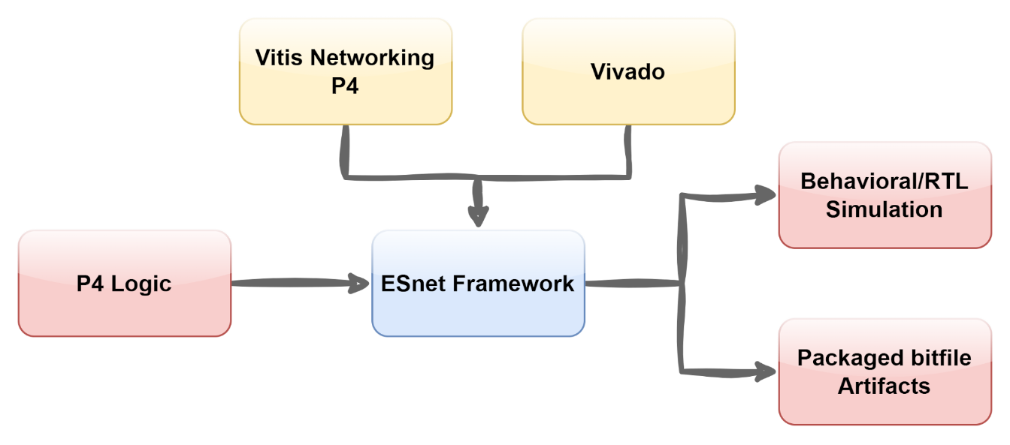
ESnet P4 SmartNIC
https://docs.nrp.ai/userdocs/fpgas/esnet/
7

Slide 8
Hands-On https://github.com/nrp-nautilus/esnet-smartnic/

Slide 9
Future Direction
Establishing a high-level approach to running P4 programs on FPGAs
High-level approach to establishing L2 paths (ESnet SENSE)
One-stop environment for joint NRP/FABIRC Experiments
Pipeline for compiling P4 using CI/CD
Future talks/tutorials

Slide 10
Q&A

Slide 11
For more information:
National Research Platform: https://nrp.ai/
Joining NRP: https://portal.nrp-nautilus.io/
NRP Getting Started docs: https://portal.nrp.ai/documentation/userdocs/tutorial/introduction/
NRP FPGA docs: https://portal.nrp.ai/documentation/userdocs/fpgas/vivado-vitis/
FABRIC Testbed: https://fabric-testbed.net/
FABRIC docs on FPGAs: https://learn.fabric-testbed.net/knowledge-base/using-xilinx-u280-fpgas-on-fabric/
The tutorial documentation: https://github.com/nrp-nautilus/esnet-smartnic/
To contact us:
Email: mfsada@ucsd.edu
Support: support@nationalresearchplatform.org
NRP's Matrix: https://element.nrp-nautilus.io/

