Slide 1
Inside the National
Research Platform
How we build it, how we run it, and how you can use it
Daniel Diaz · San Diego Supercomputer Center, UC San Diego
SCinet · SC26 · Chicago · November 2026

Slide 2
Agenda
What NRP is, in five minutes
How it's built: the network, sites, storage, ingress
How we run it: GitLab and Argo CD, CI in VMs, NetBox, monitoring, perfSONAR, security, sharing GPUs
AI: the LLM service, from the gateway to the GPUs, and an ops bot built on it
Using it yourself
Live demo, then questions
About 33 minutes of slides,
a 12-minute demo,
then questions.
Ask anything along the way.
Slides and the demo notebook:
https://training.nrp-nautilus.io/scinet-sc26
1

Slide 3
What NRP Is
2

Slide 4
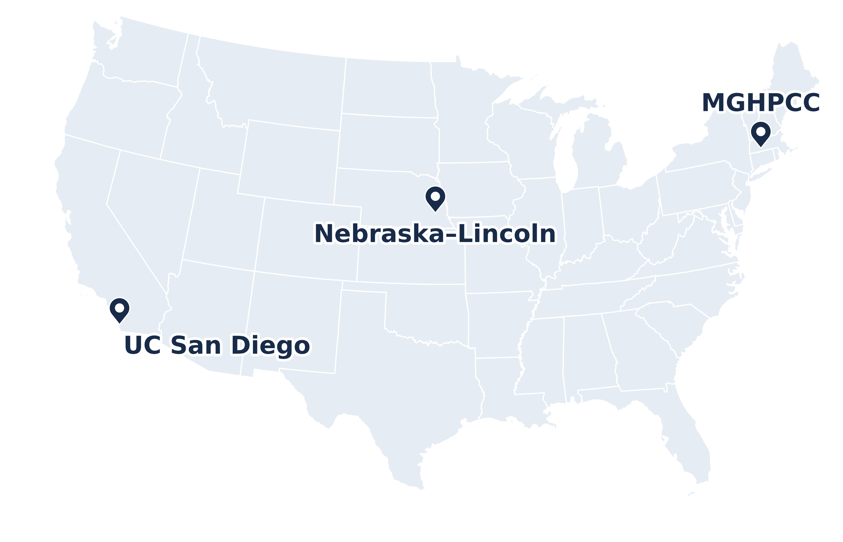
What is NRP?
One national Kubernetes cluster, Nautilus, for research and education
Operated by SDSC (UC San Diego), Nebraska–Lincoln and MGHPCC; funded by NSF
https://dash.nrp-nautilus.io
Nodes, GPUs, cores and storage: cluster snapshot, 10 Nov 2026
3

Slide 5
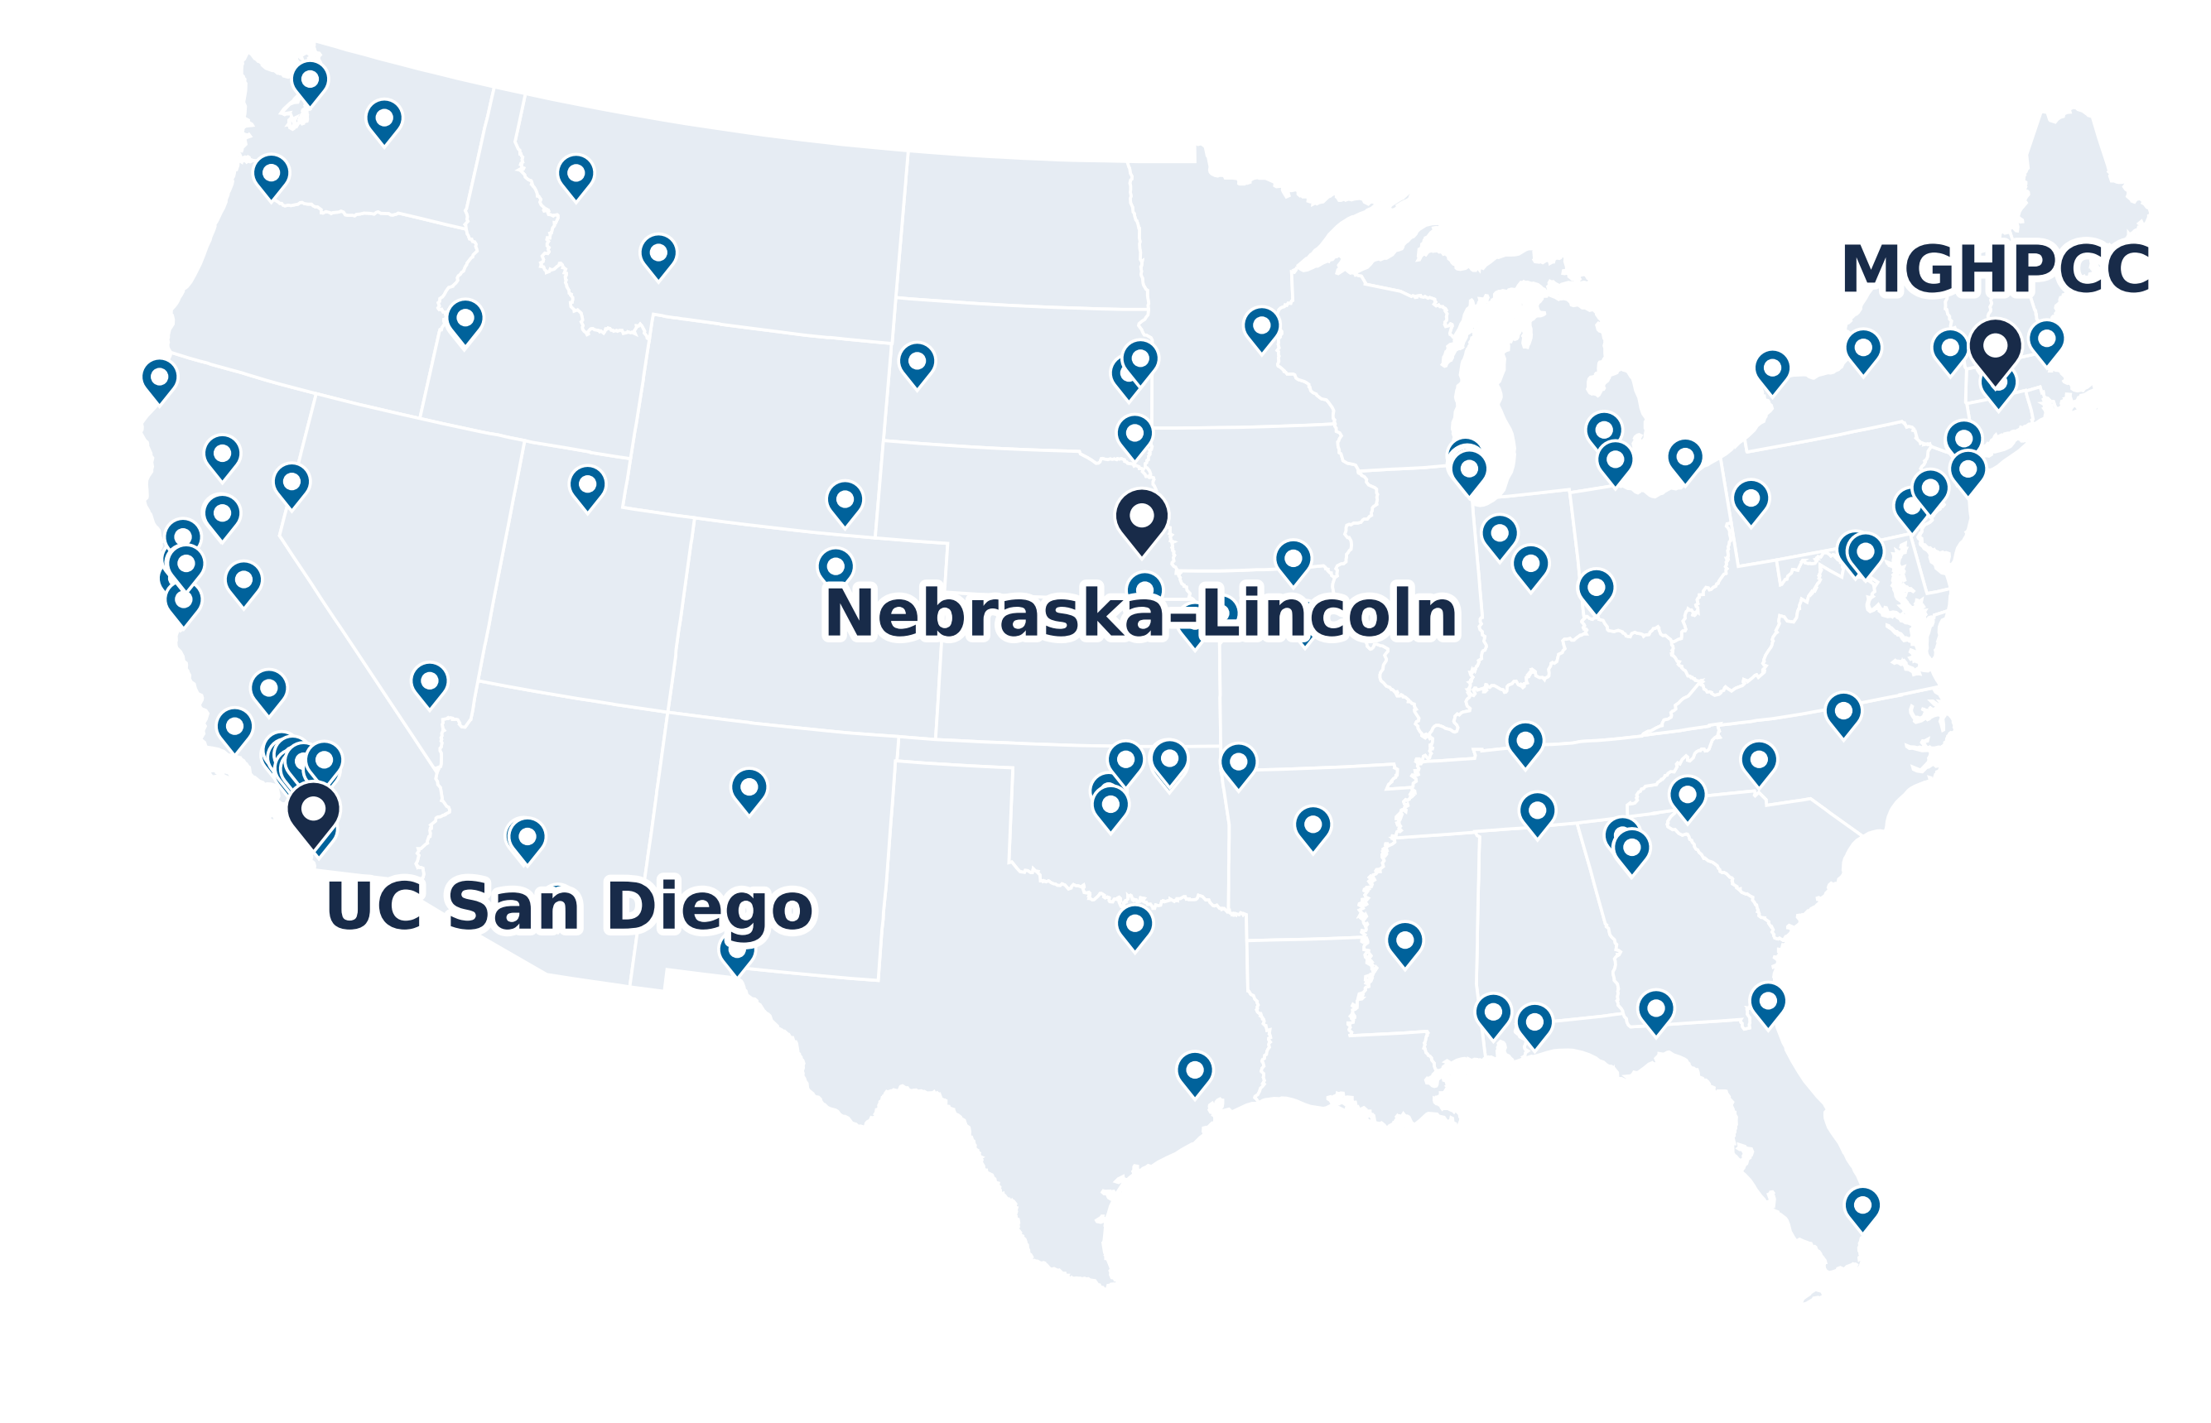
What is NRP?
One national Kubernetes cluster, Nautilus, for research and education
Operated by SDSC (UC San Diego), Nebraska–Lincoln and MGHPCC; funded by NSF
Hardware from 70+ institutions, on research and education networks
Today:
536 nodes at 129 sites
1,460 GPUs in 33 models; 59,352 CPU cores
15 PB of raw Ceph storage
https://dash.nrp-nautilus.io
Sites from the NRP dashboard, 10 Nov 2026
Not drawn: 8 sites in Hawaii, Guam, Korea, Brazil and Europe
Nodes, GPUs, cores and storage: cluster snapshot, 10 Nov 2026
3

Slide 6
What is NRP?
One national Kubernetes cluster, Nautilus, for research and education
Operated by SDSC (UC San Diego), Nebraska–Lincoln and MGHPCC; funded by NSF
Hardware from 70+ institutions, on research and education networks
Today:
536 nodes at 129 sites
1,460 GPUs in 33 models; 59,352 CPU cores
15 PB of raw Ceph storage
Free for non-commercial research and education
One team runs it from the OS up; campuses keep priority on what they contribute
https://dash.nrp-nautilus.io
Sites from the NRP dashboard, 10 Nov 2026
Not drawn: 8 sites in Hawaii, Guam, Korea, Brazil and Europe
Nodes, GPUs, cores and storage: cluster snapshot, 10 Nov 2026
3

Slide 7
From PRP to NRP
2015
2018
2021
2026
Pacific Research Platform
Data transfer nodes (FIONAs) in campus Science DMZs, on CENIC and Pacific Wave
OAC-1541349
Toward a National Research Platform
The same model, beyond the West Coast
OAC-1826967
National Research Platform
An NSF Category II resource: GPUs, storage and services for research and education
OAC-2112167
Today
One Kubernetes cluster, Nautilus: 536 nodes at 129 sites, and AI models as a service
Under each milestone: its NSF award.
4

Slide 8
NRP in Numbers
536
nodes
129
sites on the dashboard
1,460
GPUs in 33 models
59,352
CPU cores
14.9 PB
raw Ceph in 9 clusters
2,334
namespaces: labs, courses, services
Cluster snapshot, 10 Nov 2026 (Kubernetes v1.34.11). Sites: the NRP dashboard.
5

Slide 9
How It's Built
6

Slide 10
The Network Underneath
Nodes sit in campus Science DMZs, outside campus firewalls, at 10–100 Gb/s
Jumbo frames: MTU 9000 between all nodes
Regional and national R&E networks carry the traffic
54 nodes sit in 51 Internet2 locations
Calico builds the pod network: a VXLAN overlay, IPv4 and IPv6 (309 nodes dual-stack)
Campus A
Campus B
Campus C
Campus LAN
firewall, IDS
Campus LAN
firewall, IDS
Campus LAN
firewall, IDS
NRP node
Science DMZ
NRP node
Science DMZ
NRP node
Science DMZ
R&E networks
regional networks, Internet2, international links
Dashed: the Calico VXLAN overlay. Pods on any node reach pods on any other node directly.
7

Slide 11
Policy Lives in the Cluster
Nodes are open to the world; Calico GlobalNetworkPolicy filters at the host, before NAT
Hosts in a central network set reach each other with no filtering
Campuses keep no per-node firewall rules; local iptables and firewalld stay off
Why: the node population changes every week, faster than any campus change process
From the internet | Why
22/tcp | SSH, for NRP operators
443/tcp | HTTPS; opened on every node by cluster policy
ICMP | ping, and path MTU discovery for jumbo frames
8443/tcp | object reads over HTTPS and XRootD (data caches)
8444/tcp | Pelican tokens, director health checks, metrics
50000–51000/tcp | GridFTP data channels
The last three only on nodes that run a data cache, an origin or a Globus endpoint.
https://nrp.ai/documentation/admindocs/participating/network/
8

Slide 12
One Cluster, Many Sites
One control plane; Kubernetes 1.34
Topology labels on every node: region, zone (143 zones), site
Workloads ask for locality: spread over zones, or stay near their data
Mostly x86-64; 3 ARM64 nodes
Operated from SDSC, Nebraska–Lincoln and MGHPCC
Nodes by region
us-west
289
us-central
105
us-east
100
us-mountain
15
pacific
13
no region label
5
eu
5
latin-america
4
topology.kubernetes.io/region, 10 Nov 2026
9

Slide 13
Storage
Rook runs 9 Ceph clusters, one per region or large site: 14.9 PB raw
CephFS for shared files, RBD for block, S3 for objects
Linstor (DRBD) for fast replicated block storage
CVMFS for software; local NVMe for scratch
Pick the pool near your compute
Ceph clusters: raw capacity, and used
rook
6.25 PB
rook-haosu
1.97 PB
rook-central
1.51 PB
rook-east
1.48 PB
rook-fullerton
1.46 PB
rook-south-east
0.89 PB
rook-tide
0.73 PB
rook-pacific
0.37 PB
rook-ucsd
0.27 PB
From the CephCluster resources, 10 Nov 2026
10

Slide 14
More Than GPUs
Accelerators
Runtimes and networking
NVIDIA GPUs
1,460 in 33 models, GTX 1080 Ti to H200
AMD GPUs
ROCm device plugin
Containers
runc, plus the NVIDIA runtime
Kata VMs
a lightweight VM per pod
Qualcomm Cloud AI 100
inference cards, requested like a GPU
Xilinx Alveo FPGAs
Vivado and Vitis
Sysbox
system containers: Docker inside a pod
KubeVirt
full VMs: Ubuntu, Windows, Talos
ESnet SmartNIC
FPGA network cards, P4 pipelines
ARM64 nodes
they need multi-arch images
Multus and SR-IOV
extra NICs in a pod, for network research
Confidential VMs
Kata with AMD SNP or Intel TDX, GPUs included
Runtime classes on the cluster: 29, most of them Kata variants (QEMU, Cloud Hypervisor, Firecracker, Dragonball).
11

Slide 15
Getting Traffic In
Client
anywhere
Upstream router
learns the VIPs by BGP
Ingress
Envoy Gateway; HAProxy on 19 nodes
Service
in your namespace
Your pods
on any node
MetalLB
announces service VIPs, IPv4 and IPv6
cert-manager
TLS certificates for every host name
1,006 Ingress objects on HAProxy, and 33 Gateway API routes on Envoy Gateway, which newer services use
Users expose a web service with an Ingress or an HTTPRoute in their own namespace; DNS and TLS come with it
Load-balancer VIPs for non-HTTP services, by request
12

Slide 16
How We Run It
13

Slide 17
Git Is the Source of Truth
An admin
git push
GitLab
the repo: manifests, Helm values
Argo CD
compares git with the cluster
The cluster
what's actually running
Self-hosted GitLab 19.5.4: code, issues, a container registry, CI
Argo CD syncs 20 applications, GitLab itself among them
Self-heal: a manual change is reverted to what's in git; history and review come free
Not everything is in Argo yet: some services are still applied by hand from their repos (kubectl diff, kubectl apply, then push)
14

Slide 18
Git Is the Source of Truth
An admin
git push
GitLab
the repo: manifests, Helm values
Argo CD
compares git with the cluster
The cluster
what's actually running
Self-hosted GitLab 19.5.4: code, issues, a container registry, CI
Argo CD syncs 20 applications, GitLab itself among them
Self-heal: a manual change is reverted to what's in git; history and review come free
Not everything is in Argo yet: some services are still applied by hand from their repos (kubectl diff, kubectl apply, then push)
14

Slide 19
Git Is the Source of Truth
An admin
git push
GitLab
the repo: manifests, Helm values
Argo CD
compares git with the cluster
The cluster
what's actually running
kubectl edit
a manual change: drift
Self-hosted GitLab 19.5.4: code, issues, a container registry, CI
Argo CD syncs 20 applications, GitLab itself among them
Self-heal: a manual change is reverted to what's in git; history and review come free
Not everything is in Argo yet: some services are still applied by hand from their repos (kubectl diff, kubectl apply, then push)
14

Slide 20
Git Is the Source of Truth
An admin
git push
GitLab
the repo: manifests, Helm values
Argo CD
compares git with the cluster
The cluster
what's actually running
self-heal: put back what git says
kubectl edit
a manual change: drift
Self-hosted GitLab 19.5.4: code, issues, a container registry, CI
Argo CD syncs 20 applications, GitLab itself among them
Self-heal: a manual change is reverted to what's in git; history and review come free
Not everything is in Argo yet: some services are still applied by hand from their repos (kubectl diff, kubectl apply, then push)
14

Slide 21
CI in a VM per Job
GitLab
a pipeline starts
Runner
Kubernetes executor
Runner config (from the cluster)
[[runners]]
[runners.kubernetes]
namespace = "gitlab-ci-kata"
runtime_class_name = "kata"
privileged = false
image = "alpine:3.22"
cpu_limit = "4"
cpu_limit_overwrite_max_allowed = "12"
memory_limit = "8Gi"
memory_limit_overwrite_max_allowed = "50Gi"
namespace gitlab-ci-kata
Kata VM
Kata VM
Kata VM
CI job
build an image
CI job
run tests
CI job
deploy
The shared runners start each CI job as a pod in its own lightweight VM: a privileged build can't reach the node
4 runners; images go to gitlab-registry.nrp-nautilus.io and are pulled from inside the cluster
15

Slide 22
Build and Deploy Your Own
.gitlab-ci.yml (from the NRP docs)
image: ghcr.io/osscontainertools/kaniko:debug
build-and-push-job:
stage: build
variables:
GODEBUG: "http2client=0"
script:
- echo "{\"auths\":{\"$CI_REGISTRY\":{\"username\":
\"$CI_REGISTRY_USER\",\"password\":\"$CI_REGISTRY_PASSWORD\"}}}"
> /kaniko/.docker/config.json
- /kaniko/executor --cache=true --push-retry=10
--context $CI_PROJECT_DIR
--dockerfile $CI_PROJECT_DIR/Dockerfile
--destination $CI_REGISTRY_IMAGE:$CI_COMMIT_SHORT_SHA
Any NRP user can create projects at gitlab.nrp-nautilus.io
Kaniko builds an image with no Docker daemon
The registry is in the cluster: pulls are fast
The GitLab agent for Kubernetes deploys to your namespace
Build multi-arch images for the ARM64 nodes
https://nrp.ai/documentation/userdocs/development/gitlab/
16

Slide 23
NetBox Knows Every Node
NetBox 4, deployed by Argo CD from the NetBox Labs Helm chart
netbox-agent on every node (529 pods): privileged, host network
lldpd learns the switch and port each NIC is cabled to
The site comes from the node's netbox.io/site label
Alongside: Diode for ingest, and a Nornir pod for automation
Switch
at the site
NetBox: what the agent records
Device
node name, role Server, site
Interfaces
names, MACs, IPs
LLDP
Cable
NIC to the switch port, from LLDP
NRP node
netbox-agent + lldpd
Inventory
CPUs, memory, disks, GPUs
Updated
once a day, plus up to an hour of jitter
17

Slide 24
The Agent, Up Close
netbox_agent.yaml (token left out)
netbox:
url: https://netbox-4.nrp-nautilus.io
network:
ignore_interfaces: (dummy.*|docker.*|tunl*|cali*|vxlan.*|lo|ibp.*|.*ifb.*)
ignore_ips: (127\.0\..*)
lldp: true
nic_id: name
primary_mac: permanent
virtual:
cluster_name: nautilus
datacenter_location:
driver: cmd:kubectl get node ${NODE_NAME} -o jsonpath=
'{.metadata.labels.netbox\.io/site}' | tr '[:upper:]' '[:lower:]'
inventory: true
The run loop (from the startup script)
lldpd # start listening for LLDP
# at least 30 s so LLDP has found its neighbours
pause $(random_between 30 "$INITIAL_DELAY_MAX")
while true; do
netbox_agent -c "$RUNTIME_CONFIG" --update-all -d &&
netbox_agent -c "$RUNTIME_CONFIG" --update-inventory -d
# a day, plus up to an hour of jitter
pause $((RUN_INTERVAL + $(random_between 0 "$RUN_JITTER")))
done
Interfaces the overlay creates (cali*, vxlan*, tunl*) are ignored, so NetBox holds the physical network only.
18

Slide 25
Watching the Cluster
Sources
Consumers
node-exporter
on all 536 nodes
Grafana
dashboards
Prometheus
2 replicas, run by the Prometheus operator
Thanos
querier (14 replicas), store, compactor
kube-state-metrics
objects and their state
Alertmanager
3 replicas; routes the alerts
DCGM
GPU use, memory, power
Public dashboards
nrp.ai/viz
Apps
Ceph, the ingress, every service
Logs: Elastic collects syslog from every node, SSH logins included.
19

Slide 26
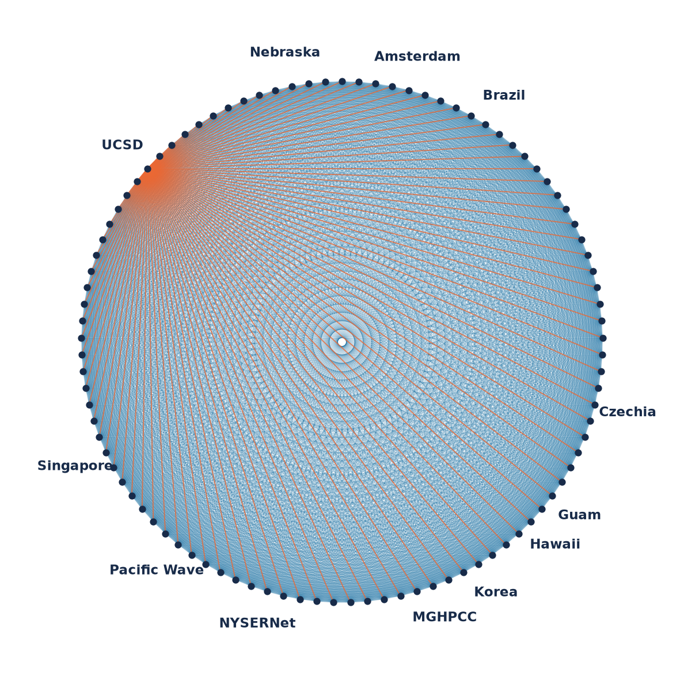
Measuring the Network
A perfSONAR testpoint on every node (526 pods, from a DaemonSet)
MaDDash all-to-all between one node per site: 97 sites, with the nautilus.io/a2a-latency label
Mesh config, iperf3 servers and traceroute run as services in the cluster
When a user says the cluster is slow, we can see whether it's the path
perfsonar.nrp-nautilus.io
97 sites in the mesh, 10 Nov 2026; orange: one site's tests to every other
20

Slide 27
Security
Identity
Detect
Prevent
Audit
Authentik
CILogon: federated campus login
Groups drive namespace access
Falco: runtime alerts, e.g. crypto miners in user pods
Falco Talon: automated response
Wazuh; Elastic syslog, SSH logins included
Gatekeeper admission policies
Kata VMs for CI and untrusted builds
Central Calico policy
CVE mitigations rolled out by Argo CD
IPMI scanner: alerts if a BMC is reachable from outside
JupyterHub scanner: no anonymous hubs
21

Slide 28
Routine Care
Tool | What it does
kured | Rolling reboots after kernel updates, a few nodes at a time
self-node-remediation | Fences and recovers nodes that stop responding
node-label-monitor | Watches node labels the scheduler depends on
GPU operator, power management | Drivers, and GPU power tracking
Nagios NRPE | Host checks
Upgrade runbooks | Kubernetes, Calico, Rook, GitLab, JupyterHub, Prometheus ... in the admin docs
https://nrp.ai/documentation/admindocs/upgrades/intro/
22

Slide 29
Sharing GPUs Fairly
Contributors keep priority on their nodes: reservation taints, and Kueue with NRP's own controllers
Priority classes: owner, nice (−10), opportunistic (preempted first)
Idle GPUs go to opportunistic work, such as Open Science Grid jobs for IceCube and LIGO
Opportunistic work must tolerate being preempted: checkpoint, or just restart
A contributed GPU node · 8 GPUs
owner
owner
owner
owner
opport.
opport.
opport.
opport.
The owner submits more work: the scheduler preempts opportunistic pods to make room.
23

Slide 30
How a Node Joins
1. Rack and cable
power, cooling, a Science DMZ port, jumbo frames
2. Hand over access
IPMI, or root SSH from NRP's management address
3. NRP installs
Ubuntu 24.04, drivers and storage; joins Nautilus
4. Labels and policy
region, zone, site, GPU model; the central Calico policy
5. It reports in
to NetBox, Prometheus and the perfSONAR mesh
The site
NRP
Keeps an on-site contact for hands-on work
Sends maintenance notices; forwards warranty tickets
Patching, packages and host hardening
24/7 monitoring and alerting; incident handling from the OS up
Then it's schedulable, yours first: owner priority for your users, idle time for everyone else.
https://nrp.ai/documentation/admindocs/participating/new-contributor-guide/
24

Slide 31
AI on NRP
25

Slide 32
The LLM Service
One OpenAI-compatible endpoint, ellm.nrp-nautilus.io/v1; an Anthropic-compatible one too
25 model names on that one endpoint
83 GPUs serve them, from A10s to H200s, at 9 sites
About 7.1 billion tokens a day (September 2026)
Free for research and education, with a token from nrp.ai/llmtoken
Model name | Serving on
deepseek-v4-flash | 16 × H100
glm-5 | 8 × H200, 8 × H100
kimi | 8 × A100
minimax | 8 × A100
qwen3 | 8 × A100
qwen3-small | 4 × A6000, 2 × H200
gpt-oss | 2 × A6000
gemma | 4 × A100, 1 × A6000
gemma-small | 9 × A10
gemma-small-e4b | 1 × A6000
qwen3-embedding | 2 × L40, 2 × V100
Model-server pods by GPU, 10 Nov 2026. The catalog changes.
26

Slide 33
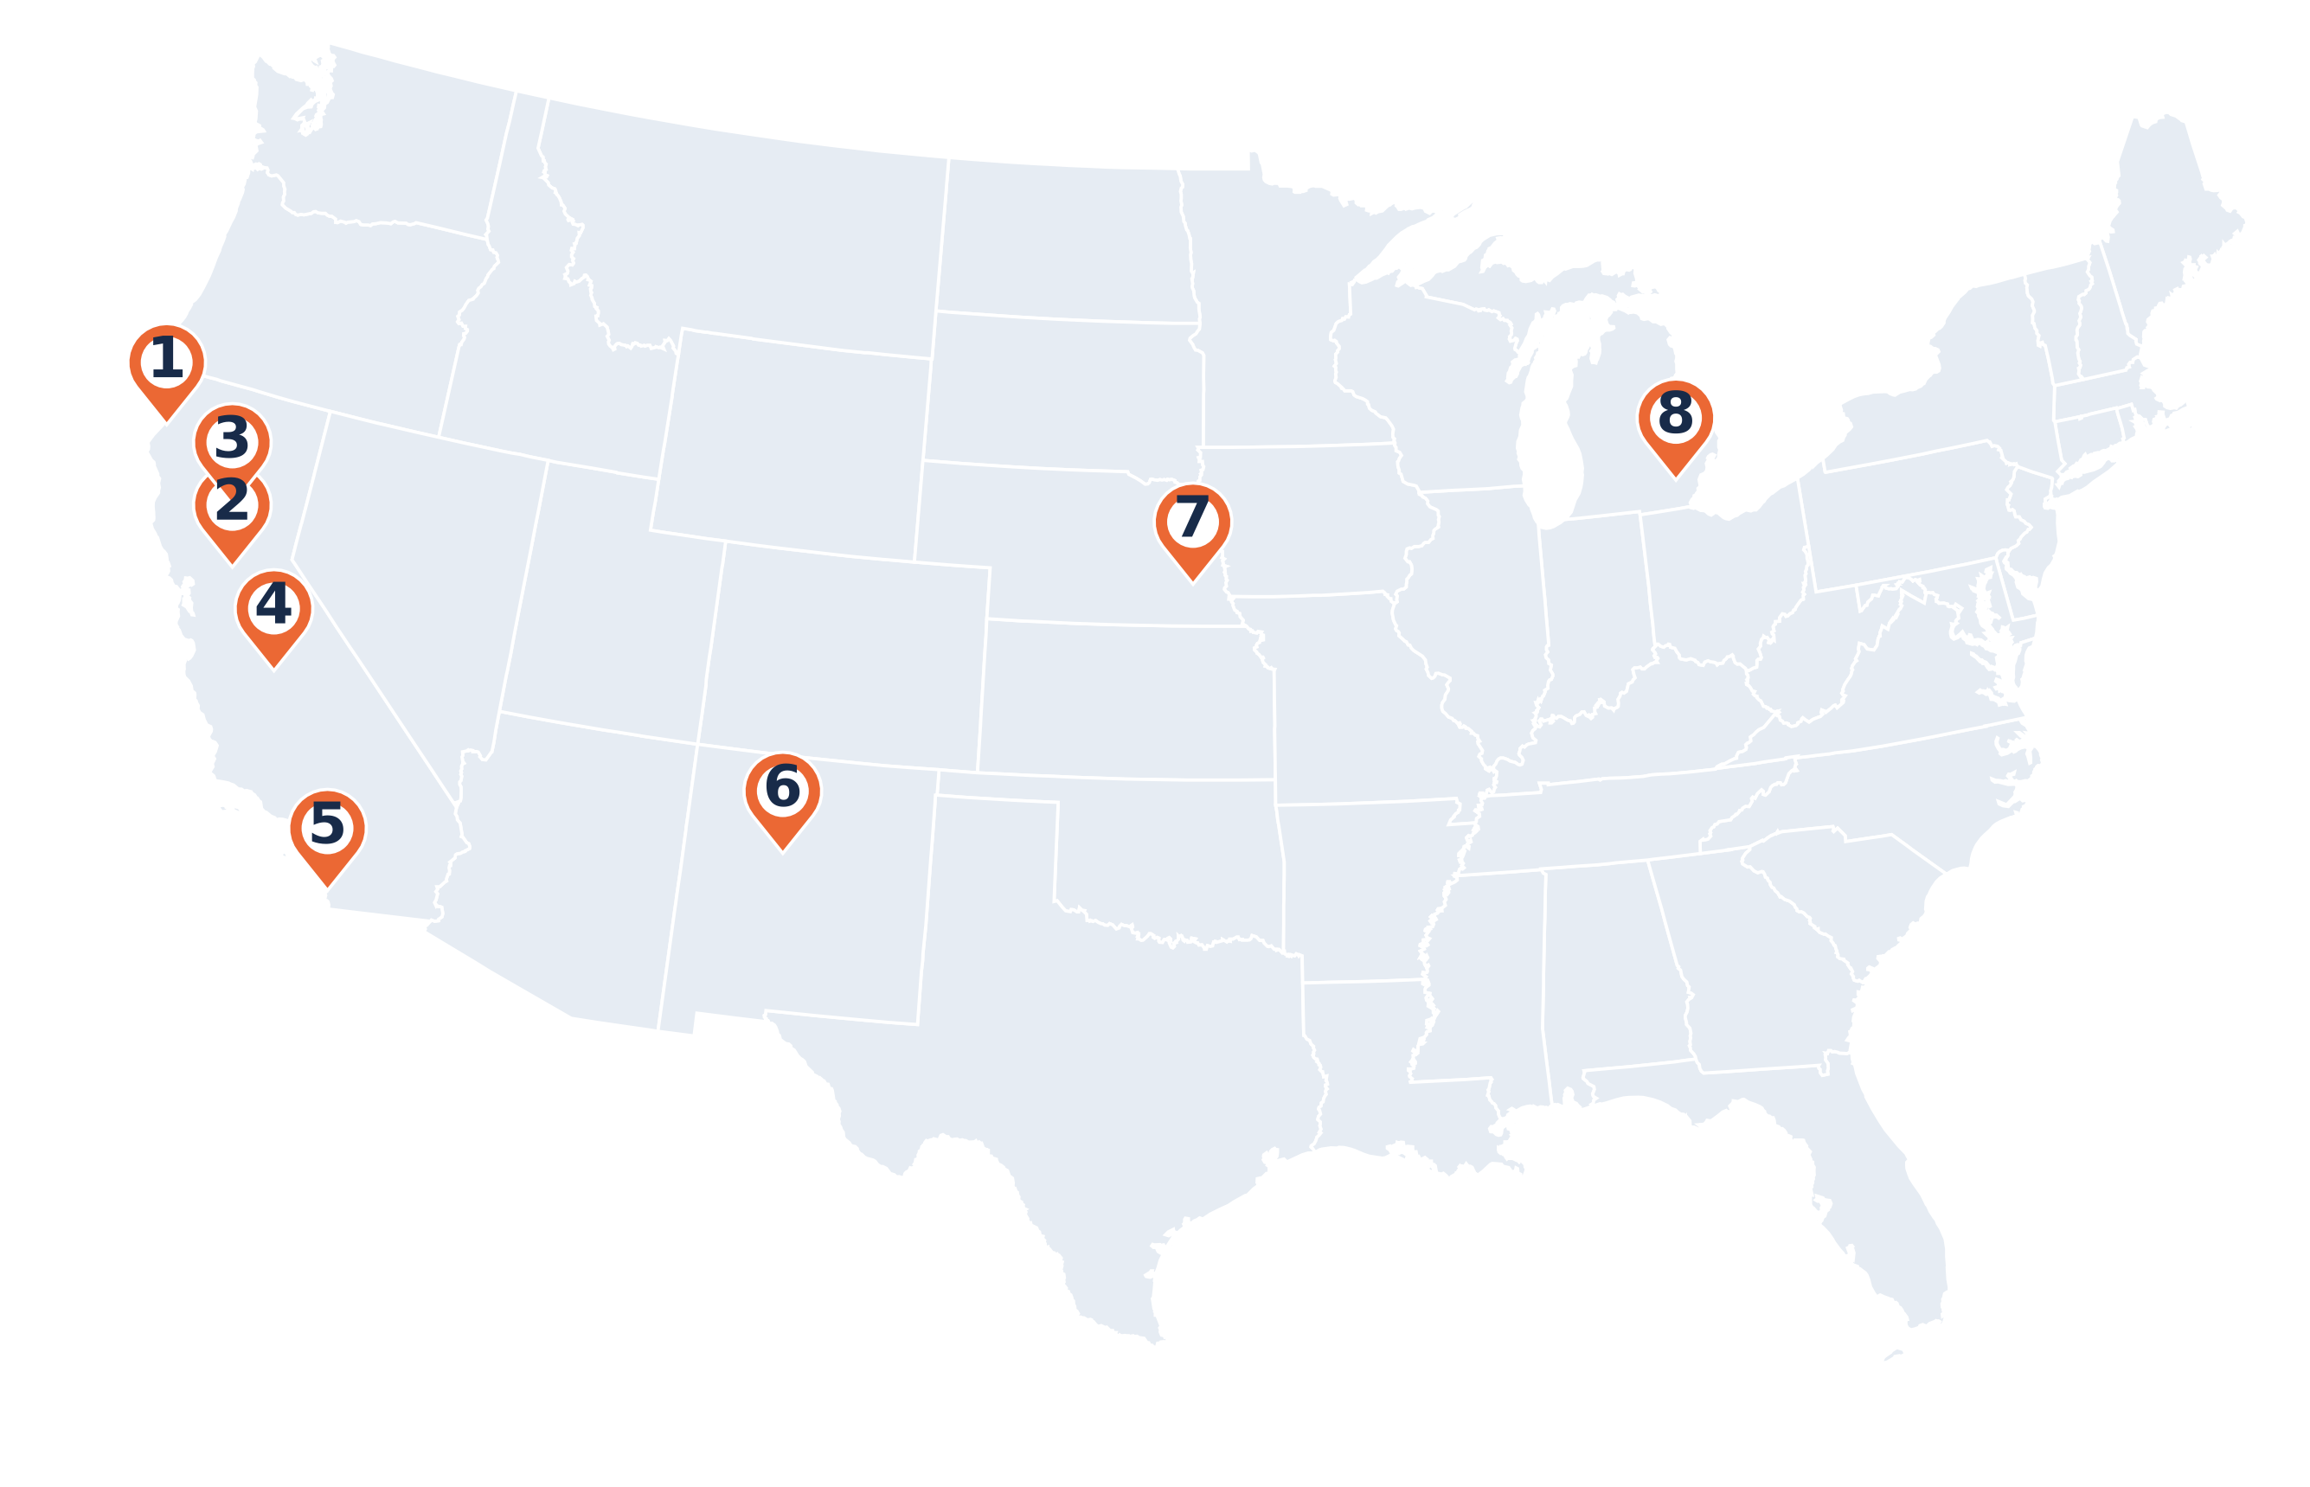
Where the Models Run
# | Site | Models | GPUs
1 | Cal Poly Humboldt | qwen3-embedding | 2 V100
2 | Sacramento State | gemma-small-e4b, glm-5 | 4 H200, 1 A6000
3 | CSU Chico | qwen3-small | 4 A6000
4 | Fresno State | qwen3-small | 2 H200
5 | UC San Diego + SDSU | deepseek-v4-flash, gemma, kimi, minimax, qwen3-embedding | 20 A100, 16 H100, 2 L40
6 | UNM | gemma | 1 A6000
7 | Nebraska–Lincoln | gemma-small, glm-5, gpt-oss | 9 A10, 8 H100, 4 H200, 2 A6000
8 | Internet2, Ann Arbor | qwen3 | 8 A100
Every pin is a set of model servers in the same cluster, behind the same endpoint. Fresno State and Internet2 Ann Arbor are placed by city.
27

Slide 34
A Request, Step by Step
vLLM pod a
queue 6 · KV cache 88%
Client
OpenAI API
Envoy AI Gateway
ellm.nrp-nautilus.io
AIGatewayRoute
x-ai-eg-model: qwen3
InferencePool
with an endpoint picker
vLLM pod b
queue 0 · KV cache 31%
vLLM pod c
queue 2 · KV cache 64%
llm-auth
ext_authz over gRPC; fail closed
Rate limiter
output tokens per token and model
example values
One request, five stops
The gateway is the Envoy Gateway from the ingress slide, plus its AI extension, Envoy AI Gateway. A client asks for qwen3.
28

Slide 35
A Request, Step by Step
vLLM pod a
queue 6 · KV cache 88%
Client
OpenAI API
Envoy AI Gateway
ellm.nrp-nautilus.io
AIGatewayRoute
x-ai-eg-model: qwen3
InferencePool
with an endpoint picker
vLLM pod b
queue 0 · KV cache 31%
vLLM pod c
queue 2 · KV cache 64%
llm-auth
ext_authz over gRPC; fail closed
Rate limiter
output tokens per token and model
example values
1. Who are you?
The gateway sends the bearer token to an external auth service over gRPC. If auth can't answer, the request fails: fail closed.
28

Slide 36
A Request, Step by Step
vLLM pod a
queue 6 · KV cache 88%
Client
OpenAI API
Envoy AI Gateway
ellm.nrp-nautilus.io
AIGatewayRoute
x-ai-eg-model: qwen3
InferencePool
with an endpoint picker
vLLM pod b
queue 0 · KV cache 31%
vLLM pod c
queue 2 · KV cache 64%
llm-auth
ext_authz over gRPC; fail closed
Rate limiter
output tokens per token and model
example values
2. Which model?
The gateway reads model from the JSON body into the x-ai-eg-model header, and an AIGatewayRoute rule matches it to a backend: here an InferencePool.
28

Slide 37
A Request, Step by Step
vLLM pod a
queue 6 · KV cache 88%
Client
OpenAI API
Envoy AI Gateway
ellm.nrp-nautilus.io
AIGatewayRoute
x-ai-eg-model: qwen3
InferencePool
with an endpoint picker
vLLM pod b
queue 0 · KV cache 31%
vLLM pod c
queue 2 · KV cache 64%
llm-auth
ext_authz over gRPC; fail closed
Rate limiter
output tokens per token and model
example values
3. Which pod?
The endpoint picker scores the pool's vLLM pods by queue depth, KV-cache use and prefix-cache hits, and picks one.
28

Slide 38
A Request, Step by Step
vLLM pod a
queue 6 · KV cache 88%
Client
OpenAI API
Envoy AI Gateway
ellm.nrp-nautilus.io
AIGatewayRoute
x-ai-eg-model: qwen3
InferencePool
with an endpoint picker
vLLM pod b
queue 0 · KV cache 31%
vLLM pod c
queue 2 · KV cache 64%
llm-auth
ext_authz over gRPC; fail closed
Rate limiter
output tokens per token and model
example values
4. The answer, and the bill
vLLM answers. The gateway reads the token counts from the response; the rate limiter charges output tokens to this token and model.
28

Slide 39
Gateway Policies
apiVersion: gateway.envoyproxy.io/v1alpha1
kind: BackendTrafficPolicy
metadata: {name: envoy-ai-gateway-nrp, namespace: nrp-llm}
spec:
rateLimit:
type: Global
global:
rules:
- clientSelectors:
- headers:
- {name: authorization, type: Distinct}
- {name: x-ai-eg-model, type: Distinct}
limit: {requests: 48000, unit: Minute}
cost:
request: {from: Number, number: 1}
response:
from: Metadata
metadata: {namespace: io.envoy.ai_gateway,
key: llm_output_token}
retry:
numRetries: 2
retryOn: {httpStatusCodes: [500, 502, 503, 504]}
healthCheck:
active: {type: HTTP, http: {path: /health}, interval: 10s,
unhealthyThreshold: 3}
passive: {consecutive5XxErrors: 2, baseEjectionTime: 30s,
maxEjectionPercent: 50}
Rate limit: 48,000 output tokens a minute, per token and model
Retries: twice, on 5xx
Health: probe /health every 10 s; eject a pod after two 5xx
What a client sees (demo, 10 Nov)
$ curl -si https://ellm.nrp-nautilus.io/v1/chat/completions \
-H "Authorization: Bearer $OPENAI_API_KEY" \
-d '{"model": "qwen3", ...}' | grep -i ratelimit
x-ratelimit-limit: 48000, 48000;w=60
x-ratelimit-remaining: 47999
x-ratelimit-reset: 9
29

Slide 40
Ask for a Task, Not a Model
Ask for | Tried in this order
agents | kimi → deepseek-v4-flash → qwen3 → qwen3-small
coding | deepseek-v4-flash → qwen3 → gemma → qwen3-small
general | deepseek-v4-flash → qwen3 → qwen3-small → minimax
reasoning | deepseek-v4-flash → minimax → qwen3-small → qwen3
vision | qwen3 → qwen3-small → kimi → deepseek-v4-flash
long-context | deepseek-v4-flash → gemma → kimi → minimax
kubernetes | kimi → gemma → qwen3 → qwen3-small
cuda | deepseek-v4-flash → qwen3-small → gpt-oss → gemma-small-e4b
service | deepseek-v4-flash → minimax → qwen3 → qwen3-small → gemma → gemma-small → gpt-oss
model: coding
deepseek-v4-flash
priority 0
qwen3
priority 1
gemma
priority 2
qwen3-small
priority 3
GitLab Duo Self-Hosted uses service.
30

Slide 41
Serving with vLLM
qwen3, from the cluster (shortened)
apiVersion: apps/v1
kind: StatefulSet
metadata: {name: qwen38-flash-next-a100, namespace: nrp-llm}
spec:
replicas: 2
template:
metadata:
labels: {component: llm, service-group: qwen-vllm-inference}
spec:
priorityClassName: owner # tolerates the reservation taint
containers:
- image: vllm/vllm-openai:v0.33.0
args: ["vllm serve Qwen/Qwen3.8-Flash-Next-FP8 --port 5000
--tensor-parallel-size 4 --enable-expert-parallel
--enable-prefix-caching --max-model-len 1000000
--kv-cache-dtype bfloat16 --otlp-traces-endpoint ..."]
resources:
limits: {cpu: "36", memory: 440Gi, nvidia.com/a100: 4}
readinessProbe: {httpGet: {path: /health, port: 5000}}
affinity: # GPU memory > 80 GB, Ampere or newer
volumeClaimTemplates:
- metadata: {name: qwen38-flash-cache}
spec: {storageClassName: linstor-igrok,
resources: {requests: {storage: 256Gi}}}
Labels put the pod in the qwen3 pool; priority owner
vLLM: tensor parallel 4, expert parallel, prefix caching, traces to OpenTelemetry
Health: probes on /health; vLLM and DCGM metrics go to the same Prometheus and Thanos, and drive the LLM status page
Weights on a Linstor volume, so a restart doesn't download them again
16 servers like this. Their config is in GitLab (prp/llm-proxy), applied by hand, not yet by Argo CD
31

Slide 42
Borrowing Idle GPUs
Extra replicas run at opportunistic priority on idle GPUs and join the same pool
qwen3-small: 4 × A6000 at Chico State as owner, plus two H200 replicas at Fresno State as opportunistic
glm-5 and gemma borrow H100s and A100s at low priority too
Preempted when the owner needs the GPU; the endpoint picker routes around the gap
InferencePool qwen3-small
selects pods by label: service-group=qwen3-small
CSU Chico
4 × A6000 · owner
Fresno State
1 × H200 · opportunistic
Fresno State
1 × H200 · opportunistic
Step 1: the H200's owner needs it back. One replica is preempted; the pool keeps answering from the other two.
32

Slide 43
One Model, Two Nodes
Node A · 4 × H100
Node B · 4 × H100
DeepSeek V4.1 Flash, two copies
Head and worker StatefulSets
A custom supervisor restarts both together (LeaderWorkerSet isn't installed)
Headless Service; NetworkPolicy limits traffic to the group
NCCL settings pinned, e.g. NCCL_SOCKET_IFNAME=eth0
head pod: serves the API
pipeline stage 1
worker pod
pipeline stage 2
GPU 0
TP rank
GPU 1
TP rank
GPU 2
TP rank
GPU 3
TP rank
GPU 0
TP rank
GPU 1
TP rank
GPU 2
TP rank
GPU 3
TP rank
tensor parallel 4, inside the node (NVLink)
tensor parallel 4, inside the node (NVLink)
pipeline parallel 2, across nodes (NCCL over the network)
Expert parallelism spreads the model's experts across the GPUs. Both copies run on SDSC's Expanse H100 nodes.
33

Slide 44
Around the Models
Open WebUI
chat in the browser, with a terminals operator
Web search
SearXNG, for tools and chat
Embeddings
qwen3-embedding; TEI on a GPU
Vector databases
Milvus (managed) and Qdrant
MCP route
an MCP gateway; an accounting MCP server
Telemetry
OpenTelemetry collector into ClickHouse
Coding agents
Claude Code, opencode and others, with tested configurations
All of it on the same cluster, most of it deployed the same way as everything else: from git.
34

Slide 45
An LLM on Call: nrp-ops-bot
An operator in Slack
mentions the bot with a question
A model on NRP
deepseek-v4-flash, through the same gateway
16 read-only tools
pods, logs, events, nodes · PromQL on Thanos · NRP docs search · accounting MCP · triage playbooks
a loop
An answer in the thread
the finding, the evidence, the tool calls
Guardrails
Status
RBAC denies secrets, exec and every write
Namespace allowlist; credentials redacted
Logs and events treated as untrusted (prompt injection)
Budgets on tool calls, iterations and time
Phase 1, read-only: built and tested with mocks
Phase 2, write actions behind two-human approval: not started
Also an MCP server, and an eval harness to compare models
35

Slide 46
Using It Yourself
36

Slide 47
Ways In
JupyterHub
notebooks with a GPU, in the browser
Coder
VS Code in the browser, in your namespace
kubectl
jobs, services and storage in a namespace
jupyterhub-west.nrp-nautilus.io
coder.nrp-nautilus.io
nrp.ai/config
GitLab
repos, CI in Kata VMs, a registry
LLM API
OpenAI- and Anthropic-compatible
Open WebUI
chat with every model
gitlab.nrp-nautilus.io
ellm.nrp-nautilus.io/v1
nrp-openwebui.nrp-nautilus.io
Who uses them today: research groups, each in a namespace; courses, each with its own JupyterHub; and collaborations through OSG.
37

Slide 48
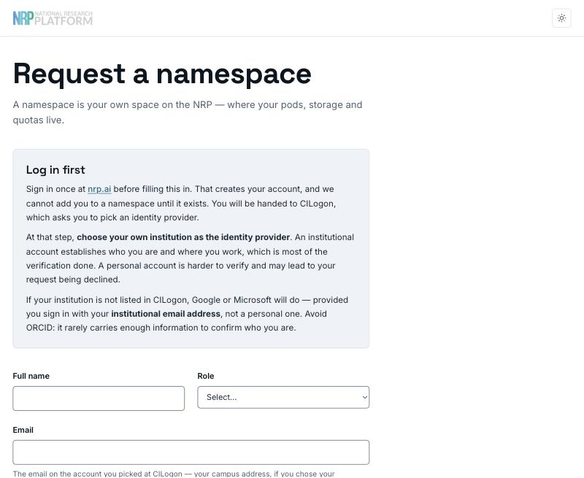
Getting Access
1. Log in at nrp.ai
Log In → CILogon → your institution
2. Get into a namespace
Request one at get-started.nrp-nautilus.io
Or ask an existing namespace admin to add you
3. Start working
JupyterHub, kubectl, GitLab, or an LLM token from nrp.ai/llmtoken
Who can request a namespace: faculty, staff, postdocs and research scientists; students through their PI.
https://get-started.nrp-nautilus.io
38

Slide 49
Ways to Run Work
Interactive: JupyterHub
Batch: a Job
Pick a GPU from the start menu; explore, debug, teach
Idle servers stop: 1 hour after you close the browser on NRP's hub, 6 hours at most on any hub
Runs your script to the end, then gives the GPU back
Submit many at once; the rest wait in Pending for a free GPU
$ kubectl apply -f sweep/ # six training jobs
Interactive: a pod
Start a container with kubectl, then open a shell in it
Deleted after 6 hours; at most 2 GPUs
GPU 1
lr-0.1
lr-0.0003
GPU 2
lr-0.03
Long-running: a Deployment
GPU 3
lr-0.01
lr-0.001
Keeps a service up (a web app, a database) and restarts it if it crashes
Removed after 2 weeks unless admins grant an exception; no GPU if it sits mostly idle
GPU 4
lr-0.003
Six jobs on four GPUs: two wait in Pending and take the first GPUs that free up. When the last one ends, all four GPUs are free again.
39

Slide 50
A GPU Job
apiVersion: batch/v1
kind: Job
metadata: {name: gpu-train-daniel, namespace: my-lab} # (1)
spec:
template:
spec:
restartPolicy: Never
containers:
- name: train
image: pytorch/pytorch:2.9.0-cuda13.0-cudnn9-runtime # (2)
command: ["python", "train.py"]
resources: # (3)
requests: {cpu: "2", memory: 6Gi, nvidia.com/gpu: 1}
limits: {cpu: "2", memory: 6Gi, nvidia.com/gpu: 1}
affinity: # (4)
nodeAffinity:
requiredDuringSchedulingIgnoredDuringExecution:
nodeSelectorTerms:
- matchExpressions:
- {key: nvidia.com/gpu.memory, operator: Gt, values: ["20000"]}
- {key: nvidia.com/gpu.compute.major, operator: Gt, values: ["7"]}
(1) Where: your namespace
(2) What: a container image, and the command to run
(3) Resources: 2 CPUs, 6 GB of memory, one GPU
(4) Which GPU: more than 20 GB, Ampere or newer; or name exact models
40

Slide 51
Where to Start
Use it
Connect to it
The LLM API in your automation: config review, log triage, a docs assistant; task names keep working as the catalog changes
Your tools in a namespace: web apps, Postgres and ClickHouse from the operators, S3 for data
GitLab CI to build and ship them
GPUs for AI and ML: a notebook to start, Jobs when it's real
Contribute nodes, the way a node joins: you keep priority, NRP runs them
InterLink: a Slurm cluster appears as a virtual node
Federation with another Kubernetes cluster
FABRIC and SENSE testbeds, with Multus for extra NICs
perfSONAR: a testpoint on your node joins the mesh
https://nrp.ai/documentation/admindocs/participating/new-contributor-guide/
41

Slide 52
Live Demo
42

Slide 53
Acknowledgments
NRP is supported by NSF awards OAC-1541349, OAC-1826967, OAC-2030508, OAC-1841530, OAC-2005369, OAC-2112167, CISE-1713149, CISE-2100237 and CISE-2120019
Networks: CENIC, Pacific Wave, Internet2, MREN, GPN, NYSERNet, FLR, NEREN, Sun Corridor, OARnet, SCLR and the Albuquerque GigaPoP
The NRP operations teams at SDSC, the University of Nebraska–Lincoln and MGHPCC, and the campuses that host and share their hardware
SCinet, for having us during the NOC move
43

Slide 54
Questions?
Today's materials
training.nrp-nautilus.io/scinet-sc26
Portal and login
nrp.ai
Request a namespace
get-started.nrp-nautilus.io
LLM endpoint
ellm.nrp-nautilus.io/v1
LLM token
nrp.ai/llmtoken
perfSONAR
perfsonar.nrp-nautilus.io
Admin guide
nrp.ai/documentation/admindocs
Support chat and email
nrp.ai/contact
Daniel Diaz · d4diaz@ucsd.edu
44

Slide 55
Backup
45

Slide 56
What Argo CD Runs
Application | Source | Sync
cve-mitigations | NRP GitLab: prp/cve-mitigations | auto
falco | Helm chart: falco | manual
falco-talon | Helm chart: falco-talon | auto, self-heal
gitlab | GitHub: nrp-nautilus/gitlab | auto, self-heal
gpu-power-management | GitHub: Sam6734/nrp-gpu-operator-tracking | auto, self-heal
grafana | Helm chart: grafana | auto, self-heal
inspect | NRP GitLab: nrp/inspect | auto, self-heal
kueue | GitHub: nrp-nautilus/kueue-gitops | manual
kured | Helm chart: charts | auto
netbox | Helm chart: netbox | auto, self-heal
Application | Source | Sync
netbox-agent | NRP GitLab: nrp/netbox-4 | auto, self-heal
nrp-aime | GitHub: djw8605/nrp-aime | auto, self-heal
nrp-clickhouse-deploy | GitHub: djw8605/nrp-clickhouse | auto
nrp-onboarding | NRP GitLab: prp/nrp-onboarding | auto, self-heal
nrp-ops-bot | GitHub: djw8605/nrp-ops-bot | auto
openwebui | NRP GitLab: nrp/openwebui | auto
ray | NRP GitLab: prp/ray | manual
self-node-remediation | NRP GitLab: nrp/self-node-remediation | manual
wazuh | NRP GitLab: nrp/wazuh | auto, self-heal
Argo CD applications on the cluster, 10 Nov 2026; Argo's own example app left out.
46

Slide 57
Envoy AI Gateway Objects
EnvoyProxy
proxy deployment settings
GatewayClass
envoy-ai-gateway-nrp
Gateway
envoy-ai-gateway-nrp
SecurityPolicy
ext auth: llm-auth (gRPC)
25 route rules
6 InferencePools
Up to 16 rules per AIGatewayRoute, so routes are split across objects
AIGatewayRoute
match x-ai-eg-model
BackendTrafficPolicy
rate limit, retries, health
InferencePool
+ endpoint picker (EPP)
AIServiceBackend → Backend
one endpoint, schema OpenAI
vLLM pods
selected by label
BackendSecurityPolicy
API key to the backend
From the NRP admin guide, Managing AI Models; object names from the cluster.
47

Slide 58
Using GPUs Fairly
Do
Don't
Run batch work as a Job that exits
Request what you'll use; keep limits within 20% of requests
Keep data on a persistent volume or in S3
Run a sweep as many one-GPU jobs
Borrow idle A100/H100s with priorityClassName: opportunistic, and checkpoint
Leave a notebook holding a GPU overnight
Put sleep in a Job to keep a GPU (bannable)
Ask for 4 GPUs "just in case": use must stay above 40%
Keep results on the pod's own disk; it vanishes with the pod
https://nrp.ai/documentation/userdocs/start/policies/
48

