Slide 1
The National Research Platform
for AI-Enabled Research
GPUs and AI for research and education
Daniel Diaz · San Diego Supercomputer Center, UC San Diego
UCLA Health IT Research Tech Talk · 10 November 2026

Slide 2
Agenda
What is NRP?
Getting access, and what a namespace is
GPUs: what's available, and how to run a GPU job
AI services: hosted LLMs and Jupyter AI
JupyterHub for labs and classes
Live demo
Questions
Slides, the demo notebooks and the GPU job:
https://training.nrp-nautilus.io/ucla-health
2

Slide 3
The Platform
3

Slide 4
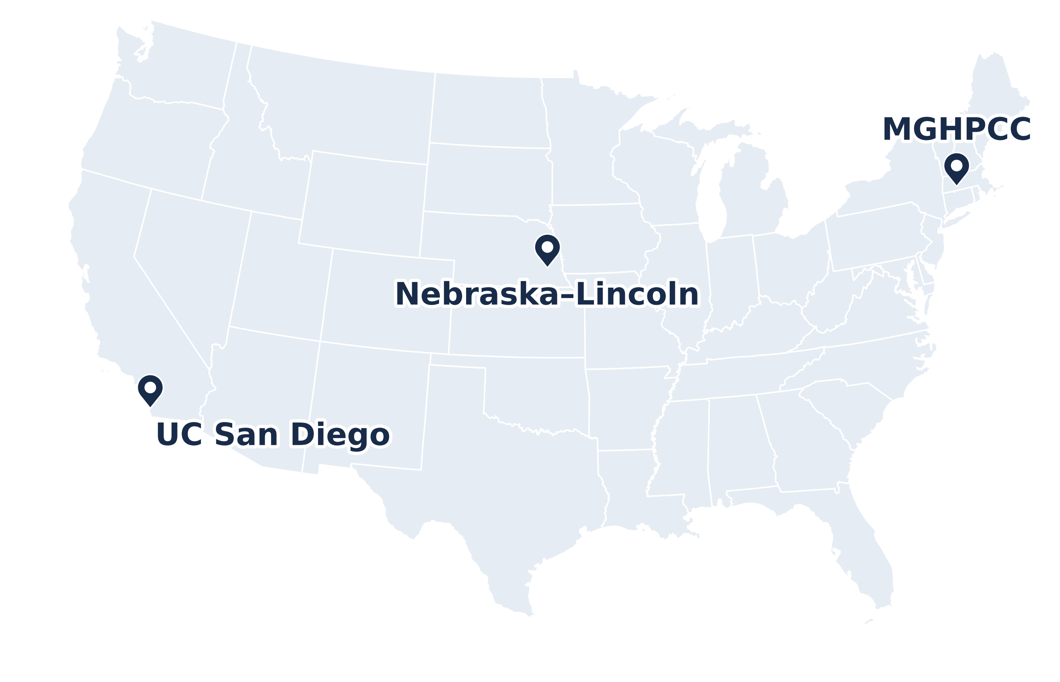
What is NRP?
A national Kubernetes cluster, Nautilus, for research and education
Run by SDSC (UC San Diego), Nebraska–Lincoln and MGHPCC; funded by NSF
https://dash.nrp-nautilus.io
GPUs and nodes: cluster snapshot, 9 Nov 2026
4

Slide 5
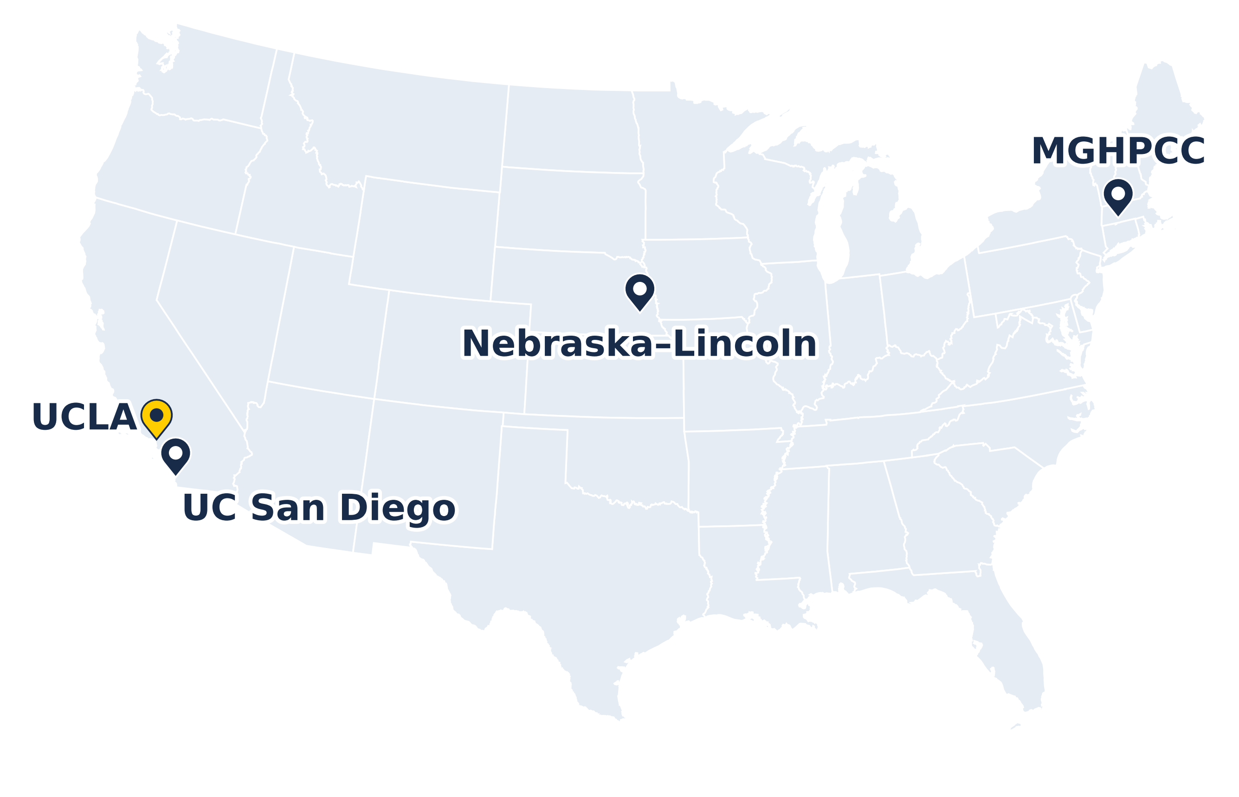
What is NRP?
A national Kubernetes cluster, Nautilus, for research and education
Run by SDSC (UC San Diego), Nebraska–Lincoln and MGHPCC; funded by NSF
Hardware contributed by 70+ institutions, UCLA among them
https://dash.nrp-nautilus.io
GPUs and nodes: cluster snapshot, 9 Nov 2026
4

Slide 6
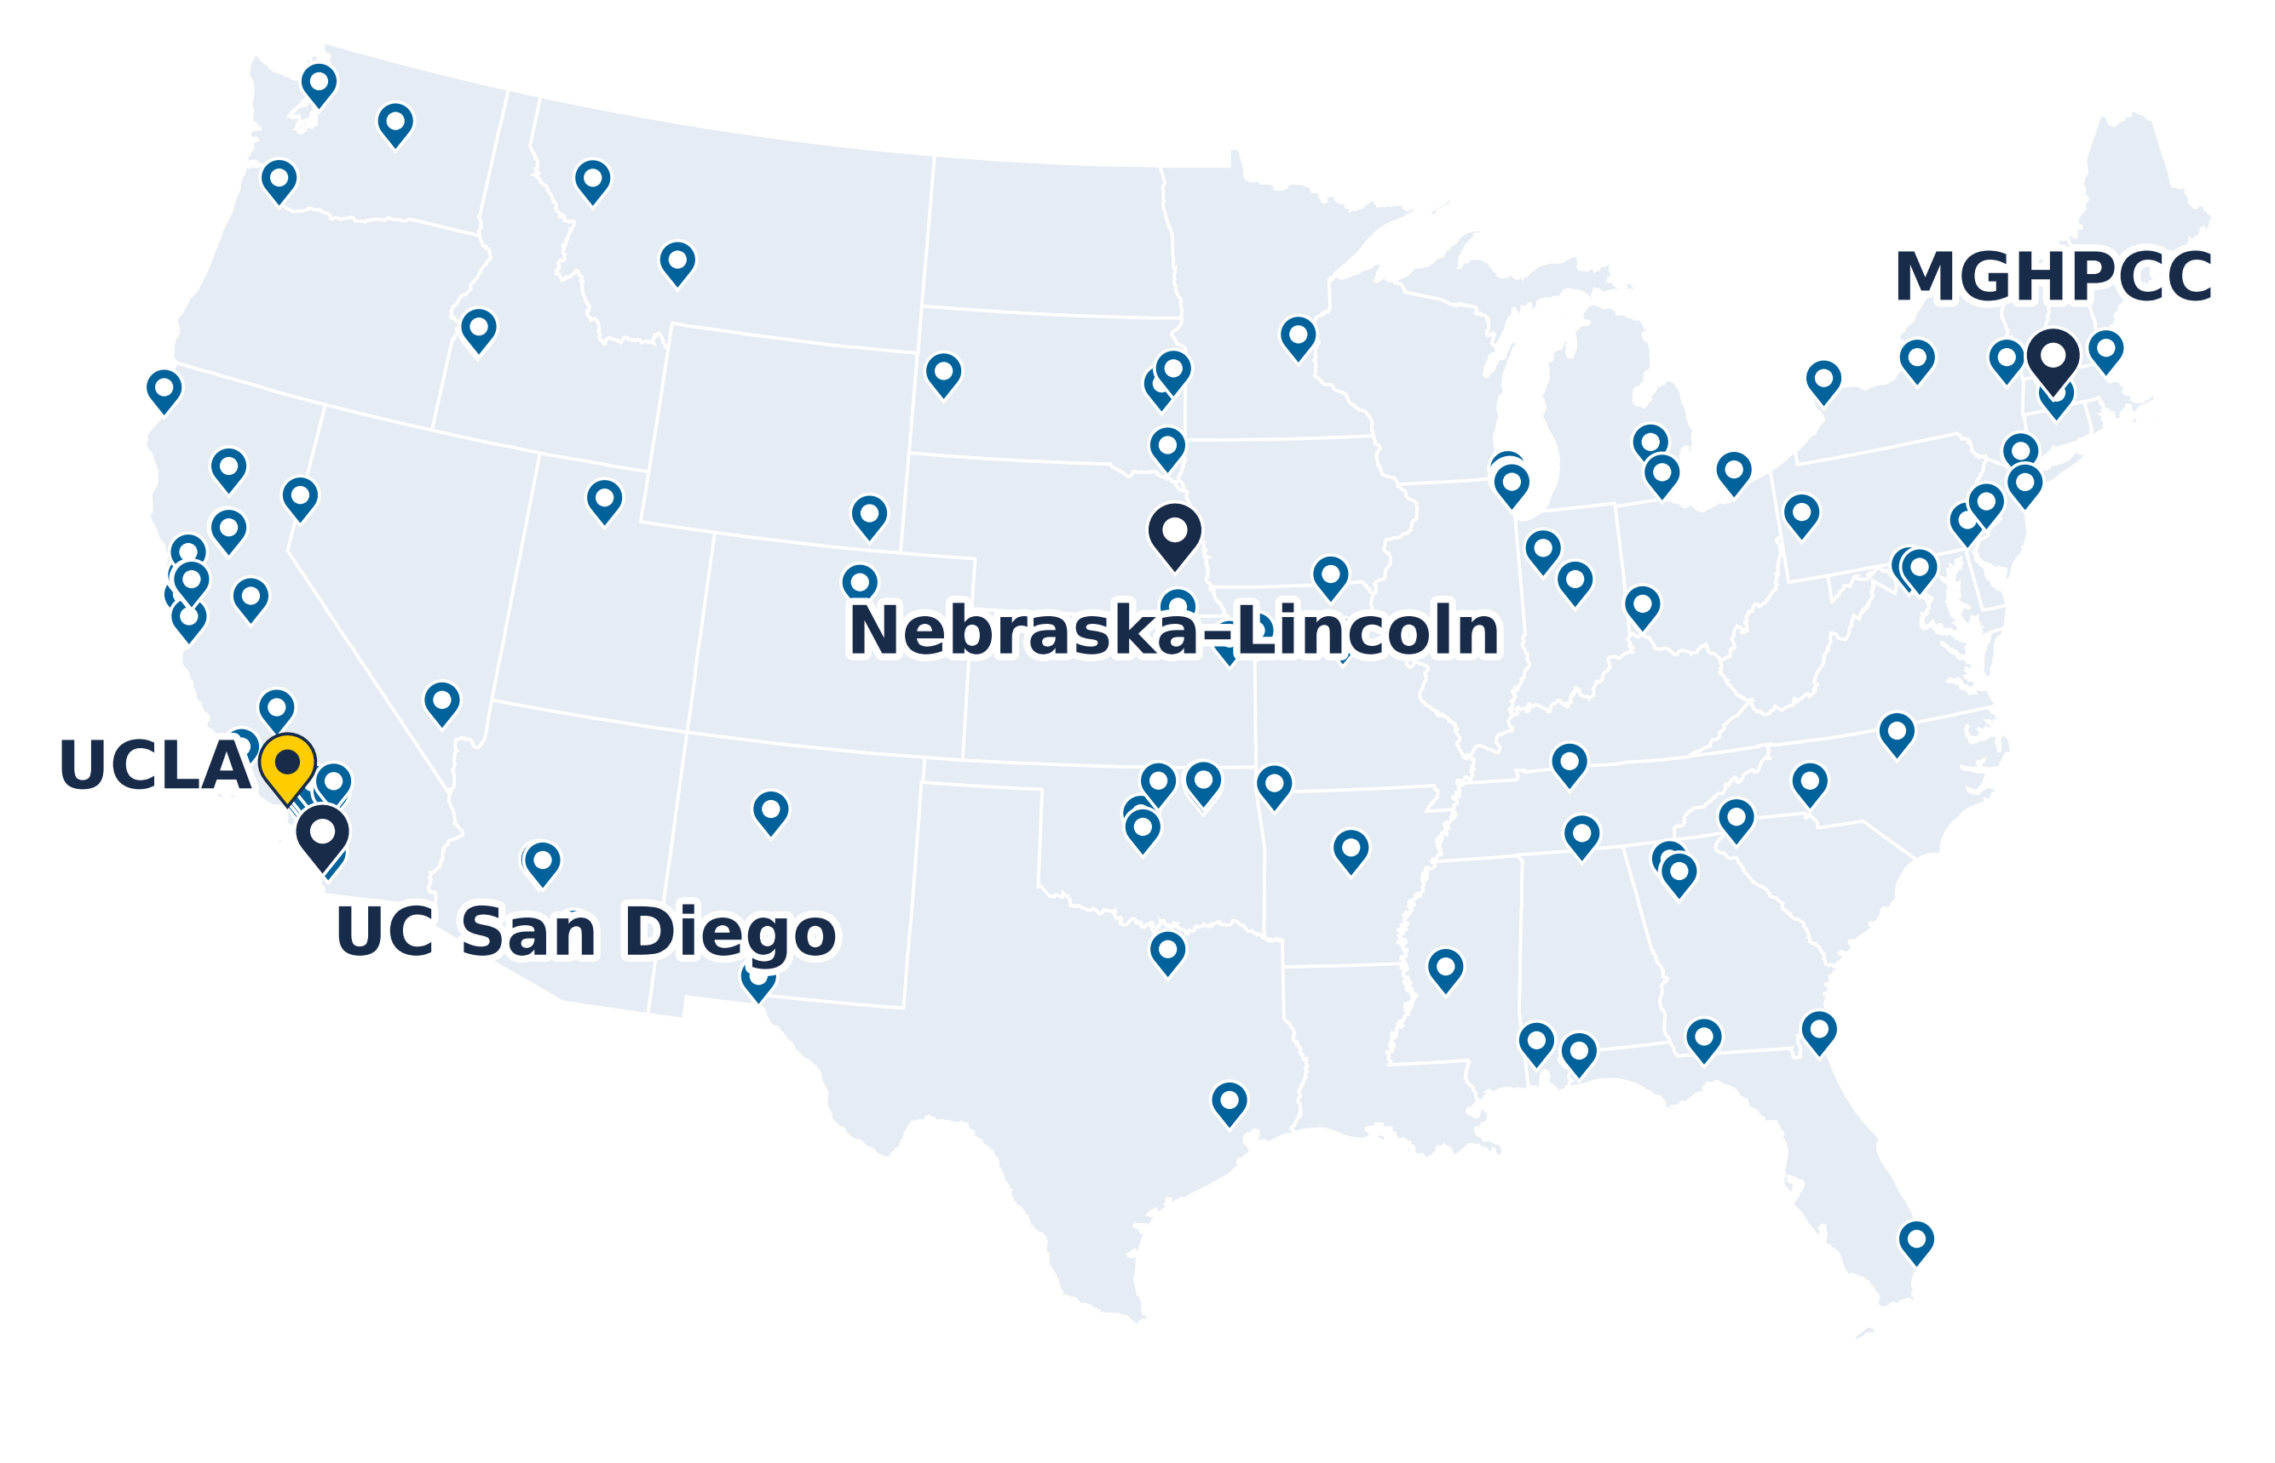
What is NRP?
A national Kubernetes cluster, Nautilus, for research and education
Run by SDSC (UC San Diego), Nebraska–Lincoln and MGHPCC; funded by NSF
Hardware contributed by 70+ institutions, UCLA among them
Scale today:
536 nodes
1,411 GPUs in 33 models
Petabytes of storage
https://dash.nrp-nautilus.io
Site locations from the NRP dashboard, 10 Nov 2026
Not drawn: 8 sites in Hawaii, Guam, Korea, Brazil and Europe
GPUs and nodes: cluster snapshot, 9 Nov 2026
4

Slide 7
What is NRP?
A national Kubernetes cluster, Nautilus, for research and education
Run by SDSC (UC San Diego), Nebraska–Lincoln and MGHPCC; funded by NSF
Hardware contributed by 70+ institutions, UCLA among them
Scale today:
536 nodes
1,411 GPUs in 33 models
Petabytes of storage
Free for non-commercial research and education
https://dash.nrp-nautilus.io
Site locations from the NRP dashboard, 10 Nov 2026
Not drawn: 8 sites in Hawaii, Guam, Korea, Brazil and Europe
GPUs and nodes: cluster snapshot, 9 Nov 2026
4

Slide 8
Kubernetes and Containers
Container image: your code plus everything it needs (Python, PyTorch, CUDA), in one package
Runs the same on a laptop, a cluster or the cloud
Kubernetes runs containers across many machines
You say what you need (CPUs, memory, a GPU); it finds a machine that has it
NRP is one Kubernetes cluster: 536 nodes
Container image
Kubernetes cluster
train.py
your code
Node
64 CPU cores
PyTorch, NumPy
CUDA libraries
Node
8 × A10 GPUs
your container
Linux
Node
4 × A100 GPUs
built once, from a Dockerfile
the scheduler picks a node with a free GPU
5

Slide 9
Access Methods
You
Hosted LLMs
browser chat or an API key
AI gateway
checks your token, routes
Model servers
open-weight models on NRP GPUs
JupyterHub
log in, pick an image and a GPU
Your notebook server
a container started for you
A CPU or GPU node
chosen by Kubernetes
Kubernetes
kubectl apply -f job.yaml
Scheduler
finds a node with what you asked for
Your pods
run, write results, exit
No login node and no batch queue: pick the door that matches how much infrastructure you want to touch.
Most people start with JupyterHub or the hosted LLMs.
6

Slide 10
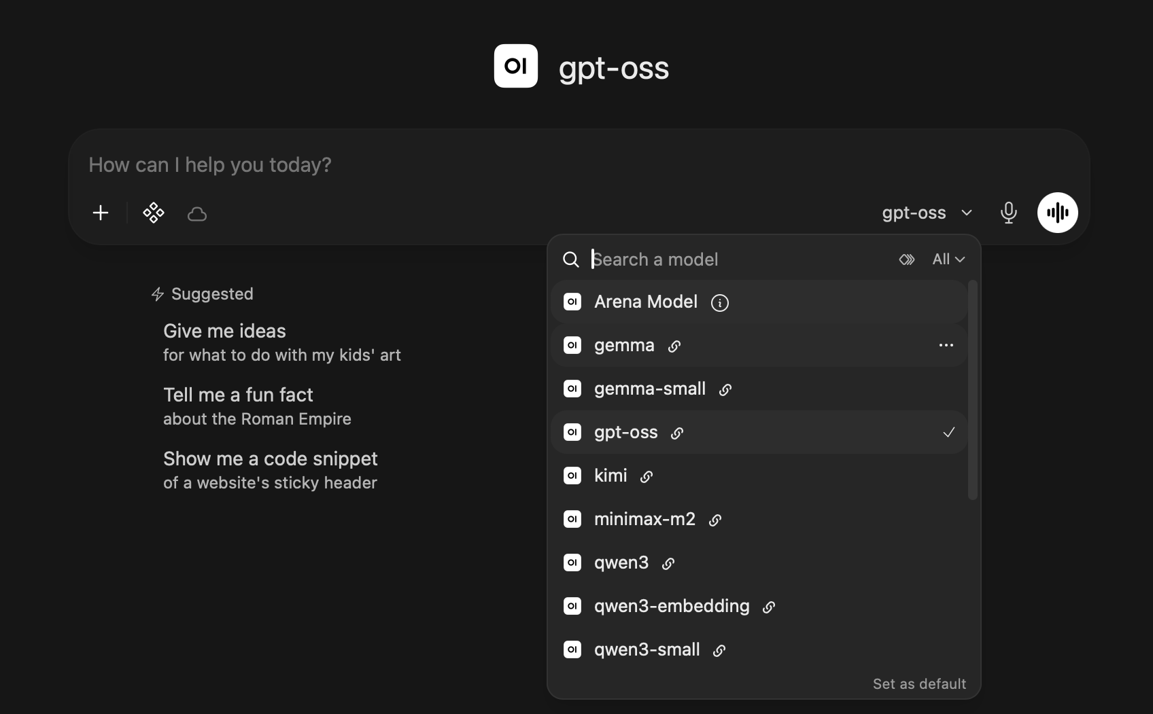
Access Methods
You
Hosted LLMs
browser chat or an API key
AI gateway
checks your token, routes
Model servers
open-weight models on NRP GPUs
JupyterHub
log in, pick an image and a GPU
Your notebook server
a container started for you
A CPU or GPU node
chosen by Kubernetes
Kubernetes
kubectl apply -f job.yaml
Scheduler
finds a node with what you asked for
Your pods
run, write results, exit
from openai import OpenAI
client = OpenAI(base_url="https://ellm.nrp-nautilus.io/v1",
api_key=TOKEN) # from nrp.ai/llmtoken
client.chat.completions.create(model="gpt-oss",
messages=[{"role": "user", "content": "Hi"}])
In the browser at nrp-openwebui.nrp-nautilus.io, or from any code that speaks the OpenAI API
6

Slide 11
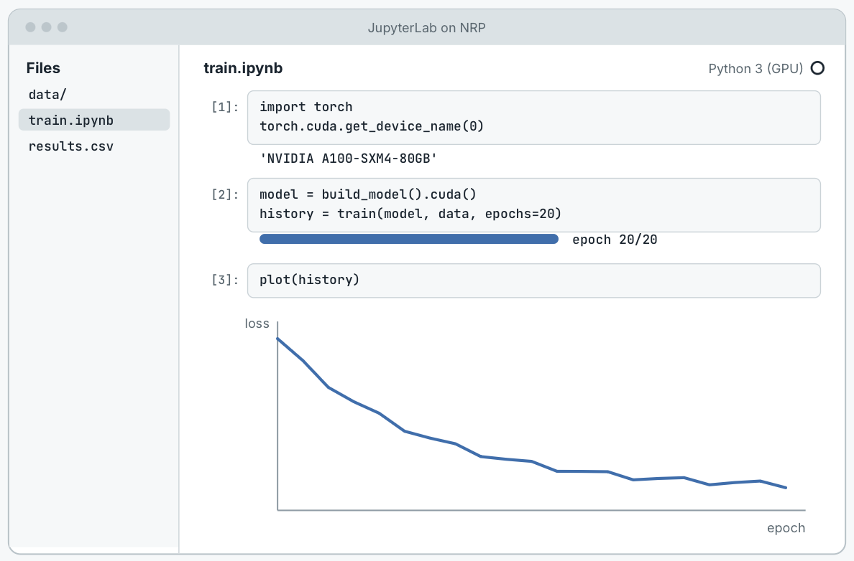
Access Methods
You
Hosted LLMs
browser chat or an API key
AI gateway
checks your token, routes
Model servers
open-weight models on NRP GPUs
JupyterHub
log in, pick an image and a GPU
Your notebook server
a container started for you
A CPU or GPU node
chosen by Kubernetes
Kubernetes
kubectl apply -f job.yaml
Scheduler
finds a node with what you asked for
Your pods
run, write results, exit
Log in with your campus account through CILogon
Choose an image, CPUs, memory and a GPU type
NRP's hubs: jupyterhub-west.nrp-nautilus.io and jupyterhub-east.nrp-nautilus.io
Today's demo: jh-training.nrp-nautilus.io
6

Slide 12
Access Methods
You
Hosted LLMs
browser chat or an API key
AI gateway
checks your token, routes
Model servers
open-weight models on NRP GPUs
JupyterHub
log in, pick an image and a GPU
Your notebook server
a container started for you
A CPU or GPU node
chosen by Kubernetes
Kubernetes
kubectl apply -f job.yaml
Scheduler
finds a node with what you asked for
Your pods
run, write results, exit
Your jobs
$ kubectl apply -f sweep/
job.batch/train-lr-0.1 created
job.batch/train-lr-0.01 created
job.batch/train-lr-0.001 created
$ kubectl get pods
NAME READY STATUS RESTARTS AGE
train-lr-0.1-7xkqp 1/1 Running 0 40s
train-lr-0.01-m4q9d 1/1 Running 0 40s
train-lr-0.001-c8w3n 0/1 Pending 0 40s
GPU node · 4 × A10
GPU node · 4 × RTX 3090
lr-0.1
lr-0.01
busy
busy
busy
busy
busy
busy
lr-0.001 waits in Pending until a GPU frees up; a finished job releases its GPU
6

Slide 13
What NRP Is For
OK on NRP
Not on NRP
Public or synthetic data
De-identified data
Protected health information
public datasets, simulations, benchmark and synthetic data
if your IRB and data use agreement allow it
PHI or identifiable patient data, including in LLM prompts
Good uses
model development and training · image analysis · simulation · teaching · LLMs on non-sensitive text
Also not for: commercial work, or services that need guaranteed uptime (it is a shared, best-effort cluster)
NRP is not HIPAA compliant. Keep PHI in UCLA Health's approved environments.
7

Slide 14
Getting Access
8

Slide 15
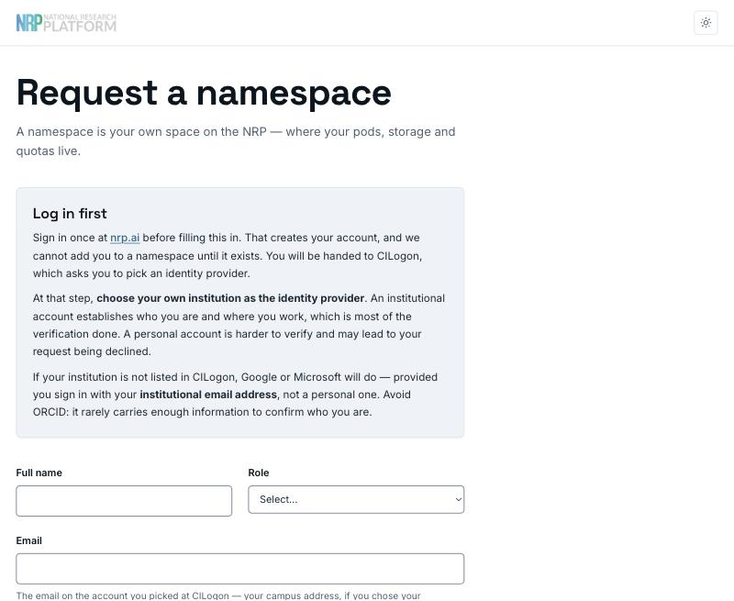
Getting Access
1. Log in at nrp.ai
Log In → CILogon → choose UCLA → your UCLA login
2. Get into a namespace
Request one at get-started.nrp-nautilus.io
Or ask an existing namespace admin to add you
3. Start working
JupyterHub, kubectl, or an LLM token from nrp.ai/llmtoken
Who can request a namespace: faculty, staff, postdocs and research scientists. Students: your PI or instructor requests it and adds you.
https://get-started.nrp-nautilus.io
9

Slide 16
What is a Namespace?
Your group's workspace on the cluster
One per lab, project or course; the PI or instructor is its admin and adds members
Needed for GPU jobs, storage, your own JupyterHub, and API access to the hosted LLMs
Not needed to chat with the LLMs in the browser
What's inside is visible only to its members
Nautilus cluster
lab-smith
Dr. Smith (admin) and 3 students
GPU jobs · a data volume · LLM tokens
bio-course
the instructor (admin) and 40 students
a course JupyterHub · shared datasets
another-lab
their members only
you can't see their jobs or data
10

Slide 17
Talking to the Cluster
Your laptop
kubectl + ~/.kube/config
CILogon
your UCLA login, once
Nautilus API
checks who you are
Your namespace
jobs, pods, data
1. Install kubectl and the kubelogin plugin
2. Download your config from nrp.ai/config, save it as ~/.kube/config
3. Run any kubectl command: a browser opens for the UCLA login
4. Work in your namespace
On the training JupyterHub this is already set up.
# one-time setup
mkdir -p ~/.kube
curl -o ~/.kube/config -fSL https://nrp.ai/config
# first command: a browser opens for CILogon
kubectl get pods -n my-lab
No resources found in my-lab namespace.
# make my-lab your default namespace
kubectl config set contexts.nautilus.namespace my-lab
https://nrp.ai/documentation/userdocs/start/getting-started/
11

Slide 18
GPUs
12

Slide 19
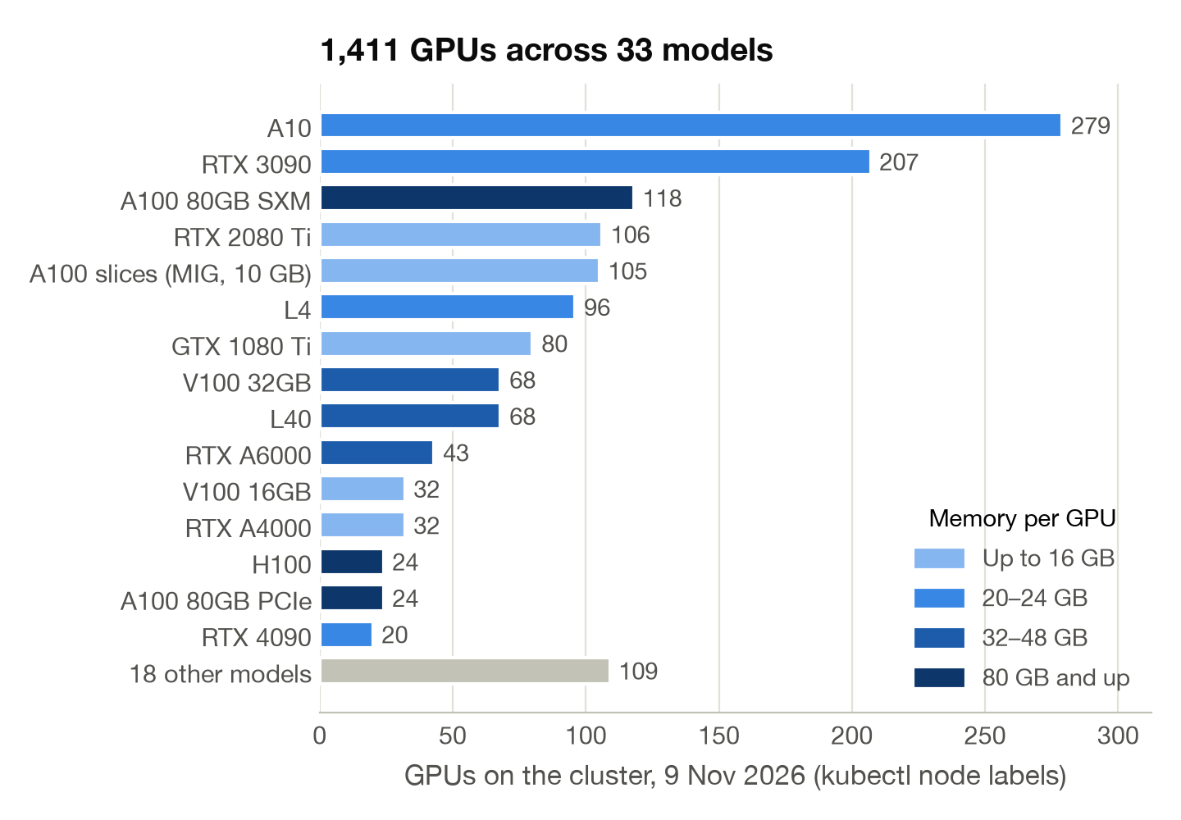
GPUs on NRP
1,411 GPUs in 33 models, contributed by campuses
Most common: A10 and RTX 3090, 24 GB each
About 140 A100s with 80 GB, plus H100s and H200s
Ask for the GPU memory your job needs, not a brand name
What's free right now: nrp.ai/viz/resources
13

Slide 20
Choosing a GPU
GPU memory | Examples | Good for | How to ask
Up to 16 GB | RTX 2080 Ti, GTX 1080 Ti, A4000, A100 slices | Teaching, debugging, classic ML, small CNNs | nvidia.com/gpu: 1
20–24 GB | A10, RTX 3090, L4, RTX 4090 | Most deep learning; fine-tuning and serving models up to ~8B parameters | nvidia.com/gpu: 1 + memory or model
32–48 GB | L40, V100 32 GB, RTX A6000, A40 | Bigger models and batches; serving models up to ~30B | nvidia.com/gpu, or rtxa6000 / a40
80 GB and up | A100 80 GB, H100, H200 | Large training runs and large models | A100: access request; H100/H200 reserved
Current PyTorch builds need Turing or newer: on a GTX 1080 Ti or V100, use an older image.
https://nrp.ai/documentation/userdocs/running/gpu-pods/
14

Slide 21
Ways to Run Work
Interactive: JupyterHub
Batch: a Job
Pick a GPU from the start menu; explore, debug, teach
Idle servers stop: 1 hour after you close the browser on NRP's hub, 6 hours at most on any hub
Runs your script to the end, then gives the GPU back
Submit many at once; the rest wait in Pending for a free GPU
$ kubectl apply -f sweep/ # six training jobs
Interactive: a pod
Start a container with kubectl, then open a shell in it
Deleted after 6 hours; at most 2 GPUs
GPU 1
lr-0.1
lr-0.0003
GPU 2
lr-0.03
Long-running: a Deployment
GPU 3
lr-0.01
lr-0.001
Keeps a service up (a web app, a database) and restarts it if it crashes
Removed after 2 weeks unless admins grant an exception; no GPU if it sits mostly idle
GPU 4
lr-0.003
time
Six jobs on four GPUs: two wait in Pending and take the first GPUs that free up. When the last one ends, all four GPUs are free again.
15

Slide 22
A GPU Job
apiVersion: batch/v1
kind: Job
metadata: {name: gpu-train-daniel, namespace: my-lab} # (1)
spec:
template:
spec:
restartPolicy: Never
containers:
- name: train
image: pytorch/pytorch:2.9.0-cuda13.0-cudnn9-runtime # (2)
command: ["python", "train.py"]
resources: # (3)
requests: {cpu: "2", memory: 6Gi, nvidia.com/gpu: 1}
limits: {cpu: "2", memory: 6Gi, nvidia.com/gpu: 1}
affinity: # (4)
nodeAffinity:
requiredDuringSchedulingIgnoredDuringExecution:
nodeSelectorTerms:
- matchExpressions:
- {key: nvidia.com/gpu.memory, operator: Gt, values: ["20000"]}
- {key: nvidia.com/gpu.compute.major, operator: Gt, values: ["7"]}
(1) Where: your namespace
(2) What: a container image, and the command to run
(3) Resources: 2 CPUs, 6 GB of memory, one GPU
(4) Which GPU: more than 20 GB, Ampere or newer; or name exact models
16

Slide 23
Running the Job
# submit
kubectl apply -f gpu-job.yaml
# watch: Pending → Running → Completed
kubectl get pods -l job-name=gpu-train-daniel
# read the output
kubectl logs -f job/gpu-train-daniel
# clean up
kubectl delete job gpu-train-daniel
Output, 9 Nov 2026
Running on: NVIDIA A10
Matrix multiply, 4096 x 4096:
CPU (2 cores) 0.09 TFLOP/s
GPU 14.0 TFLOP/s (154x)
Training on 60,000 images, testing on 10,000
epoch 1: loss 0.090, accuracy 98.4%, 1.6 s
epoch 2: loss 0.009, accuracy 98.7%, 1.0 s
epoch 3: loss 0.033, accuracy 98.7%, 1.1 s
Done: the job exits and frees the GPU.
Stuck in Pending? kubectl describe pod says why, usually that no matching GPU is free.
Our test: under 30 s from submit to done on an A10 that had the image; several minutes in Pending when the cluster was full.
17

Slide 24
Using GPUs Fairly
Do
Don't
Run batch work as a Job that exits
Request what you'll use; keep limits within 20% of requests
Keep data on a persistent volume or in S3
Run a sweep as many one-GPU jobs
Borrow idle A100/H100s with priorityClassName: opportunistic, and checkpoint
Leave a notebook holding a GPU overnight
Put sleep in a Job to keep a GPU (bannable)
Ask for 4 GPUs "just in case": use must stay above 40%
Keep results on the pod's own disk; it vanishes with the pod
https://nrp.ai/documentation/userdocs/start/policies/
18

Slide 25
AI Services
19

Slide 26
Hosted LLMs
Open-weight models on NRP GPUs, behind one OpenAI-compatible endpoint:
ellm.nrp-nautilus.io/v1
Free for non-commercial research and education
Prompts are processed on NRP hardware, not sent to a commercial provider
Still not for PHI
About 7.1 billion tokens a day (September 2026)
Model | Good for
qwen3, qwen3-small | Hard reasoning, long documents, images
gpt-oss | General chat, reproducible research
glm-5, kimi, minimax | Agentic coding
deepseek-v4-flash | Whole codebases, very long documents
gemma, gemma-small | Images, video, audio transcription
qwen3-embedding | Search and RAG (embeddings)
https://nrp.ai/documentation/userdocs/ai/llm-managed/models/
Uses from the models page, 26 Oct 2026. The catalog rotates.
20

Slide 27
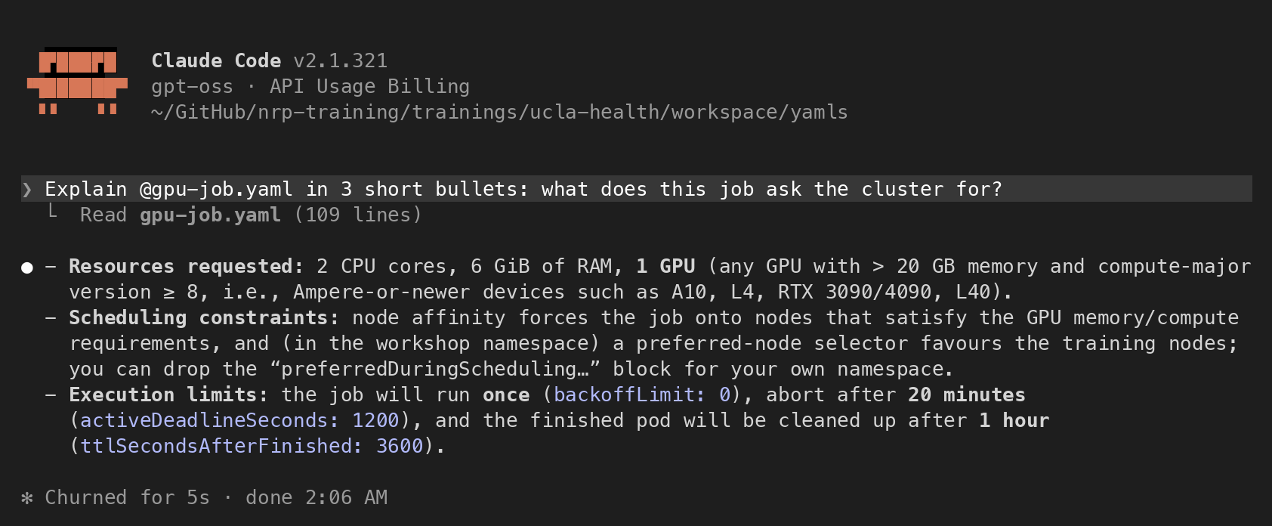
Using the LLMs
In the browser: Open WebUI
nrp-openwebui.nrp-nautilus.io
From code: the standard OpenAI library; token from nrp.ai/llmtoken
In JupyterHub: Jupyter AI (in the demo)
Coding agents: Claude Code, opencode, VS Code and others
tested configurations in the NRP docs
Claude Code on NRP's gpt-oss, asked about the demo's GPU job
21

Slide 28
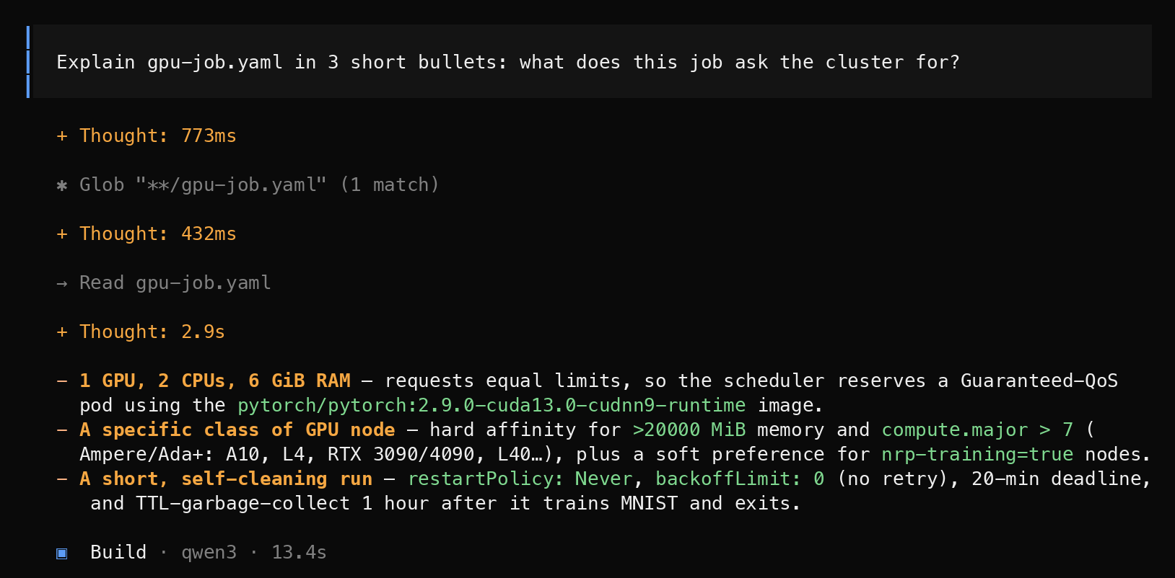
Using the LLMs
In the browser: Open WebUI
nrp-openwebui.nrp-nautilus.io
From code: the standard OpenAI library; token from nrp.ai/llmtoken
In JupyterHub: Jupyter AI (in the demo)
Coding agents: Claude Code, opencode, VS Code and others
tested configurations in the NRP docs
opencode on NRP's qwen3, same question
21

Slide 29
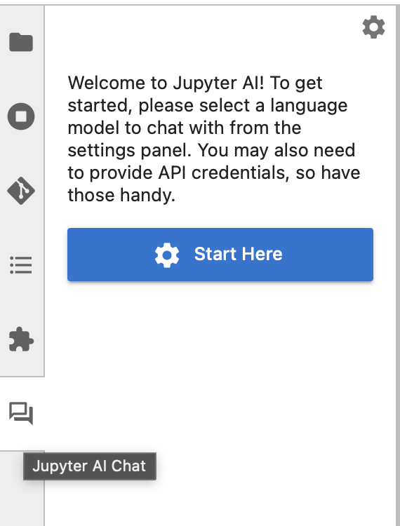
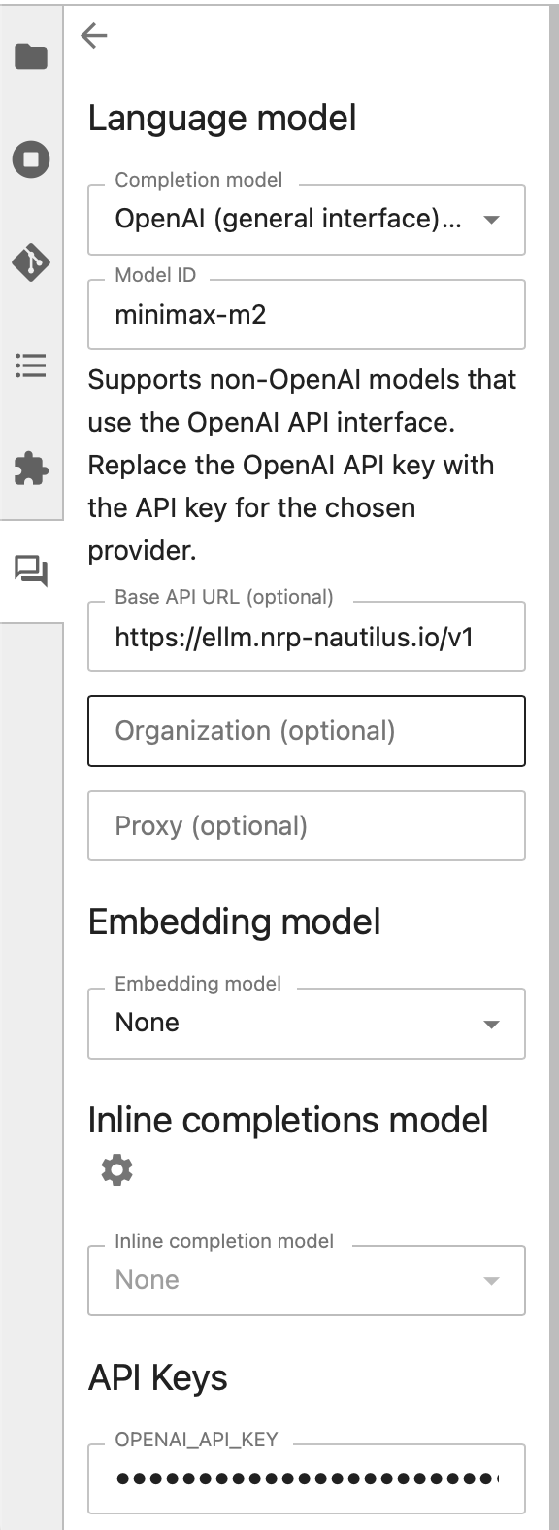
Jupyter AI
Already pointed at NRP's models on the training hub, and on any course hub you run
Chat panel: ask about code, an error or a concept
/fix: select a cell that crashed; it explains and proposes a fix
%%ai magics: {variables} in a prompt become their live values, so the model sees your data
%%ai openai-chat:gpt-oss
Here is a summary of my dataset: {summary}
Which columns would you check first, and why?
22

Slide 30
Running Your Own Models
Serve your own model: vLLM or SGLang on a GPU in your namespace, your weights or your fine-tune behind the same OpenAI API; ask the admins before running one as a long-lived service
Train and fine-tune: PyTorch and Hugging Face in GPU jobs, from one GPU to eight on a node
Search your documents (RAG): qwen3-embedding and NRP's managed Milvus vector database
Inference accelerators: Qualcomm Cloud AI 100 cards, requested in a job like a GPU
Worked examples: the PEARC26 tutorial (serving, RAG), and a physics neural network trained in GPU jobs (CMS HATS)
https://training.nrp-nautilus.io
23

Slide 31
Labs and Classes
24

Slide 32
JupyterHub for Classes
Your class needs | A hub on NRP gives it
The same environment for every student | A container image you choose
No laptop setup on day one | JupyterLab in the browser, with campus login
GPUs for a neural-network unit | GPU options on the start menu, with limits
An AI assistant, without per-seat fees | Jupyter AI and the hosted LLMs, preconfigured
Shared datasets and notebooks | One shared volume in every server
Instructors: contact us; we'll help you set up a hub for your lab or course
It's one configuration file in a namespace you own
Students: if your course needs GPUs, ask your professor to get in touch
25

Slide 33
Getting Started
1. Log in: nrp.ai (CILogon → UCLA)
2. Request a namespace: get-started.nrp-nautilus.io
PIs, faculty, staff, postdocs; students ask their PI
3. Try the LLMs: nrp-openwebui.nrp-nautilus.io
4. Run your first GPU job:
training.nrp-nautilus.io/ucla-health
Help
Documentation: nrp.ai/documentation
Support chat and email: nrp.ai/contact
Labs, courses or a UCLA campus group: d4diaz@ucsd.edu
26

Slide 34
Live Demo
27

Slide 35
Acknowledgments
NRP is supported by NSF awards OAC-1541349, OAC-1826967, OAC-2030508, OAC-1841530, OAC-2005369, OAC-2112167, CISE-1713149, CISE-2100237 and CISE-2120019
Networks: CENIC, Pacific Wave, Internet2, MREN, GPN, NYSERNet, FLR, NEREN, Sun Corridor, OARnet, SCLR and the Albuquerque GigaPoP
The NRP operations teams at SDSC, the University of Nebraska–Lincoln and MGHPCC, and the campuses that host and share their hardware, UCLA among them
Clifford and UCLA Health IT's Research Tech Talks, for hosting
28

Slide 36
Questions?
Today's materials
training.nrp-nautilus.io/ucla-health
Portal and login
nrp.ai
Request a namespace
get-started.nrp-nautilus.io
Chat with the LLMs
nrp-openwebui.nrp-nautilus.io
LLM token
nrp.ai/llmtoken
GPUs free right now
nrp.ai/viz/resources
GPU jobs, docs
nrp.ai/documentation/userdocs/running/gpu-pods
Support
nrp.ai/contact
Daniel Diaz · d4diaz@ucsd.edu
29

Slide 37
Backup
30

Slide 38
Glossary
Term | Meaning
Kubernetes | Software that runs containers across many machines; NRP's cluster is one
Container | Your software and everything it needs, packaged to run anywhere
Pod | One or more containers running together on one machine
Job | A pod that runs to completion, then releases its resources
Namespace | Your group's workspace on the cluster: members, jobs, data
Volume (PVC) | Storage in your namespace that outlives any one pod
kubectl | The command-line tool you use to talk to the cluster
GPU memory | How big a model or batch fits on one GPU; the main number to ask for
Open-weight model | A model whose weights are published for anyone to run
Token (LLM) | A piece of a word, about ¾ of an English word
Embedding | A vector that captures meaning, for search and RAG
RAG | Look up relevant text first, then ask the model to answer from it
31

Slide 39
Organizing Groups at UCLA
UCLA group
a department, or IT
Namespaces can be nested under a campus-level group
Its admins create namespaces for labs and courses, and name their admins
Fresno State does this through central IT and HPC staff
UCLA has no campus-level admin yet: a department or group could take that role
Lab A
a PI and students
Lab B
its own data
Course
a class hub
Operations
shared tools
Data lives on volumes inside a namespace, so each lab's data is visible only to its members.
32

Slide 40
GPU Resource Keys
GPU | Request it as | Notes
Most GPUs (A10, 3090, L4, 2080 Ti, L40, V100 ...) | nvidia.com/gpu: 1 | Pick a model or memory with node affinity
NVIDIA RTX A6000 | nvidia.com/rtxa6000: 1 | 48 GB
NVIDIA A40 | nvidia.com/a40: 1 | 48 GB
NVIDIA A100 (80 GB) | nvidia.com/a100: 1 | Quota is zero by default: access request at nrp.ai/reservations
A100 slice (MIG 1g.10gb) | nvidia.com/mig-small: 1 | 10 GB slice of an A100
NVIDIA H100 / H200 / GH200 | nvidia.com/h100 · h200 · gh200 | Reserved for contributors and LLM serving
Any of the big ones, preemptibly | priorityClassName: opportunistic | Runs on idle capacity; can be preempted
Check live with kubectl get nodes -L nvidia.com/gpu.product
33

Slide 41
%%ai Magics
%load_ext jupyter_ai_magics
%%ai openai-chat:gpt-oss
What is the National Research Platform, in two sentences?
# explain the most recent traceback, no copy-paste
%ai error openai-chat:gpt-oss
# {variables} are replaced by their live values
%%ai openai-chat:gpt-oss
My readings are {readings} and my code printed {average}.
Is that the mean of every reading after the first?
The chat panel can't see the kernel; the magics can
%ai error reads the last traceback
The silent bug: code that runs and prints the wrong number has no traceback, so you have to say what you meant
%ai list is Jupyter AI's built-in list, not NRP's catalog; the name you type passes through to NRP
34

