Slide 1
Prototype National Research
Platform Classroom
NAIRR AI Education Webinar Series
Daniel Diaz · San Diego Supercomputer Center, UC San Diego
Edge Webinar · NJEdge · 13 November 2026

Slide 2

Agenda
What is NRP?
Getting in: your login, a namespace, NAIRR Classroom
What a course can use: CPUs, GPUs, storage, AI models
JupyterHub for your class: what you control as the instructor
Live demo: a class hub from one file
Questions
Nautilus: the name of NRP's cluster
Slides, the demo notebook and the files:
https://training.nrp-nautilus.io/nairr-classroom
1

Slide 3
What NRP Is
2

Slide 4
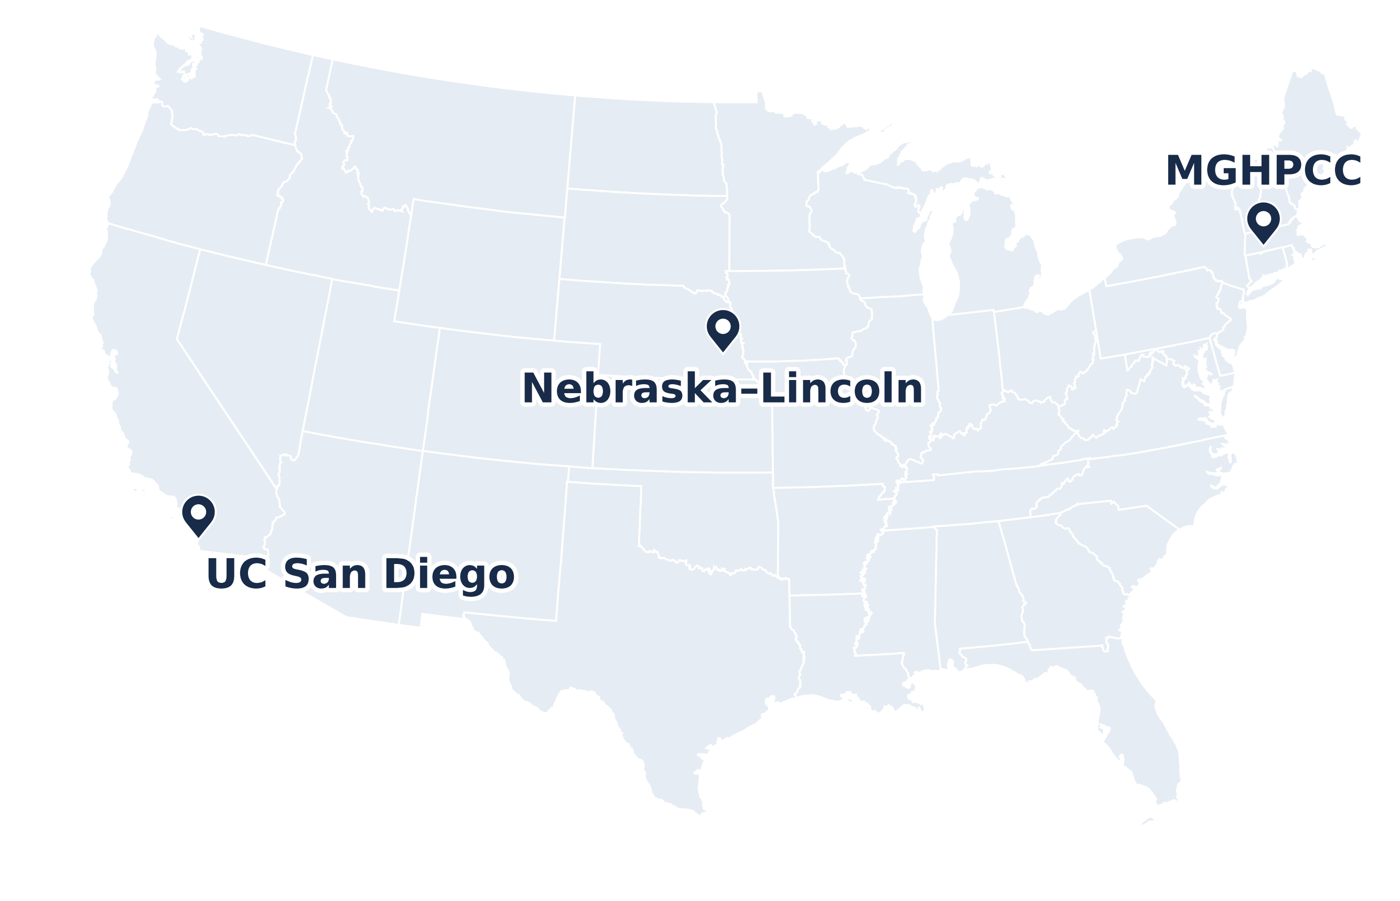
What is NRP?
One national Kubernetes cluster, Nautilus, for research and education
Run by SDSC, Nebraska–Lincoln and MGHPCC; funded by NSF
https://dash.nrp-nautilus.io
Nodes, GPUs, CPUs (hardware threads) and storage: cluster snapshot, 10 Nov 2026
3

Slide 5
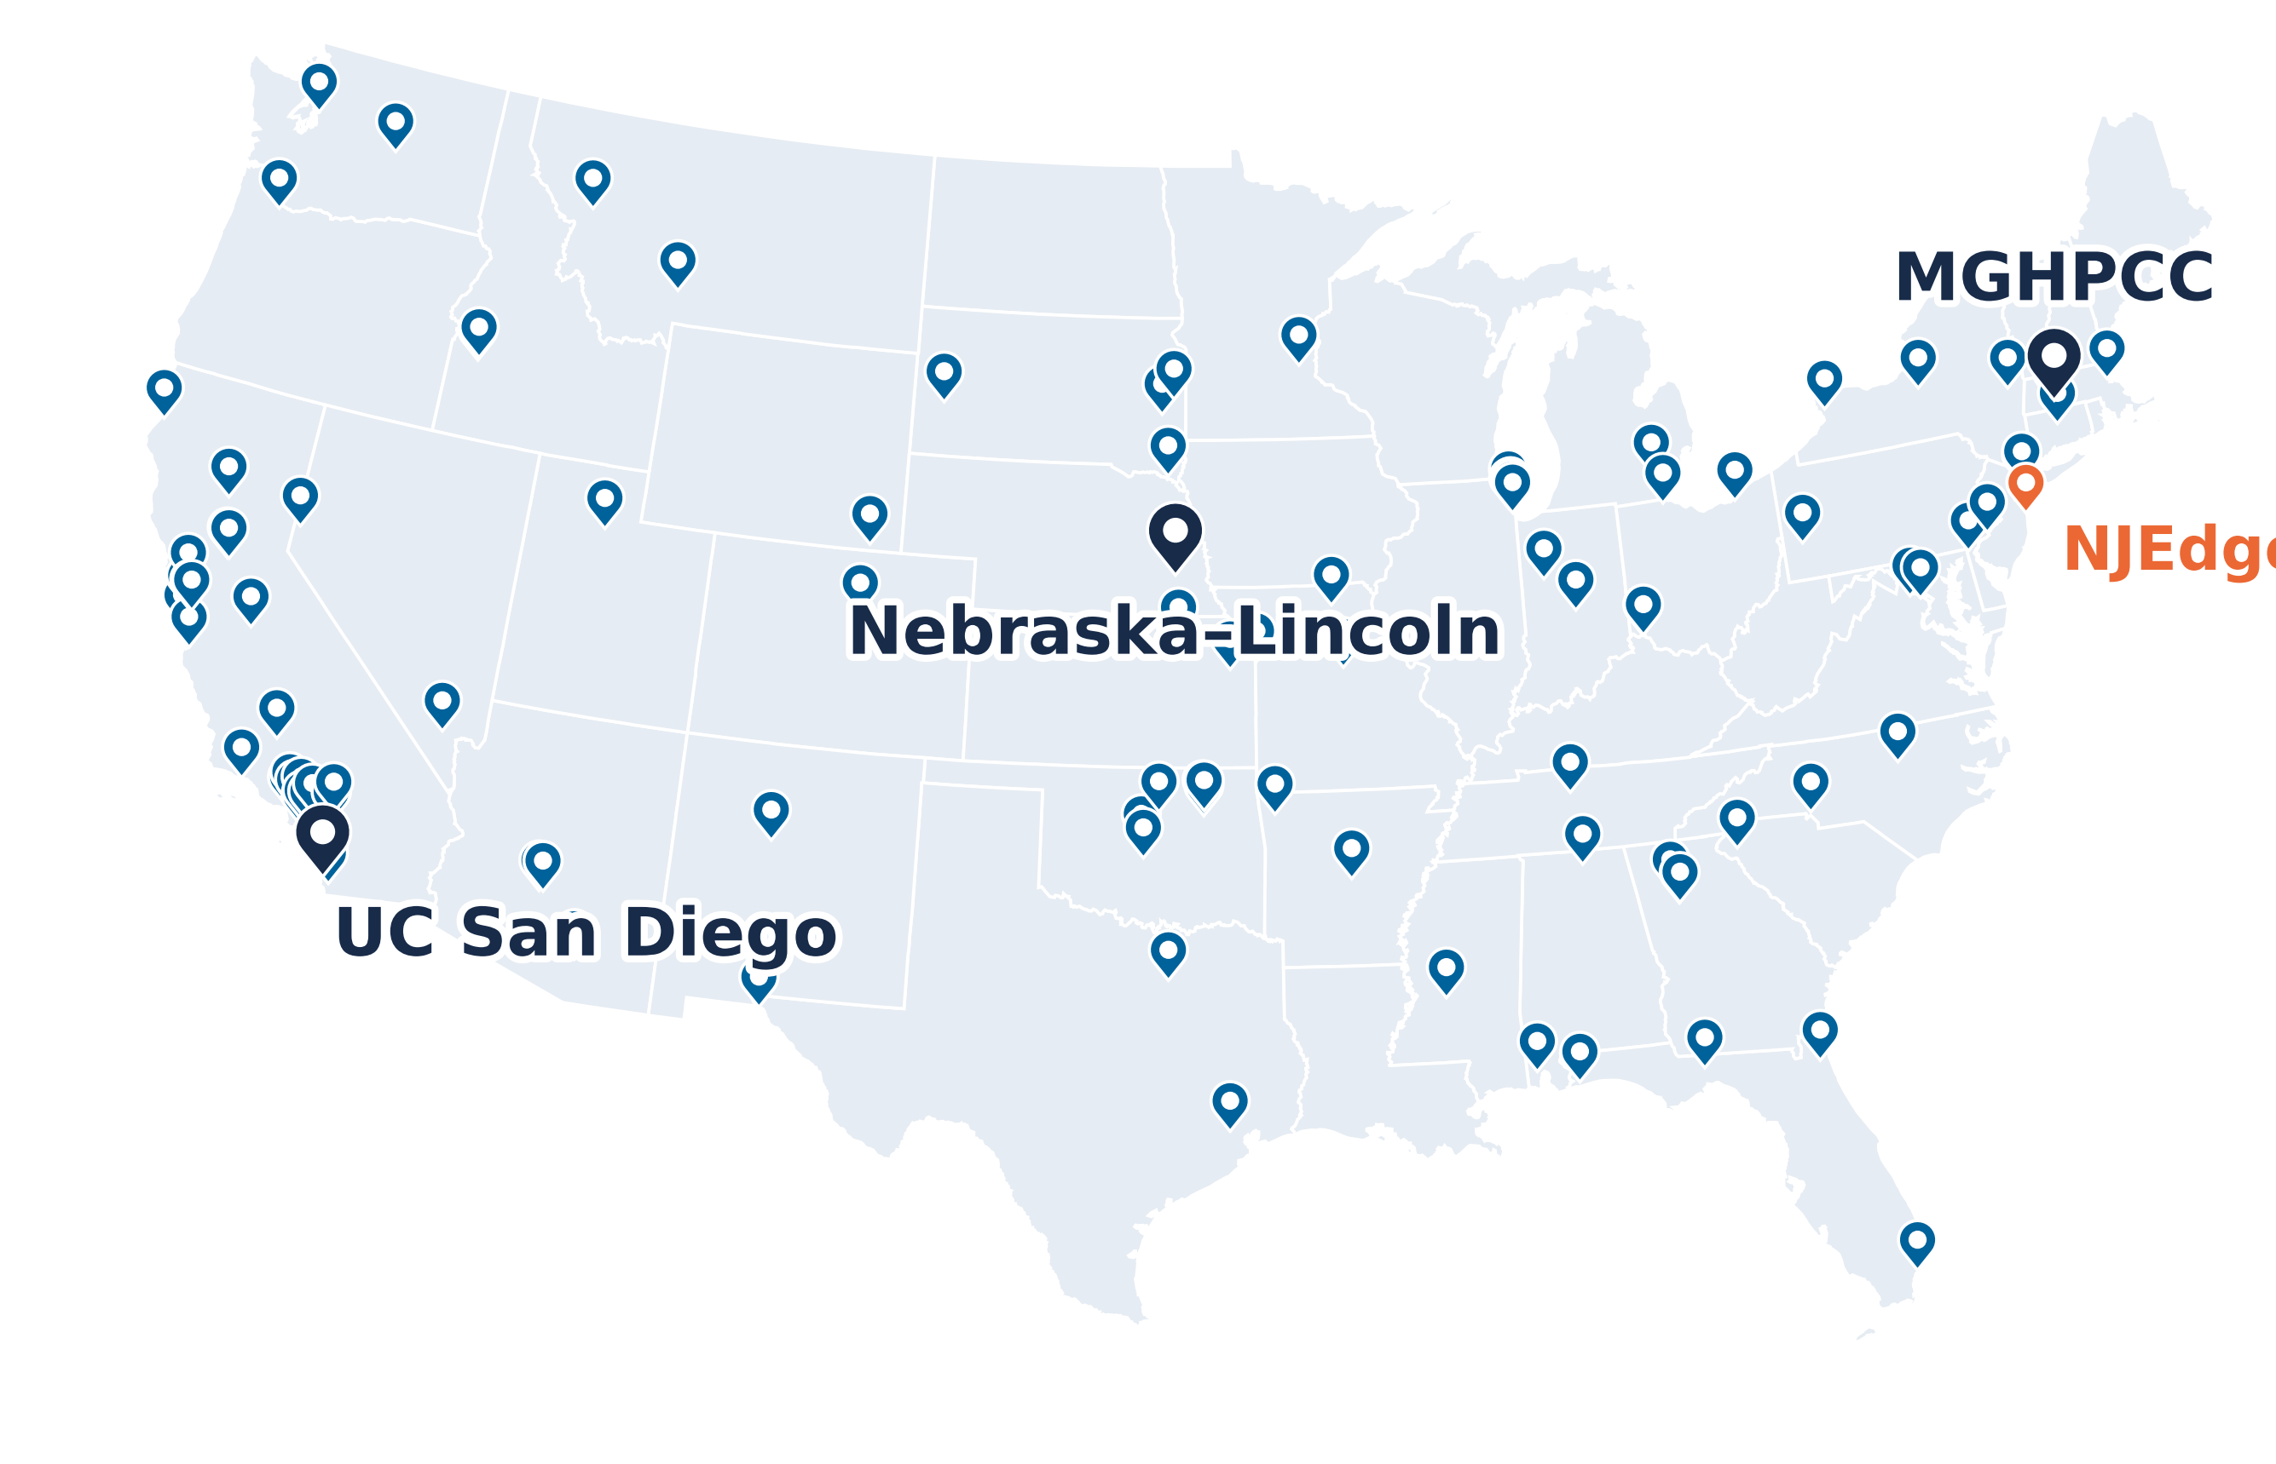
What is NRP?
One national Kubernetes cluster, Nautilus, for research and education
Run by SDSC, Nebraska–Lincoln and MGHPCC; funded by NSF
Hardware from 70+ institutions, on research and education networks
NJEdge hosts NRP nodes too (orange)
Today:
534 nodes at 129 sites
1,460 GPUs in 33 models; 35,448 CPUs
15 PB of raw Ceph storage
https://dash.nrp-nautilus.io
Sites from the NRP dashboard, 10 Nov 2026
Not drawn: 8 sites in Hawaii, Guam, Korea, Brazil and Europe
Nodes, GPUs, CPUs (hardware threads) and storage: cluster snapshot, 10 Nov 2026
3

Slide 6
What is NRP?
One national Kubernetes cluster, Nautilus, for research and education
Run by SDSC, Nebraska–Lincoln and MGHPCC; funded by NSF
Hardware from 70+ institutions, on research and education networks
NJEdge hosts NRP nodes too (orange)
Today:
534 nodes at 129 sites
1,460 GPUs in 33 models; 35,448 CPUs
15 PB of raw Ceph storage
Free for US nonprofit institutions, community colleges included
One team runs it from the OS up: no Kubernetes team needed on your campus
https://dash.nrp-nautilus.io
Sites from the NRP dashboard, 10 Nov 2026
Not drawn: 8 sites in Hawaii, Guam, Korea, Brazil and Europe
Nodes, GPUs, CPUs (hardware threads) and storage: cluster snapshot, 10 Nov 2026
3

Slide 7
From PRP to NRP
2015
2018
2021
2026
Pacific Research Platform
Data transfer nodes (FIONAs) in campus Science DMZs, on CENIC and Pacific Wave
OAC-1541349
Toward a National Research Platform
The same model, beyond the West Coast
OAC-1826967
National Research Platform
An NSF Category II resource: GPUs, storage and services for research and education
OAC-2112167
Today
One Kubernetes cluster, Nautilus: 534 nodes at 129 sites, and AI models as a service
Under each milestone: its NSF award.
4

Slide 8
NRP in Numbers
534
nodes
129
sites on the dashboard
1,460
GPUs in 33 models
35,448
CPUs (hardware threads)
14.9 PB
raw Ceph in 9 clusters
2,334
namespaces: labs, courses, services
Cluster snapshot, 10 Nov 2026 (Kubernetes v1.34.11). Sites: the NRP dashboard.
5

Slide 9
Containers and Kubernetes
Container image: an app and everything it needs, built once from a Dockerfile; runs the same anywhere
Kubernetes runs containers across many machines: you declare what you want (an image, CPUs, memory, a GPU), the scheduler picks a node that has it, and controllers keep it that way
A running container is a pod. Pods, Jobs, Deployments and Services live in a namespace: one per lab, course or service
NRP is one Kubernetes cluster: 534 nodes
Container image
Kubernetes cluster
app.py
your code
Node
64 CPU cores
PyTorch, NumPy
Node
8 × A10 GPUs
CUDA libraries
your container
Linux userland
Node
4 × A100 GPUs
built once, from a Dockerfile
the scheduler picks a node with a free GPU
6

Slide 10
Getting In
7

Slide 11
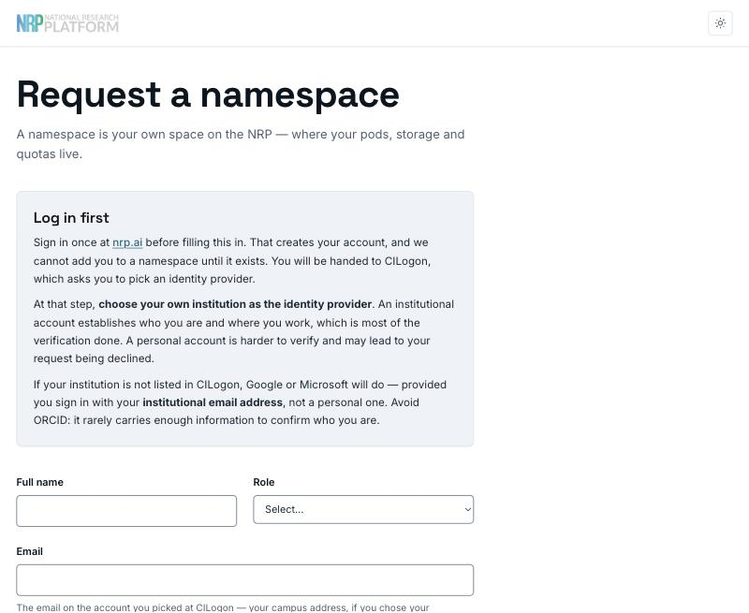
Getting Access
1. Log in at nrp.ai
Log In → CILogon → your institution's own login
2. Get a namespace for your course
Request one at get-started.nrp-nautilus.io, or email the NRP team the course, the number of students and the start date
3. Bring your students
They log in the same way, with their campus account: no new passwords, nothing to install
Who can request a namespace: faculty, staff, postdocs and research scientists. Free for US nonprofit institutions.
https://get-started.nrp-nautilus.io
8

Slide 12
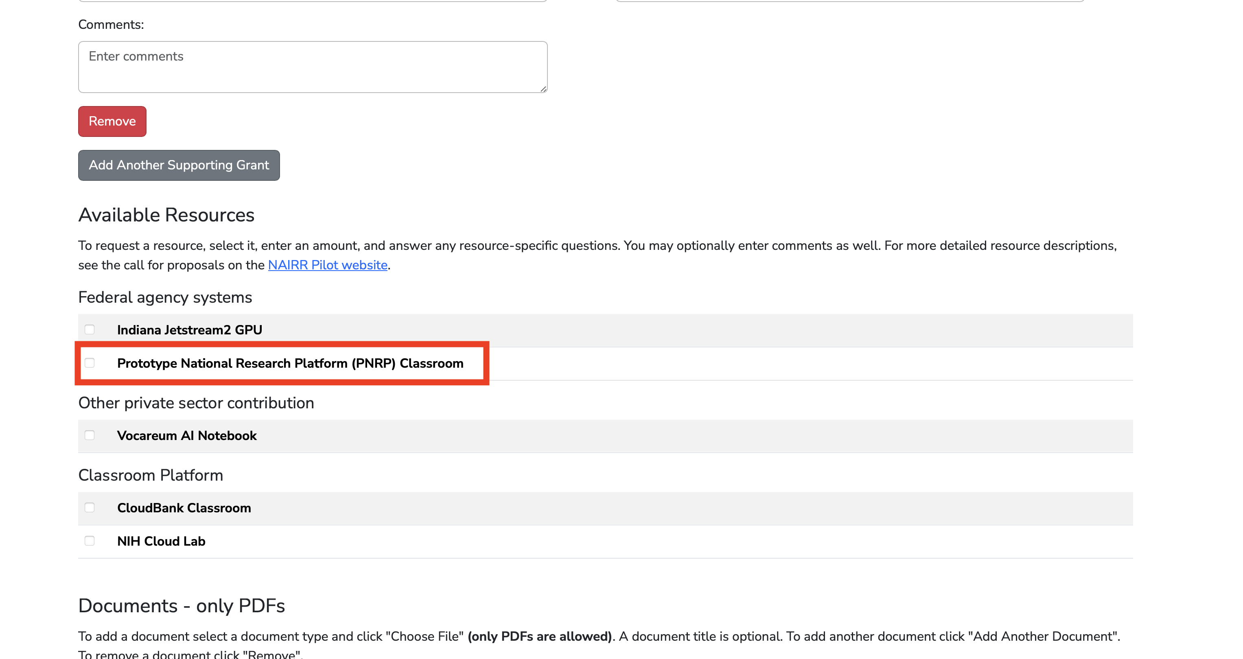
NAIRR Classroom
The NAIRR Pilot takes Classroom requests from US educators
Your course, and what it needs, in up to three pages
Courses that teach AI, in any discipline, for US-based students
Reviewed as they arrive; a decision within a month
Tick Prototype NRP (PNRP) Classroom: a Jupyter platform, CPUs, GPUs, storage and hosted AI models, run by the NRP team
Not required to use NRP, but it gives your course priority
The NAIRR Classroom request form: NRP's option, among the other providers
https://nairrpilot.org
9

Slide 13
What is a Namespace?
Your course's space on the cluster: one per course, lab or project
You're its admin, and you add your TAs
Your course hub, its storage and anything else you run lives in it
Members see their own namespaces, not anyone else's
2,334 of them today
Nautilus cluster
bio-210
the instructor (admin), 2 TAs, 40 students · the course JupyterHub · shared datasets
ml-lab
a PI (admin) and three students · GPU jobs · a data volume · a web app
another-course
their members only · you can't see their servers or files
10

Slide 14
Ways In
JupyterHub
notebooks in the browser; NRP's, or your course's own
Coder
VS Code in the browser, for programming courses
kubectl
jobs, services and storage in your namespace
jupyterhub-west.nrp-nautilus.io
coder.nrp-nautilus.io
nrp.ai/config
GitLab
course repositories, and builds of course images
LLM API
hosted models for notebooks and apps
Chat
talk to the hosted models in a browser
gitlab.nrp-nautilus.io
ellm.nrp-nautilus.io/v1
nrp-openwebui.nrp-nautilus.io
Most students only ever see the first one. The rest are there when a course outgrows notebooks.
11

Slide 15
Resources for Your Course
12

Slide 16
What a Course Can Use
CPUs
about 35 thousand; most coursework needs nothing else
GPUs on NRP, the ten most common models
A10
279
RTX 3090
207
GPUs
1,460 in 33 models, from classroom cards to A100s
RTX 2080 Ti
148
A100 80 GB
118
A100 slice (10 GB)
105
L4
96
Storage
a home folder per student, shared course data, S3
GTX 1080 Ti
80
V100 32 GB
68
L40
68
AI models
hosted open-weight LLMs behind an OpenAI-style API
RTX A6000
50
Cluster snapshot, 10 Nov 2026. Live view: nrp.ai/viz/resources
Ask for the kind of hardware the work needs, not the biggest card: most of a semester runs on CPUs.
13

Slide 17
Choosing GPUs for a Course
Intro data science: pandas, scikit-learn
CPUs only: 2 CPUs, 8 GB
GPU memory decides what fits
A100 slice
10 GB · 105 on NRP
RTX 2080 Ti
11 GB · 148 on NRP
A10
24 GB · 279 on NRP
RTX 3090
24 GB · 207 on NRP
L4
24 GB · 96 on NRP
V100
32 GB · 68 on NRP
L40
48 GB · 68 on NRP
RTX A6000
48 GB · 50 on NRP
A100
80 GB · 118 on NRP
14

Slide 18
Choosing GPUs for a Course
Intro data science: pandas, scikit-learn
CPUs only: 2 CPUs, 8 GB
GPU memory decides what fits
A100 slice
10 GB · 105 on NRP
RTX 2080 Ti
11 GB · 148 on NRP
Deep-learning labs: CNNs, small transformers
one GPU with 10–24 GB
A10
24 GB · 279 on NRP
RTX 3090
24 GB · 207 on NRP
L4
24 GB · 96 on NRP
V100
32 GB · 68 on NRP
L40
48 GB · 68 on NRP
RTX A6000
48 GB · 50 on NRP
A100
80 GB · 118 on NRP
14

Slide 19
Choosing GPUs for a Course
Intro data science: pandas, scikit-learn
CPUs only: 2 CPUs, 8 GB
GPU memory decides what fits
A100 slice
10 GB · 105 on NRP
RTX 2080 Ti
11 GB · 148 on NRP
Deep-learning labs: CNNs, small transformers
one GPU with 10–24 GB
A10
24 GB · 279 on NRP
RTX 3090
24 GB · 207 on NRP
Bigger models: fine-tuning, long training runs
48–80 GB, fewer students at once
L4
24 GB · 96 on NRP
V100
32 GB · 68 on NRP
L40
48 GB · 68 on NRP
RTX A6000
48 GB · 50 on NRP
A100
80 GB · 118 on NRP
Ask by memory and generation (say, more than 20 GB, Ampere or newer) rather than by name: more GPUs qualify, and students wait less.
14

Slide 20
Choosing GPUs for a Course
Intro data science: pandas, scikit-learn
CPUs only: 2 CPUs, 8 GB
GPU memory decides what fits
A100 slice
10 GB · 105 on NRP
RTX 2080 Ti
11 GB · 148 on NRP
Deep-learning labs: CNNs, small transformers
one GPU with 10–24 GB
A10
24 GB · 279 on NRP
RTX 3090
24 GB · 207 on NRP
Bigger models: fine-tuning, long training runs
48–80 GB, fewer students at once
L4
24 GB · 96 on NRP
V100
32 GB · 68 on NRP
L40
48 GB · 68 on NRP
Using LLMs, not training them
no GPU: NRP's hosted models
RTX A6000
48 GB · 50 on NRP
A100
80 GB · 118 on NRP
Ask by memory and generation (say, more than 20 GB, Ampere or newer) rather than by name: more GPUs qualify, and students wait less.
14

Slide 21
Sharing GPUs Fairly
Reserved nodes: on request, admins taint a contributor's nodes; only pods that tolerate the taint, the owner's, run there
Today: 119 nodes reserved for 23 groups
Reserved node · taint nautilus.io/reservation=lab-a
lab-a pod
lab-a pod
idle, reserved
idle, reserved
lab-b pod ✕ no toleration
Shared node: no taint
a user's job
idle
idle
idle
A pod without the toleration can't land on the reserved node, even on an idle GPU.
15

Slide 22
Sharing GPUs Fairly
Reserved nodes: on request, admins taint a contributor's nodes; only pods that tolerate the taint, the owner's, run there
Today: 119 nodes reserved for 23 groups
Shared nodes: idle GPUs go to opportunistic pods, the lowest priority class, e.g. OSG jobs for IceCube and LIGO
232 opportunistic pods running, 208 of them from OSG
Reserved node · taint nautilus.io/reservation=lab-a
lab-a pod
lab-a pod
idle, reserved
idle, reserved
lab-b pod ✕ no toleration
Shared node: no taint
a user's job
opportunistic (OSG)
opportunistic (OSG)
opportunistic (OSG)
On a shared node, opportunistic pods fill the idle GPUs.
15

Slide 23
Sharing GPUs Fairly
Reserved nodes: on request, admins taint a contributor's nodes; only pods that tolerate the taint, the owner's, run there
Today: 119 nodes reserved for 23 groups
Shared nodes: idle GPUs go to opportunistic pods, the lowest priority class, e.g. OSG jobs for IceCube and LIGO
232 opportunistic pods running, 208 of them from OSG
When anyone needs that GPU, the opportunistic pod is preempted: it must checkpoint, or just restart
Reserved node · taint nautilus.io/reservation=lab-a
lab-a pod
lab-a pod
idle, reserved
idle, reserved
lab-b pod ✕ no toleration
Shared node: no taint
a user's job
new job (took this GPU)
opportunistic (OSG)
opportunistic (OSG)
A normal pod arrives: the scheduler preempts an opportunistic pod to make room.
15

Slide 24
Regions and Storage
Every node is labeled with its region, zone (143 zones) and site; workloads spread out or stay near their data
Rook runs 9 Ceph clusters, one per region or large site: 14.9 PB raw
CephFS for shared files, RBD for block, S3 for objects
Linstor (DRBD) for fast replicated block storage; CVMFS for software; local NVMe for scratch
Pick the storage in the region where you compute
Ceph clusters: raw capacity, and used
rook
6.25 PB
rook-haosu
1.97 PB
rook-central
1.51 PB
rook-east
1.48 PB
rook-fullerton
1.46 PB
rook-south-east
0.89 PB
rook-tide
0.73 PB
rook-pacific
0.37 PB
rook-ucsd
0.27 PB
From the CephCluster resources, 10 Nov 2026
16

Slide 25
Ways to Run Work
Interactive: JupyterHub
Batch: a Job
Pick a GPU from the start menu; explore, debug, teach
Idle servers stop: 1 hour after you close the browser on NRP's hub, 6 hours at most on any hub
Runs your script to the end, then gives the GPU back
Submit many at once; the rest wait in Pending for a free GPU
$ kubectl apply -f sweep/ # six training jobs
Interactive: a pod
Start a container with kubectl, then open a shell in it
Deleted after 6 hours; at most 2 GPUs
GPU 1
lr-0.1
lr-0.0003
GPU 2
lr-0.03
Long-running: a Deployment
GPU 3
lr-0.01
lr-0.001
Keeps a service up (a web app, a database) and restarts it if it crashes
Removed after 2 weeks unless admins grant an exception; no GPU if it sits mostly idle
GPU 4
lr-0.003
Six jobs on four GPUs: two wait in Pending and take the first GPUs that free up. When the last one ends, all four GPUs are free again.
17

Slide 26
A GPU Job
apiVersion: batch/v1
kind: Job
metadata: {name: gpu-train-daniel, namespace: my-lab} # (1)
spec:
template:
spec:
restartPolicy: Never
containers:
- name: train
image: pytorch/pytorch:2.9.0-cuda13.0-cudnn9-runtime # (2)
command: ["python", "train.py"]
resources: # (3)
requests: {cpu: "2", memory: 6Gi, nvidia.com/gpu: 1}
limits: {cpu: "2", memory: 6Gi, nvidia.com/gpu: 1}
affinity: # (4)
nodeAffinity:
requiredDuringSchedulingIgnoredDuringExecution:
nodeSelectorTerms:
- matchExpressions:
- {key: nvidia.com/gpu.memory, operator: Gt, values: ["20000"]}
- {key: nvidia.com/gpu.compute.major, operator: Gt, values: ["7"]}
(1) Where: your namespace
(2) What: a container image, and the command to run
(3) Resources: 2 CPUs, 6 GB of memory, one GPU
(4) Which GPU: more than 20 GB, Ampere or newer; or name exact models
18

Slide 27
Using GPUs Fairly
Do
Don't
Give GPUs only to the menu options that need them
Let idle servers stop: keep the culling on
Request what students will use; keep limits close to requests
Keep data in home folders or the shared volume, not inside the image
Leave servers holding GPUs overnight
Give every student 4 GPUs “just in case”: use must stay above 40%
Put results on the server's own disk: it vanishes with the server
https://nrp.ai/documentation/userdocs/start/policies/
19

Slide 28
JupyterHub for Your Class
20

Slide 29
Two Ways to Give Students Jupyter
NRP's JupyterHub
jupyterhub-west.nrp-nautilus.io
Your own hub, in your namespace
jhub-yourcourse.nrp-nautilus.io
Nothing to run: share the link
Students choose CPUs, memory and a GPU from a menu
NRP's images, the same rules for everyone
Good for trying things, small classes and research
Your image menu, built for the syllabus
Your login rules: only your students
Your limits, storage and course files
One Helm chart and one settings file: the rest of this section
152 JupyterHubs were running on NRP on 12 Nov, with 111 servers open at that moment.
21

Slide 30
How a Class Hub Works
CILogon
campus login
Your namespace on Nautilus
Student
a browser
Node · 64 CPUs
Node · 4 GPUs
Student
a browser
Your hub
login, menu, servers
Student
a browser
A class hub, step by step
One URL for the whole class. Behind it: your hub, in your namespace, and the cluster's nodes.
22

Slide 31
How a Class Hub Works
CILogon
campus login
Your namespace on Nautilus
Student
a browser
Node · 64 CPUs
Node · 4 GPUs
Student
a browser
Your hub
login, menu, servers
Student
a browser
1. Students log in
With their campus account, through CILogon. The hub lets in only the people you allow.
22

Slide 32
How a Class Hub Works
CILogon
campus login
Your namespace on Nautilus
Student
a browser
Node · 64 CPUs
Node · 4 GPUs
Student
a browser
Your hub
login, menu, servers
alex's server
Python · 2 CPUs
bea's server
R · 2 CPUs
chen's server
PyTorch · 1 GPU
Student
a browser
2. Each student gets a server
The hub starts a container for each student, with the image, CPUs, memory or GPU of the option they picked.
22

Slide 33
How a Class Hub Works
CILogon
campus login
Your namespace on Nautilus
Student
a browser
Node · 64 CPUs
Node · 4 GPUs
Student
a browser
Your hub
login, menu, servers
alex's server
Python · 2 CPUs
bea's server
R · 2 CPUs
chen's server
PyTorch · 1 GPU
Student
a browser
alex's home
bea's home
chen's home
shared course folder: read-only for students
3. Their files are there
Each server mounts the student's own home folder, plus a shared course folder everyone reads from.
22

Slide 34
How a Class Hub Works
CILogon
campus login
Your namespace on Nautilus
Student
a browser
Node · 64 CPUs
Node · 4 GPUs
Student
a browser
Your hub
login, menu, servers
alex's server
Python · 2 CPUs
bea's server
R · 2 CPUs
chen's server
PyTorch · 1 GPU
Student
a browser
alex's home
bea's home
chen's home
shared course folder: read-only for students
4. Idle servers stop
After an hour with no activity the server shuts down and its GPU goes back to the pool. The home folder stays for next time.
22

Slide 35
Who Can Log In
Campus login through CILogon: you never hand out or reset passwords
Your class list: allow your students by name or email, or a whole campus domain
Admins: you and your TAs; an admin can open a student's server to help
For a workshop or a demo, a shared password works too: today's demo uses one
Sign in
at your hub's URL
CILogon
pick your campus
On the list?
your hub checks
In
a server starts
Not on it
turned away
CILogon connects your hub to your institution's own sign-in, the same one students use for email.
23

Slide 36
Setting Up Campus Login
The login part of values.yaml
hub:
config:
JupyterHub:
authenticator_class: cilogon
CILogonOAuthenticator:
client_id: <from CILogon> # and its client secret
oauth_callback_url: https://jhub-bio210.nrp-nautilus.io/hub/oauth_callback
allowed_idps:
https://idp.campus.edu/idp/shibboleth: # your campus's entity ID
username_derivation: {username_claim: email}
admin_users: [you@campus.edu, ta@campus.edu]
allowed_users: [student1@campus.edu, student2@campus.edu]
1. Ask CILogon for a client
for your hub's address; it's issued by hand, so ask early
2. Look up your campus
its entity ID, in the CILogon IdP list
3. Name who gets in
admins, and your class list or your whole campus domain
4. helm upgrade
students who drop lose access at the next upgrade
Allow rules add up: allowed_domains admits a whole campus, allowed_users named people; blocked_users wins over both.
24

Slide 37
Setting Up Campus Login
The login part of values.yaml
hub:
config:
JupyterHub:
authenticator_class: cilogon
CILogonOAuthenticator:
client_id: <from CILogon> # and its client secret
oauth_callback_url: https://jhub-bio210.nrp-nautilus.io/hub/oauth_callback
allowed_idps:
https://idp.campus.edu/idp/shibboleth: # your campus's entity ID
username_derivation: {username_claim: email}
admin_users: [you@campus.edu, ta@campus.edu]
allowed_users: [student1@campus.edu, student2@campus.edu]
1. Ask CILogon for a client
for your hub's address; it's issued by hand, so ask early
2. Look up your campus
its entity ID, in the CILogon IdP list
3. Name who gets in
admins, and your class list or your whole campus domain
4. helm upgrade
students who drop lose access at the next upgrade
Allow rules add up: allowed_domains admits a whole campus, allowed_users named people; blocked_users wins over both.
24

Slide 38
Setting Up Campus Login
The login part of values.yaml
hub:
config:
JupyterHub:
authenticator_class: cilogon
CILogonOAuthenticator:
client_id: <from CILogon> # and its client secret
oauth_callback_url: https://jhub-bio210.nrp-nautilus.io/hub/oauth_callback
allowed_idps:
https://idp.campus.edu/idp/shibboleth: # your campus's entity ID
username_derivation: {username_claim: email}
admin_users: [you@campus.edu, ta@campus.edu]
allowed_users: [student1@campus.edu, student2@campus.edu]
1. Ask CILogon for a client
for your hub's address; it's issued by hand, so ask early
2. Look up your campus
its entity ID, in the CILogon IdP list
3. Name who gets in
admins, and your class list or your whole campus domain
4. helm upgrade
students who drop lose access at the next upgrade
Allow rules add up: allowed_domains admits a whole campus, allowed_users named people; blocked_users wins over both.
24

Slide 39
Setting Up Campus Login
The login part of values.yaml
hub:
config:
JupyterHub:
authenticator_class: cilogon
CILogonOAuthenticator:
client_id: <from CILogon> # and its client secret
oauth_callback_url: https://jhub-bio210.nrp-nautilus.io/hub/oauth_callback
allowed_idps:
https://idp.campus.edu/idp/shibboleth: # your campus's entity ID
username_derivation: {username_claim: email}
admin_users: [you@campus.edu, ta@campus.edu]
allowed_users: [student1@campus.edu, student2@campus.edu]
1. Ask CILogon for a client
for your hub's address; it's issued by hand, so ask early
2. Look up your campus
its entity ID, in the CILogon IdP list
3. Name who gets in
admins, and your class list or your whole campus domain
4. helm upgrade
students who drop lose access at the next upgrade
Allow rules add up: allowed_domains admits a whole campus, allowed_users named people; blocked_users wins over both.
24

Slide 40
Setting Up Campus Login
The login part of values.yaml
hub:
config:
JupyterHub:
authenticator_class: cilogon
CILogonOAuthenticator:
client_id: <from CILogon> # and its client secret
oauth_callback_url: https://jhub-bio210.nrp-nautilus.io/hub/oauth_callback
allowed_idps:
https://idp.campus.edu/idp/shibboleth: # your campus's entity ID
username_derivation: {username_claim: email}
admin_users: [you@campus.edu, ta@campus.edu]
allowed_users: [student1@campus.edu, student2@campus.edu]
1. Ask CILogon for a client
for your hub's address; it's issued by hand, so ask early
2. Look up your campus
its entity ID, in the CILogon IdP list
3. Name who gets in
admins, and your class list or your whole campus domain
4. helm upgrade
students who drop lose access at the next upgrade
Allow rules add up: allowed_domains admits a whole campus, allowed_users named people; blocked_users wins over both.
24

Slide 41
Your Image Menu
Server Options
What students see when they start a server: a menu you write.
Python for data science
2 CPUs · 8 GB
R with the tidyverse
2 CPUs · 8 GB
PyTorch with a GPU
4 CPUs · 16 GB · 1 GPU
BIO 210 course image
your packages, preinstalled
25

Slide 42
Your Image Menu
Server Options
What students see when they start a server: a menu you write.
Ready-made images for Python, R, Julia and Spark, from the Jupyter Docker Stacks
Python for data science
2 CPUs · 8 GB
R with the tidyverse
2 CPUs · 8 GB
PyTorch with a GPU
4 CPUs · 16 GB · 1 GPU
BIO 210 course image
your packages, preinstalled
25

Slide 43
Your Image Menu
Server Options
What students see when they start a server: a menu you write.
Ready-made images for Python, R, Julia and Spark, from the Jupyter Docker Stacks
Each option sets the CPUs and memory a student gets
Python for data science
2 CPUs · 8 GB
R with the tidyverse
2 CPUs · 8 GB
PyTorch with a GPU
4 CPUs · 16 GB · 1 GPU
BIO 210 course image
your packages, preinstalled
25

Slide 44
Your Image Menu
Server Options
What students see when they start a server: a menu you write.
Ready-made images for Python, R, Julia and Spark, from the Jupyter Docker Stacks
Each option sets the CPUs and memory a student gets
GPUs only where the work needs them, and you choose the kind
Python for data science
2 CPUs · 8 GB
R with the tidyverse
2 CPUs · 8 GB
PyTorch with a GPU
4 CPUs · 16 GB · 1 GPU
BIO 210 course image
your packages, preinstalled
25

Slide 45
Your Image Menu
Server Options
What students see when they start a server: a menu you write.
Ready-made images for Python, R, Julia and Spark, from the Jupyter Docker Stacks
Each option sets the CPUs and memory a student gets
GPUs only where the work needs them, and you choose the kind
Your own course image: exactly your packages (next slide)
Every student runs the same environment: no more “it works on my laptop”.
Python for data science
2 CPUs · 8 GB
R with the tidyverse
2 CPUs · 8 GB
PyTorch with a GPU
4 CPUs · 16 GB · 1 GPU
BIO 210 course image
your packages, preinstalled
25

Slide 46
Your Course Image
Dockerfile
FROM quay.io/jupyter/scipy-notebook:2024-04-22
# what BIO 210 needs, installed once for everyone
RUN pip install --no-cache-dir \
biopython scanpy seaborn statsmodels
Start from a ready-made image; add only what your course needs
NRP's GitLab builds it for you: no Docker on your laptop
Pull it in class from the cluster's own registry: fast
Dockerfile
in your course repo
GitLab CI
builds it on every push
Registry
gitlab-registry.nrp-nautilus.io
Your menu
an option points at it
Students
start it from the menu
26

Slide 47
Your Course Image
Dockerfile
FROM quay.io/jupyter/scipy-notebook:2024-04-22
# what BIO 210 needs, installed once for everyone
RUN pip install --no-cache-dir \
biopython scanpy seaborn statsmodels
Start from a ready-made image; add only what your course needs
NRP's GitLab builds it for you: no Docker on your laptop
Pull it in class from the cluster's own registry: fast
Dockerfile
in your course repo
GitLab CI
builds it on every push
Registry
gitlab-registry.nrp-nautilus.io
Your menu
an option points at it
Students
start it from the menu
26

Slide 48
Your Course Image
Dockerfile
FROM quay.io/jupyter/scipy-notebook:2024-04-22
# what BIO 210 needs, installed once for everyone
RUN pip install --no-cache-dir \
biopython scanpy seaborn statsmodels
Start from a ready-made image; add only what your course needs
NRP's GitLab builds it for you: no Docker on your laptop
Pull it in class from the cluster's own registry: fast
Dockerfile
in your course repo
GitLab CI
builds it on every push
Registry
gitlab-registry.nrp-nautilus.io
Your menu
an option points at it
Students
start it from the menu
26

Slide 49
Your Course Image
Dockerfile
FROM quay.io/jupyter/scipy-notebook:2024-04-22
# what BIO 210 needs, installed once for everyone
RUN pip install --no-cache-dir \
biopython scanpy seaborn statsmodels
Start from a ready-made image; add only what your course needs
NRP's GitLab builds it for you: no Docker on your laptop
Pull it in class from the cluster's own registry: fast
Dockerfile
in your course repo
GitLab CI
builds it on every push
Registry
gitlab-registry.nrp-nautilus.io
Your menu
an option points at it
Students
start it from the menu
26

Slide 50
Your Course Image
Dockerfile
FROM quay.io/jupyter/scipy-notebook:2024-04-22
# what BIO 210 needs, installed once for everyone
RUN pip install --no-cache-dir \
biopython scanpy seaborn statsmodels
Start from a ready-made image; add only what your course needs
NRP's GitLab builds it for you: no Docker on your laptop
Pull it in class from the cluster's own registry: fast
Dockerfile
in your course repo
GitLab CI
builds it on every push
Registry
gitlab-registry.nrp-nautilus.io
Your menu
an option points at it
Students
start it from the menu
Change a package, push, and next week's servers start with it.
26

Slide 51
Files and Course Material
Home folders
Course material by link
Shared data
One per student, kept between sessions. You set the size; the demo uses 5 GB.
One link pulls your course's git repository into each student's folder (nbgitpuller). This webinar's launch links work the same way.
One shared volume in every server: read-only for students, writable for you. Big datasets live once, not 40 times.
https://jhub-bio210.nrp-nautilus.io/hub/user-redirect/git-pull?repo=https://github.com/you/bio210&urlpath=lab/tree/bio210/week3.ipynb
A student clicks it and lands in week 3's notebook; their own edits are kept when the repository updates.
27

Slide 52
A Student's First Day
1. Click the link
from the syllabus or the LMS
28

Slide 53
A Student's First Day
1. Click the link
from the syllabus or the LMS
2. Campus login
CILogon, nothing new to remember
From the student's side, the first day is four clicks. No installs, no “which Python?”, and the same environment as everyone else.
Screenshots: NRP's own hub. Your hub's menu shows your options.
28

Slide 54
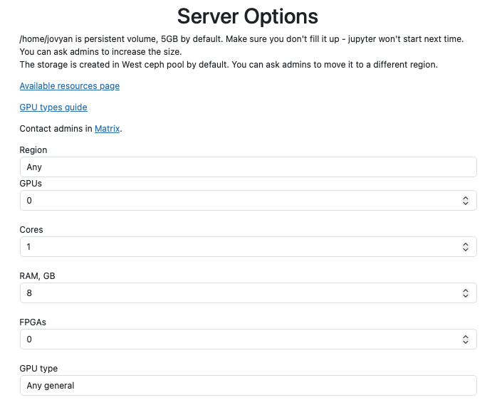
A Student's First Day
1. Click the link
from the syllabus or the LMS
2. Campus login
CILogon, nothing new to remember
3. Pick from the menu
the options you wrote
From the student's side, the first day is four clicks. No installs, no “which Python?”, and the same environment as everyone else.
Screenshots: NRP's own hub. Your hub's menu shows your options.
28

Slide 55
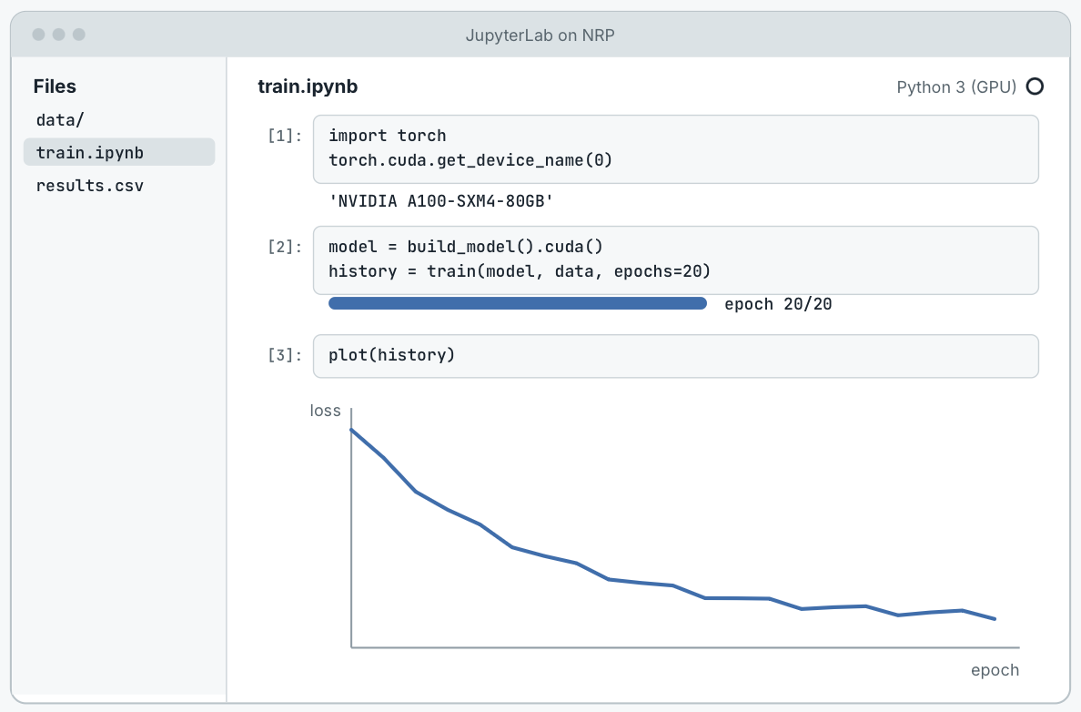
A Student's First Day
1. Click the link
from the syllabus or the LMS
2. Campus login
CILogon, nothing new to remember
3. Pick from the menu
the options you wrote
4. JupyterLab opens
week 1's notebook, ready to run
From the student's side, the first day is four clicks. No installs, no “which Python?”, and the same environment as everyone else.
Screenshots: NRP's own hub. Your hub's menu shows your options.
28

Slide 56
Sizing a Class
Each server asks for the CPUs, memory and GPU of its menu option; the scheduler sets exactly that aside
29

Slide 57
Sizing a Class
Each server asks for the CPUs, memory and GPU of its menu option; the scheduler sets exactly that aside
So set options to what a student really uses, not the most you can get
40 students on the Python option: 2 CPUs · 8 GB each
= 80 CPUs · 320 GB
29

Slide 58
Sizing a Class
Each server asks for the CPUs, memory and GPU of its menu option; the scheduler sets exactly that aside
So set options to what a student really uses, not the most you can get
GPU options for the units that need them; the rest of the term on CPUs
40 students on the Python option: 2 CPUs · 8 GB each
= 80 CPUs · 320 GB
10 students in the GPU lab: 1 GPU (24 GB) each
= 10 GPUs
29

Slide 59
Sizing a Class
Each server asks for the CPUs, memory and GPU of its menu option; the scheduler sets exactly that aside
So set options to what a student really uses, not the most you can get
GPU options for the units that need them; the rest of the term on CPUs
Idle servers stop, so a class only holds resources while it works
Tell the NRP team your class size and your lab times
40 students on the Python option: 2 CPUs · 8 GB each
= 80 CPUs · 320 GB
10 students in the GPU lab: 1 GPU (24 GB) each
= 10 GPUs
20 servers idle after class: stopped after an hour
= resources back to the pool
29

Slide 60
Running the Class
Admin · BIO 210 hub
The admin page lists every student's server: stop it, or open it to help
Idle servers stop on their own: an hour by default, or what you set
A big lab session? Ask the NRP team to set nodes aside for it
End of term: students download their work, then you remove the hub
Student | Option | Server
alex@campus.edu | Python | running
bea@campus.edu | R | running
chen@campus.edu | PyTorch · GPU | stopped (idle)
dana@campus.edu | Python | running
“Open” drops you into the student's own JupyterLab, with their files, so you can see exactly what they see.
30

Slide 61
A Hub Is One File
values.yaml (shortened)
hub:
config:
JupyterHub:
authenticator_class: cilogon # campus login
admin_users: [you@campus.edu, ta@campus.edu]
CILogonOAuthenticator:
allowed_idps:
https://idp.campus.edu/idp/shibboleth:
allowed_domains: [campus.edu]
singleuser:
profileList: # the image menu
- display_name: Python for data science
kubespawner_override:
image_spec: quay.io/jupyter/scipy-notebook:2024-04-22
- display_name: PyTorch with a GPU
kubespawner_override:
image_spec: quay.io/jupyter/pytorch-notebook:cuda12-2024-04-22
extra_resource_limits: {nvidia.com/gpu: "1"}
storage:
capacity: 5Gi # each student's home folder
cull:
timeout: 3600 # stop idle servers after an hour
ingress:
hosts: [jhub-bio210.nrp-nautilus.io] # your class's URL
Who logs in
campus login, your admins, your campus
The image menu
an image and resources per option
Home folders
the size of each student's folder
Idle servers
stop after an hour
The address
the URL you give the class
31

Slide 62
A Hub Is One File
values.yaml (shortened)
hub:
config:
JupyterHub:
authenticator_class: cilogon # campus login
admin_users: [you@campus.edu, ta@campus.edu]
CILogonOAuthenticator:
allowed_idps:
https://idp.campus.edu/idp/shibboleth:
allowed_domains: [campus.edu]
singleuser:
profileList: # the image menu
- display_name: Python for data science
kubespawner_override:
image_spec: quay.io/jupyter/scipy-notebook:2024-04-22
- display_name: PyTorch with a GPU
kubespawner_override:
image_spec: quay.io/jupyter/pytorch-notebook:cuda12-2024-04-22
extra_resource_limits: {nvidia.com/gpu: "1"}
storage:
capacity: 5Gi # each student's home folder
cull:
timeout: 3600 # stop idle servers after an hour
ingress:
hosts: [jhub-bio210.nrp-nautilus.io] # your class's URL
Who logs in
campus login, your admins, your campus
The image menu
an image and resources per option
Home folders
the size of each student's folder
Idle servers
stop after an hour
The address
the URL you give the class
31

Slide 63
A Hub Is One File
values.yaml (shortened)
hub:
config:
JupyterHub:
authenticator_class: cilogon # campus login
admin_users: [you@campus.edu, ta@campus.edu]
CILogonOAuthenticator:
allowed_idps:
https://idp.campus.edu/idp/shibboleth:
allowed_domains: [campus.edu]
singleuser:
profileList: # the image menu
- display_name: Python for data science
kubespawner_override:
image_spec: quay.io/jupyter/scipy-notebook:2024-04-22
- display_name: PyTorch with a GPU
kubespawner_override:
image_spec: quay.io/jupyter/pytorch-notebook:cuda12-2024-04-22
extra_resource_limits: {nvidia.com/gpu: "1"}
storage:
capacity: 5Gi # each student's home folder
cull:
timeout: 3600 # stop idle servers after an hour
ingress:
hosts: [jhub-bio210.nrp-nautilus.io] # your class's URL
Who logs in
campus login, your admins, your campus
The image menu
an image and resources per option
Home folders
the size of each student's folder
Idle servers
stop after an hour
The address
the URL you give the class
31

Slide 64
A Hub Is One File
values.yaml (shortened)
hub:
config:
JupyterHub:
authenticator_class: cilogon # campus login
admin_users: [you@campus.edu, ta@campus.edu]
CILogonOAuthenticator:
allowed_idps:
https://idp.campus.edu/idp/shibboleth:
allowed_domains: [campus.edu]
singleuser:
profileList: # the image menu
- display_name: Python for data science
kubespawner_override:
image_spec: quay.io/jupyter/scipy-notebook:2024-04-22
- display_name: PyTorch with a GPU
kubespawner_override:
image_spec: quay.io/jupyter/pytorch-notebook:cuda12-2024-04-22
extra_resource_limits: {nvidia.com/gpu: "1"}
storage:
capacity: 5Gi # each student's home folder
cull:
timeout: 3600 # stop idle servers after an hour
ingress:
hosts: [jhub-bio210.nrp-nautilus.io] # your class's URL
Who logs in
campus login, your admins, your campus
The image menu
an image and resources per option
Home folders
the size of each student's folder
Idle servers
stop after an hour
The address
the URL you give the class
31

Slide 65
A Hub Is One File
values.yaml (shortened)
hub:
config:
JupyterHub:
authenticator_class: cilogon # campus login
admin_users: [you@campus.edu, ta@campus.edu]
CILogonOAuthenticator:
allowed_idps:
https://idp.campus.edu/idp/shibboleth:
allowed_domains: [campus.edu]
singleuser:
profileList: # the image menu
- display_name: Python for data science
kubespawner_override:
image_spec: quay.io/jupyter/scipy-notebook:2024-04-22
- display_name: PyTorch with a GPU
kubespawner_override:
image_spec: quay.io/jupyter/pytorch-notebook:cuda12-2024-04-22
extra_resource_limits: {nvidia.com/gpu: "1"}
storage:
capacity: 5Gi # each student's home folder
cull:
timeout: 3600 # stop idle servers after an hour
ingress:
hosts: [jhub-bio210.nrp-nautilus.io] # your class's URL
Who logs in
campus login, your admins, your campus
The image menu
an image and resources per option
Home folders
the size of each student's folder
Idle servers
stop after an hour
The address
the URL you give the class
31

Slide 66
A Hub Is One File
values.yaml (shortened)
hub:
config:
JupyterHub:
authenticator_class: cilogon # campus login
admin_users: [you@campus.edu, ta@campus.edu]
CILogonOAuthenticator:
allowed_idps:
https://idp.campus.edu/idp/shibboleth:
allowed_domains: [campus.edu]
singleuser:
profileList: # the image menu
- display_name: Python for data science
kubespawner_override:
image_spec: quay.io/jupyter/scipy-notebook:2024-04-22
- display_name: PyTorch with a GPU
kubespawner_override:
image_spec: quay.io/jupyter/pytorch-notebook:cuda12-2024-04-22
extra_resource_limits: {nvidia.com/gpu: "1"}
storage:
capacity: 5Gi # each student's home folder
cull:
timeout: 3600 # stop idle servers after an hour
ingress:
hosts: [jhub-bio210.nrp-nautilus.io] # your class's URL
Who logs in
campus login, your admins, your campus
The image menu
an image and resources per option
Home folders
the size of each student's folder
Idle servers
stop after an hour
The address
the URL you give the class
helm install bio210 \
jupyterhub/jupyterhub -f values.yaml
31

Slide 67
Changing the Hub Mid-Term
Week 1
values.yaml
the hub you agreed to run
32

Slide 68
Changing the Hub Mid-Term
Week 1
Week 6
values.yaml
+ gpu-unit.yaml
the hub you agreed to run
a GPU option for the deep-learning unit
helm upgrade bio210 jupyterhub/jupyterhub \
-f values.yaml -f gpu-unit.yaml
Each change is a small file on top of the one you started with. Remove the file and upgrade again, and the change is gone; the base file never changes.
32

Slide 69
Changing the Hub Mid-Term
Week 1
Week 6
Week 9
values.yaml
+ gpu-unit.yaml
+ dataset.yaml
the hub you agreed to run
a GPU option for the deep-learning unit
this term's dataset, shared
helm upgrade bio210 jupyterhub/jupyterhub \
-f values.yaml -f gpu-unit.yaml
Each change is a small file on top of the one you started with. Remove the file and upgrade again, and the change is gone; the base file never changes.
32

Slide 70
Changing the Hub Mid-Term
Week 1
Week 6
Week 9
Finals
values.yaml
+ gpu-unit.yaml
+ dataset.yaml
+ finals.yaml
the hub you agreed to run
a GPU option for the deep-learning unit
this term's dataset, shared
a longer idle timeout
helm upgrade bio210 jupyterhub/jupyterhub \
-f values.yaml -f gpu-unit.yaml
Each change is a small file on top of the one you started with. Remove the file and upgrade again, and the change is gone; the base file never changes.
32

Slide 71
Changing the Hub Mid-Term
Week 1
Week 6
Week 9
Finals
After
values.yaml
+ gpu-unit.yaml
+ dataset.yaml
+ finals.yaml
helm uninstall
the hub you agreed to run
a GPU option for the deep-learning unit
this term's dataset, shared
a longer idle timeout
students keep their work
helm upgrade bio210 jupyterhub/jupyterhub \
-f values.yaml -f gpu-unit.yaml
Each change is a small file on top of the one you started with. Remove the file and upgrade again, and the change is gone; the base file never changes.
32

Slide 72
From Request to First Lecture
1. Ask
email the NRP team, or a NAIRR Classroom request
2. Namespace ready
you and your TAs as admins
3. Write the file
start from this webinar's values file
4. helm install
minutes to a running hub
5. Test, then share
with your TAs first, then the class URL
Before the term: a week or two is plenty. The NRP team helps at every step, in office hours and on chat.
After the term: students download their work; helm uninstall removes the hub.
https://nrp.ai/documentation/userdocs/jupyter/jupyterhub/
33

Slide 73
This Webinar Runs on One
jh-training.nrp-nautilus.io: a JupyterHub on NRP for workshops like this one
Every attendee's server comes with kubectl and helm set up, and an LLM token
Jupyter AI is in the image, pointed at NRP's models
A pool of 100 namespaces, nrp-training-000 to 099: each person claims one for the session
Sized for about 200 people at once; idle servers stop on their own
Workshop hub vs. course hub
Same chart, same kind of values file
A workshop: short-lived, a shared login, tools preinstalled
A course: a term long, campus login, your class list, home folders that last
If you follow the demo, you're using it right now.
34

Slide 74
AI in the Classroom
35

Slide 75
Hosted Models in JupyterLab
NRP hosts open-weight models (Qwen, DeepSeek, Gemma, gpt-oss and more) behind one OpenAI-compatible endpoint
Jupyter AI in JupyterLab: a chat panel, and an %%ai cell magic, pointed at NRP's models
Put it in your course image: students log in and use it, no token handoff
Or students call the models from Python, with a token from nrp.ai/llmtoken
Free for research and education, like the rest of NRP
Notebook cells
%load_ext jupyter_ai_magics
%%ai openai-chat:qwen3
Explain a p-value to a biology student in three sentences.
# or from Python, with a token from nrp.ai/llmtoken
from openai import OpenAI
client = OpenAI(base_url="https://ellm.nrp-nautilus.io/v1",
api_key=os.environ["OPENAI_API_KEY"])
https://nrp.ai/documentation/userdocs/ai/llm-managed/
36

Slide 76
Models and Task Names
Ask for | Tried in this order
agents | kimi → deepseek-v4-flash → qwen3 → qwen3-small
coding | deepseek-v4-flash → qwen3 → gemma → qwen3-small
general | deepseek-v4-flash → qwen3 → qwen3-small → minimax
reasoning | deepseek-v4-flash → minimax → qwen3-small → qwen3
vision | qwen3 → qwen3-small → kimi → deepseek-v4-flash
long-context | deepseek-v4-flash → gemma → kimi → minimax
kubernetes | kimi → gemma → qwen3 → qwen3-small
cuda | deepseek-v4-flash → qwen3-small → gpt-oss → gemma-small-e4b
service | deepseek-v4-flash → minimax → qwen3 → qwen3-small → gemma → gemma-small → gpt-oss
model: coding
unhealthy: ejected
deepseek-v4-flash
1st choice
qwen3
2nd choice
gemma
3rd choice
qwen3-small
4th choice
Only when it's down, or ejected by the health checks, does the 2nd choice answer.
37

Slide 77
Live Demo
38

Slide 78
Getting Help
Office hours with the NRP team, every two weeks
Chat with the team and other instructors, for quick questions
Docs for every step in today's talk, at nrp.ai/documentation
Recorded trainings on Docker, Kubernetes and JupyterHub, at nrp.ai/training
Today's materials: the slides, the demo notebook and the values files
Bringing a course?
Email the NRP team with the course, the number of students and the start date, and they'll have your namespace ready before the first lecture.
https://nrp.ai/contact/
39

Slide 79
Where to Start
This term
Your own hub
Log in at nrp.ai and try NRP's JupyterHub
Email the NRP team about your course: what it is, how many students, when it starts
For priority, a NAIRR Classroom request
Come to office hours: every two weeks, with the NRP team
Start from today's values file: it's in the materials
Add CILogon and your class list before students arrive
Build a course image when the default menu isn't enough
Follow along later: every step of today's demo is on the training page
https://nrp.ai/education/
40

Slide 80
Acknowledgments
NRP is supported by NSF awards OAC-1541349, OAC-1826967, OAC-2030508, OAC-1841530, OAC-2005369, OAC-2112167, CISE-1713149, CISE-2100237 and CISE-2120019
Networks: CENIC, Pacific Wave, Internet2, MREN, GPN, NYSERNet, FLR, NEREN, Sun Corridor, OARnet, SCLR and the Albuquerque GigaPoP
The NRP operations teams at SDSC, the University of Nebraska–Lincoln and MGHPCC, and the campuses that host and share their hardware
Forough Ghahramani and Edge, for hosting this webinar series
41

Slide 81
Questions?
Today's materials
training.nrp-nautilus.io/nairr-classroom
Portal and login
nrp.ai
Teaching with NRP
nrp.ai/education
Request a namespace
get-started.nrp-nautilus.io
NRP's JupyterHub
jupyterhub-west.nrp-nautilus.io
Your own hub (docs)
nrp.ai/documentation/userdocs/jupyter/jupyterhub
LLM token
nrp.ai/llmtoken
Support chat and email
nrp.ai/contact
Daniel Diaz · d4diaz@ucsd.edu
42

Slide 82
Backup
43

Slide 83
NRP's Hub or Your Own?
 | NRP's JupyterHub | Your own hub
Setup | none: share the link | one values file, helm install
Who logs in | anyone with an NRP login | your class list, through CILogon
Images | NRP's menu | your menu, or your course image
Resources | students choose from the menu | you set them per option
Course files | students copy them in | a link, and a shared folder
Help | NRP's support chat | you open a student's server
44

