Slide 1
Inside the National
Research Platform
How we build it, how we run it, and how you can use it
Daniel Diaz · San Diego Supercomputer Center, UC San Diego
SCinet · SC26 · Chicago · November 2026

Slide 2

Agenda
What is NRP?
How it's built: the network, storage, hardware, ingress
How we run it: deploying services, CI in VMs, NetBox, monitoring, perfSONAR, security, sharing GPUs
AI: the LLM service, from the gateway to the GPUs, and an ops bot built on it
Using it yourself
Live demo, then questions
Nautilus: the name of NRP's cluster
Slides and the demo notebook:
https://training.nrp-nautilus.io/scinet-sc26
1

Slide 3
What NRP Is
2

Slide 4
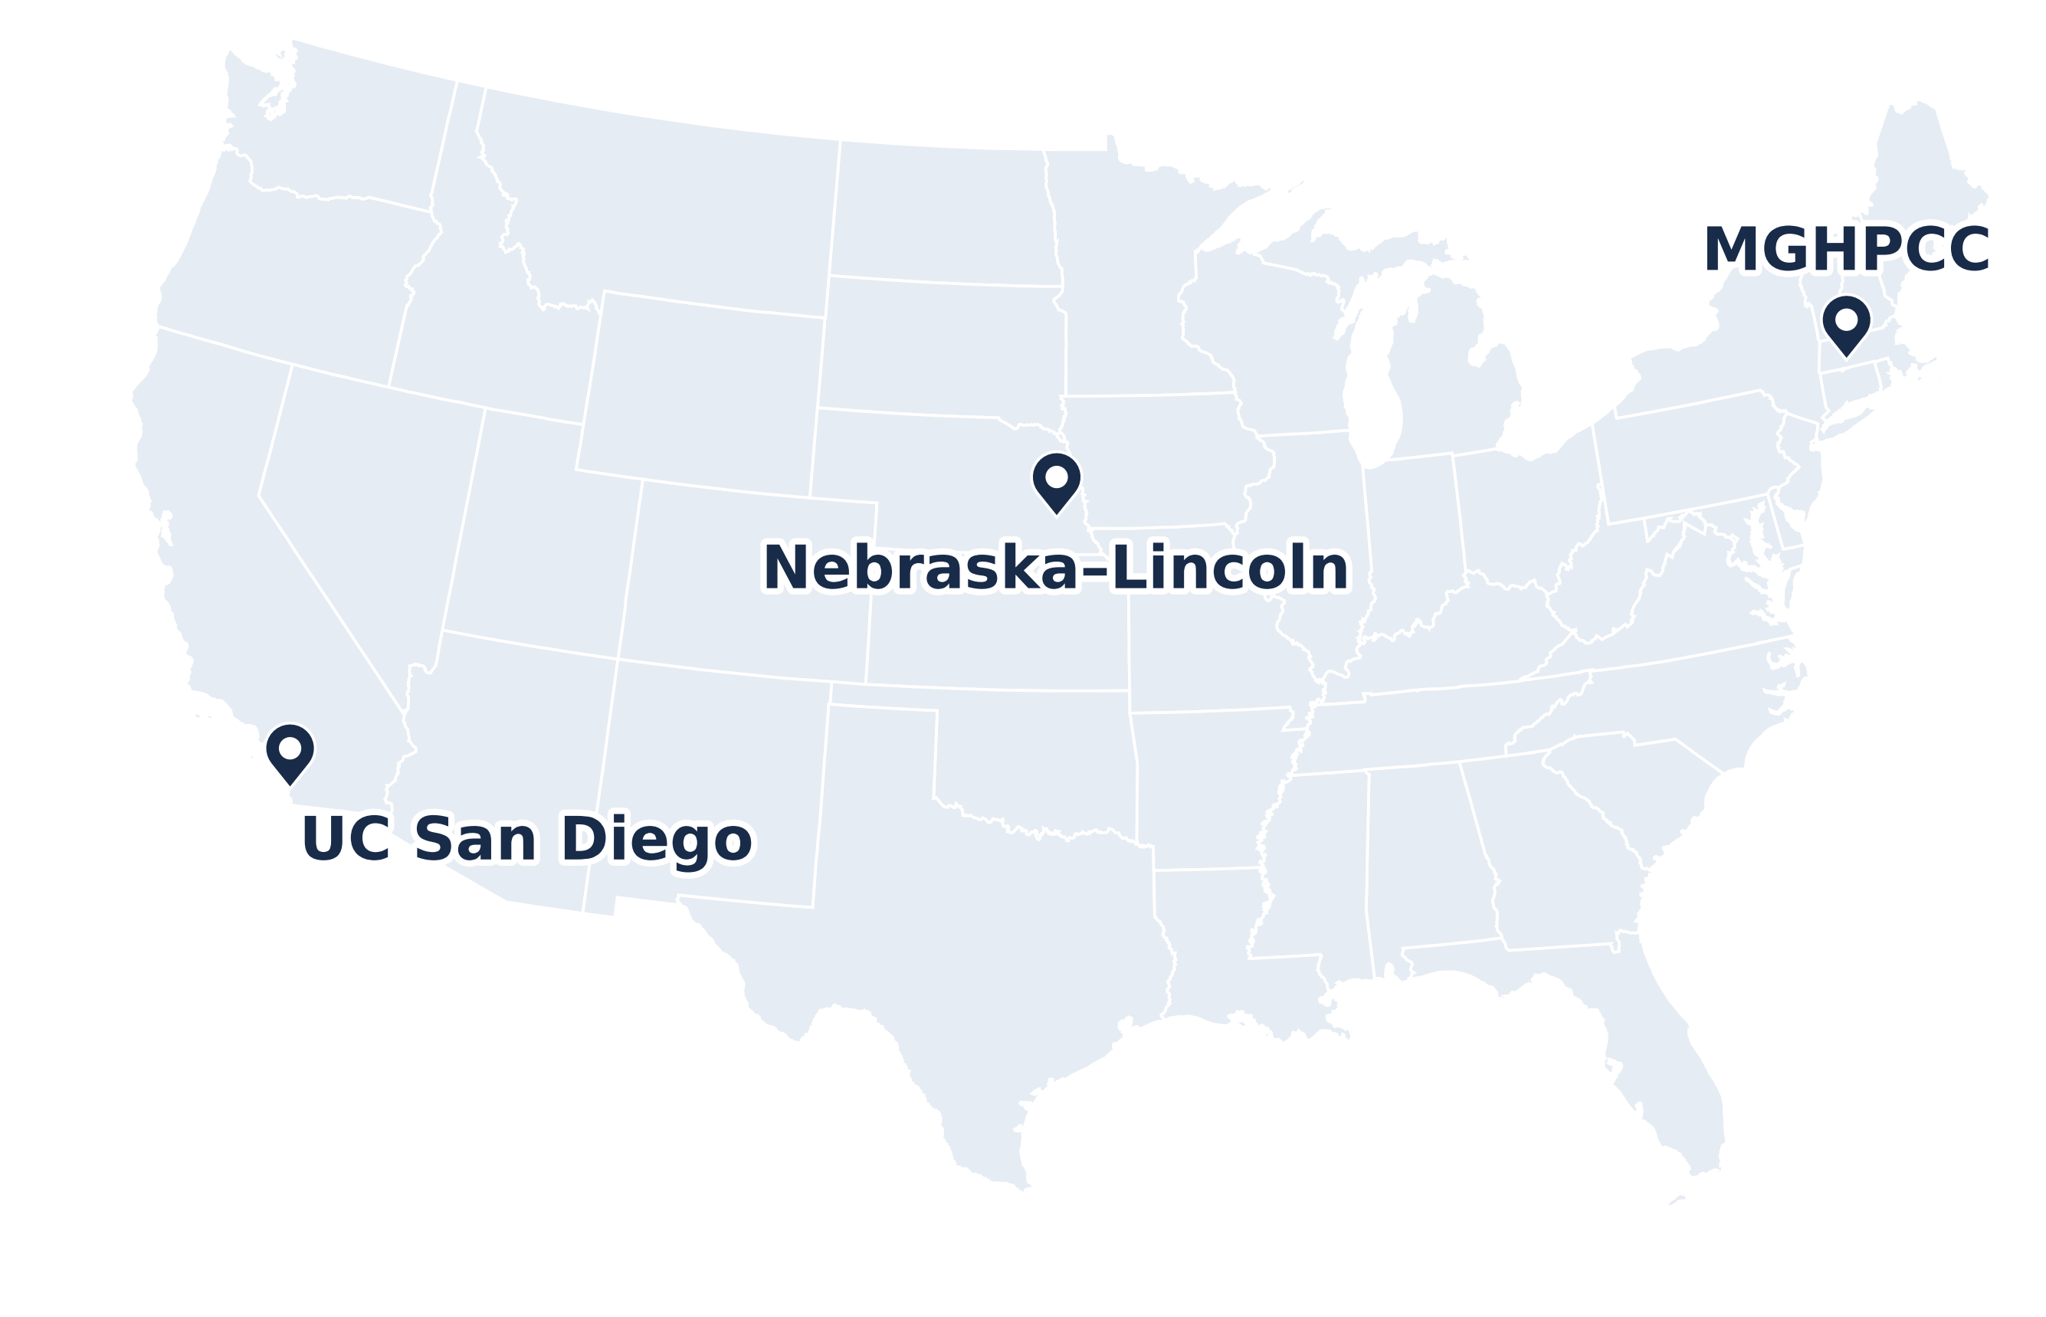
What is NRP?
One national Kubernetes cluster, Nautilus, for research and education
Operated by SDSC (UC San Diego), Nebraska–Lincoln and MGHPCC; funded by NSF
https://dash.nrp-nautilus.io
Nodes, GPUs, cores and storage: cluster snapshot, 10 Nov 2026
3

Slide 5
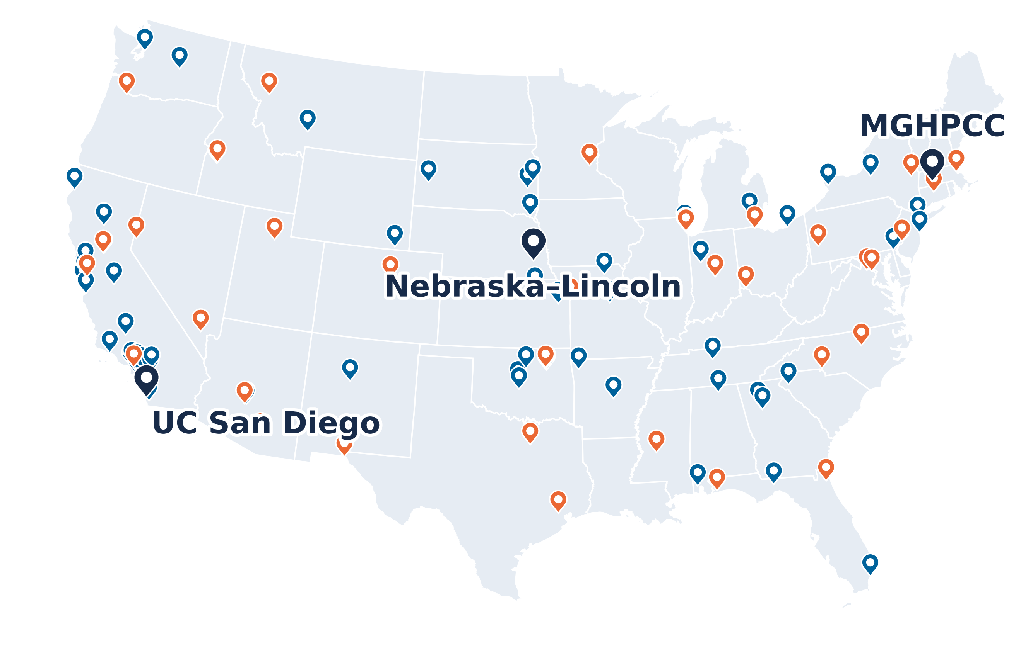
What is NRP?
One national Kubernetes cluster, Nautilus, for research and education
Operated by SDSC (UC San Diego), Nebraska–Lincoln and MGHPCC; funded by NSF
Hardware from 70+ institutions, on research and education networks
Internet2 hosts 54 nodes in 51 of its own locations (orange)
Today:
536 nodes at 129 sites
1,460 GPUs in 33 models; 59,352 CPU cores
15 PB of raw Ceph storage
https://dash.nrp-nautilus.io
Sites from the NRP dashboard, 10 Nov 2026
Not drawn: 8 sites in Hawaii, Guam, Korea, Brazil and Europe
Nodes, GPUs, cores and storage: cluster snapshot, 10 Nov 2026
3

Slide 6
What is NRP?
One national Kubernetes cluster, Nautilus, for research and education
Operated by SDSC (UC San Diego), Nebraska–Lincoln and MGHPCC; funded by NSF
Hardware from 70+ institutions, on research and education networks
Internet2 hosts 54 nodes in 51 of its own locations (orange)
Today:
536 nodes at 129 sites
1,460 GPUs in 33 models; 59,352 CPU cores
15 PB of raw Ceph storage
Free for non-commercial research and education
One team runs it from the OS up; campuses keep priority on what they contribute
https://dash.nrp-nautilus.io
Sites from the NRP dashboard, 10 Nov 2026
Not drawn: 8 sites in Hawaii, Guam, Korea, Brazil and Europe
Nodes, GPUs, cores and storage: cluster snapshot, 10 Nov 2026
3

Slide 7
Containers and Kubernetes
Container image: an app and everything it needs, built once from a Dockerfile; runs the same anywhere
Kubernetes runs containers across many machines: you declare what you want (an image, CPUs, memory, a GPU), the scheduler picks a node that has it, and controllers keep it that way
A running container is a pod. Pods, Jobs, Deployments and Services live in a namespace: one per lab, course or service
NRP is one Kubernetes cluster: 536 nodes
Container image
Kubernetes cluster
app.py
your code
Node
64 CPU cores
PyTorch, NumPy
Node
8 × A10 GPUs
CUDA libraries
your container
Linux userland
Node
4 × A100 GPUs
built once, from a Dockerfile
the scheduler picks a node with a free GPU
4

Slide 8
From PRP to NRP
2015
2018
2021
2026
Pacific Research Platform
Data transfer nodes (FIONAs) in campus Science DMZs, on CENIC and Pacific Wave
OAC-1541349
Toward a National Research Platform
The same model, beyond the West Coast
OAC-1826967
National Research Platform
An NSF Category II resource: GPUs, storage and services for research and education
OAC-2112167
Today
One Kubernetes cluster, Nautilus: 536 nodes at 129 sites, and AI models as a service
Under each milestone: its NSF award.
5

Slide 9
NRP in Numbers
536
nodes
129
sites on the dashboard
1,460
GPUs in 33 models
59,352
CPU cores
14.9 PB
raw Ceph in 9 clusters
2,334
namespaces: labs, courses, services
Cluster snapshot, 10 Nov 2026 (Kubernetes v1.34.11). Sites: the NRP dashboard.
6

Slide 10
How It's Built
7

Slide 11
The Network Underneath
Nodes sit in campus Science DMZs, outside campus firewalls, at 10–100 Gb/s
Jumbo frames: MTU 9000 between all nodes
Regional networks and Internet2 carry the traffic
Calico builds the pod network: a VXLAN overlay, IPv4 and IPv6 (309 nodes dual-stack)
Pod to pod, the packet is wrapped in UDP between the two nodes' addresses and crosses the real network
Campus A
Campus B
Campus C
Campus LAN
firewall, IDS
Campus LAN
firewall, IDS
Campus LAN
firewall, IDS
NRP node
Science DMZ
NRP node
Science DMZ
NRP node
Science DMZ
R&E networks
regional networks, Internet2, international links
Orange dot: what the pods see, one hop on the overlay. Gold dot: what the network carries, the same packet inside VXLAN, node to node.
8

Slide 12
Policy Lives in the Cluster
Nodes sit outside campus firewalls, so the cluster filters traffic at each node itself
One Calico GlobalNetworkPolicy for every node, written once and stored in the cluster
From other NRP nodes: everything is allowed
From the internet: only the ports in the table
A new node is covered the moment it joins; campuses keep no per-node firewall rules, and turn local iptables and firewalld off
Why: nodes come and go every week, faster than any campus change process
443 ✓
NRP node
filters at its own interfaces
Internet
any address
Other NRP nodes
any port
3306 ✗
the policy
From the internet | Why
22/tcp | SSH, for NRP operators
443/tcp | HTTPS; open on every node
ICMP | ping, and path MTU discovery for jumbo frames
8443/tcp | object reads over HTTPS and XRootD (data caches)
8444/tcp | Pelican tokens, director health checks, metrics
50000–51000/tcp | GridFTP data channels
https://nrp.ai/documentation/admindocs/participating/network/
The last three only on nodes that run a data cache, an origin or a Globus endpoint.
9

Slide 13
Regions and Storage
Every node is labeled with its region, zone (143 zones) and site; workloads spread out or stay near their data
Rook runs 9 Ceph clusters, one per region or large site: 14.9 PB raw
CephFS for shared files, RBD for block, S3 for objects
Linstor (DRBD) for fast replicated block storage; CVMFS for software; local NVMe for scratch
Pick the storage in the region where you compute
Ceph clusters: raw capacity, and used
rook
6.25 PB
rook-haosu
1.97 PB
rook-central
1.51 PB
rook-east
1.48 PB
rook-fullerton
1.46 PB
rook-south-east
0.89 PB
rook-tide
0.73 PB
rook-pacific
0.37 PB
rook-ucsd
0.27 PB
From the CephCluster resources, 10 Nov 2026
10

Slide 14
More Than GPUs
Hardware beyond x86 and NVIDIA
Runtimes and networking
NVIDIA GPUs
1,460 in 33 models, GTX 1080 Ti to H200
AMD GPUs
ROCm device plugin
Containers
runc, plus the NVIDIA runtime
Kata VMs
a lightweight VM per pod
Qualcomm Cloud AI 100
inference cards, requested like a GPU
Xilinx Alveo FPGAs
Vivado and Vitis
Sysbox
system containers: Docker inside a pod
KubeVirt
full VMs: Ubuntu, Windows, Talos
ESnet SmartNIC
FPGA network cards you program in P4
ARM64 nodes
a second CPU architecture (3 nodes): needs multi-arch images
Multus and SR-IOV
extra NICs in a pod, for network research
Confidential VMs
Kata with AMD SNP or Intel TDX, GPUs included
Runtime classes on the cluster: 29, most of them Kata variants (QEMU, Cloud Hypervisor, Firecracker, Dragonball).
11

Slide 15
Getting Traffic In
Client
anywhere
Ingress node
HAProxy and Envoy Gateway, on 19 nodes
Service
in your namespace
Your pods
on any node
DNS
Constellix: the name → an ingress node
cert-manager
renews the *.nrp-nautilus.io certificate
A request from the internet to a pod
Web traffic comes in through ingress nodes; anything else gets its own address.
1,006 Ingress objects (HAProxy) and 33 Gateway API routes (Envoy Gateway); users create them in their own namespace.
12

Slide 16
Getting Traffic In
Client
anywhere
Ingress node
HAProxy and Envoy Gateway, on 19 nodes
Service
in your namespace
Your pods
on any node
DNS
Constellix: the name → an ingress node
cert-manager
renews the *.nrp-nautilus.io certificate
1. Find it
A name under nrp-nautilus.io resolves to one of the 19 ingress nodes, which sit at sites in the US, Europe and Korea. The client connects to it on port 443.
1,006 Ingress objects (HAProxy) and 33 Gateway API routes (Envoy Gateway); users create them in their own namespace.
12

Slide 17
Getting Traffic In
Client
anywhere
Ingress node
HAProxy and Envoy Gateway, on 19 nodes
Service
in your namespace
Your pods
on any node
DNS
Constellix: the name → an ingress node
cert-manager
renews the *.nrp-nautilus.io certificate
2. Decrypt
HAProxy on that node ends TLS with the *.nrp-nautilus.io certificate that cert-manager renews from Let's Encrypt, reads the host name, and finds the matching Ingress rule.
1,006 Ingress objects (HAProxy) and 33 Gateway API routes (Envoy Gateway); users create them in their own namespace.
12

Slide 18
Getting Traffic In
Client
anywhere
Ingress node
HAProxy and Envoy Gateway, on 19 nodes
Service
in your namespace
Your pods
on any node
DNS
Constellix: the name → an ingress node
cert-manager
renews the *.nrp-nautilus.io certificate
3. Deliver
The rule names a Service in the owner's namespace. The Service spreads requests over its pods, wherever they run, across the overlay.
1,006 Ingress objects (HAProxy) and 33 Gateway API routes (Envoy Gateway); users create them in their own namespace.
12

Slide 19
Getting Traffic In
Client
anywhere
Ingress node
HAProxy and Envoy Gateway, on 19 nodes
Service
in your namespace
Your pods
on any node
DNS
Constellix: the name → an ingress node
cert-manager
renews the *.nrp-nautilus.io certificate
MetalLB
2 speaker nodes at SDSC
BGP
SDSC router
AS 26397; learns the IP by BGP
LB Service
its own public IP
Not HTTP?
A LoadBalancer Service gets its own public IP. MetalLB, on two nodes at SDSC, announces it to SDSC's router over BGP, for IPv4 and IPv6.
1,006 Ingress objects (HAProxy) and 33 Gateway API routes (Envoy Gateway); users create them in their own namespace.
12

Slide 20
How We Run It
13

Slide 21
How Services Get Deployed
Three ways in
Who uses it, and for what
GitLab
repos: manifests, Helm values, code
Argo CD
pulls from git, keeps syncing, puts back drift
The cluster
objects in a namespace
Admins: platform services, such as Falco, NetBox, Grafana and GitLab itself
GitLab CI/CD
a pipeline builds, tests and deploys through GitLab's Kubernetes integration
Admins and users: the most common path: build an image, roll it out to a namespace
By hand
kubectl apply or helm upgrade from a repo
Admins: some services, like the LLM servers. Users: most work in their own namespace
Next: Argo CD up close, then CI. Whichever way it comes, a service ends up as Kubernetes objects in a namespace.
14

Slide 22
How Services Get Deployed
Three ways in
Who uses it, and for what
GitLab
repos: manifests, Helm values, code
Argo CD
pulls from git, keeps syncing, puts back drift
The cluster
objects in a namespace
Admins: platform services, such as Falco, NetBox, Grafana and GitLab itself
GitLab CI/CD
a pipeline builds, tests and deploys through GitLab's Kubernetes integration
Admins and users: the most common path: build an image, roll it out to a namespace
By hand
kubectl apply or helm upgrade from a repo
Admins: some services, like the LLM servers. Users: most work in their own namespace
Next: Argo CD up close, then CI. Whichever way it comes, a service ends up as Kubernetes objects in a namespace.
14

Slide 23
How Services Get Deployed
Three ways in
Who uses it, and for what
GitLab
repos: manifests, Helm values, code
Argo CD
pulls from git, keeps syncing, puts back drift
The cluster
objects in a namespace
Admins: platform services, such as Falco, NetBox, Grafana and GitLab itself
GitLab CI/CD
a pipeline builds, tests and deploys through GitLab's Kubernetes integration
Admins and users: the most common path: build an image, roll it out to a namespace
By hand
kubectl apply or helm upgrade from a repo
Admins: some services, like the LLM servers. Users: most work in their own namespace
Next: Argo CD up close, then CI. Whichever way it comes, a service ends up as Kubernetes objects in a namespace.
14

Slide 24
How Services Get Deployed
Three ways in
Who uses it, and for what
GitLab
repos: manifests, Helm values, code
Argo CD
pulls from git, keeps syncing, puts back drift
The cluster
objects in a namespace
Admins: platform services, such as Falco, NetBox, Grafana and GitLab itself
GitLab CI/CD
a pipeline builds, tests and deploys through GitLab's Kubernetes integration
Admins and users: the most common path: build an image, roll it out to a namespace
By hand
kubectl apply or helm upgrade from a repo
Admins: some services, like the LLM servers. Users: most work in their own namespace
Next: Argo CD up close, then CI. Whichever way it comes, a service ends up as Kubernetes objects in a namespace.
14

Slide 25
Git Is the Source of Truth
An admin
git push
GitLab
the repo: manifests, Helm values
Argo CD
compares git with the cluster
The cluster
what's actually running
Self-hosted GitLab 19.5.4: code, issues, a container registry, CI
Argo CD syncs 20 applications, GitLab itself among them
Self-heal: a manual change is reverted to what's in git; history and review come free
Argo CD is one of the three ways in: other services deploy from GitLab CI, or by hand from their repos
15

Slide 26
Git Is the Source of Truth
An admin
git push
GitLab
the repo: manifests, Helm values
Argo CD
compares git with the cluster
The cluster
what's actually running
Self-hosted GitLab 19.5.4: code, issues, a container registry, CI
Argo CD syncs 20 applications, GitLab itself among them
Self-heal: a manual change is reverted to what's in git; history and review come free
Argo CD is one of the three ways in: other services deploy from GitLab CI, or by hand from their repos
15

Slide 27
Git Is the Source of Truth
An admin
git push
GitLab
the repo: manifests, Helm values
Argo CD
compares git with the cluster
The cluster
what's actually running
kubectl edit
a manual change: drift
Self-hosted GitLab 19.5.4: code, issues, a container registry, CI
Argo CD syncs 20 applications, GitLab itself among them
Self-heal: a manual change is reverted to what's in git; history and review come free
Argo CD is one of the three ways in: other services deploy from GitLab CI, or by hand from their repos
15

Slide 28
Git Is the Source of Truth
An admin
git push
GitLab
the repo: manifests, Helm values
Argo CD
compares git with the cluster
The cluster
what's actually running
self-heal: put back what git says
kubectl edit
a manual change: drift
Self-hosted GitLab 19.5.4: code, issues, a container registry, CI
Argo CD syncs 20 applications, GitLab itself among them
Self-heal: a manual change is reverted to what's in git; history and review come free
Argo CD is one of the three ways in: other services deploy from GitLab CI, or by hand from their repos
15

Slide 29
CI in a VM per Job
GitLab
a pipeline starts
Runner
Kubernetes executor
The default runner's config (from the cluster)
[[runners]]
[runners.kubernetes]
namespace = "gitlab-ci-kata"
runtime_class_name = "kata"
privileged = false
image = "alpine:3.22"
pull_policy = ["always"]
cpu_limit = "4"
cpu_limit_overwrite_max_allowed = "12"
memory_limit = "8Gi"
memory_limit_overwrite_max_allowed = "50Gi"
namespace gitlab-ci-kata
Kata VM
Kata VM
Kata VM
CI job
build an image
CI job
run tests
CI job
deploy
The shared runners start each CI job as a pod in its own lightweight VM: even a privileged build can't reach the node
4 runner flavors (backup slide); images go to gitlab-registry.nrp-nautilus.io and are pulled from inside the cluster
16

Slide 30
Build and Deploy Your Own
.gitlab-ci.yml (from the NRP docs)
image: ghcr.io/osscontainertools/kaniko:debug
build-and-push-job:
stage: build
variables:
GODEBUG: "http2client=0"
script:
- echo "{\"auths\":{\"$CI_REGISTRY\":{\"username\":
\"$CI_REGISTRY_USER\",\"password\":\"$CI_REGISTRY_PASSWORD\"}}}"
> /kaniko/.docker/config.json
- /kaniko/executor --cache=true --push-retry=10
--context $CI_PROJECT_DIR
--dockerfile $CI_PROJECT_DIR/Dockerfile
--destination $CI_REGISTRY_IMAGE:$CI_COMMIT_SHORT_SHA
Any NRP user can create projects at gitlab.nrp-nautilus.io
Kaniko builds an image with no Docker daemon
The registry is in the cluster: pulls are fast
Deploy to your namespace through GitLab's Kubernetes integration: the CI/CD path from before
Build multi-arch images for the ARM64 nodes
https://nrp.ai/documentation/userdocs/development/gitlab/
17

Slide 31
NetBox Knows Every Node
NetBox 4, deployed by Argo CD from the NetBox Labs Helm chart
netbox-agent on every node (529 pods): privileged, host network
lldpd learns the switch and port each NIC is cabled to
The site comes from the node's netbox.io/site label
Alongside: Diode for ingest, and a Nornir pod for automation
Switch
at the site
NetBox: what the agent records
Device
node name, role Server, site
Interfaces
names, MACs, IPs
LLDP
Cable
NIC to the switch port, from LLDP
NRP node
netbox-agent + lldpd
Inventory
CPUs, memory, disks, GPUs
Updated
once a day, plus up to an hour of jitter
18

Slide 32
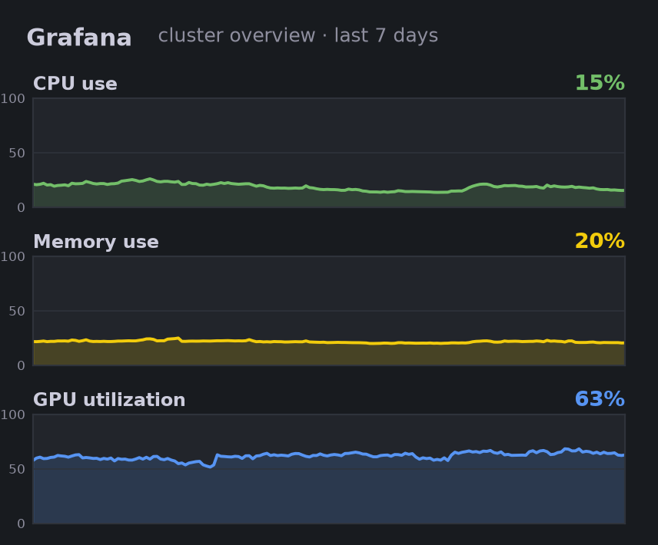
Watching the Cluster
Sources
node-exporter
on all 536 nodes
kube-state-metrics
objects and their state
Prometheus
2 replicas, run by the Prometheus operator
Thanos
querier (14 replicas), store, compactor
DCGM
GPU use, memory, power
Apps
Ceph, the ingress, every service
Alertmanager
3 replicas; routes alerts
Public dashboards
nrp.ai/viz
Logs: Elastic collects syslog from every node, SSH logins included.
From Thanos, hourly, 4–11 Nov 2026: CPU and memory averaged over nodes, GPU over GPUs
19

Slide 33
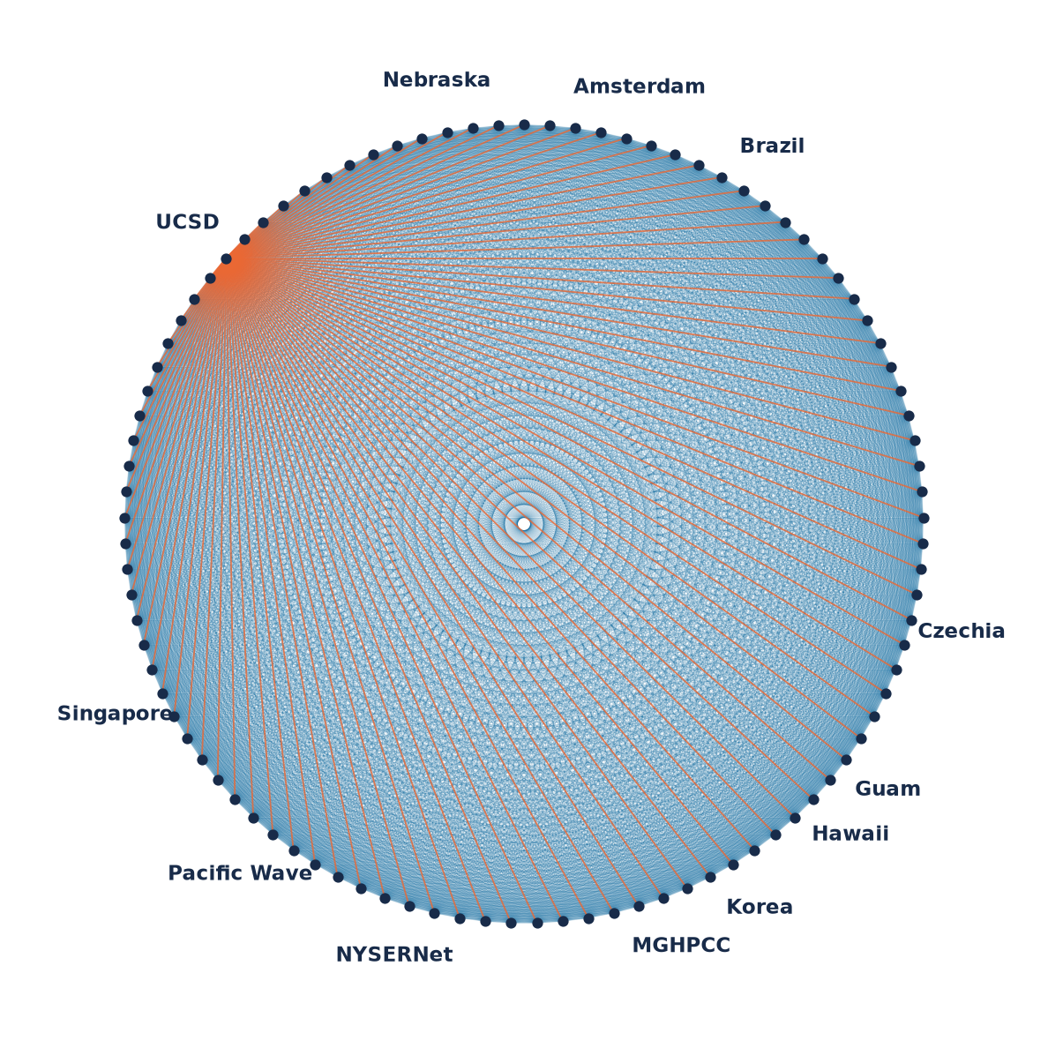
Measuring the Network
Two perfSONAR testpoints on every node (526 each): one on the host network, one in the pod network
A mesh config says who tests whom; each testpoint's pScheduler runs its share
20

Slide 34
Measuring the Network
Two perfSONAR testpoints on every node (526 each): one on the host network, one in the pod network
A mesh config says who tests whom; each testpoint's pScheduler runs its share
All-to-all between one node per site (97 sites): one-way latency and loss nonstop, throughput every 18 h, traceroute every 6 h
Orange: one site's tests to every other site
20

Slide 35
Measuring the Network
Two perfSONAR testpoints on every node (526 each): one on the host network, one in the pod network
A mesh config says who tests whom; each testpoint's pScheduler runs its share
All-to-all between one node per site (97 sites): one-way latency and loss nonstop, throughput every 18 h, traceroute every 6 h
Every site tests every other: 97 × 96 directed pairs
20

Slide 36
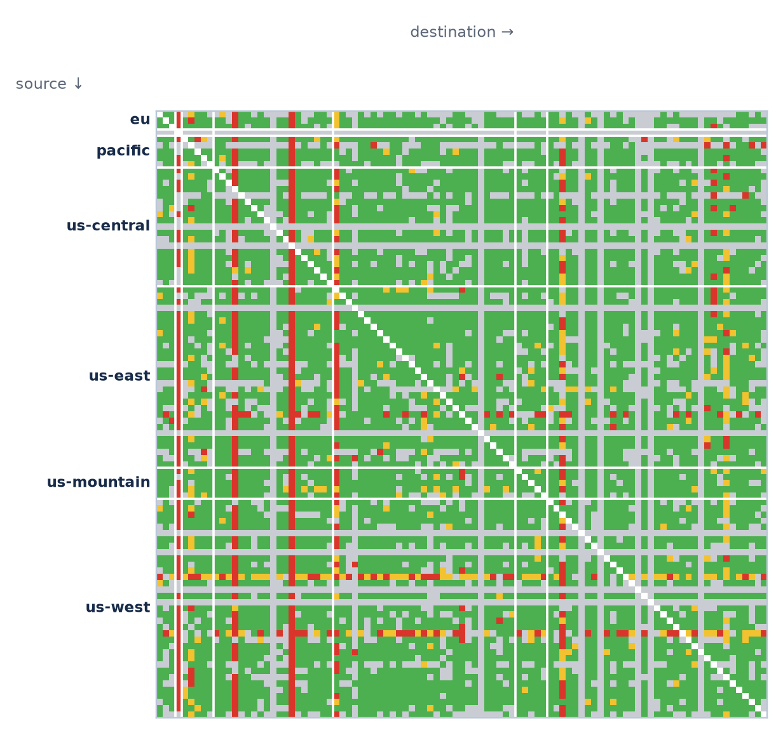
Measuring the Network
Two perfSONAR testpoints on every node (526 each): one on the host network, one in the pod network
A mesh config says who tests whom; each testpoint's pScheduler runs its share
All-to-all between one node per site (97 sites): one-way latency and loss nonstop, throughput every 18 h, traceroute every 6 h
Results go to an archive; MaDDash draws them as a grid at perfsonar.nrp-nautilus.io
Host network vs pod network: is a slow path the network, or the overlay?
MaDDash packet-loss grid, 11 Nov 2026: green ≤ 0.001%, yellow more, red ≥ 0.1%, gray no data yet
20

Slide 37
Security
Identity
Detect
Prevent
Audit
Authentik
CILogon: federated campus login
Groups drive namespace access
Falco: runtime alerts
Falco Talon: automated response
Wazuh; Elastic syslog, SSH logins included
Gatekeeper admission policies
Kata VMs for CI and untrusted builds
Central Calico policy
CVE mitigations rolled out by Argo CD
IPMI scanner: alerts if a BMC is reachable from outside
JupyterHub scanner: no anonymous hubs
e.g. a new login sees no namespaces until a namespace admin adds it
e.g. a pod runs a crypto miner or calls a mining pool: Falco alerts, Talon kills the pod
e.g. a pod that asks to be privileged, or sets CUDA_VISIBLE_DEVICES to reach GPUs it wasn't given, is rejected
e.g. a node's BMC answers from the internet: operators get an alert
21

Slide 38
Routine Care
Tool | What it does
kured | Rolling reboots after kernel updates, a few nodes at a time
self-node-remediation | Fences and recovers nodes that stop responding
node-label-monitor | Watches node labels the scheduler depends on
GPU operator, power management | Drivers, and GPU power tracking
Nagios NRPE | Host checks
Upgrade runbooks | Kubernetes, Calico, Rook, GitLab, JupyterHub, Prometheus ... in the admin docs
https://nrp.ai/documentation/admindocs/upgrades/intro/
22

Slide 39
Sharing GPUs Fairly
Reserved nodes: on request, admins taint a contributor's nodes; only pods that tolerate the taint, the owner's, run there
Today: 119 nodes reserved for 23 groups
Reserved node · taint nautilus.io/reservation=lab-a
lab-a pod
lab-a pod
idle, reserved
idle, reserved
lab-b pod ✕ no toleration
Shared node: no taint
a user's job
idle
idle
idle
A pod without the toleration can't land on the reserved node, even on an idle GPU.
23

Slide 40
Sharing GPUs Fairly
Reserved nodes: on request, admins taint a contributor's nodes; only pods that tolerate the taint, the owner's, run there
Today: 119 nodes reserved for 23 groups
Shared nodes: idle GPUs go to opportunistic pods, the lowest priority class, e.g. OSG jobs for IceCube and LIGO
232 opportunistic pods running, 208 of them from OSG
Reserved node · taint nautilus.io/reservation=lab-a
lab-a pod
lab-a pod
idle, reserved
idle, reserved
lab-b pod ✕ no toleration
Shared node: no taint
a user's job
opportunistic (OSG)
opportunistic (OSG)
opportunistic (OSG)
On a shared node, opportunistic pods fill the idle GPUs.
23

Slide 41
Sharing GPUs Fairly
Reserved nodes: on request, admins taint a contributor's nodes; only pods that tolerate the taint, the owner's, run there
Today: 119 nodes reserved for 23 groups
Shared nodes: idle GPUs go to opportunistic pods, the lowest priority class, e.g. OSG jobs for IceCube and LIGO
232 opportunistic pods running, 208 of them from OSG
When anyone needs that GPU, the opportunistic pod is preempted: it must checkpoint, or just restart
Reserved node · taint nautilus.io/reservation=lab-a
lab-a pod
lab-a pod
idle, reserved
idle, reserved
lab-b pod ✕ no toleration
Shared node: no taint
a user's job
new job (took this GPU)
opportunistic (OSG)
opportunistic (OSG)
A normal pod arrives: the scheduler preempts an opportunistic pod to make room.
23

Slide 42
How a Node Joins
1. Rack and cable
power, cooling, a Science DMZ port, jumbo frames
2. Hand over access
IPMI, or root SSH from NRP's management address
3. NRP installs
Ubuntu 24.04, drivers and storage; joins Nautilus
4. Labels and policy
region, zone, site, GPU model; the central Calico policy
5. It reports in
to NetBox, Prometheus and the perfSONAR mesh
Host site
NRP
Keeps an on-site contact for hands-on work
Sends maintenance notices; forwards warranty tickets
Patching, packages and host hardening
24/7 monitoring and alerting; incident handling from the OS up
Then it's schedulable: shared with everyone, or reserved for your group if you ask, with a taint only your pods tolerate.
https://nrp.ai/documentation/admindocs/participating/new-contributor-guide/
24

Slide 43
AI on NRP
25

Slide 44
The LLM Service
OpenAI API: ellm.nrp-nautilus.io/v1
Anthropic API, for Claude Code and similar tools: ellm.nrp-nautilus.io/anthropic
25 model names, the same on both
83 GPUs serve them, from A10s to H200s, at 9 sites
About 7.1 billion tokens a day (September 2026)
Free for research and education, with a token from nrp.ai/llmtoken
Model name | Serving on
deepseek-v4-flash | 16 × H100
glm-5 | 8 × H200, 8 × H100
kimi | 8 × A100
minimax | 8 × A100
qwen3 | 8 × A100
qwen3-small | 4 × A6000, 2 × H200
gpt-oss | 2 × A6000
gemma | 4 × A100, 1 × A6000
gemma-small | 9 × A10
gemma-small-e4b | 1 × A6000
qwen3-embedding | 2 × L40, 2 × V100
Model-server pods by GPU, 10 Nov 2026. The catalog changes.
26

Slide 45
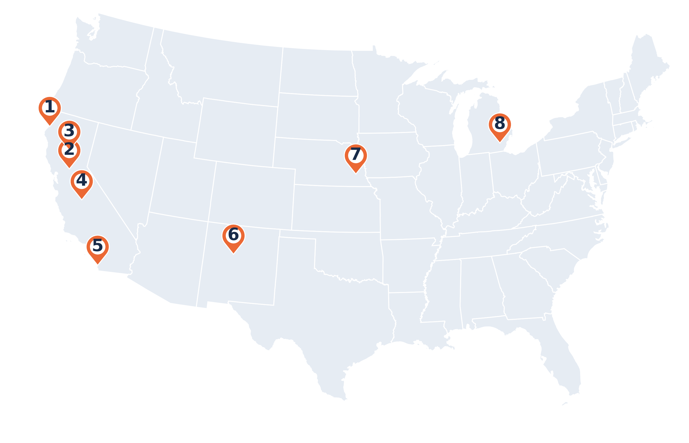
Where the Models Run
# | Site | Models | GPUs
1 | Cal Poly Humboldt | qwen3-embedding | 2 V100
2 | Sacramento State | gemma-small-e4b, glm-5 | 4 H200, 1 A6000
3 | CSU Chico | qwen3-small | 4 A6000
4 | Fresno State | qwen3-small | 2 H200
5 | UC San Diego + SDSU | deepseek-v4-flash, gemma, kimi, minimax, qwen3-embedding | 20 A100, 16 H100, 2 L40
6 | UNM | gemma | 1 A6000
7 | Nebraska–Lincoln | gemma-small, glm-5, gpt-oss | 9 A10, 8 H100, 4 H200, 2 A6000
8 | Internet2, Ann Arbor | qwen3 | 8 A100
Every pin is a set of model servers in the same cluster, behind the same endpoint. Fresno State and Internet2 Ann Arbor are placed by city.
27

Slide 46
A Request, Step by Step
vLLM pod a
queue 6 · KV cache 88%
Client
OpenAI API
Envoy AI Gateway
ellm.nrp-nautilus.io
AIGatewayRoute
x-ai-eg-model: qwen3
InferencePool
with an endpoint picker
vLLM pod b
queue 0 · KV cache 31%
vLLM pod c
queue 2 · KV cache 64%
llm-auth
ext_authz over gRPC; fail closed
Rate limiter
output tokens per API token and model
example values
One request, five stops
The gateway is the Envoy Gateway from the ingress slide, plus its AI extension, Envoy AI Gateway. A client asks for qwen3.
28

Slide 47
A Request, Step by Step
vLLM pod a
queue 6 · KV cache 88%
Client
OpenAI API
Envoy AI Gateway
ellm.nrp-nautilus.io
AIGatewayRoute
x-ai-eg-model: qwen3
InferencePool
with an endpoint picker
vLLM pod b
queue 0 · KV cache 31%
vLLM pod c
queue 2 · KV cache 64%
llm-auth
ext_authz over gRPC; fail closed
Rate limiter
output tokens per API token and model
example values
1. Who are you?
The gateway sends the bearer token to an external auth service over gRPC. If auth can't answer, the request fails: fail closed.
28

Slide 48
A Request, Step by Step
vLLM pod a
queue 6 · KV cache 88%
Client
OpenAI API
Envoy AI Gateway
ellm.nrp-nautilus.io
AIGatewayRoute
x-ai-eg-model: qwen3
InferencePool
with an endpoint picker
vLLM pod b
queue 0 · KV cache 31%
vLLM pod c
queue 2 · KV cache 64%
llm-auth
ext_authz over gRPC; fail closed
Rate limiter
output tokens per API token and model
example values
2. Which model?
The gateway reads model from the JSON body into the x-ai-eg-model header, and an AIGatewayRoute rule matches it to a backend: here an InferencePool.
28

Slide 49
A Request, Step by Step
vLLM pod a
queue 6 · KV cache 88%
Client
OpenAI API
Envoy AI Gateway
ellm.nrp-nautilus.io
AIGatewayRoute
x-ai-eg-model: qwen3
InferencePool
with an endpoint picker
vLLM pod b
queue 0 · KV cache 31%
vLLM pod c
queue 2 · KV cache 64%
llm-auth
ext_authz over gRPC; fail closed
Rate limiter
output tokens per API token and model
example values
3. Which pod?
The endpoint picker scores the pool's vLLM pods by queue depth, KV-cache use and prefix-cache hits, and picks one.
28

Slide 50
A Request, Step by Step
vLLM pod a
queue 6 · KV cache 88%
Client
OpenAI API
Envoy AI Gateway
ellm.nrp-nautilus.io
AIGatewayRoute
x-ai-eg-model: qwen3
InferencePool
with an endpoint picker
vLLM pod b
queue 0 · KV cache 31%
vLLM pod c
queue 2 · KV cache 64%
llm-auth
ext_authz over gRPC; fail closed
Rate limiter
output tokens per API token and model
example values
4. The answer, and the token count
vLLM's answer goes back through the gateway, which reads the token counts and tells the rate limiter how many output tokens this API token just used on this model.
28

Slide 51
Gateway Policies
apiVersion: gateway.envoyproxy.io/v1alpha1
kind: BackendTrafficPolicy
metadata: {name: envoy-ai-gateway-nrp, namespace: nrp-llm}
spec:
rateLimit:
type: Global
global:
rules:
- clientSelectors:
- headers:
- {name: authorization, type: Distinct}
- {name: x-ai-eg-model, type: Distinct}
limit: {requests: 48000, unit: Minute}
cost:
request: {from: Number, number: 1}
response:
from: Metadata
metadata: {namespace: io.envoy.ai_gateway,
key: llm_output_token}
retry:
numRetries: 2
retryOn: {httpStatusCodes: [500, 502, 503, 504]}
healthCheck:
active: {type: HTTP, http: {path: /health}, interval: 10s,
unhealthyThreshold: 3}
passive: {consecutive5XxErrors: 2, baseEjectionTime: 30s,
maxEjectionPercent: 50}
Rate limit: 48,000 output tokens a minute, per API token and model
Retries: twice, on 5xx
Health: probe /health every 10 s; eject a pod after two 5xx
What a client sees (demo, 10 Nov)
$ curl -si https://ellm.nrp-nautilus.io/v1/chat/completions \
-H "Authorization: Bearer $OPENAI_API_KEY" \
-d '{"model": "qwen3", ...}' | grep -i ratelimit
x-ratelimit-limit: 48000, 48000;w=60
x-ratelimit-remaining: 47999
x-ratelimit-reset: 9
29

Slide 52
Ask for a Task, Not a Model
Ask for | Tried in this order
agents | kimi → deepseek-v4-flash → qwen3 → qwen3-small
coding | deepseek-v4-flash → qwen3 → gemma → qwen3-small
general | deepseek-v4-flash → qwen3 → qwen3-small → minimax
reasoning | deepseek-v4-flash → minimax → qwen3-small → qwen3
vision | qwen3 → qwen3-small → kimi → deepseek-v4-flash
long-context | deepseek-v4-flash → gemma → kimi → minimax
kubernetes | kimi → gemma → qwen3 → qwen3-small
cuda | deepseek-v4-flash → qwen3-small → gpt-oss → gemma-small-e4b
service | deepseek-v4-flash → minimax → qwen3 → qwen3-small → gemma → gemma-small → gpt-oss
model: coding
unhealthy: ejected
deepseek-v4-flash
1st choice
qwen3
2nd choice
gemma
3rd choice
qwen3-small
4th choice
Only when it's down, or ejected by the health checks, does the 2nd choice answer.
GitLab Duo Self-Hosted uses service.
30

Slide 53
Fitting Big Models on Contributed GPUs
One model: GLM-5.3, 744 B parameters
What its weights need at each precision
What runs where today
4 × H200 = 564 GB
Model | Weights | Format | GPUs
glm-5 | 465 GB | NVFP4 | 4 × H200, or 8 × H100
kimi | 595 GB | INT4 | 8 × A100
deepseek-v4-flash | 510 GB | FP8 | 2 nodes × 4 H100
minimax | 250 GB | MXFP8 | 8 × A100
qwen3 | 186 GB | FP8 | 4 × A100
qwen3-small | 31 GB | FP8 | 4 × A6000, or 1 × H200
gpt-oss | 65 GB | MXFP4 | 2 × A6000
BF16
2 bytes a weight
1,488 GB · doesn't fit
FP8
1 byte
744 GB · doesn't fit
NVFP4
4 bits, plus scales
465 GB
fits; the rest holds the KV cache
0 GB
500 GB
1,000 GB
1,500 GB
Quantize: FP8, NVFP4, MXFP4, INT4: ½ to ¼ the bytes of BF16
Split: tensor parallel inside a node, pipeline parallel across nodes, expert parallel for MoE
Budget the KV cache: what's left after the weights holds the context
Place by capability: GPU memory and generation, not hostname
Weights: checkpoint size on Hugging Face. GPUs: the model servers on the cluster, 10 Nov 2026.
31

Slide 54
Serving with vLLM
qwen3, from the cluster (shortened)
apiVersion: apps/v1
kind: StatefulSet
metadata: {name: qwen38-flash-next-a100, namespace: nrp-llm}
spec:
replicas: 2
template:
metadata:
labels: {component: llm, service-group: qwen-vllm-inference}
spec:
containers:
- image: vllm/vllm-openai:v0.33.0
args: ["vllm serve Qwen/Qwen3.8-Flash-Next-FP8 --port 5000
--tensor-parallel-size 4 --enable-expert-parallel
--enable-prefix-caching --max-model-len 1000000
--kv-cache-dtype bfloat16 --otlp-traces-endpoint ..."]
resources:
limits: {cpu: "36", memory: 440Gi, nvidia.com/a100: 4}
readinessProbe: {httpGet: {path: /health, port: 5000}}
affinity: # GPU memory > 80 GB, Ampere or newer
volumeClaimTemplates:
- metadata: {name: qwen38-flash-cache}
spec: {storageClassName: linstor-igrok,
resources: {requests: {storage: 256Gi}}}
Labels put the pod in the qwen3 pool, the InferencePool from the request slide
vLLM: the FP8 checkpoint, tensor parallel 4, expert parallel, prefix caching, traces to OpenTelemetry
Health: probes on /health; vLLM and DCGM metrics go to the same Prometheus and Thanos, and drive the LLM status page
Weights on a Linstor volume, so a restart doesn't download them again
16 servers like this. Their config is in GitLab (prp/llm-proxy), applied by hand, not yet by Argo CD
32

Slide 55
Borrowing Idle GPUs
A pool selects its pods by label, so a model can have replicas anywhere
Extra replicas run at opportunistic priority on idle GPUs; on a reserved node they also tolerate its reservation taint
qwen3-small: 4 × A6000 at Chico State, plus two 1-GPU replicas on Fresno State's H200 node, which is reserved for Fresno
glm-5 and gemma borrow H100s and A100s at low priority too
When the owners' pods need the GPUs, the borrowed replicas are preempted; the endpoint picker routes around the gap
InferencePool qwen3-small
selects pods by label: service-group=qwen3-small
CSU Chico
4 × A6000
Fresno State
1 × H200 · opportunistic
Fresno State
1 × H200 · opportunistic
Fresno's own pods need the GPU back. One replica is preempted; the pool keeps answering from the other two.
33

Slide 56
Multi-Node Serving
DeepSeek V4.1 Flash: 510 GB of weights; one 4 × H100 node holds 320 GB
Tensor parallel 4 inside each node, over NVLink; the experts spread across the GPUs too
Pipeline parallel 2 across the nodes: activations cross the network with NCCL
Two StatefulSets: the head pod serves the API, the worker runs headless
A supervisor in each pod restarts both when either restarts (LeaderWorkerSet isn't installed)
A headless Service gives the pods stable names; a NetworkPolicy keeps the NCCL traffic to the pair
group: deepseek-v41-flash-vllm
Node A · 4 × H100
Node B · 4 × H100
supervisor
supervisor
head pod
serves the API · pipeline stage 1
worker pod
headless · pipeline stage 2
GPU 0
GPU 1
GPU 2
GPU 3
NCCL
GPU 0
GPU 1
GPU 2
GPU 3
NVLink: tensor parallel 4
NVLink: tensor parallel 4
Two copies of this pair run on SDSC's Expanse H100 nodes.
34

Slide 57
Around the Models
Open WebUI
chat in the browser, with a terminals operator
Coding agents
Claude Code, opencode and others, with tested configurations
Web search
SearXNG, for tools and chat
The models
on the same gateway
Telemetry
OpenTelemetry collector into ClickHouse
Embeddings
qwen3-embedding; TEI on a GPU
MCP route
an MCP gateway; an accounting MCP server
Vector databases
Milvus (managed) and Qdrant
All of it on the same cluster, most of it deployed the same way as everything else: from git.
35

Slide 58
An LLM on Call: nrp-ops-bot
An operator in Slack
mentions the bot with a question
A model on NRP
deepseek-v4-flash, through the same gateway
16 read-only tools
pods, logs, events, nodes · PromQL on Thanos · NRP docs search · accounting MCP · triage playbooks
a loop
An answer in the thread
the finding, the evidence, the tool calls
Guardrails
Status
RBAC denies secrets, exec and every write
Namespace allowlist; credentials redacted
Logs and events treated as untrusted (prompt injection)
Budgets on tool calls, iterations and time
Phase 1, read-only: built and tested with mocks
Phase 2, write actions behind two-human approval: not started
Also an MCP server, and an eval harness to compare models
36

Slide 59
Using It Yourself
37

Slide 60
Ways In
JupyterHub
notebooks with a GPU, in the browser
Coder
VS Code in the browser, in your namespace
kubectl
jobs, services and storage in a namespace
jupyterhub-west.nrp-nautilus.io
coder.nrp-nautilus.io
nrp.ai/config
GitLab
repos, CI in Kata VMs, a registry
LLM API
OpenAI- and Anthropic-compatible
Open WebUI
chat with every model
gitlab.nrp-nautilus.io
ellm.nrp-nautilus.io/v1
nrp-openwebui.nrp-nautilus.io
Who uses them today: research groups, each in a namespace; courses, each with its own JupyterHub; and collaborations through OSG.
38

Slide 61
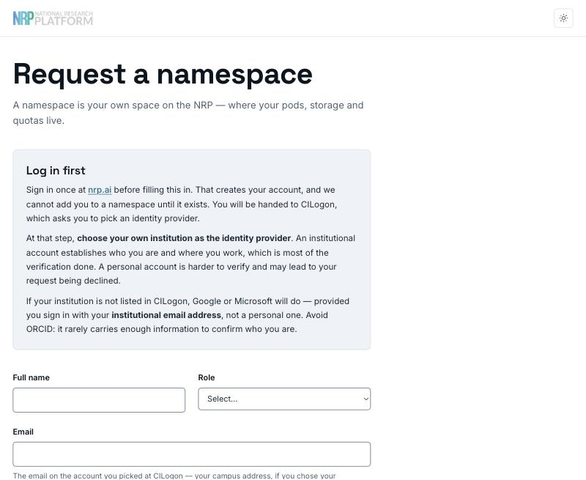
Getting Access
1. Log in at nrp.ai
Log In → CILogon → your institution
2. Get into a namespace
Request one at get-started.nrp-nautilus.io
Or ask an existing namespace admin to add you
3. Start working
JupyterHub, kubectl, GitLab, or an LLM token from nrp.ai/llmtoken
Who can request a namespace: faculty, staff, postdocs and research scientists; students through their PI.
https://get-started.nrp-nautilus.io
39

Slide 62
What is a Namespace?
Your group's space on the cluster: one per lab, project, course or service
The PI or instructor is its admin and adds members
Everything you run lives in it: pods, Jobs, volumes, Services, Ingresses
Members see their own namespaces, not anyone else's
2,334 of them today
Nautilus cluster
netlab
a PI (admin) and three students · GPU jobs · a Ceph volume · a web app
cse-course
the instructor (admin) and 40 students · a course JupyterHub · shared datasets
another-lab
their members only · you can't see their pods or data
40

Slide 63
Ways to Run Work
Interactive: JupyterHub
Batch: a Job
Pick a GPU from the start menu; explore, debug, teach
Idle servers stop: 1 hour after you close the browser on NRP's hub, 6 hours at most on any hub
Runs your script to the end, then gives the GPU back
Submit many at once; the rest wait in Pending for a free GPU
$ kubectl apply -f sweep/ # six training jobs
Interactive: a pod
Start a container with kubectl, then open a shell in it
Deleted after 6 hours; at most 2 GPUs
GPU 1
lr-0.1
lr-0.0003
GPU 2
lr-0.03
Long-running: a Deployment
GPU 3
lr-0.01
lr-0.001
Keeps a service up (a web app, a database) and restarts it if it crashes
Removed after 2 weeks unless admins grant an exception; no GPU if it sits mostly idle
GPU 4
lr-0.003
Six jobs on four GPUs: two wait in Pending and take the first GPUs that free up. When the last one ends, all four GPUs are free again.
41

Slide 64
A GPU Job
apiVersion: batch/v1
kind: Job
metadata: {name: gpu-train-daniel, namespace: my-lab} # (1)
spec:
template:
spec:
restartPolicy: Never
containers:
- name: train
image: pytorch/pytorch:2.9.0-cuda13.0-cudnn9-runtime # (2)
command: ["python", "train.py"]
resources: # (3)
requests: {cpu: "2", memory: 6Gi, nvidia.com/gpu: 1}
limits: {cpu: "2", memory: 6Gi, nvidia.com/gpu: 1}
affinity: # (4)
nodeAffinity:
requiredDuringSchedulingIgnoredDuringExecution:
nodeSelectorTerms:
- matchExpressions:
- {key: nvidia.com/gpu.memory, operator: Gt, values: ["20000"]}
- {key: nvidia.com/gpu.compute.major, operator: Gt, values: ["7"]}
(1) Where: your namespace
(2) What: a container image, and the command to run
(3) Resources: 2 CPUs, 6 GB of memory, one GPU
(4) Which GPU: more than 20 GB, Ampere or newer; or name exact models
42

Slide 65
Where to Start
Use it
Connect to it
The LLM API in your automation: config review, log triage, a docs assistant; task names keep working as the catalog changes
Your tools in a namespace: web apps, Postgres and ClickHouse from the operators, S3 for data
GitLab CI to build and ship them
GPUs for AI and ML: a notebook to start, Jobs when it's real
Contribute nodes, the way a node joins: you keep priority, NRP runs them
InterLink: a Slurm cluster appears as a virtual node
Federation with another Kubernetes cluster
FABRIC and SENSE testbeds, with Multus for extra NICs
perfSONAR: a testpoint on your node joins the mesh
https://nrp.ai/documentation/admindocs/participating/new-contributor-guide/
43

Slide 66
Live Demo
44

Slide 67
Acknowledgments
NRP is supported by NSF awards OAC-1541349, OAC-1826967, OAC-2030508, OAC-1841530, OAC-2005369, OAC-2112167, CISE-1713149, CISE-2100237 and CISE-2120019
Networks: CENIC, Pacific Wave, Internet2, MREN, GPN, NYSERNet, FLR, NEREN, Sun Corridor, OARnet, SCLR and the Albuquerque GigaPoP
The NRP operations teams at SDSC, the University of Nebraska–Lincoln and MGHPCC, and the campuses that host and share their hardware
SCinet, for having us during the NOC move
45

Slide 68
Questions?
Today's materials
training.nrp-nautilus.io/scinet-sc26
Portal and login
nrp.ai
Request a namespace
get-started.nrp-nautilus.io
LLM endpoint
ellm.nrp-nautilus.io/v1
LLM token
nrp.ai/llmtoken
perfSONAR
perfsonar.nrp-nautilus.io
Admin guide
nrp.ai/documentation/admindocs
Support chat and email
nrp.ai/contact
Daniel Diaz · d4diaz@ucsd.edu
46

Slide 69
Backup
47

Slide 70
What Argo CD Runs
Application | Source | Sync
cve-mitigations | NRP GitLab: prp/cve-mitigations | auto
falco | Helm chart: falco | manual
falco-talon | Helm chart: falco-talon | auto, self-heal
gitlab | GitHub: nrp-nautilus/gitlab | auto, self-heal
gpu-power-management | GitHub: Sam6734/nrp-gpu-operator-tracking | auto, self-heal
grafana | Helm chart: grafana | auto, self-heal
inspect | NRP GitLab: nrp/inspect | auto, self-heal
kueue | GitHub: nrp-nautilus/kueue-gitops | manual
kured | Helm chart: charts | auto
netbox | Helm chart: netbox | auto, self-heal
Application | Source | Sync
netbox-agent | NRP GitLab: nrp/netbox-4 | auto, self-heal
nrp-aime | GitHub: djw8605/nrp-aime | auto, self-heal
nrp-clickhouse-deploy | GitHub: djw8605/nrp-clickhouse | auto
nrp-onboarding | NRP GitLab: prp/nrp-onboarding | auto, self-heal
nrp-ops-bot | GitHub: djw8605/nrp-ops-bot | auto
openwebui | NRP GitLab: nrp/openwebui | auto
ray | NRP GitLab: prp/ray | manual
self-node-remediation | NRP GitLab: nrp/self-node-remediation | manual
wazuh | NRP GitLab: nrp/wazuh | auto, self-heal
Argo CD applications on the cluster, 10 Nov 2026; Argo's own example app left out.
48

Slide 71
Runner Flavors
Runner | For | Privileged | Jobs at once | Limits a job can raise to
gitlab-runner-kata-default | every project on gitlab.nrp-nautilus.io (the default) | no | 10 | 12 CPUs, 50 GiB
gitlab-runner-kata | Docker builds: Docker-in-Docker (docker:28-dind) | yes, inside its VM | 3 | Docker gets 48 GiB of memory for image layers
gitlab-runner-gitlab | projects on gitlab.com | no | 2 | 12 CPUs, 24 GiB
gitlab-runner-sdsc | SDSC's own GitLab, hpc-gitlab.sdsc.edu | no | 2 | 12 CPUs, 24 GiB
All four run each job in its own Kata VM, in namespace gitlab-ci-kata, on x86 nodes tainted nautilus.io/testing=kata
Pull policy always (except the Docker runner): a job can't start another project's private image from a node's cache
Groups can also run their own runners in their namespaces, e.g. ihv-cenic and unl-dtih
49

Slide 72
The Agent, Up Close
netbox_agent.yaml (token left out)
netbox:
url: https://netbox-4.nrp-nautilus.io
network:
ignore_interfaces: (dummy.*|docker.*|tunl*|cali*|vxlan.*|lo|ibp.*|.*ifb.*)
ignore_ips: (127\.0\..*)
lldp: true
nic_id: name
primary_mac: permanent
virtual:
cluster_name: nautilus
datacenter_location:
driver: cmd:kubectl get node ${NODE_NAME} -o jsonpath=
'{.metadata.labels.netbox\.io/site}' | tr '[:upper:]' '[:lower:]'
inventory: true
The run loop (from the startup script)
lldpd # start listening for LLDP
# at least 30 s so LLDP has found its neighbours
pause $(random_between 30 "$INITIAL_DELAY_MAX")
while true; do
netbox_agent -c "$RUNTIME_CONFIG" --update-all -d &&
netbox_agent -c "$RUNTIME_CONFIG" --update-inventory -d
# a day, plus up to an hour of jitter
pause $((RUN_INTERVAL + $(random_between 0 "$RUN_JITTER")))
done
Interfaces the overlay creates (cali*, vxlan*, tunl*) are ignored, so NetBox holds the physical network only.
50

Slide 73
Envoy AI Gateway Objects
EnvoyProxy
proxy deployment settings
GatewayClass
envoy-ai-gateway-nrp
Gateway
envoy-ai-gateway-nrp
SecurityPolicy
ext auth: llm-auth (gRPC)
25 route rules
6 InferencePools
Up to 16 rules per AIGatewayRoute, so routes are split across objects
AIGatewayRoute
match x-ai-eg-model
BackendTrafficPolicy
rate limit, retries, health
InferencePool
+ endpoint picker (EPP)
AIServiceBackend → Backend
one endpoint, schema OpenAI
vLLM pods
selected by label
BackendSecurityPolicy
API key to the backend
From the NRP admin guide, Managing AI Models; object names from the cluster.
51

Slide 74
Using GPUs Fairly
Do
Don't
Run batch work as a Job that exits
Request what you'll use; keep limits within 20% of requests
Keep data on a persistent volume or in S3
Run a sweep as many one-GPU jobs
Borrow idle A100/H100s with priorityClassName: opportunistic, and checkpoint
Leave a notebook holding a GPU overnight
Put sleep in a Job to keep a GPU (bannable)
Ask for 4 GPUs "just in case": use must stay above 40%
Keep results on the pod's own disk; it vanishes with the pod
https://nrp.ai/documentation/userdocs/start/policies/
52

