Slide 1
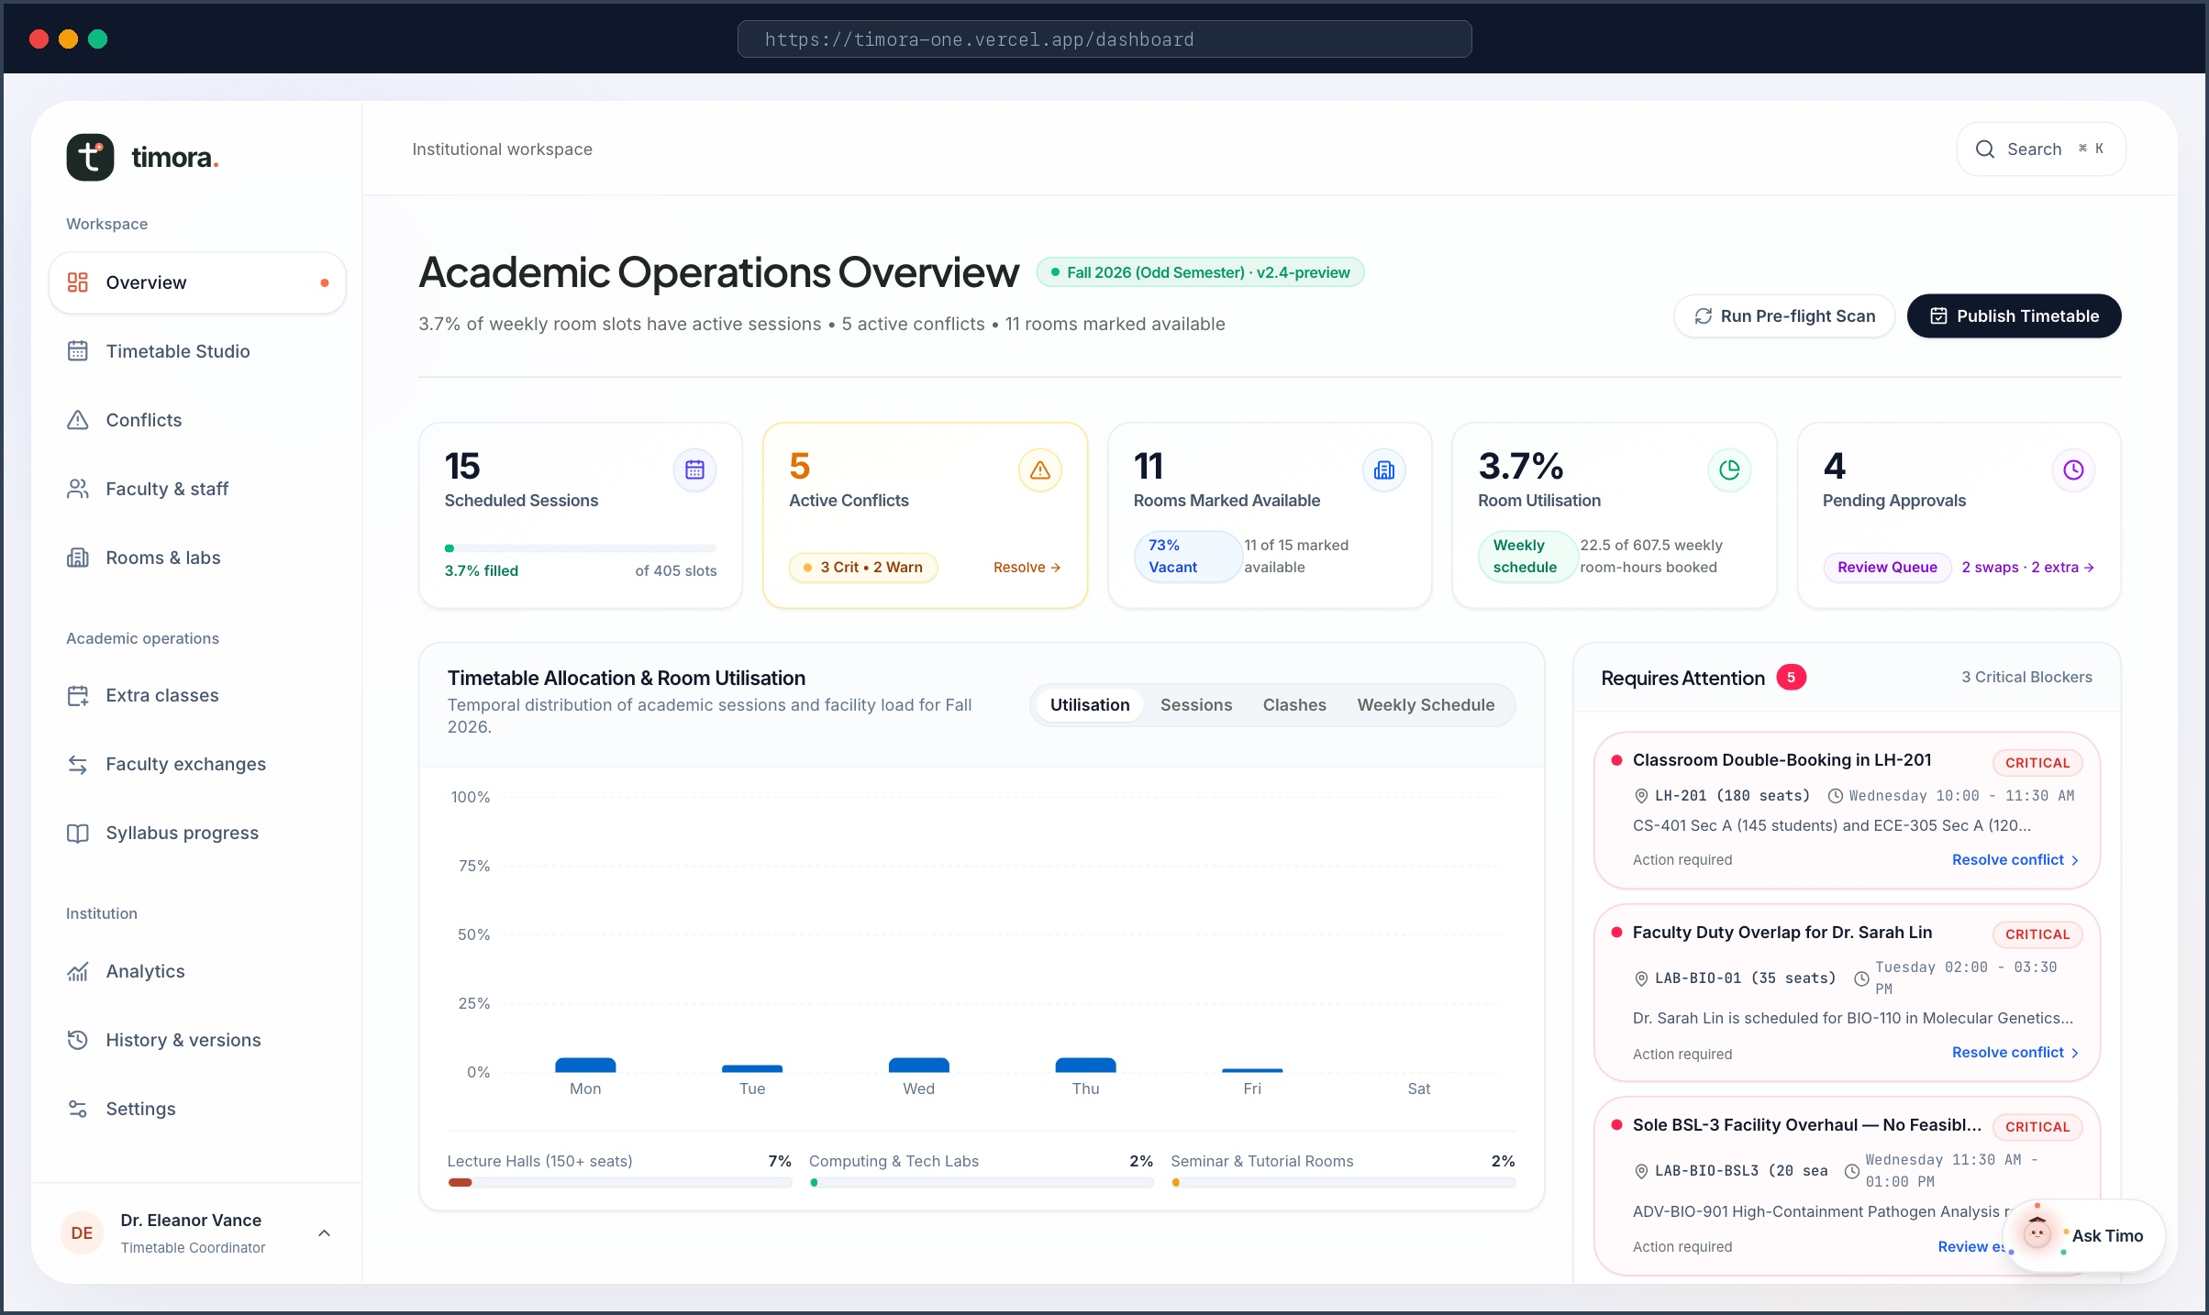
⚡ HACKATHON SHOWCASE • LIVE ON VERCEL
TIMORA
The Autonomous Academic Operations System & Timetable Brain
Transforming university scheduling chaos into conflict-free operational flow. Powered by real-time multi-constraint solving, clash cascade prediction, and Timo—an AI copilot grounded in actual institutional records.
Zero-Conflict Guarantee
Grounded Timo Copilot
95% Faster Allocation
ENGINEERED WITH MODERN ROBUST STACK:
• Next.js 16 (App Router) + React 19 + TypeScript + Tailwind CSS 4
• Google Gemini 2.5 Flash + OpenRouter Cognitive Brain
• Supabase PostgreSQL (RLS) + In-Memory Evaluation Store
• 100% Passing Test Suite (Playwright E2E + Vitest)
🌐 LIVE EVALUATION ENVIRONMENT
URL: https://timora-one.vercel.app
Includes 1-Click Persona Sign-In for Coordinators, Faculty & Students.
TIMORA • Autonomous Academic Operations System • timora-one.vercel.app
01 / 06

Slide 2
🚨 THE CRISIS • HIGHER EDUCATION SCHEDULING TRAP
Universities Spend 400+ Hours Every Semester Fighting Spreadsheets
Higher education operations still rely on fragile, disconnected grids that fracture the moment reality changes.
400+ Hours
0 Memory
120 Stranded
Cascading Conflict Ripple
A Single Teacher Absence Breaks 5+ Classes
Academic schedules are deeply interconnected graphs. When one professor takes emergency leave, moving their lecture triggers a cascade of room double-bookings, laboratory conflicts, and student cohort overlaps across 4 other courses.
Coordinators spend days manually tracing dependencies across dozens of siloed Excel sheets.
Institutional Amnesia
Zero Central History & Vanishing Approvals
University coordination knowledge lives trapped in personal inboxes and scattered spreadsheets. Special room requirements, teacher availability preferences, and prior swap approvals disappear when staff turns over.
Without an immutable audit ledger, universities face zero institutional memory and endless disputes.
Late-Stage Catastrophes
Clashes Discovered Only on Lecture Day
Spreadsheets possess zero constraint intelligence. Overlaps and room capacity overflows remain completely invisible until 120 students arrive at an occupied lecture hall on Monday morning.
Emergency room scrambles damage student satisfaction, faculty morale, and institutional prestige.
THE ROOT CAUSE: Spreadsheets are static rectangular grids. Academic operations are complex, living, multi-constraint constraint graphs.
TIMORA • Autonomous Academic Operations System • timora-one.vercel.app
02 / 06

Slide 3
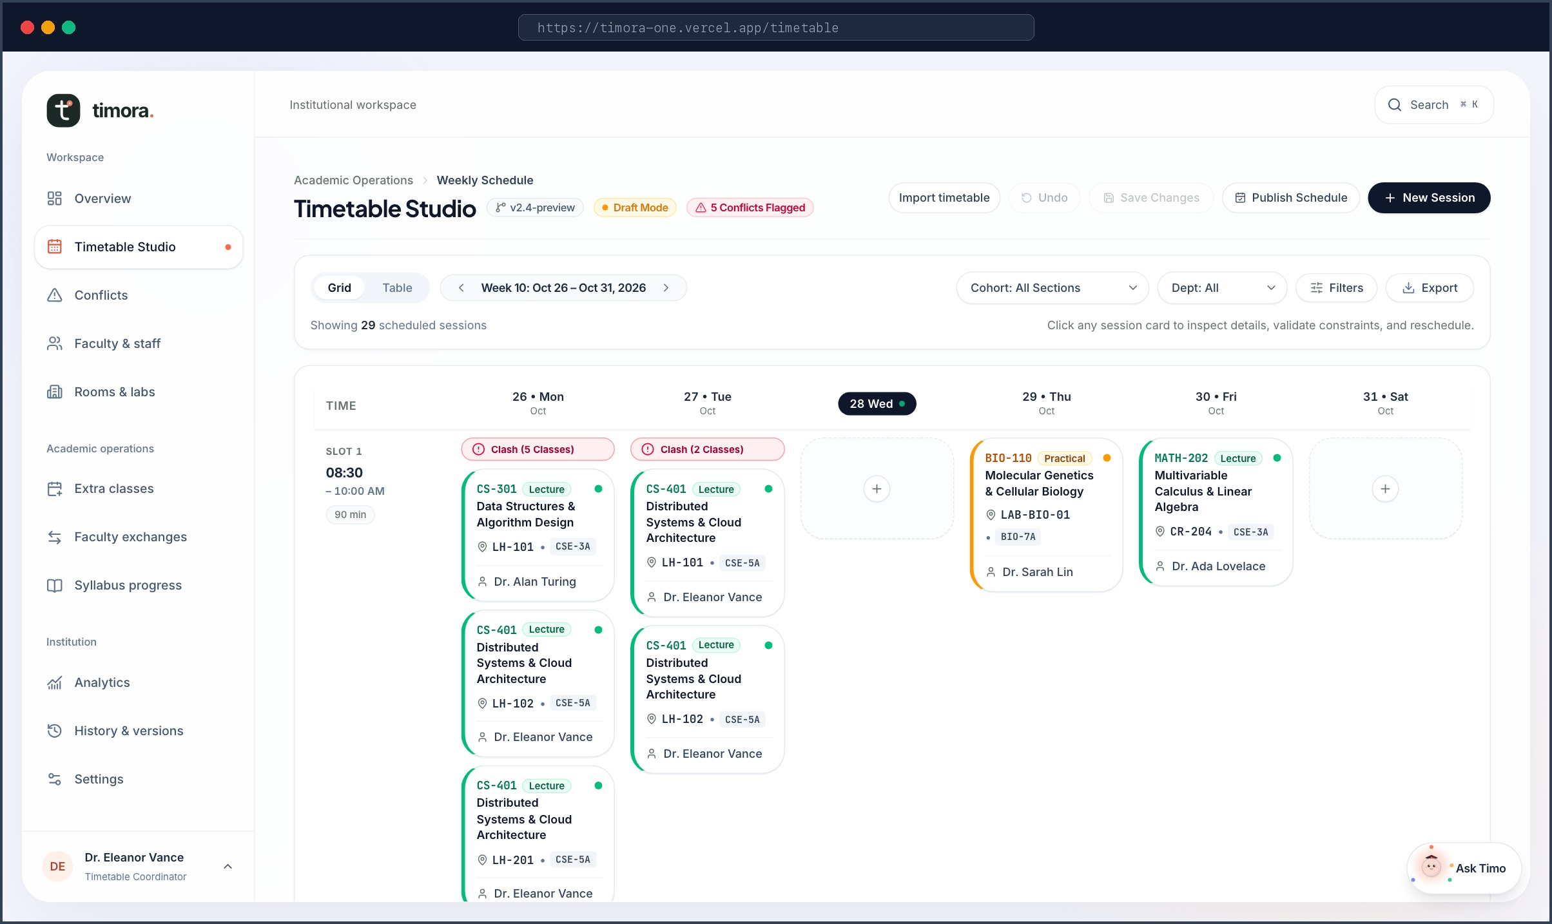
🖥️ PRODUCT SHOWCASE 1 • LIVE SYSTEM
Live Operations Command & Visual Timetable Studio
From high-level institutional triage to minute-by-minute calendar management in under 3 clicks.
Live KPI Operations Row
Instant visibility into scheduled sessions (15), active detected conflicts (5), room capacity utilisation (11 venues), and pending extra-class requests.
Requires Attention Panel
Algorithmic triage surfaces unassigned faculty slots, room overflows, and teacher exchange approvals directly on the coordinator's morning dashboard.
Interactive Timetable Studio
Interactive 5-day visual matrix mapping course codes, faculty assignments, student sections, and room allocations with instant visual validation.
TIMORA • Autonomous Academic Operations System • timora-one.vercel.app
03 / 06

Slide 4
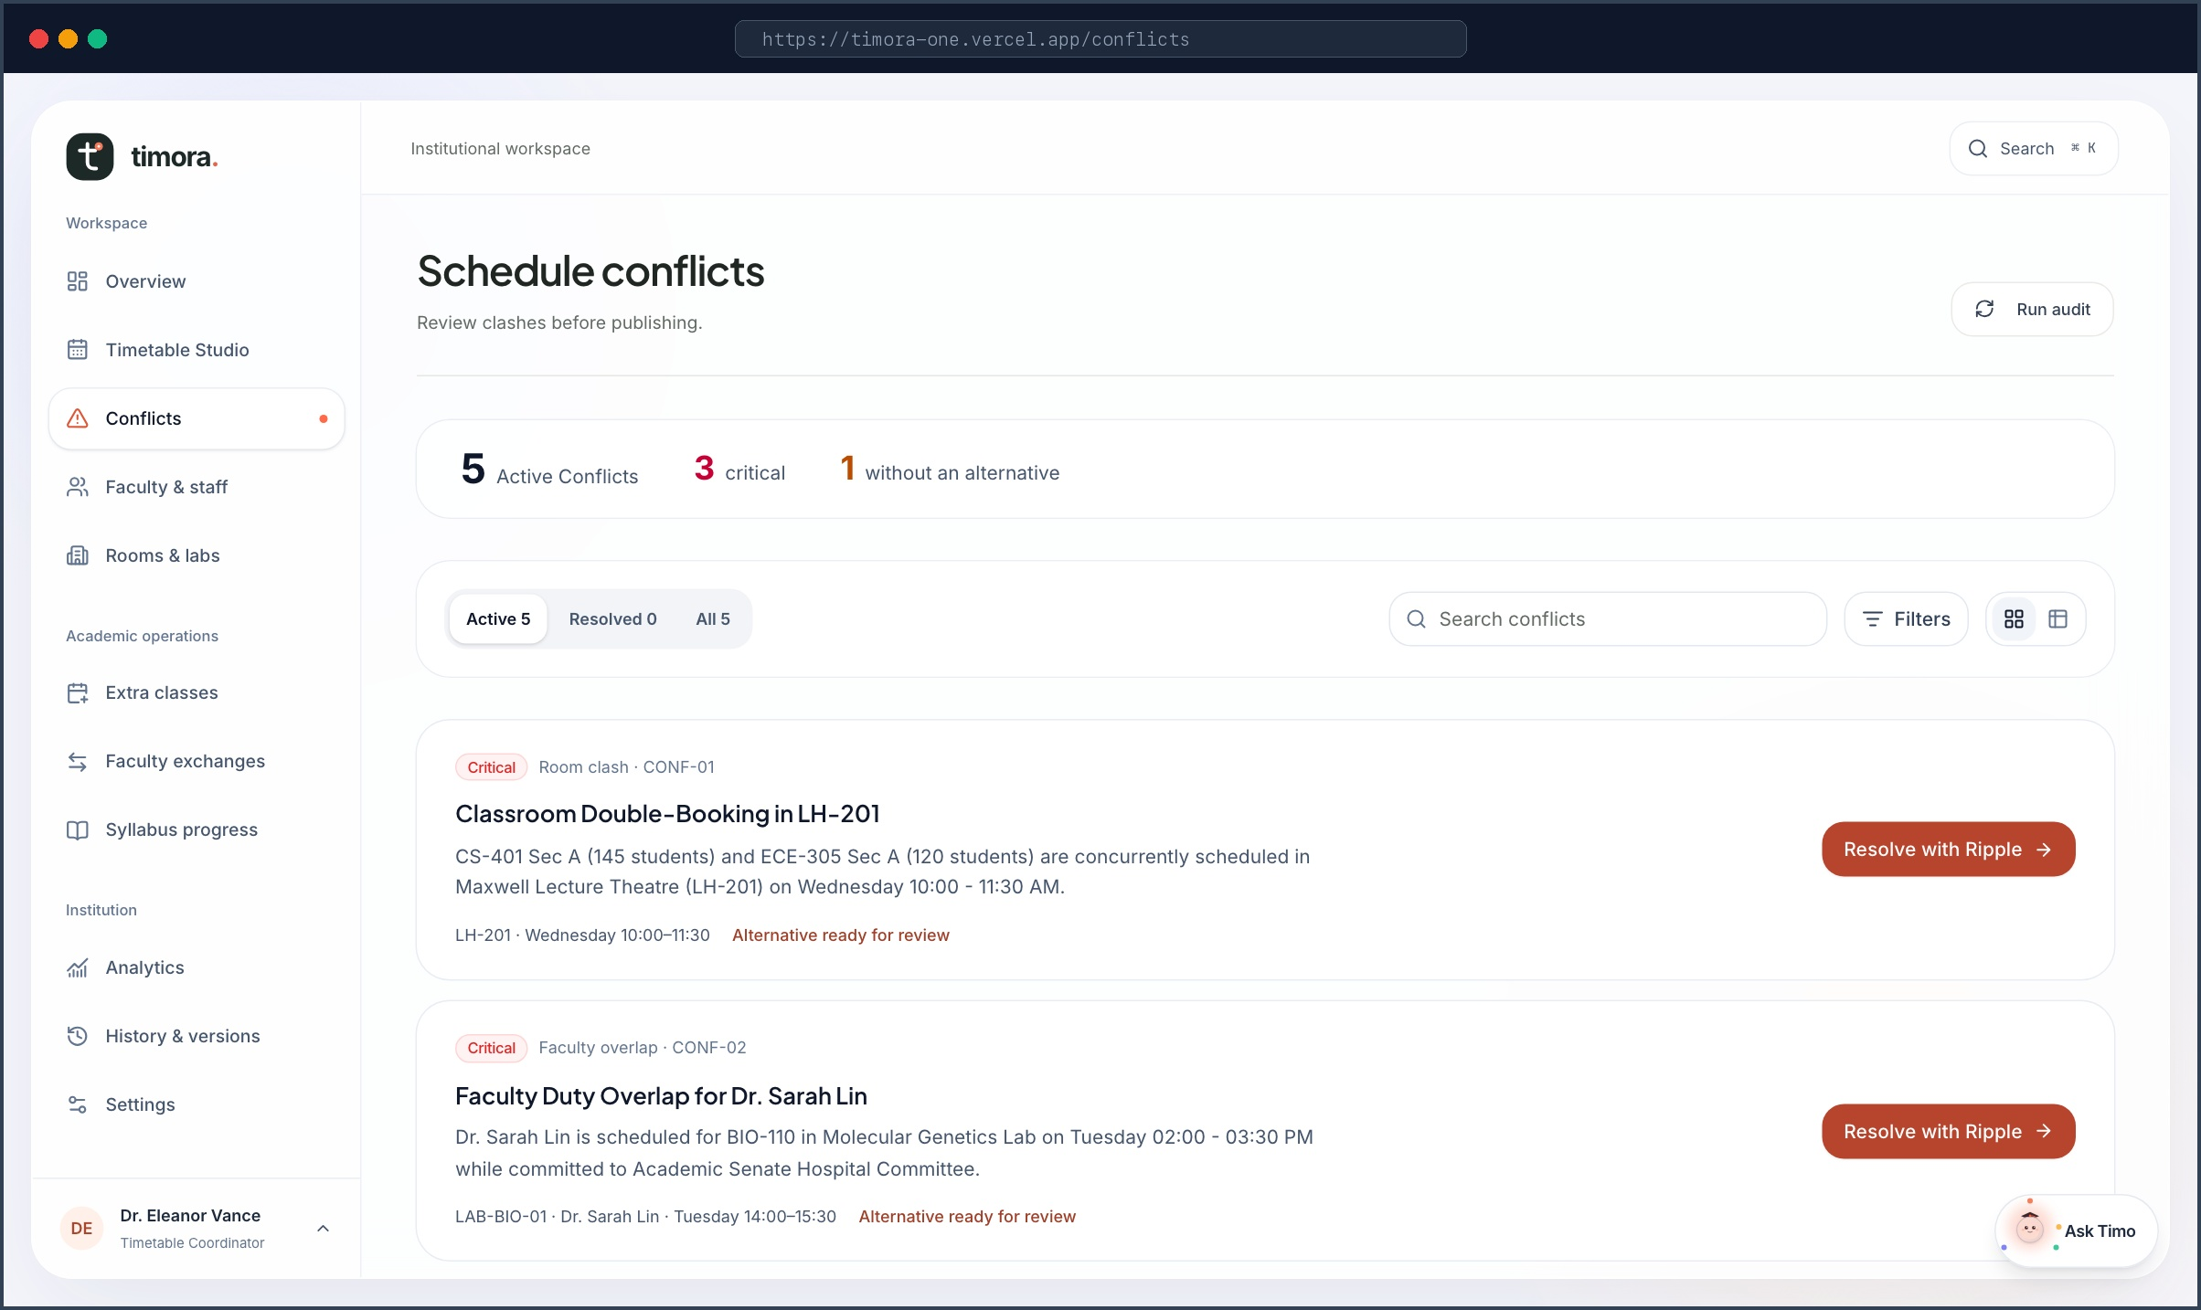
⚡ STANDOUT CAPABILITY • MULTI-CONSTRAINT SOLVER
Automated Conflict Resolution & Ripple Suggestions
Deterministic clash detection across rooms, faculty commitments, and room capacity limits.
Categorized Conflict Severity
Clashes are classified into Critical (direct room double-booking, professor dual-assignment) and Warning (capacity tight, non-optimal lab equipment).
Ripple Alternative Suggestions
Rather than just pointing out clashes, Timora's constraint engine automatically suggests alternative slots and rooms guaranteed to have 0 downstream conflicts.
Schema-Aware Bulk Import
Coordinators can upload university CSV or XLSX timetables. Timora performs fuzzy schema matching, staged preview, and dry-run conflict checks before writing to database.
TIMORA • Autonomous Academic Operations System • timora-one.vercel.app
04 / 06

Slide 5
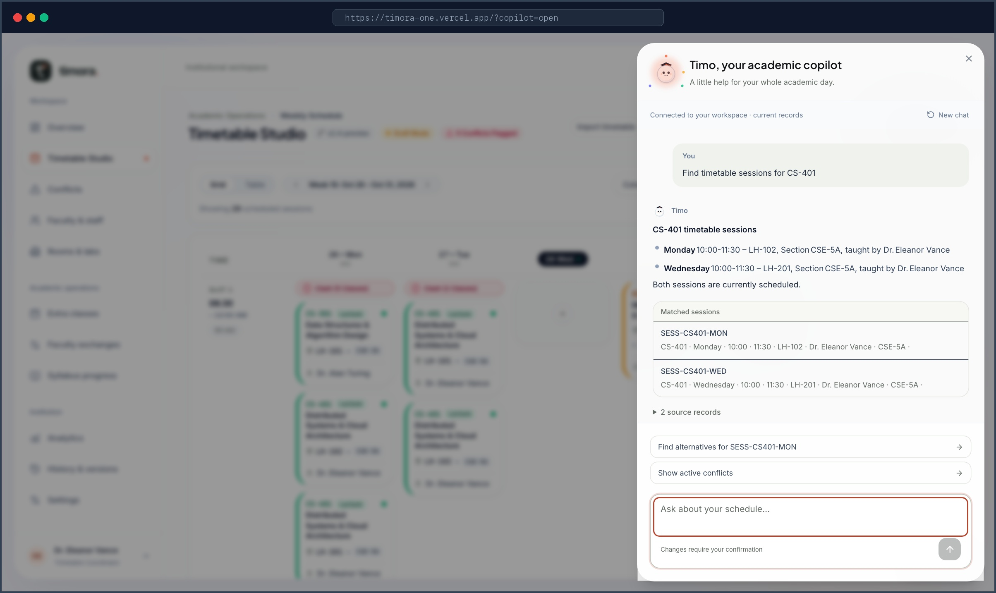
🧠 AI INNOVATION & TECH STACK • ZERO HALLUCINATIONS
Timo: Grounded Academic Brain & Enterprise Architecture
Direct database tool execution with cryptographic action previews and 100% test verification.
Bounded Database Tool Execution
Timo executes real function tools directly against the SchedulingRepository. When asked 'Find sessions for CS-401', it reads live database records and returns exact deep-linked session cards—never hallucinated.
Signed HMAC Action Tokens (Human Gate)
To prevent autonomous corruption, any AI schedule modification (rescheduling, extra classes) generates an HMAC-signed preview token requiring explicit coordinator click confirmation.
Dual-Brain Architecture & Tech Stack
Next.js 16 (App Router), React 19, Tailwind CSS 4, Supabase PostgreSQL (RLS), and Dual-Brain AI (Google Gemini 2.5 Flash + OpenRouter Cognitive Brain with local fallback).
🧪 RIGOROUS AUTOMATED VERIFICATION (100% PASSING):
Playwright E2E journey tests + Vitest unit test suite verify scheduling, Copilot tool calls, and XLSX bulk import across all 6 core institutional roles.
TIMORA • Autonomous Academic Operations System • timora-one.vercel.app
05 / 06

Slide 6
🎯 PROVEN ROI & LIVE DEMO READY • TEST IT NOW
Experience Timora Live Right Now
95%
Time Savings
Weeks of manual meetings reduced to 15 minutes of guided planning
0
Day-One Clashes
Zero double-booked classrooms or faculty duty overlaps at publish time
100%
Audit History
Complete immutable record of all schedule edits, approvals, and swaps
<20ms
CAS Solver Speed
Sub-20 millisecond constraint check per slot across 400+ calendar cells
INSTANT EVALUATION ACCESS
🌐 Live URL: https://timora-one.vercel.app
🔑 1-Click Instant Persona Sign-In:
• Coordinator: coordinator@timora.edu (Full studio & publish rights)
• Faculty: faculty@timora.edu (Availability & leave request)
• Student: student@timora.edu (Personalized timetable & venue view)
📂 Open Source Repository:
https://github.com/nrrahulurs-cmyk/Timora
WHY TIMORA WINS THIS HACKATHON
• Real Working System: Fully functional full-stack app with Next.js 16 and Supabase.
• Zero-Hallucination AI: Timo executes bounded tools on the real database with cryptographic action tokens.
• Sub-20ms CAS Solver: Real-time algorithmic solver enforcing room capacity, faculty schedules, and equipment.
• Solves a Universal $3.8B Pain: Saves 400+ hours per department across 25,000+ universities worldwide.
• Enterprise Quality Bar: 100% passing Playwright E2E and Vitest unit test coverage.
“ The right people. The right place. The right time. ”
Thank you! Open for Questions & Live Interactive Demonstration.
TIMORA • Autonomous Academic Operations System • timora-one.vercel.app
06 / 06

