Slide 1
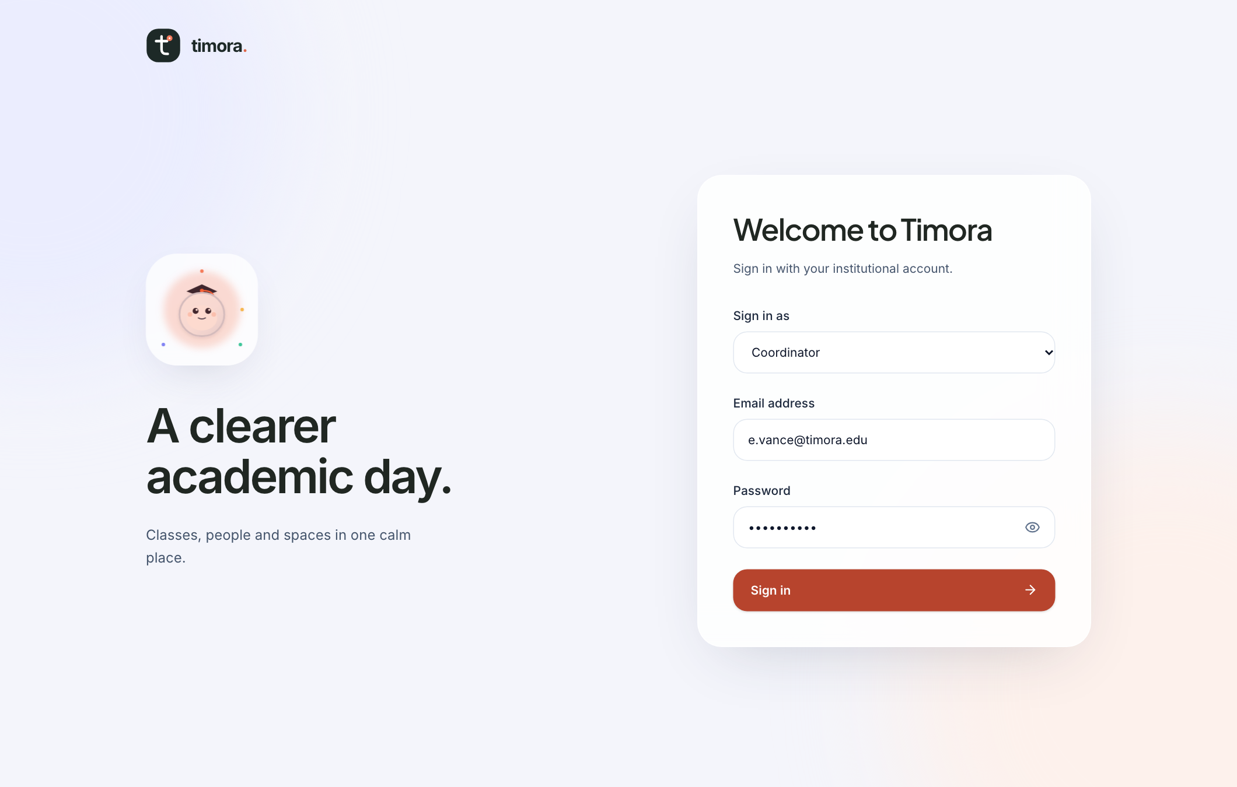
t
timora.
PROJECT PRESENTATION
01 THE IDEA
A clearer academic day
One workspace for the people, places, and decisions behind a timetable.
ACADEMIC OPERATIONS
Every timetable change has a
ripple effect.
Timora connects scheduling, resource allocation, and
conflict review so teams can make changes with
context and confidence.
REAL PRODUCT SCREEN / LOCAL BUILD
TIMORA / LOCAL EVALUATION BUILD
01 / 06

Slide 2
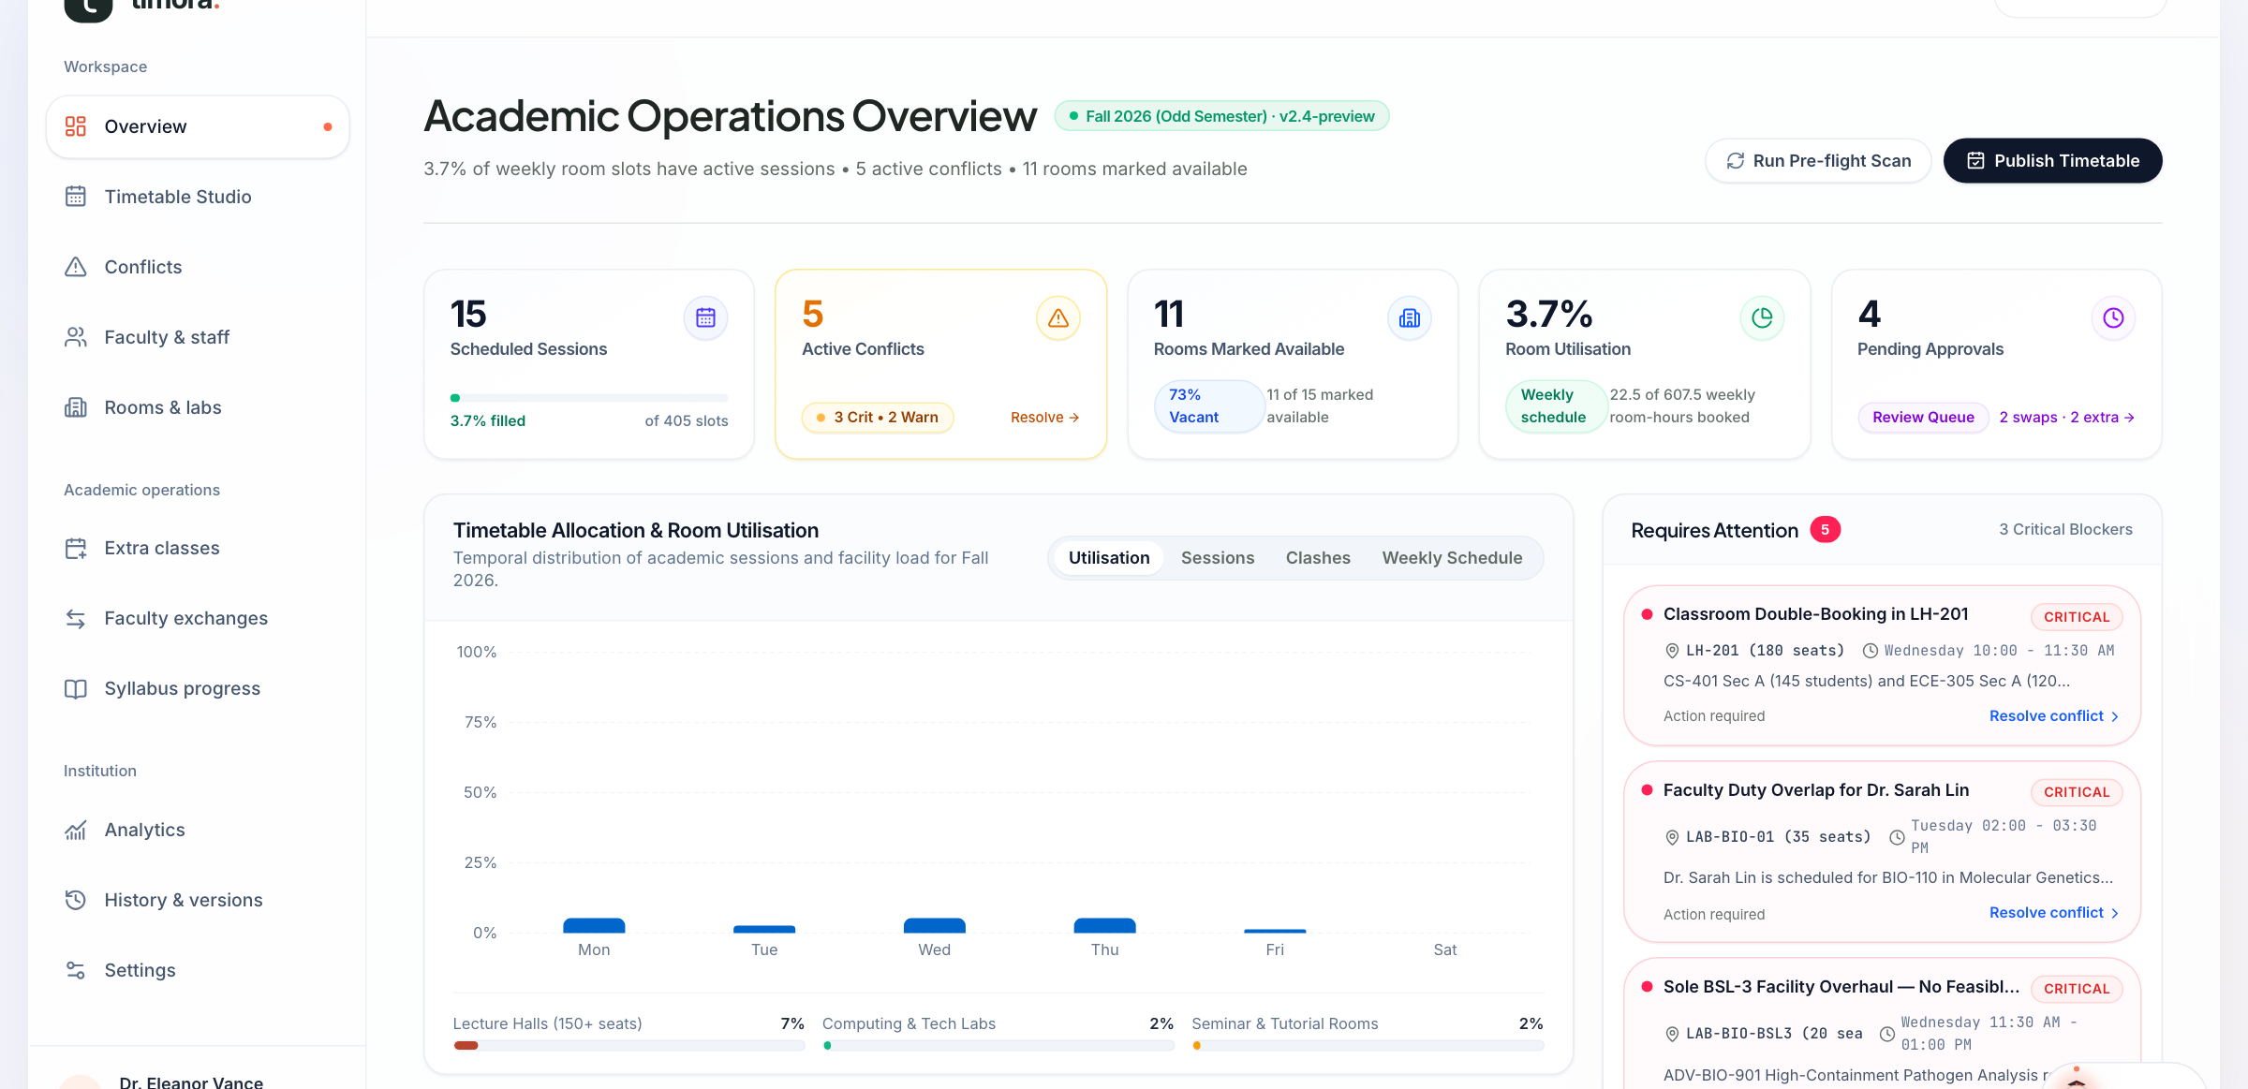
t
timora.
PROJECT PRESENTATION
02 PRODUCT OVERVIEW
The week, in one view
Operational signals and the workflows behind them share the same scheduling records.
See the state
Sessions, conflicts, rooms, approvals, and
utilisation together.
Follow the issue
Move from an overview signal to a
focused workflow.
Work across teams
Faculty, rooms, requests, analytics, and
history stay connected.
TIMORA / LOCAL EVALUATION BUILD
02 / 06

Slide 3
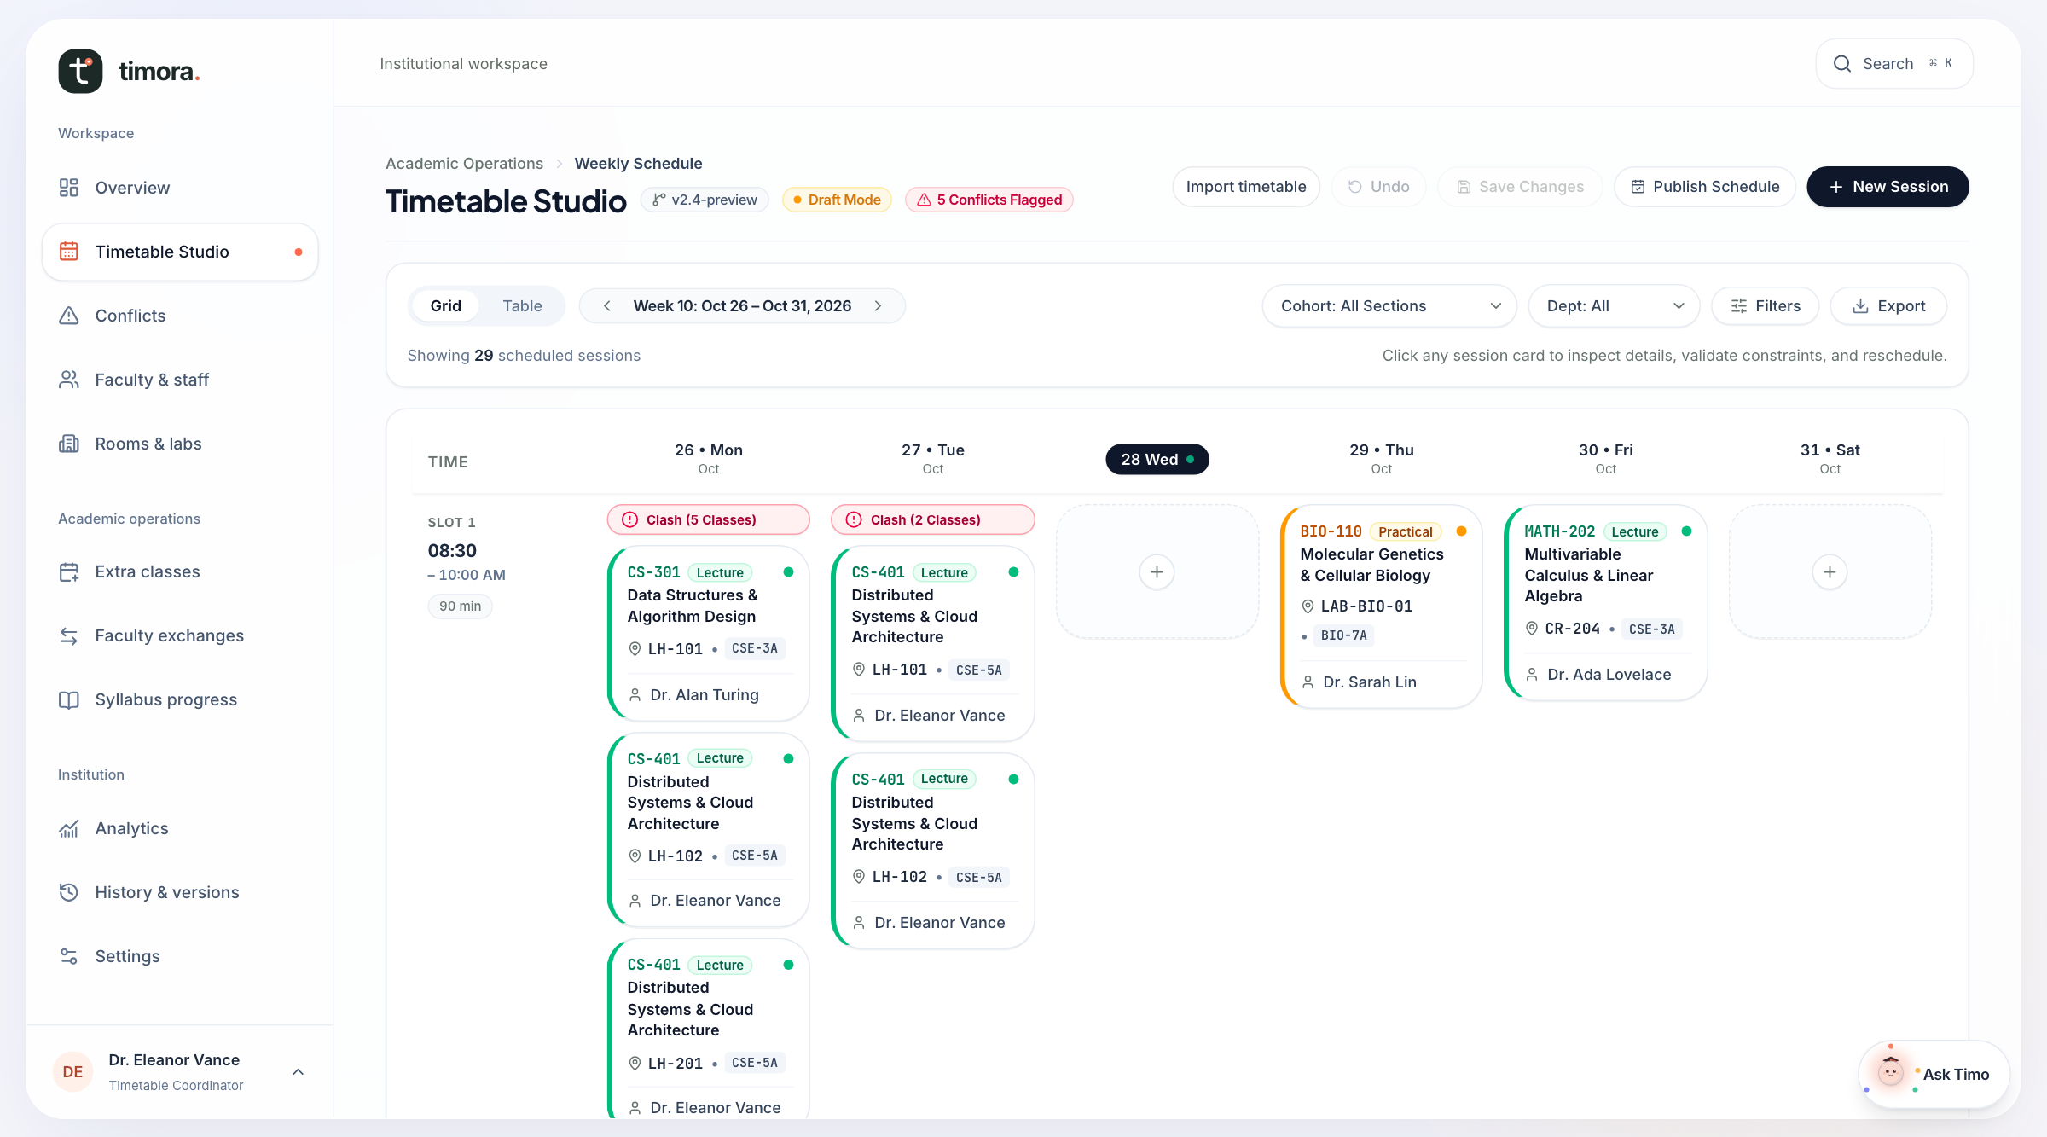
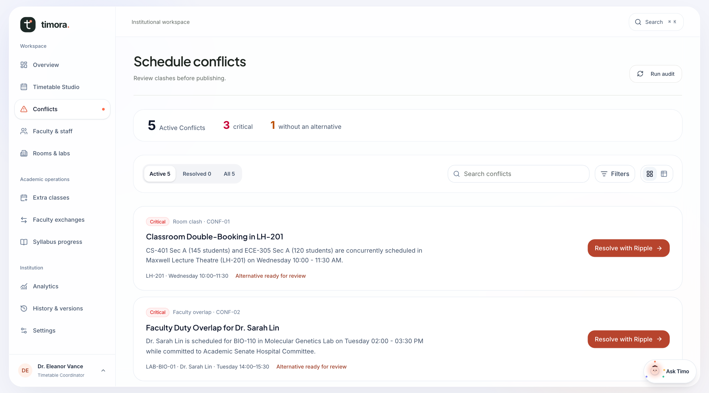
t
timora.
PROJECT PRESENTATION
03 SMART TIMETABLE MANAGEMENT
Plan. Check. Resolve.
A coordinator can inspect the week, stage a change, and validate before saving.
TIMETABLE STUDIO
CONFLICT CENTER
Day-by-day sessions, course, section, room, and teacher.
Room and faculty clashes with reviewable alternatives.
CSV + XLSX IMPORT: MATCH / REVIEW / VALIDATE / CONFIRM
TIMORA / LOCAL EVALUATION BUILD
03 / 06

Slide 4
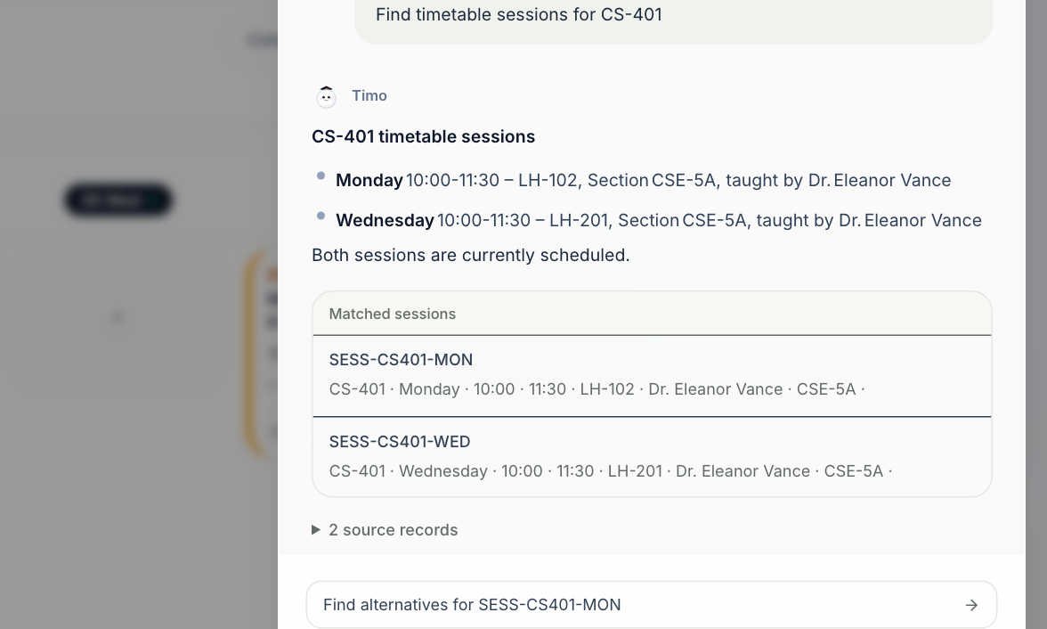
t
timora.
PROJECT PRESENTATION
04 TIMO AI COPILOT
Answers tied to records
A real CS-401 lookup from the local Timora workspace.
WHAT IT DOES TODAY
Ask in natural language.
Timo retrieves timetable, availability, conflict, workload,
syllabus, and version data through bounded tools.
Source records and follow-up suggestions make answers
traceable. Supported changes are previewed first and
require user confirmation.
READ > PROPOSE > CONFIRM
TIMORA / LOCAL EVALUATION BUILD
04 / 06

Slide 5
t
timora.
PROJECT PRESENTATION
05 TECHNOLOGY & ARCHITECTURE
A shared source of truth
The current code separates the interface, scheduling logic, data access, and AI service.
INTERFACE
Next.js 16 + React 19
TypeScript + Tailwind
SCHEDULING LAYER
Repository + constraints
Plans, imports, requests
DATA PATH
Local evaluation store
Supabase live adapter
TIMO SERVICE
Server-side OpenRouter
Validated, scoped tools
VALIDATION BEFORE WRITE
LIVE DEPLOYMENT GATE
Constraint checks, role checks, confirmation, audit, and read-after-write verification protect local workflows.
Supabase row policies, transactional writes, and live role tests still require completion.
LOCAL SCREENS SHOWN IN THIS DECK
TIMORA / LOCAL EVALUATION BUILD
05 / 06

Slide 6
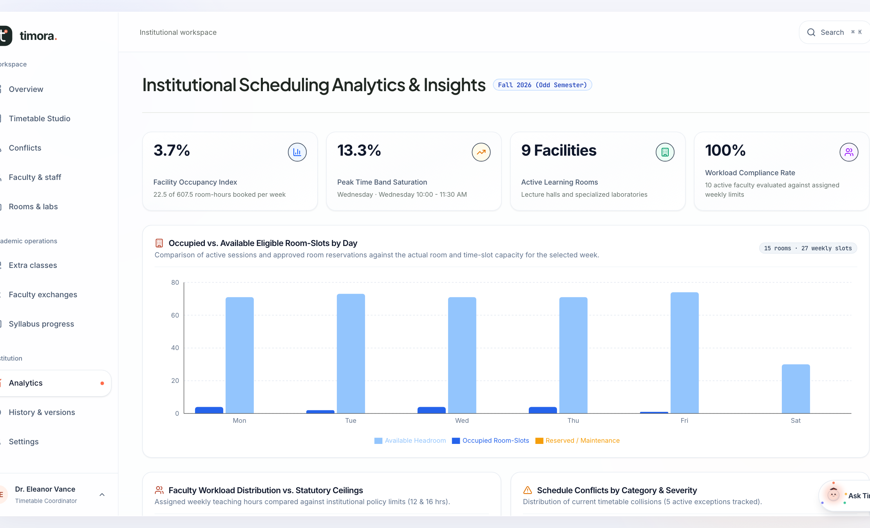
t
timora.
PROJECT PRESENTATION
06 IMPACT & NEXT STEPS
Make every change trustworthy
Timora connects insight, planning, and review in a single academic workflow.
PRACTICAL VALUE
See conflicts earlier. Compare options. Keep
a trace of decisions.
ROADMAP TO INSTITUTIONAL LAUNCH
1
Scoped Supabase row policies
2
Transactional, audited live writes
3
Complete exchange consent and application
4
Live permission, recovery, and accessibility tests
The right people. The right place. The right time. A change you can explain.
TIMORA / LOCAL EVALUATION BUILD
06 / 06

