Slide 1

14 October 2026
MediMap
Diagnostic service discovery
and price comparison in Dhaka
Notes:
Introduce MediMap as a planned diagnostic-service comparison platform for Dhaka. The repository currently contains project requirements and architecture decisions. The application is not yet implemented. The cover image is an AI-generated conceptual illustration, not a real hospital or product screenshot.

Slide 2
Project description
Compare the same diagnostic service across Dhaka branches
before contacting a provider.
05
For patients, caregivers and healthcare professionals
Search by service name or alias.
Compare prices in BDT, location, travel estimates,
opening hours and reviews.
hospitals in the
planned release dataset
Browse without an account. Sign in to submit reviews.
Scope: diagnostic services in Dhaka. Booking and medical advice are excluded.
02
Notes:
MediMap connects provider-specific names and abbreviations to a canonical diagnostic-service catalog. The release target covers ten hospitals, their Dhaka branches and all in-scope diagnostic services. This is a dataset target, not a completed dataset. Prices apply to specific branches and show their sources and verification dates. Browsing is public; reviews require an account

Slide 3
Problem-solving approach
Make branch information comparable and traceable
01
Resolve service names
02
Find relevant branches
Match names and aliases to one service.
Ask users to select ambiguous matches.
Filter by location and straight-line radius.
Show road distance and travel time separately.
03
Compare branch data
04
Maintain published data
Show base prices and verification dates.
Use at least two eligible branches for statistics.
Administrators review prices and corrections.
03
Notes:
The problem is that service names, price records and branch details need a common structure before users can compare providers. For example, CBC must resolve to Complete Blood Count. The location filter uses straight-line distance; road travel estimates are separate values. Default statistics use one eligible verified price per active branch-service listing, with at least three eligible branches. Missing prices and travel estimates remain unknown. Reports trigger administrator review rather than direct public edits.
Sources
I:/Development/MediMap/context/project-overview.md
I:/Development/MediMap/context/architecture.md
I:/Development/MediMap/context/code-standards.md

Slide 4
Selected technology stack
Planned architecture. Package versions are not yet selected.
Layer | Technology | Project role
Interface | React + TypeScript | Reusable UI with strict type checks
Application | TanStack Start | Server-rendered service and branch pages
Runtime | Cloudflare Workers | One deployment with internal feature modules
Database | Cloudflare D1 | Relational records, prepared SQL and migrations
Authentication | Google sign-in | Review accounts; separate administrator access
04
Notes:
These are selected technologies for future implementation, not an installed stack. Public service and branch pages will use server rendering. The single Workers application will keep public pages, administration, database access and external integrations in separate modules. The browser must not access D1 or receive server secrets. Mapping and routing providers still need research. Hono is optional. Google sign-in is selected, but session implementation is unresolved.

Slide 5
Why this stack
Selection rationale based on MediMap requirements
Selected choice | Comparison option | Reason for this project
React + TanStack Start | Browser-only React SPA | Server rendering suits public service pages.
Cloudflare Workers | Separate Node.js server | One deployment for UI and backend modules.
Cloudflare D1 | Document database | SQL represents relationships between records.
Direct prepared SQL | ORM abstraction | Explicit queries and migrations suit the scope.
Trade-offs: verify Workers compatibility, D1 limits and mapping costs before implementation.
05
Notes:
This slide explains the fit of the already selected stack. Alternatives are comparison points, not completed experiments or performance benchmarks. React with TanStack Start supports the chosen server-rendering approach, and Cloudflare documents its Workers deployment path. A single deployment avoids introducing a separate application server into the selected architecture. SQL fits the documented entity relationships. Direct SQL follows the explicit no-ORM-by-default decision. Cloudflare free-tier suitability remains unverified, and no cost or performance advantage has been measured.

Slide 6
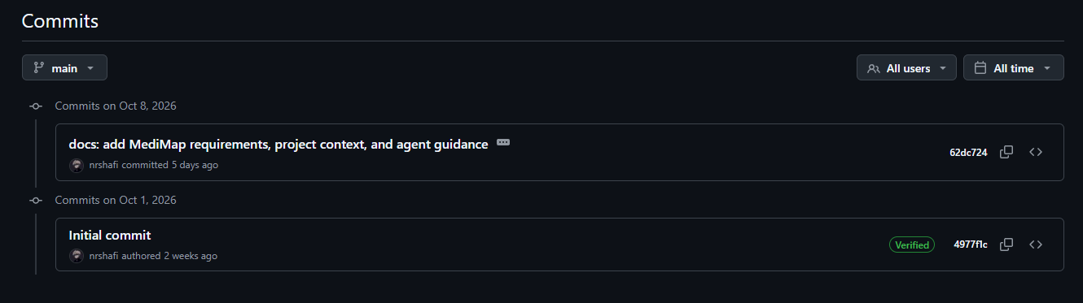
Proof of commits
View initial commit
View requirements commit
The latest commit contains the PRD, six context files and agent guidance.
07
Notes:
The commit evidence comes from the local Git repository inspected on 13 October 2026. git rev-list --count HEAD returned 2. git log -2 showed the full hashes, dates and messages. git show --name-only 62dc724 confirmed the PRD, six context documents and AGENTS.md in that commit. This does not establish completed application functionality or remotely published work. The repository remote is https://github.com/nrshafi/MediMap.git. Full hashes are listed below for verification.

