Slide 1
[Prediction of License Status]

Slide 2

PROJECT ATTRIBUTES
Project Title Prediction of License Status Tech Stack
Python, Machine Learning
Domain
INDUSTRIES
Programming Language Used
Python
Machine Learning
Project Difficulty level
Veteran
Tools used
Google Colab, MS - Excel

Slide 3
OBJECTIVE
Understanding various Ensemble techniques and implementing them to predict license status for the given business.

Slide 4




Background
The dataset used is a licensed dataset. It contains information about 86K different businesses over various features. The target variable is the status of the license, which has five different categories

Slide 5



Scope
Predicting the likelihood of a license renewal or revocation based on historical compliance data and other factors.
Forecasting the demand for licenses in a particular industry or jurisdiction based on historical trends and other economic or demographic factors.
Identifying patterns or trends in license application and approval rates based on historical data and other variables.
Developing predictive models to help license holders and regulators identify potential compliance issues or risks in advance.

Slide 6


Benefits
Improved decision-making: License status prediction can help businesses and regulators make more informed decisions by providing insights into historical trends and potential future outcomes. This can help to reduce uncertainty and improve planning and resource allocation.
Increased efficiency: Predictive models can help automate and streamline license status monitoring and decision-making processes, reducing the need for manual intervention and saving time and resources.
Better compliance: By predicting license statuses in advance, regulators and license holders can proactively identify and address compliance issues, reducing the risk of fines, penalties, or other legal repercussions.

Slide 7
Project Approach
Data Description
Exploratory Data Analysis
Data Cleaning
Missing Value imputation
Outlier Detection
Data Imbalance
Data Encoding
Model Building
Random Forest
AdaBoost
XG Boost
Hyperparameter tuning
Random search optimization
Grid search optimization
Bayesian optimization

Slide 8


Data Set Information
SL No & Sample ID:
Represents Index.
BMI:
Represents body fat based on Height and Weight.
OB Score:
Ob score It's related to previous history of pregnancy (Gravidity, Pavity, Abortation)
Del Mode:
Mode of delivery <- Target Variable

Slide 9
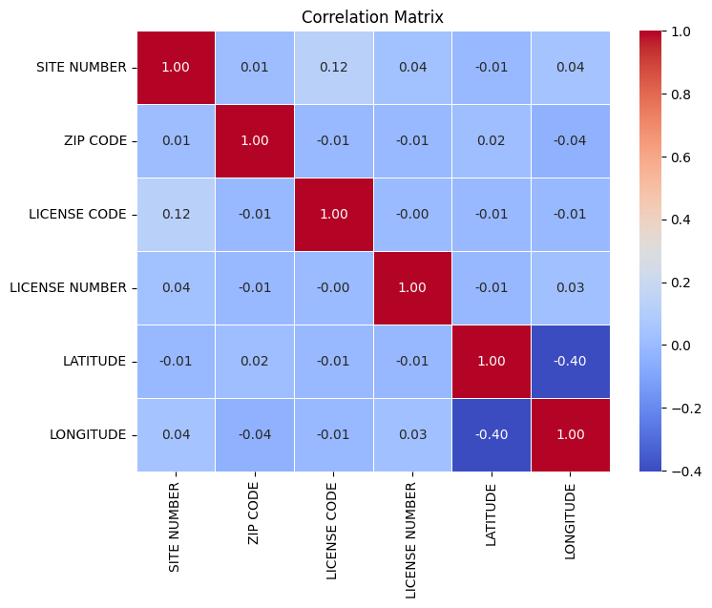
No Correlation was observed between numerical features

Slide 10
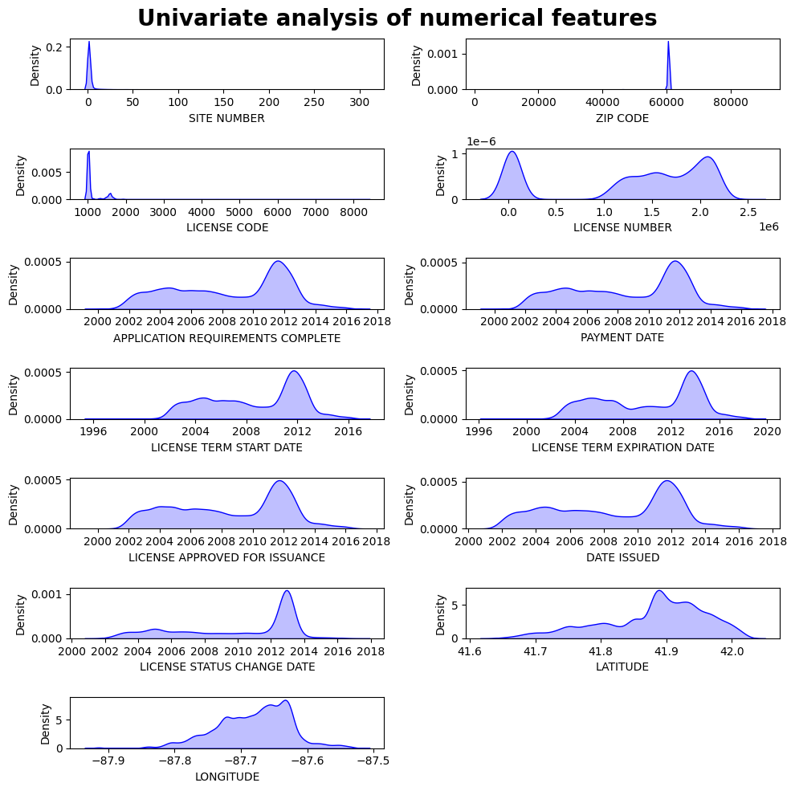
Most of the licenses were approved and issued in 2012.

Slide 11
Key Points
Converted all datetime columns to datetime format and then transformed them to days from epoche.
Detected outliers.
Used oneHotEncoding to convert categorical variables into numeric form.
Making imbalance dataset to balanced
Used lasso regression for feature selection.
Only 3 variables are affecting target variable.
Used Xgboost, Adaboost, Randomforest with crossvalidation techniques like GridsearchCV,Randomized optimization, Bayesian Optimization.

Slide 12
XGBoost and XGBoost with Bayesian Optimization are giving Best results
Model Name | Test Accuracy | F1Score | Precision | Recall
Random Forest_GridsearchCV | 0.804399 | 0.803693 | 0.829906 | 0.805417
AdaBoost Classifier_RandomsearchCV | 0.552223 | 0.466004 | 0.533313 | 0.556377
XGBoost Classfier | 0.938603 | 0.938617 | 0.941492 | 0.938809
XGBoost Classfier_Baye | 0.938603 | 0.941492 | 0.938617 | 0.938809

