Slide 1
Final project: Bookstore
Tokenov Bekzhan, 21B030933

Slide 2
How to use my program?

Slide 3
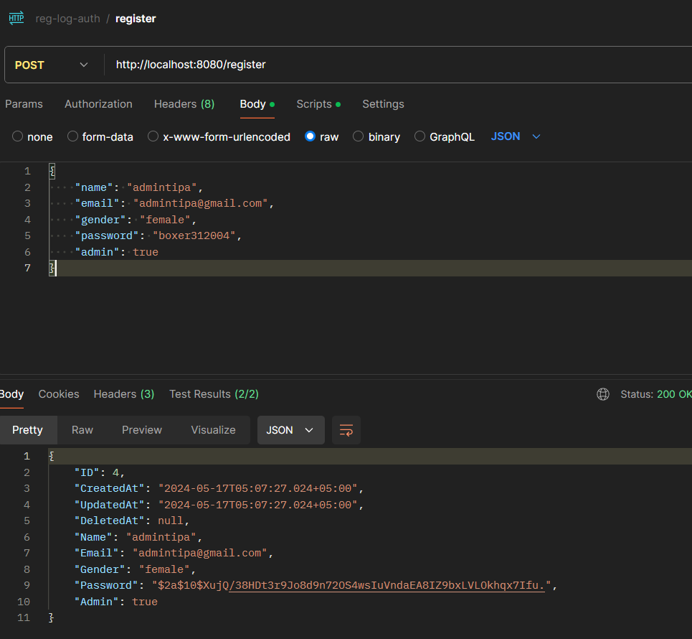
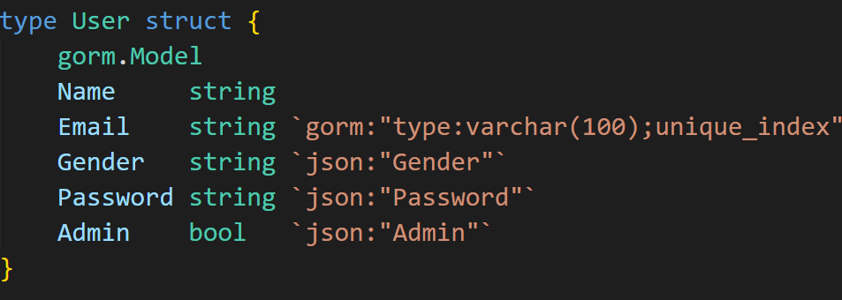
First step: you have to register
This is the model of my user

Slide 4
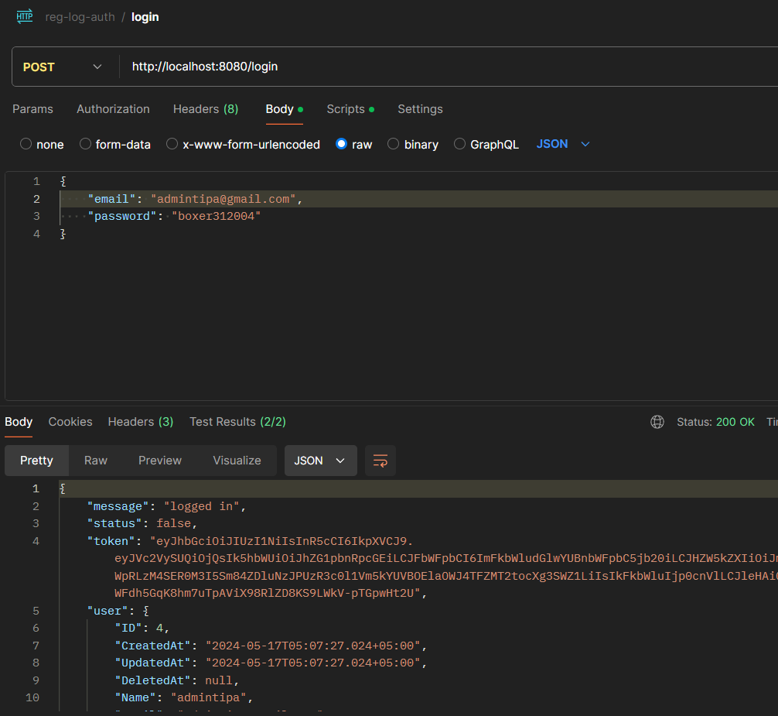
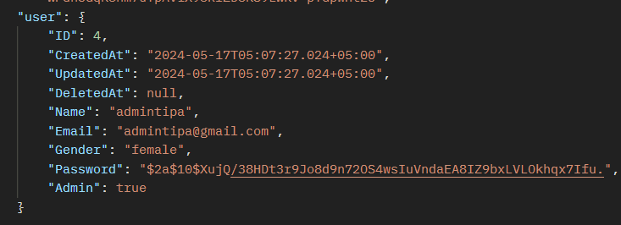
Then you have to login
Password is encrypted

Slide 5
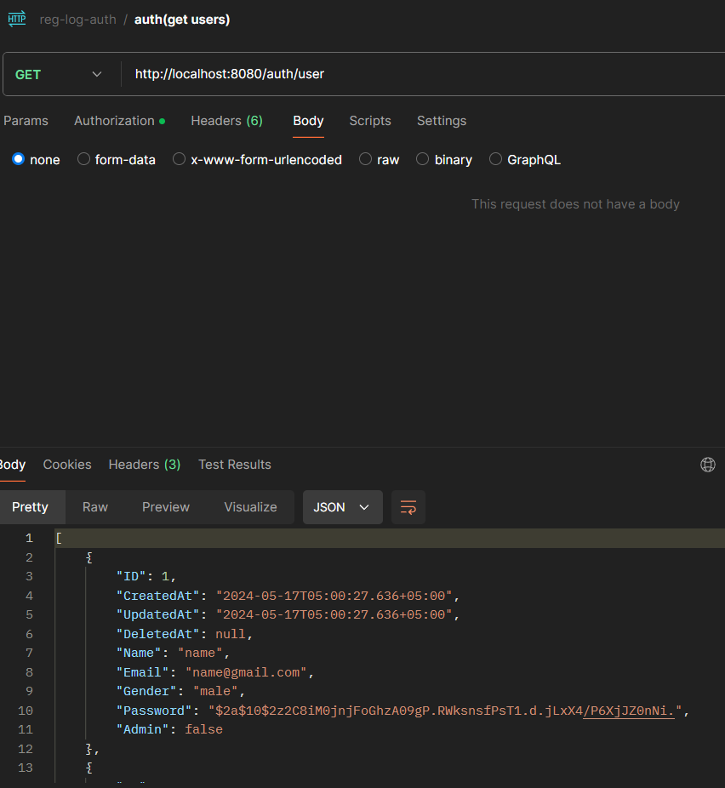
Then you have to auth
Token is inserted automatically

Slide 6
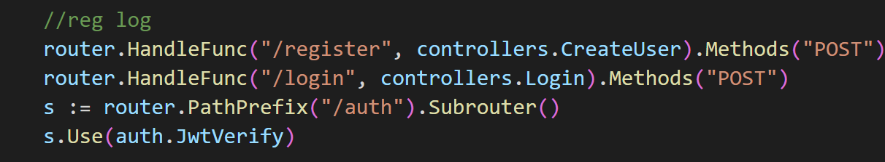

Slide 7
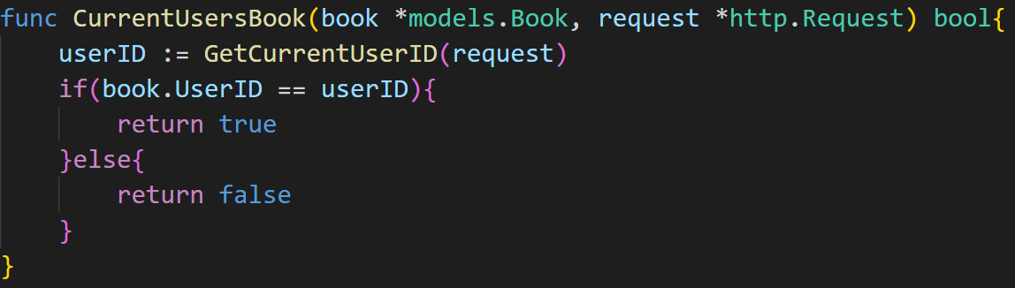
If you are not admin you have access to these
GET users
GET users by id
GET book (pagination, filtering, sorting) | example query when all of these used: db.Preload("User").Preload("Category").Offset(offset).Limit(perPage).Where("price < ?", price).Order(column + " " + order).Find(&books)
GET book by id
CREATE book
UPDATE book (you can update only your own book)
DELETE book (you can delete only your own book)
GET book by category (pagination, filtering sorting)
GET categories
GET categories by id
It checks is this your book or not

Slide 8
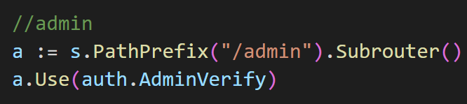
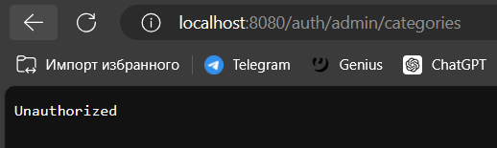
Are you admin or not checked there
If you are not admin

Slide 9
If you are admin you have access to these
GET users
GET users by id
DELETE every user
GET book (pagination, filtering, sorting) | example query when all of these used: db.Preload("User").Preload("Category").Offset(offset).Limit(perPage).Where("price < ?", price).Order(column + " " + order).Find(&books)
GET book by id
CREATE book
UPDATE book (you can update everyone’s book)
DELETE book (you can delete everyone’s book)
GET categories
GET categories by id
CREATE categories
UPDATE categories
DELETE categories

Slide 10
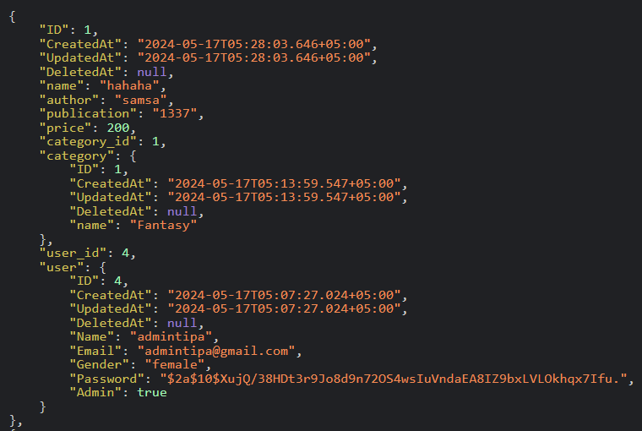
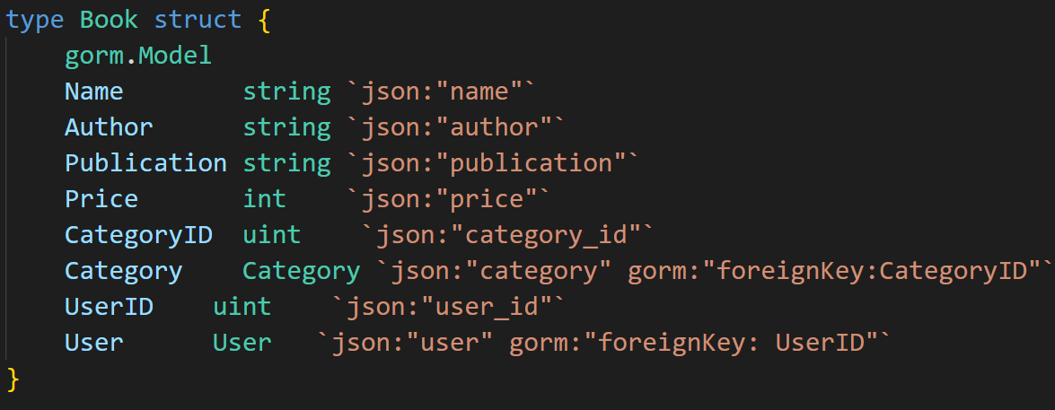
Here is the book model

Slide 11
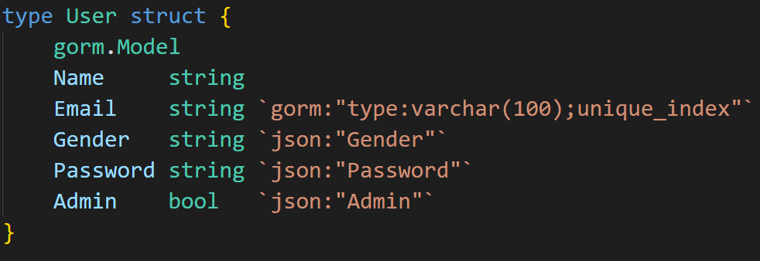
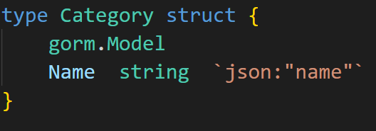
Each book has info about its category and about user that created that book.
One user can have a lot of books, but one book has only one user
One category can have a lot of books, but one book has only one category
User model and category model they have relation between

Slide 12
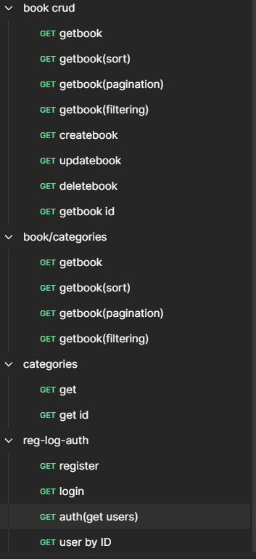
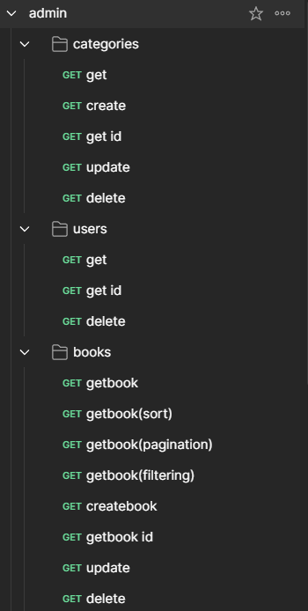
Postman tests:

Slide 13
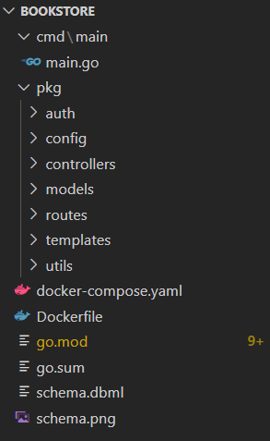
Code quality:

Slide 14
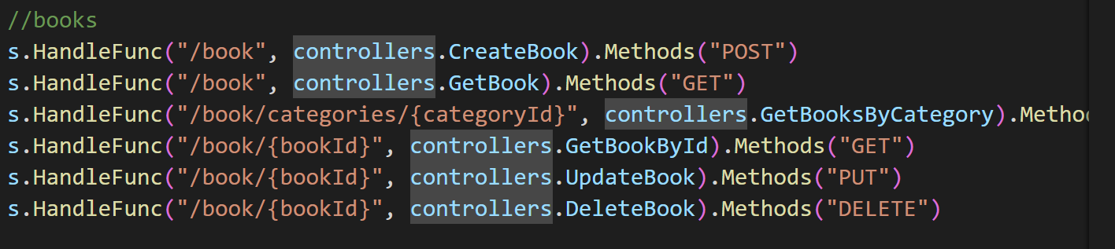
REST architecture style

Slide 15
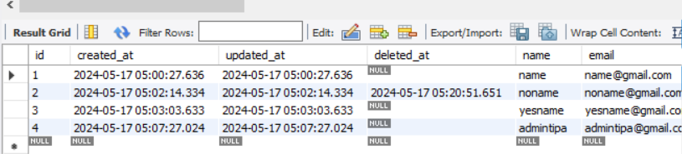
I used GORM and Database is MySQL:

Slide 16
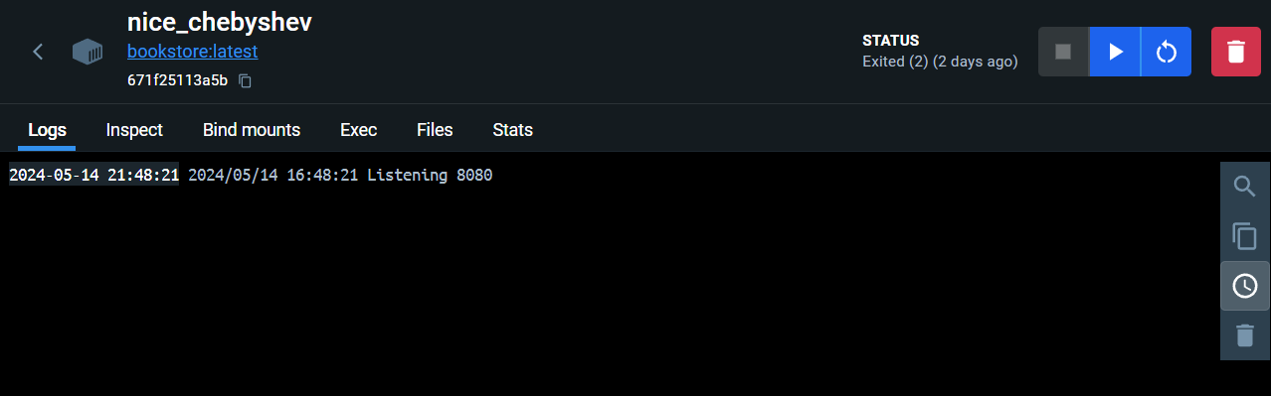
Also I have Docker:

