Slide 1
Canonical Numerical Associations in Linear Trends
Nick Tarantino and Martha W. Alibali

Slide 2
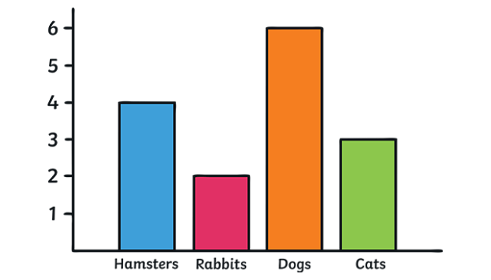
Graphs as Representations
One of the earliest symbolic tools used to depict spatial, temporal, and numerical information (e.g., maps)

Slide 3
Graphs as Representations
One of the earliest symbolic tools used to depict spatial, temporal, and numerical information
Rely on perceptually basic non-symbolic magnitudes to depict this information

Slide 4
Graphs as Representations
One of the earliest symbolic tools used to depict spatial, temporal, and numerical information
Rely on perceptually basic non-symbolic magnitudes to depict this information
So simple, that people without mathematics education and non-human primates can judge trends in graphs

Slide 5
Which data set has a positive correlation?
Data Set A
Data Set B
x | y
1 | 7.23
2 | 4.32
3 | 5.98
4 | 9.42
5 | 6.29
6 | 10.11
7 | 5.34
8 | 12.98
9 | 7.09
10 | 10.65
x | y
1 | 6.89
2 | 13.8
3 | 8.45
4 | 9.82
5 | 5.71
6 | 9.32
7 | 7.33
8 | 10.5
9 | 3.12
10 | 5.11

Slide 6
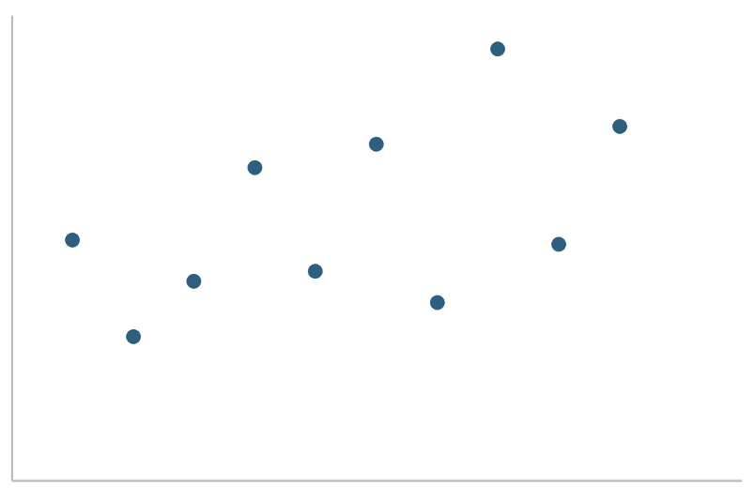
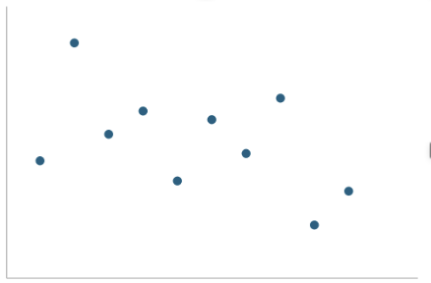
Which data set has a positive correlation?
Data Set A
Data Set A
Data Set B
x | y
1 | 7.23
2 | 4.32
3 | 5.98
4 | 9.42
5 | 6.29
6 | 10.11
7 | 5.34
8 | 12.98
9 | 7.09
10 | 10.65
x | y
1 | 6.89
2 | 13.8
3 | 8.45
4 | 9.82
5 | 5.71
6 | 9.32
7 | 7.33
8 | 10.5
9 | 3.12
10 | 5.11
Data Set B

Slide 7
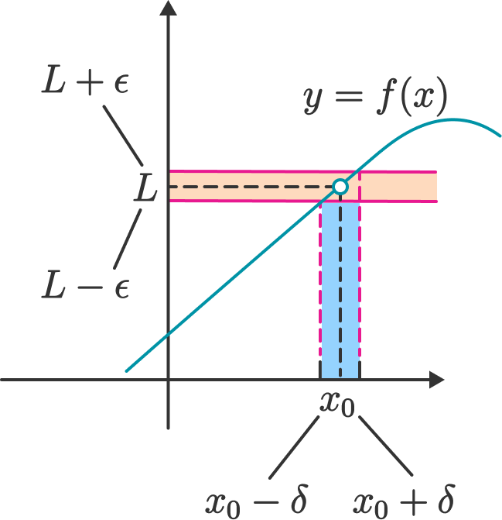
Graphs
Despite their simplicity, graphs facilitate highly complex mathematical thinking

Slide 8
Graphs
Despite their simplicity, graphs facilitate highly complex mathematical thinking
Does this basic perception of graphs still activate quantitative representations?
Such as number

Slide 9
Are there canonical associations between numerosity and linear trends in simple dot arrays?
The number of points is automatically perceived when judging trends in graphs (Ciccione et al., 2023)

Slide 10
Are there canonical associations between numerosity and linear trends in simple dot arrays?
The number of points is automatically perceived when judging trends in graphs (Ciccione et al., 2023)
Numerous arrays may be associated with increasing trends and sparse arrays with decreasing trends

Slide 11
Are there canonical associations between numerosity and linear trends in simple dot arrays?
The number of points is automatically perceived when judging trends in graphs (Ciccione et al., 2023)
Numerous arrays may be associated with increasing trends and sparse arrays with decreasing trends
If performance differs as a function of this putative congruency then participants must be recruiting these abstract associations

Slide 12
Are there canonical associations between numerosity and linear trends in simple dot arrays?
The number of points is automatically perceived when judging trends in graphs (Ciccione et al., 2023)
Numerous arrays may be associated with increasing trends and sparse arrays with decreasing trends
If performance differs as a function of this putative congruency then participants must be recruiting these abstract associations
Should appear when judging trend not number because trend is irrelevant to judgements of number

Slide 13
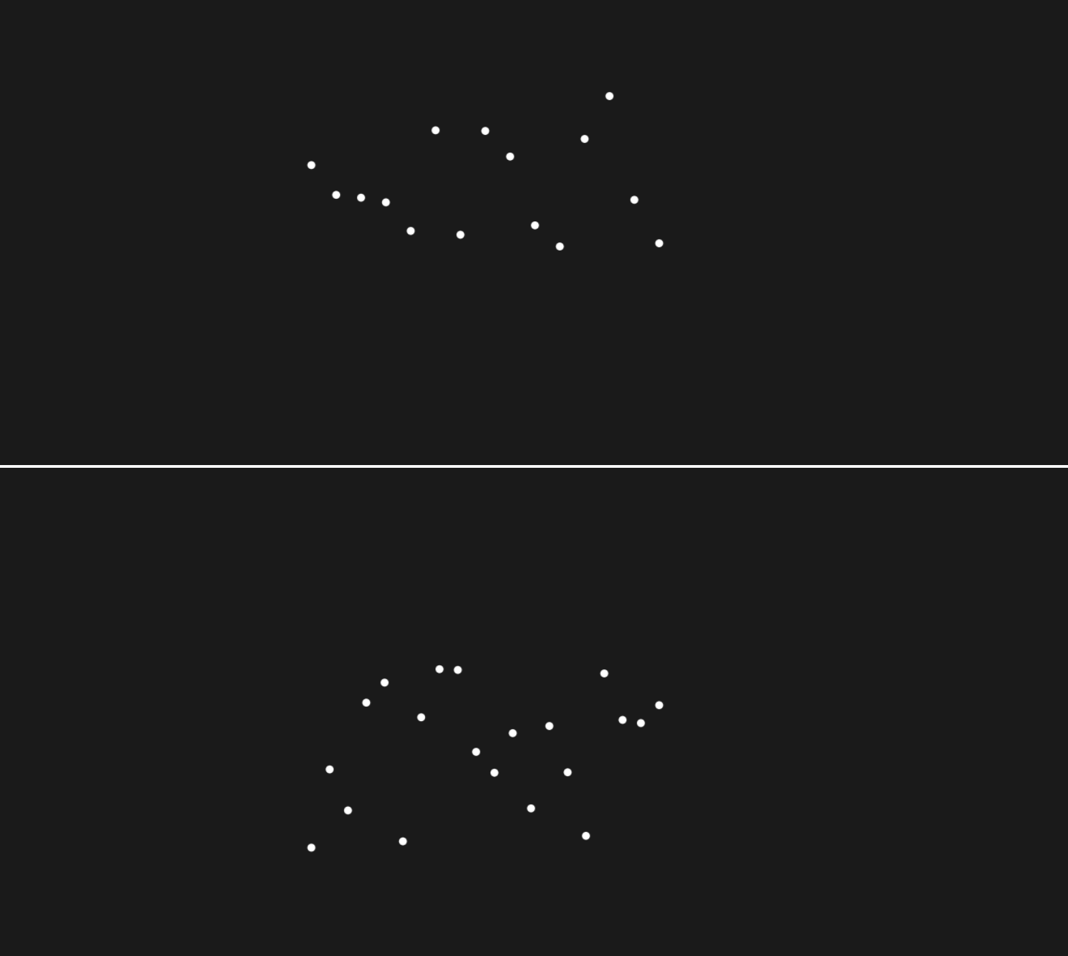
Method
82 undergraduates compared dot arrays online
Trend and Number task between-subjects
Arrays had few (8-14) or many (15-22) points with increasing or decreasing trends
Task: Compare bottom array to top neutral array with 0 trend and 15 points
Use P and Q to indicate if the trend of array on bottom is (increasing/decreasing) or (more/less numerous) compared to top

Slide 14
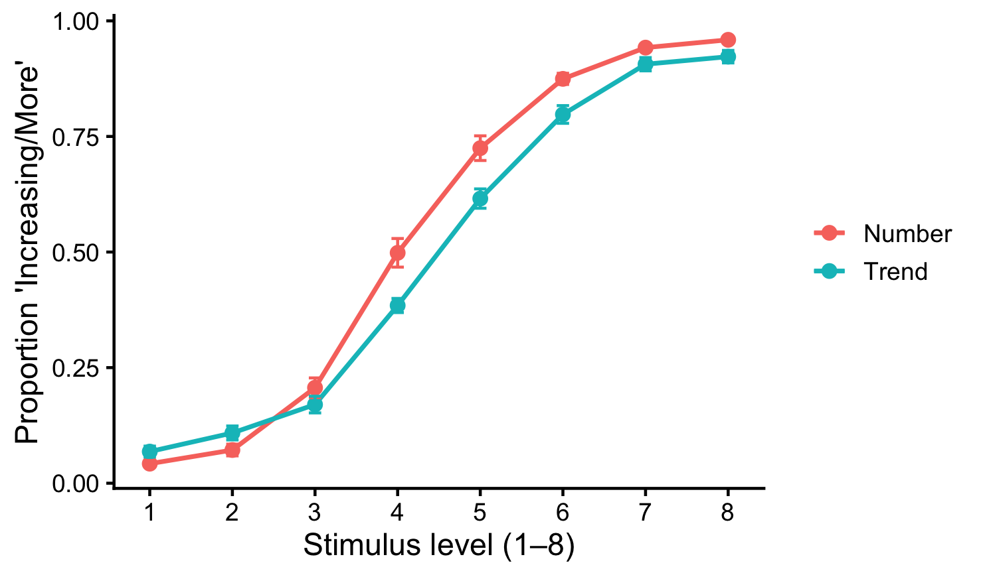
Results
Similar sensitivity to features in both tasks

Slide 15
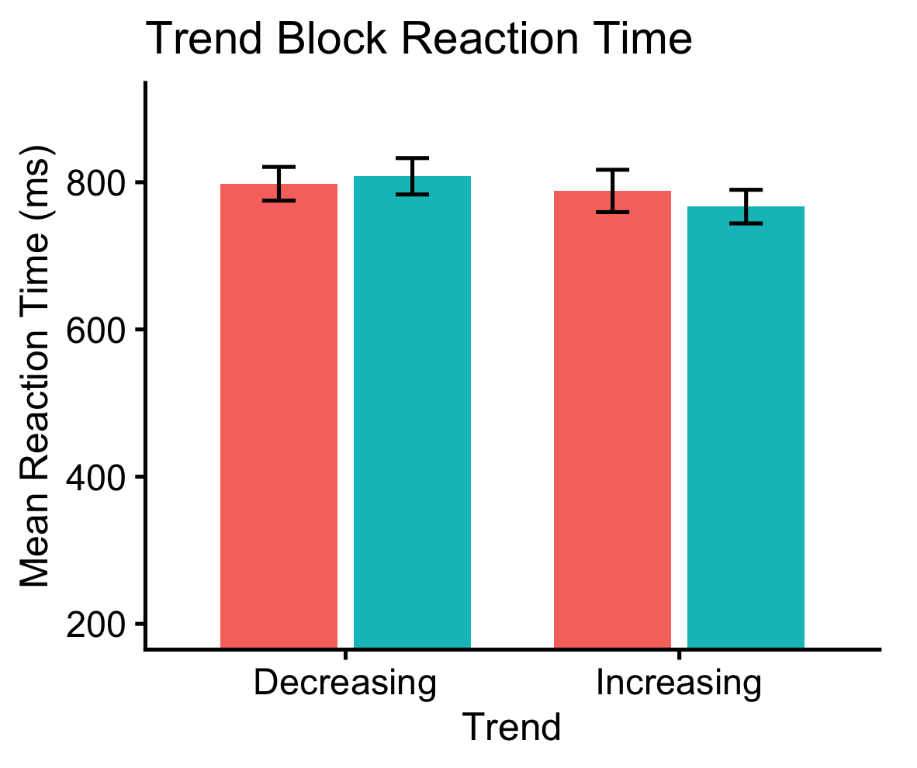
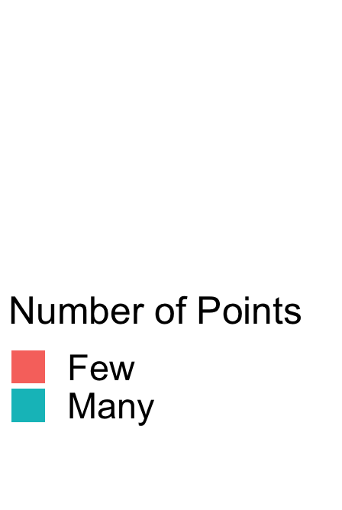
Does numerosity of an array influence judgments of its trend depending on direction?
More numerosity reduced reaction time for increasing trends but not for decreasing trends
(b = −0.034, SE = 0.011, z = −3.13, p = .0017)
ns
**

Slide 16
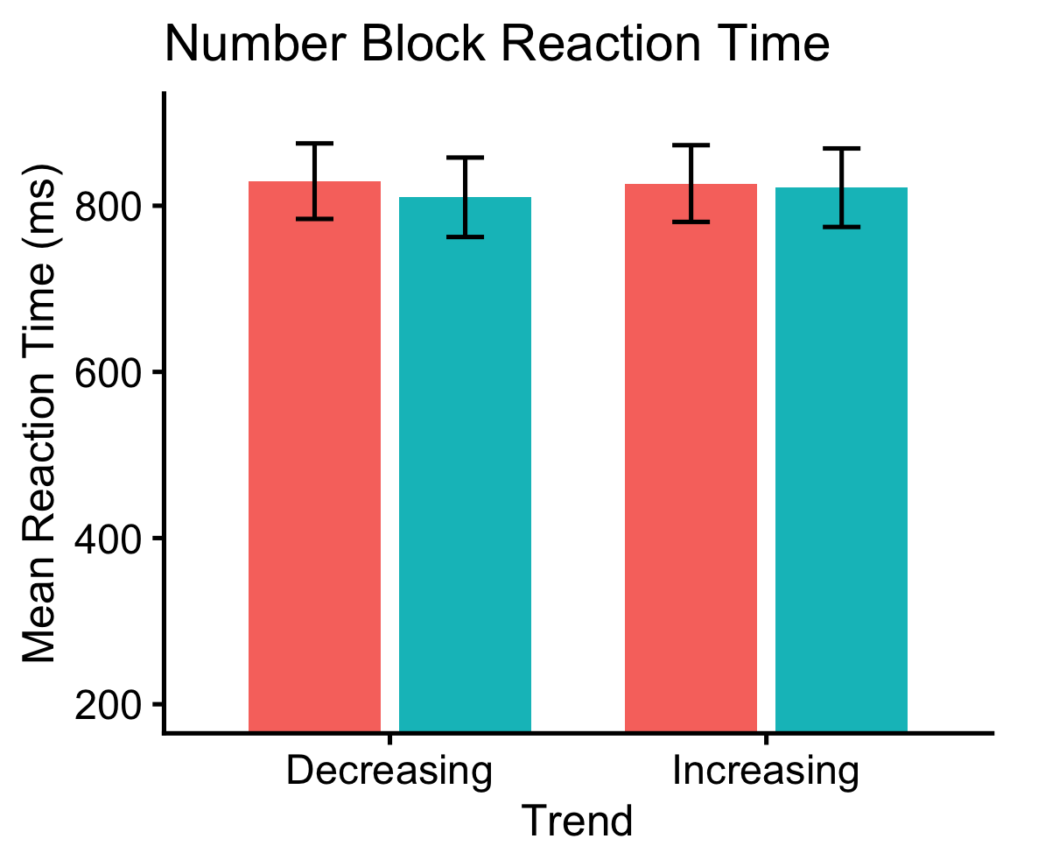
Does trend influence judgements of numerosity?
Trend had no influence on judgements of numerosity
(b = 0.002, SE = 0.001, z = 1.66, p = .098)
ns
ns

Slide 17
How might judging trend elicit associations with number?
Larger magnitudes are judged more accurately when they occur later in time
Temporal relations may serve as an analogy for graphs depicting spatial relations (where time becomes the x-axis)
Therefore, more numerous sets which contain more events might be perceived as further along this dimension and thus may be easier to represent as increasing
Further research is needed to elucidate the nature of this effect

Slide 18
Conclusions
Numerosity and the linear trend of an array have canonical associations
Very simple quasi-graphical stimuli elicit these abstract representations of numerical magnitude and relations thereof
Those studying graphical perception should consider that tasks which need not implicate mathematical thinking still might
Those studying the basic processing of ordinality and magnitude relations should look to graph perception for analogous biases

