Slide 1
Canonical Numerical Associations in Linear Trends
Nick R. Tarantino and Martha W. Alibali

Slide 2
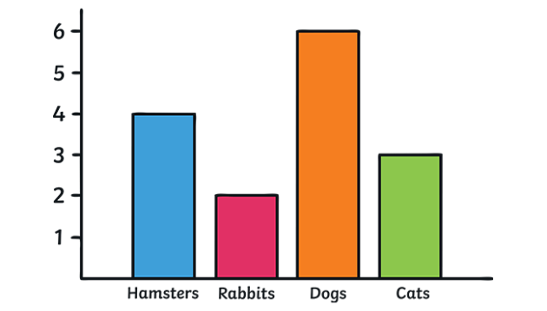
Graphs as Representations
One of the earliest symbolic tools used to depict spatial, temporal, and numerical information (Clarke, 2013)

Slide 3
Graphs as Representations
One of the earliest symbolic tools used to depict spatial, temporal, and numerical information (Clarke, 2013)
Rely on perceptually basic non-symbolic magnitudes to depict this information

Slide 4
Graphs as Representations
One of the earliest symbolic tools used to depict spatial, temporal, and numerical information (Clarke, 2013)
Rely on perceptually basic non-symbolic magnitudes to depict this information
So simple that people without mathematics education and non-human primates can judge trends in graphs (Ciccione et al., 2023; Ciccione et al., 2025)

Slide 5
Which data set has a positive trend?
Data Set A
Data Set B
x | y
1 | 7.23
2 | 4.32
3 | 5.98
4 | 9.42
5 | 6.29
6 | 10.11
7 | 5.34
8 | 12.98
9 | 7.09
10 | 10.65
x | y
1 | 6.89
2 | 13.8
3 | 8.45
4 | 9.82
5 | 5.71
6 | 9.32
7 | 7.33
8 | 10.5
9 | 3.12
10 | 5.11

Slide 6
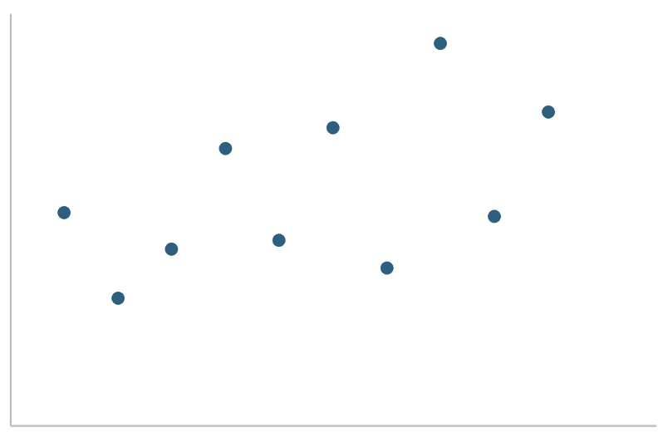
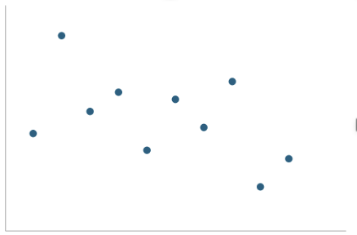
Which data set has a positive trend?
Data Set A
Data Set A
Data Set B
x | y
1 | 7.23
2 | 4.32
3 | 5.98
4 | 9.42
5 | 6.29
6 | 10.11
7 | 5.34
8 | 12.98
9 | 7.09
10 | 10.65
x | y
1 | 6.89
2 | 13.8
3 | 8.45
4 | 9.82
5 | 5.71
6 | 9.32
7 | 7.33
8 | 10.5
9 | 3.12
10 | 5.11
Data Set B

Slide 7
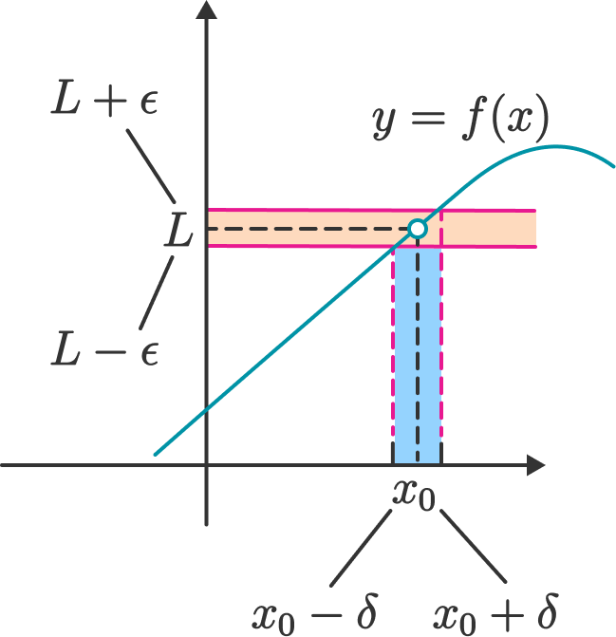
Graphs as Representations
Despite their simplicity, graphs facilitate highly complex mathematical thinking

Slide 8
Graphs as Representations
Despite their simplicity, graphs facilitate highly complex mathematical thinking
Does this basic perception of graphs still activate quantitative representations?
Such as number

Slide 9
Spatial Numerical Associations
People associate non-numerical magnitudes, like physical size, with numerical magnitudes
When these features are incongruent, judgments about those features are slowed and less accurate
3 7 3 7
Congruent
Incongruent
Congruent = The font size and the numerical size match
Incongruent = The font size and numerical size are reversed
(Henik & Tzelgov, 1982)

Slide 10
Does the basic perception of trend still activate quantitative representations?
Numerous arrays may be associated with increasing trends, and sparse arrays with decreasing trends

Slide 11
Does the basic perception of trend still activate quantitative representations?
Numerous arrays may be associated with increasing trends, and sparse arrays with decreasing trends
People assess the number of data points when judging trends in graphs (Ciccione et al., 2023)
The reverse is not true: the trend of an array is irrelevant to judging its numerosity

Slide 12
Does the basic perception of trend still activate quantitative representations?
Numerous arrays may be associated with increasing trends, and sparse arrays with decreasing trends
People assess the number of data points when judging trends in graphs (Ciccione et al., 2023)
The reverse is not true: the trend of an array is irrelevant to judging its numerosity
Does performance differ as a function of this putative congruency?

Slide 13
Research Questions
Does the numerosity of an array influence judgments of its trend, depending on trend direction?
Increasing trends will be perceived faster in numerous arrays than in sparse arrays
Decreasing trends will be perceived faster in sparse arrays than in numerous arrays

Slide 14
Research Questions
Does the numerosity of an array influence judgments of its trend, depending on trend direction?
Increasing trends will be perceived faster in numerous arrays than in sparse arrays
Decreasing trends will be perceived faster in sparse arrays than in numerous arrays
Does the trend of an array influence judgments of its numerosity?
Trend should have no effect on judgments of numerosity

Slide 15
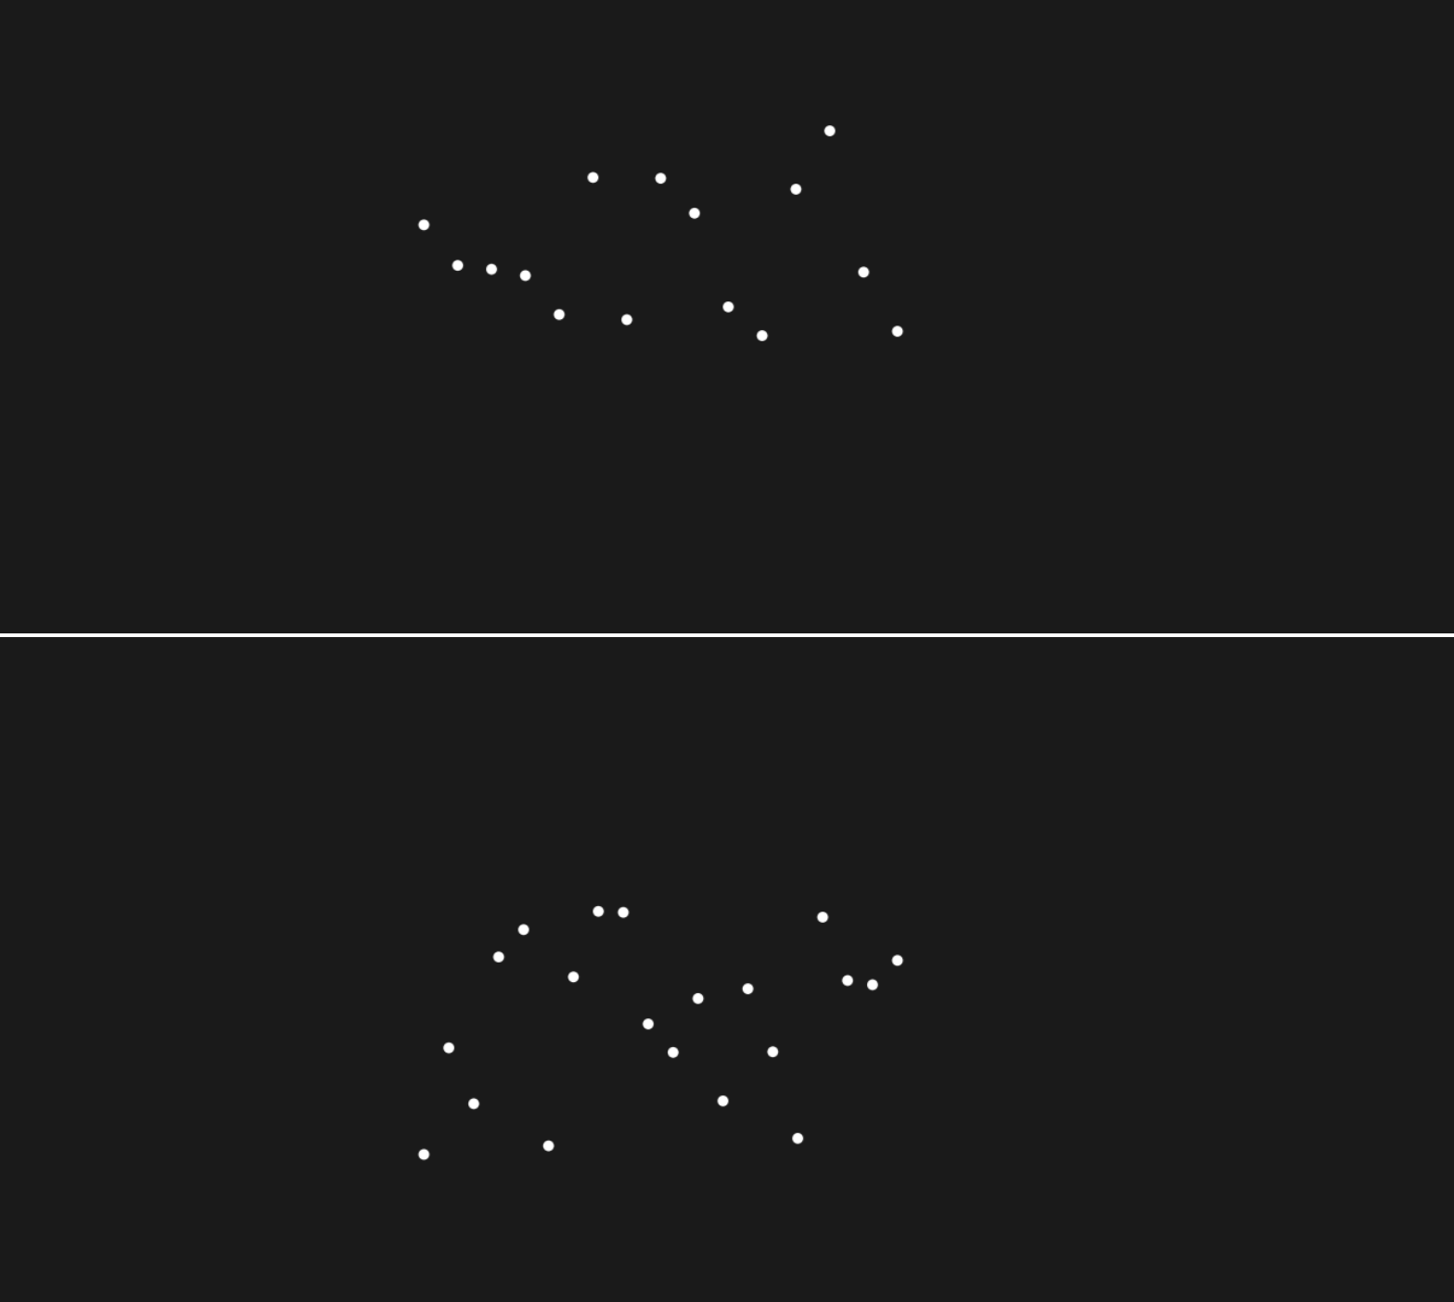
Method
82 undergraduates compared dot arrays online
Participants either completed a trend judgment or a numerosity judgment task
Arrays had few (8-14) or many (16-22) points with increasing or decreasing trends
Task: Compare bottom array to top neutral array with 0 trend and 15 points

Slide 16
Trend Task
If the bottom dot array's trend is increasing compared to the array on top, press Q; if it is decreasing, press P.

Slide 17
Numerosity Task
If the bottom dot array has more dots than the array on top press P; if it has fewer press Q.

Slide 18
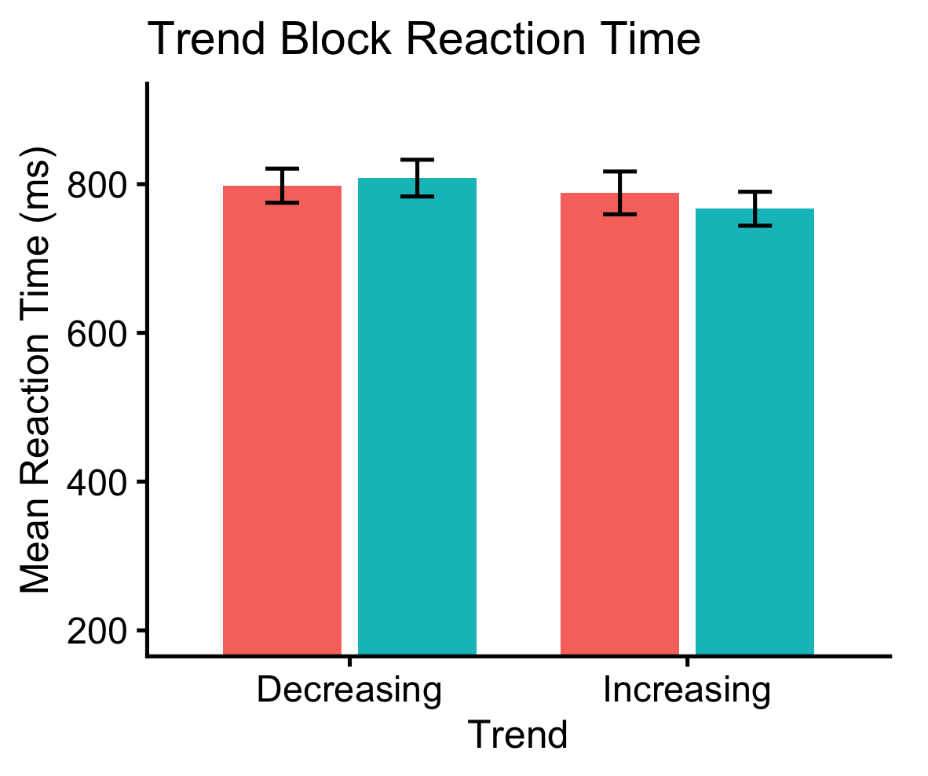
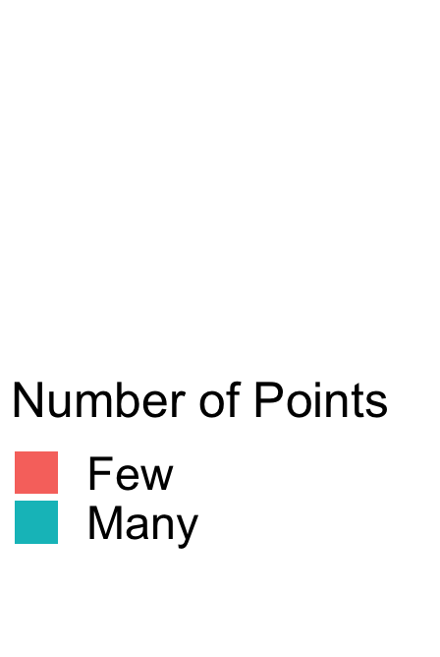
Does the numerosity of an array influence judgments of its trend?
Participants were faster at judging increasing arrays that were numerous compared to sparse ones
This effect differed for decreasing arrays
(b = −0.034, SE = 0.011, z = −3.13, p = .0017)
ns
**
Congruent
Incongruent
Incongruent
Congruent

Slide 19
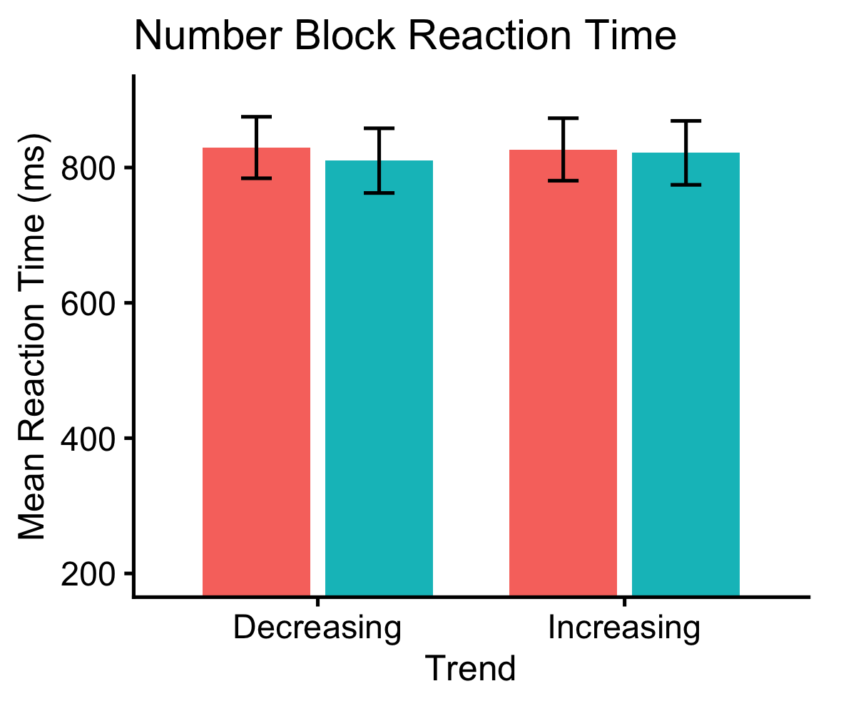
Does trend influence judgments of numerosity?
Trend had no influence on judgments of numerosity
(b = 0.002, SE = 0.001, z = 1.66, p = .098)
ns
ns

Slide 20
Conclusions
The numerosity and linear trend of an array have canonical associations
Very simple quasi-graphical stimuli elicit these abstract representations of numerical magnitude
Tasks that do not need to implicate mathematical thinking still might
Biases in graph perception might be explained by biases observed in the basic processing of magnitude and ordinality
This study further urges the investigation of graphs as tools for thinking

