Slide 1
Analyze Real Estate Investment Locations

Slide 2
Business Problem
Toronto as a dynamic metropolis with strong economy
Potential to rent high standard appartments to wealthy customers
Target group consists of private and commercial investors willing to buy real estate in Toronto

Slide 3
Data Sources
Toronto Crime Data: Major Crime Indicators (MCI) from the years 2014 to 2018http://data.torontopolice.on.ca
Demographic Data: Information about the neighborhoods in Toronto like average income or density https://open.toronto.ca/dataset/neighbourhood-profiles
Venue Data: Foursquare API https://developer.foursquare.com

Slide 4
Data Wrangling
Instead of single incidents use total number of crimes per neighborhood
Unify neighborhood names in different datasets
Drop unused data
Merge datasets
Add Latitudes and Longitudes (Nomatim)
Fetch venue data for each neighborhood

Slide 5
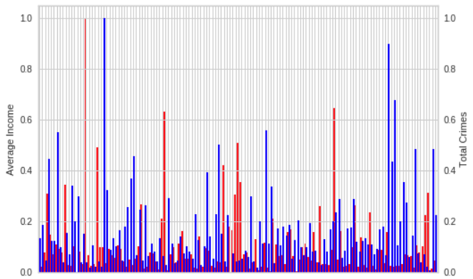
Exploratory Analysis I
Distribution of incomes and crime rates across neighborhoods

Slide 6
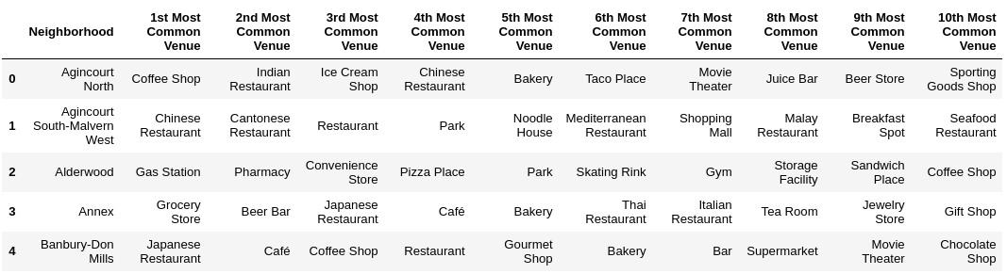
Exploratory Analysis II
Explore top venues of neighborhoods (example)

Slide 7
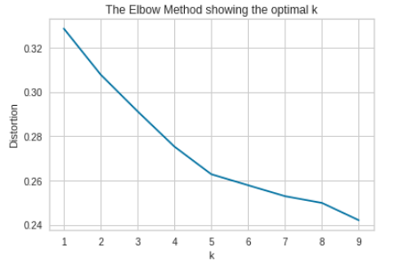
K-Means Clustering
Segmentation of neighborhoods
Start with elbow method

Slide 8
K-Means Clustering
Result of K-Means with K=5
Cluster 1: High crime rate, low income, mid to low density and lot of lower priced food venues. Located mainly north-west and east of center.
Cluster 2: Moderate crime rate, low income, mid to low density and mostly food and recreational venues (parks etc.). Spread across city excluding the center.
Cluster 3: Low crime rate, high income, low density, more exclusive food and recreational venues (Sushi, Spa etc.) and some expensive stores. Located west and in the middle of town.
Cluster 4: High crime rate, mid income, high density and a lot of cafés and coffee shops as well food venues. Located near the waterfront in the very center of the town.
Cluster 5: Mixed crime rate and mixed income, high density. Mainly food venues. Located in the center.

Slide 9
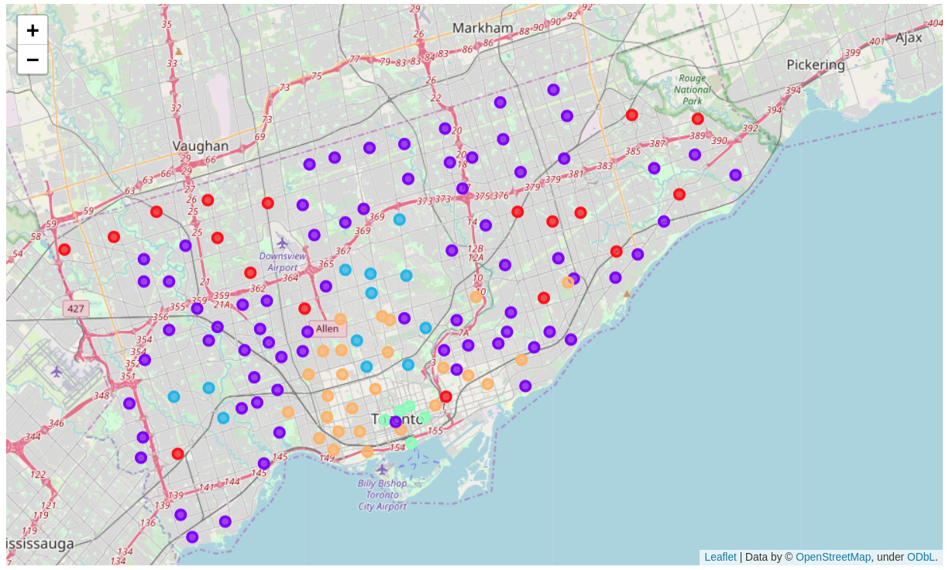
Results
Clusters 3 and 5 seem to be promosing (orange and blue)

Slide 10
Conclusion / Future Directions
Two of five clusters seem to be promising for investments
Some of the used data relativly old (2016)
Data for real estate price trends missing
Further analysis with more data needed

