Slide 1
Simplified Model of an X-ray Horizon Crossing
Physics 304 Final Project
Nathaniel Ruhl
Haverford College
Notes:
The goal of this simplified model is to provide good physical insight into the horizon crossing and to provide insight into the numerical methods in the full, unsimplified analysis.

Slide 2
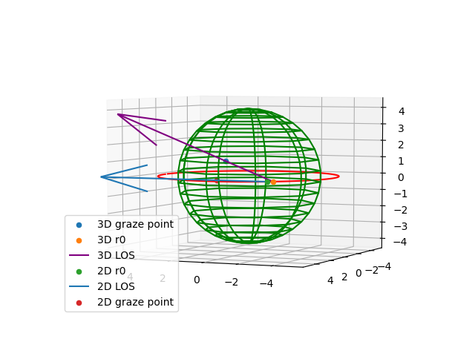
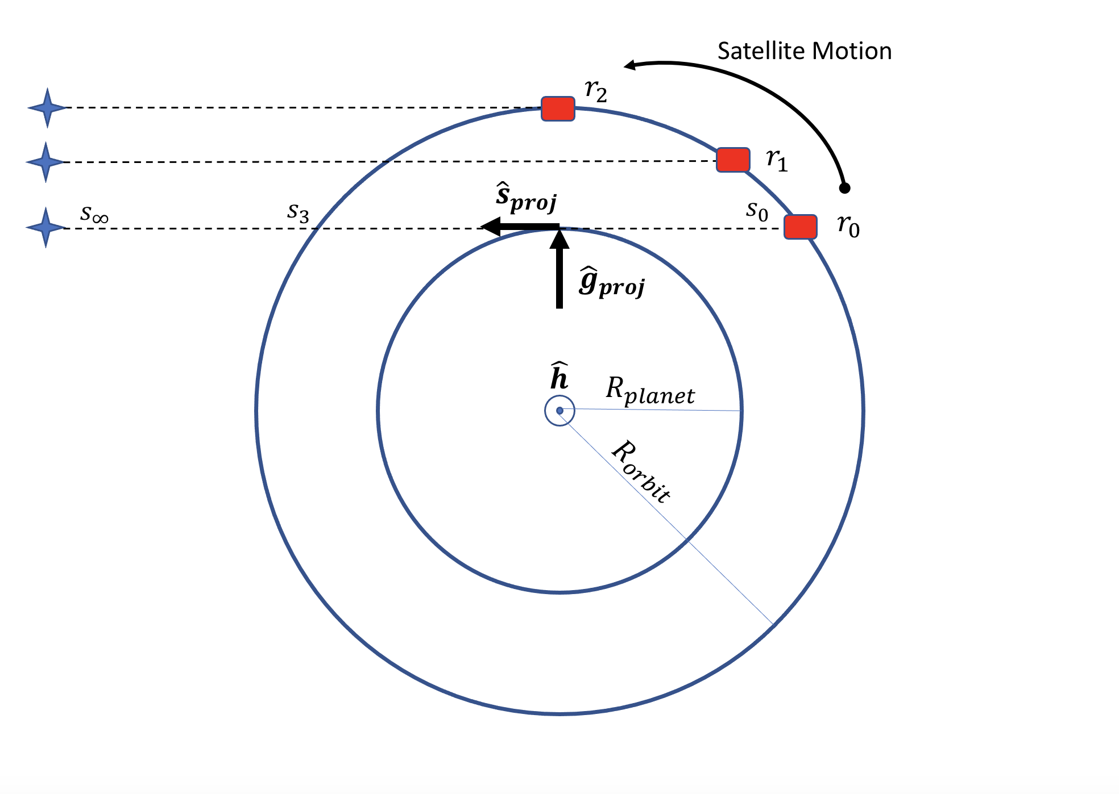
Horizon Crossing Geometry
We consider a “two-dimensional” horizon crossing where the source is “in” the plane of the orbit
Notes:
A horizon crossing is an occultation, which is the event in which a telescope aboard a satellite looks over Earth’s horizon towards star.
For a planet with an atmosphere like Earth, the X-rays will gradually come in over time (as compared to the moon).

Slide 3
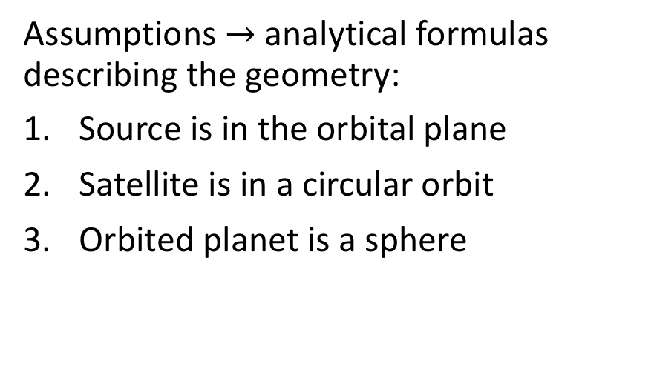
Simplified horizon crossing geometry
Assumptions $→$ analytical formulas describing the geometry:
Source is in the orbital plane
Satellite is in a circular orbit
Orbited planet is a sphere
*This is known in remote sensing as a “limb-looking geometry”

Slide 4
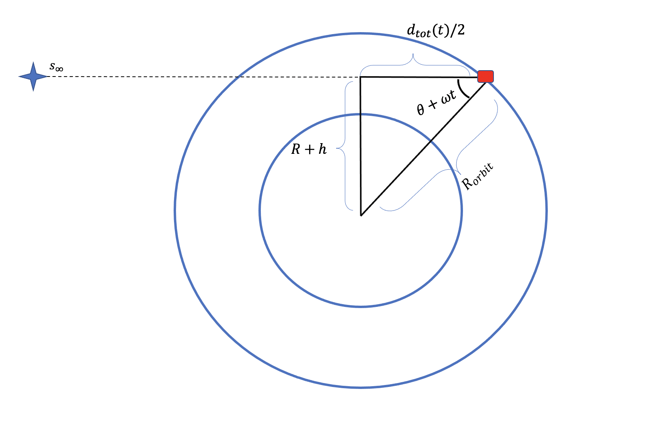
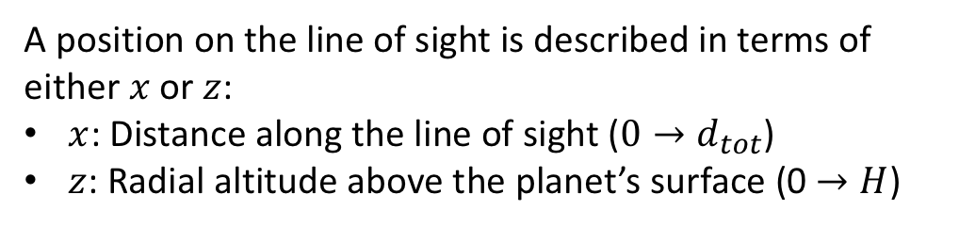
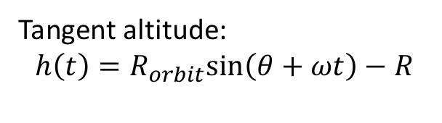
Simplified limb-looking geometry
Tangent altitude:
$$h\left(t\right)=R_{orbit}sin\left(θ+ωt\right)−R$$
A position on the line of sight is described in terms of either $x$ or $z$:
$x$: Distance along the line of sight ($0→d_{tot}$)
$z$: Radial altitude above the planet’s surface (0 $→H$)

Slide 5
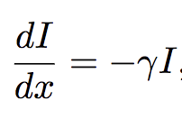
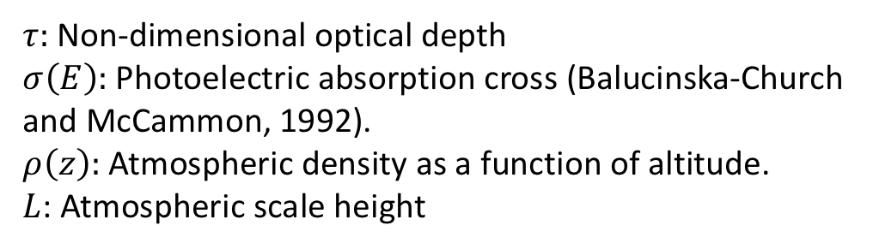
X-ray Absorption in Planetary Atmospheres
The “Radiative Transfer Equation” can be written as
The solution is known as “Beer’s Law”:
Transmittance along the entire line of sight:
$τ:$ Non-dimensional optical depth
$σ\left(E\right):$ Photoelectric absorption cross (Balucinska-Church and McCammon, 1992).
$ρ\left(z\right):$ Atmospheric density as a function of altitude.
$L$: Atmospheric scale height
“Soft” X-rays (1-10 keV) are solely absorbed by atmospheric constituents. Scattering is negligible.
Notes:
Stars can often be assumed to be point sources, but it is particularly true for X-rays, which are not dispersed in the ISM.
Think of delta x as the width of the medium with normal parallel to radiation travel direction.
Gamma is an interaction coefficient, constant along delta x. Absorption of soft X-rays is highly predictable because gamma is only dependent on the photoelectric absorption cross section, as well as atmospheric density.

Slide 6
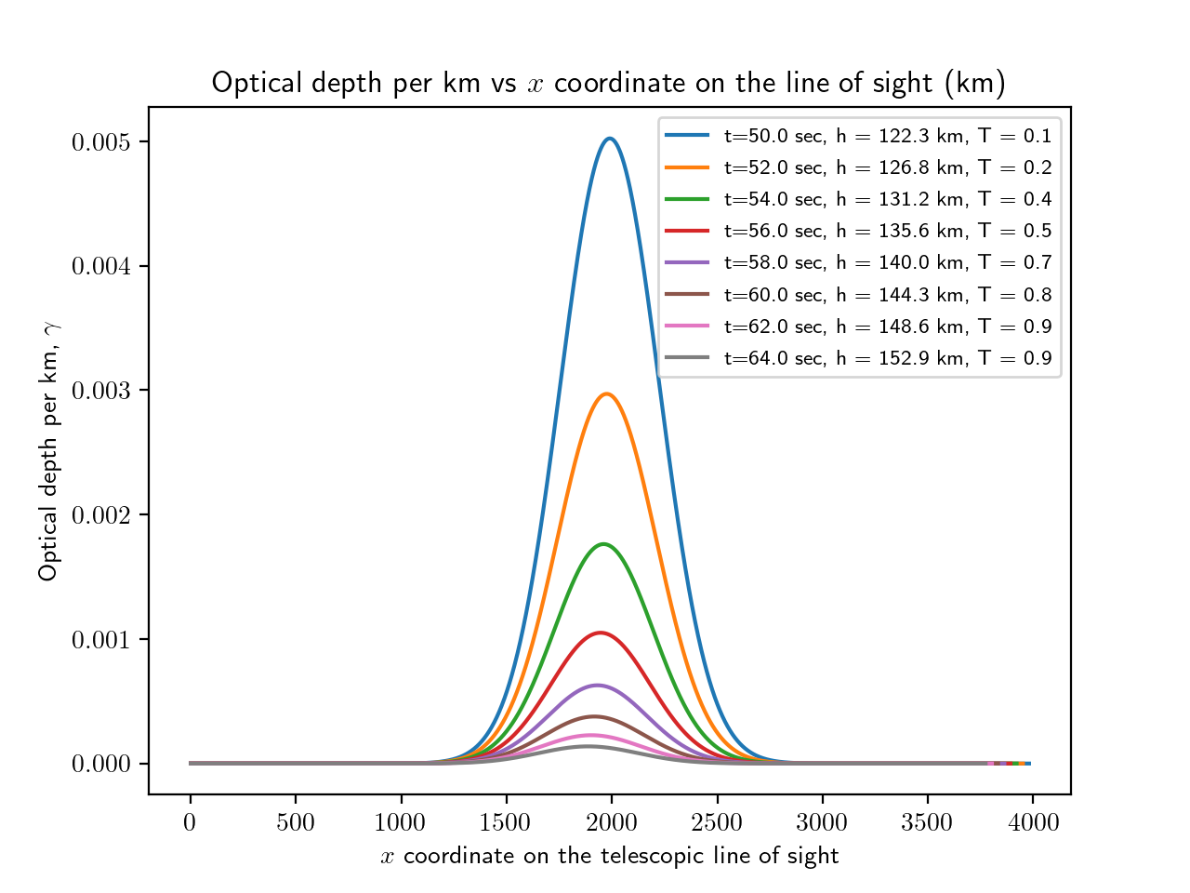
Motivation for numerical integration with adaptive step sizes
Smallest step sizes are needed near the middle of the telescopic line of sight
Optical Depth:

Slide 7
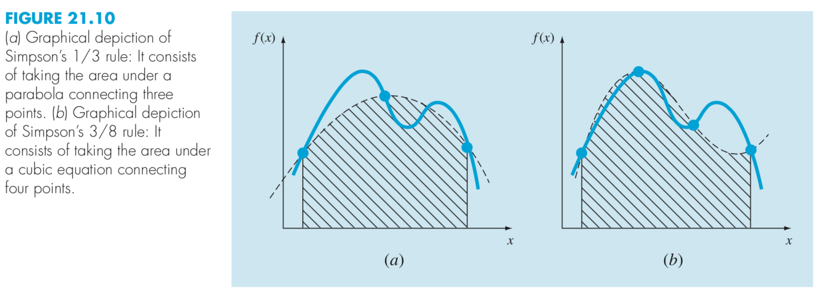
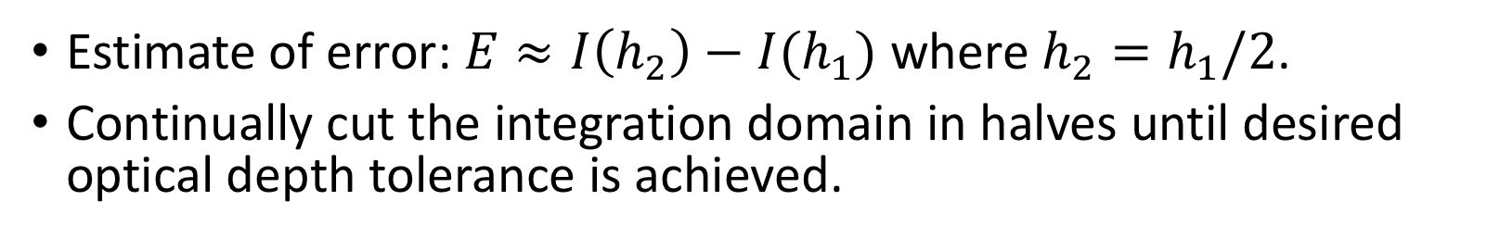
Adaptive Quadrature (Simpson’s Rule)
Chapra and Canale, 2013 [8]
Estimate of error: $E≈I\left(h_{2}\right)−I(h_{1})$ where $h_{2}=h_{1}/2$.
Continually cut the integration domain in halves until desired optical depth tolerance is achieved.

Slide 8
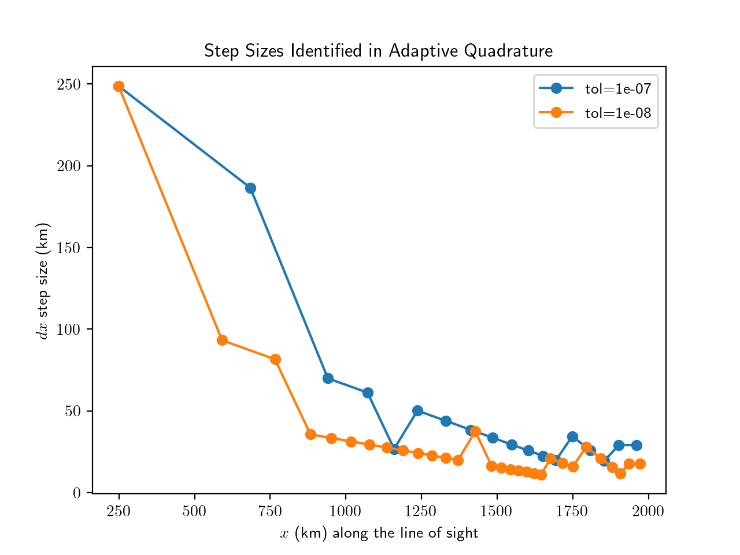
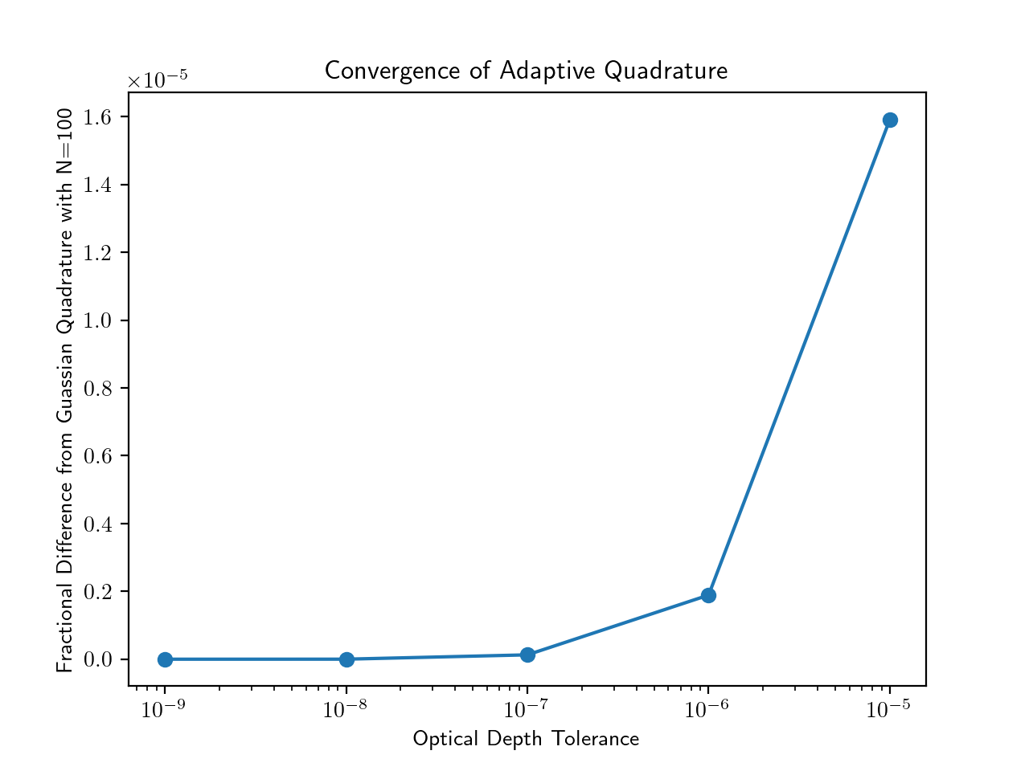
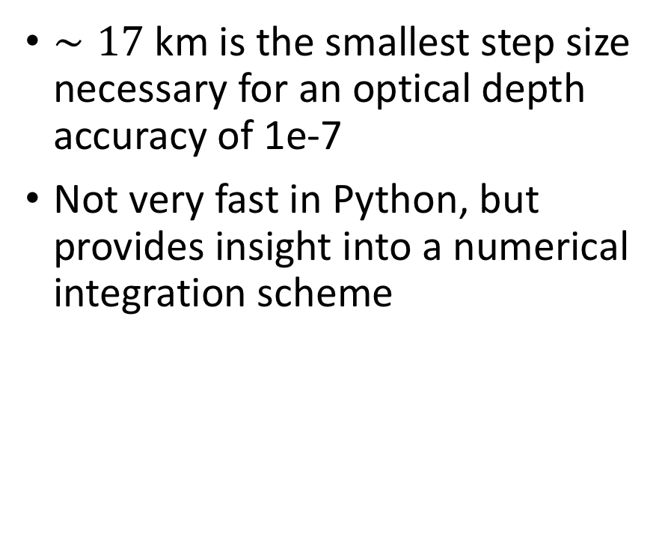
Results of Adaptive Quadrature
$∼17$km is the smallest step size necessary for an optical depth accuracy of 1e-7
Not very fast in Python, but provides insight into a numerical integration scheme
The “standard LEO” used in this paper is a circular low-Earth orbit with an altitude of 420 km.
Notes:
This seemed to be numerical precision for Python/MacOS, which we will see on the next slide

Slide 9
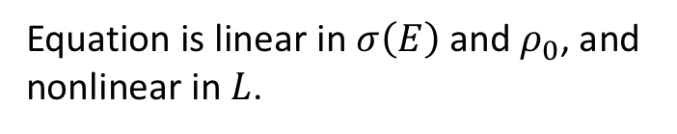
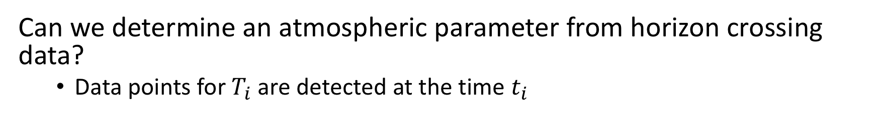
Atmospheric Science Problem
Can we determine an atmospheric parameter from horizon crossing data?
Data points for $T_{i}$ are detected at the time $t_{i}$
Equation is linear in $σ\left(E\right)$ and $ρ_{0}$, and nonlinear in $L$.

Slide 10
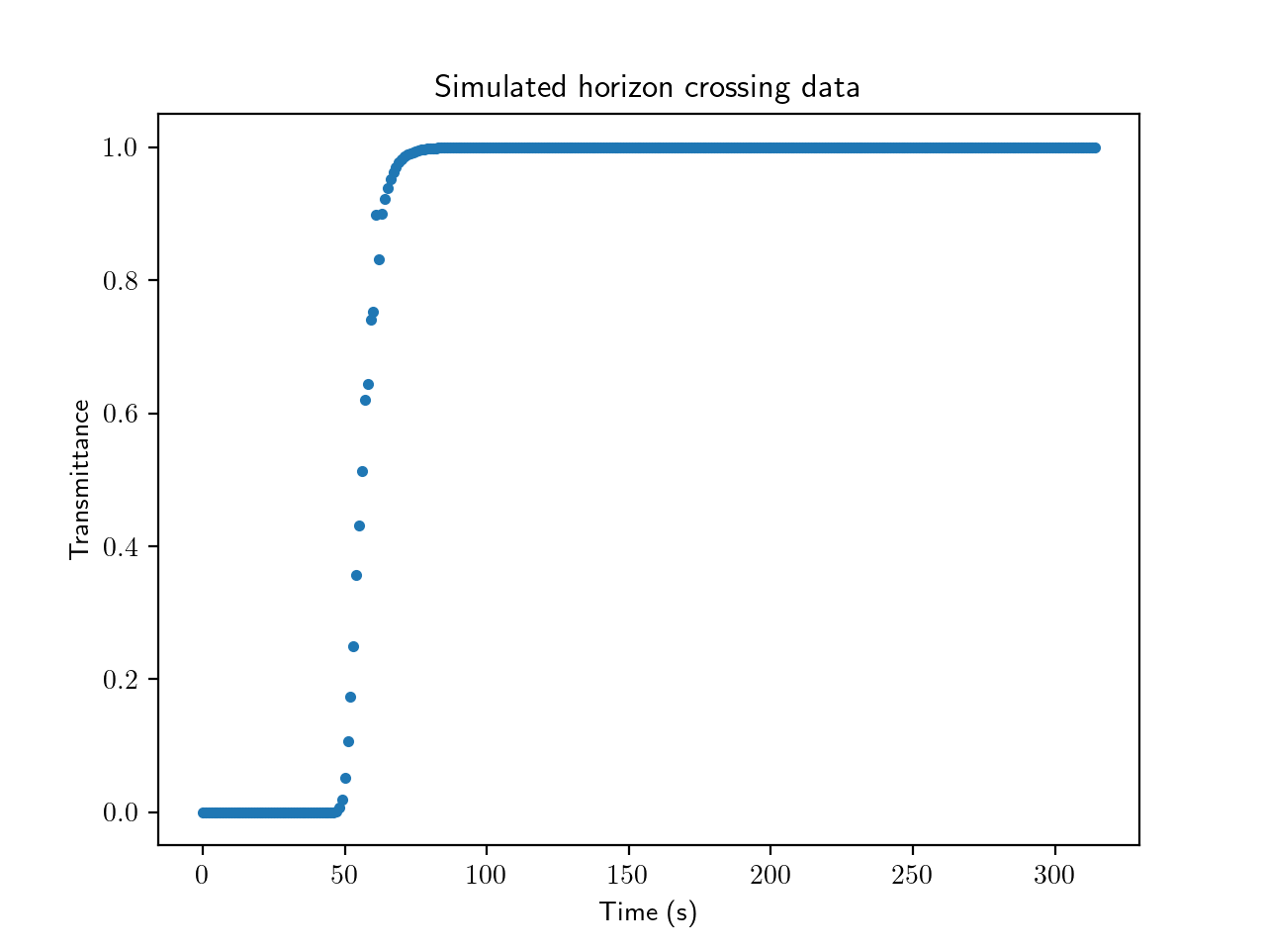
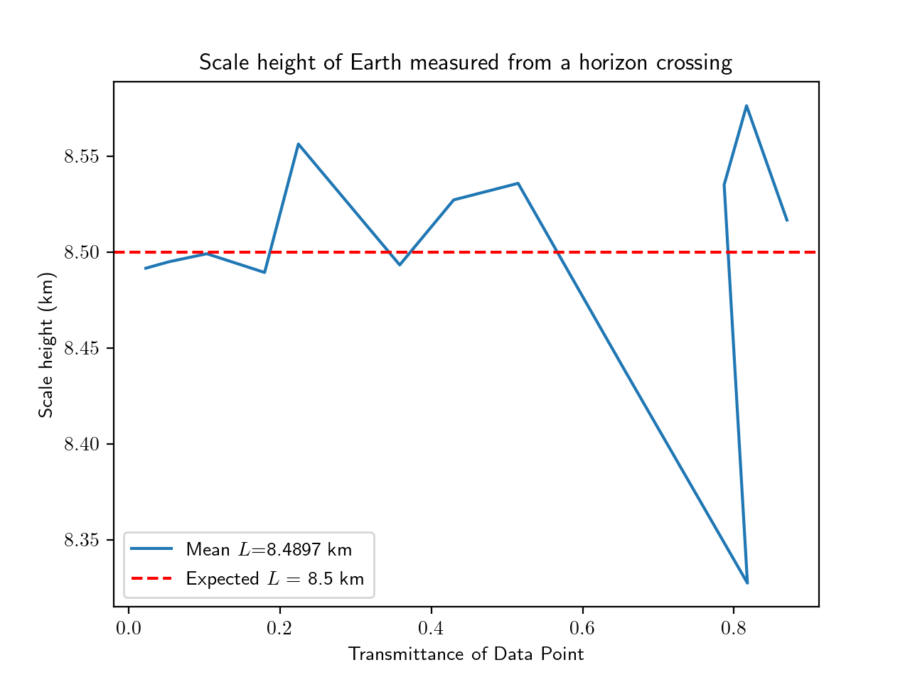
Nonlinear Equation Solving:
Solve for $L$ with Newton’s method, assume $σ\left(E\right)$ and $ρ_{0}$ are known
Notes:
Newton’s method is not sensitive to the initial guess for scale height and will always converge.

Slide 11
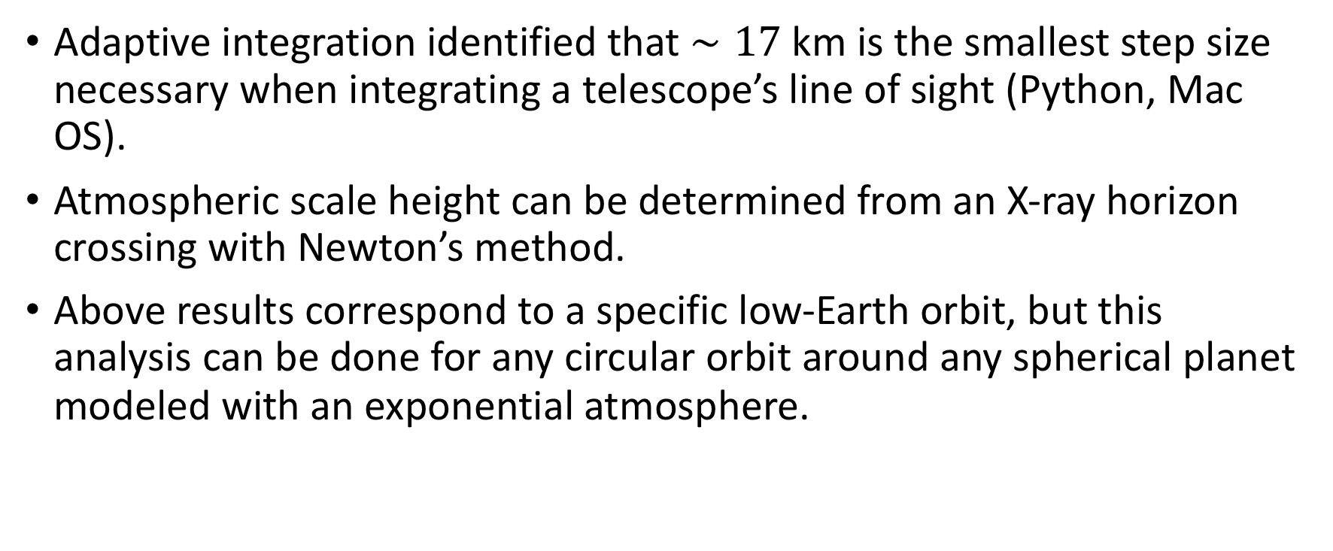
Conclusion
Adaptive integration identified that $∼17$km is the smallest step size necessary when integrating a telescope’s line of sight (Python, Mac OS).
Atmospheric scale height can be determined from an X-ray horizon crossing with Newton’s method.
Above results correspond to a specific low-Earth orbit, but this analysis can be done for any circular orbit around any spherical planet modeled with an exponential atmosphere.

Slide 12
Thank You

Slide 13
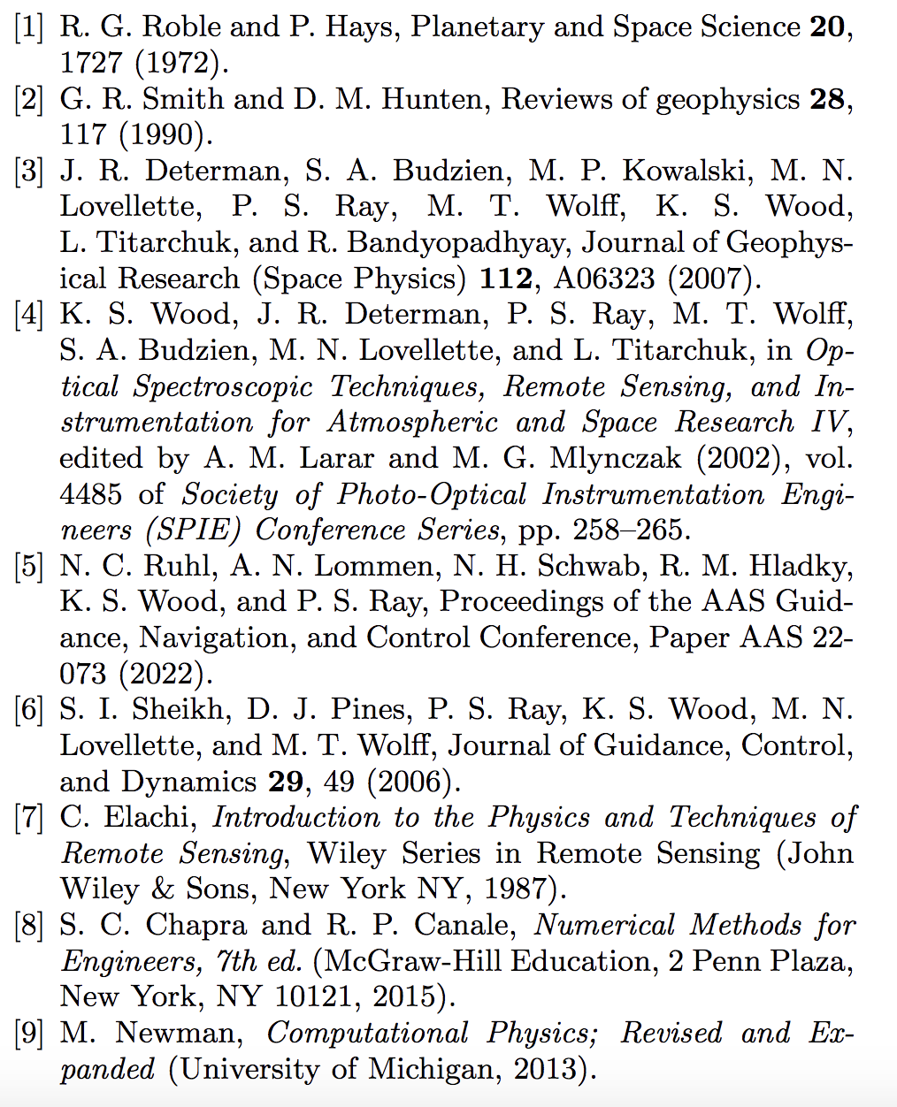
References

Slide 14
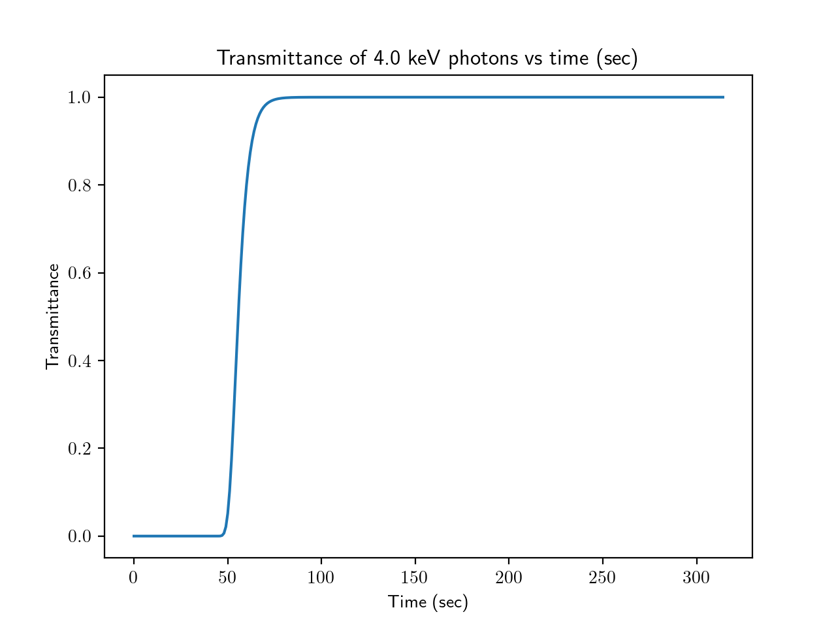
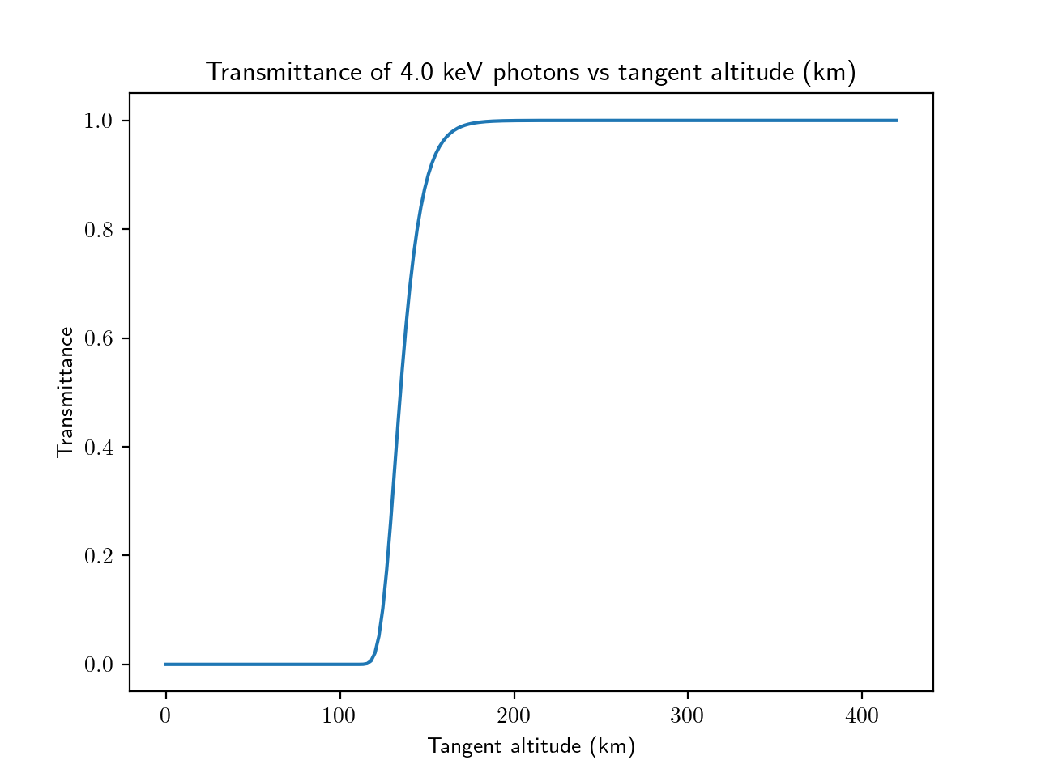
Beer’s Law in Earth’s Atmosphere
Transmittance vs time curve is a property of both the orbit geometry and the planet’s atmosphere
Transmittance vs tangent altitude curve is a property of an atmosphere
Notes:
Any satellite in Earth orbit would see the same transmitance vs tangent altitude curve.

Slide 15
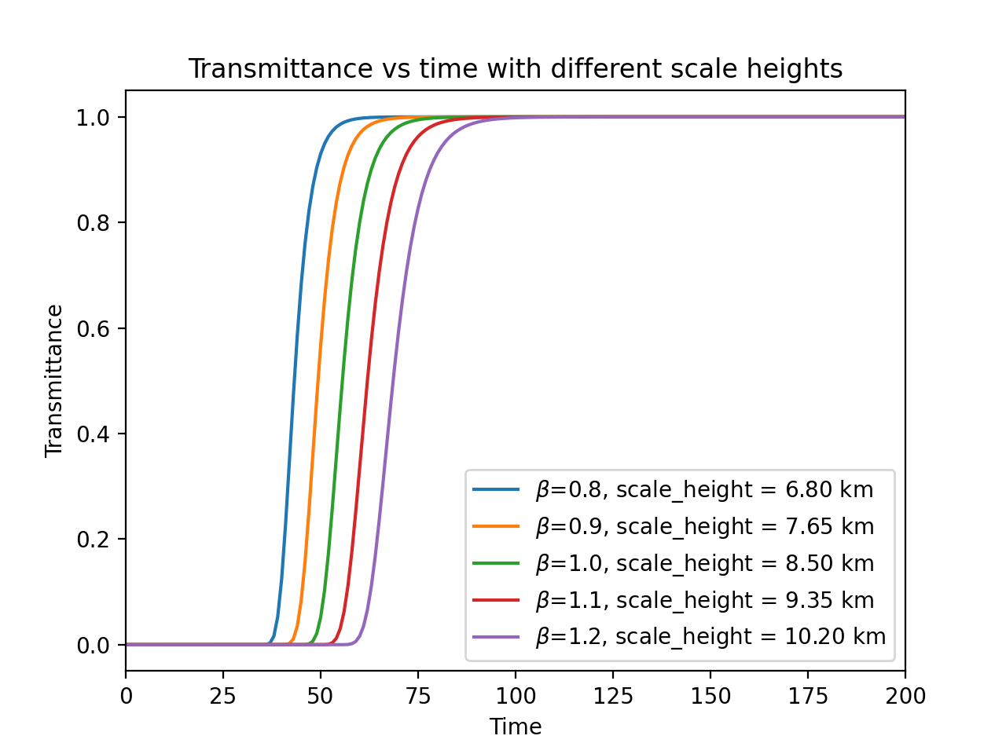
Transmittance vs time for different scale heights

Slide 16

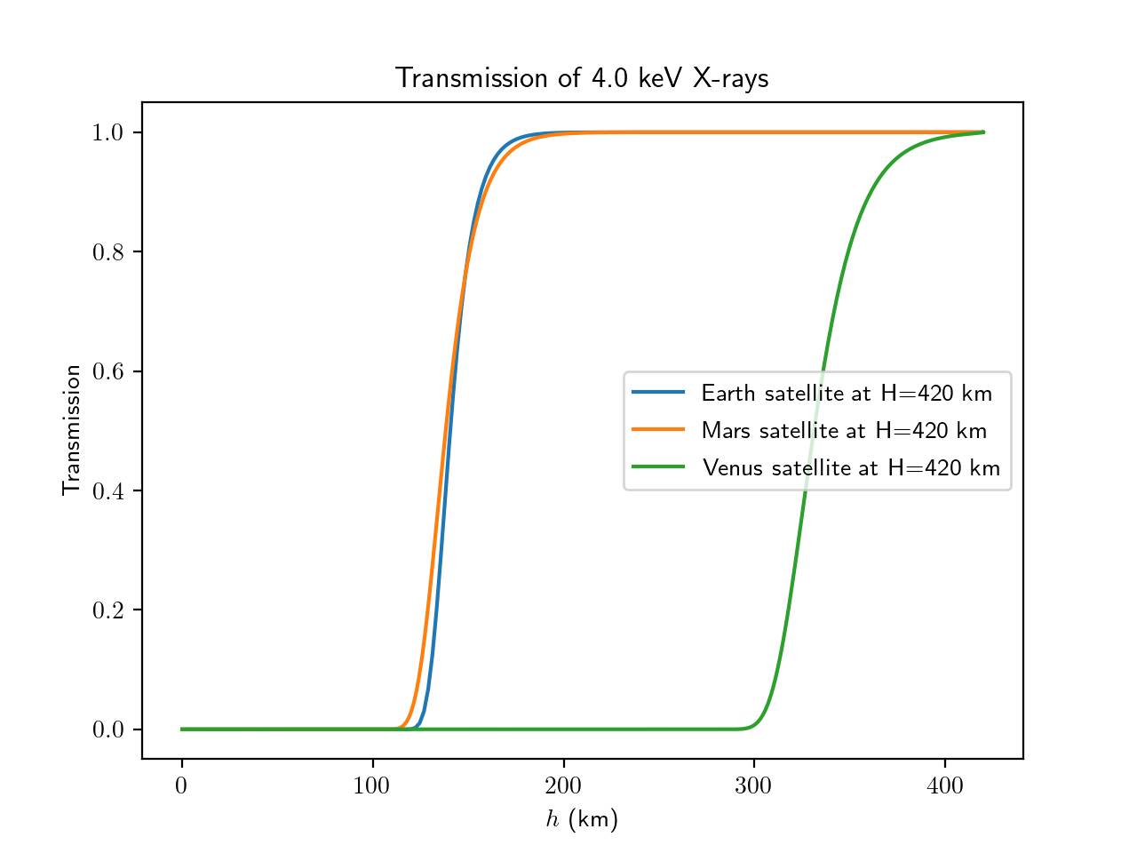
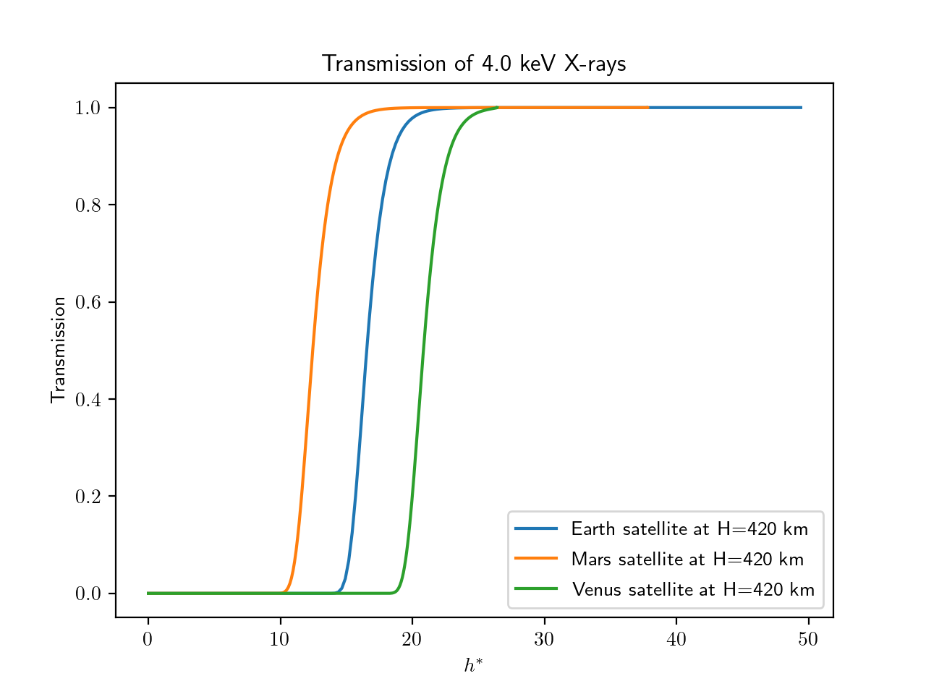
Dimensionless Parameters
One promising example is the non-dimensional altitude:
Notes:
Two dimensionless parameters are needed to capture the units. We’ve seen that three ratios would be needed to full non-dimensionalize the geometry in the optical depth integral. One example is the non-dimensional altitude

Slide 17
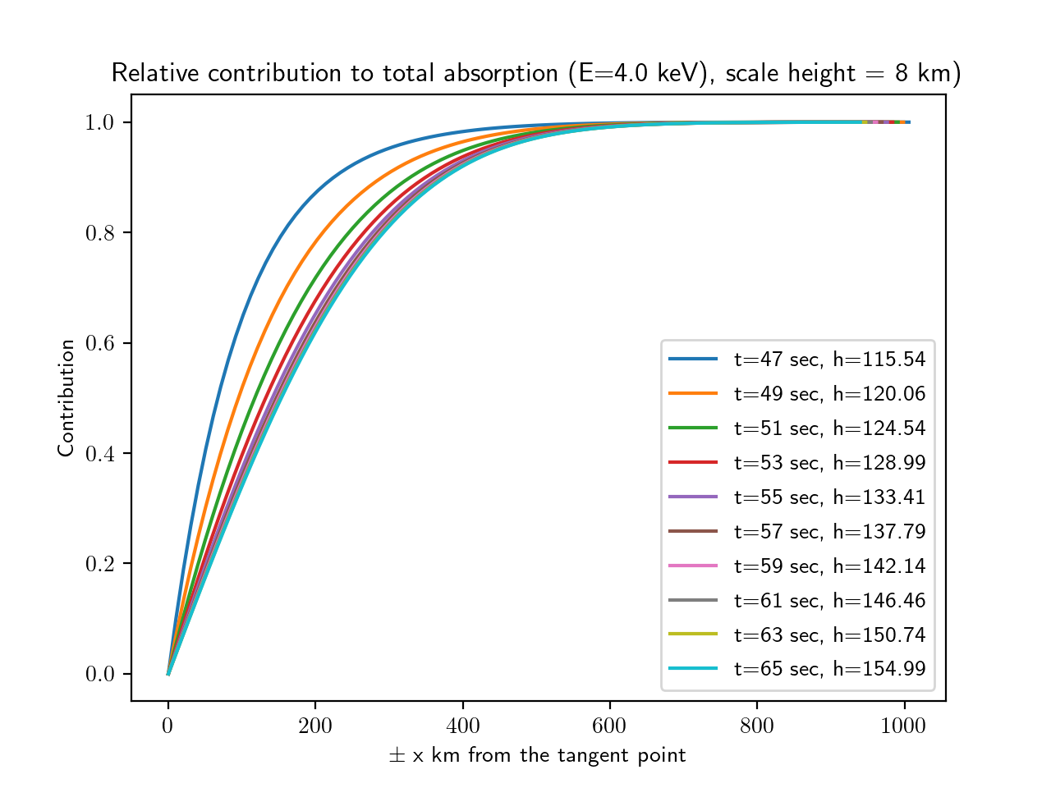
Percent Contribution to optical depth

Slide 18
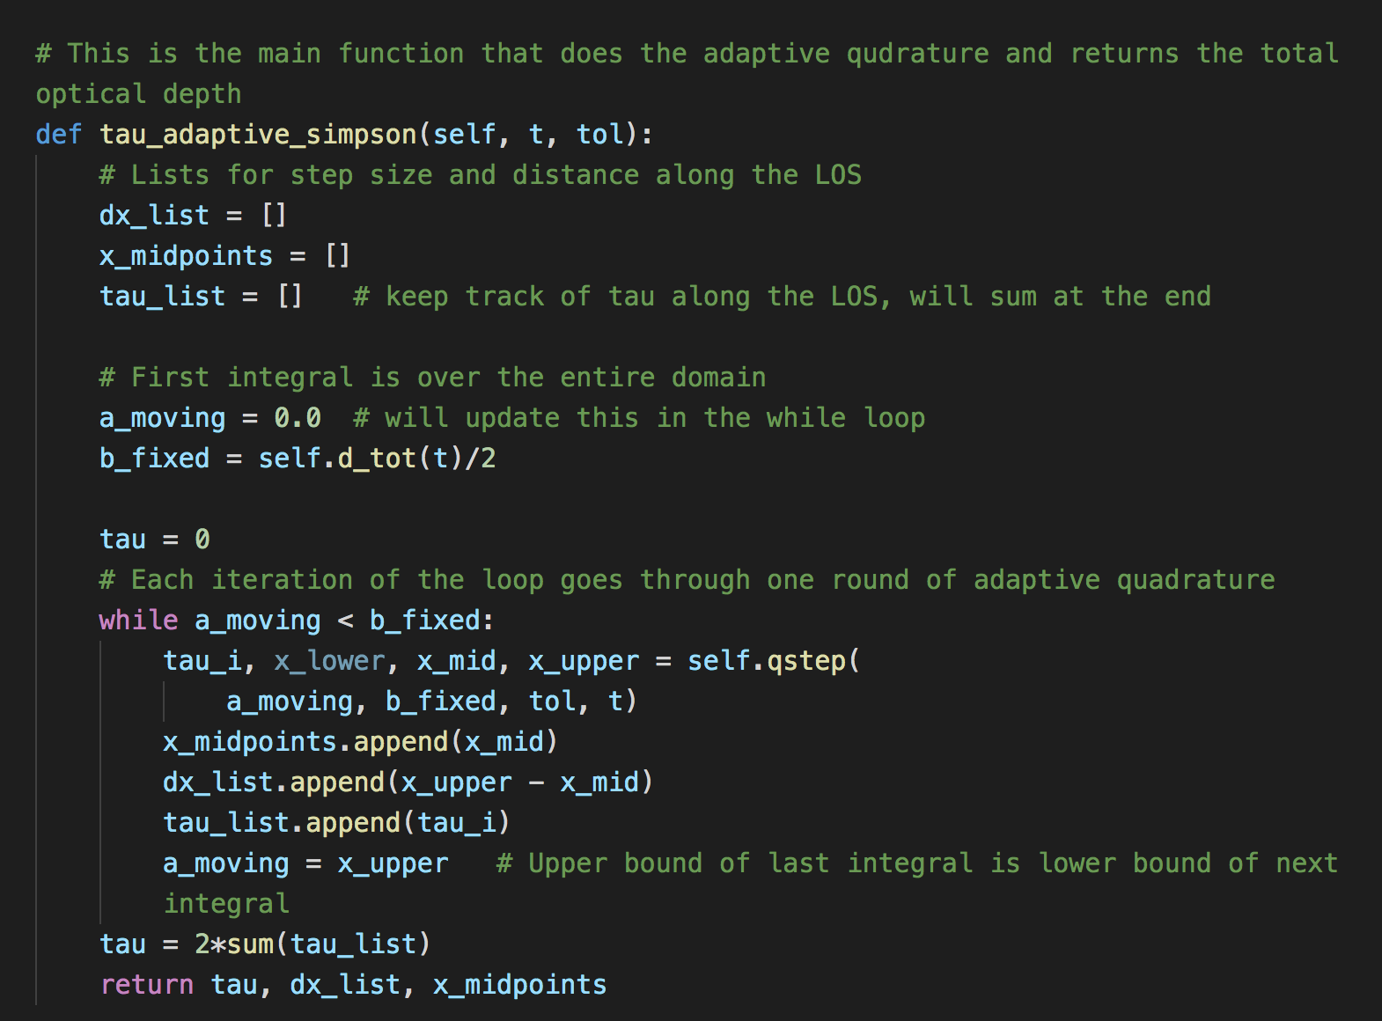
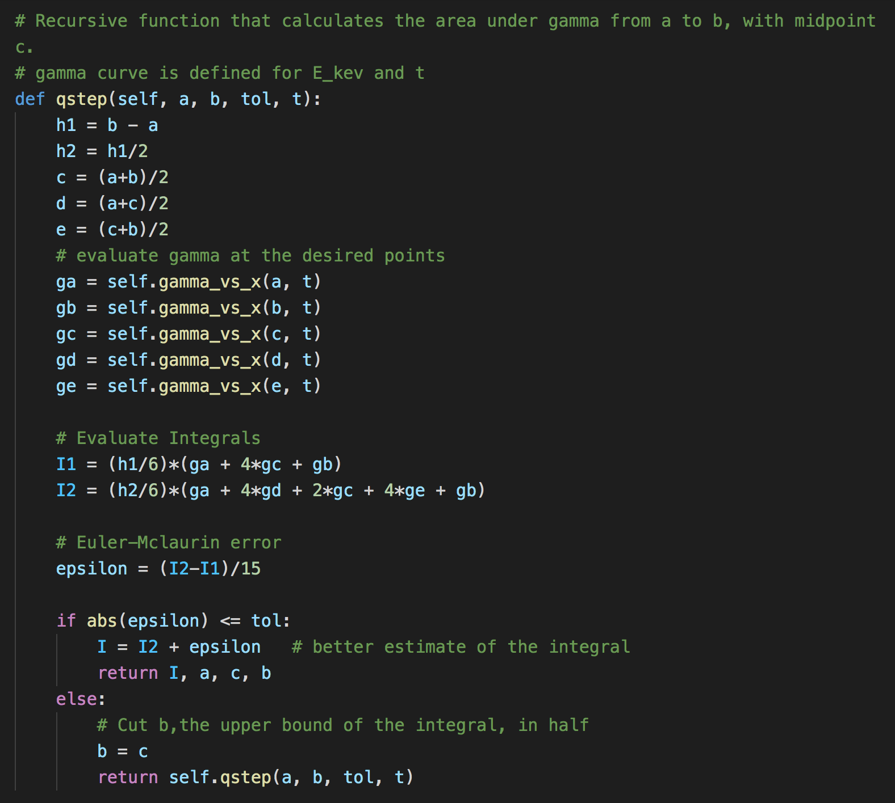
Adaptive Quadrature

Slide 19
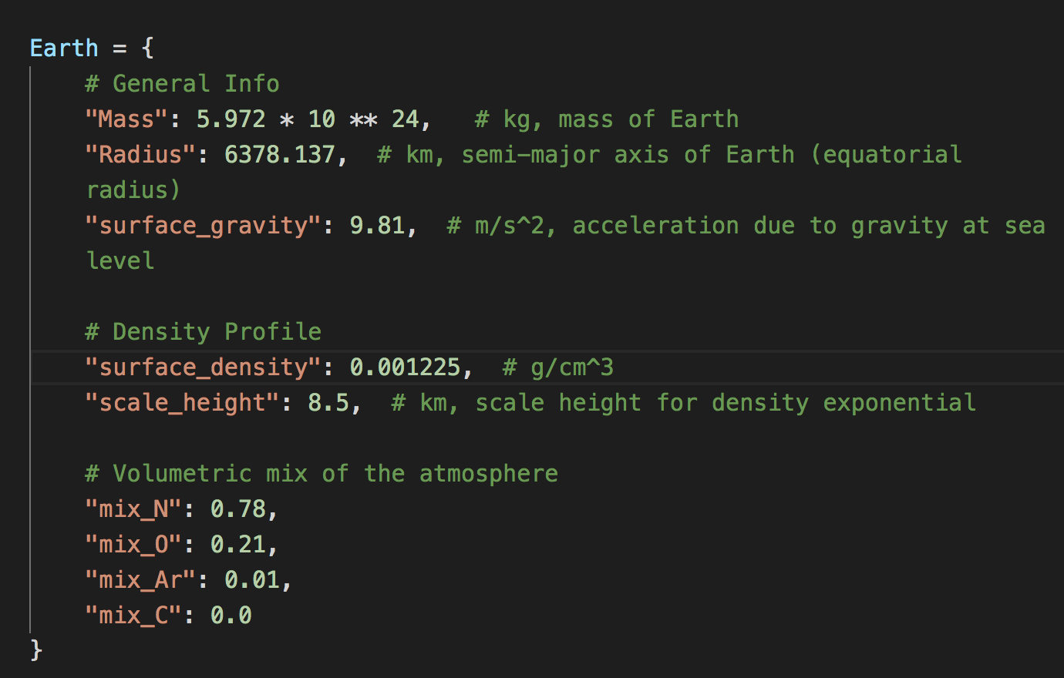
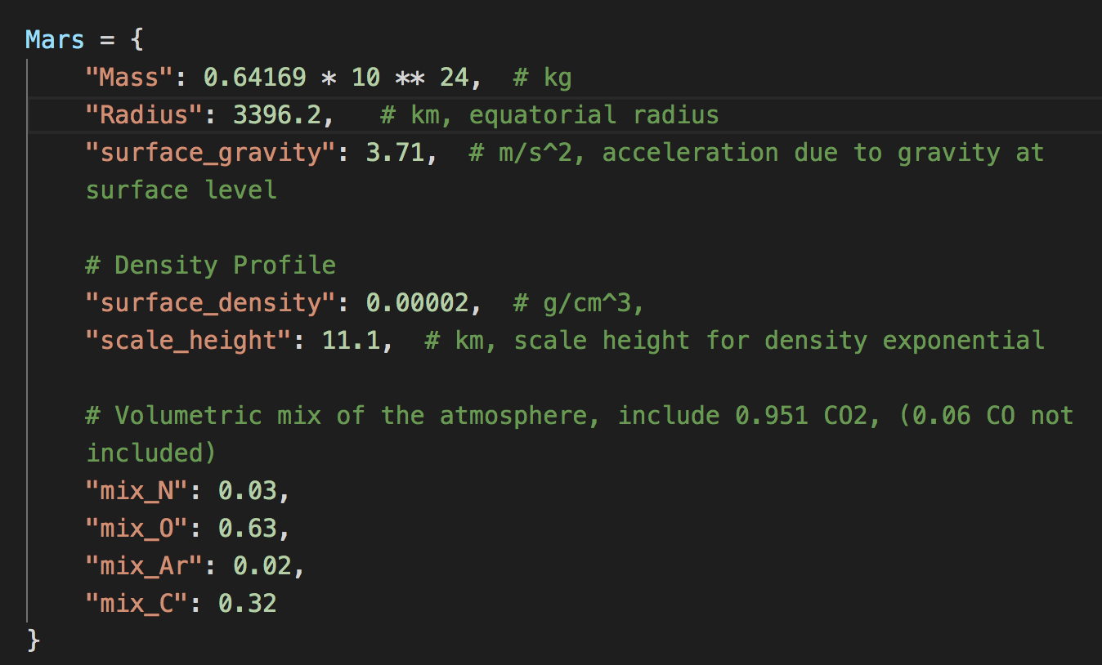
Planet Dictionaries

