Slide 1
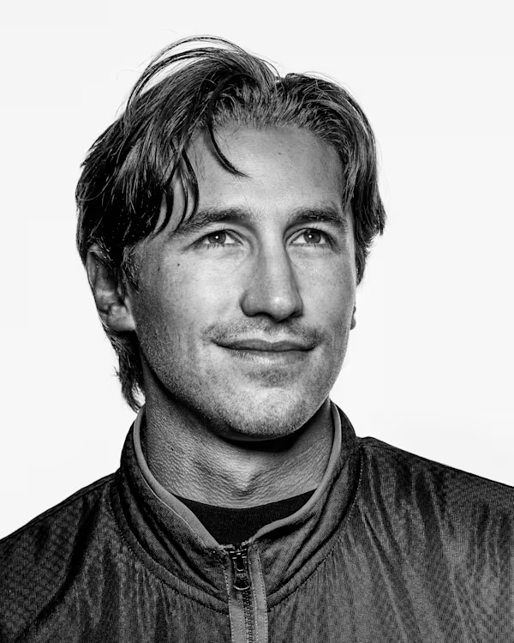
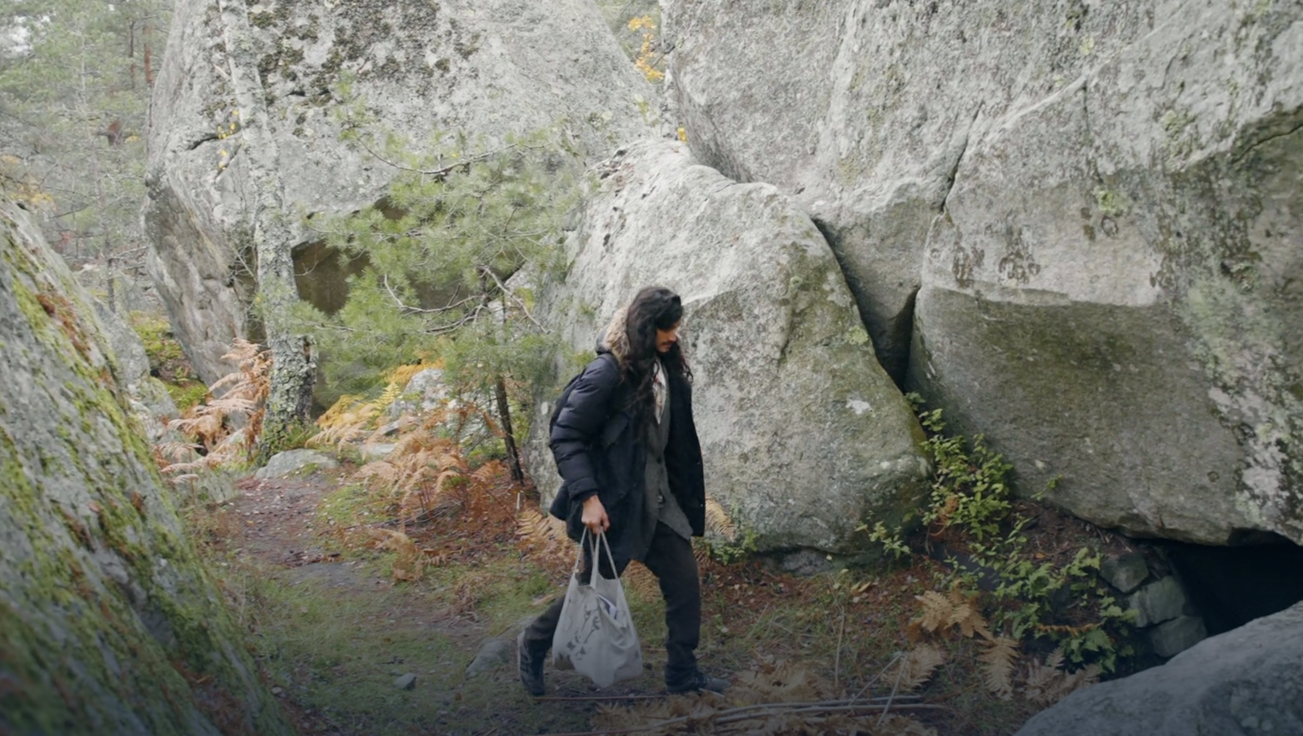
F***, I do 9A just a couple times, and now people have expectations of me?
Hinds under a rock with this guy in fear (allegedly)

Slide 2


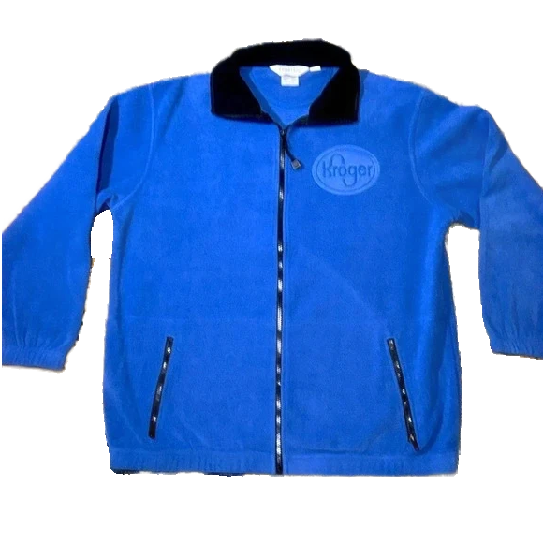
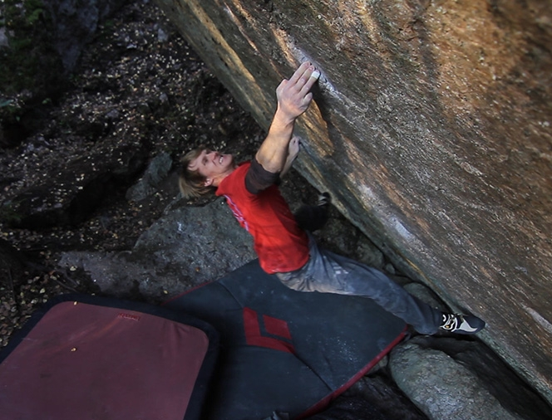
Bruh,
You Are …
Kroger MK
I’m manifesting Nalle!

