Slide 1

Attributes
An attribute is a property or characteristic of the entity that holds it.
For example, a Student might have attributes: roll_no, name, address, phone_no, etc.
It is represented by an ellipse/oval.

Slide 2
There exists a specific domain or set of values for each attribute from where the attribute can take its values.
a student's name cannot be a numeric value. It has to be alphabetic.
A student's age cannot be negative, etc.

Slide 3
Types of Attributes
Simple attribute.
Composite attribute.
Single valued attribute.
Multi valued attribute.
Derived attribute.
Key attributes.

Slide 4
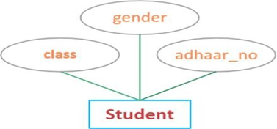
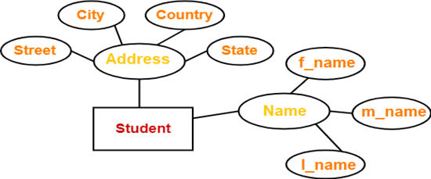
Simple attribute
Composite attribute

Slide 5
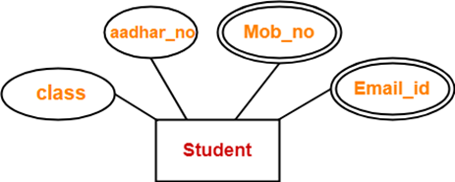
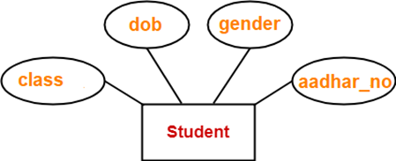
Single valued attribute
Multi valued attribute.
double ellipse

Slide 6
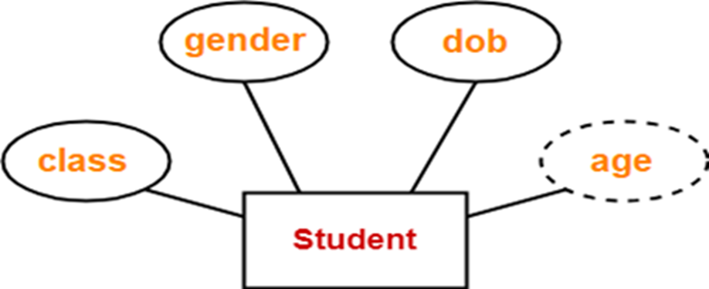
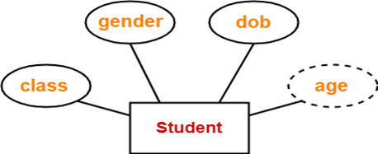
Derived attribute
Stored attribute
dashed ellipses

Slide 7
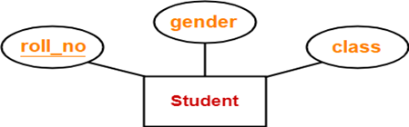
Key Attribute
underlined

Slide 8
Relationship
A relationship is an association among two or more entities. Entities take part in the relationship. It is represented by a diamond shape.
An employee works at a specific department. Here, "works at" is a relationship and this is the relationship between an Employee entity and a Department entity.

Slide 9
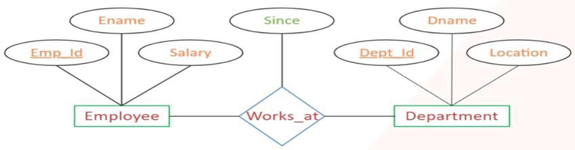
“Since” is the descriptive attribute

Slide 10
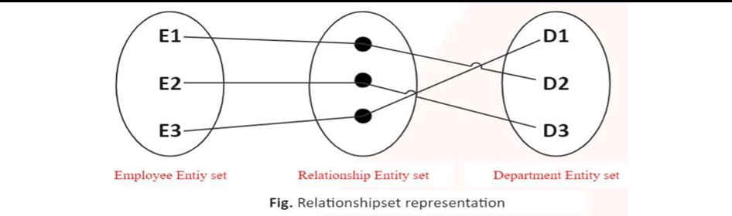
Relationship Set
A set of relationships of similar type is called a relationship set

Slide 11
Degree of a Relationship
The number of entity sets that participate in a relationship set is termed as the degree of that relationship.
Degree of above relationship is 2

Slide 12
Types of Relationships
On the basis of degree of a relationship set
Unary relationship.
Binary relationship.
Ternary relationship.
N-ary relationship.

Slide 13
Unary relationship
When there is a relationship between two entities of the same type is known as Unary relationship. It is known as a recursive relationship. This means that the relationship is between different instances of the same entity type. For example, an employee can supervise group of employees. Hence, this is a recursive relationship of entity employee with itself.

Slide 14
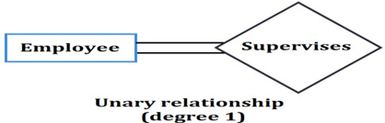

Slide 15
Binary Relationship
When there are exactly two entity sets participating in a relationship then such type of relationship is called binary relationship. For example, a student enrolls a course, here, enrolls is a relationship and this is the relationship between a Student entity and a Course entity.

Slide 16
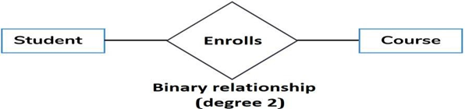

Slide 17
Ternary relationship
When there are exactly three entity sets participating in a relationship then such type of relationship is called ternary relationship and For example: In the real world, a patient goes to a doctor and doctor prescribes the medicine to the patient.
Three entities Doctor, Patient and Medicine are involved in the relationship ―prescribes.

Slide 18
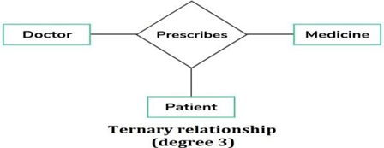

Slide 19
N-ary relationship
When more than three entity sets are participating in a relationship, then such type of relationship is called an N-ary relationship.
a patient goes to a doctor and doctor prescribes the diagnosis and medicine to the patient.
four entities
Doctor, Patient, Medicine and Diagnostics
relationship
prescribes

Slide 20
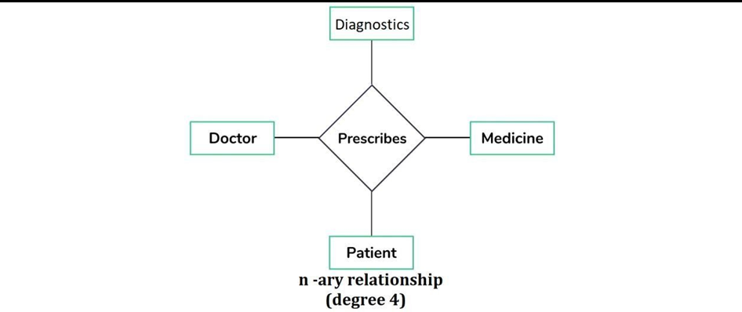

Slide 21
Mapping Cardinalities / Constraints
It defines how many entities in entity set A can be related to entities in entity set B in a relationship set R. (or) it defines number of instances participated in a relationship.

Slide 22
One to one (1:1)
One to many (1:M)
Many to one (M: 1)
Many to many (M:M)

Slide 23
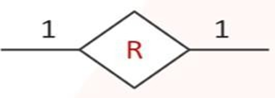
One to one (1:1)
An entity in A is associated with at most one entity in B, and an entity in B is associated with at most one entity in A.

Slide 24
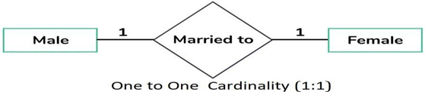
For example, assume that the only male can be married to only one female and one female can be married to only one male, this can be viewed as one-to-one cardinality.

Slide 25

One to many (1:M)
An entity in A is associated with any (zero or more) entities of B, and an entity in B can be associated with at most one entity in A.

Slide 26
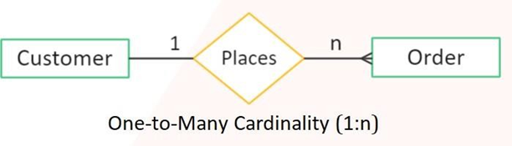
For example, a customer can place multiple orders from a website/shop.

Slide 27

Many to one (M: 1)
An entity in A is associated with at most one entity in B and an entity in B can be associated with any (zero or more) number of entities in A.

Slide 28
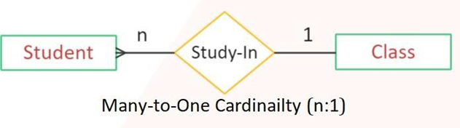
For example: A student can belong to at most one class but one class can have many students.

Slide 29

Many to many (M:M)
An entity in A is associated with any number of entities in B and an entity in Bis associated with any number of entities in A.

Slide 30
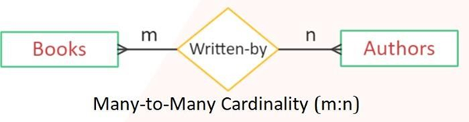
For example: Here many books are written by many authors and many authors write many books.

Slide 31
Participation Constraints
There are two types of participation constraints — total and partial.
The participation of an entity set E in a relationship set R is said to be total if every entity in E participates in at least one relationship in R.
If only some entities in E participate in relationships in R, the participation of entity set E in relationship R is said to be partial.
Double line indicates the total participation constraint.
Single line indicates the partial participation constraint.

Slide 32

The participation of entity set course in enrolled relationship set is partial because a course may or may not have students enrolled in.
The participation of entity set student in enrolled relationship set is total because every student is expected to relate at least one course through the enrolled relationship set

Slide 33
"cardinality" defines the number of instances of one entity that can be related to the number of instances of another entity (like one-to-one, one-to-many), while "participation" indicates whether an entity must participate in a relationship (total participation) or if it can exist without participating (partial participation)

Slide 34
Extended Features of E – R Model
As the complexity of data increased in the late 1980s, it became more and more difficult to use the traditional ER Model for database modeling. Hence some improvements or enhancements were made to the existing ER Model to make it able to handle the complex applications better.

Slide 35
As part of the Enhanced ER Model, three new concepts were added to the existing ER Model, they were:
Generalization.
Specialization.
Aggregation.

Slide 36
Features of Extended E-R Model
EER creates a design more accurate to database schemas.
It reflects the data properties and constraints more precisely.
It includes all modeling concepts of the ER model.
Diagrammatic technique helps for displaying the EER schema.
It includes the concept of specialization and generalization.

Slide 37
Enhanced ER modeling
Enhanced features of ER model are specialization and Generalization.
Specialization - Specialization is the process of identifying subsets of an entity set (the superclass) that share some distinguishing characteristic.
Generalization - Generalization consists of identifying some common characteristics of a collection of entity sets and creating a new entity set that contains entities possessing these common characteristics.
We can inherit the properties of super class into sub class by ISA relationship.

Slide 38
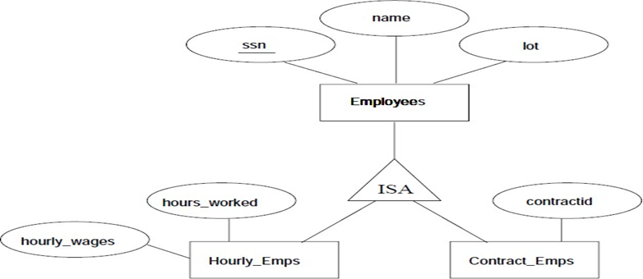

Slide 39
We can specify two kinds of constraints with respect to ISA hierarchies, namely, overlap and covering constraints. Overlap constraints determine whether two subclasses are allowed to contain the same entity. Covering constraints determine whether the entities in the subclasses collectively include all entities in the superclass.

Slide 40
If an employee can be both
a Professor and a Researcher simultaneously,
then the specialization is overlapping.
If every Employee must be either a Professor or a Researcher,
then it is a covering constraint (total specialization).

Slide 41
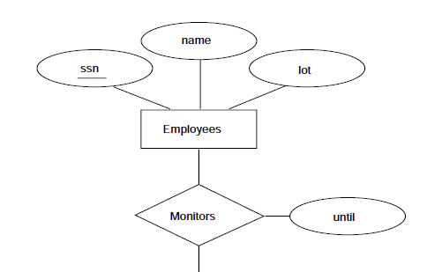
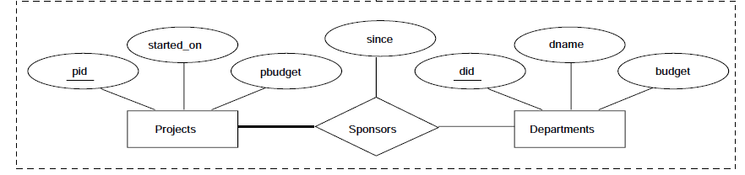
Aggregation

