Slide 1
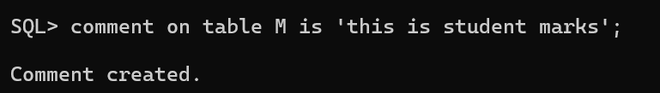
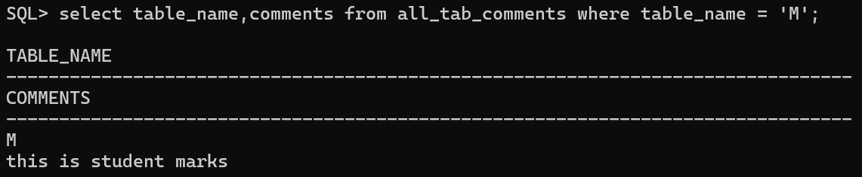

Slide 2
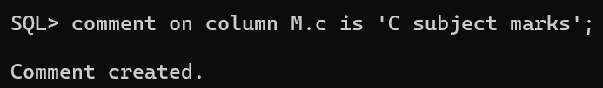
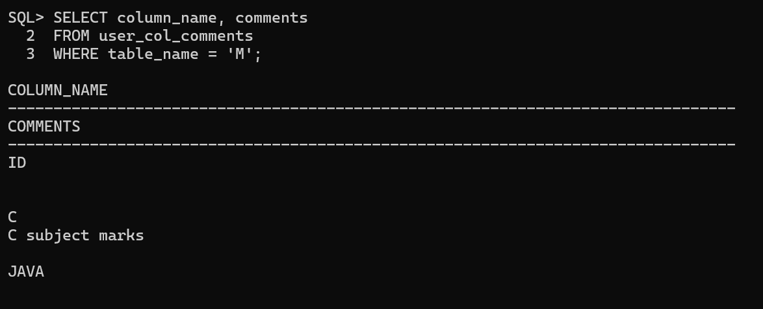

Slide 3
Operators in Oracle SQL
Arithmetic
Comparison
Logical
Bitwise
other operations

Slide 4
Operator | Description | Syntax | Example | Output
+ | Addition | SELECT column1 + column2 FROM table; | SELECT 10 + 5 FROM dual; | 15
- | Subtraction | SELECT column1 - column2 FROM table; | SELECT 10 - 5 FROM dual; | 5
* | Multiplication | SELECT column1 * column2 FROM table; | SELECT 10 * 5 FROM dual; | 50
/ | Division | SELECT column1 / column2 FROM table; | SELECT 10 / 5 FROM dual; | 2
MOD | Modulus (Remainder) | SELECT MOD (column1, column2) FROM table; | SELECT MOD (10, 3) FROM dual; | 1

Slide 5
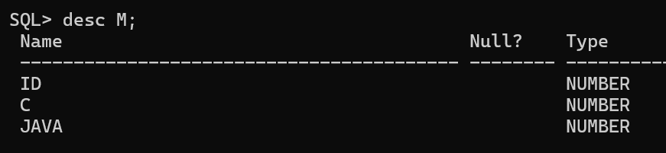

Slide 6
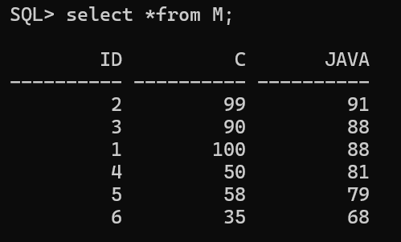

Slide 7
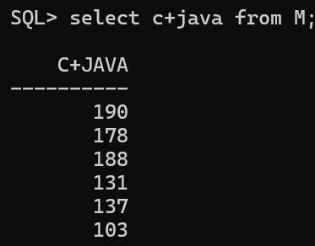

Slide 8
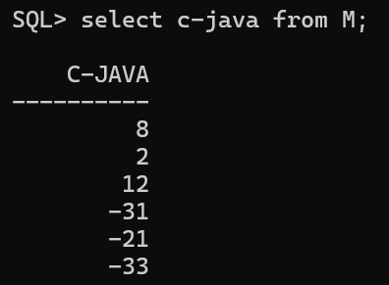

Slide 9
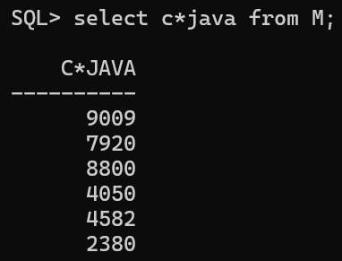

Slide 10
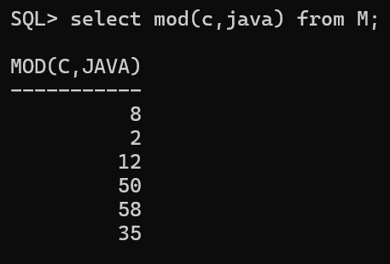

Slide 11
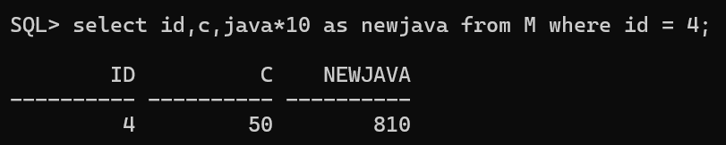

Slide 12
Comparison Operators

Slide 13
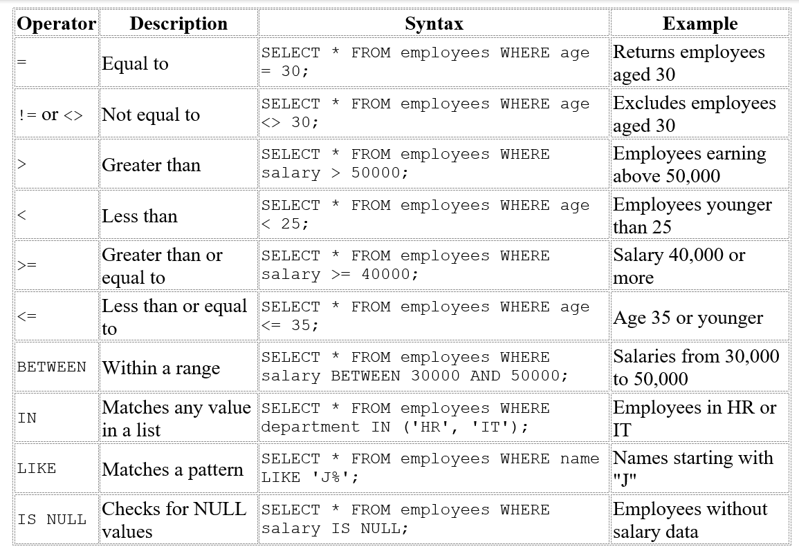

Slide 14
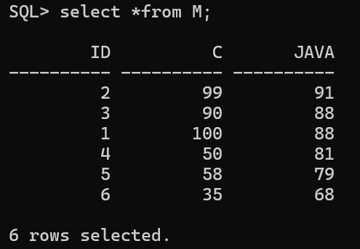
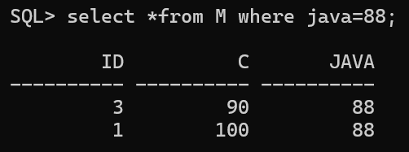

Slide 15
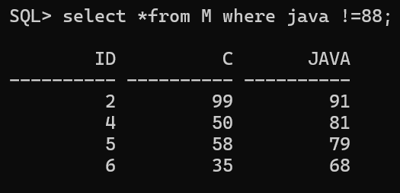
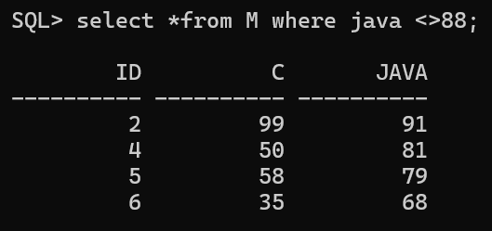

Slide 16
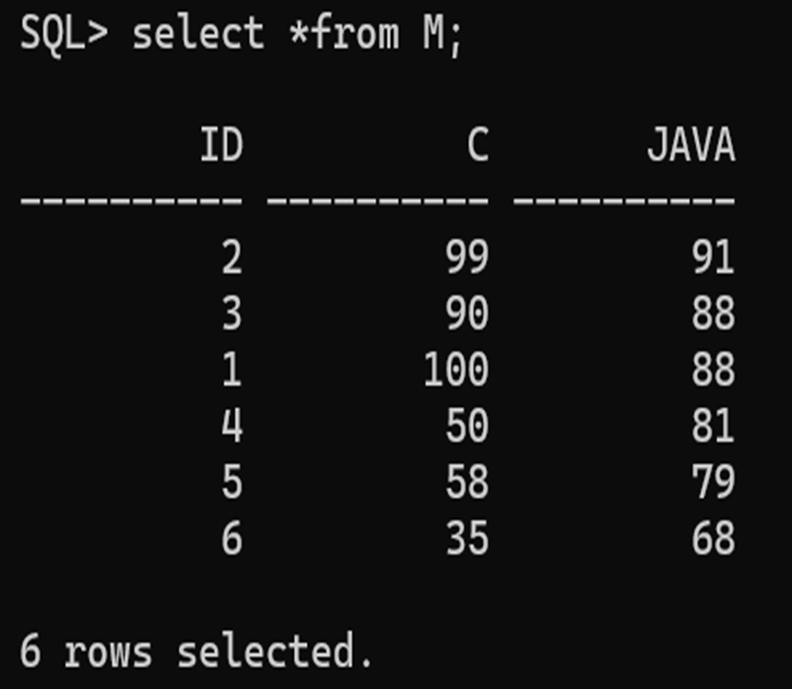
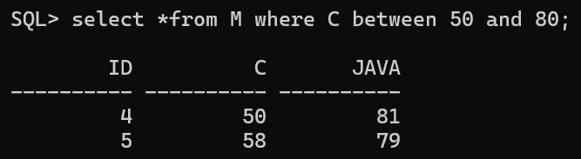

Slide 17
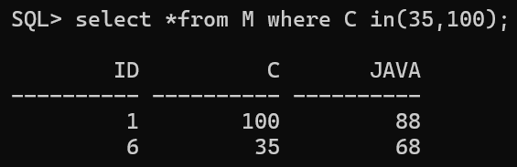

Slide 18


Slide 19
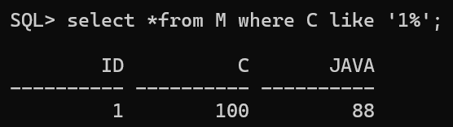

Slide 20
Logical Operators
Used to combine multiple conditions.

Slide 21
Operator | Description | Syntax
AND | Returns TRUE if both conditions are true | SELECT * FROM employees WHERE age > 30 AND department = 'HR';
OR | Returns TRUE if at least one condition is true | SELECT * FROM employees WHERE age > 30 OR department = 'HR';
NOT | Negates a condition | SELECT * FROM employees WHERE NOT department = 'HR';

Slide 22

DIFFERENCE BETWEEN != NOT

Slide 23

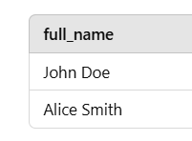
Concatenation Operator ||
concatenation operator (||) is used to combine two or more strings into a single string.

Slide 24

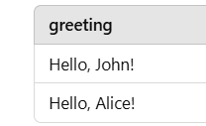

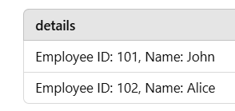



Slide 25
Set Operators
Used to combine the results of multiple SELECT queries.

Slide 26
Operator | Description | Syntax
UNION | Combines unique records from both queries | SELECT column1 FROM table1 UNION SELECT column1 FROM table2;
UNION ALL | Combines all records (including duplicates) | SELECT column1 FROM table1 UNION ALL SELECT column1 FROM table2;
INTERSECT | Returns common records from both queries | SELECT column1 FROM table1 INTERSECT SELECT column1 FROM table2;
MINUS | Returns records in first query but not in second | SELECT column1 FROM table1 MINUS SELECT column1 FROM table2;

Slide 27
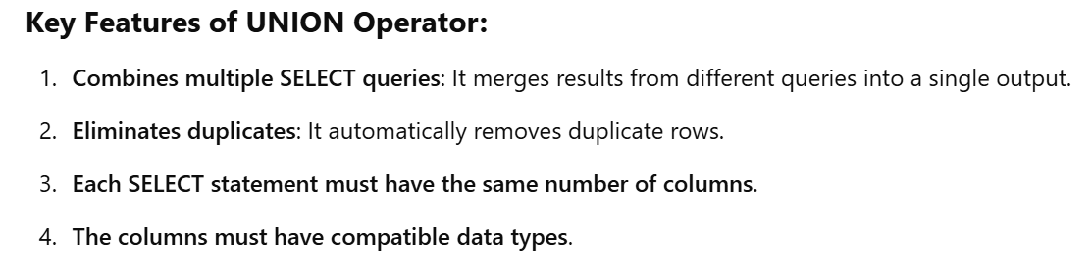

Slide 28
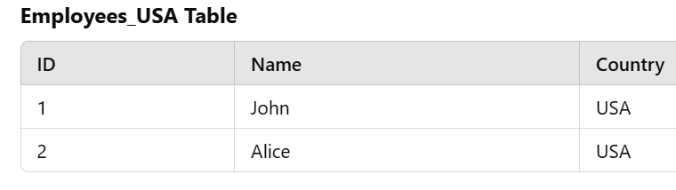
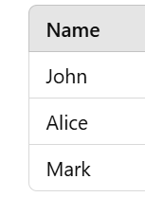
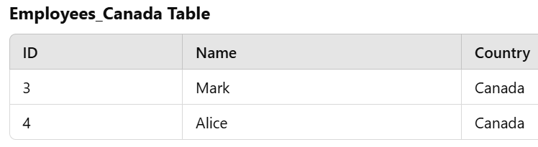
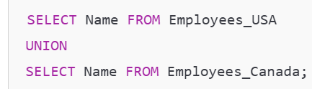

Slide 29
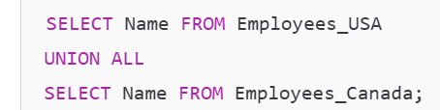
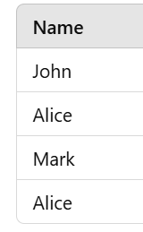
UNION vs UNION ALL
If you want to include duplicate rows, use UNION ALL:

Slide 30
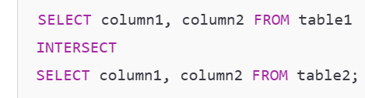
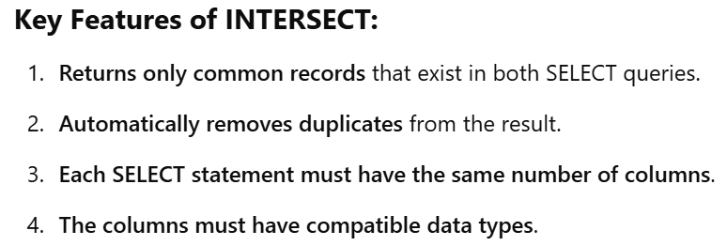
The INTERSECT operator in DBMS is used to return the common records (intersection) from two or more SELECT queries. It only includes rows that appear in both result sets.

Slide 31
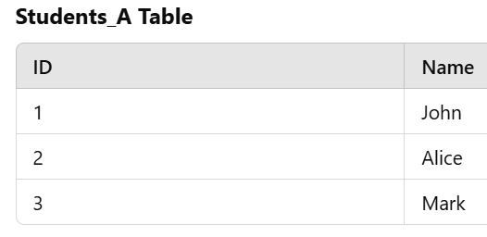
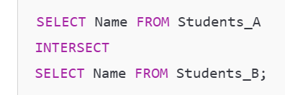
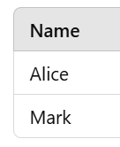
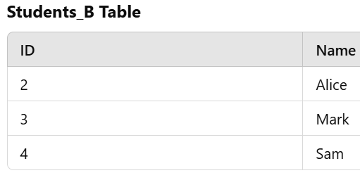

Slide 32
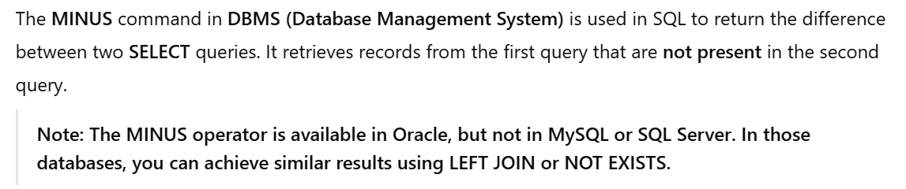

Slide 33
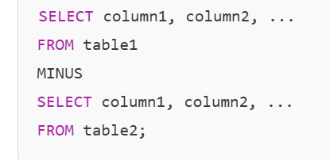

Slide 34
Both queries must have the same number of columns and data types.
The result includes only unique rows from the first query that
do not exist in the second query.

Slide 35
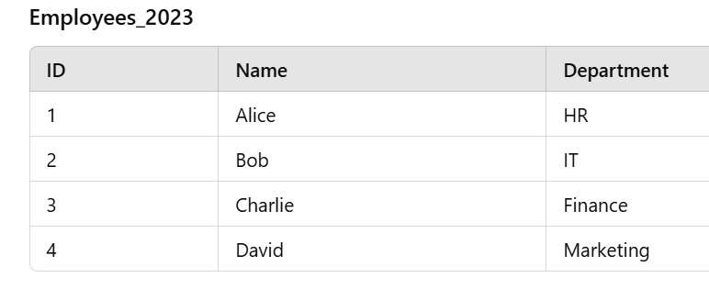
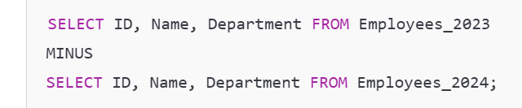
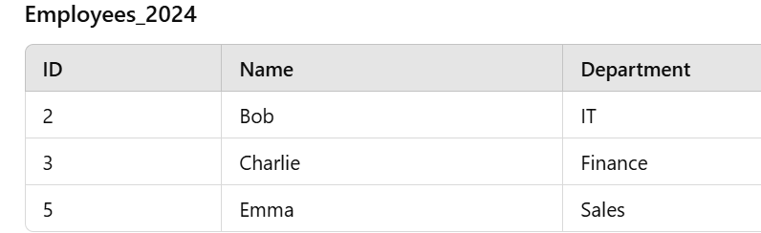
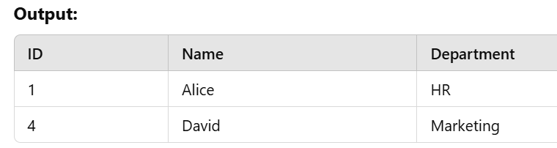

Slide 36
Bitwise Operators
Bitwise operators perform operations at the binary level.

Slide 37
Bitwise operators in DBMS are used to perform operations at the bit level on integer values. These operators manipulate individual bits of numbers and are useful in scenarios like permissions handling, flag operations, and data compression.

Slide 38
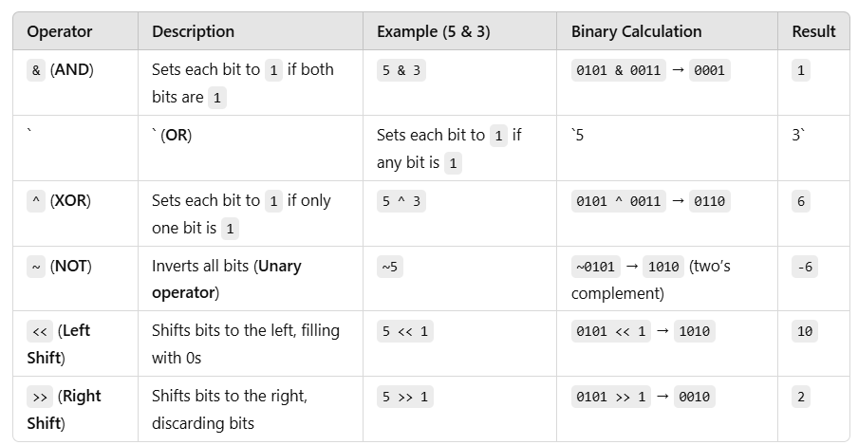

Slide 39
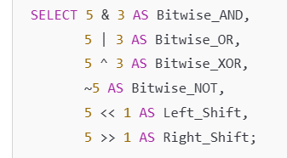

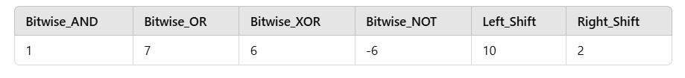

Slide 40
