Slide 1
Relational Model
It was proposed by E.F. Codd in 1970
A relational model stores data in the form of relations (tables). Each relation has columns and rows which are formally called attributes and tuples respectively. Each tuple in relation is a real-world entity.
Peter Chen

Slide 2
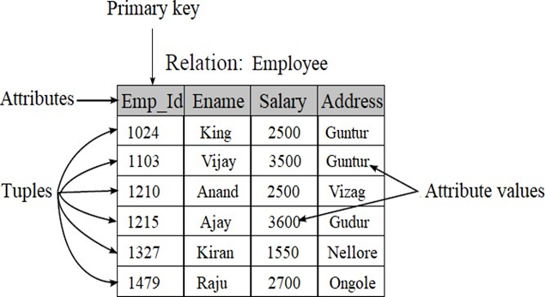
Relational Model Diagram

Slide 3
Terminology
Relations / Tables – Relations are saved in the table format. A table has two properties rows and columns. Rows represent records and columns represent attributes.
Attribute: Attributes are the properties which define a relation.
Tuple: It is nothing but a single row of a table.
Degree / arity: The total number of attributes in a relation.
Cardinality: Total number of rows present in the Table.
Domain: Set of possible values for an attribute.
Relation instance: It is a finite set of tuples. They never have duplicate tuples.
Relation Schema: It represents the name of the relation with its attributes.
Relation key: Every row has one, two or multiple attributes, which is called relation key.

Slide 4
Integrity Constraints
They are referred to as conditions that are applied to the relation/table to ensure the correctness of the data in the database. These constraints are checked before performing any operation in database. If there is a violation in any of constrains, operation will fail. Thus, integrity constraint is used to guard against accidental damage to the database.

Slide 5
Domain Constraints
Entity Integrity Constraints
Key Constraints
Referential Integrity Constraints

Slide 6
Domain Constraints
Domain constraint defines the domain or set of possible values for an attribute.
It specifies that the value taken by the attribute must be from its domain only.
Example: Consider the following Student table

Slide 7
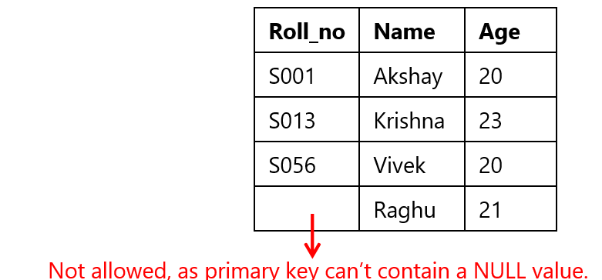
2. Entity Integrity Constraints
Entity integrity constraint ensures that the primary key attribute in a relation, should not accept a null value. This is because the primary key attribute value uniquely defines an entity in a relation.

Slide 8
4. Referential Integrity Constraints
A referential integrity constraint is specified between two tables to establish a relationship/link between them. They are implemented in the name of foreign keys.
It states that if a foreign key exists in a relation, then either the foreign key value must match a primary key value of some tuple in its parent relation or its value must be null.

Slide 9
RULES
1. You can't delete a record from a primary table if matching records exist in a child table.
2. You can't change a primary key value in the primary table if that record has child records.
3. You can't enter a value in the foreign key field of the child table that doesn't exist in the primary key of the parent table.
4. However, you can enter a Null value in the foreign key, specifying that the records are unrelated.

Slide 10
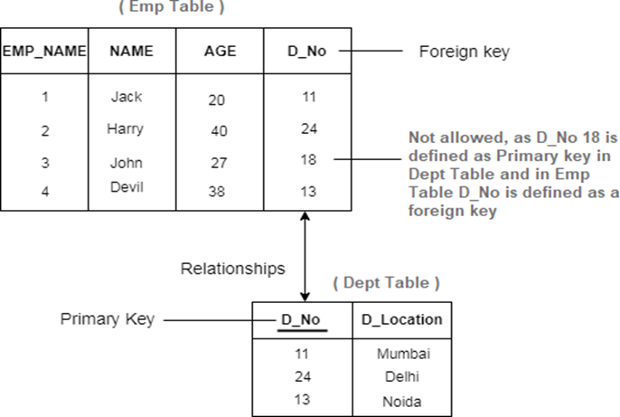

Slide 11
3. Key Constraints
A Key Constraint is a statement that a certain minimal subset of the fields of a relation is a unique identifier for a tuple.
Super Key
Candidate key.
Primary key.
Foreign key.

Slide 12
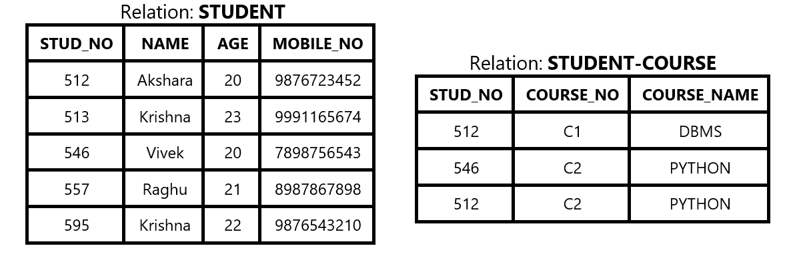

Slide 13
Candidate Key
The minimal set of attributes which can uniquely identify a tuple is known as a candidate key. For example, STUD_NO in STUDENT relation.
A candidate key can never be NULL or empty and its value should be
unique.
There can be more than one candidate keys for table. For example, STUD_NO, as well as MOBILE_NO both, are candidate keys for relation STUDENT.
The candidate key can be simple or composite. For Example, {STUD_NO, COURSE_NO} is a composite candidate key for relation STUDENT_COURSE.

Slide 14
Super Key
The set of attributes which can uniquely identify a tuple is known as Super Key. For Example, STUD_NO, (STUD_NO, STUD_NAME), MOBILE_NO, etc.
Adding zero or more attributes to candidate key generates a super key.
Super Key is a super set of Candidate key.
A candidate key is a super key but vice versa is not true.

Slide 15
Primary Key
There can be more than one candidate key in a relation out of which one can be chosen as a primary key.
For Example, STUD_NO as well as MOBILE_NO both are candidate keys for
relation STUDENT but STUD_NO can be chosen as primary key

Slide 16
Secondary or Alternative key
The candidate key other than the primary key is called an alternate key / Secondary key.
For Example, STUD_NO, as well as MOBILE_NO both, are candidate keys for relation STUDENT but STUD_PHONE will be alternate key.

Slide 17
Foreign Key
If an attribute can only take the values which are present as values of some other attribute, it will be a foreign key to the attribute to which it refers.
The relation which is being referenced is called referenced relation and the corresponding attribute is called referenced attribute and the relation which refers to the referenced relation is called referencing relation and the corresponding attribute is called referencing attribute.

