Slide 1
SQL Joins - Explanation & Examples
Understanding Different Types of Joins in SQL

Slide 2
INNER JOIN
Returns only matching rows from both tables.
Syntax:
SELECT table1.column, table2.column FROM table1 INNER JOIN table2 ON table1.column1 = table2.column1;

Slide 3
LEFT JOIN (LEFT OUTER JOIN)
Returns all records from the left table and matching records from the right table. If no match, NULL is returned.
Syntax:
SELECT table1.column, table2.column FROM table1 LEFT JOIN table2 ON table1.column1 = table2.column1;

Slide 4
RIGHT JOIN (RIGHT OUTER JOIN)
Returns all records from the right table and matching records from the left table.
Syntax:
SELECT table1.column, table2.column FROM table1 RIGHT JOIN table2 ON table1.column1 = table2. column1;

Slide 5
FULL JOIN (FULL OUTER JOIN)
Returns all records from both tables. If no match is found, NULL is returned.
Syntax:
SELECT table1.column, table2.column FROM table1 FULL JOIN table2 ON table1.column1 = table2.column1;

Slide 6
CROSS JOIN
Returns the Cartesian product of both tables (each row from one table is combined with every row from the other).
Syntax:
SELECT table1.column, table2.column FROM table1 CROSS JOIN table2;

Slide 7
SELF JOIN
A table is joined with itself to compare rows.
Syntax:
SELECT A.column, B.column FROM table_name A JOIN table_name B ON A.column1 = B.column2;

Slide 8
Natural JOIN
Natural join is an SQL join operation that creates a join on the base of the common columns in the tables. To perform natural join there must be one common attribute(Column) between two tables.
Syntax:
SELECT A.column, B.column FROM table_name A NATURAL JOIN table_name B;

Slide 9
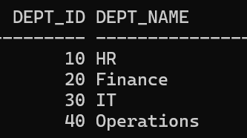
Department

Slide 10
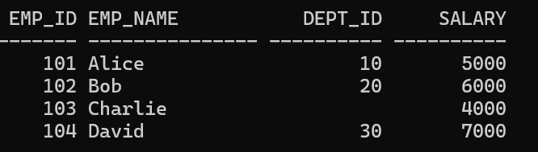
Employee

Slide 11
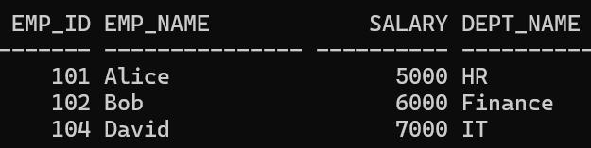
INNER JOIN
SELECT e.emp_id, e.emp_name, e.salary, d.dept_name
FROM employee e
INNER JOIN department d
ON e.dept_id = d.dept_id;

Slide 12
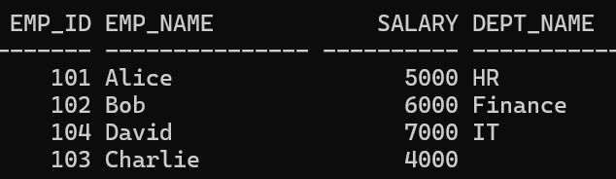
LEFT OUTER JOIN
SELECT e.emp_id, e.emp_name, e.salary, d.dept_name
FROM employee e
LEFT OUTER JOIN department d
ON e.dept_id = d.dept_id;

Slide 13
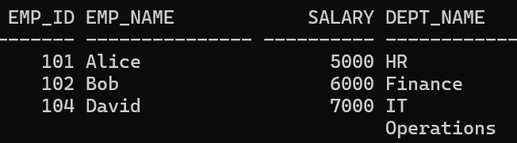
RIGHT OUTER JOIN
SELECT e.emp_id, e.emp_name, e.salary, d.dept_name
FROM employee e
RIGHT OUTER JOIN department d
ON e.dept_id = d.dept_id;

Slide 14
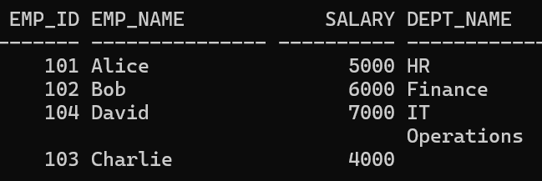
FULL OUTER JOIN
SELECT e.emp_id, e.emp_name, e.salary, d.dept_name
FROM employee e
FULL OUTER JOIN department d
ON e.dept_id = d.dept_id;

Slide 15
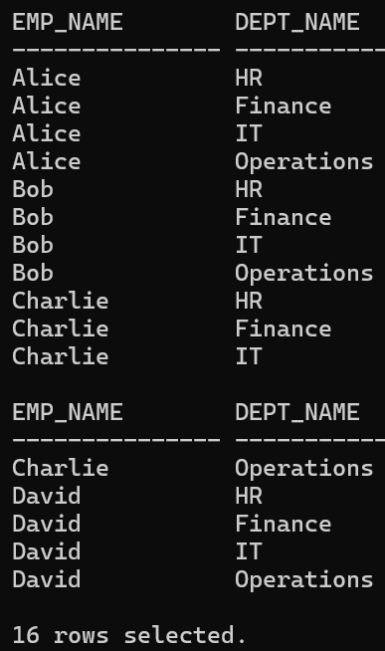
CROSS JOIN
SELECT e.emp_name, d.dept_name
FROM employee e
CROSS JOIN department d;

Slide 16
NATURAL JOIN
It automatically joins tables based on columns with the same name and compatible data types.
In our case, DEPT_ID is common in both tables, so Oracle will join on DEPT_ID automatically.

Slide 17
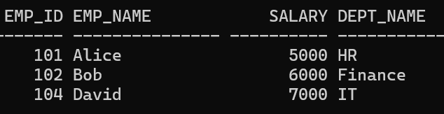
NATURAL JOIN
SELECT emp_id, emp_name, salary, dept_name
FROM employee
NATURAL JOIN department;

Slide 18
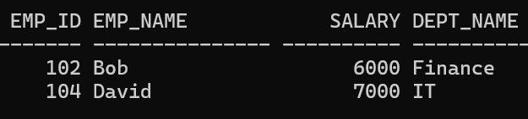
NATURAL JOIN with additional conditions
SELECT emp_id, emp_name, salary, dept_name
FROM employee
NATURAL JOIN department
WHERE salary > 5500;

Slide 19
Sample Queries
List all employees along with their department names where the department is assigned
SELECT e.emp_name, d.dept_name
FROM employees e
INNER JOIN departments d
ON e.dept_id = d.dept_id;

Slide 20
Show employee names, department names, and salaries for only those employees who belong to a valid department
SELECT e.emp_name, e.salary, d.dept_name
FROM employees e
INNER JOIN departments d
ON e.dept_id = d.dept_id;

Slide 21
List all employees along with their department names. If a department is not assigned, show NULL for department name.
SELECT e.emp_name, d.dept_name
FROM employees e
LEFT JOIN departments d
ON e.dept_id = d.dept_id;

Slide 22
Find employees who do not have any assigned department.
SELECT e.emp_name
FROM employees e
LEFT JOIN departments d
ON e.dept_id = d.dept_id
WHERE d.dept_id IS NULL;

Slide 23
Display all departments along with the employees working in them. If no employee is working in that department, display NULL for employee names.
SELECT e.emp_name, d.dept_name
FROM employees e
RIGHT JOIN departments d
ON e.dept_id = d.dept_id;

Slide 24
Identify departments that do not have any employees
SELECT d.dept_name
FROM employees e
RIGHT JOIN departments d
ON e.dept_id = d.dept_id
WHERE e.emp_id IS NULL;

Slide 25
List all employees and all departments. For employees without departments and departments without employees, show NULL values accordingly.
SELECT e.emp_name, d.dept_name
FROM employees e
FULL OUTER JOIN departments d
ON e.dept_id = d.dept_id;

Slide 26
Find both employees who don’t belong to any department and departments without employees in one single query.
SELECT e.emp_name, d.dept_name
FROM employees e
FULL OUTER JOIN departments d
ON e.dept_id = d.dept_id
WHERE e.dept_id IS NULL OR d.dept_id IS NULL;

Slide 27
Generate a report showing every possible pair of employee and department
SELECT e.emp_name, d.dept_name
FROM employees e
CROSS JOIN departments d;

Slide 28
How many total combinations of employees and departments are possible from the current data?
SELECT COUNT(*)
FROM employees e
CROSS JOIN departments d;

Slide 29
Display employee ID, employee name, department ID, and department name using a natural join.
SELECT emp_id, emp_name, dept_id, dept_name
FROM employees
NATURAL JOIN departments;

Slide 30
Write a query that automatically joins employees and departments on the common column (without specifying ON conditions).
SELECT emp_id, emp_name, salary, dept_name
FROM employees
NATURAL JOIN departments;

Slide 31
List employees and their department names, but include also departments that have no employees. Sort by department name.
SELECT e.emp_name, d.dept_name
FROM employees e
RIGHT JOIN departments d
ON e.dept_id = d.dept_id
ORDER BY d.dept_name;

Slide 32
Find employees whose salary is above the average salary of all employees in their department.
SELECT e.emp_name, e.salary, d.dept_name
FROM employees e
JOIN departments d ON e.dept_id = d.dept_id
WHERE e.salary > (
SELECT AVG(salary)
FROM employees
WHERE dept_id = e.dept_id
);

Slide 33
Identify mismatches: list employees whose dept_id does not exist in the departments table.
SELECT e.emp_name, e.dept_id
FROM employees e
LEFT JOIN departments d
ON e.dept_id = d.dept_id
WHERE d.dept_id IS NULL AND e.dept_id IS NOT NULL;

