Slide 1
Exceptions

Slide 2
Introduction to Exception
Python uses exceptions to handle errors and anomalies
Exception is an object that indicates an error or anomalous condition
We can explicitly raise an exception by using a raise statement.
If a program does not handle an exception, it terminates with an error trace back message

Slide 3
Types Of Errors
Compile-time errors: These are syntax errors found in the code, due to which a program fails to compile.
Runtime errors: When PVM cannot execute the byte code, it flags runtime error.
For example, insufficient memory to store something or inability of PVM to execute some statement come under runtime errors.
Logical errors: These errors depict flaws in the logic of the program. The programmer might be using a wrong formula. Logical errors are not detected either by Python compiler or PVM.

Slide 4
Exception Handling
An exception is a runtime error which can be handled by the programmer.
Error handling increases the robustness of your code, which guards against potential failures .
Program will not exit in an uncontrolled fashion.
try, except, finally used for exception handling.

Slide 5
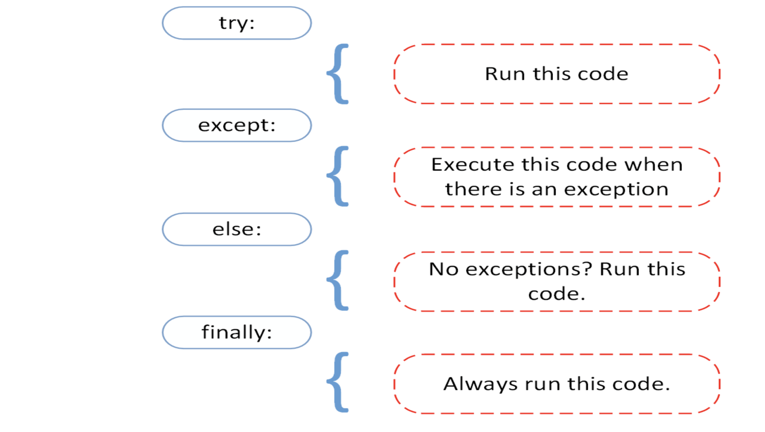
Exception Handling

Slide 6
try, except, else, finally
try: all operations are done within this block. .
except: this block will get executed if any exception encounters
else: this block will get executed if no exception is found.
finally: this block will get executed every time irrespective of exception.

Slide 7
Handling Exception
a = int(input("Enter a:"))
b = int(input("Enter b:"))
c = a//b
print("a/b = ",c)
print("Program Executed Successfully")
a = int(input("Enter a:"))
b = int(input("Enter b:"))
try:
c = a//b
print("a/b = ",c)
except:
print("Error Handled")
print("Program Executed Successfully")

Slide 8
Handling Exception
try:
a = int(input("Enter a:"))
b = int(input("Enter b:"))
c = a//b
print("a/b = ",c)
print(x)
except NameError:
print("Name Error Handled")
except ValueError:
print("Value Error Handled")
except ZeroDivisionError:
print("Division by Zero Error Handled")
except Exception:
print("Exception Handled")
else:
print("Program Executed Successfully")
finally:
print("Always Executes")

Slide 9
Handling Exception
try:
a = int(input("Enter a:"))
b = int(input("Enter b:"))
c = a//b
print("a/b = ",c)
print(x)
except (Exception, NameError, ValueError, ZeroDivisionError) as e:
print("Error Handled :", e)
else:
print("No Error")
finally:
print("Always Executes")

Slide 10
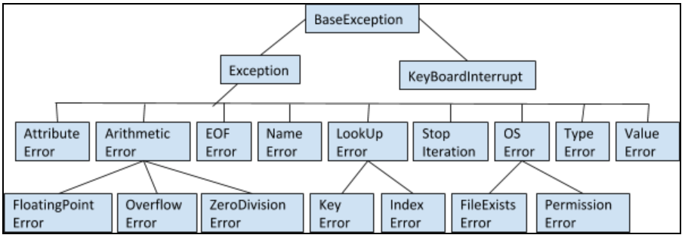
Exception Hierarchy

Slide 11
Raising an Exception
We can choose to throw an exception if a condition occurs.
To throw (or raise) an exception, use the raise keyword.

Slide 12
Raising an Exception
try:
a = int(input("Enter a:"))
b = int(input("Enter b:"))
if b==0:
raise ZeroDivisionError
c = a//b
print("a/b = ",c)
except:
print("Error Handled")

Slide 13
User defined Exception
The python allows us to create our exceptions that can be raised from the program and caught using the except clause.
In Python, users can define custom exceptions by creating a new class.
This exception class has to be derived from the built-in Exception class.

Slide 14
User defined Exception
class MyException(Exception):
def __init__(self,msg):
self.msg=msg
def __str__(self):
return "Reason for not providing Voter ID: "+self.msg
class Voter:
def __init__(self,name,age):
self.name=name
self.age=age
def __str__(self):
if self.age<18:
raise MyException("Invalid Age - {}".format(self.age))
else:
print("Age is Valid")
self.id=int(input("Give ID: "))
return "{} has an age of {}, {} voter id is {}".format(self.name,self.age,self.name,self.id)
V=Voter("John",24)
V1=Voter("",16)
try:
print(V)
print(V1)
except MyException as me:
print(me)

Slide 15
Defining Clean-up Actions:
The try statement has another optional clause which is intended to define clean-up actions that must be executed under all circumstances. For example:
try:
raise KeyboardInterrupt
finally:
print('Goodbye, world!')
Goodbye, world!
KeyboardInterrupt
A finally clause is always executed before leaving the try statement, whether an exception has occurred or not. When an exception has occurred in the try clause and has not been handled by an except clause (or it has occurred in a except or else clause), it is re-raised after the finally clause has been executed. The finally clause is also executed “on the way out” when any other clause of the try statement is left via a break, continue or return statement.

Slide 16
def divide(x, y):
try:
result = x / y
except ZeroDivisionError:
print("division by zero!")
else:
print("result is", result)
finally:
print("executing finally clause")
>>> divide(2, 1)
result is 2.0
executing finally clause
>>> divide(2, 0)
division by zero!
executing finally clause
>>> divide("2", "1")
executing finally clause
Traceback (most recent call last):
File "<stdin>", line 1, in ?
File "<stdin>", line 3, in divide
TypeError: unsupported operand type(s) for /: 'str' and 'str'

Slide 17
Predefined Clean-up Actions
Some objects define standard clean-up actions to be undertaken when the object is no longer needed, regardless of whether or not the operation using the object succeeded or failed. Look at the following example, which tries to open a file and print its contents to the screen.
for line in open("myfile.txt"):
print(line, end="")
The problem with this code is that it leaves the file open for an indeterminate amount of time after this part of the code has finished executing. This is not an issue in simple scripts, but can be a problem for larger applications. The with statement allows objects like files to be used in a way that ensures they are always cleaned up promptly and correctly.
with open("myfile.txt") as f:
for line in f:
print(line, end="")
After the statement is executed, the file f is always closed, even if a problem was encountered while processing the lines. Objects like files provide predefined clean-up actions.

