Slide 1
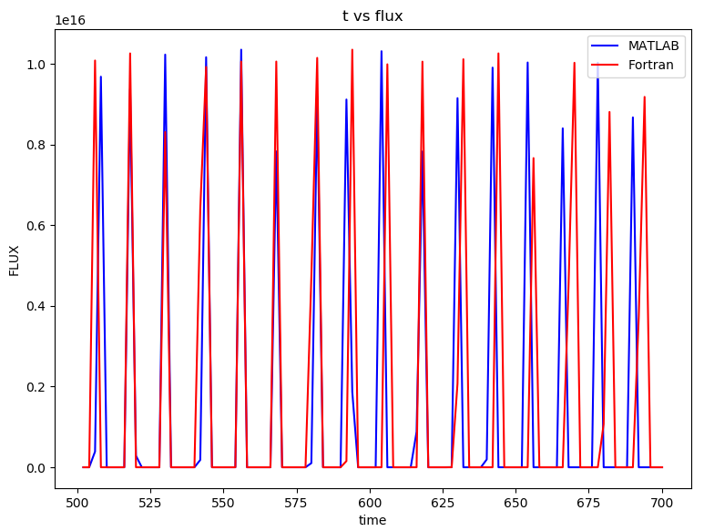
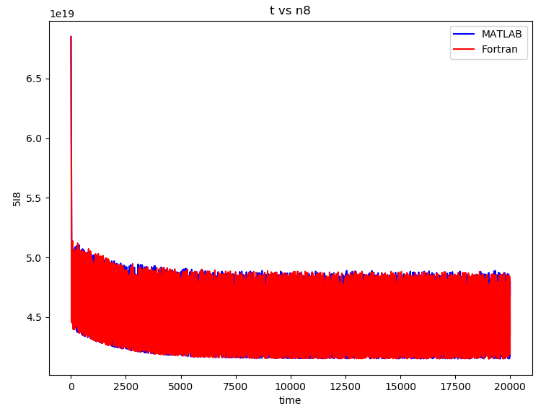
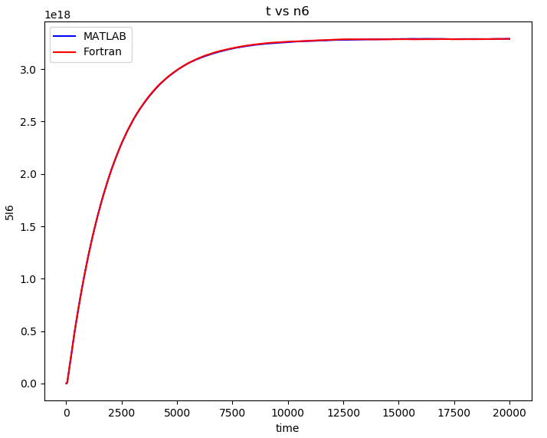
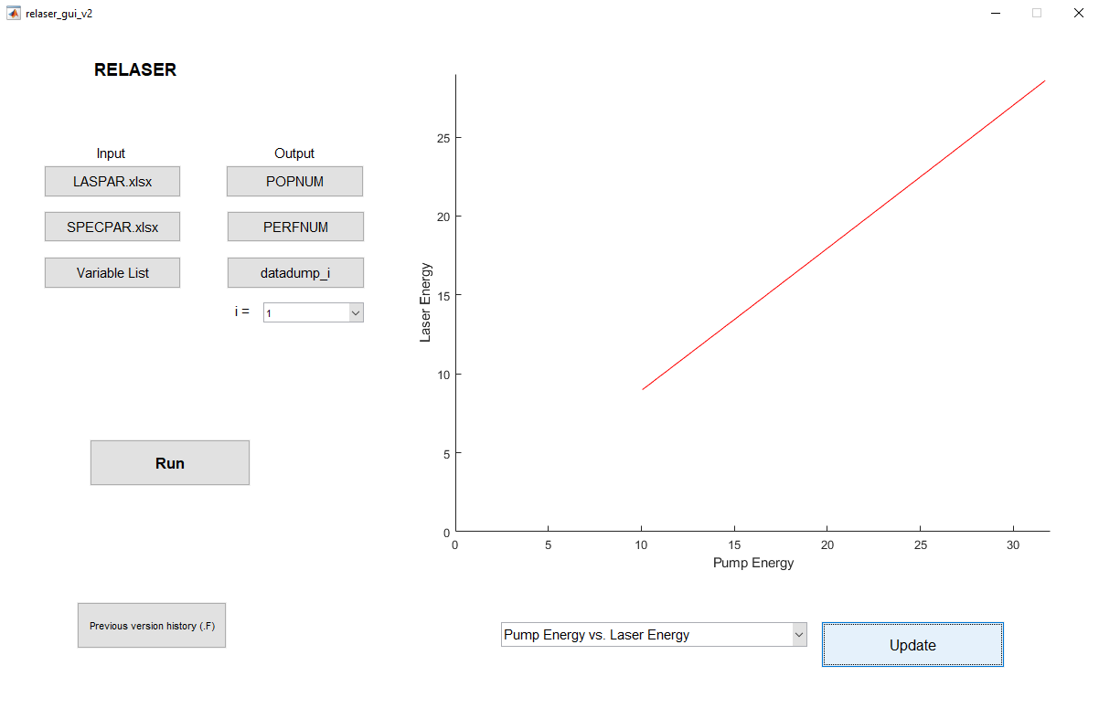
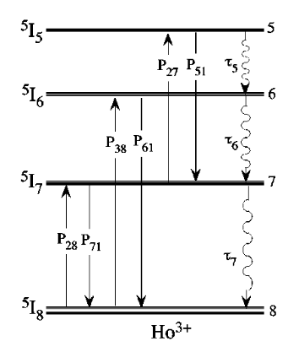
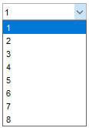
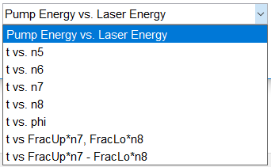
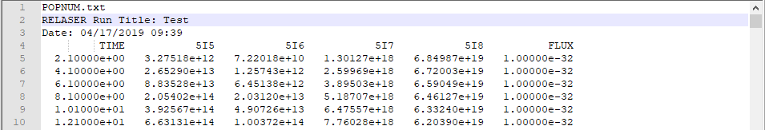
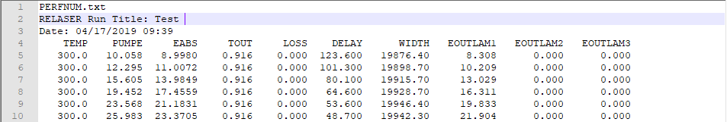
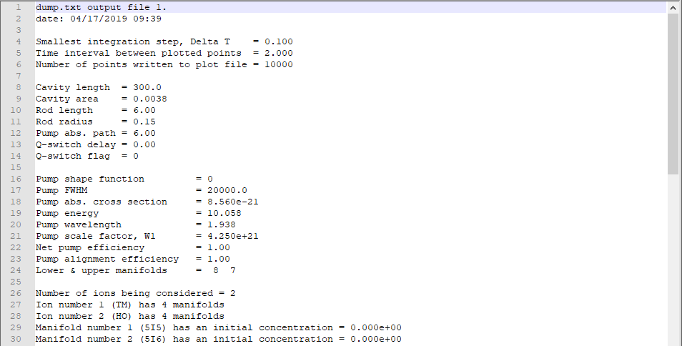
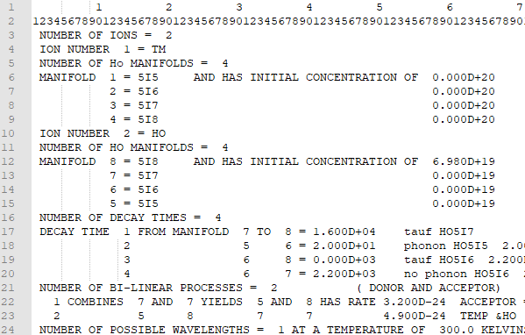
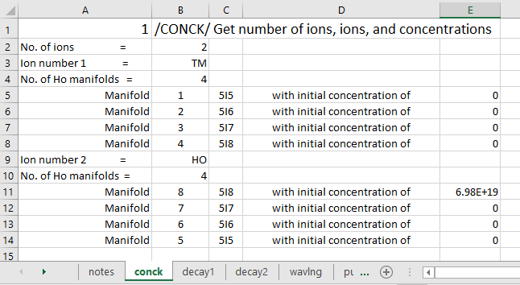

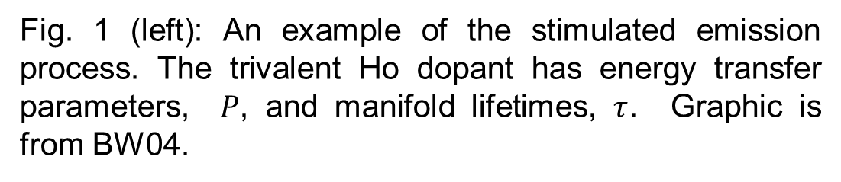
Modeling Solid State Lanthanide Lasers
Nick Wade, Frostburg State University
Brian M. Walsh, NASA Langley Research Center
Abstract
Results
When the first laser was invented in the 1960’s, it was described as a solution looking for a problem. Today, we use thousands of different types of lasers for commercial, military, and research purposes. For example, we use a diode pumped 2.0 μm Holmium (Ho) and Thulium (Tm) co-doped Yttrium Lithium Fluorine (YLF) lidar transmitter to take wind measurements in the atmosphere. In this work, we aim to rebuild a model used to evaluate the performance of lasers, such as Ho:Tm:YLF. Using a complex theoretical framework and collection of spectroscopic parameters found through experimentation, we can quantitatively assess the behavior of solid state lanthanide lasers. Not only does this model allow researchers to predict laser performance, it can also identify the advantages and their causes between changes in laser composition. Distinguishing the perks of each can be used to decide between a YLF crystal as opposed to a Lutetium Lithium Fluorine (LuLF) crystal. Translating and modernizing this model from Fortran to MATLAB will allow a broad range of scientists access to this tool and open a door for user-friendly features.
Figures 3, 4, and 5 (from left to right) show the photon flux, population change of the 8th manifold, and population change of 6th manifold, respectively. The blue line represents the current MATLAB reproduction and red shows the original Fortran output for the same parameters. Figure 3 also exemplifies the error in laser pulse width.
The program, associated files, and GUI (figure 6) were created gradually over the course of a month. The foremost issue to be resolved is the incorrect calculation of the laser pulse width. This problem can be seen visually in figure 3. Previous versions of the original program mention problems with “width increasing as Eoutlam1 is increasing,” so this may be a remnant of a past error. In order to successfully reproduce the results of BW04, this error needs to be fixed.
A possible solution is to follow the code at each iteration, through the datadump files (figure 7) and search for variables changing unexpectedly. Preliminary analysis using this method indicates the max value of pulse width errs beyond the first iteration. The appropriate fix had not yet been found.
Methods
The model judges laser performance by following a set of governing rate equations described in BW04 and OL07 that measure the populations of manifolds affecting the performance laser directly (figure 1). This model requires over 40 parameters to operate. These parameters, which are empirically found and theoretically tested are taken from BW98 and table 4 of BW04.
Fig. 1 (left): An example of the stimulated emission process. The trivalent Ho dopant has energy transfer parameters, $P$, and manifold lifetimes, $τ$. Graphic is from BW04.
Examples of the rate of change equations used for the 5th and 6th measured manifold include:
Rebuilding this model in a well-known, modern programming language grants a user more versatility through customizable interfaces, streamlined procedures, and less meticulous input and output methods (figure 2).
Figure 6 (above): The MATLAB GUI can be used to execute a run, update input parameters, open output files, view a list of the variables used in the program, see past Fortran version history, and plot data from the previous run.
Figure 7 (right): Examples of the updated output files. POPNUM.txt shows the populations of selected manifolds over time, see figures 3-5 for their plots. PERFNUM.txt outputs laser performance data, such as pump energy, total loss, and pulse width. datadump_i.txt displays debugging data in each iteration of pump energies. This file describes the effects each individual process has on the overall laser performance.
$$\frac{dn_{5}}{dt}=−\frac{n_{5}}{τ_{5}}+n_{2}n_{7}p_{27}−n_{5}n_{1}p_{51},$$
$$\frac{dn_{6}}{dt}=−\frac{n_{6}}{τ_{6}}+\frac{β_{56}}{τ_{5}}{n_{5}−n}_{6}n_{1}p_{61}+n_{3}n_{8}p_{38}.$$
Improvements
Several future updates to further improve the MATLAB reproduction include:
Fix the current error in pulse width.
Successfully reproduce more test cases, and specifically reproduce BW04.
Solve the rate of change equations using a differential equation solver instead of step-wise integration.
Improve code efficiency and expand generality (memory pre-allocation, ode solver, different I/O, etc.)
Keep helpful comments for the code and a detailed version history to aid future users.
References
B.M. Walsh, N.P. Barnes, & B. Di Bartolo. (1998). “Branching Ratios, Cross Sections, and Radiative Lifetimes of Rare Earth Ions in Solids: Application to Tm3+ and Ho3+ Ions in LiYF4,” Journal of Applied Physics. (BW98)
B.M. Walsh, N.P. Barnes, M. Petros, J. Yu, & U.N. Singh. (2004). “Spectroscopy and modeling of solid state lanthanide lasers: Application to trivalent Tm3+ and Ho3+ in YliF4 and LuLiF4,” Journal of Applied Physics. (BW04)
O. Louchev, Y. Urata, N. Saito, & S. Wada. (2007). “Computational model for operation of 2 μm co-doped Tm, Ho solid state lasers,” Optical Society of America. (OL07)
Fortran imports data in .DAT format
MATLAB imports data in .XLSX format
Fig. 2: Bookkeeping with columnar-rigid data in Fortran is difficult. Importing data in MATLAB using MS Excel makes it easier to add and edit data, but could have unfavorable effects on program speed.

