Slide 1

Quick Docs: AI-Powered Document Access
Empowering AI features to access information for everyone, everywhere.

Slide 2



Meet the Unstoppable Force
Our team brings together diverse expertise to build Quick Docs, an innovative solution for accessible information.
Rajeswar Yadav
Jyothi Swaroopa
Team Lead: Manages project, handles full-stack development, ensures architecture alignment, and manages AI, cloud, and security integrations.
Team Member: Designs and implements user interface with React Native, focusing on accessibility, multilingual support, and smooth interactions.
Lova Reddy
Team Member: Develops secure backend services using Node.js, MongoDB, and cloud integration, implementing encryption and AI pipelines securely.

Slide 3

The Problem: Information Overload & Barriers
In today's data-driven world, individuals and organizations face significant challenges in accessing and utilizing information.
Overwhelmed by Documents
Language & Tech Barriers
Large volumes of documents, reports, and academic content are scattered across various formats (PDFs, images, text files), making information retrieval time-consuming and inefficient.
Language barriers prevent users from accessing critical information in their native tongue, limiting opportunities and widening inequalities, especially for non-English speakers or those not tech-savvy.
Inefficient Search
Time taking during Critical Moments
Searching for specific information, particularly across multiple documents, is a major hurdle, leading to lost productivity and missed opportunities in various sectors.
Information retrieval during emergencies where time is critical. Reading entire documents when they only need a small piece of information.

Slide 4
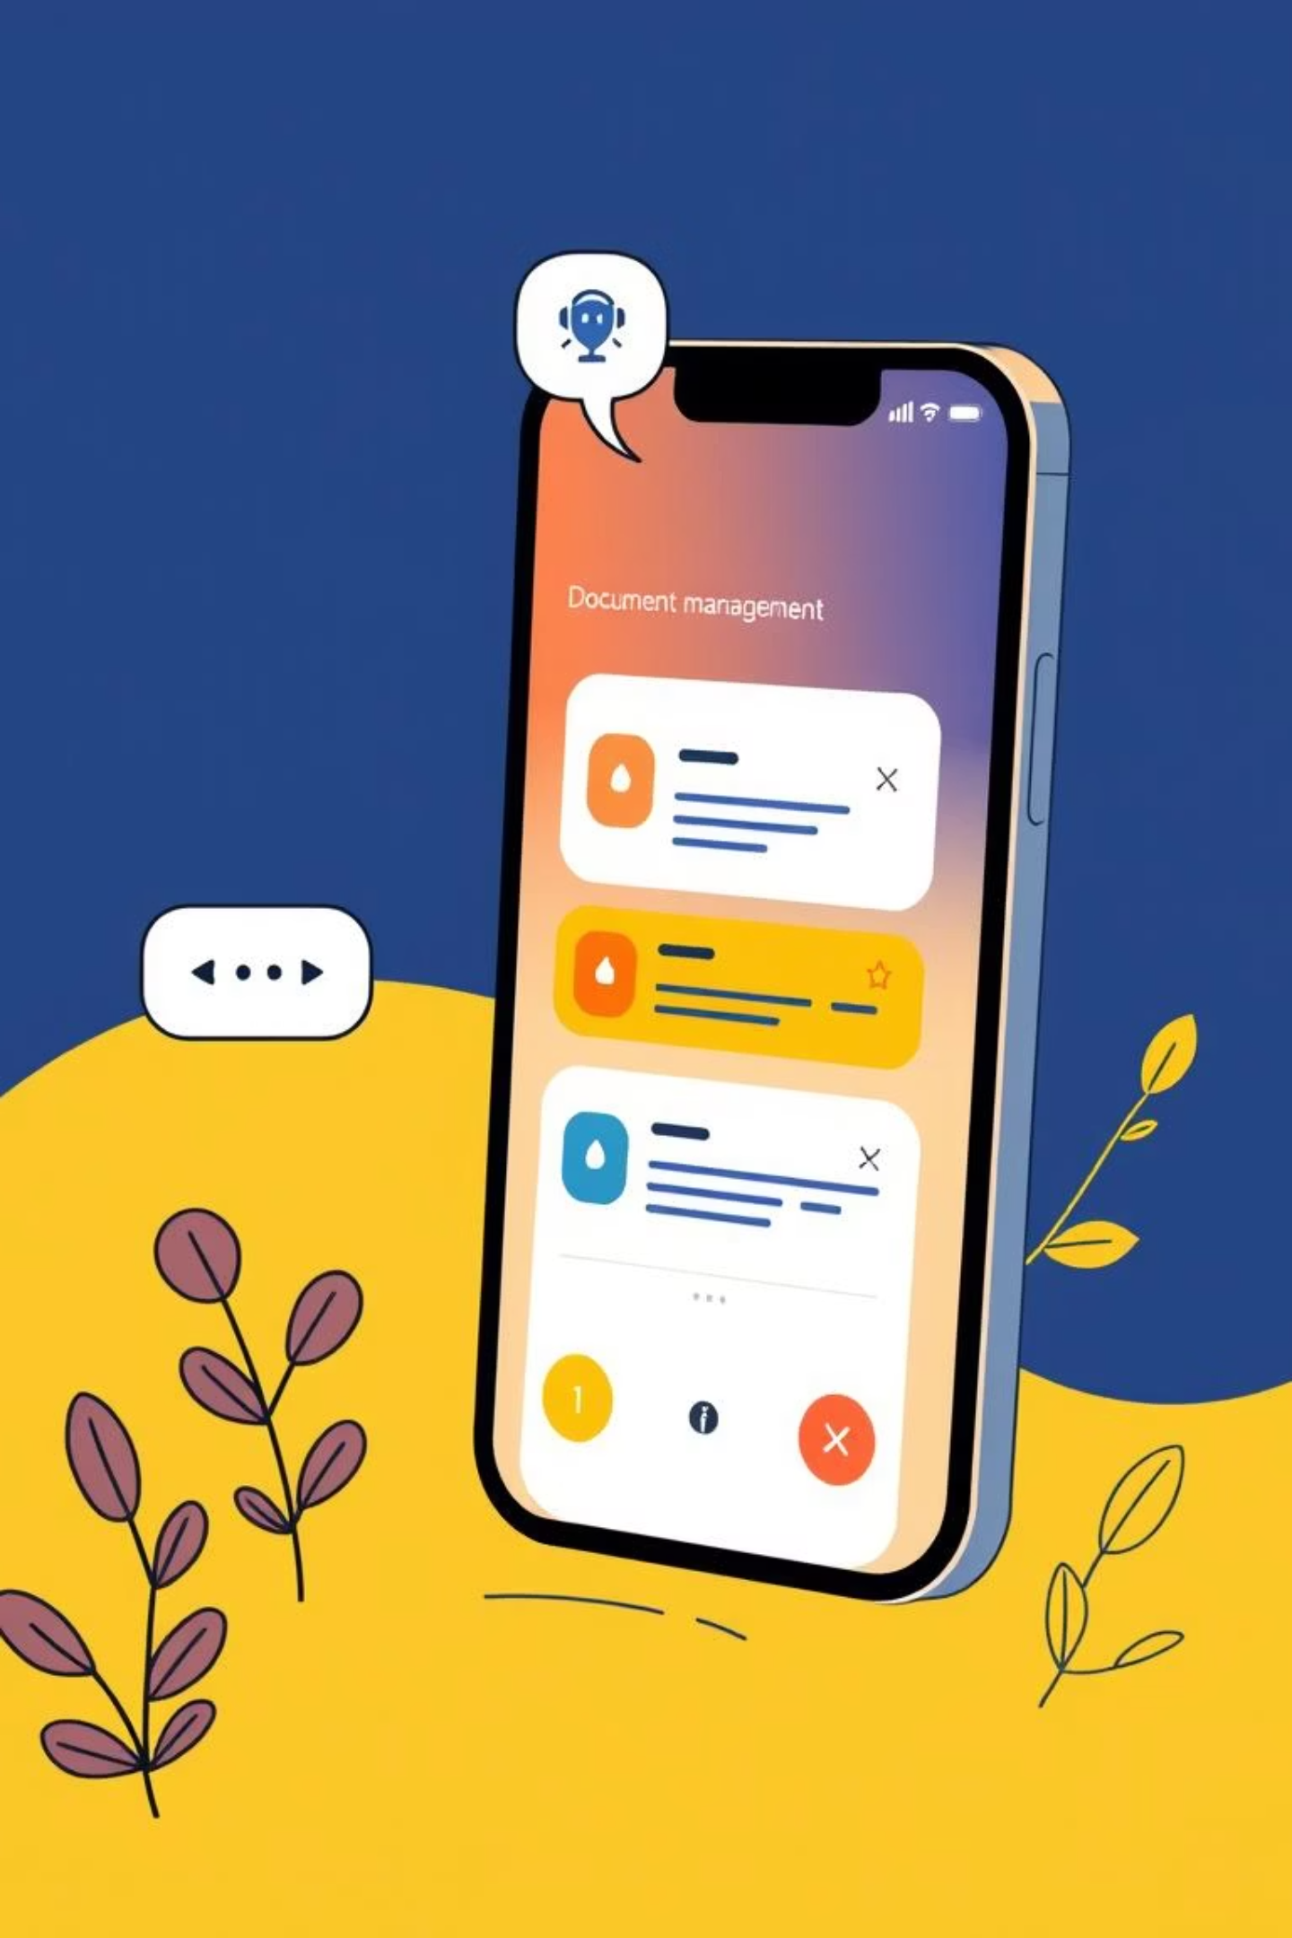

Introducing Quick Docs:
Our AI-Powered Solution
Quick Docs is an AI-powered mobile application designed to simplify document access and retrieval, making it inclusive, multilingual, and secure for everyone.
Instant Retrieval
1
Retrieve information instantly via a text-based AI chatbot or multilingual
voice assistant (supports Regional Language Talkback ability).
Content Indexing
2
Extract and index content using OCR and Google Cloud’s Vision API for easy search and access by storing them as vector embeddings.
Secure Storage
3
Upload and store user documents in the supported formats
( like PDF, JPG, JPEG, PNG, DOCX ) securely on the Google Cloud Platform.

Slide 5





Key Features: Bridging Gaps
Quick Docs empowers users to access critical data instantly and confidently, irrespective of location, literacy, or language.
Multilingual Voice Assistant
Currently supports Telugu, Hindi, and English, with plans for expansion. Communicate naturally without typing.
Text-Based AI Chatbot
Engage with an intelligent chatbot for quick and accurate query responses from your documents.
Robust Data Security
Ensures data privacy by encrypting sensitive information using AES standards, protecting your valuable content.
Premium Services
Offers prioritized access and enhanced features like advanced voice interaction for premium users.

Slide 6

Expected Impact & Benefits
Quick Docs is set to transform how people interact with information, fostering a more equitable and productive society.
Inclusion
Breaks language barriers with multilingual voice support, making information accessible to diverse communities.
Efficiency
Reduces time spent searching documents, significantly improving productivity for individuals and organizations.
Accessibility
Democratizes access to educational, medical, and governmental information for all, regardless of literacy or location.
Security
Protects sensitive data through advanced encryption standards, ensuring user privacy and trust.
Empowerment
Helps students, teachers, healthcare workers, and farmers access information in their native language, leading to better decision-making.
Social Impact
Bridges the gap between technology and underserved communities, aligning with crucial social equity goals.

Slide 7


Resource Requirements for Quick Docs
Developing and deploying Quick Docs requires a strategic allocation of technical, human, and financial resources, alongside key partnerships.
Technical Resources
Financial Resources
Cloud infrastructure (Google Cloud Storage, APIs, Node.js, Express.js)
Cloud hosting services
Licensing for third-party APIs
MongoDB for encrypted data storage
Development and maintenance costs
AI services (NLP and OCR tools)
Time & Partnerships
Mobile development tools (React Native, Expo)
MVP development (1–2 months)
Human Resources
Testing with pilot user groups
Business People, Students, Working Professionals, Educational institutes, NGOs, healthcare providers for pilot testing
AI engineers, Backend, Frontend developers
UI/UX designers focused on accessibility

Slide 8

Aligning with D3CODE 2025: Data, Intelligence, Social Impact
Quick Docs perfectly aligns with the D3CODE 2025 theme, leveraging data and intelligence to create significant positive social impact.
Data Transformation
AI-Driven Intelligence
Converts unstructured data (documents, images, PDFs) into searchable, structured knowledge, managing vast amounts of information securely in the cloud.
Implements AI-driven NLP models and OCR to understand, index, and respond to queries intelligently, with multilingual interaction adapting to user preferences.
Profound Social Impact
Reduces the digital divide, assists professionals in critical sectors, and promotes inclusivity by enabling access to knowledge for all, especially underserved communities.

Slide 9
Validating the Need & Competitive Edge
There is a demonstrated need for Quick Docs across multiple sectors, and our unique feature set provides a strong competitive advantage.
Demonstrated Need
Competitive Landscape
Education: Students struggle with textbooks, especially in rural areas with minimal regional language support.
While related products exist, no direct competitor offers Quick Docs exact combination of features:
Healthcare: Doctors need quick access to medical records and protocols in emergencies.
Google Lens / Adobe Scan / Microsoft Office Lens: Lack document indexing, AI-driven search, and multilingual voice interaction.
Business: Employees waste hours searching for reports and files.
ChatGPT/ Conversational AI: Not integrated into secure document storage or indexing environments.
Agriculture: Farmers need real-time market rates and weather reports, often hindered by language/literacy gaps.
Quick Docs differentiates itself by combining document management, AI search, security encryption, and multilingual voice interaction, tailored for real-world users.
User research shows a significant preference for voice-based interaction and a demand for accessible information retrieval.

Slide 10

Technologies & Architecture: Our Foundation
Primary Technologies
Languages: JavaScript (Node.js, React Native), Python (for AI/NLP)
Databases: MongoDB (with AES encryption)
Cloud & APIs: Google Cloud Storage, Google Cloud Vision API, OpenAI API
Frameworks: React Native with Expo, Express.js
Security: AES-256 encryption, JWT tokens, OAuth
Voice: Google Speech-to-Text API
Conceptual Architecture
→ Users upload documents
→ AI parses and indexes content
→ Data stored securely
→ Users search via text or voice
→ AI retrieves and responds instantly
→ Users manage documents through a secure interface.
Last Word: Quick Docs is more than a document viewer—it’s a bridge between technology and real-world needs. By leveraging AI and secure data handling, it empowers users to access information in the way that best suits them: by voice, language, or text. It’s designed not only to improve productivity but also to foster inclusivity, especially in regions where language and literacy barriers prevent access to critical information. Quick Docs aligns perfectly with D3CODE 2025’s goal of using data and intelligence to create positive social impact, and it has the potential to transform how people interact with information globally.

