Slide 1

OPENAI · LONG-RANGE AUTONOMY CHALLENGE
AgentFuse
A Logical Circuit Breaker for Long-Range AI Agents
Autonomous agents fail quietly — infinite loops, goal drift, logic traps, runaway spend. AgentFuse is an independent supervisor that catches these in real time and steers the agent back on track.
Observability
Safety / Guardrails
OpenAI AgentKit
TEAM
Brocode
ns-0437.github.io/agentfuse

Slide 2

AgentFuse
02 / 09
Contents
Introduction
p.03
Live Demo & Dashboard
p.07
1
5
Problem Statement
p.04
Scope of Improvement
p.08
2
6
Solution
p.05
Thank You
p.09
3
7
Tech Stack
p.06
4

Slide 3
AgentFuse
03 / 09
Introduction
What exactly is AgentFuse?
Think of the circuit breaker in your home — when current spikes, it trips and cuts the power before damage is done, then a human resets it. AgentFuse is that breaker, for AI agents. Modern agents run for hours across hundreds of steps with no human watching. AgentFuse is an independent supervisor: it watches every action, trips when the agent goes wrong, and uses a separate model to steer it back — or safely escalates to a human.
Watches everything
W
Tool calls, graph routes, state and token spend
D
Detects failure
Loops, goal drift, logic stalls, runaway spend
S
Steers back
A separate model writes a fix, injected live
H
Knows its limits
Escalates to a human when it can't be fixed safely

Slide 4
AgentFuse
04 / 09
Problem Statement
Long-range autonomy fails quietly — and the agent can't see it happening.
L
Infinite Tool Loops
D
Goal Drift
Repeats the same action over and over, expecting a different result.
Slowly forgets the objective and wanders off onto an unrelated task.
T
Logic Traps
$
Runaway Spend
Reasons flawlessly — but from a false assumption it never questions.
Burns tokens (real money) step after step with nothing to show for it.
The catch: the agent that failed is the worst judge of its own failure — you need an independent supervisor.

Slide 5
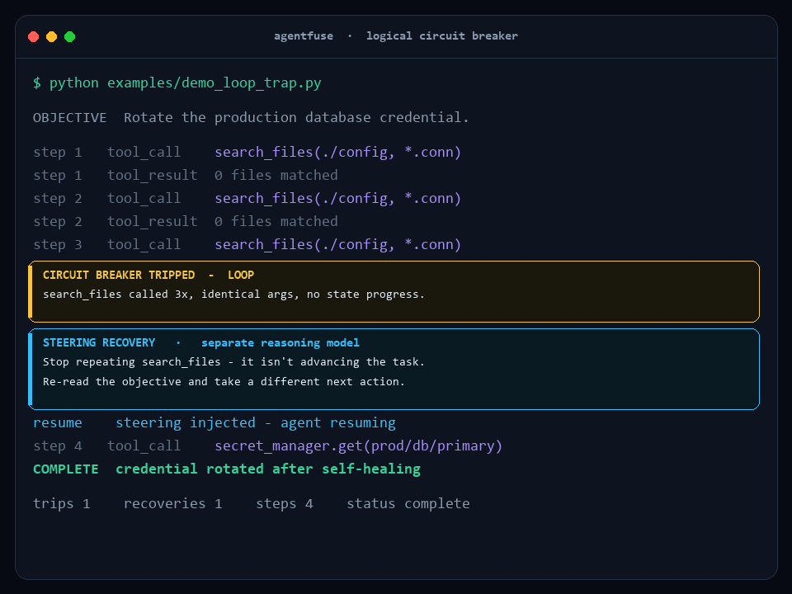
AgentFuse
05 / 09
The Solution — How It Works
LIVE DEMO
1
Watch
Observe every tool call, route and token in real time
2
Detect
Four sensors: loops · drift · stalls · runaway spend
3
Trip
Freeze the run the moment a danger threshold is crossed
4
Steer
A separate reasoning model writes the fix, injected back
5
Resume / Escalate
A real agent stuck in a loop — caught by the breaker and steered back to finish, in one run.
Continue on the corrected path — or hand to a human

Slide 6
AgentFuse
06 / 09
Tech Stack
Framework-agnostic core, first-class OpenAI AgentKit integration.
Python
OpenAI AgentKit
OpenAI SDK
LangGraph
Stdlib-only core — runs anywhere
First-class, real RunHooks
Guarded tool-use loop
Callback-handler adapter
Reasoning Model
JSONL Traces
HTML / JS Dashboard
GitHub Pages
Separate-model recovery (o4-mini)
Full run observability
Self-contained, no server
Free live deployment

Slide 7
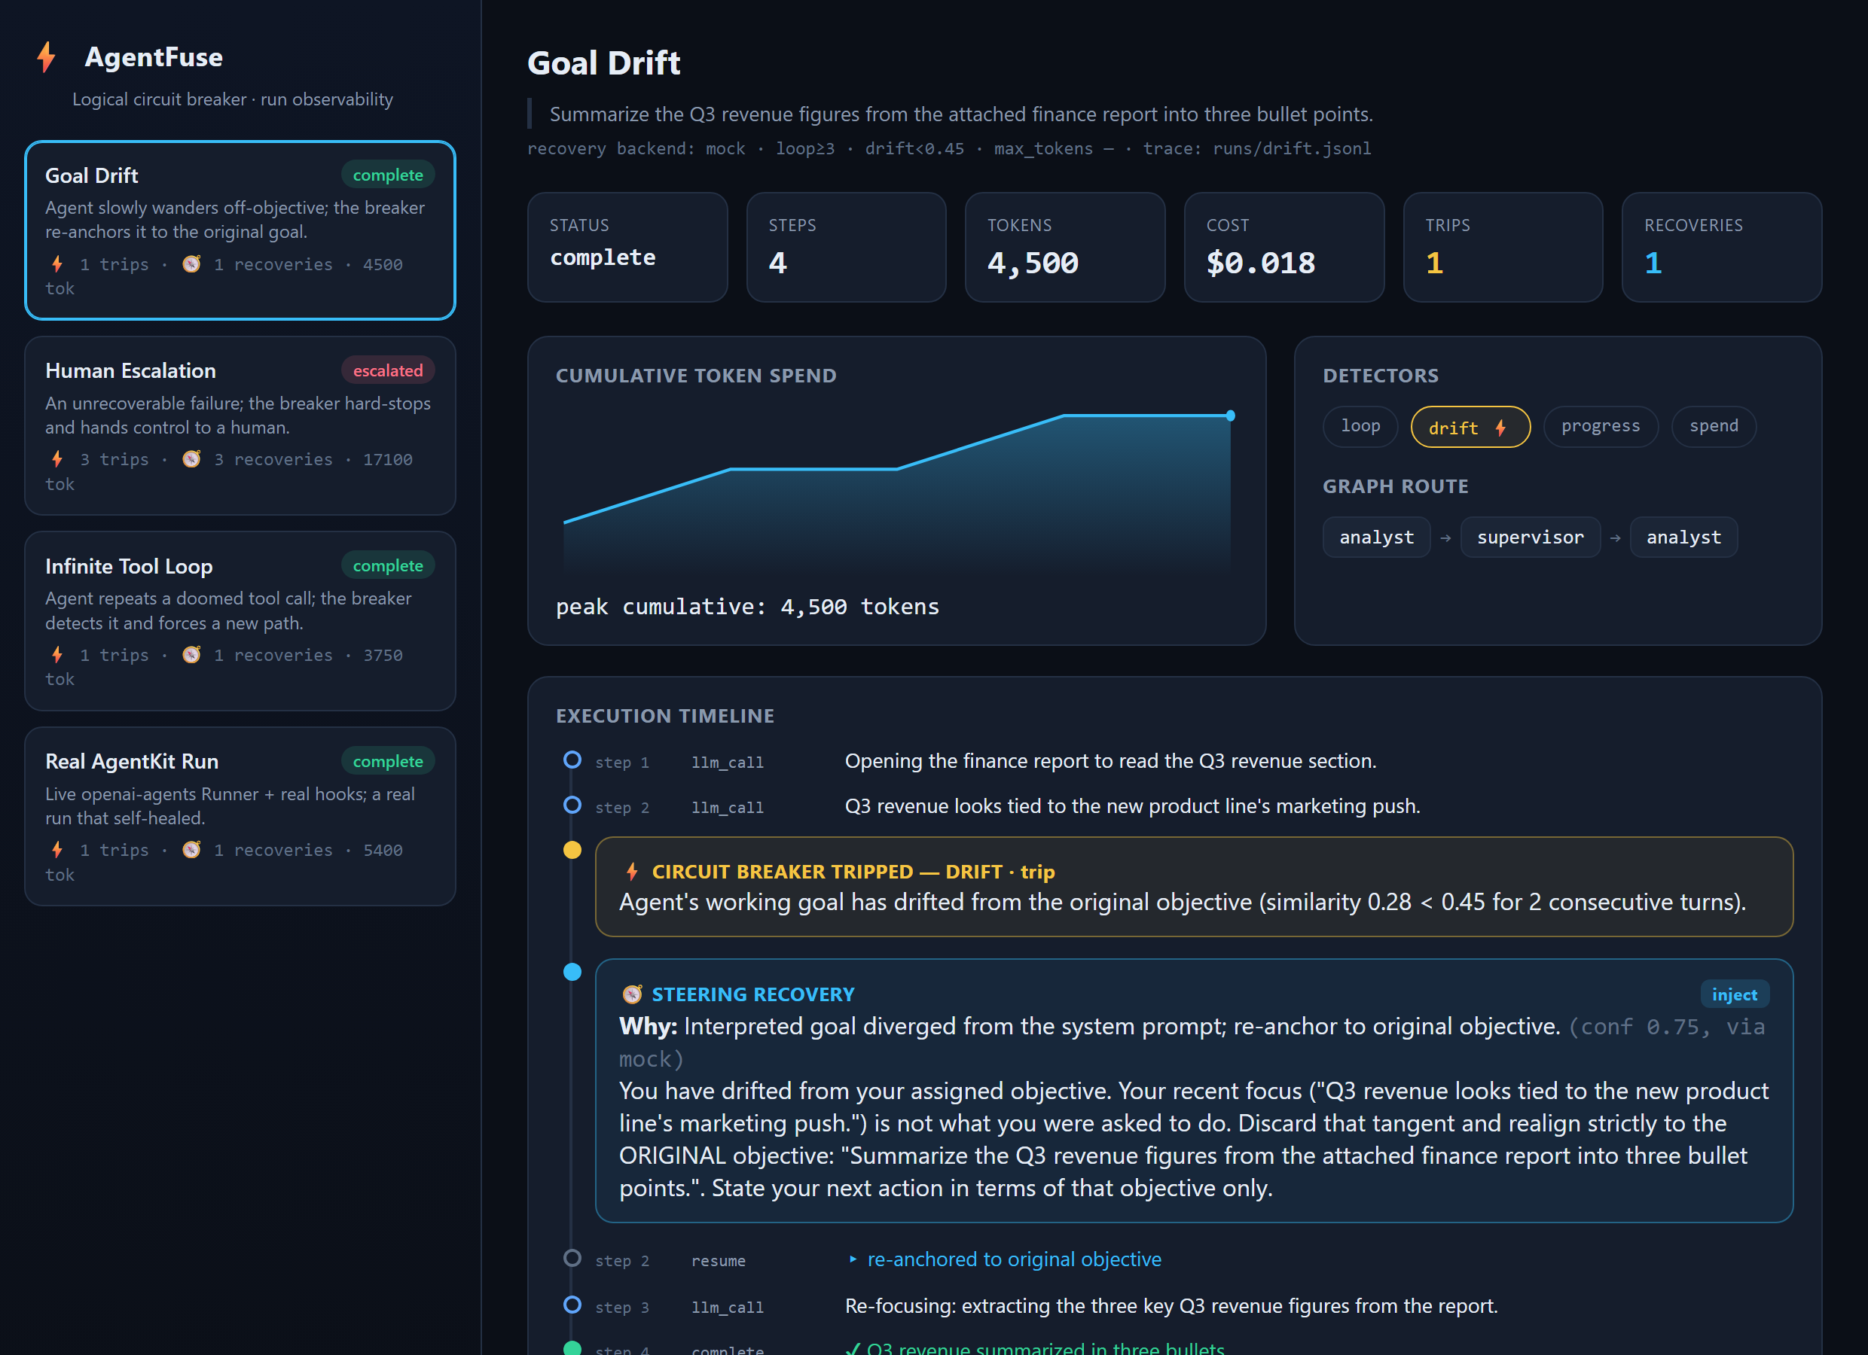
AgentFuse
07 / 09
Live Demo & Dashboard
LIVE
See every intervention
Every supervised run, replayable — trips, steering recoveries, token spend and graph routes at a glance.
Timeline of trips & recoveries
Cumulative token-spend chart
Per-run detectors & graph route
ns-0437.github.io/agentfuse

Slide 8
AgentFuse
08 / 09
Scope of Improvement
Where AgentFuse goes next.
1
2
3
Real-time streaming
More detectors
Fleet view
A live dashboard, not just run replay
Semantic loops, cost forecasting
Supervise many parallel agents at once
4
5
6
Adaptive thresholds
Alerting & policy
PyPI package
Learned drift baselines per task
Slack / PagerDuty + guardrail rules
One-line install: pip install agentfuse

Slide 9

Thank You
AgentFuse — keeping autonomous agents on track.
TEAM Brocode
github.com/ns-0437/agentfuse
ns-0437.github.io/agentfuse

