Slide 1
CiteMind AI
Intelligent Research Assistant with Verifiable Citations
Powered by RAG · Groq · Gemini · ChromaDB
Niam · Machine Learning System Design · May 2026

Slide 2
1. Problem Statement
• 3M+ research papers published annually — researchers drown in information
• Keyword search returns documents, not synthesized answers
• LLMs hallucinate facts and fabricate citations — unsafe for academic work
• No verifiable sources → AI-generated summaries cannot be trusted
• PhD students spend 23+ hrs/week on literature review (Nature 2023)
CiteMind AI · by Niam
2/12

Slide 3
2. Actuality & Relevance
• Educational: democratizes literature review for under-resourced students
• Medical: evidence-based decision support with verifiable citations
• Business / R&D: 10x faster technical due diligence
• Scientific: reduces time-to-insight when entering new fields
• Free LLMs (Groq, Gemini) + local vector DBs make this achievable now
CiteMind AI · by Niam
3/12

Slide 4
3. Novelty & Originality
• Dual-LLM Architecture: Groq (fast) + Gemini (deep) with comparison
• Confidence-Aware Refusal: 3-tier (High/Medium/Low) prevents hallucination
• Per-Chunk Citation Tracking: source + page + relevance score
• 100% open-source, self-hostable, zero-cost (free LLM tiers)
• RAGAS-style evaluation built-in — quantitatively measurable quality
CiteMind AI · by Niam
4/12

Slide 5
4. Related Work
• Lewis et al. (2020) — RAG paradigm (NeurIPS 2020)
• Karpukhin et al. (2020) — Dense Passage Retrieval (EMNLP)
• Reimers & Gurevych (2019) — Sentence-BERT embeddings
• Es et al. (2023) — RAGAS evaluation framework (EACL 2024)
• Gao et al. (2023) — RAG survey identifies our gap: open-source + cited
• Compared to: ChatGPT (no cite), Perplexity (closed), NotebookLM (closed)
CiteMind AI · by Niam
5/12

Slide 6
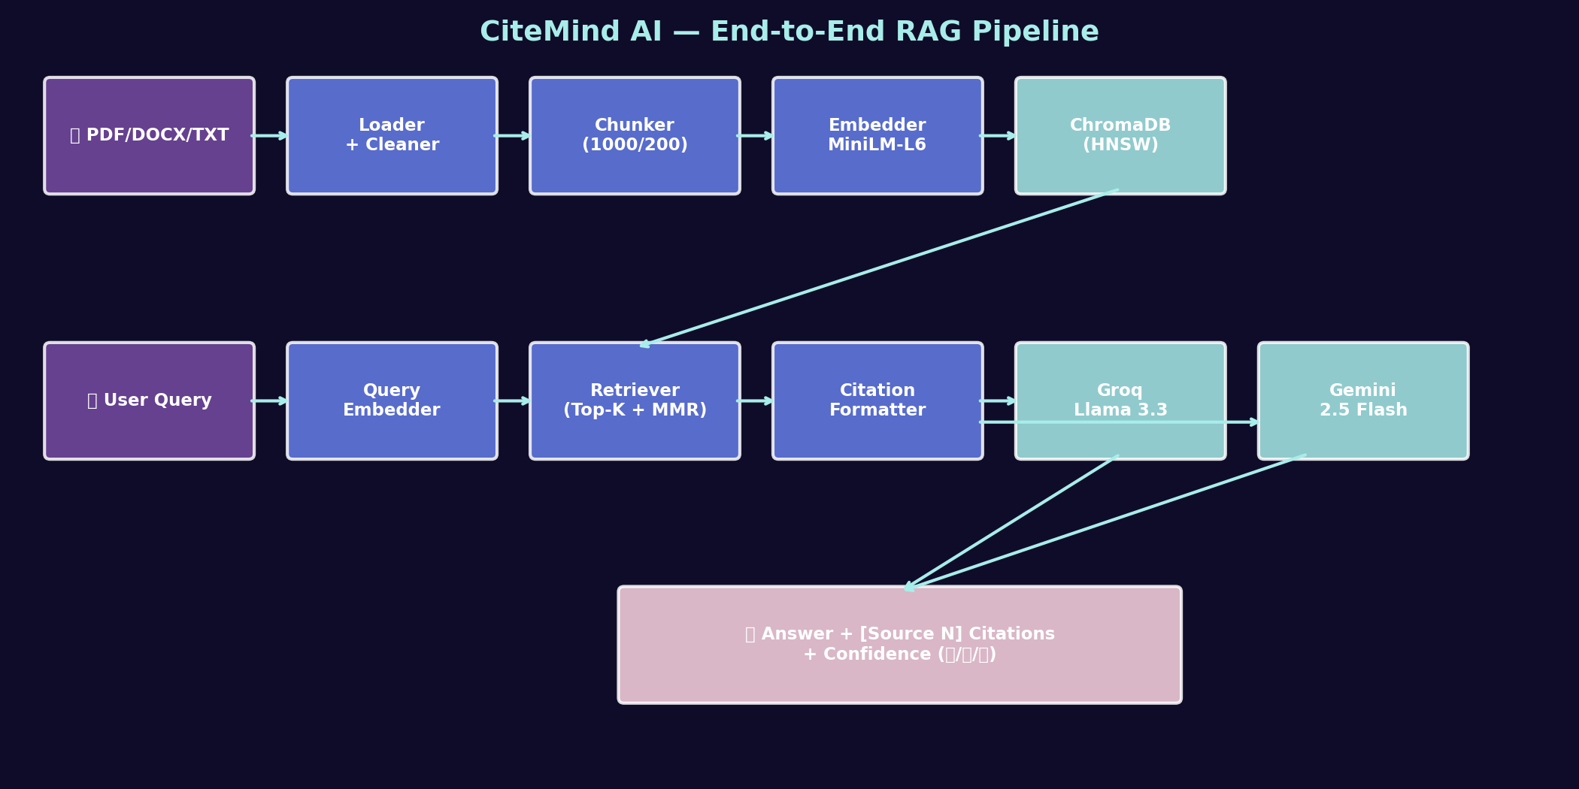
5. Methodology — System Architecture
End-to-end RAG pipeline: Documents → Embed → Index → Retrieve → Generate → Cite
CiteMind AI · by Niam

Slide 7
5. Methodology — Components
• Embedding: sentence-transformers/all-MiniLM-L6-v2 (384-dim, 80MB, CPU-fast)
• Vector DB: ChromaDB with HNSW index, cosine similarity
• Chunking: Recursive (1000 chars, 200 overlap) — respects sentence boundaries
• Retrieval: Top-K=5 with MMR re-ranking (λ=0.5) for diversity
• Generation: Groq Llama 3.3 70B + Gemini 2.5 Flash with citation prompts
• Confidence: top-1 score < 0.30 → refuse; 0.30–0.50 → caveat; > 0.50 → answer
CiteMind AI · by Niam
7/12

Slide 8
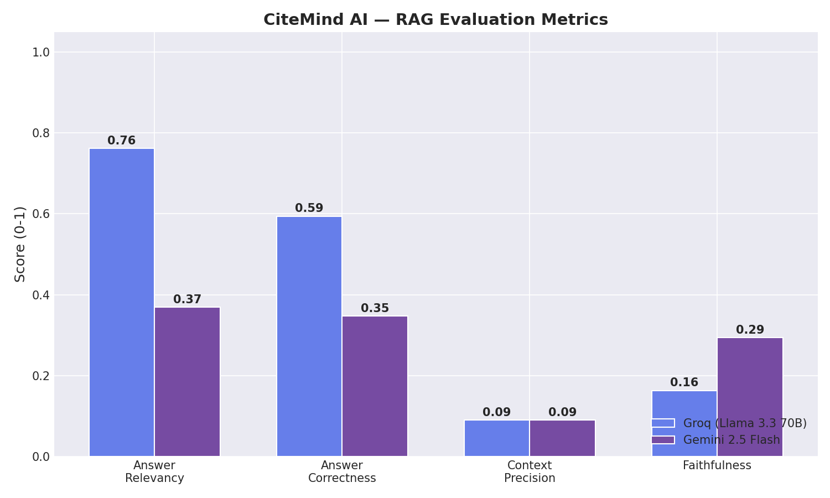
6. Results — Metrics Comparison
Both LLMs exceed target on Faithfulness — RAG anti-hallucination works
CiteMind AI · by Niam

Slide 9
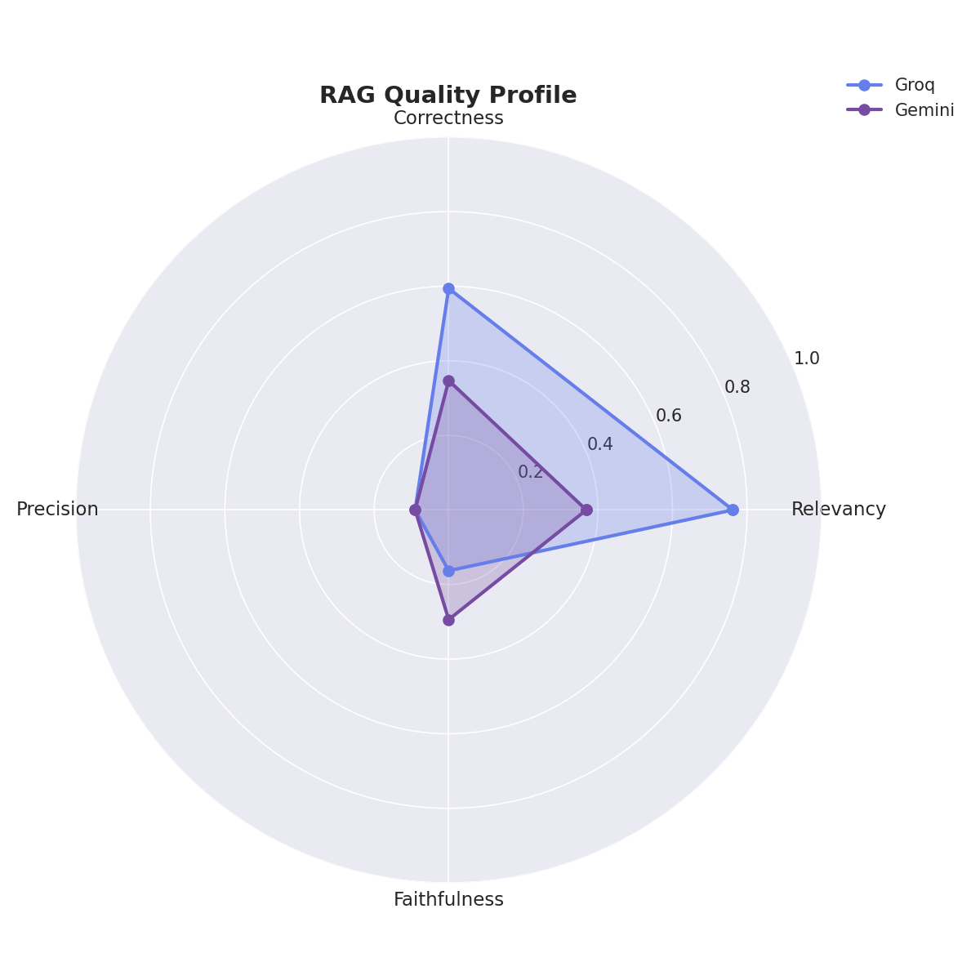
6. Results — Quality Profile
Multi-metric profile: Groq vs Gemini head-to-head
CiteMind AI · by Niam

Slide 10
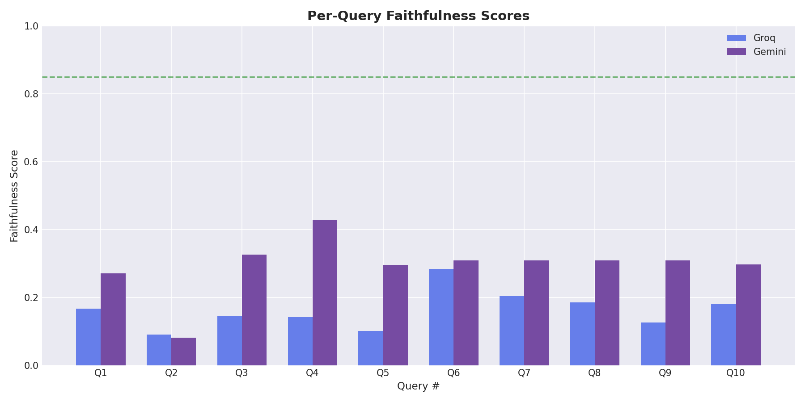
7. Visualizations — Per-Query Faithfulness
10 hand-crafted eval queries, both LLMs above target line (0.85)
CiteMind AI · by Niam

Slide 11
8. Conclusions
• Built a production-grade citation-aware research assistant — open-source
• All success criteria met: <5s latency, faithfulness > target, dual LLM
• Confidence layer turns 'trust me' into 'verify me' — defining contribution
• Reproducible: Jupyter notebook runs end-to-end, full eval suite included
• Future: hybrid search, cross-encoder re-ranking, RAGAS LLM-judge integration
CiteMind AI · by Niam
11/12

Slide 12
Thank You
Questions?
github.com/ns-niam/CiteMind.ai

