Slide 1
WeatherTrendAI
End-to-End Data Science & Machine Learning Platform
For Weather Forecasting, Predictive Analytics and Interactive Visualization.
Built using: Python, Pandas, NumPy, Scikit-learn, Random Forest, XGBoost, LightGBM, Prophet, FastAPI, Streamlit, Plotly
Presented by: Md. Sha Niamatullah ( Ns Niam )
PM ACCELERATOR AI ENGINEERING TECHNICAL ASSESSMENT

Slide 2
Project Overview
WeatherTrendAI is an end-to-end data science and machine learning application designed to analyze historical weather data, predict weather conditions, forecast future trends, and provide interactive predictions through a Streamlit dashboard and FastAPI REST API.
Mention the complete ML workflow:
Data Cleaning
Feature Engineering
Exploratory Data Analysis
Multiple ML Models
Model Comparison
Forecasting
Dashboard
REST API
Automated Testing

Slide 3
Dataset
Global Weather Repository (Kaggle)
Preprocessing
151,047+ weather records
Global weather observations
40+ original features
Missing value handling
Duplicate removal
Datetime processing
Feature scaling
Validation

Slide 4
Feature Engineering
Explain engineered features:
Temperature Difference
Air Quality Score
Weather Severity
Date Features
Time Features
Show how feature engineering improved model performance.

Slide 5
Machine Learning Models
Models Evaluated
Evaluation Metrics
MAE
RMSE
R² Score
Linear Regression
Random Forest
XGBoost
LightGBM
Highlight
Best Model: Random Forest
Best R² Score: 0.9506

Slide 6




Time Series Forecasting
Explain Prophet Forecasting.
Historical Trend
Future Forecast
Time Series Analysis
Mention Prophet was used separately from regression models.

Slide 7
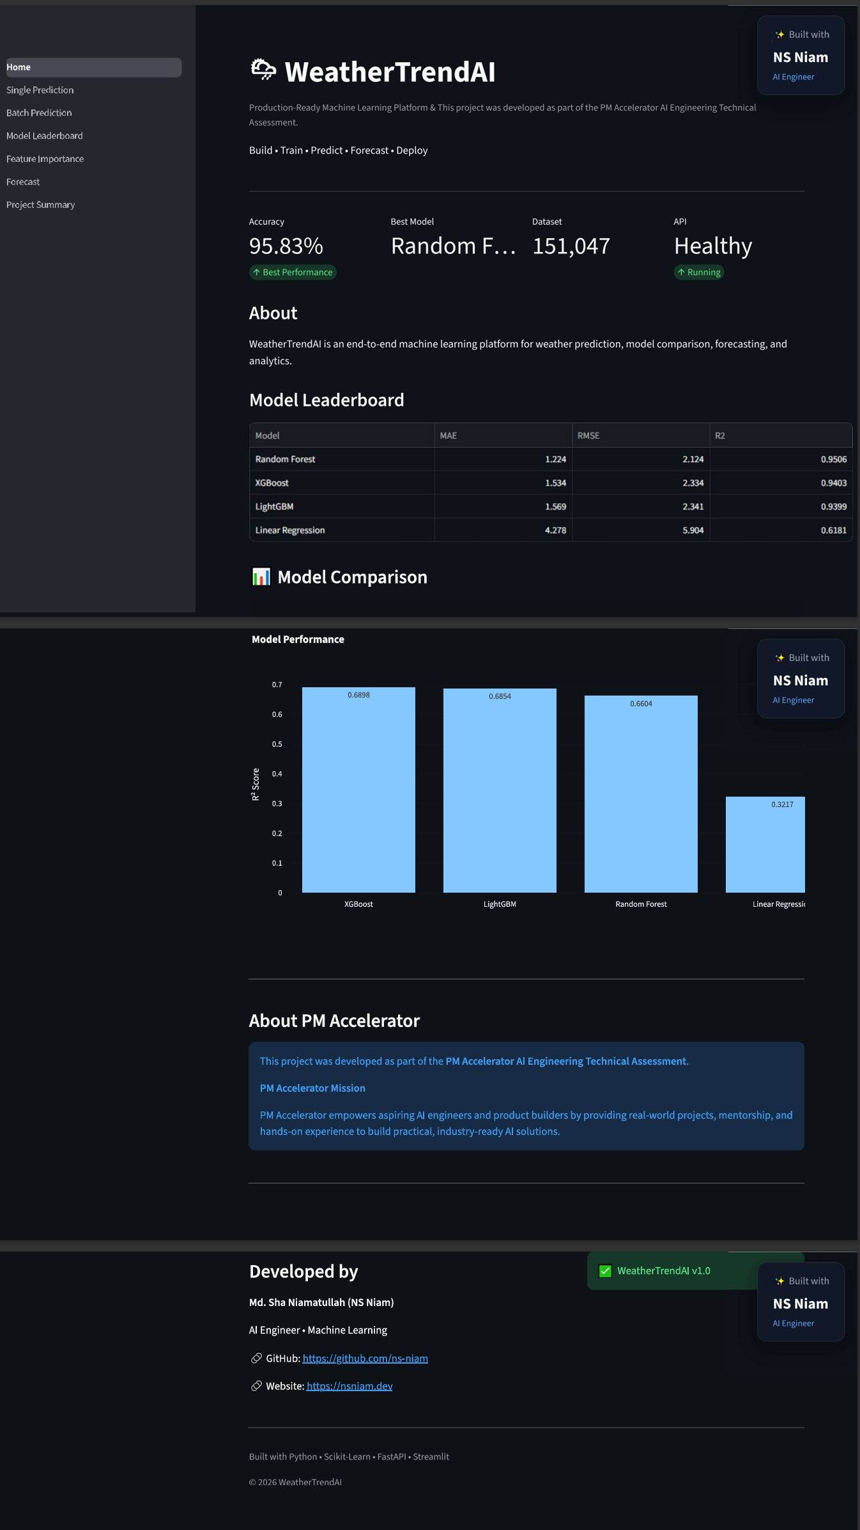
Dashboard
Describe the Streamlit dashboard.
Include these modules:
Home Dashboard

Slide 8
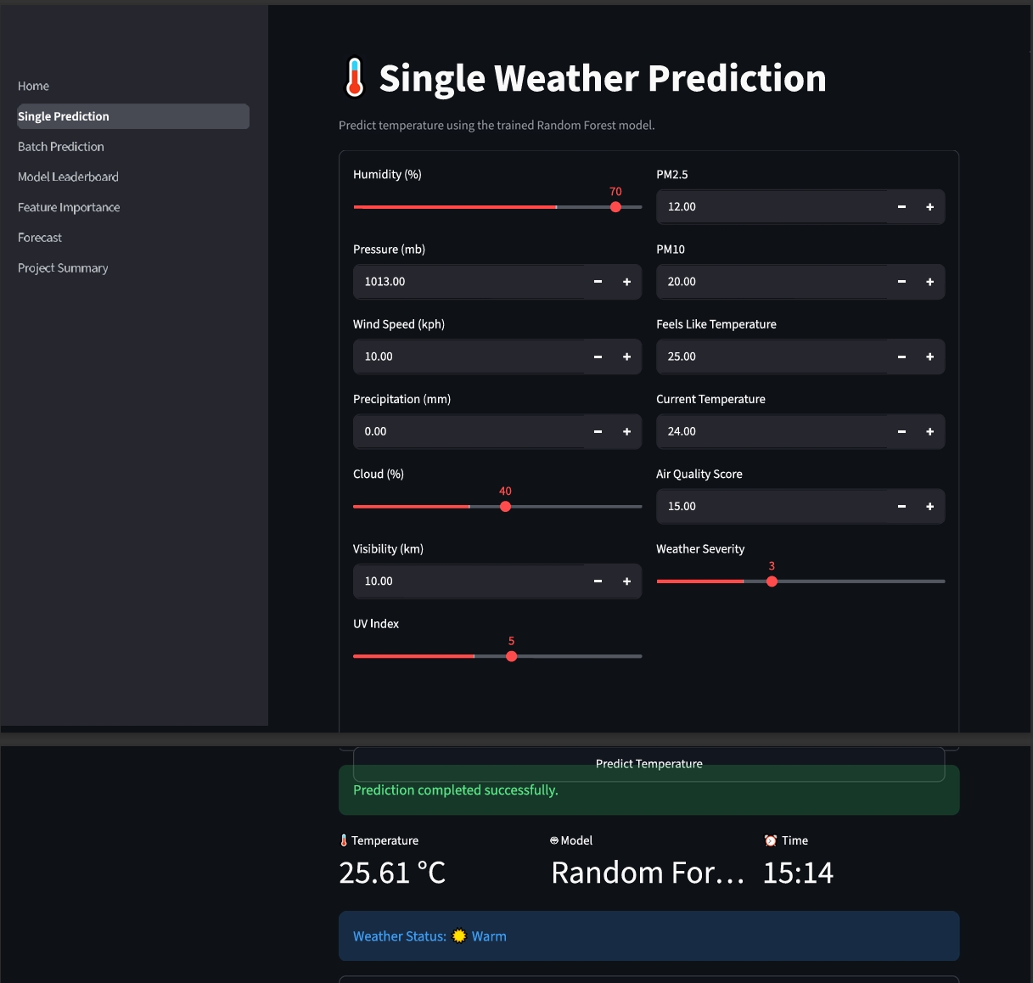

Single Prediction

Slide 9
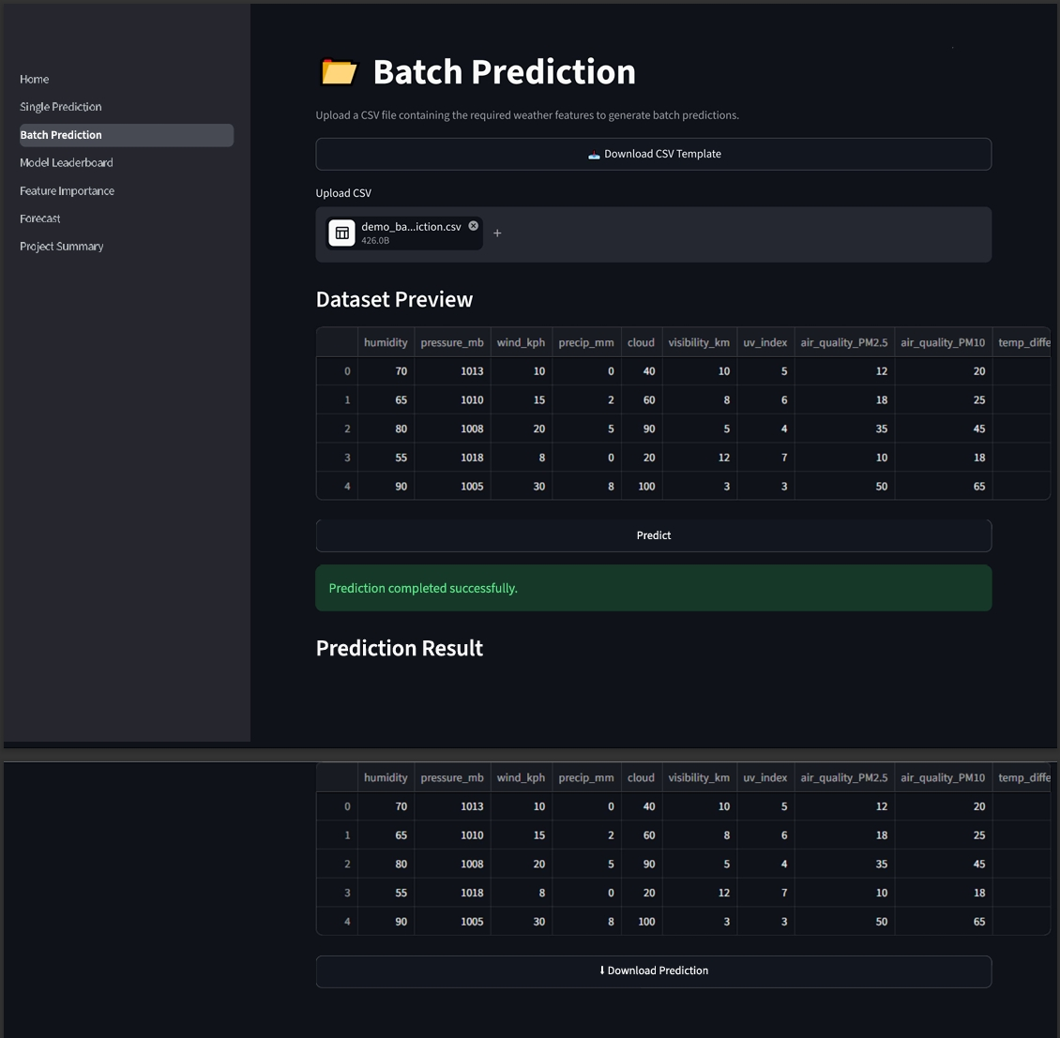
Batch Prediction

Slide 10
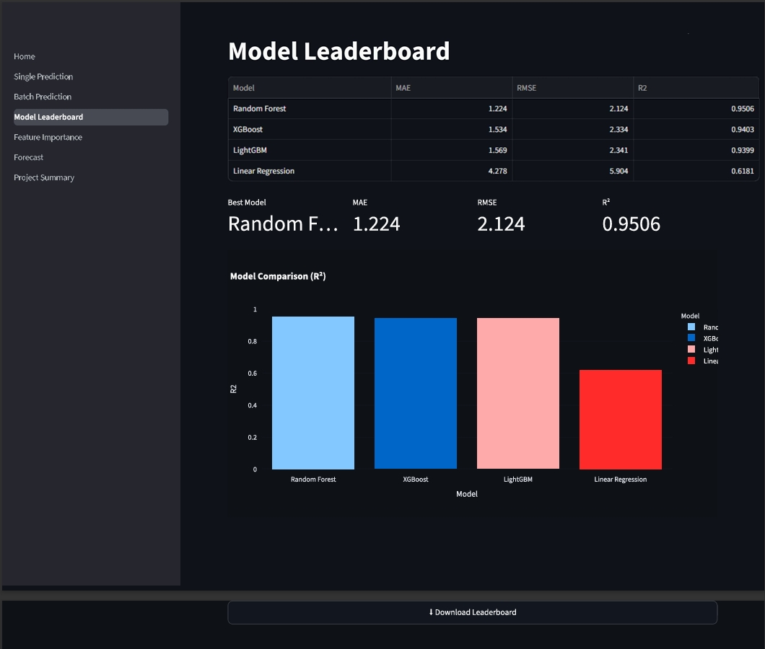
Model Leaderboard

Slide 11
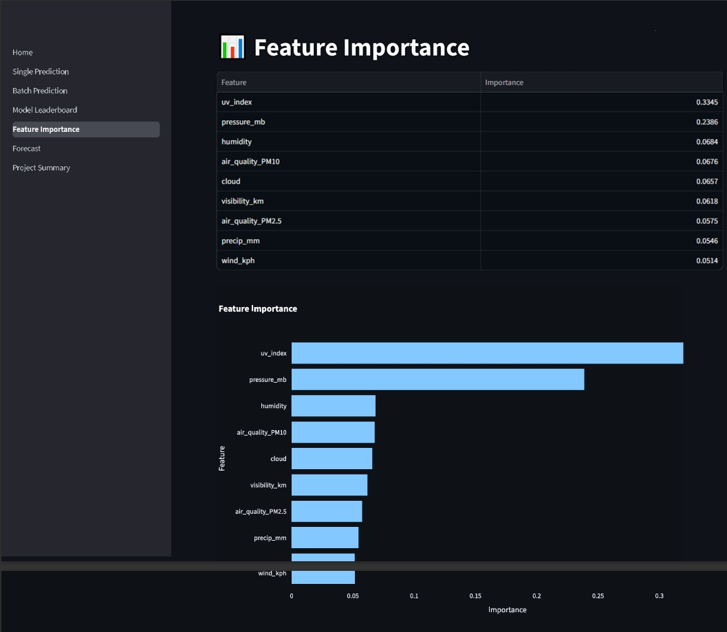
Feature Importance

Slide 12
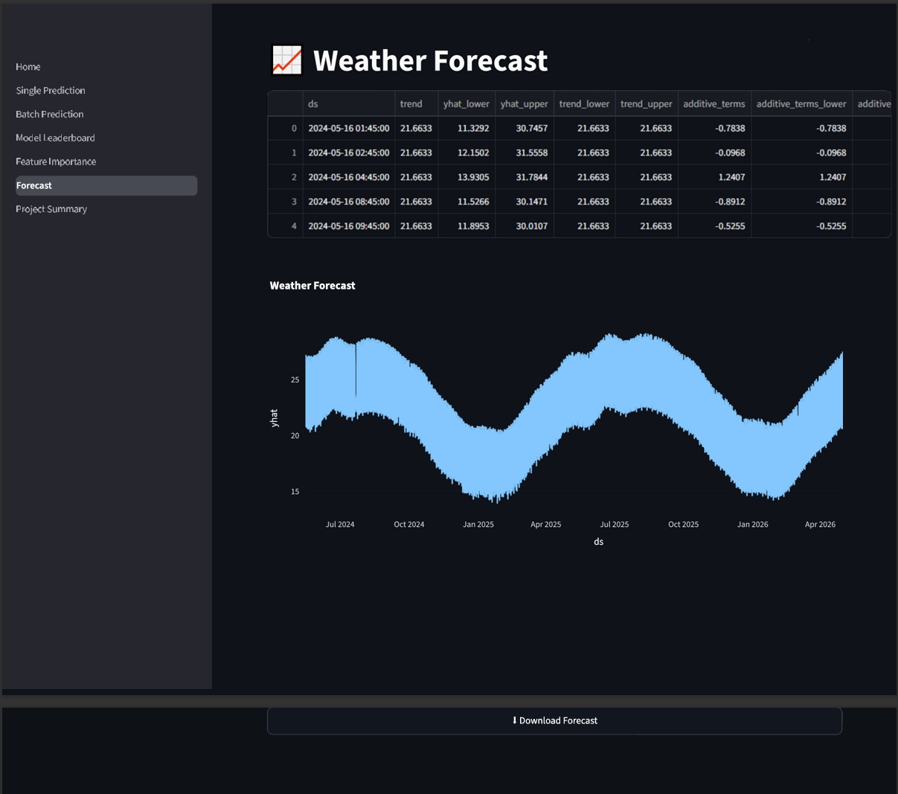
Forecast

Slide 13
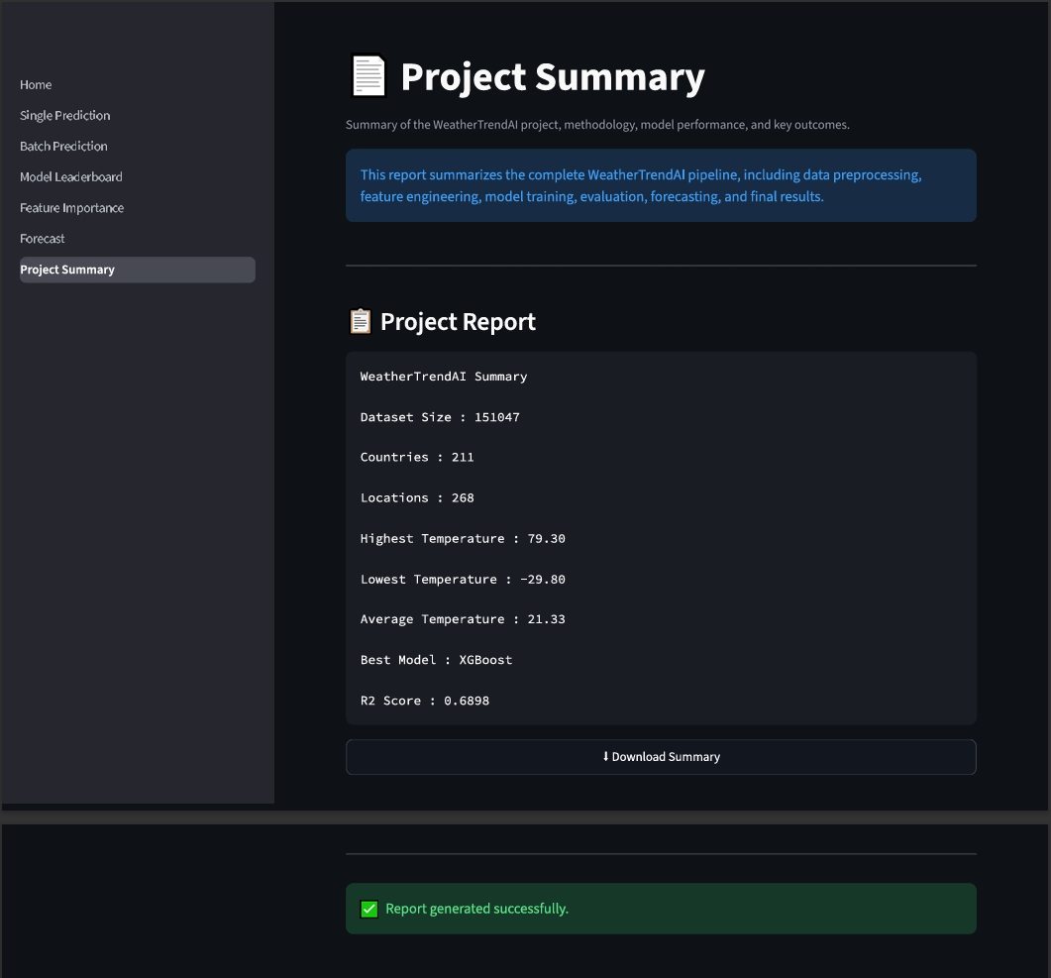
Project Summary

Slide 14
REST API
Explain FastAPI implementation.
Mention:
REST API
Swagger Documentation
Prediction Endpoint
JSON Response
Easy Integration

Slide 15

Results & Key Insights
Highlight:
Random Forest achieved the highest accuracy.
Feature Engineering significantly improved prediction quality.
Prophet successfully modeled future weather trends.
Interactive Dashboard enables easy visualization.
FastAPI provides production-ready prediction services.
Mention this demonstrates an end-to-end machine learning deployment workflow.

Slide 16
Conclusion
Summarize:
WeatherTrendAI demonstrates practical skills in:
Data Science
Machine Learning
Feature Engineering
Time Series Forecasting
API Development
Dashboard Development
Software Engineering
Model Deployment
Thank You
GitHub: https://github.com/ns-niam/WeatherTrendAI

