Slide 1
CIAM Support Assistant for L1 Ticket Resolution
AIM
Give L1 support a safe, fast way to resolve Netskope portal login issues on their own — without needing direct access to sensitive systems like DynamoDB or Auth0 — while freeing up engineering time currently spent on repetitive, manual troubleshooting.
GOAL
• Build a secure, AI-powered agentic system to support L1 troubleshooting
• Automatically investigate login & access issues raised in tickets
• Check user access against policy to catch mismatches
• Deliver a clear, ready-to-use fix — quickly and safely
• Cut resolution time and reduce escalations to engineering

Slide 2
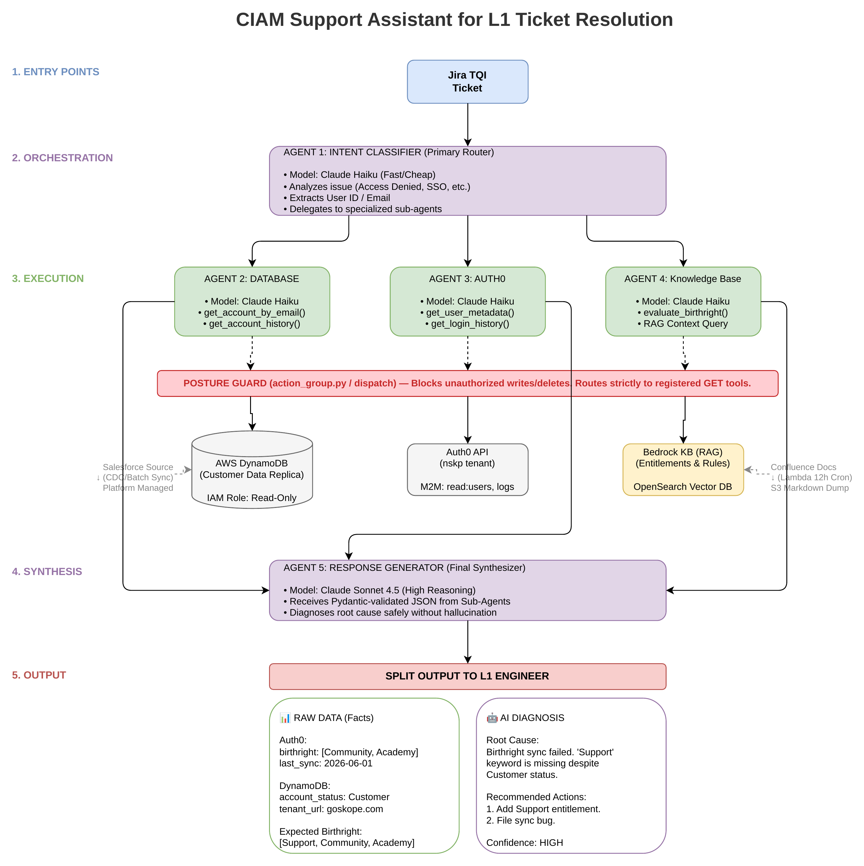
How It Works: Conceptual Architecture
A Jira ticket triggers 5 specialist AI agents that gather data, check policy, and generate a safe response for L1 — without direct access to production applications (DynamoDB, Auth0).

Slide 3
Meet the 5 Agents
AGENT 1 — Intent Classifier
Classifies the type of issue in the ticket, extracts the user's email, and routes it to the right agent (Database, Auth0, or Knowledge Base) based on what's needed.
AGENT 2 — Database Agent
Confirms account status & tenant info from a secure, read-only copy of our database.
AGENT 3 — Auth0 Agent
Retrieves the user's login history and current access permissions.
AGENT 4 — Knowledge Base Agent
Checks Confluence birthright & entitlement policy pages to flag any gap between actual and expected access.
AGENT 5 — Response Generator
• Combines all agents' findings into one clear answer to support L1 review.
• Delivers the raw data facts alongside an AI-recommended fix.

Slide 4
Project Timeline
AWS SANDBOX ENVIRONMENT
Problem Discovery & Project Scoping
All 5 Agent Specs Approved
Agent 1 Refined
Agent 2 – Database Agent Designed
Agent 2 Refine & Test
Agent 3 Refine & Test
Agent 4 Refine & Test
Agent 5 Refine & Test
Wiring Agents to Prod Connectors**
Architecture Diagram Designed & Approved
Agent 1 – Intent Classifier Deployed
Agent 1 Tested*
Agent 2 Deployed
Agent 3 – Auth0 Agent Design & Deploy
Agent 4 – Knowledge Base Deployed
Agent 5 – Response Generator Deployed
Migration to Prod
Completed
Upcoming
*Tested by converting 20 real, PII-stripped Slack support queries into Jira-formatted test cases to validate Agent 1's routing and accuracy.
Full results: Confluence test summary
**Current step: deploying and refining the remaining agents in the AWS sandbox, then migrating to production and wiring everything to live connectors — Jira, Auth0, DynamoDB, and Confluence (birthright pages).

Slide 5
Roadblocks
Current blocker: AWS Bedrock AgentCore has not yet been approved for production use.
Impact: Without approval, we can't test or train the agents against real, live Netskope data (Auth0, DynamoDB, Confluence) — validation so far relies on synthetic/test data.
What we need: Approval to connect AgentCore to real production data sources, so accuracy can be validated before rollout to L1.

Slide 6
Thank You
Questions & Discussion

