Slide 1

MUSES
AI that sees, understands, and acts in the real world.
A next-generation multimodal AI platform.
Notes:
MUSES stands for Multimodal Universal Sense & Simulation Engine. It's a groundbreaking AI platform driven by Gemini 3 technology. MUSES facilitates real-time understanding, perception, and guidance in various contexts like video and motion. Its significance lies in the ability to connect AI capabilities directly with human experiences in the physical world, unlike traditional AI systems confined to chat interfaces.

Slide 2
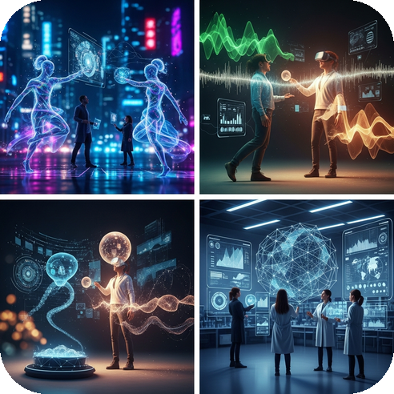
Inspiration & Problem
The Problem
AI tools in their current state are passive and reactive. They can explain existing scenarios but lack the capability to participate actively. Existing systems are characterized by being single-purpose, having high latency, and being blind to physical context.
The Gap
There is a notable absence of unified intelligence capable of observing the real world, reasoning in real-time, guiding human actions, and simulating alternate realities.
Notes:
This slide explores the significant limitations of current AI technologies. Traditional AI struggles with engaging and understanding the dynamic physical world, thus remaining mostly passive. While humans possess rich intuition and real-world experience, AI tools have not evolved to match this level of interaction. The launch of Gemini 3 represents a significant step forward, enhancing AI's ability to reason in alignment with human thoughts, improving the potential for meaningful engagements.

Slide 3

What sets MUSES apart?
Unique Features
MUSES distinguishes itself by consolidating all functionalities within a single AI brain, rather than utilizing disparate tools for different tasks. This integration allows for a seamless user experience.
Comprehensive Capabilities
Its capabilities span across observing, understanding, simulating, and guiding in real-time, thus catering to a wide range of applications effectively.
Notes:
The key differentiator of MUSES lies in its unique ability to provide all essential functionalities under one integrated AI system. This ensures that users can benefit from a cohesive experience, engaging with diverse applications like sports analysis, cooking assistance, and driving simulations without the complexity of using multiple separate tools. This comprehensive approach gives MUSES a significant advantage in functionality and usability.

Slide 4
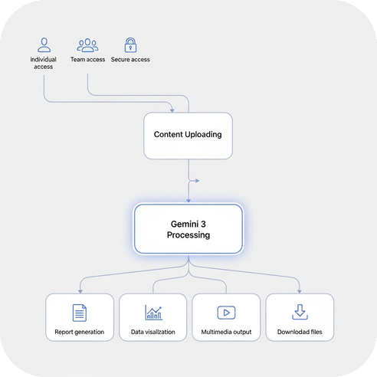
Understanding the Workflow of MUSES
User Flow
Users can either access MUSES as guests or log in. They then select a desired mode such as Sports, Safety, Create, or Coach and proceed to upload or stream their content, including videos, images, or voice inputs.
Processing and Output
Gemini 3 processes these inputs in real-time to detect objects and motion, reason about actions, and simulate alternatives. The resulting feedback is provided with visual overlays, voice responses, and immersive interactive scenarios, creating a truly context-aware experience.
Notes:
This slide explains how MUSES operates, starting with the user flow where individuals can choose to log in or access the system as guests. They select a mode such as Sports or Safety and upload content like videos or images. Next, Gemini 3 processes this content in real time, allowing it to detect objects, reason about their actions, and simulate alternatives, delivering the output through visual and audio means. The low latency and context-aware feedback give users an experience that feels almost magical.

Slide 5
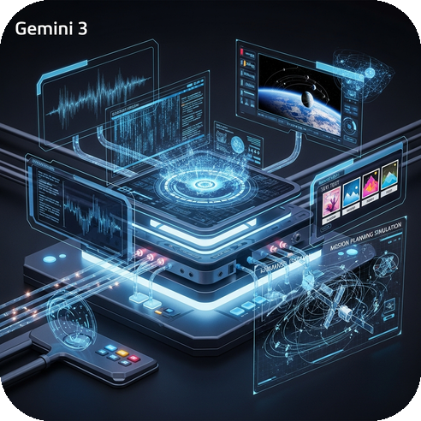
Gemini 3 Integration
Revolutionizing Interaction
Gemini 3 incorporates multimodal reasoning, blending video, images, audio, and text seamlessly. It excels in long context understanding, effectively tracking actions over time. Featuring low-latency inference, it provides real-time feedback, making processes smoother. Its advanced planning and simulation capabilities allow prediction of outcomes before execution. This unique blend of features enables it to not only describe but also understand and guide interactions, paving the way for MUSES to become a reality.
Notes:
Gemini 3 is a groundbreaking technology that integrates various forms of data, offering functions like multimodal reasoning and low-latency feedback. These capabilities not only enhance understanding and prediction but also guide interactions effectively. This makes it superior to other models, which may only describe rather than truly understand.

Slide 6

Impact & Market Value
Insights and Opportunities
Measured Impact (Early Benchmarks)
🚦 15–30% reduction in risky driving behavior (training scenarios)
🏏 10–20% sports technique improvement
🗣 25–40% interview confidence increase
🥗 18–25% food waste reduction
📚 12–22% faster skill learning
Market Opportunity
MUSES spans multiple markets:
SectorSizeAI Vision$20B+AR /MR$40B+EdTech$30B+Smart Safety$25B+Career Tech$12B+Sports Tech$8B+
Total Addressable Market ≈ $135B+
Notes:
The impact of MUSES can be seen through early benchmarks across several areas. There’s a marked reduction in risky driving behaviors, alongside improvements in sports techniques, interview confidence, food waste management, and faster skill acquisition. MUSES is also strategically positioned within expansive market segments, with a combined total addressable market of over $135 billion. This diverse market opportunity showcases the potential and versatility of the MUSES platform.

Slide 7
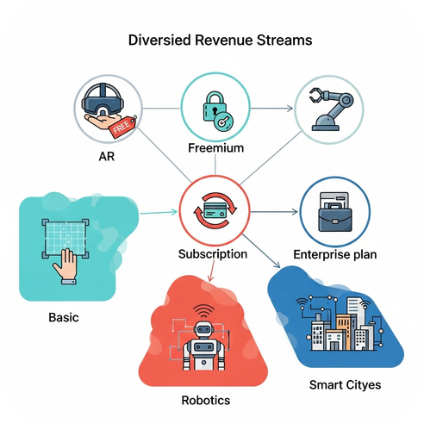
Business Model & Scalability
Revenue Streams
Freemium offers guest access and basic analysis. Pro tier is $10/month for full features. Enterprise options begin at $1,000+/year.
Why It Scales
One core intelligence supports expansion into multiple sectors. With API-ready capabilities, MUSES can venture into AR glasses, robotics, and smart cities. Capturing just 1% of the market equates to a $1.35B opportunity.
Notes:
The business model is structured around different revenue streams, including a freemium model that provides basic access and a Pro plan priced at $10 monthly, along with enterprise options starting at $1,000 for institutions. The model's scalability hinges on one core intelligence that facilitates expansion into various new technologies, such as AR glasses and smart cities. Aiming for a mere 1% market capture poses a $1.35 billion revenue opportunity.

Slide 8
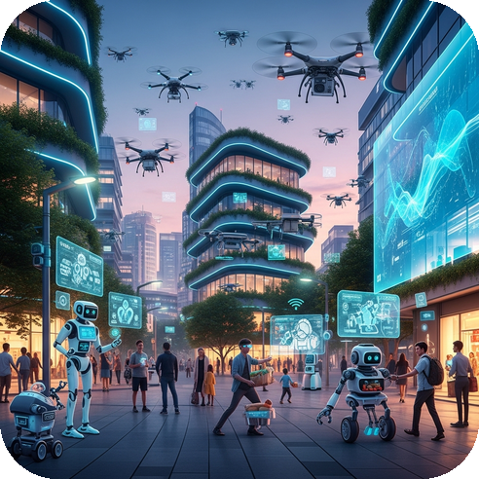
Image for Future & Closing Slide
Visual Representation
The image will depict a vibrant, futuristic city showcasing elements like AR glasses, drones flying, advanced robotics, and features that enhance urban safety, all working together harmoniously. The depiction should convey a sense of innovation and forward-thinking.
Notes:
An image portraying the integration of advanced technologies in a city setting will enhance the understanding of MUSES' future plans. This visual will serve as an engaging backdrop to reinforce the concepts shared in the presentation, depicting how seamlessly technology can enhance everyday life.

Slide 9

Thank You
Your attention is appreciated
Looking forward to our next steps
Notes:
Appreciate the audience for their time and engagement. Highlight the importance of collaboration and express eagerness for future opportunities.

