Slide 1

KIET Group of Institutions Department of Computer Application
Presentation on Colloquium
Component One FlexGrid[Wpf]
Presented by
Nitin Sharma, MCA V!-B
1900290149069

Slide 2
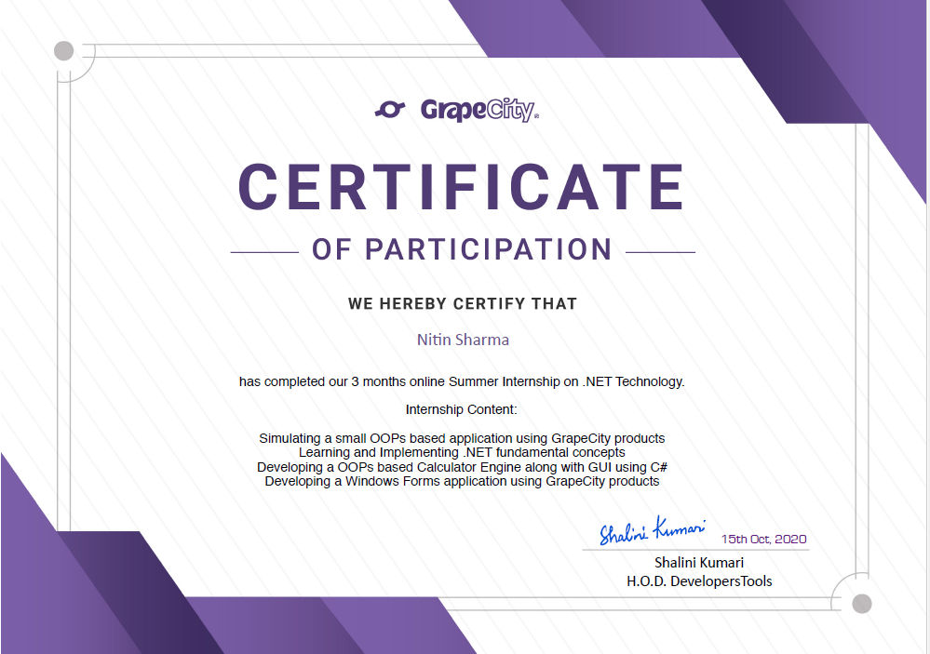
Internship Certificate

Slide 3
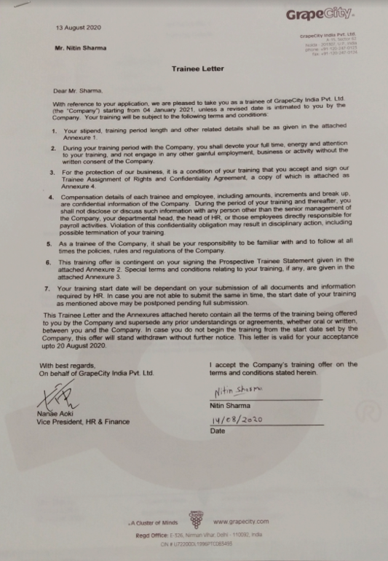

Slide 4
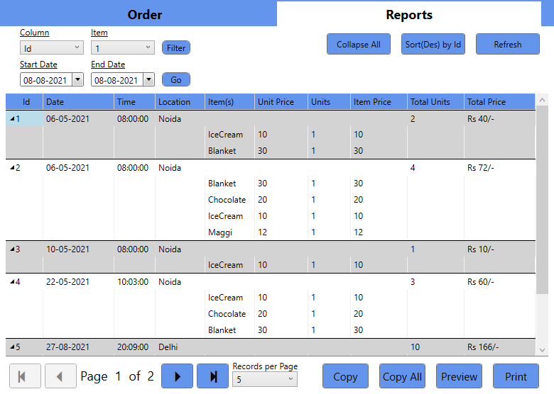
Component One FlexGrid

Slide 5
Overview
FlexGrid for WPF is a lightweight data grid control designed on a flexible object model. Based on the popular WinForms version, FlexGrid offers many unique features such as unbound mode, flexible cell merging, and multi-cell row and column headers that make it a proven solution for data management and tabulation.

Slide 6
Technology-[.Net(WPF)]
WPF, which stands for Windows Presentation Foundation, is Microsoft's latest approach to a GUI framework, used with the .NET framework.
There are a lot of GUI frameworks out there, but for .NET developers, the most interesting ones are currently WinForms and WPF. WPF is the newest, but Microsoft is still maintaining and supporting WinForms.

Slide 7
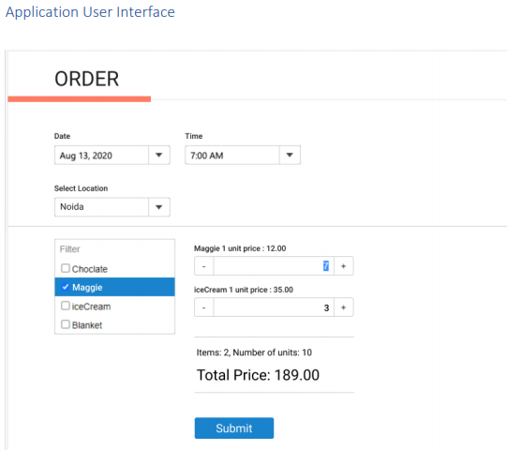
Project Requirement

Slide 8


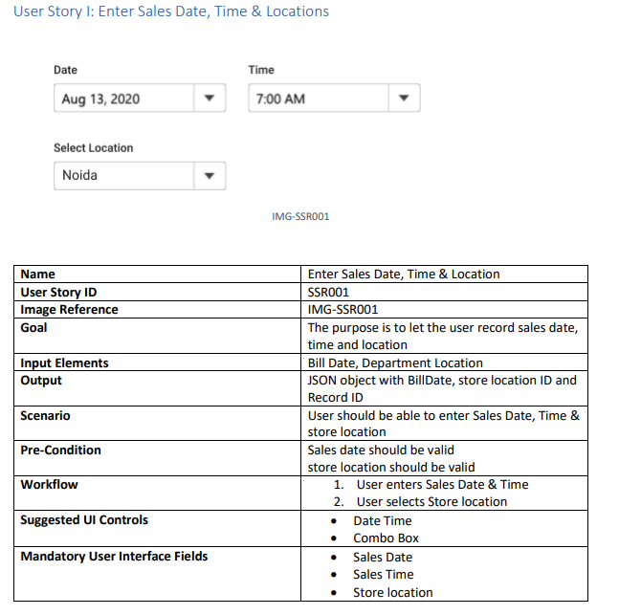



Module-1, User Story-1

Slide 9
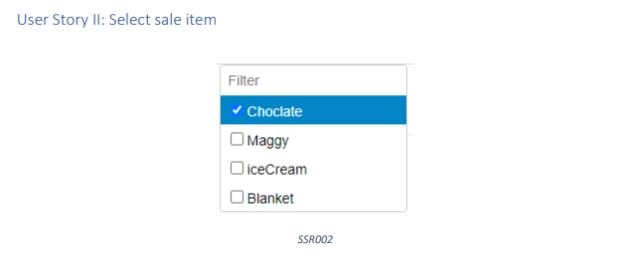
Module-1, UserStory-2

Slide 10
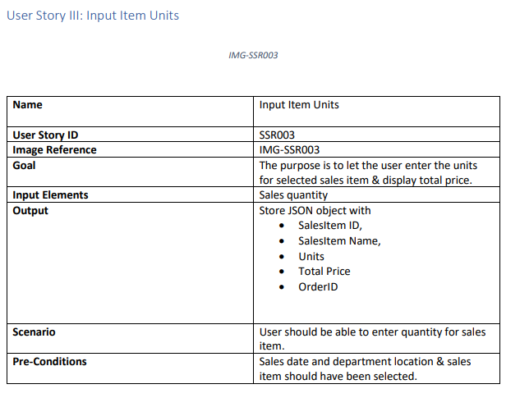
Module-1, User Story-3

Slide 11

Module-2, User Story-1

Slide 12
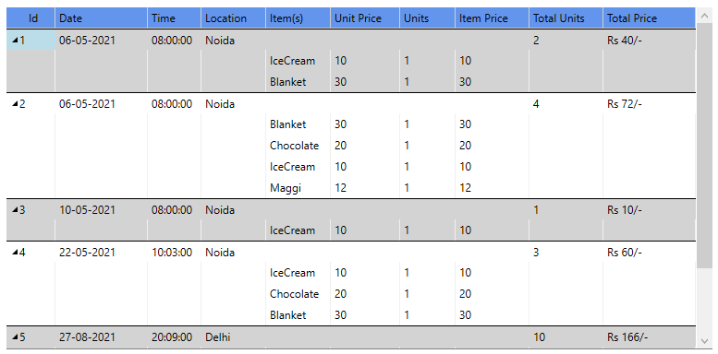
Module-2, User Story-2

Slide 13
Module-2, User Story-3

Slide 14
Thank You

