Slide 1
Problem Statement
Friend Affinity Finder

Slide 2
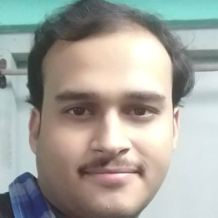
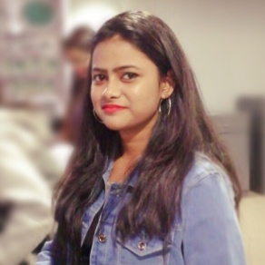
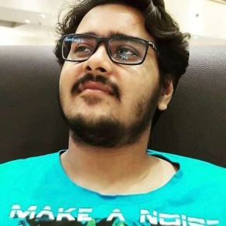

Team Details
Team Size: 4
Team Members
Navoneel Chakrabarty
Email: nc2012@cse.jgec.ac.in
Sangita D Kanni
Email: sdk2081@cse.jgec.ac.in
Swarnakeshar Mukherjee
Email: sm2084@cse.jgec.ac.in
Siddhartha Chowdhury
Email: sc2024@cse.jgec.ac.in

Slide 3
Team Details (contd.)
Names | Role in the project | Expertise areas
Navoneel Chakrabarty | Overall Solution Composition, Back-End Development, Integration | Application Developer, Data Scientist
Sangita D Kanni | Front-End Development (HTML, CSS) | Application Developer
Swarnakeshar Mukherjee | Front-End Development (JS, jQuery) | Application Developer
Siddhartha Chowdhury | Dummy Dataset Preparation | Data Assimilator, Arranger

Slide 4
Technologies Used
Hyper Text Markup Language (HTML)
Cascading Style Sheets (CSS)
JavaScript (JS)
jQuery
Python Programming using Common Gateway Interface (CGI)

Slide 5
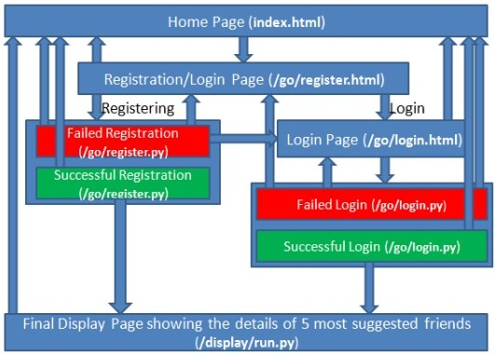
Architectural Diagram of the Web Application

Slide 6
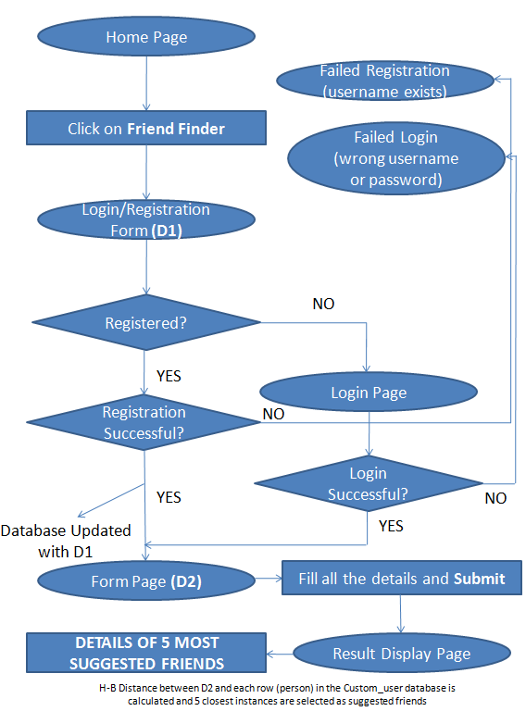
Data Flow Diagram (DFD) of the Web Application
D1: First Name, Last Name, username, password
D2: Ratings on the 5 major dimensions on a rating scale of 5

Slide 7
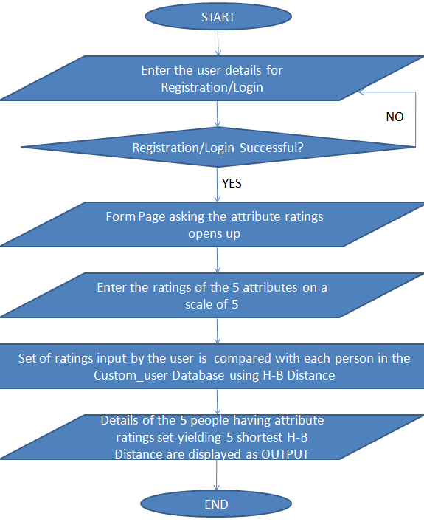
Flow Chart of the Web Application

Slide 8




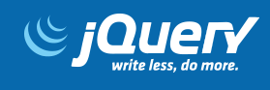
Frameworks for UI/UX Design
Cascading Style Sheets (CSS) powered by Bootstrap and W3.CSS have been used for UI Design.
JavaScript (JS) along with jQuery have been used for UX Design namely form-validation

