Slide 1
Roundtable Presentation: Final Project
Nathan Shek

Slide 2
Idea 1:
#StopAsianHate – a short comic

Slide 3
Storyboard [Idea 1]

Slide 4
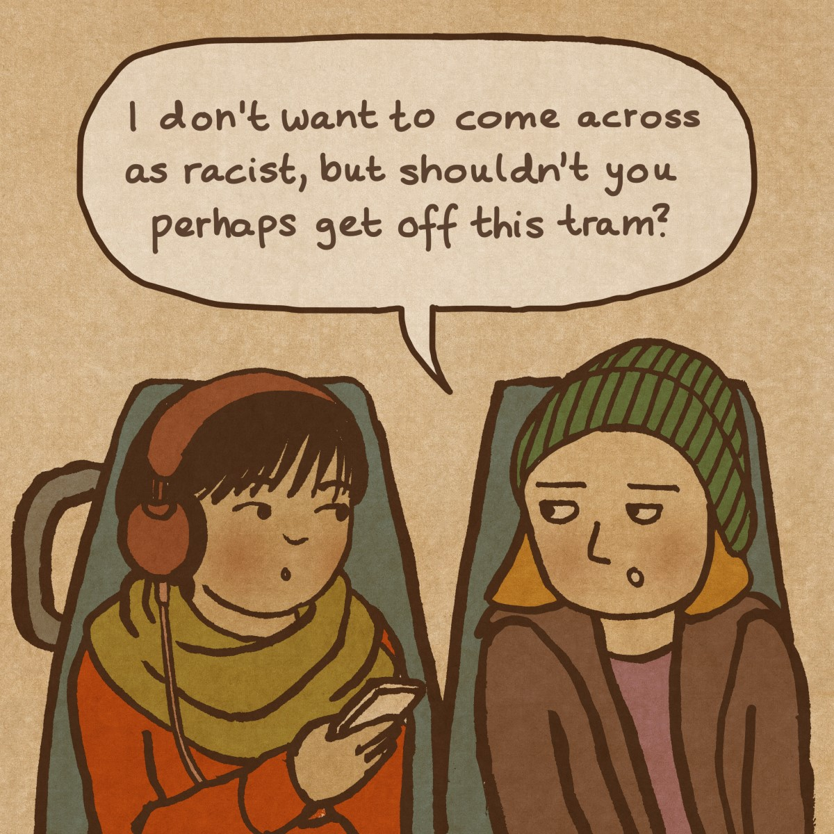
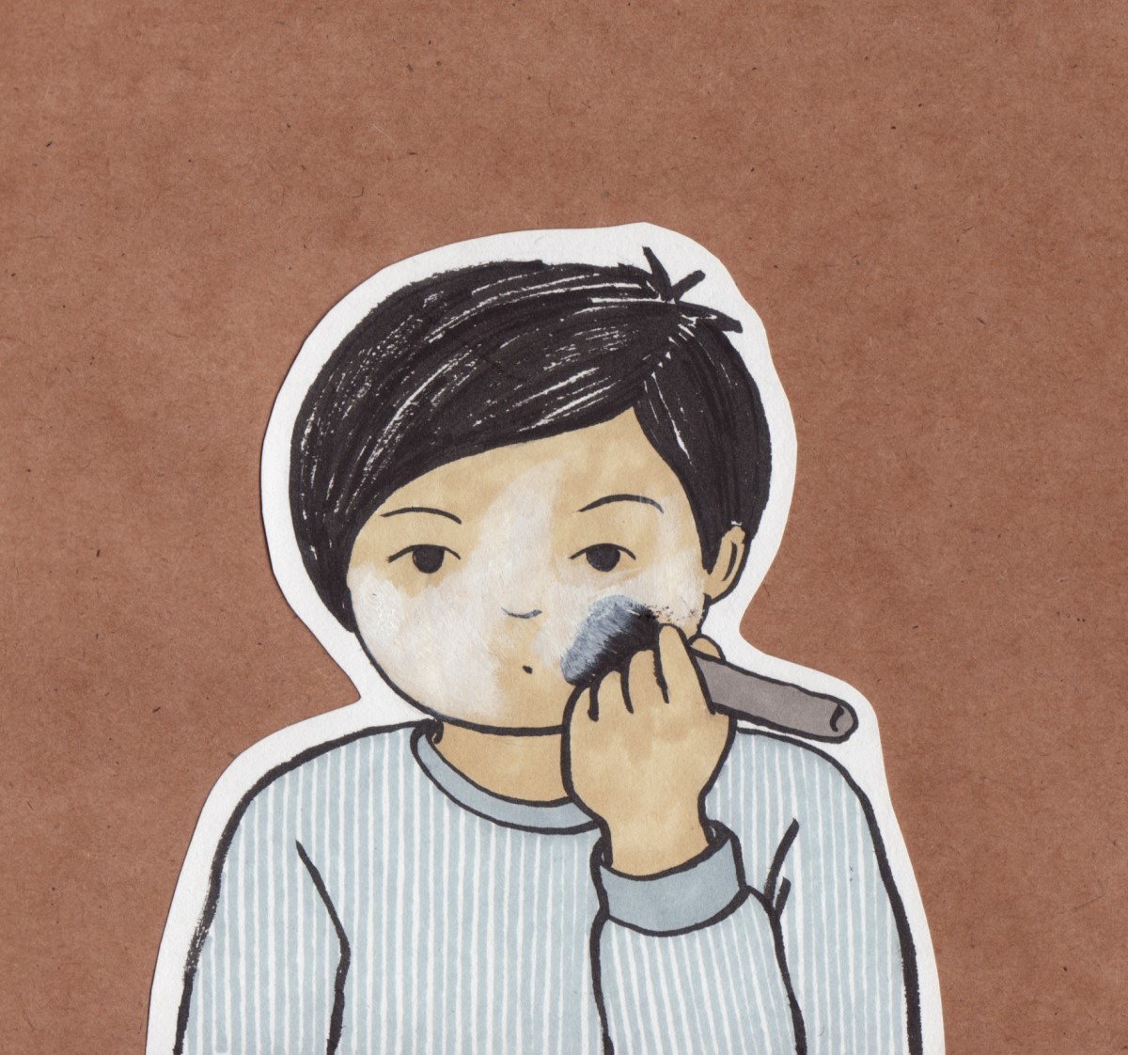
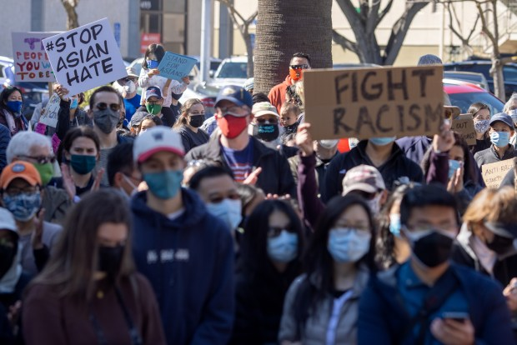
References [Idea 1]:
Cartoon panels by Lisa Wool-Rim Sjöblom
(Art style reference)
Heavily influenced by the recent protests
and my own personal feelings about recent events

Slide 5
Idea 2:
Interactive Narrative: Life

Slide 6
Storyboard [Idea 2]

Slide 7

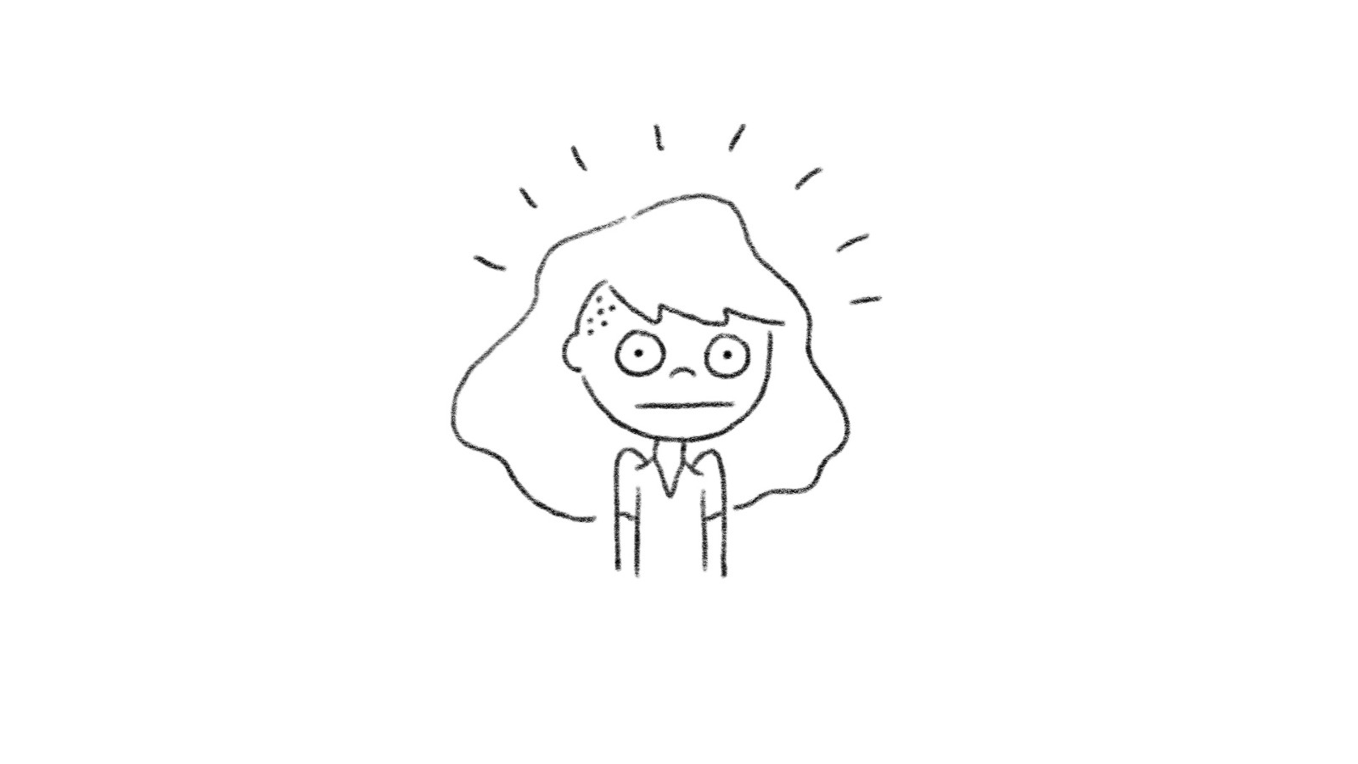
References [Idea 2]:
The Game of Life [see video]
Art style reference

Slide 8
Idea 3:
Short Animated Music Video – Love Story

Slide 9
Storyboard [Idea 3]

Slide 10

References [Idea 3]:
Taylor Swift’s Love Story (see video)

