Slide 1
FrameSense
Evaluating Vision Transformer Models for Image Quality Assessment in Accessibility Applications
A Comparative Study of ViT, CLIP, and DINOv2 Using the VizWiz Dataset
By: Nahan Salam . 8226337

Slide 2
Introduction
Background
Image quality affects how reliably computer vision systems interpret visual information. Real-world photographs often contain imperfections that can influence model predictions.

Slide 3
Introduction
Problem
Blur, poor framing, rotation and unclear content can make images difficult for AI systems to interpret. This reduces the reliability of image-based predictions.

Slide 4
Introduction
Accessibility
Blur, poor framing, rotation and unclear content can make images difficult for AI systems to interpret, reducing the reliability of image-based predictions.

Slide 5
Introduction
Aim
This study compares ViT, CLIP and DINOv2 on the VizWiz dataset to evaluate their ability to identify image-quality issues and explore their potential to support accessibility applications.

Slide 6
Dataset
Dataset Overview
The VizWiz-QualityIssues dataset contains real-world images captured by people who are blind or have low vision, reflecting practical challenges in image quality assessment.
Dataset Size
Training set: 23,431 images
Validation set: 7,750 images
Classification Tasks
The study examines four image-quality issues: blur, poor framing, rotation and unrecognisability.
Labelling Strategy
An image is labelled positive for an issue when at least three annotators vote for that issue, helping establish consistent classification targets.

Slide 7
Models and Methodology
Images → Preprocessing → Feature Extraction → Standardisation → Logistic Regression → Prediction
Models Compared
ViT: Vision Transformer
CLIP: Contrastive Language–Image Pre-training
DINOv2: Self-supervised vision model
Methodology
All three pretrained models were used as frozen feature extractors, with no end-to-end fine-tuning.
Evaluation
Model performance was evaluated using F1-score, ROC-AUC, Precision, and Recall.

Slide 8
Models and Methodology
Images → Preprocessing → Feature Extraction → Standardisation → Logistic Regression → Prediction
Methodology
All three pretrained models were used as frozen feature extractors, with no end-to-end fine-tuning.
Models Compared
ViT: Vision Transformer
CLIP: Contrastive Language–Image Pre-training
DINOv2: Self-supervised vision model
Evaluation
Model performance was evaluated using F1-score, ROC-AUC, Precision, and Recall.

Slide 9
Models and Methodology
Images → Preprocessing → Feature Extraction → Standardisation → Logistic Regression → Prediction
Evaluation
Model performance was evaluated using F1-score, ROC-AUC, Precision, and Recall.
Models Compared
ViT: Vision Transformer
CLIP: Contrastive Language–Image Pre-training
DINOv2: Self-supervised vision model
Methodology
All three pretrained models were used as frozen feature extractors, with no end-to-end fine-tuning.

Slide 10
Preprocessing Pipeline
Image Preparation: Images were loaded and converted to RGB.
Model-Specific Processing: Each model's processor applied the required resizing, normalisation and input formatting.
Dataset Splitting: Official training and validation splits were kept separate.
Label Preparation: Separate binary labels were prepared for framing, blur, rotation and unrecognizability, using a minimum of three annotation votes for a positive label.
Data Integrity Checks: Checked missing or rejected entries and matched image filenames, extracted features and annotations.
Feature Extraction: Extracted features from the frozen pretrained encoders and stored them for reuse.
Reproducibility: Used a fixed random seed and began with a subset of 3,000 training and 750 validation images before extending the experiment to the full dataset.

Slide 11
Feature Extraction and Classifier Training
Used frozen pretrained encoders; no end-to-end fine-tuning.
Extracted features from ViT, CLIP and DINOv2.
Trained separate Logistic Regression classifiers for each of the four tasks.
Applied StandardScaler and balanced class weights to address class imbalance.
Tested regularisation using Grid Search and 5-fold Stratified Cross-Validation.
Selected decision thresholds using training out-of-fold predictions.
Final Experiment: 23,431 training images and 7,750 validation images.

Slide 12
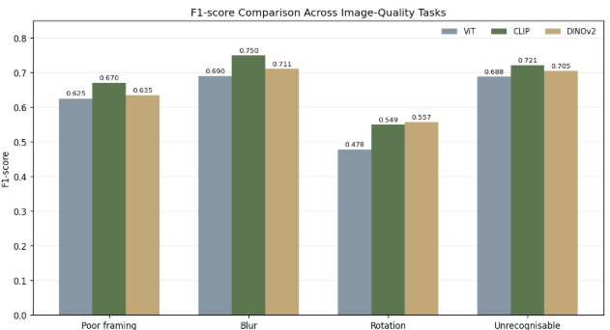
Evaluation Metrics & Results
Evaluation Metrics: F1-score, ROC-AUC, Precision, Recall, Balanced Accuracy and Average Precision.
CLIP achieved the highest F1-scores for framing (0.670), blur (0.750) and unrecognisability (0.721)
while DINOv2 performed best for rotation (0.557). ViT had lower F1-scores than the other models across all four tasks.

Slide 13
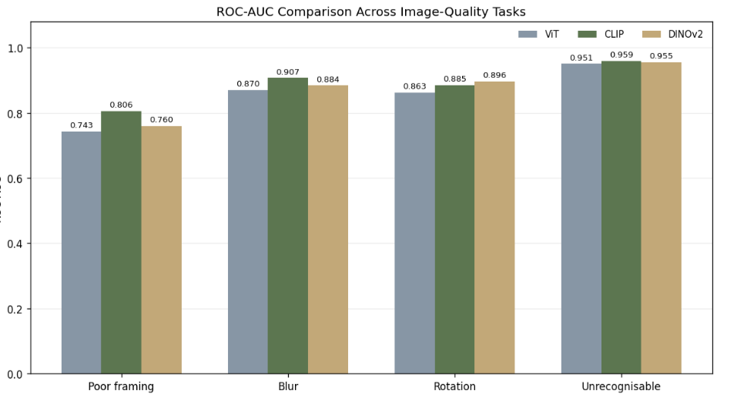
Evaluation Metrics & Results
Evaluation Metrics: F1-score, ROC-AUC, Precision, Recall, Balanced Accuracy and Average Precision.
CLIP achieved the highest ROC-AUC for framing (0.806), blur (0.907) and unrecognizability (0.959),
while DINOv2 performed best for rotation (0.896).

Slide 14
Ethical & Societal Implications
Accessibility:
Image-quality detection could help users identify when a photograph needs to be retaken.
Prediction Errors:
False negatives may allow poor-quality images to pass through, while false positives may cause unnecessary retakes.
Privacy:
Images may contain faces or sensitive personal information and must be handled carefully.
Limitations:
-Evaluation was limited to the training and validation splits; test-set performance remains unverified.
-Further testing on other datasets and with blind and low-vision users is needed to assess real-world reliability.

Slide 15
Ethical & Societal Implications
Accessibility:
Image-quality detection could help users identify when a photograph needs to be retaken.
Prediction Errors:
False negatives may allow poor-quality images to pass through, while false positives may cause unnecessary retakes.
Privacy:
Images may contain faces or sensitive personal information and must be handled carefully.
Limitations:
-Evaluation was limited to the training and validation splits; test-set performance remains unverified.
-Further testing on other datasets and with blind and low-vision users is needed to assess real-world reliability.

Slide 16
Thank you!
Github: https://github.com/ns732/framesense-image-quality
Streamlit App: https://framesense.streamlit.app/

