Slide 2
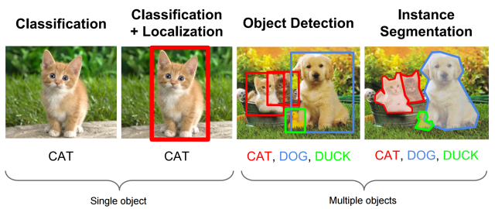
Different Vision Tasks
1000-category ImageNet with 50 million labelled images
On the ILSVRC 2013 dataset OverFeat ranked 4th in classification, 1st in localization, and 1st in detection
Replaced by SSD , YOLO

Slide 3
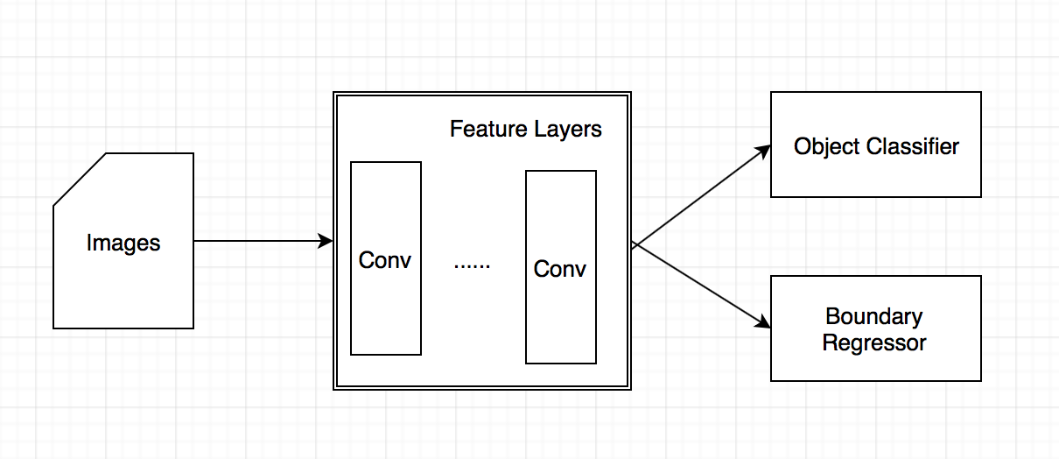
Overfeat (2013)
Training a convolutional network that simultaneously classifies, locates, and detects objects in images can boost the classification, detection, and localization accuracy of all tasks.
Overfeat trains an image classifier first
Then it fixes the feature layers and train the boundary regressor
Accumulates predicted bounding boxes
Fully connected layers do not exist

Slide 4
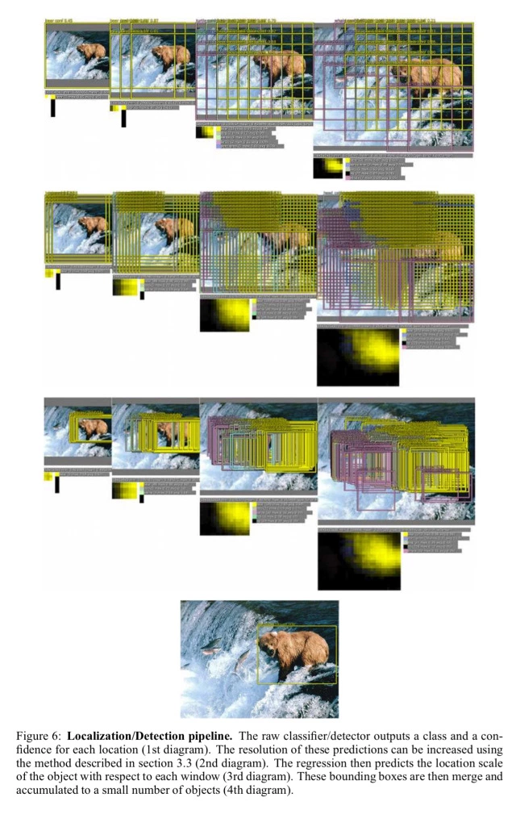
3 ideas of Overfeat
The first idea in addressing this is to apply a ConvNet at multiple locations in the image, in a sliding window fashion, and over multiple scales
The second idea is to train the system to not only produce a distribution over categories for each window, but to also produce a prediction of the location and size of the bounding box containing the object relative to the window
The third idea is to accumulate the evidence for each category at each location and size

Slide 5
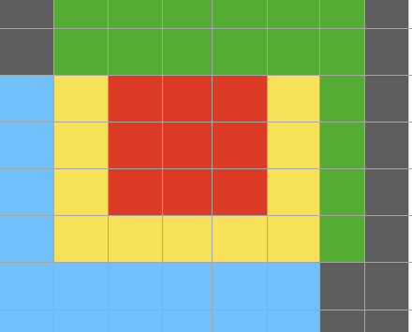
Multi-scale Classification
takes advantage of the spatial feature of convolutional neural nets to reduce computation
improve image classification accuracy by simply cropping multiple image patches and voting the final prediction from the predictions of the patches in the testing phrase.
proposes a clever method to remove multi crop redundancy

Slide 6
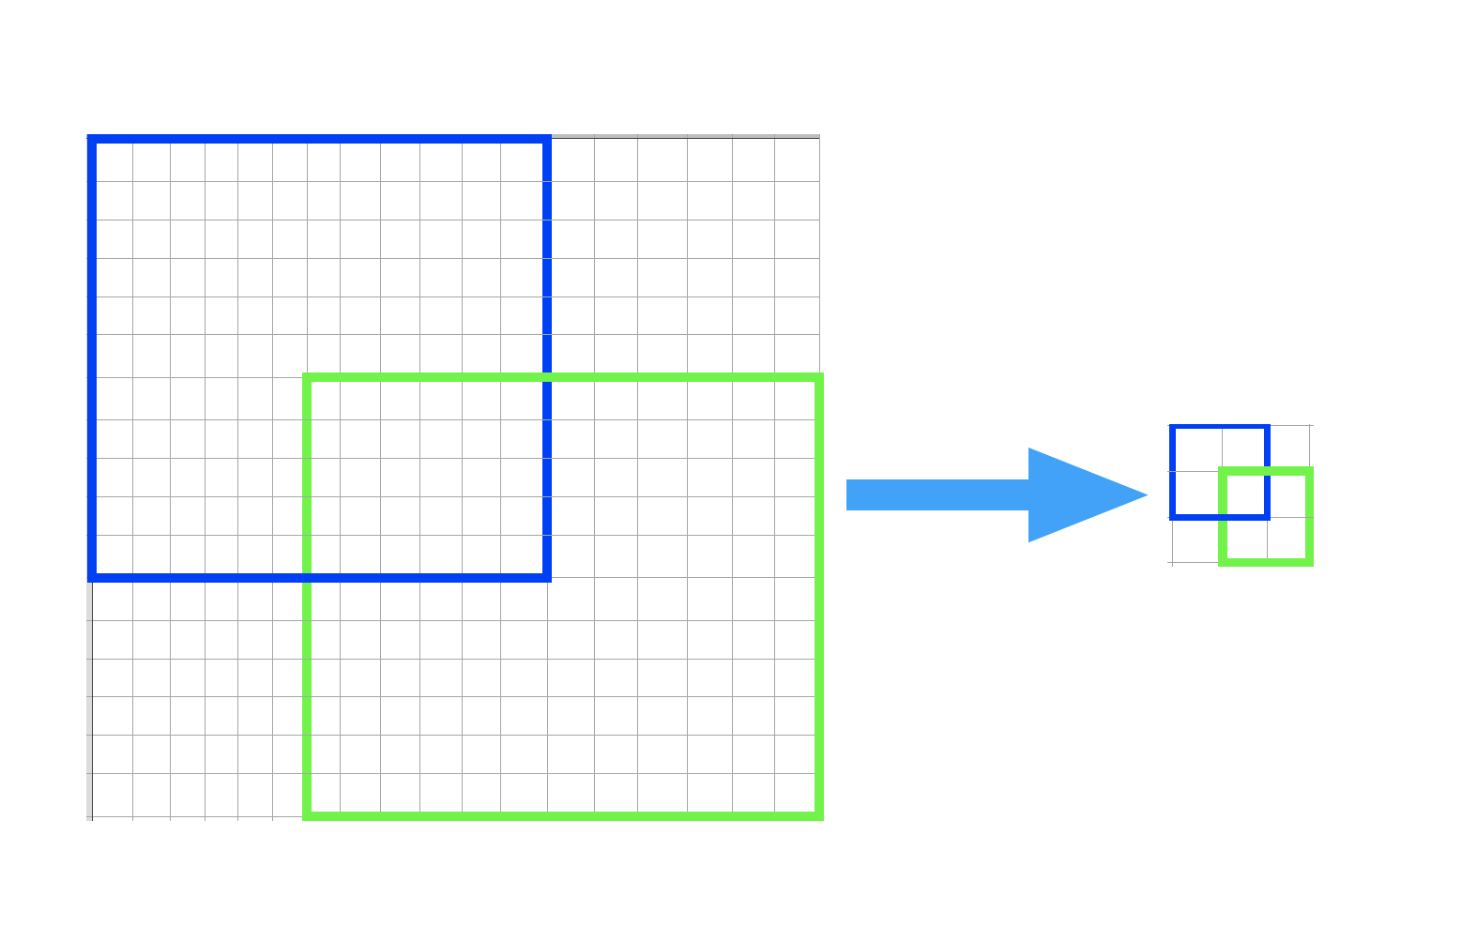
The sliding window technique
Here ,feature map or image with size 18x18
Consider ,crop with size 12x12 ,apply convolutional and pooling.
apply the operations on the original map once and get the feature maps for the four crops
The comprise on the architecture here is non-overlap, no-overlap filters and non-overlap poolings.
Smaller stride to improve accuracy

Slide 7
multiple classifiers predict one box for each of the objects
Overfeat keeps the boxes with big overlap and close to each other, and average the coordinates of two far away boxes
Then the classification score of a detector is used to pick out the final box.
you need some negative samples to make the classifier be able to predict background besides objects
multiple crops and multi-scale classification can help in terms of accuracy and performance

Slide 8
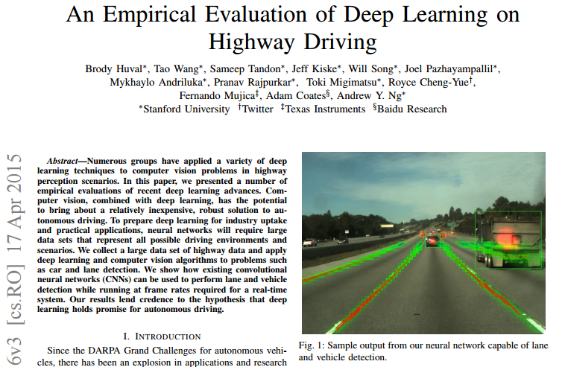

Slide 9
Thedetection system capable of operating at greater than 10Hz using nothing but a laptop GPU
can detect cars more than 100m away and can operate at speeds greater than 10Hz @ higher image resolutions of 640 × 480
Use Overfeat few minor modifications to its labels in order to handle occlusions of cars, predictions of lanes, and accelerate performance during inference

Slide 10
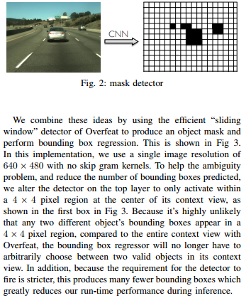
Final Grid Structure instead of single feature vector
uses the CNN that takes an image as input and outputs an object mask through regression, highlighting the object location
To distinguish multiple nearby objects, different part-detectors output object masks,from which bounding boxes are then extracted .
The detector must take many crops of the image, and run multiple CNNs for each part on every crop [Szegedy et al]

Slide 11
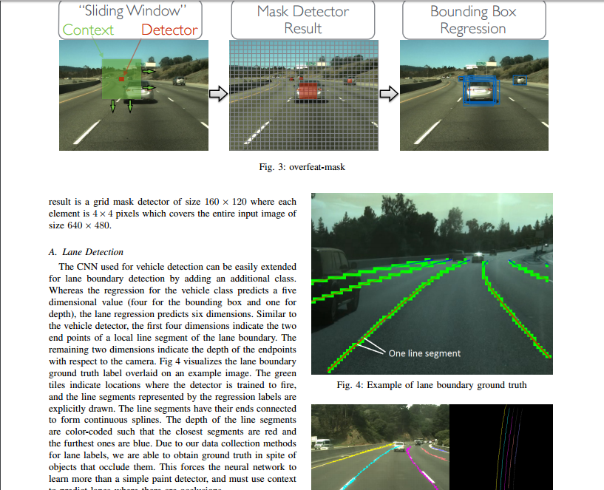

Slide 12
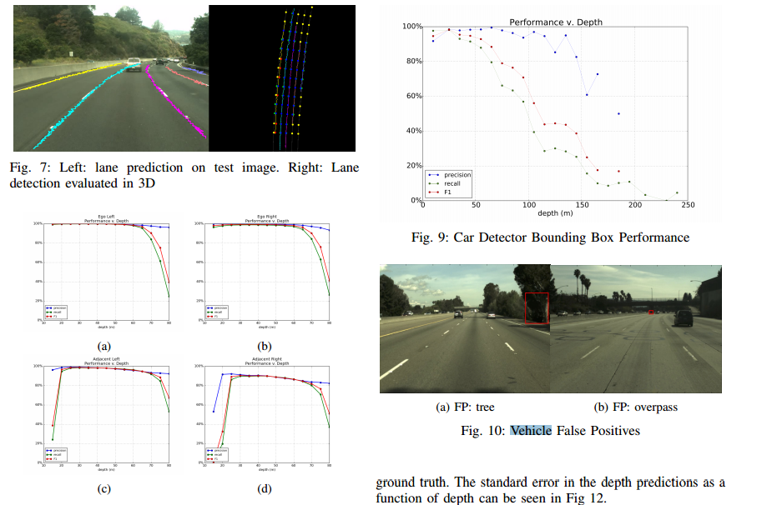

Slide 13
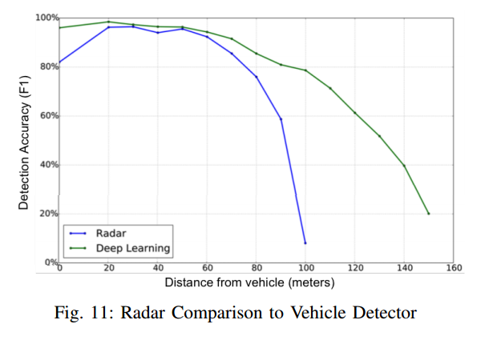
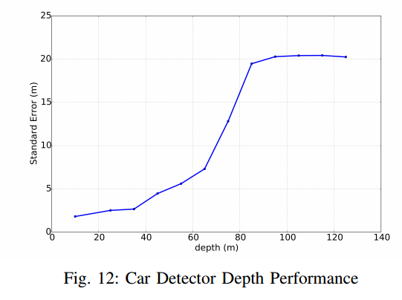

Slide 14
