Slide 1
Group 3: Mini Project
Team Members:
1 | Siti Nor Efarahin binti Musiran
2 | Muhammad Mustafa bin Zulkefli
3 | Nor Safina binti Julaini
4 | Nur Afiqah binti Ismail
5 | Risha Syazwani binti Samanuddin

Slide 2
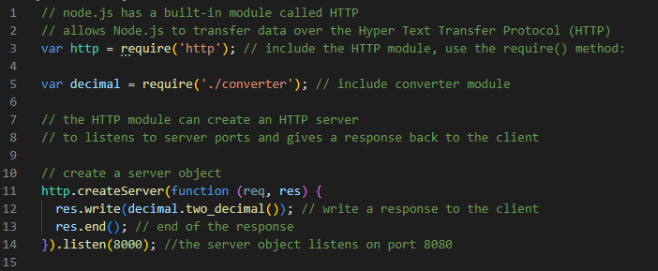
First Scenario: Node JS
a) Converts a number to 2 decimal places
index.js

Slide 3
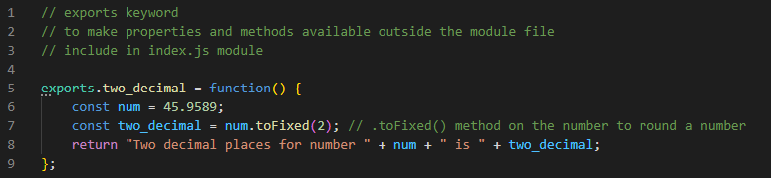
First Scenario: Node JS
a) Converts a number to 2 decimal places
converter.js

Slide 4
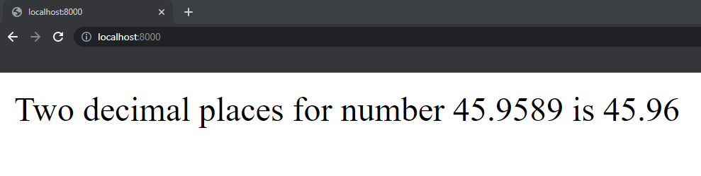
First Scenario: Node JS
a) Converts a number to 2 decimal places
Output

Slide 5
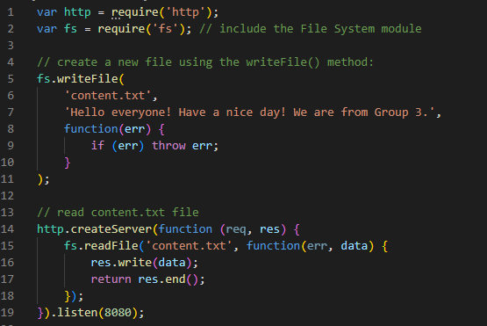
First Scenario: Node JS
b) Create a files and reads the contents of the file
create_read.js

Slide 6

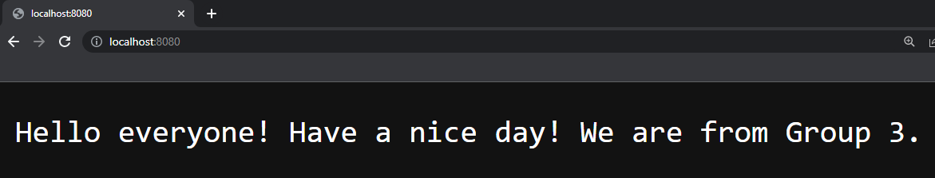
First Scenario: Node JS
a) Converts a number to 2 decimal places
a) Converts a number to 2 decimal places
Output
content.txt file created

Slide 7
Second Scenario: React JS
Create 2 components, one being class and another being functional and use a router to show the data on the screen. Functional components should use hooks.

Slide 8
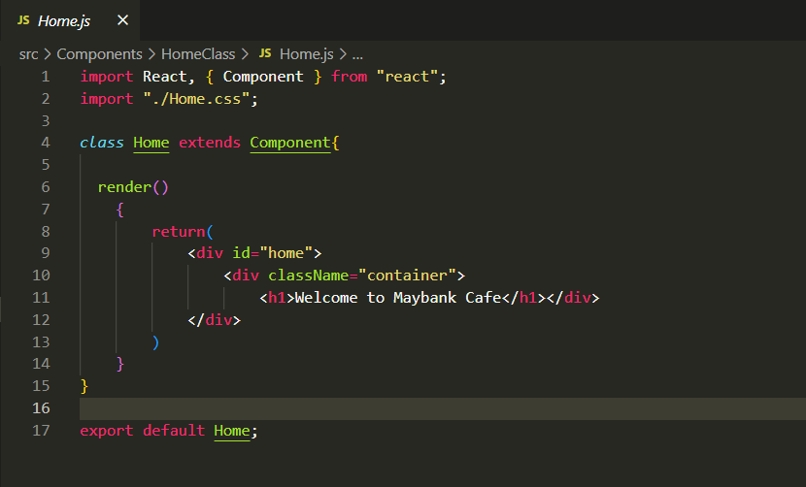
Second Scenario: React JS
Class Component : Home.js

Slide 9
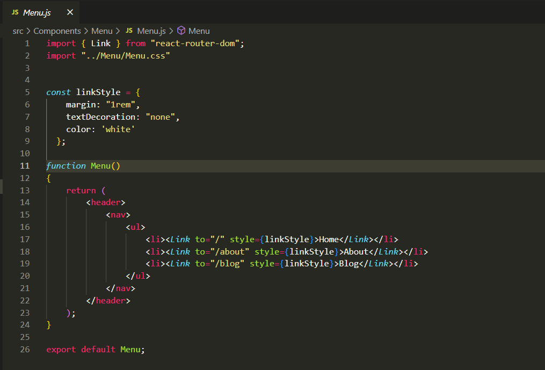
Second Scenario: React JS
Functional Component : Menu.js
In this functional component : Link is being used in order to go to the next page beside of using router also.

Slide 10
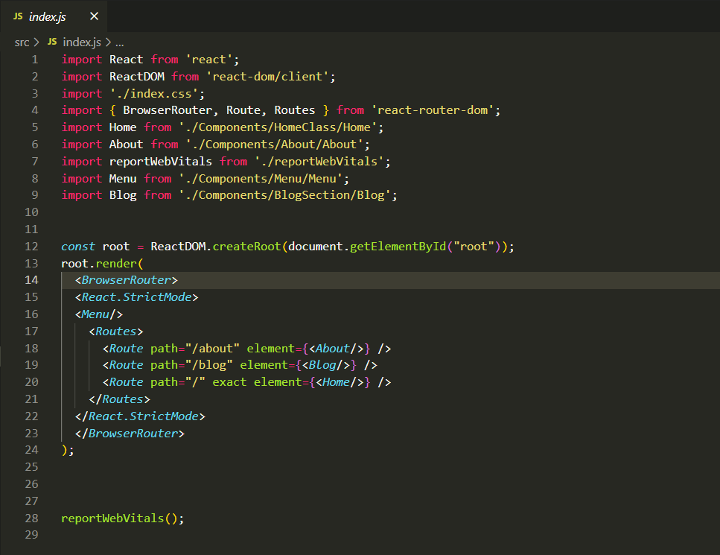
Second Scenario: React JS
Functional Component : Index.js
In this functional component : Router have been used in apply the next page destination and have been set in Index.js app.

Slide 11
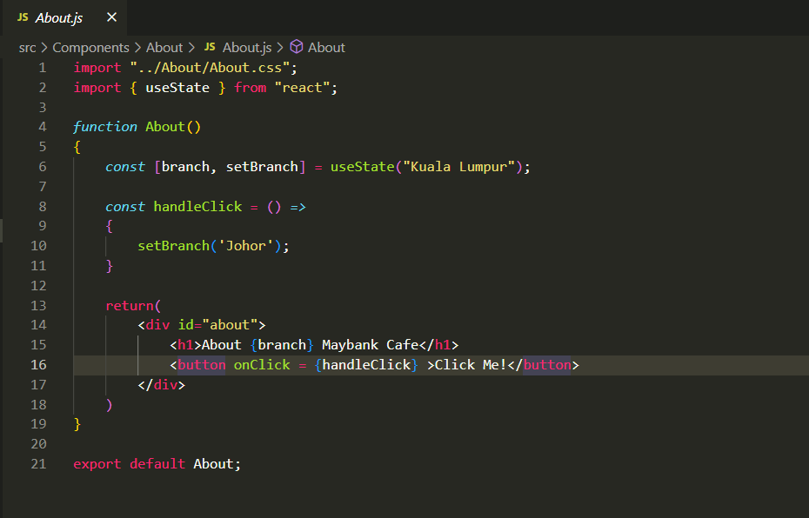
Second Scenario: React JS
Functional Component : About.js
In this functional component useState hook is being use, in order to show about which branch Café is about.

Slide 12
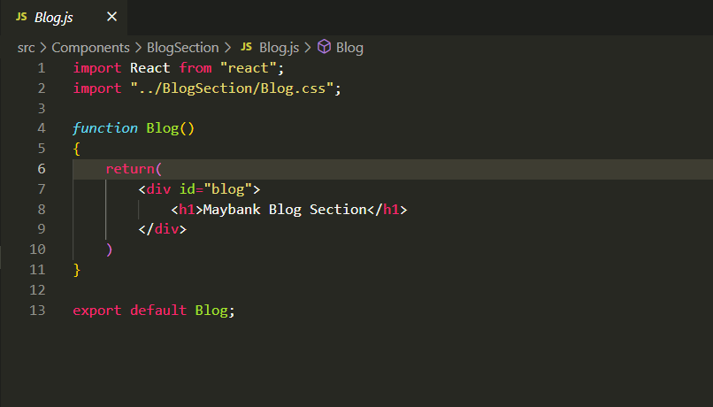
Second Scenario: React JS
Functional Component : Blog.js
Here is the basic functional component without using any hooks.

Slide 13
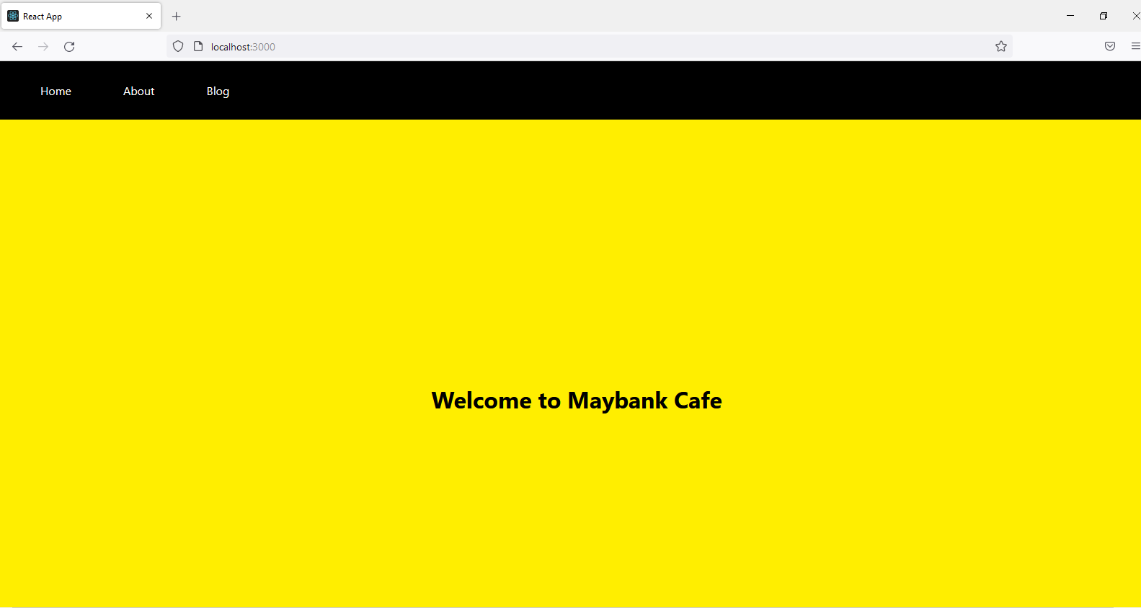
Second Scenario: React JS
Output for the class component.
Here is the navigation bar, that using the Link and Router in order to go to the next page.

Slide 14
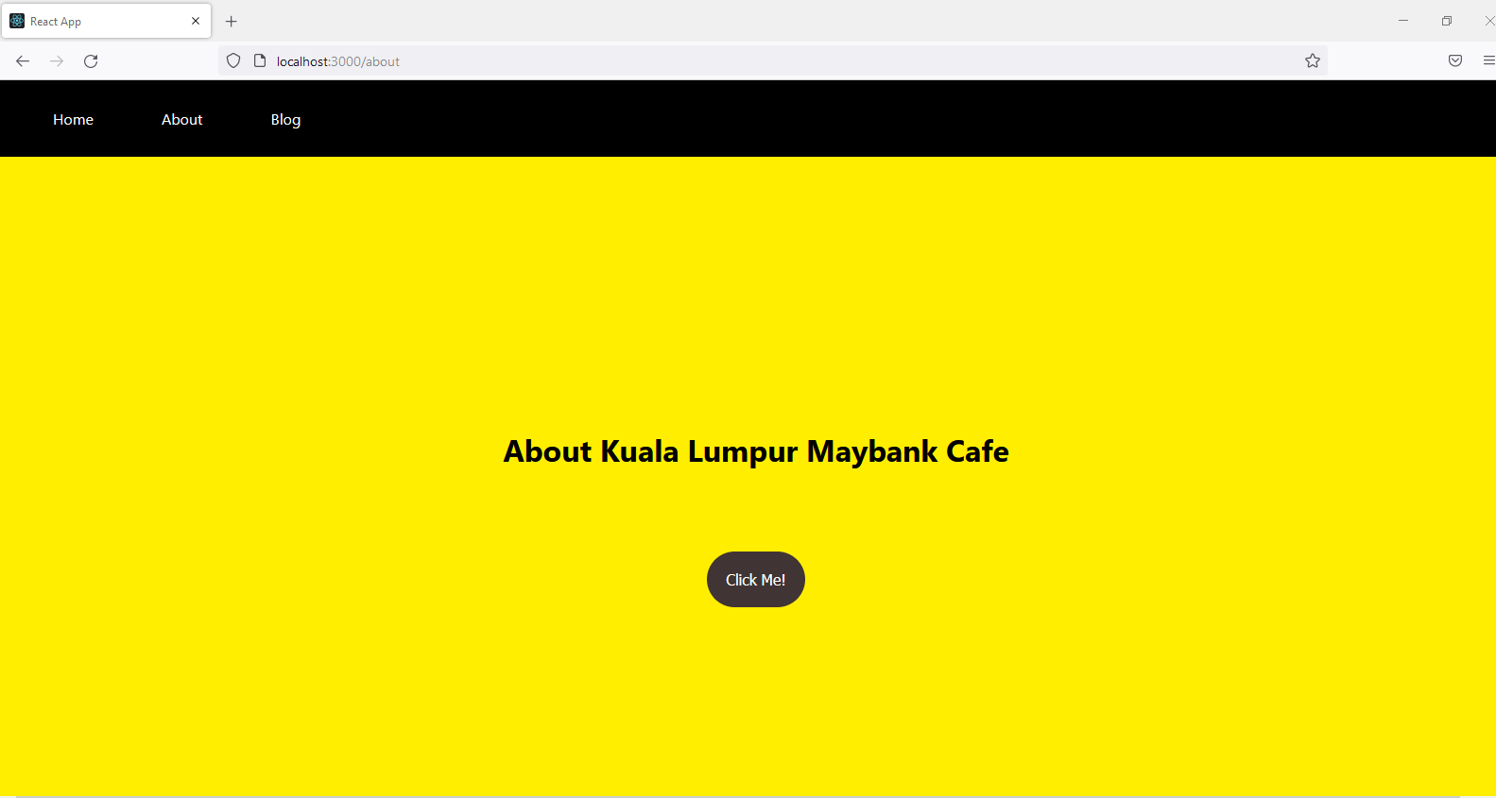
Second Scenario: React JS
Output for the functional component by using useState hook before click the button.

Slide 15
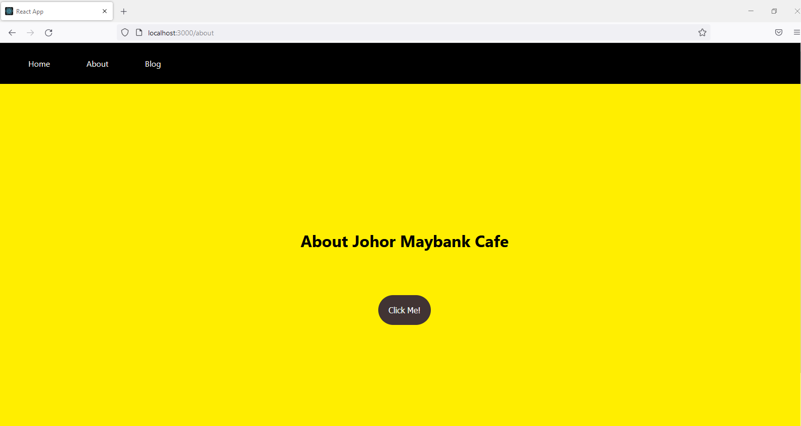
Second Scenario: React JS
Output for the functional component by using useState hook after click the button and the branch will change from Kuala Lumpur into Johor.

Slide 16
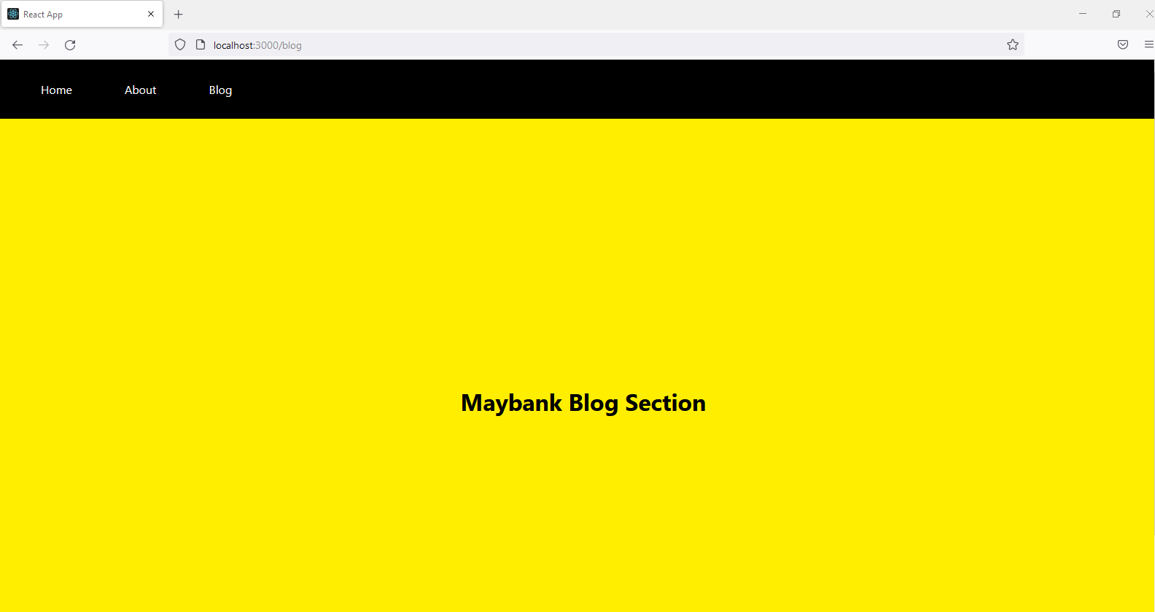
Second Scenario: React JS
Output for the basic functional component

Slide 17
Third Scenario: React Native
Convert the above react components to react native using stylesheets and native components. No html tags are allowed.

Slide 18
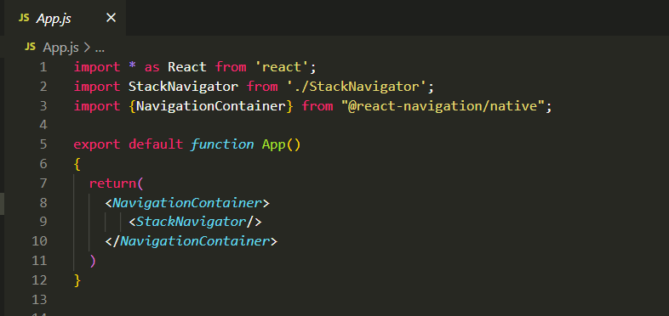
Third Scenario: React Native
App Component
In this javaScript class, react-navigation/native module have been installed in order to make the navigation in this react native app.

Slide 19
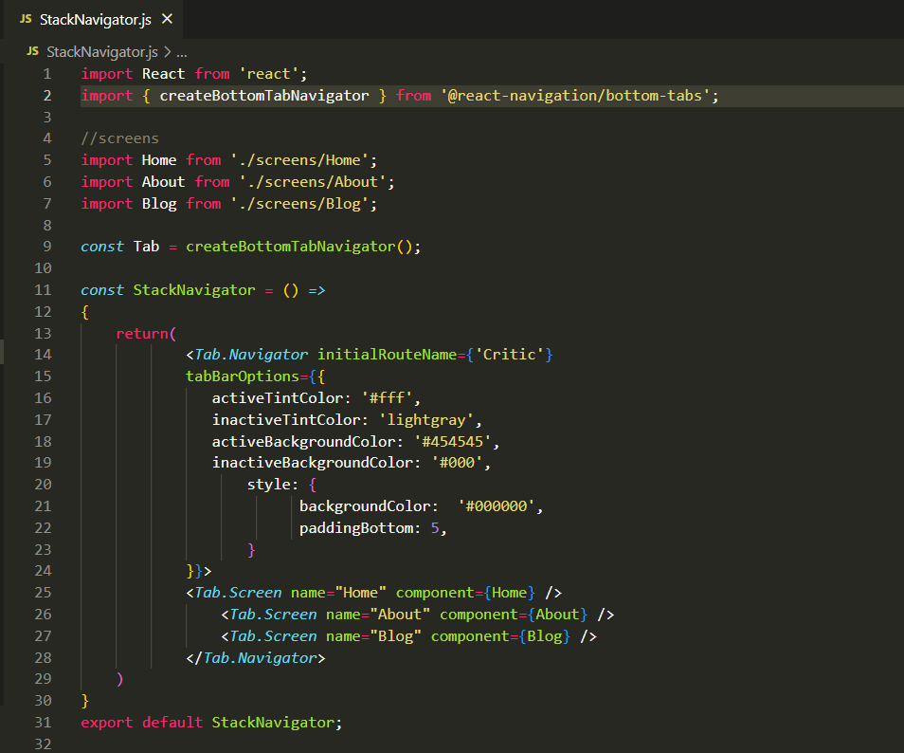
Third Scenario: React Native
StackNavigator Component
StackNavigator.js is where all the function in making the tab bar navigation for the app.
This part have using react-navigation/bottom-tabs module in build the tab.

Slide 20
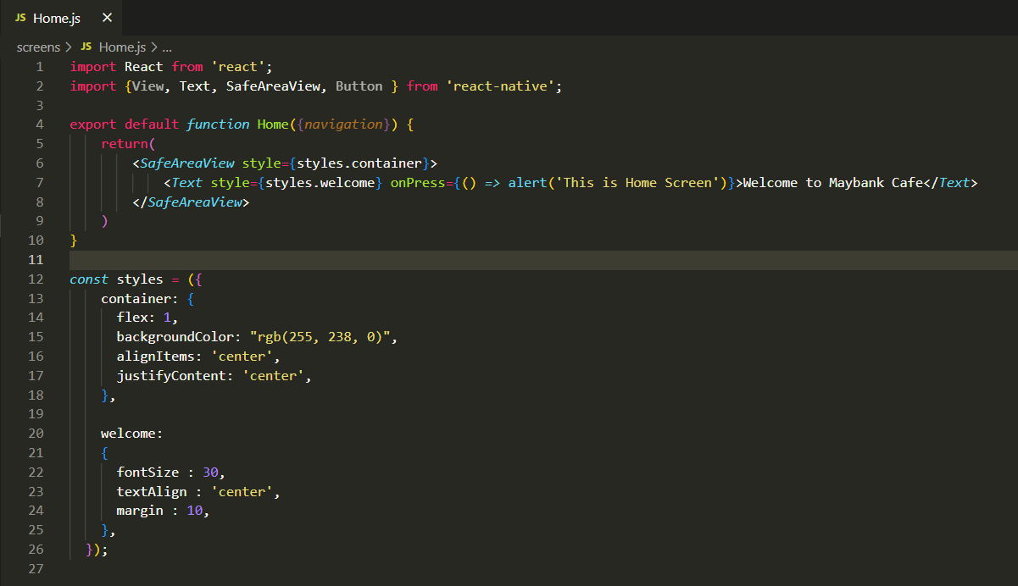
Third Scenario: React Native
Home Component
This Home.js is the home for the app. This js has using some native components such as SafeAreaView and Text also some stylesheets has been apply in this component.

Slide 21
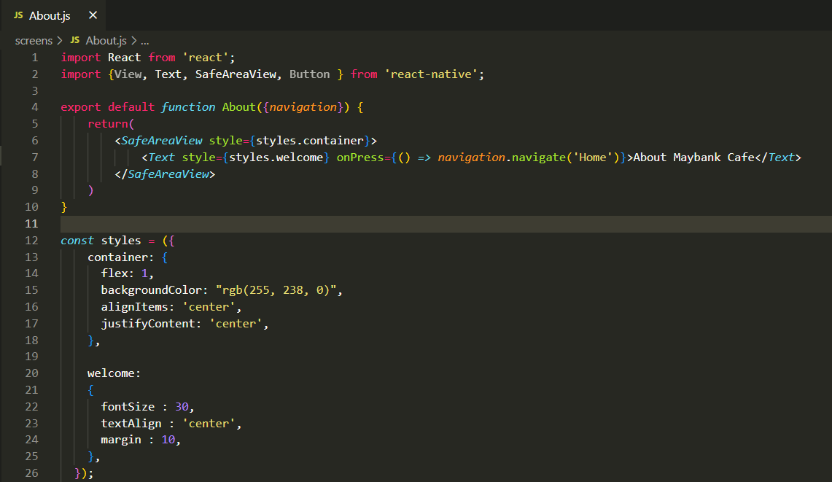
Third Scenario: React Native
About Component
This About.js will display about page and also using same native component and stylesheet with Home component.

Slide 22
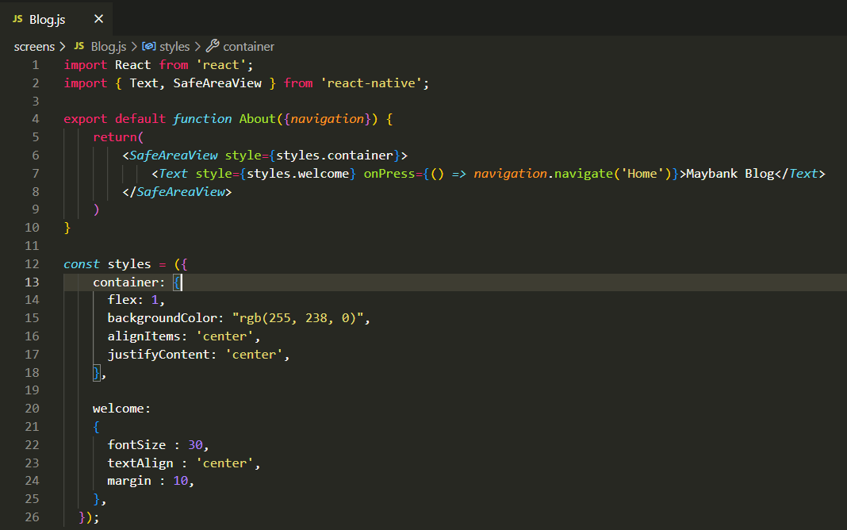
Third Scenario: React Native
Blog Component
This Blog.js will display blog page and also using same native component and stylesheet with Home and About components.

Slide 23
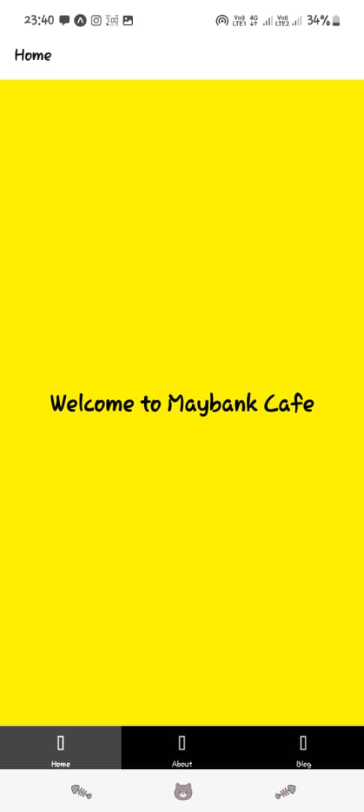
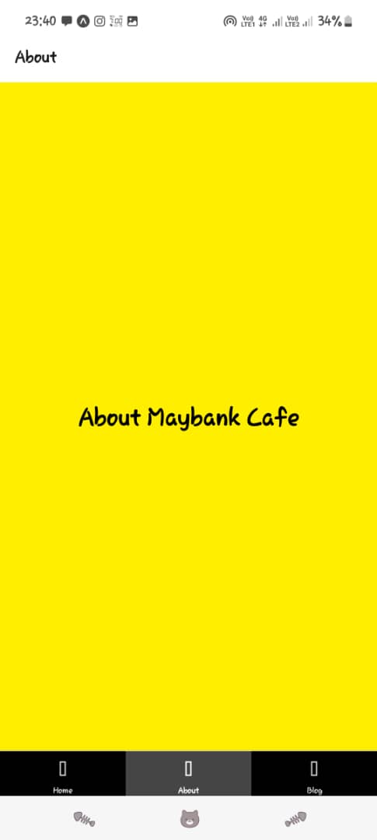
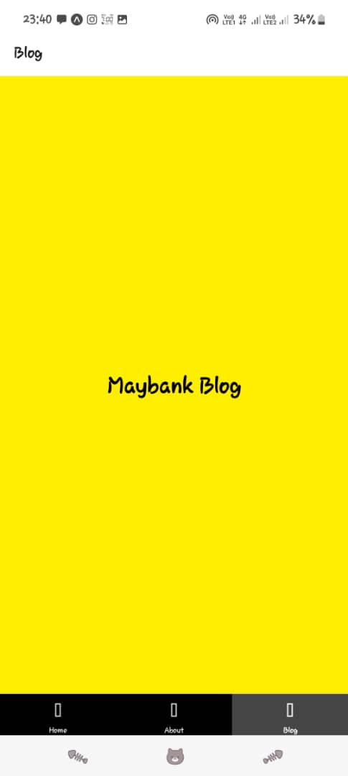
Third Scenario: React Native Output

