Slide 1


SMART INDIA HACKATHON 2026
Problem Statement ID – SIH26151
Problem Statement Title – Dark web threat actor de-anonymization
Theme- Blockchain and Cybersecurity
PS Category- Software
Team ID- 180727
Team Name- 6@RootRevival

Slide 2
SAKSHIASTRA
6@RootRevival
Proposed Solution (Describe your Idea/Solution/Prototype)
Detailed explanation of the proposed solution
Innovation and uniqueness of the solution
Problem: darknet vendors rebrand, hop markets and copy each other’s handles and PGP keys, so look-alike matching can blame the wrong person.
ML only suggests links. A separate verification layer decides what each link actually proves.
01 Claim-by-claim attribution
Key, wallet, persona, server and operator are proven separately, so we can say “key genuine, operator changed.”
1
2
3
4
02 Forgery-aware scoring
Collect
Link
Verify
Decide
Evidence counts by how hard it is to fake. A copied handle or pasted key can never prove identity alone.
Tor markets & forums, hashed snapshots
Personas, PGP keys, crypto wallets, servers
Each claim scored by how hard it is to fake
ASSERT, HOLD or REJECT each claim
03 No double-counting
A handle, key and listing copied from one source count once, not as three confirmations.
04 Takeover detection
How it addresses the problem
Sudden shifts in writing style, active hours and listing habits flag a possible account sale or takeover.
Follows actors across rebrands and markets, traces the crypto wallets they reuse, and gives analysts a timeline plus a hash-chained, tamper-evident dossier (STIX / PDF).
05 HOLD, don’t guess
When evidence is thin, the analyst gets a ranked list of exactly what evidence to fetch next.
Sakshi (witness) + Astra (weapon): similarity finds suspects, SakshiAstra shows what the evidence proves.
Notes:
PROPOSED SOLUTION AND CORE NOVELTY
SakshiAstra collects authorised footprints, stores timestamped snapshots with SHA-256 hashes, extracts identifiers, and proposes persona, infrastructure and suspect-entity links. The intelligence graph contains handles, PGP keys, wallets and directed trust links. Profiles include activity categories, source ratings, provenance and last scan dates.
ML is a discovery tool, not the attribution authority. Candidate discovery uses identifier overlap, template-cleaned stylometry, activity patterns, category and migration timing. A separate verifier evaluates what the evidence supports.
FIVE INNOVATIONS
1. Attribution Claim Graph: Key Control, Wallet Control, Persona Link, Hosting Link and Same Operator have separate supporting evidence, contradictions, confidence and statuses. Possessing a key is not the same claim as being the original operator.
2. Forgery-aware verification: each item receives a cost-to-fake label. Public artifacts such as copied handles, pasted keys or shared banners cannot, by themselves, promote a claim to VERIFIED. A valid persona-bound signature proves key control, not the identity of a human. A certificate or server-status clue requires contextual corroboration before treating it as a hosting link.
3. Evidence independence: candidate evidence items that could originate from the same copied artifact share an origin_group and count once. This prevents a copied handle, key and listing from becoming three independent confirmations. This addresses naive evidence fusion; it is not a claim that all weighted models or Dempster-Shafer implementations necessarily ignore dependence.
4. Operator continuity: change-point analysis uses writing style, activity hours, cadence and listing habits. A break flags a possible takeover or account sale. It is a warning, not proof of a change in human identity. Genuine behaviour changes can trigger it and careful imitation can evade it.
5. Actionable HOLD: unresolved claims return a ranked list of evidence to seek, such as a fresh persona-bound signature or independent continuity evidence. Analysts can continue an investigation instead of receiving an unsupported identity verdict.
ACTIVITY CATEGORIES
Drugs, arms, stolen data, hacking services, money laundering and terror financing. Category labels are investigative leads with explanations, not determinations of guilt.
POSITIONING
The proposed contribution combines these mechanisms in a darknet attribution workflow. Stylometry, graphs, evidence abstention and forensic proposition levels are established ideas. Do not claim universal uniqueness or a guaranteed win.
Source: user-supplied SakshiAstra project reference and innovation specification. Forensic foundation: Cook et al. (1998), https://doi.org/10.1016/S1355-0306(98)72117-3.
VISUAL: AI-generated conceptual illustration of Tor marketplaces, identity evidence and forensic review, with native PowerPoint labels and arrows. It is not a screenshot of the working application.

Slide 3























TECHNICAL APPROACH
6@RootRevival
Methodology and process for implementation
Scheduled rescan / auto re-verify
● Built in prototype (fixture data) ○ In development
Outlines mark fixture components; stack labels include planned integrations.
Authorised sources
Autonomous collection
Evidence store + identity graph
Own test onion service + fixtures
Research datasets
Python, FastAPI, APScheduler, Tor + stem
Scheduled capture; hashes,
identifiers and categories
Python, FastAPI, APScheduler, Tor + stem
Handles, PGP keys, wallets, trust links;
source ratings and provenance
DuckDB, NetworkX, SHA-256 hash-chained audit log
AI persona matcher
Origin mapper
Real-world entity resolver
Style, activity, identifiers;
blocking before pair matching
scikit-learn, LightGBM, MiniLM, pgpy, ruptures
SSL certs, server-status, banners,
descriptor inconsistencies → clearnet origin
requests, ssl/cryptography, mmh3 favicon hashes
PGP emails, clearnet handles,
crypto wallets, IPs / domains
requests, ssl/cryptography, mmh3 favicon hashes
Verification gate: every claim is judged separately
Key Control · Wallet Control · Persona Link · Hosting Link · Same Operator
ASSERT / HOLD / REJECT
Analyst workspace + dossier
HOLD = don’t guess; list the
evidence still needed
Docker Compose, self-hosted CPU · offline analysis and demo
Timeline query, profiles, category, last scan, source.
Analyst confirms identifications. STIX / CSV / JSON / PDF.
React, Cytoscape.js, stix2, WeasyPrint
Notes:
Tech Stack labels and categories preserved from the attached source. Solid outlines indicate implemented fixture components, not deployment of every named integration. Dashed outlines indicate development. No established original technology mark found for APScheduler, SHA-256, MiniLM, pgpy, ruptures, ssl/cryptography, mmh3. Their text labels are retained without generic replacement icons. Original brand assets: python: https://raw.githubusercontent.com/devicons/devicon/master/icons/python/python-original.svg; fastapi: https://raw.githubusercontent.com/devicons/devicon/master/icons/fastapi/fastapi-original.svg; tor: https://upload.wikimedia.org/wikipedia/commons/1/15/Tor-logo-2011-flat.svg; duckdb: https://raw.githubusercontent.com/duckdb/duckdb-web/main/images/duckdb_logo_dl.svg; networkx: https://raw.githubusercontent.com/networkx/networkx/main/doc/_static/networkx_banner.svg; scikit: https://scikit-learn.org/stable/_static/scikit-learn-logo-small.png; lightgbm: https://raw.githubusercontent.com/lightgbm-org/LightGBM/main/docs/logo/LightGBM_logo_no_text.svg; requests: https://requests.readthedocs.io/en/latest/_static/requests-sidebar.png; react: https://upload.wikimedia.org/wikipedia/commons/a/a7/React-icon.svg; cytoscape: https://js.cytoscape.org/img/cytoscape-logo.svg; stix: https://oasis-open.github.io/cti-documentation/img/STIX-logo.png; weasyprint: https://weasyprint.org/css/img/logotype-picto.svg; docker: https://raw.githubusercontent.com/devicons/devicon/master/icons/docker/docker-original.svg

Slide 4
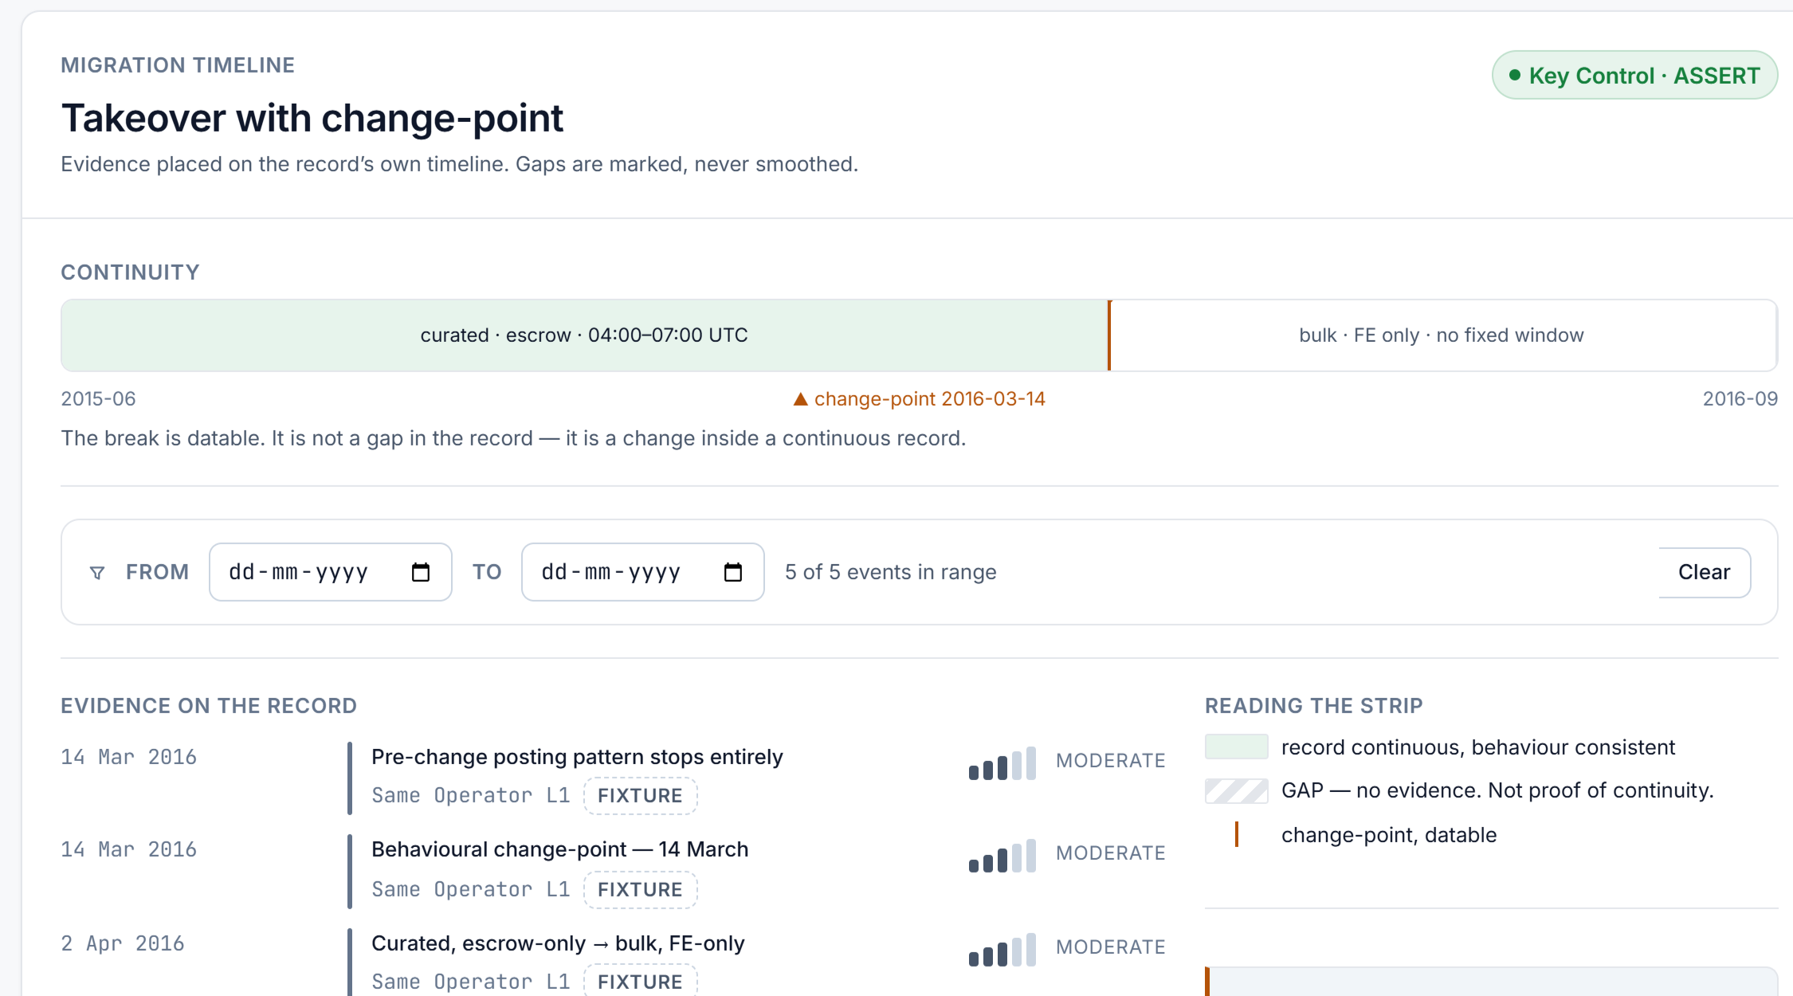
FEASIBILITY AND VIABILITY
6@RootRevival
Analysis of feasibility: working prototype
Research benchmark: locked train / validation / test protocol, 100 genuine + 210 adversarial cases, thresholds locked before testing. Working prototype: analyst workbench on fixture scenarios and Agora 2014–15 listing text. Python backend (FastAPI, DuckDB, pgpy) in development. Open-source, CPU-only.
Prototype source / benchmark: github.com/nsaharsh11/sakshiastra
Potential challenges and risks
Prototype and test results
Challenge | Strategies for overcoming it
Copied identifiers / text | Check signed proof and replays; copied signals count only once.
Too little evidence | Return HOLD instead of guessing; combine multiple independent signals.
Operator imitation | Several continuity signals + independent proof + human review.
No real-world ground truth | Controlled fixtures → licensed research datasets → supervised analyst pilot.
Legal and ethical risk | Authorised law-enforcement use only; passive collection; human sign-off; tamper-evident audit trail; built to work within the IT Act 2000 and DPDP Act 2023.
Prototype · fixture data
0 vs 30
false attributions vs. best baseline at matched recall
67%
of genuine migrations resolved with no false attribution
Controlled adversarial benchmark; real-world rates to be validated.
Viability
Low-cost on-premise deployment, modular source connectors and STIX 2.1 output for existing CTI tools. Only new or changed data is re-verified, so compute stays low as data grows.
Notes:
Controlled synthetic research benchmark imported from E:/SIH/experiment_4. Canonical report: benchmark/experiment_4/final_blind_validation_report.json. At gate validation target 64%, threshold 0.95: Test TP=67, FP=0. B4 and B8 baselines at validation target 70%: Test TP=67, FP=30. Matched observed test recall is 67%; validation targets differ. 100 genuine + 210 adversarial hard test pairs; full generated test split also includes 100 unrelated pairs. Real-world rates unvalidated. RSA/PSS synthetic proof benchmark, not end-to-end React or validated OpenPGP verification. Full experiment was not rerun during this edit; saved artifact hashes and CSV/JSON agreement audited. Source code and saved reports Git-committed: https://github.com/nsaharsh11/sakshiastra/tree/main/benchmark . Real React Scene 5 screenshot, fixture data. Python backend exists separately in the research source; React integration is in development. No public live demo URL was supplied: slide links to actual prototype source rather than claiming a deployed demo.

Slide 5
IMPACT AND BENEFITS
6@RootRevival
01 Potential impact
Illustrative case: valid key, changed operator
National security
Trace actors behind drugs, arms, stolen data, money laundering and terror financing, even after they rebrand or switch markets.
The signing key remains valid, but writing style and posting habits change after a suspected takeover.
Investigators
Before 14 March
From 14 March
NTRO, state cyber cells, CERT-In, SOCs and FIUs get one view of aliases, crypto wallets, hidden-service servers and the evidence timeline.
Stable style and cadence
Behaviour break
Claim | Result in this scenario
Key Control | ASSERT · VERIFIED: persona-bound signature
Wallet Control | not tested
Persona Link | not tested
Same Operator | HOLD · QUESTIONABLE: behavioural break
Faster follow-up
Every unresolved link names the evidence to seek next.
02 Benefits of the solution
Social: reduce risks of wrongful attribution.
Legal: hash-chained, source-graded dossiers.
Operational: focus reviews on supported leads.
HOLD: possible takeover
Economic: open-source CPU, secure on-premise use.
Next: request out-of-band continuity proof and review activity after 14 March.
Interoperable: STIX 2.1 feeds existing CTI platforms.
Notes:
Checked against current prototype Scene 5 takeover. Key Control ASSERT / VERIFIED; Same Operator HOLD / QUESTIONABLE. Wallet Control and Persona Link are not tested in this scene. Change-point: 14 March 2016.

Slide 6
RESEARCH AND REFERENCES
6@RootRevival
Research foundations and references
Technical mechanisms behind the innovations
Our work: literature / SIH26151 review, attack taxonomy, and a locked train / validation / test benchmark.
Key proof levels (L0–L3)
Tai, Soska & Christin (2019), KDD
Pasted key → valid signature → signature naming the persona → fresh signature anchored to a recent blockchain block hash.
Adversarial Matching of Dark Net Market Vendor Accounts
doi.org/10.1145/3292500.3330763
Replay + template-aware matching
Saxena et al. (2023), ACL
Reused proof gets zero weight for a new persona. Remove marketplace boilerplate before comparing writing style.
VendorLink: vendor migrants and potential aliases
aclanthology.org/2023.acl-long.481/
Evidence quality and trust
Wang et al. (2018), ASIACCS
Each item shows how hard it is to fake plus an Admiralty source grade. Clustered vouches count less.
You Are Your Photographs: vendor photo linkage
gangw.cs.illinois.edu/asiaccs18.pdf
Tamper-evident dossier
Cook et al. (1998), Science & Justice
Hash snapshots and audit entries. Export claim statuses and source-graded evidence in STIX 2.1 and PDF.
A hierarchy of propositions
doi.org/10.1016/S1355-0306(98)72117-3
Adversarial evaluation
Agora darknet marketplace data 2014–15
Benchmark: copied keys, replay, clones, takeovers, account sales. Prototype scenarios add wallet ladder and sock-puppet vouch rings.
Kaggle, philipjames11 · listing text only
Our contribution
Established forensic and cryptographic methods, combined into one claim-by-claim, forgery-aware attribution workflow for the dark web.
Notes:
Agora dataset reference: https://www.kaggle.com/datasets/philipjames11/dark-net-marketplace-drug-data-agora-20142015 . Used as scrubbed listing text only on fictional personas. No historical terror-financing examples. Benchmark and prototype scenario scope are distinguished. Replayed proof has zero weight and HOLD in the prototype.

