Slide 1
Browser stack demo website – capstone project
Under Guidance of Mrs. Vaishali sonanis mam

Slide 2
Introduction
It is a simulated online shopping platform designed for testing, learning, and automation practice.
It replicates the features of a real-world e-commerce website, allowing users to explore various functionalities in a controlled environment.
The site is widely used by QA engineers, testers, and developers to perform end-to-end testing, automation validation, and UI/UX evaluation of e-commerce workflows.

Slide 3
Members of team
NARAYANAPURAM SAIDURGA
Selenium Batch

Slide 4
Responsibilities
Functional and Automation testing for all modules
Make testcases for each module and execute them
Find out bugs and defects
Making all reports for each scenario
Cucumber bdd feature files
Page object model for each module that suites all users

Slide 5
Overview
What is BrowserStackDemo ?
Create test plan for all the features of module
Create test cases for each module in positive and negative way.
Start Automation testing using cucumber bdd framework on it.
Execute all test cases against the expected with actual results.
Report all bugs found.

Slide 6
MOdules
All test cases of the browser stack website

Slide 7
Module 1: Sign in page
Sign In Page allows users to log in securely through five ways which is very simple process to access all the features inside website.
Module 2 : Search products
Searching module helps users quickly find items they want to buy on BrowserStack by entering keywords, applying filters, or browsing categories.
Module 3 : Add to Cart
This allows users to select products they want to purchase and store them in a virtual shopping cart before checkout.

Slide 8
Module 4 : Delete Cart
It just deletes the products that are unwanted for user from the cart.
Module 5 : Filtering products
It can optimize total products to the specified effective ones.
Module 6 : Select by Categories
Users browse and explore products by selecting predefined categories, making it easier to find items without typing in search.

Slide 9
Module 7 : Checkout product
User can give complete delivery details like product specification, address, payment, before making an order after successful checkout process.
Module 8 : Orders module
User can place order after specified user product. All the placed orders are inside this module.
Module 9 : Favorites module
All the favorite products were collaborated here which is like save for later feature. It is the Wishlist of products for user.

Slide 10
Defects:
Defects make the software application to behave in an unexpected or incorrect way .It happens when actual result of software does not match the expected results as per requirements .

Slide 11
Defect Identifier : Def_BrowserStack_001
Defect Summary:
Expected result = After removing few favorites products then remaining favorites after refresh the page of Wishlist.
Actual result = All the favorites there.
Test Id : TC_01
Test case name : TC_Favorites_count
Module name : FavoritesProducts
Reproducible : When i am click on favorites module.
Severity : Medium
Priority : Medium
Raised by : Saidurga(tester)
Assigned to : Vaishali(TL name)
Date of assignment : 5/9/2025
Status: Open
Snapshots:
Fixed by : Developer name
Date of Fixing : 7/9/2025
Approvals : Manager name

Slide 12
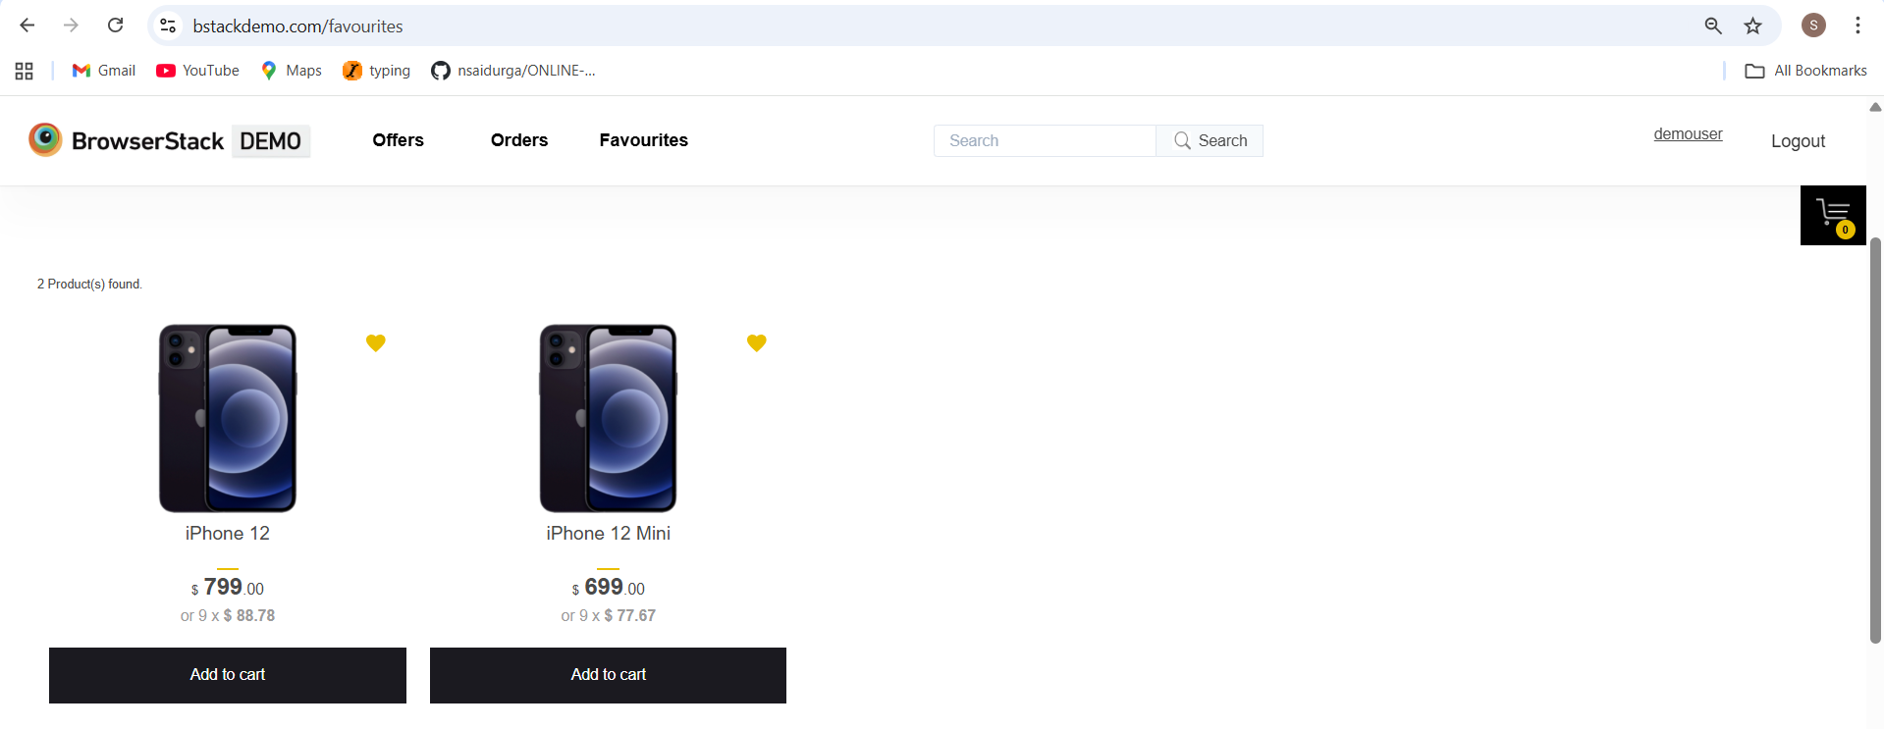

Slide 13
Defect Identifier : Def_BrowserStack_002
Defect Summary: Expected result = Search result gives specified products.
Actual result = Search result gives total products for every time.
Test Id : TC_2
Test case name : TC_SearchResult
Module name : SearchResult
Reproducible : When searched for a product name or brand.
Severity : Medium
Priority : Medium
Raised by : Saidurga(tester)
Assigned to : Vaishali(TL name)
Date of assignment : 5/9/2025
Status: Open
Snapshots:
Fixed by : Developer name
Date of Fixing : 7/9/2025
Approvals : Manager name

Slide 14
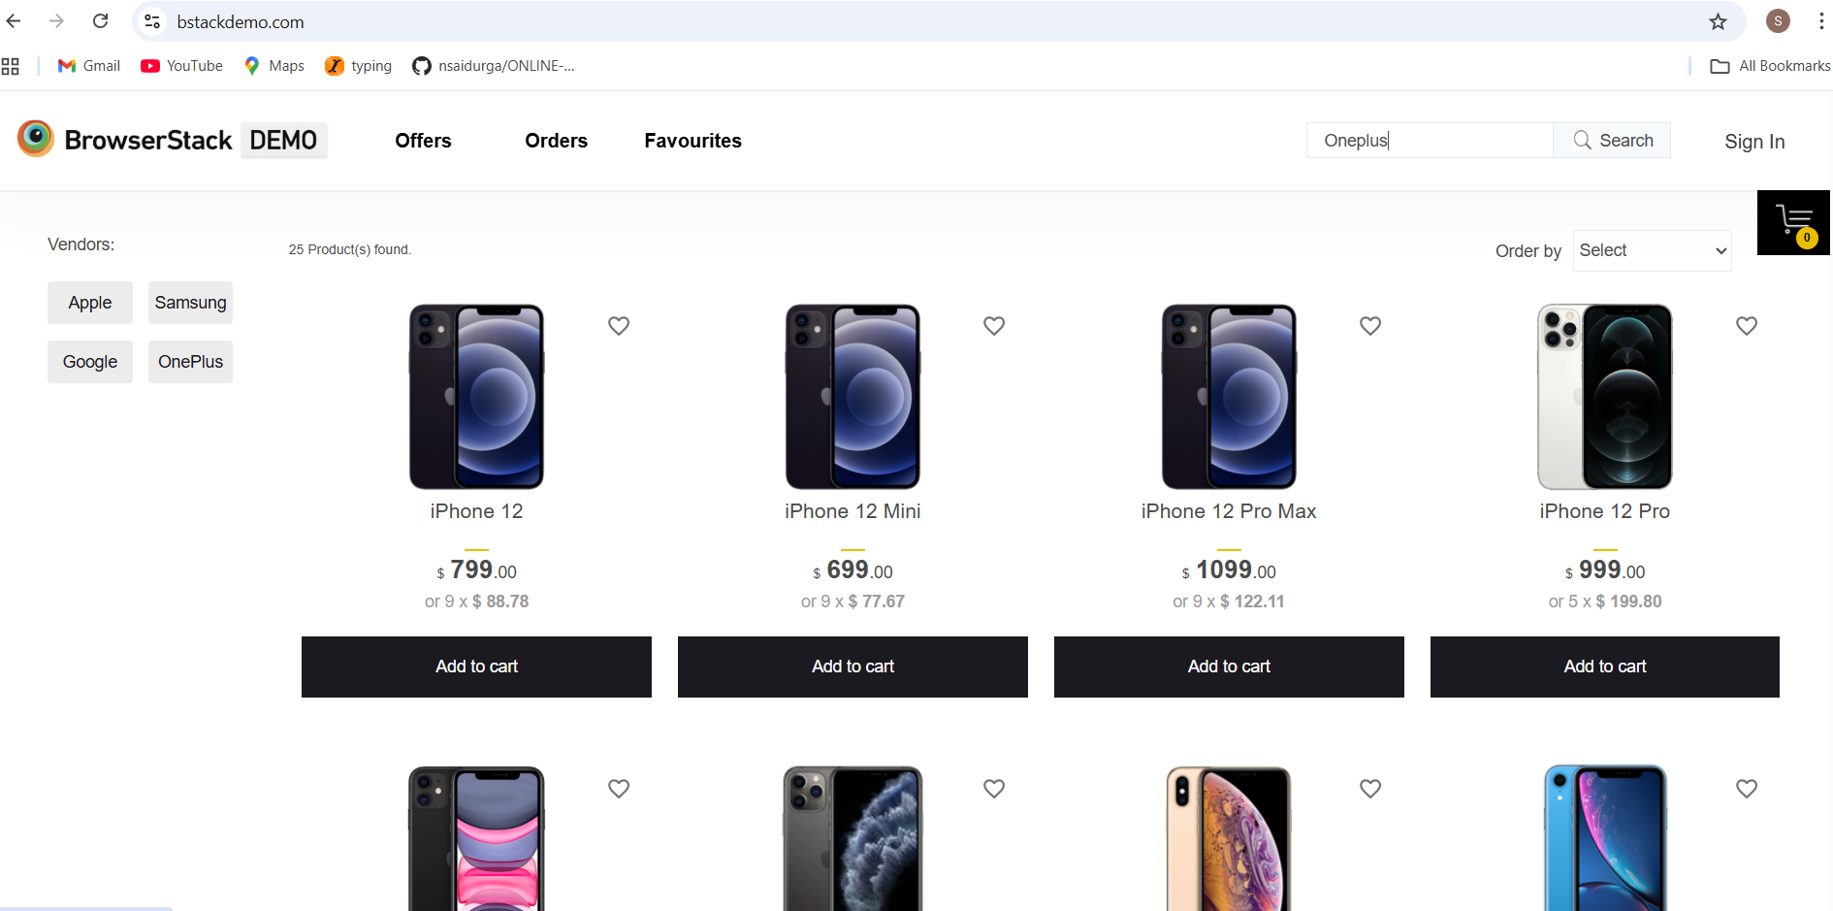

Slide 15
Defect Identifier : Def_BrowserStack_003
Defect Summary:
Expected result = All orders are sorted on and keep all separate date frame of products in single.
Actual result = It keeps separate date frame for same date ordered products.
Test Id : TC_03
Test case name : TC_OrdersDateSort
Module name : OrdersDateSort
Reproducible : When i am click on orders button.
Severity : Medium
Priority : Medium
Raised by : Saidurga(tester)
Assigned to : Vaishali(TL name)
Date of assignment : 5/9/2025
Status: Open
Snapshots:
Fixed by : Developer name
Date of Fixing : 7/9/2025
Approvals : Manager name

Slide 16
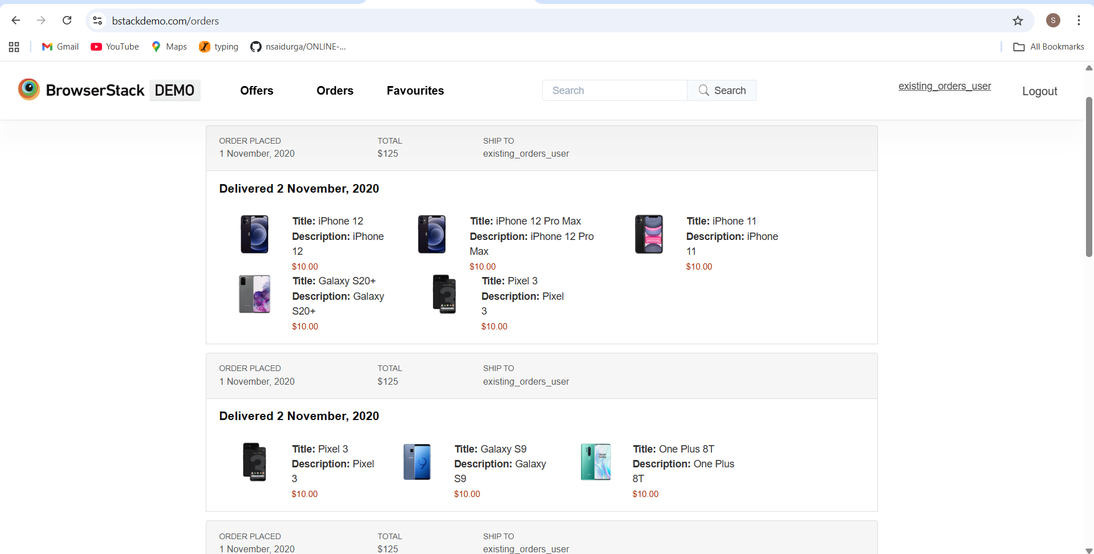

Slide 17
Defect Identifier : Def_BrowserStack_004
Defect Summary:
Expected result =In orders page, search gives the type of order .
Actual result = Searched an order is not worked.
Test Id : TC_04
Test case name : TC_SearchOrder
Module name : SearchOrder
Reproducible : When i am click on search button in orders page.
Severity : Medium
Priority : Medium
Raised by : Saidurga(tester)
Assigned to : Vaishali(TL name)
Date of assignment : 5/9/2025
Status: Open
Snapshots:
Fixed by : Developer name
Date of Fixing : 7/9/2025
Approvals : Manager name

Slide 18
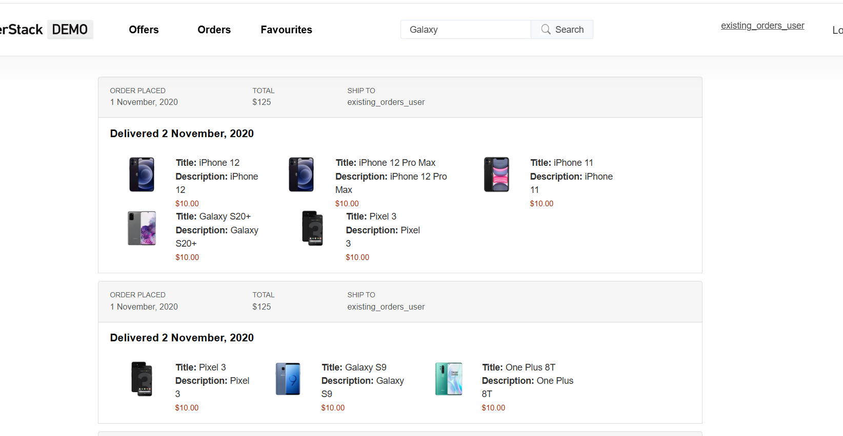

Slide 19
Challenges:
Datadriwen approach for writing code of modules like login, search, checkout etc.
Identifying different error handling of finding locators.
Login module of locators for dropdown select name.
Exceptions Handling in testing after executing each test module
Synchronization using waits

Slide 20
Experience:
Complete knowledge of automation on practical user testing websites like browser stack demo.
All the required scenario procedures for capstone project like frameworks, datadriwen approach,
automation tools, hybrid approach, Jenkins, git process etc.
Making each module in terms of multiple users accessing instead of hardcode single one.

Slide 21
Thank you

