Slide 1
eBay website
Under Guidance of Mrs. Vaishali sonanis mam

Slide 2
Introduction
eBay website is one of the biggest online shopping websites in the world.
It is a global marketplace where individuals and businesses can buy and sell products.
It is a platform that allows both bids and direct buying.
We can find everything on eBay from clothes , electronics to home items.

Slide 3
Members of team
NARAYANAPURAM SAIDURGA
Selenium Batch

Slide 4
Responsibilities
Functional and Automation testing for all modules
Make testcases for each module and execute them
Find out bugs and defects

Slide 5
Overview
What is eBay?
Create test plan for all the features of module
Create test cases for each module in positive and negative way.
Execute all test cases against the expected with actual results.
Report all bugs found.

Slide 6
Module 1: Sign in page
Sign In Page allows users to log in securely to their eBay account to access personalized features like buying, selling, managing orders, and tracking activity.
Module 2 : Search products
Searching module helps users quickly find items they want to buy on eBay by entering keywords, applying filters, or browsing categories.
Module 3 : Add to Cart
This allows users to select products they want to purchase and store them in a virtual shopping cart before checkout.

Slide 7
Module 4 : Delete Cart
It just deletes the products that are unwanted for user from the cart.
Module 5 : Shop by All categories
The Add to Cart module allows users to select products they want to purchase and store them in a virtual shopping cart before checkout.
Module 6 : Shop by category
Users browse and explore products by selecting predefined categories, making it easier to find items without typing in search.

Slide 8
Module 7 : Product details
It provides complete information about a selected item so buyers can make informed purchasing decisions.
Module 8 : Change username
Registered users to update their display username on eBay for personalization or privacy reasons.
Module 9 : Change Adress
Change adress for user convenience of buying products fro delivering products

Slide 9
Defects:
Defects make the software application to behave in an unexpected or incorrect way .It happens when actual result of software does not match the expected results as per requirements .

Slide 10
Defect Identifier : Def_eBay_Sales_Events_001
Defect Summary: Expected result = All the available sales option events shown here else no sales and events right now, Actual result = Unrelated Printed text .
Test Id : TC_01
Test case name : TC_Sales_Events_button
Module name : SalesAndEvents
Reproducible : When i am click on shop by category, proceed to sales and events section.
Severity : Medium
Priority : Medium
Raised by : Saidurga(tester)
Assigned to : Vaishali(TL name)
Date of assignment : 19/8/2025
Status: Open
Snapshots:
Fixed by : Developer name
Date of Fixing : 19/8/2025
Approvals : Manager name

Slide 11
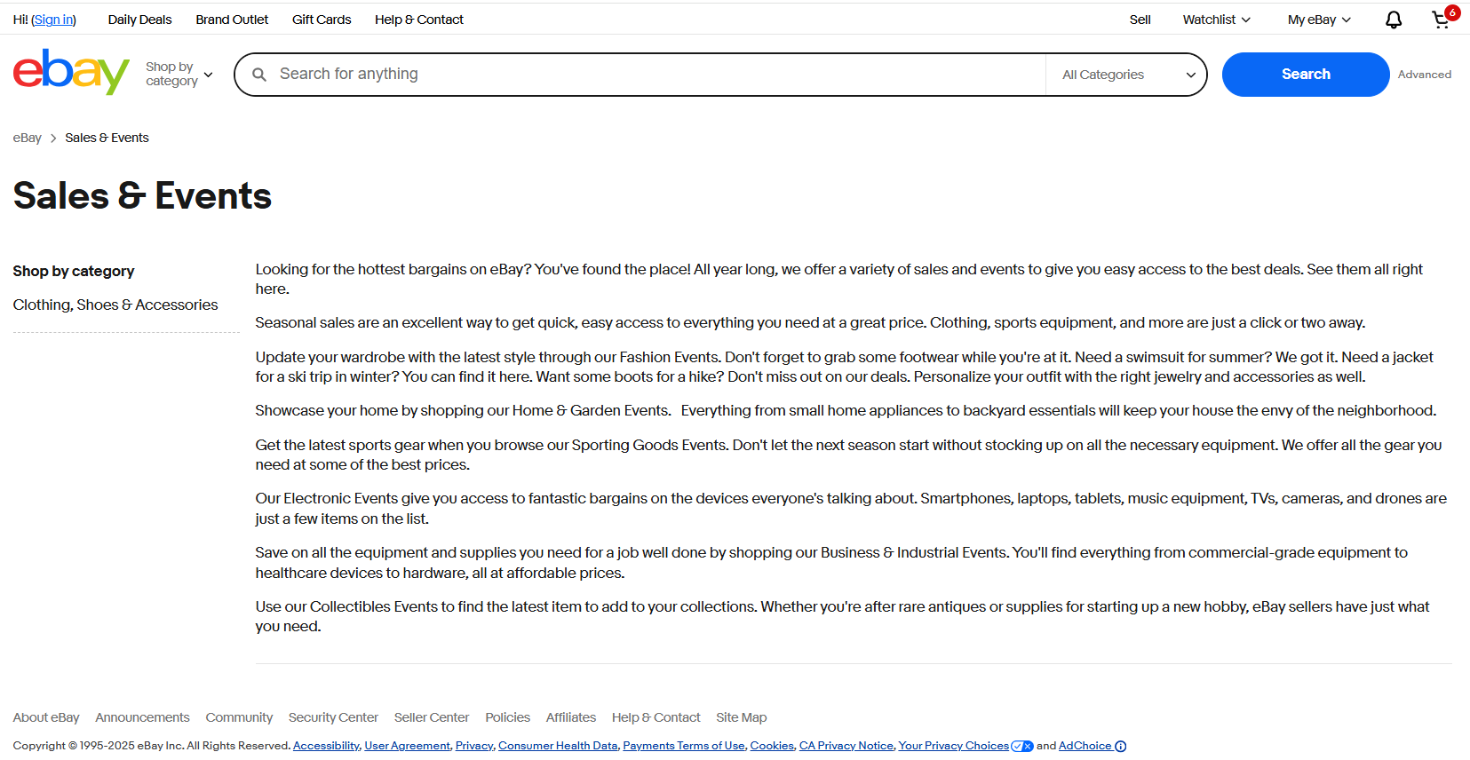

Slide 12
Defect Identifier : Def_eBay_cartLimit_003
Defect Summary: Expected result = Unlimited products you can buy for multiple quantities. Actual result = limited product quantity .
Test Id : TC_01
Test case name : TC_eBay_cartQuantity_button
Module name : cartQuantity
Reproducible : When increase product quantity for different products .
Severity : Medium
Priority : Medium
Raised by : Saidurga(tester)
Assigned to : Vaishali(TL name)
Date of assignment : 19/8/2025
Status: Open
Snapshots:
Fixed by : Developer name
Date of Fixing : 19/8/2025
Approvals : Manager name

Slide 13
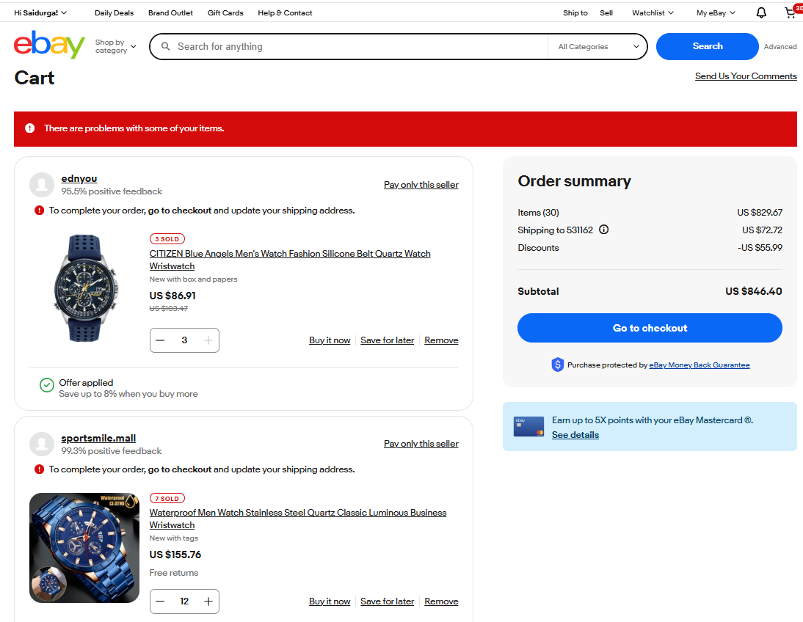

Slide 14
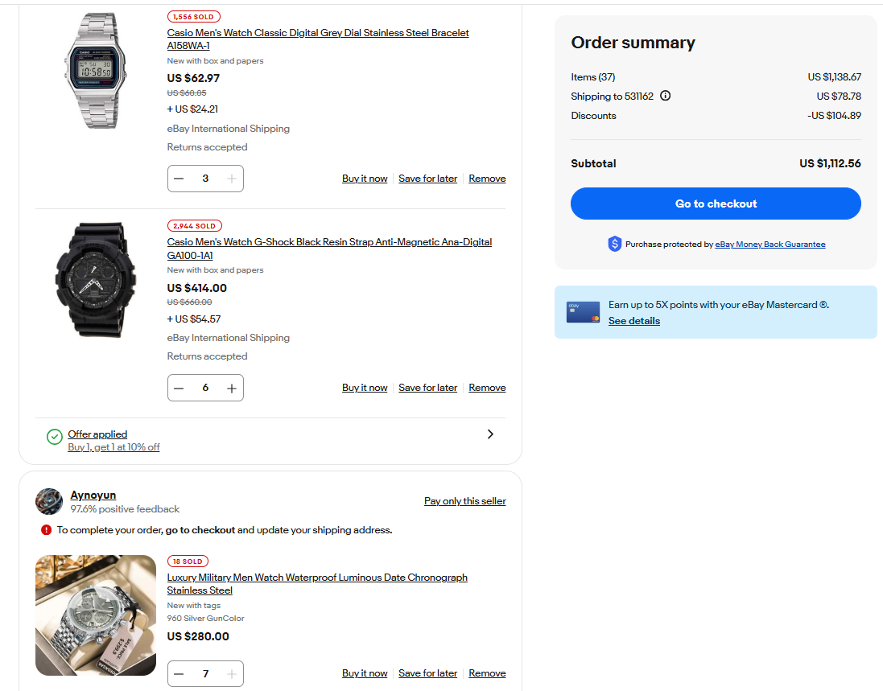

Slide 15
Defect Identifier : Def_eBay_All_Categories_002
Defect Summary: Expected result = Click on all categories button then it shows all recommended categories and the button keeps all categories options as like click on books category it keeps the books button .
Actual result = It keeps all categories button every time when selects other category options also .
Test Id : TC_01
Test case name : TC_eBay_Books_button
Module name : Category buttons
Reproducible : When i am click on shop by category, proceed to books,baby, arts etc sections.
Severity : Medium
Priority : Medium
Raised by : Saidurga(tester)
Assigned to : Vaishali(TL name)
Date of assignment : 19/8/2025
Status: Open
Snapshots:
Fixed by : Developer name
Date of Fixing : 19/8/2025
Approvals : Manager name

Slide 16
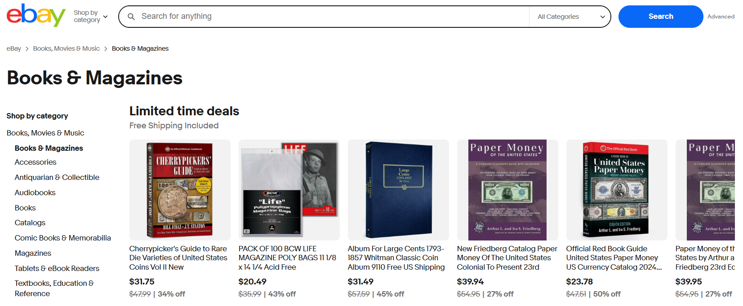

Slide 17
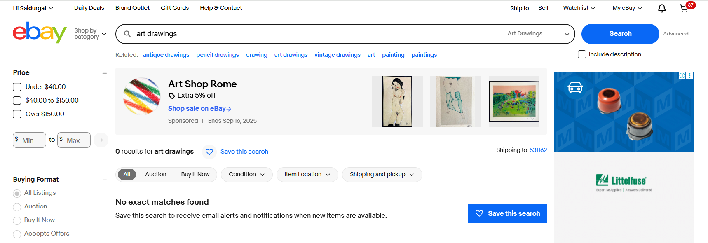

Slide 18
Defect Identifier : Def_eBay_Art_004
Defect Summary: Expected result = Click on art drawings, it shows products
Actual result = It is the first sub category of Art so it definitely contains the few items but it shows no results.
Test Id : TC_01
Test case name : TC_eBay_ArtDrawings
Module name : Art category
Reproducible : When i am click on shop by category Art, proceed to art drawings sections.
Severity : Medium
Priority : Medium
Raised by : Saidurga(tester)
Assigned to : Vaishali(TL name)
Date of assignment : 19/8/2025
Status: Open
Snapshots:
Fixed by : Developer name
Date of Fixing : 19/8/2025
Approvals : Manager name

Slide 19
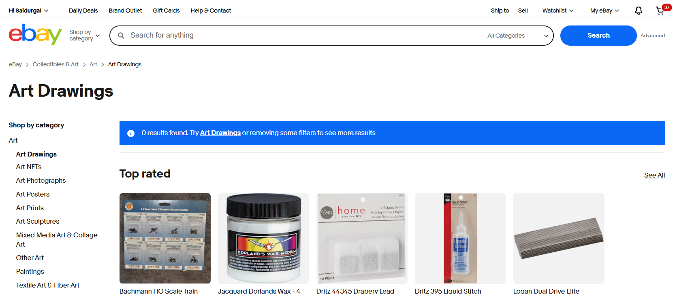

Slide 20
Challenges:
Identify and using the locators for different elements of dynamic .
Frequent Updates require continuous testing.
Changing language option
Exceptions Handling in testing after executing each test module
Capturing first product of a search that gives random and into new window also
Synchronization using waits

Slide 21
Experience:
Understanding each module functionality in real time websites
Writing test cases
Executing test cases
Able to identify bugs
Finding bugs as a tester in eBay not as a user

Slide 22
Thank you

