Slide 1
eBay website
Under Guidance of Mrs. Vaishali sonanis mam

Slide 2
Introduction
eBay website is one of the biggest online shopping websites in the world.
It is a global marketplace where individuals and businesses can buy and sell products.
It is a platform that allows both bids and direct buying.
We can find everything on eBay from clothes , electronics to home items.

Slide 3
Members of team
NARAYANAPURAM SAIDURGA
Selenium Batch

Slide 4
Responsibilities
Functional and performance testing for all modules
Make testcases for each module and execute them
Find out bugs and defects

Slide 5
Overview
What is eBay?
eBay is a global e-commerce platform that allows people to buy and sell products online.
It operates in more than 190 markets worldwide and connects millions of buyers and sellers.
Products on eBay cover a wide range: electronics, fashion, collectibles, vehicles, home goods, and more.
eBay ensures safe transactions through secure payments, buyer protection, and seller ratings.
It contains several modules for operating all the functions for customer .

Slide 6
Module 1: Sign in page
Sign In Page allows users to log in securely to their eBay account to access personalized features like buying, selling, managing orders, and tracking activity.
Module 2 : Search products
Searching module helps users quickly find items they want to buy on eBay by entering keywords, applying filters, or browsing categories.
Module 3 : Add to Cart
This allows users to select products they want to purchase and store them in a virtual shopping cart before checkout.

Slide 7
Module 4 : Delete Cart
It just deletes the products that are unwanted for user from the cart.
Module 5 : Shop by All categories
The Add to Cart module allows users to select products they want to purchase and store them in a virtual shopping cart before checkout.
Module 6 : Shop by category
Users browse and explore products by selecting predefined categories, making it easier to find items without typing in search.

Slide 8
Module 7 : Product details
It provides complete information about a selected item so buyers can make informed purchasing decisions.
Module 8 : Change username
Registered users to update their display username on eBay for personalization or privacy reasons.
Module 9 : Change Language
Change language for user convenience of selling or buying products

Slide 9
Defects:
Defects make the software application to behave in an unexpected or incorrect way .It happens when actual result of software does not match the expected results as per requirements .

Slide 10
Defect Identifier : Def_eBay_Sales_Events_001
Defect Summary: Expected result = All the available sales option events shown here else no sales and events right now, Actual result = Unrelated Printed text .
Test Id : TC_01
Test case name : TC_eBay_Sales_Events_button
Module name : SalesAndEvents
Reproducible : When i am click on shop by category, proceed to sales and events section.
Severity : Medium
Priority : Medium
Raised by : Saidurga(tester)
Assigned to : Vaishali(TL name)
Date of assignment : 19/8/2025
Status: Open
Snapshots:
Fixed by : Developer name
Date of Fixing : 19/8/2025
Approvals : Manager name

Slide 11
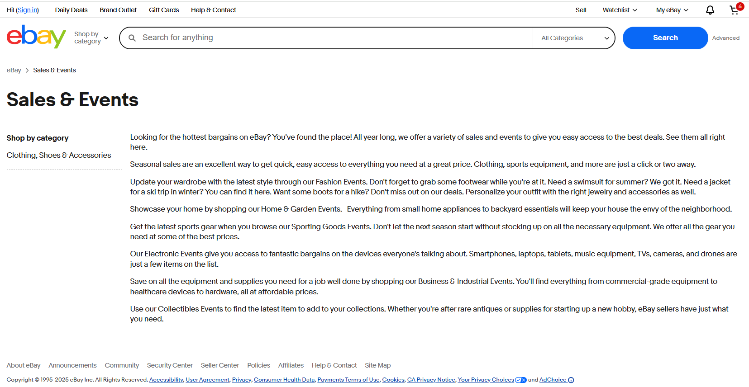

Slide 12
Defect Identifier : Def_eBay_cartLimit_003
Defect Summary: Expected result = Unlimited products you can buy for multiple quantities. Actual result = limited product quantity .
Test Id : TC_01
Test case name : TC_eBay_cartQuantity_button
Module name : cartQuantity
Reproducible : When increase product quantity for different products .
Severity : Medium
Priority : Medium
Raised by : Saidurga(tester)
Assigned to : Vaishali(TL name)
Date of assignment : 19/8/2025
Status: Open
Snapshots:
Fixed by : Developer name
Date of Fixing : 19/8/2025
Approvals : Manager name

Slide 13
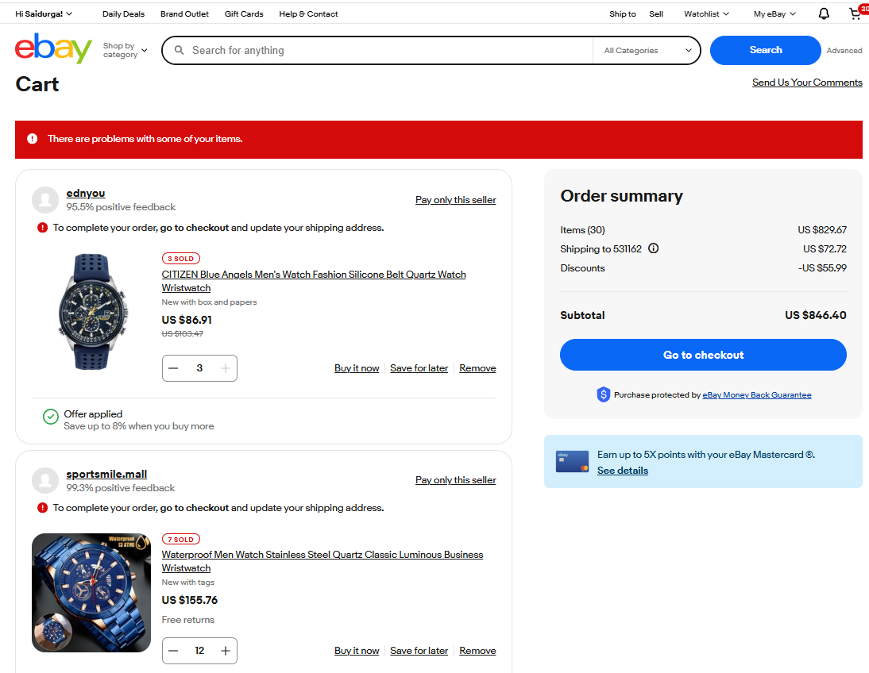

Slide 14
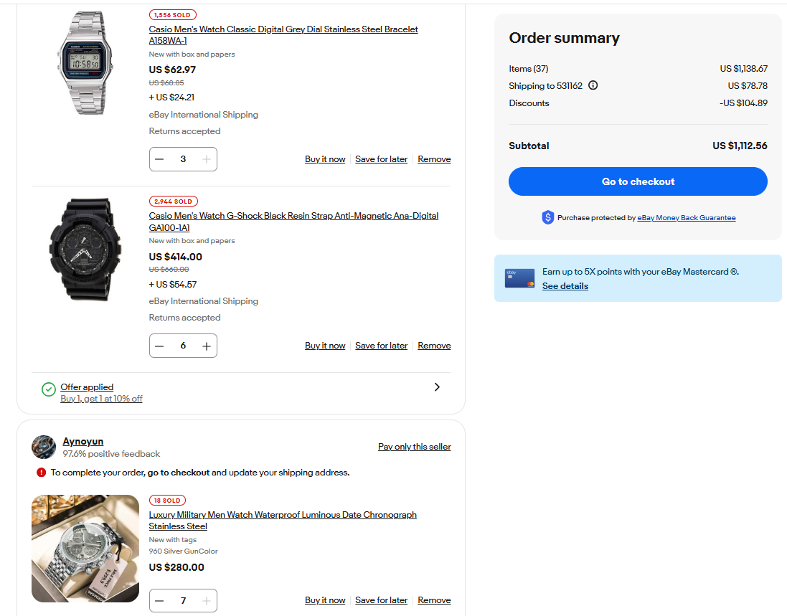

Slide 15
Defect Identifier : Def_eBay_All_Categories_002
Defect Summary: Expected result = Click on all categories button then it shows all recommended categories and the button keeps all categories options as like click on books category it keeps the books button .
Actual result = It keeps all categories button every time when selects other category options also .
Test Id : TC_01
Test case name : TC_eBay_Books_button
Module name : Category buttons
Reproducible : When i am click on shop by category, proceed to books,baby, arts etc sections.
Severity : Medium
Priority : Medium
Raised by : Saidurga(tester)
Assigned to : Vaishali(TL name)
Date of assignment : 19/8/2025
Status: Open
Snapshots:
Fixed by : Developer name
Date of Fixing : 19/8/2025
Approvals : Manager name

Slide 16
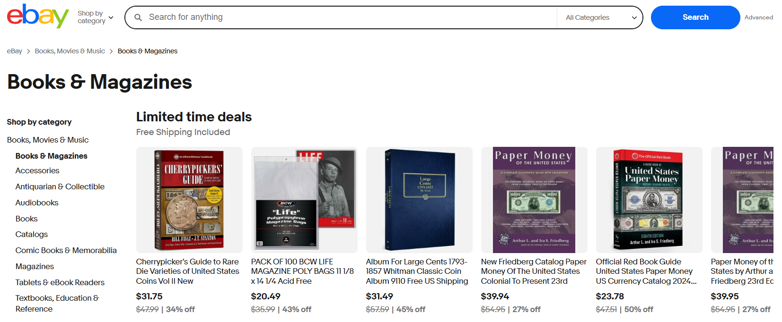

Slide 17
Challenges:
While testing big website which contains huge data we faced some challenges about:
Large Product Database – Millions of products → difficult to test search & category accuracy.
Frequent Updates – New features, design changes, and security patches → require continuous testing.
Dynamic Content – Prices, stock, discounts change frequently → need real-time validation.
Exceptions Handling like not locating elements

Slide 18
Experience:
Understanding each module functionality
Writing test cases
Executing test cases
Report bugs

Slide 19
Thank you

