Slide 1
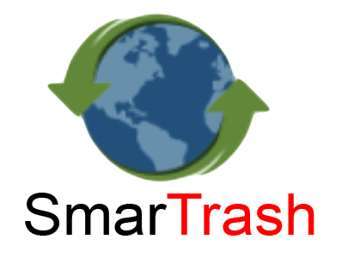

Slide 2
Recycling
Recycling is critical since it manages wastes which can have a negative impact on the environment.
Harmful chemicals and greenhouse gases are released from rubbish in landfill sites.
The increase in wastes is due to the increase of population and technological products.
In 2014, the US recycling industry employed more than 1.1 million people, generated over $236 billion in revenues and saved over $3 billion in avoided landfill disposal fees.

Slide 3
SmarTrash
SmarTrash is an web application that helps the environment by encouraging people to recycle.
The Application is supported by the concept of recycling centers.
Recycling centers are well known in California; There are over 1,700 recycling centers.
People send containers with empty wastes, and in return they receive money.(California Refund Value).
The minimum refund value is 5 cents for each container under 24 ounces and 10 cents for each container 24 ounces or greater.

Slide 4
SmarTrash
The Application’s goal is to provide an incentive for people and ease the recycling process.
Companies will offers trash cans in the areas they desire.
The application users will use their Email at the Trash can area.
The more you recycle(weight) the more points you will receive.
These points can be redeemed later as cash or offers.

Slide 5
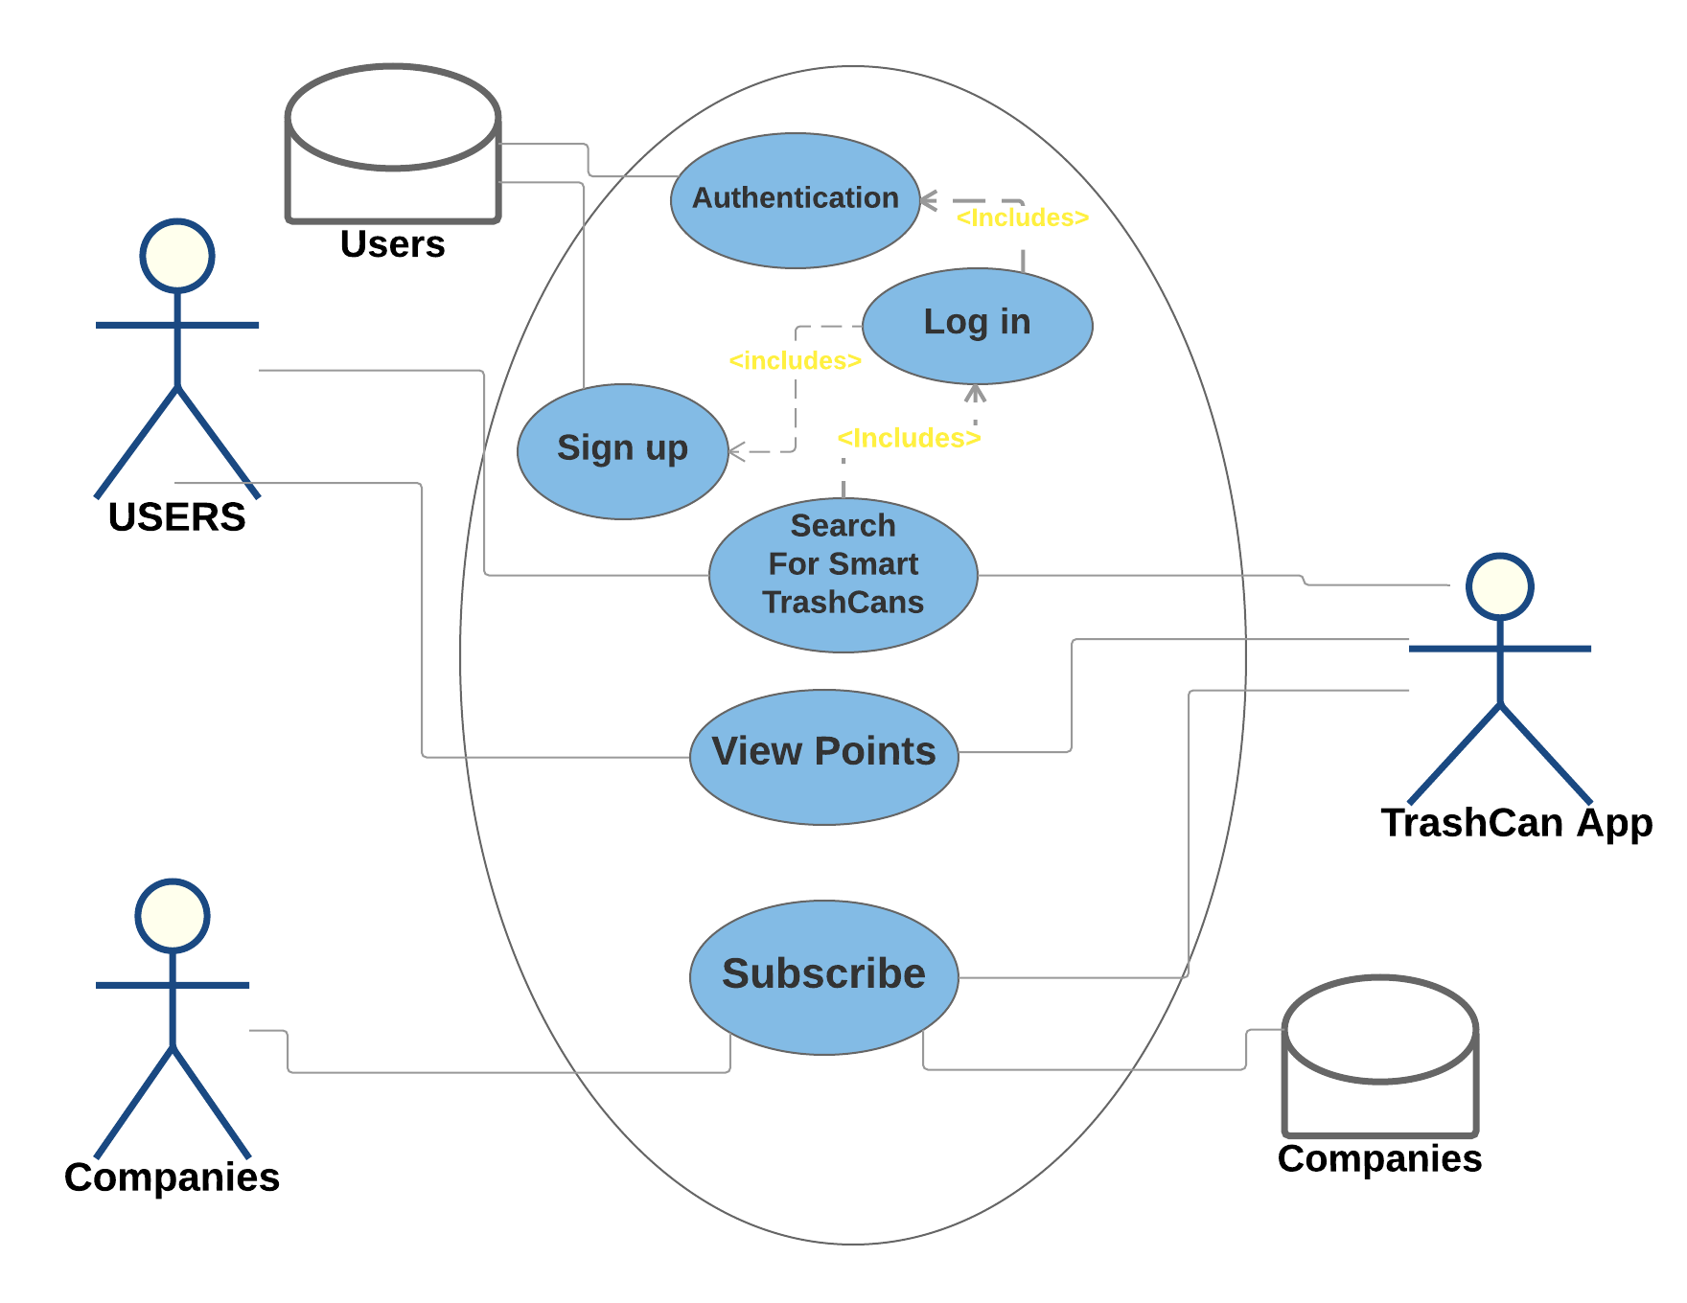
Use Case

Slide 6
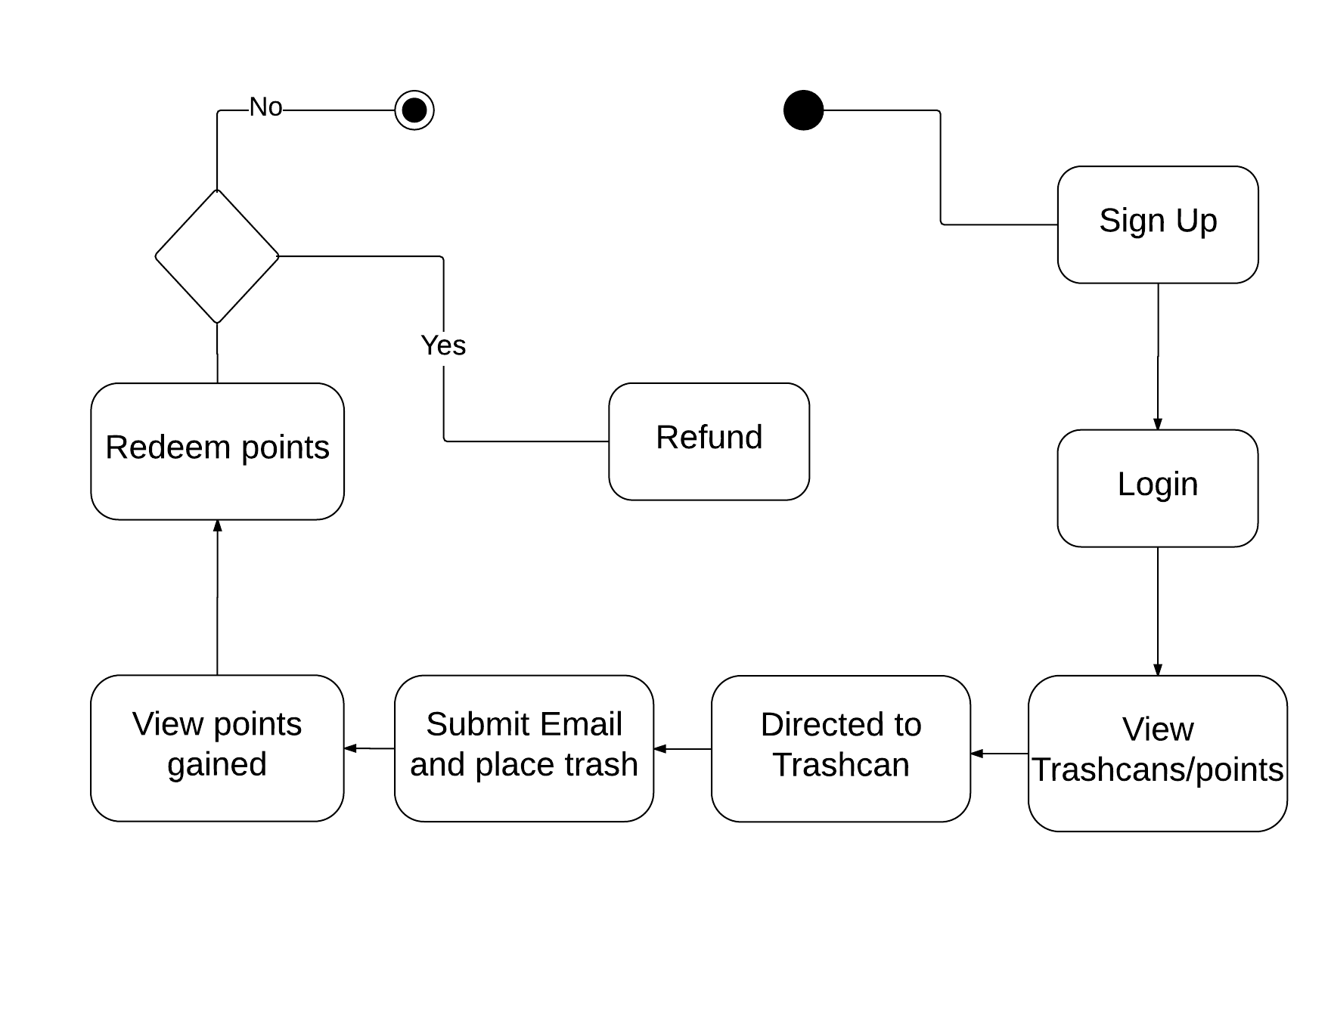
Activity Diagram

Slide 7
Why SmarTrash?
Connecting people with recycling companies.
Managing the refund system.
People will engage more in helping the environment.
Saves companies the time and cost of sorting and processing the wastes.

Slide 8
Why SmarTrash?
Encourage recycling start ups.
More recycling trash cans will be available to consumers which will give more trash a new life.
Saves more municipal budgets. (Disposal fees)

Slide 9
Future
Watson Tradeoff Analytics
Mobile Application
Push Notification
Single Sign-on (Google/Facebook)

Slide 10
Thank you
Nour Salem
Mahmoud Tarkhan
Mohamed Abdel-Mohsen
Mohamed Moussa

