Slide 1
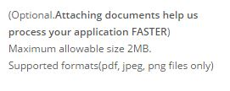
CHANGES ON INVESTOR REGISTRATION FORM
Give a space here
Remove Brackets
This will be “helps us…”

Slide 2
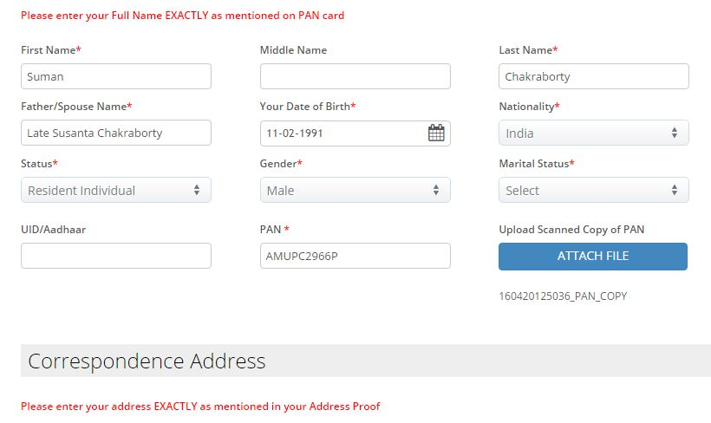
CHANGES ON INVESTOR REGISTRATION FORM
Please put “NOTE” before start of the message. Example,
NOTE: Please enter your Full Name EXACTLY as mentioned on PAN card

Slide 3
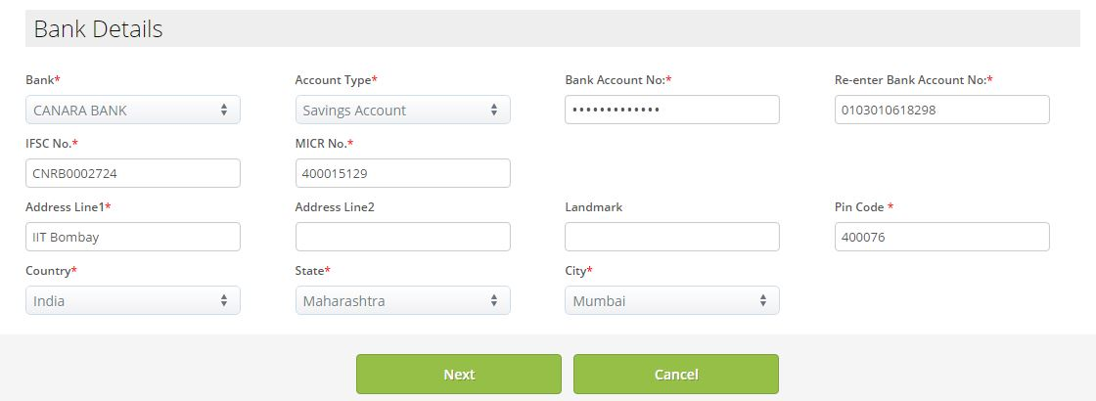
CHANGES ON INVESTOR REGISTRATION FORM
This button appears at the bottom of page1 of Investor registration.
Rename the button label to “Save & Proceed”

Slide 4
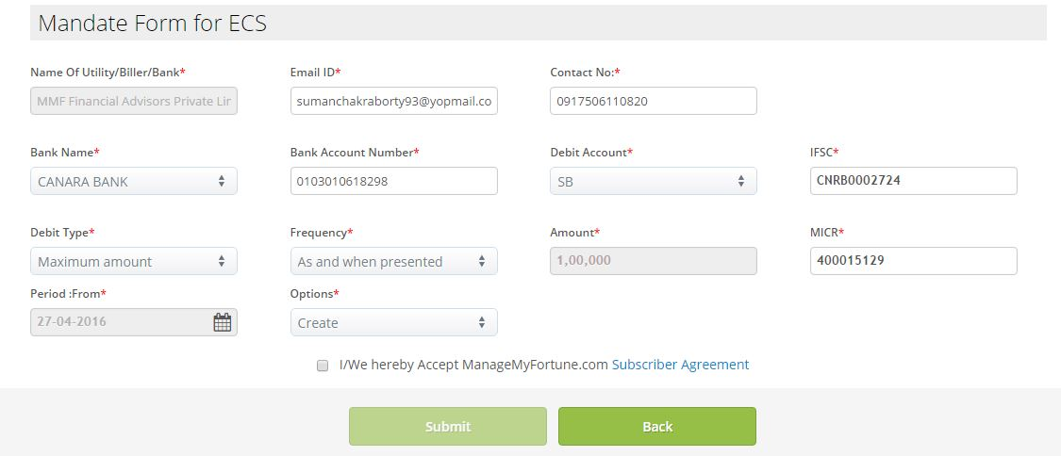
CHANGES ON INVESTOR REGISTRATION FORM
Add another button here called – “Save Draft”.
This is to let the user know that if he/she clicks on this and logs out to come back in , the data will still be there. Otherwise users are not aware of the auto-save feature

Slide 5
CHANGES ON INVESTOR REGISTRATION FORM
There will be 2 ECS mandate sections now
Headings will be: “Mandate Form for ECS (Advisory Fees Billing)” and
“Mandate Form for ECS (Funds Transfer in/out of Brokerage Account)”
3. Remove the scratched out fields (refer next slide for more points)

Slide 6
4. Keep Amount under “Mandate Form for ECS (Advisory Fees Billing)” as 10,000 (Ten Thousand)
5. Keep a description text beside this amount field – similar to the one beside Attach File button. Text will say:
“This is the maximum billable amount” - keep this in bold.
6. Keep Amount under “Mandate Form for ECS (Funds Transfer in/out of Brokerage Account)” as 100,000 (Ten Lakhs)
7. Keep a description text beside this amount field – similar to the one beside Attach File button. Text will say:
“This is the maximum amount you can transfer in/out of your Brokerage Account.” - keep this in bold
8. Keep the other un-scratched fields under both the headings on ECS and fill them up with the required values

