Slide 1
1
Luddy School of Informatics, Computing, and Engineering, IUPUI
RNA-Seq profiling in peripheral blood mononuclear cells of diabetic retinopathy patients and controls
Neel Sangani Janga Lab
IUPUI

Slide 2
Outline
Dataset Overview
Quality Control
Alignment
FeatureCounts Results
Experiment Conditions
DESeq2 results

Slide 3
3
Introduction
Dataset
Notes:
3

Slide 4
Quality Control
Control
Mild NPDR
Diabetic/DM
Severe NDPR
PDR

Slide 5
Alignment
Above 90%
Low 92% and high 95%
Control
Mild NPDR
Diabetic/DM
Severe NDPR
PDR

Slide 6
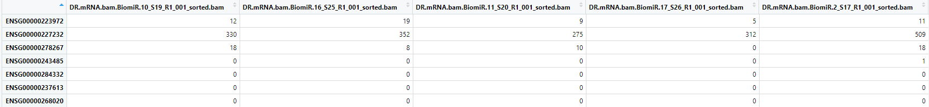
featureCounts (gene-level quantification)
Output: 60,675 x 14
Two quality control steps:
Drop all rows with zero reads in any column: 17,476 x 14
Drop rows with reads less than 5 any column: 15,431 x 14
Control
Mild NPDR
Diabetic/DM
Severe NDPR
PDR
Notes:
Gene count per sample after removing null values (Table)
Filter genes with low counts

Slide 7
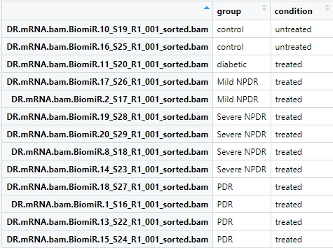
Experiment Design

Slide 8
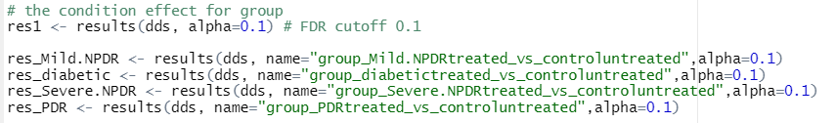
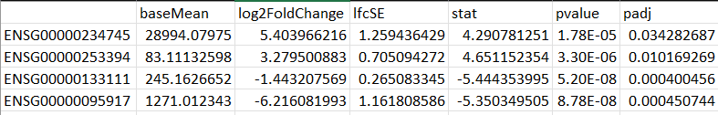
DESeq2 Analysis
Significance cutoff = 0.1
Example Output:
Notes:
the significance cutoff used for optimizing the independent filtering (by default 0.1). If the adjusted p-value cutoff (FDR) will be a value other than 0.1, alpha should be set to that value.
If we want cutoff of 0.05, we can always filter based on False discovery rate (FDR)

Slide 9
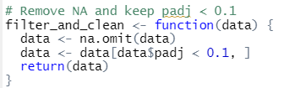
DESeq2 Analysis
Padj cutoff = 0.1 (FDR)
Example Output:
Notes:
the significance cutoff used for optimizing the independent filtering (by default 0.1). If the adjusted p-value cutoff (FDR) will be a value other than 0.1, alpha should be set to that value.
If we want cutoff of 0.05, we can always filter based on False discovery rate (FDR)

Slide 10
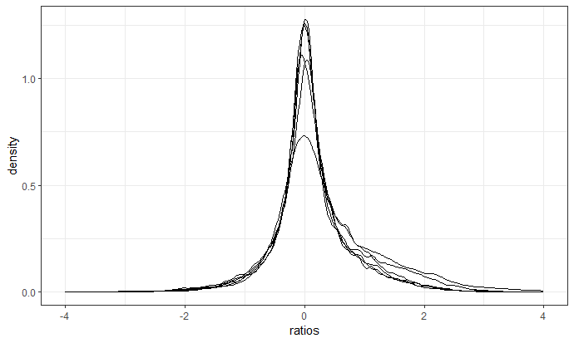
Distribution of gene ratios (size factor)
Notes:
Old Analysis

Slide 11
Dendogram
Notes:
Spearman’s Rank Correlation Coefficient is used to discover the strength of a link between two sets of data – monotonic relationship
Old Analysis

Slide 12
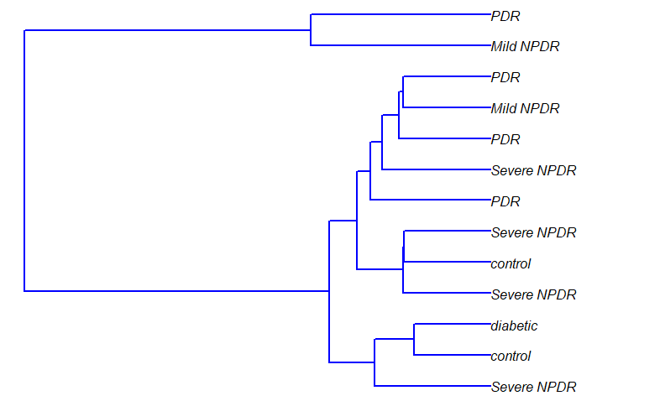
Dendrogram (diabetic replicate dropped)
Notes:
Old Analysis

Slide 13
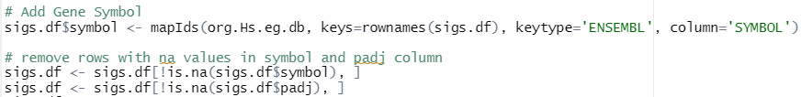
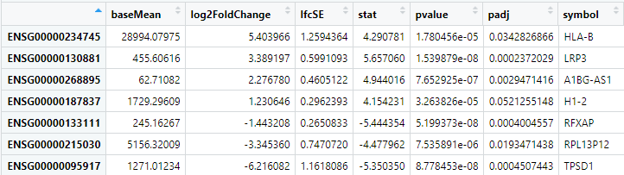
Gene Symbol

Slide 14
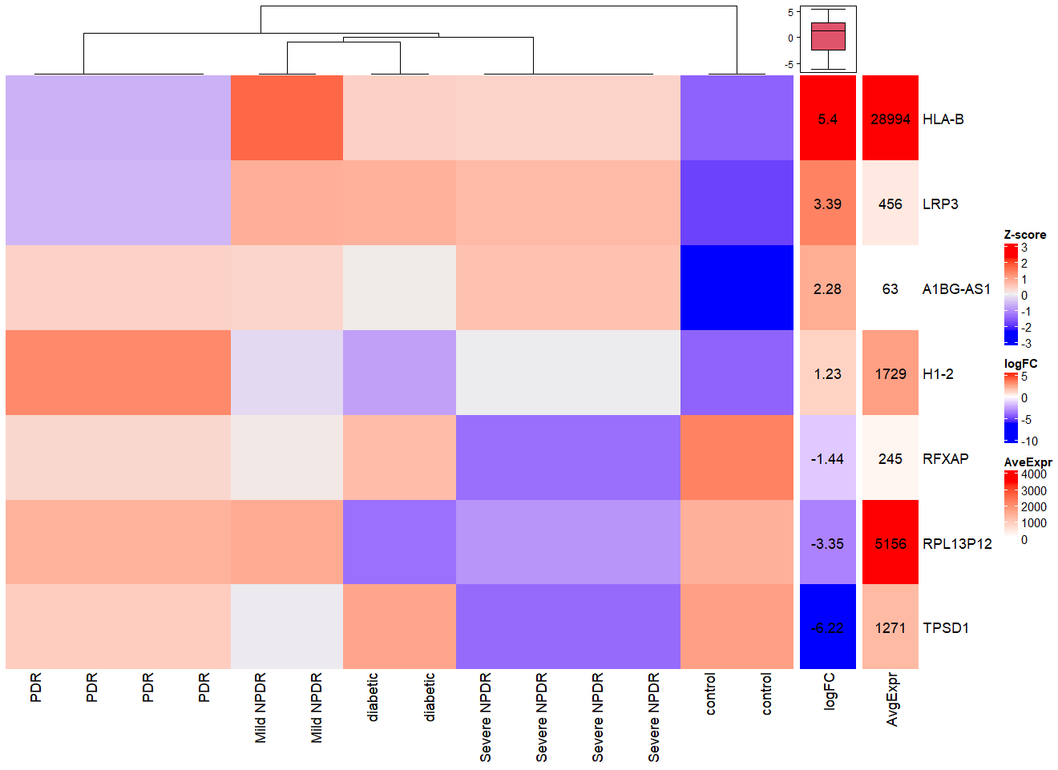
Heatmap
Notes:
Normalize count data per samples for the derived DEGs.
Center and scale each column by Z-score
Restructure

Slide 15
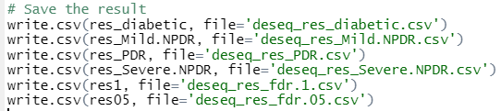
DESeq2 Results
Notes:
With and without the diabetic patient (potential outlier)
Total number of genes. Before and after filtering.
Old Analysis

Slide 16
DESeq2 Results
Notes:
With and without the diabetic patient (potential outlier)
Total number of genes. Before and after filtering.
Old Analysis

Slide 17
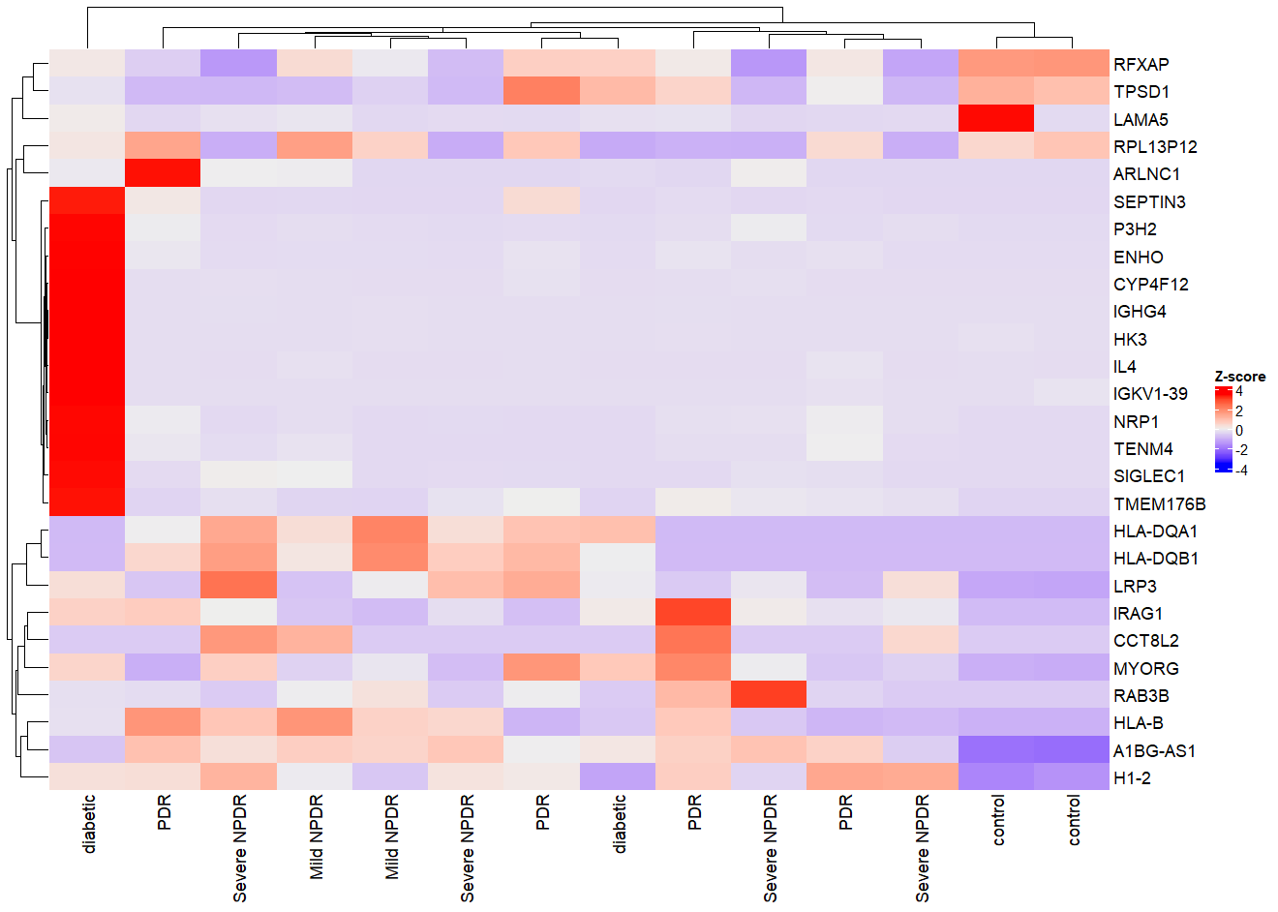
Comparison
FDR < 0.01
Padj < 0.05
Abs(Log FC) > 2
baseMean > 50
27 DEGs
Notes:
Non-redundant clustering on gene. Arrange X-axis.
Create two heatmaps. One with diabetic and one without (removing the outlier)
Old Analysis

Slide 18
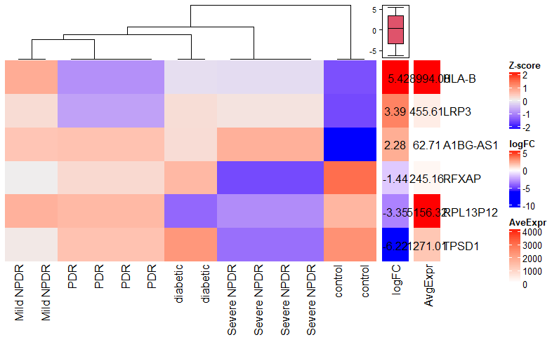
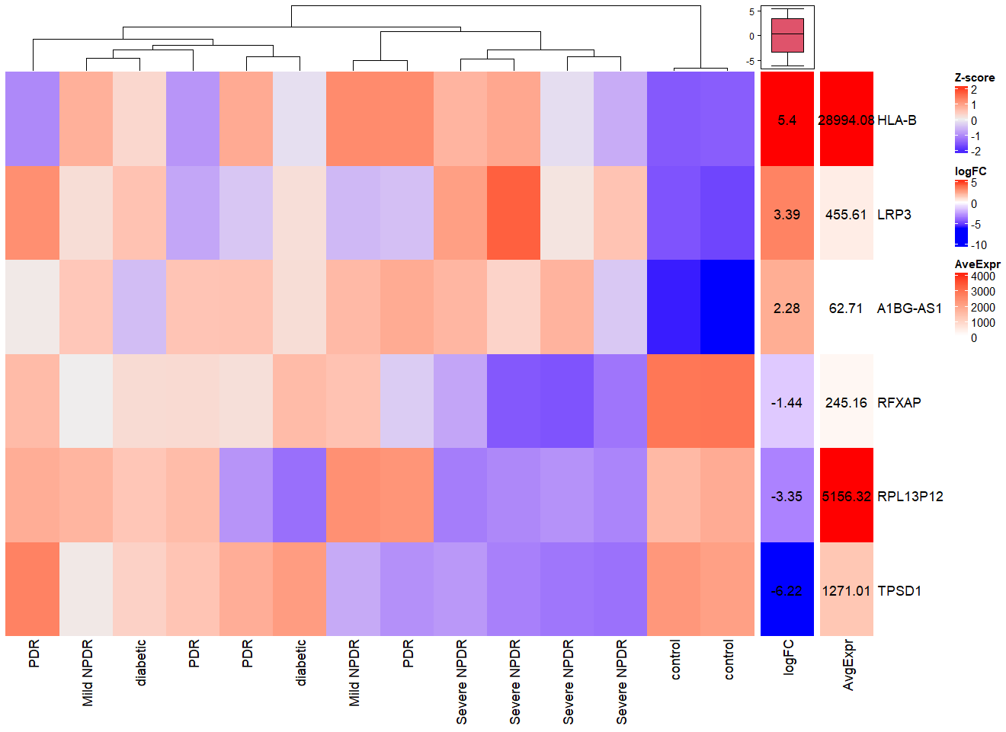
Heatmap
Notes:
Restructure

Slide 19
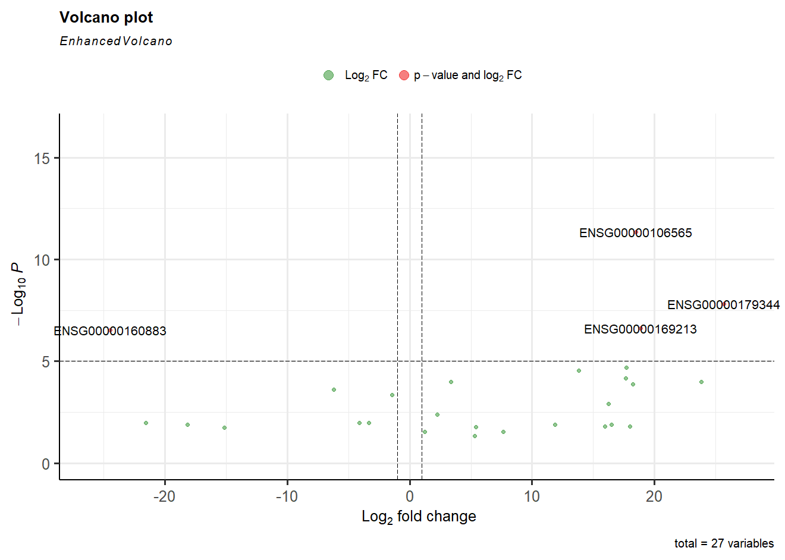
Volcano Plot
Downregulated
HK3
Upregulated
TMEM176B
HLA-DQB1
RAB3B
Notes:
Old Analysis

Slide 20
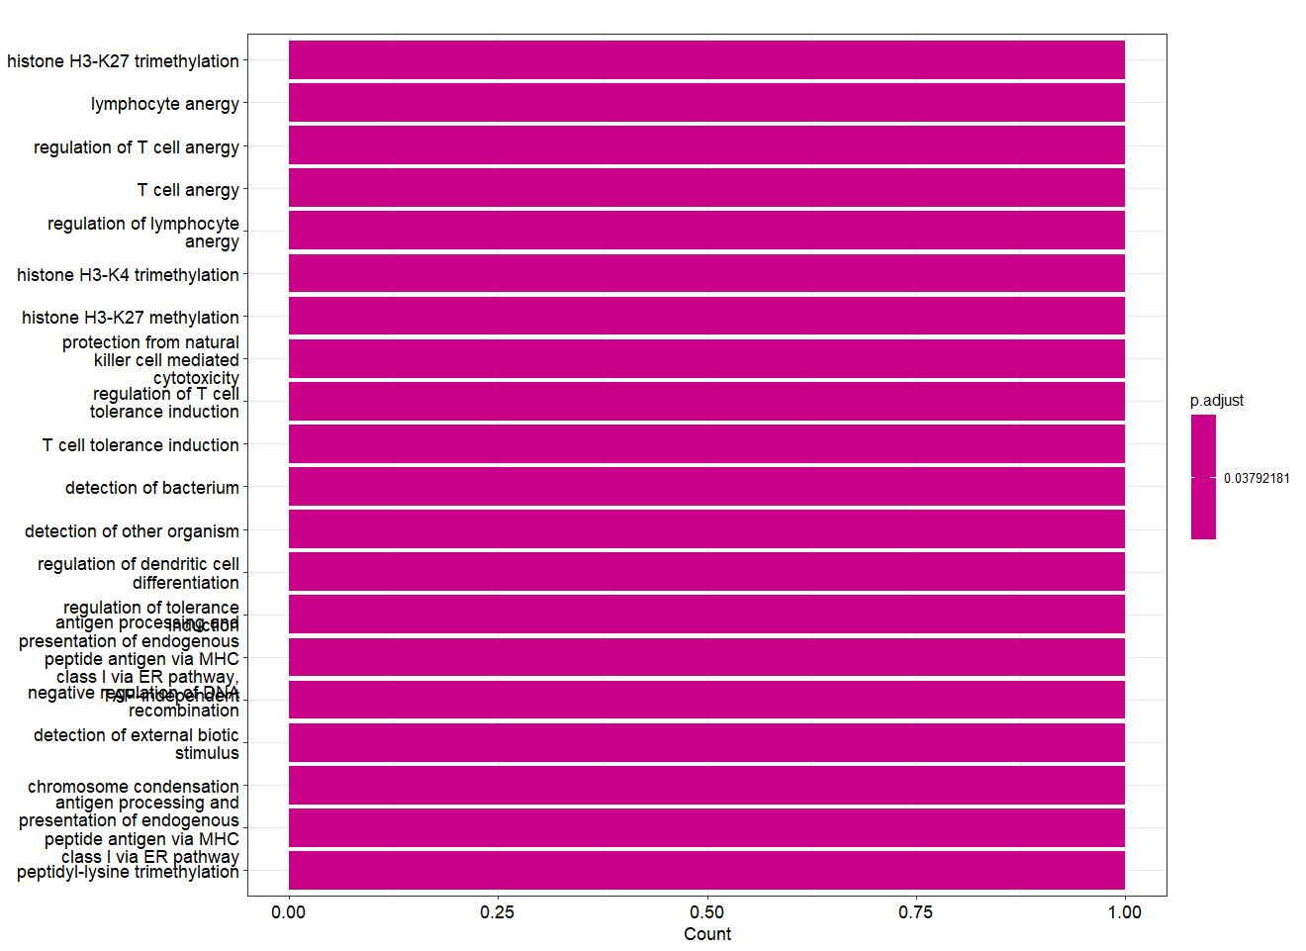
Gene Ontology
Clusterprofiler package
Gene List:
H1-2
HLA-B
RFXAP
TPSD1
RPL13P12
LRP3
A1BG-AS1
Notes:
Cluego analysis on all the conditions (treated vs untreated) – to be performed if needed.
Analysis on individual paired condition

Slide 21
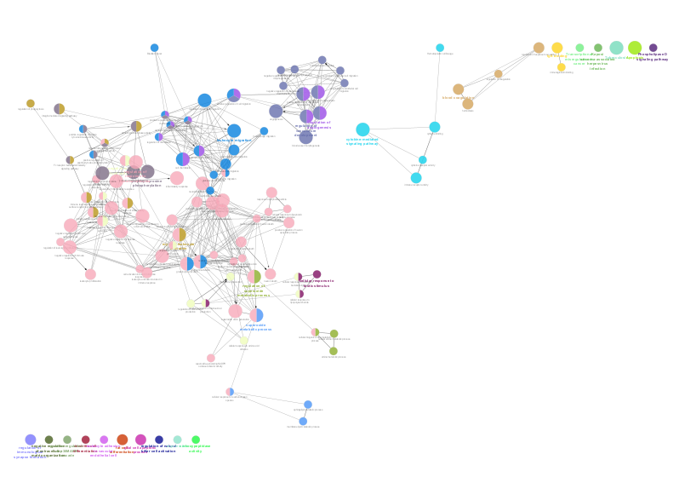
Cluego
Diabetic
Notes:
Rough Example

Slide 22
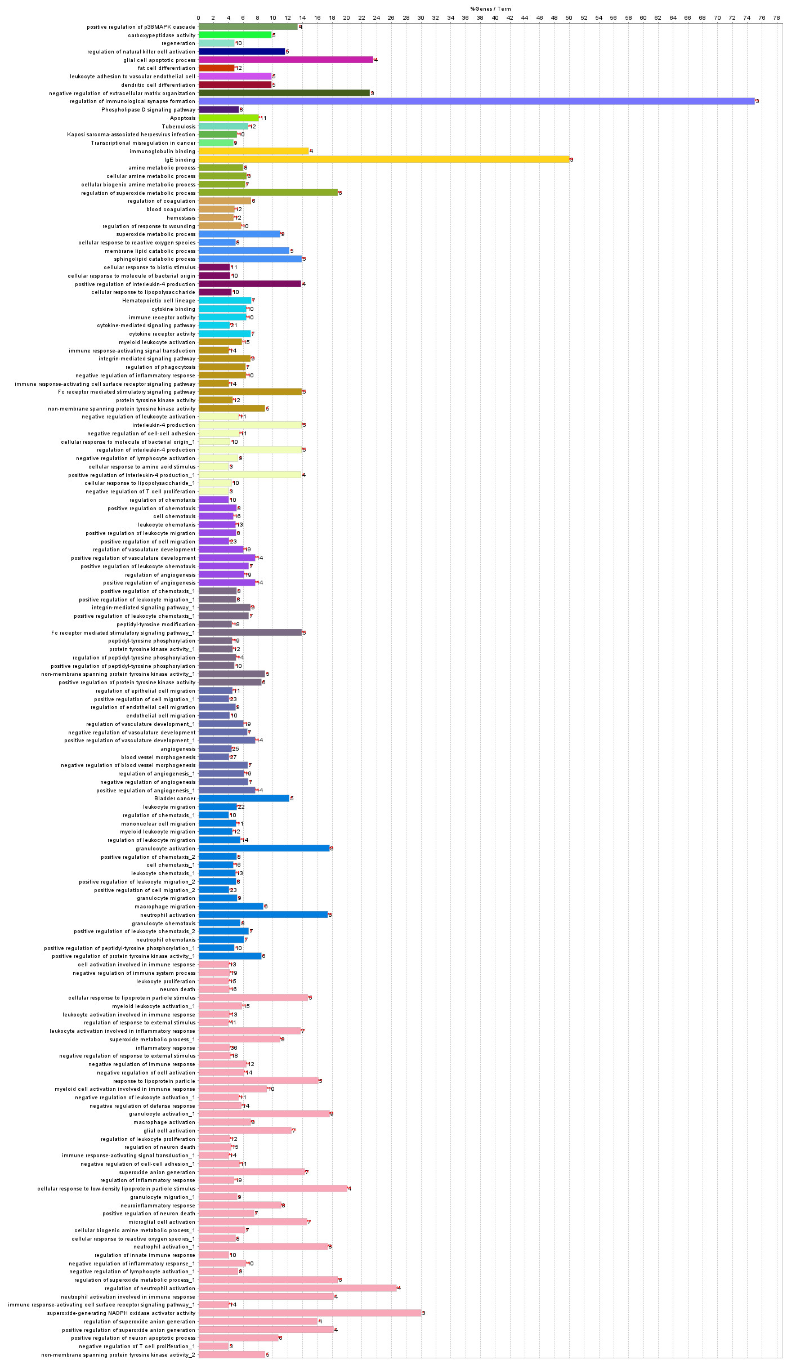
Cluego
Diabetic

Slide 23
Cluego
Diabetic
Notes:
Diabetic Enrichment list continued.

Slide 24
24
Questions?

