Slide 1
FACE FILTER USING FACIAL DETECTION
NIVETHA SANKARASUBRAMANIAN [RA2011003010172]
AMAAN ALI KHAN B [RA2011003010160]
PRAVEEN KRISHNAKANTH S [RA2011003010152]

Slide 2
Abstract

Slide 3
In the recent time automated face recognition has become a trend and has been developed very much , this is mainly due to two reasons; first it is due to availability of modern technologies and second is due to the ability to save time using face recognition in the process of taking attendance of students. Its usage will grow vast in the future as it saves a lot of time. It consumes a lot of time to take attendance manually and few might also fake the attendance, in order to prevent time consumption and avoid faking the attendance face recognition is used to identify the person present in the class and mark his attendance
, this is done with the help of image or video frame. We proposed an automatic attendance management system using machine learning techniques such as CNN algorithm. The face detection and recognition will automatically detect the students in the classroom and mark the attendance by recognizing the person. The faculty has access to add the student details such as name, USN, phone number, email-id. Then the image is captured through a high definition camera during the class hours. When the lecturing is going on faces of students are detected, segmented and stored for verification with database using the Convolutional Neural Networks (CNN) algorithm of machine learning technique. Deep learning uses multiple layers to discover the meaning of data at different levels of extraction. Improves appearance for facial research. By introducing deep learning in face recognition, state-of-the art application has been developed and success has been achieved in practical applications. Convolutional neural network is a deep neural network model that has proven success in face recognition. In real time, models must be built before CNNs can be used.

Slide 4
Requirements

Slide 5
Python:Python is a popular programming language used for developing machine learning applications. The
face recognition system can be implemented using Python.
TensorFlow: TensorFlow is a popular open-source machine learning library developed by Google. It provides a wide range of APIs for building and training deep learning models. It can be used to train a face recognition model based on CNN.
OpenCV:OpenCV is an open-source computer vision library that provides various algorithms for image and video processing. It can be used to implement face detection and image preprocessing in the face recognition system.
MySQL: MySQL is an open-source relational database management system that can be used to store the attendance data.
Flask:Flask is a lightweight web framework that can be used to create web applications for the face recognition system. It can be used to create a user interface for the system and integrate it with the database.
PyCharm:PyCharm is an integrated development environment (IDE) that can be used for developing Python applications. It provides various features such as code completion, debugging, and version control.
Anaconda:Anaconda is a distribution of Python and its packages for scientific computing. It includes many packages required for building machine learning applications, including TensorFlow and OpenCV.
GIT:Git is a version control system that can be used to track changes in the source code and collaborate with other developers.

Slide 6
Problem Statement

Slide 7
The current face filters available suffer from limitations in accuracy, realism, and responsiveness, primarily due to shortcomings in facial detection algorithms. Challenges include real-time identification and tracking of facial landmarks, handling diverse lighting conditions and occlusions, and achieving seamless mapping of virtual objects onto the user's face. These limitations hinder the creation of highly accurate, immersive, and engaging face filters. Therefore, there is a need for the development of an advanced facial detection system that addresses these challenges and delivers superior accuracy, realism, and responsiveness, enhancing the user experience with compelling and lifelike face filters.

Slide 8
Objective

Slide 9
Our objective is to develop an efficient and user-friendly Face Filter using Facial Detection enhances user experience and by seamlessly integrating virtual elements into real-time video or images

Slide 10
Scope and Applications

Slide 11
Facial filters using face detection have a wide scope of applications, including social media, entertainment, video calling, gaming, e-commerce, advertising, education, health, and accessibility. They enhance user experiences by adding virtual elements to photos, videos, and real-time interactions, providing personalization, entertainment, and practical functionalities across various industries.

Slide 12
ARCHITECTURE DIAGRAM

Slide 13
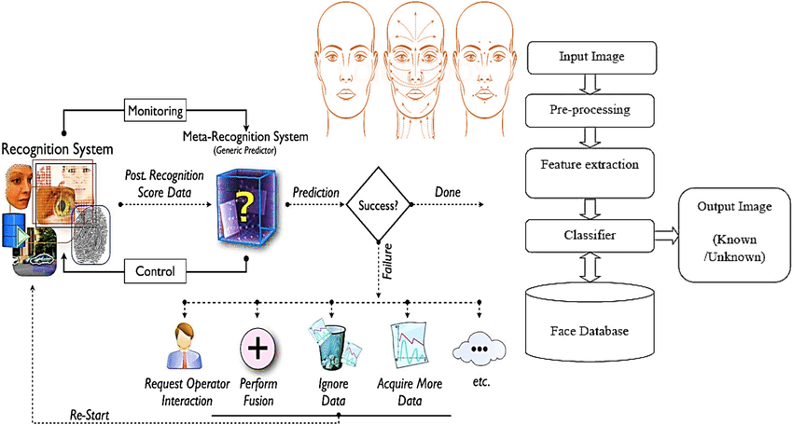

Slide 14
JOB MASTER

Slide 15
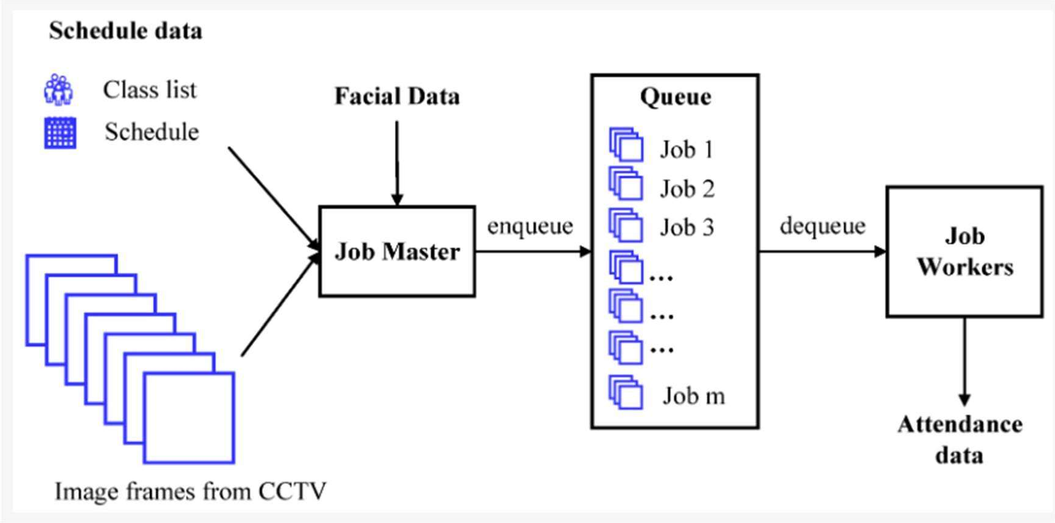

Slide 16
ARCHITECTURE OF CNN

Slide 17
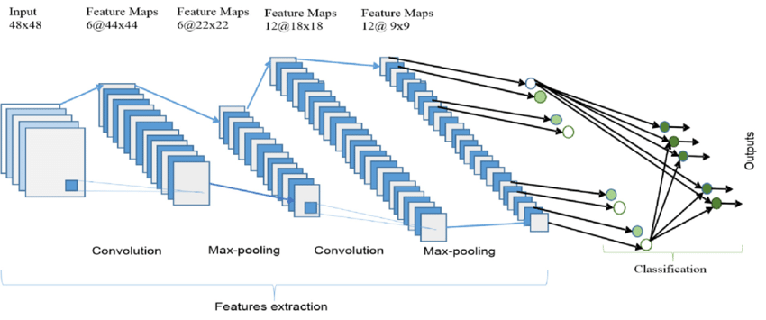

Slide 18
CONVULATIONAL LAYER

Slide 19
The first layer in a convolutional neural network (CNN) is responsible for extracting features from input images. This is achieved through a mathematical operation known as convolution, where a filter of size MxM is applied to the input image. By sliding the filter across the image, the dot product is computed between the filter and the corresponding parts of the input image.
The output of this layer is referred to as a feature map, which provides information about image characteristics such as corners and edges. This feature map is then passed to subsequent layers in the network to learn additional features of the input image.
The convolutional layer plays a crucial role in preserving the spatial relationship between pixels. By applying the convolution operation, the CNN ensures that the spatial structure of the image is maintained, enabling effective feature extraction and analysis

Slide 20
METHODOLOGY

Slide 21
Methodology
Face Detection
HOG/SVM detector working
Facial Landmarks
Image processing

Slide 22

This image shows the working of filter

Slide 23

The above image shows the person aligning his face according to the filter.

Slide 24

This shows the Face Detection process of the person.

Slide 25
Conclusion

Slide 26
In conclusion, the proposed automatic attendance system, utilizing CNN-based facial recognition technology, offers a rapid and precise method for recording attendance. By surpassing the limitations of traditional systems and previous facial recognition techniques, it introduces enhanced functionalities. The inclusion of features like in-time and out-time recording, along with liveness detection measures, ensures an improved user experience and heightened security. This system has the potential to revolutionize attendance recording processes in educational institutions and other organizations. With its integration of facial recognition technology, predictive analytics, mobile app integration, and robust security measures, it sets the stage for a more efficient and effective approach to attendance tracking. As technology advances, we anticipate further exciting developments in this field.

Slide 27
Future Enhancements

Slide 28
Enhanced accuracy: While CNN-based face recognition systems exhibit high accuracy, there is room for improvement. By utilizing larger training datasets, optimizing hyperparameters, and leveraging advanced techniques like ensemble learning, the system's accuracy can be further increased.
Integration with multiple biometric technologies: To enhance identification accuracy, the system can be expanded to integrate with additional biometric technologies like fingerprint recognition or iris recognition, enabling multi-modal biometric authentication.
Cloud-based implementation: Adopting a cloud-based implementation offers benefits such as improved scalability and reduced local computational requirements. By leveraging cloud services like Amazon Web Services or Microsoft Azure, the system can achieve seamless scalability and enhanced performance.

Slide 29
References

Slide 30
https://www.google.com/search?q=face+filter+using+facial+detection&sxsrf=APwXEdfDO_QnI-pgpfGs6bX797wIuxdSgg:1683720417478&source=lnms&tbm=isch&sa=X&ved=2ahUKEwiEqImr2-r-AhXHSWwGHfabAXAQ_AUoAXoECAEQAw&biw=799&bih=668&dpr=1#imgrc=x9AkjYxpw76tiM
https://www.google.com/search?q=face+filter+using+facial+detection&sxsrf=APwXEdfDO_QnI-pgpfGs6bX797wIuxdSgg:1683720417478&source=lnms&tbm=isch&sa=X&ved=2ahUKEwiEqImr2-r-AhXHSWwGHfabAXAQ_AUoAXoECAEQAw&biw=799&bih=668&dpr=1#imgrc=AC-FHF9ujV9WAM
https://towardsdatascience.com/how-to-make-your-own-instagram-filter-with-facial-recognition-from-scratch-using-python-d3a42029e65b?gi=36978766ce78
https://www.hindawi.com/journals/sp/2020/7846264/
https://expoleet.medium.com/facial-feature-detection-and-facial-filters-using-python-98c99b1629e
https://www.google.com/search?q=face+filter+using+facial+detection&sxsrf=APwXEdfDO_QnI-pgpfGs6bX797wIuxdSgg:1683720417478&source=lnms&tbm=isch&sa=X&ved=2ahUKEwiEqImr2-r-AhXHSWwGHfabAXAQ_AUoAXoECAEQAw&biw=799&bih=668&dpr=1#imgrc=GOZU09b5EKGLbM
https://www.researchgate.net/figure/Filter-for-face-detection_fig5_228338071

