Slide 1

DS & ML Project
Statement: Train ticket Price Prediction within Spanish Rail setup
Algorithm used: Polynomial Regression based on MLR.

Slide 2

Problem Statement

Slide 3

Analysis on Acquiring and Injestion/ETL

Slide 4

Exploratory Data Analysis
DATA WRANGLING

Slide 5

Exploratory Data Analysis
VISUALIZATION

Slide 6

Question 01: Explain the summary statistics for the data set

Slide 7

Question 02: What insights do you get from the above plot?

Slide 8
Question 03: What insights do you get from the graphs?

Slide 9

Question 04: Which train runs the maximum in number as compared to other train types?

Slide 10
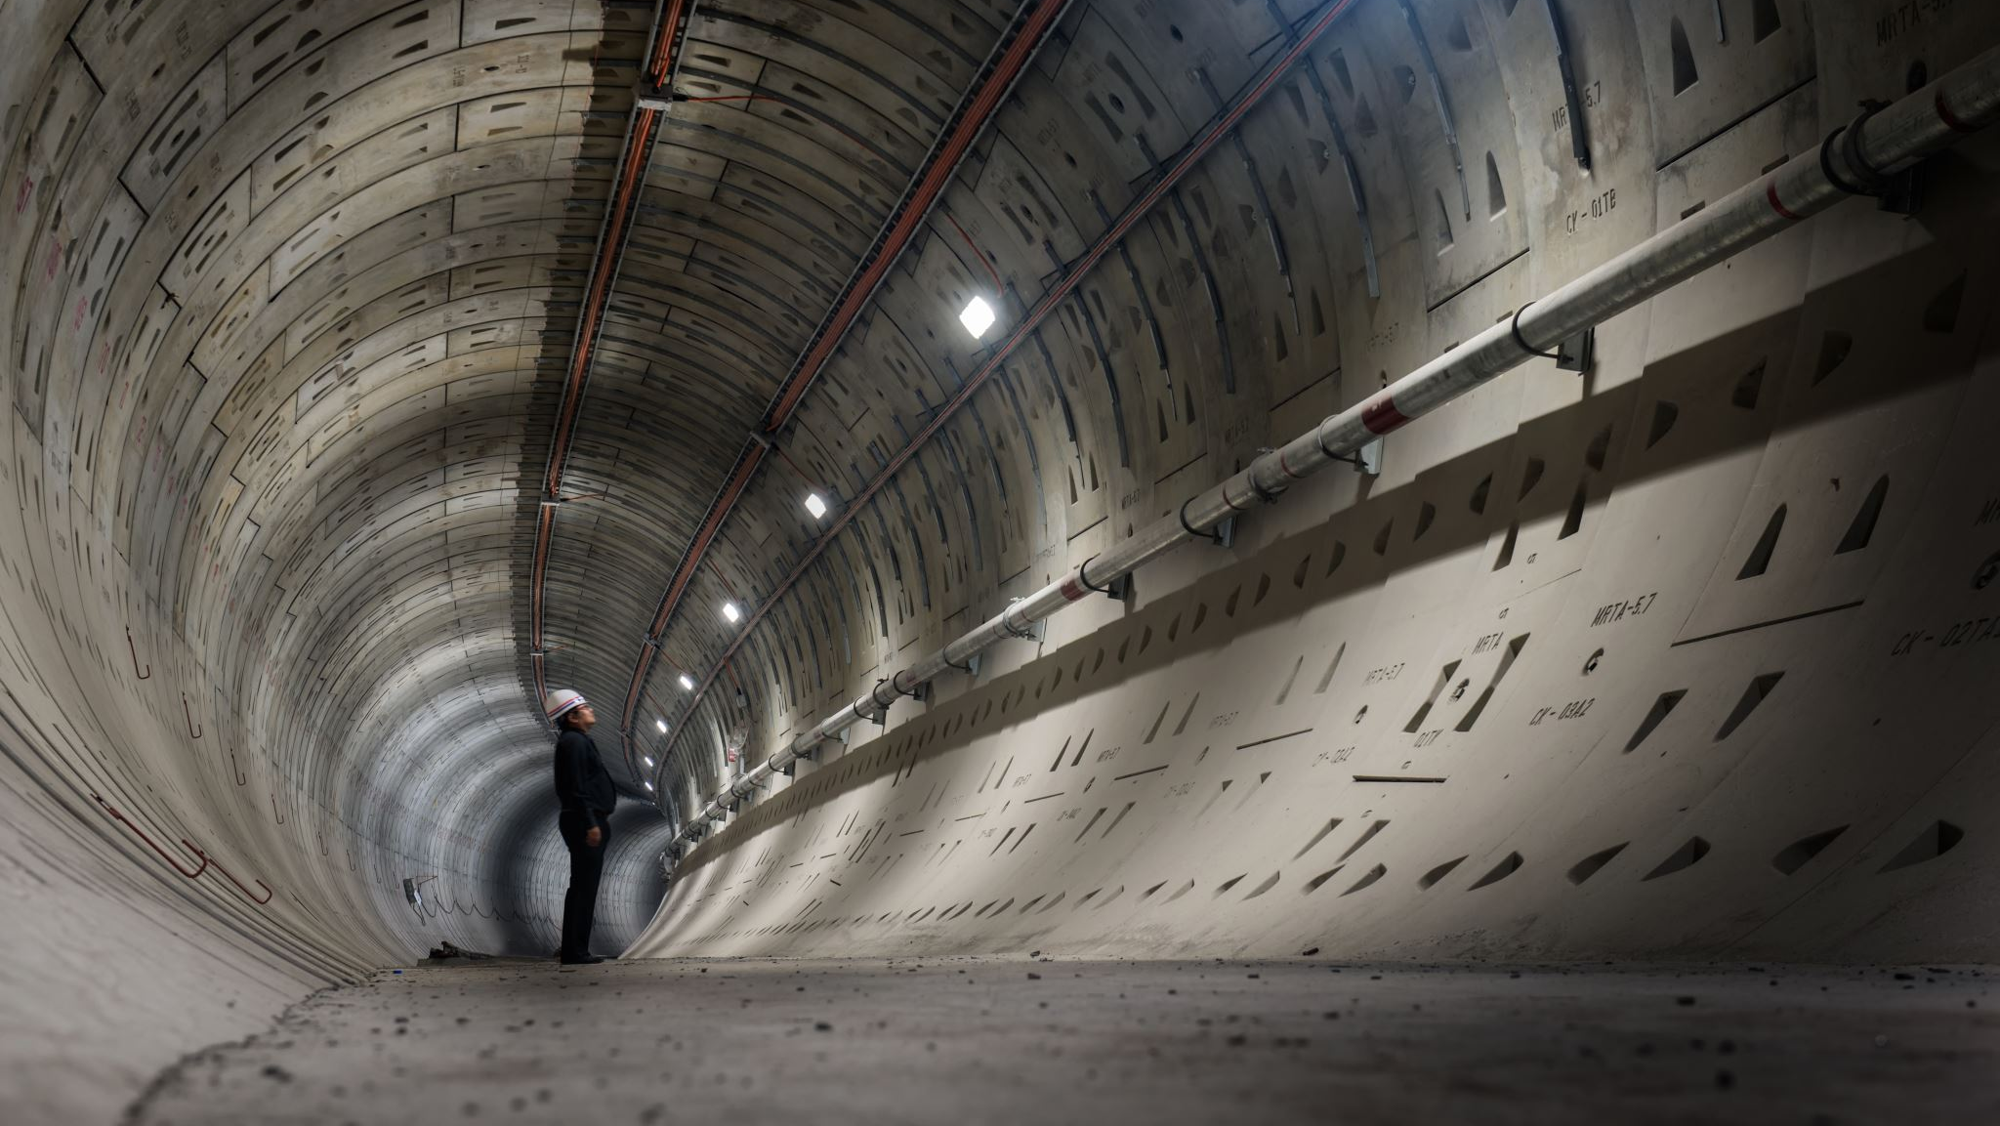
Question 05: Which the most common train class for traveling among people in general?

Slide 11

Question 06: Which type of trains cost more as compared to others?

Slide 12

Which model gives the best result for price prediction? Find out the complexity using R2 score and give your answer.

Slide 13

CONCLUSION:

