Slide 1
In this task, you will be looking at faces on a screen while laying in the scanner.

Slide 2
When you see the ‘+’, just focus on the center of the screen.

Slide 3
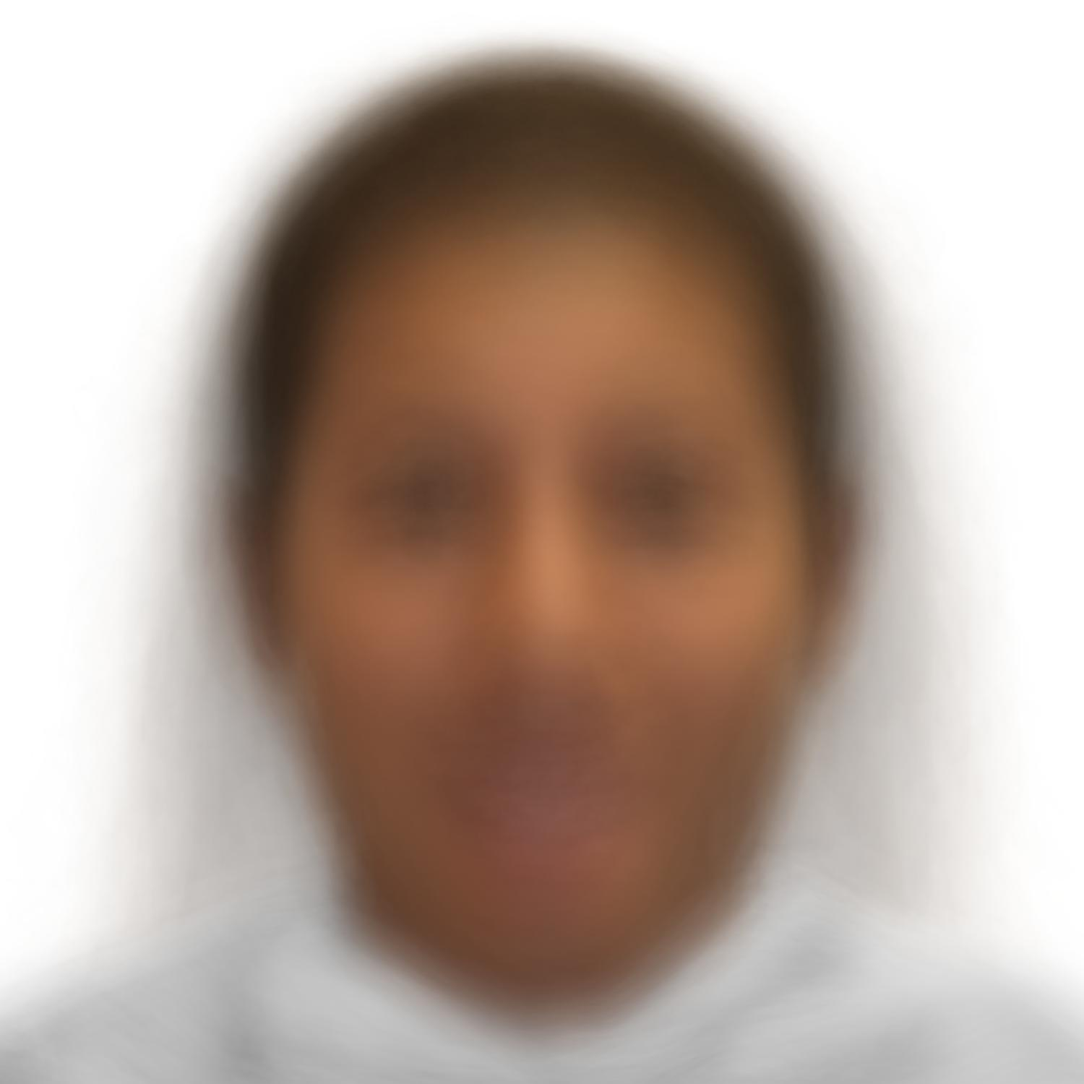
Your only task is to press the button box when you see this blurred image.

Slide 4
You may press any button on the button box to make your response.
Try pressing the buttons now.

Slide 5
Try to respond as soon as you see the blurred image.

Slide 6
Any questions?

