Slide 1
Canvas Redesign
Abigail Pease, Pendleton Pham, Nic Sarkis

Slide 2
Description of the system and its users
Our redesigned system is Canvas, which is used by students and instructors in an academic domain. We will be focusing on the Canvas desktop site, as used by college students.
Main goals include seeing assignment information and deadlines, accessing syllabus information and other course material (eg. files, modules), and checking grades.
Notes:
See question 2, assignment 1
(Explain why we're focusing on desktop site, student view).

Slide 3
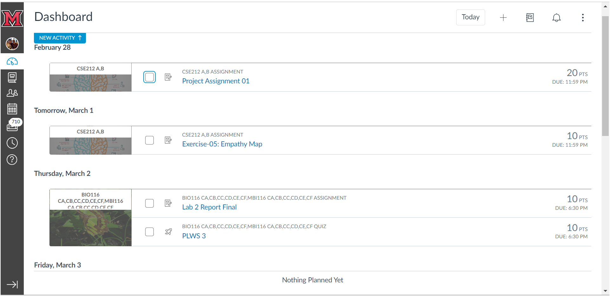
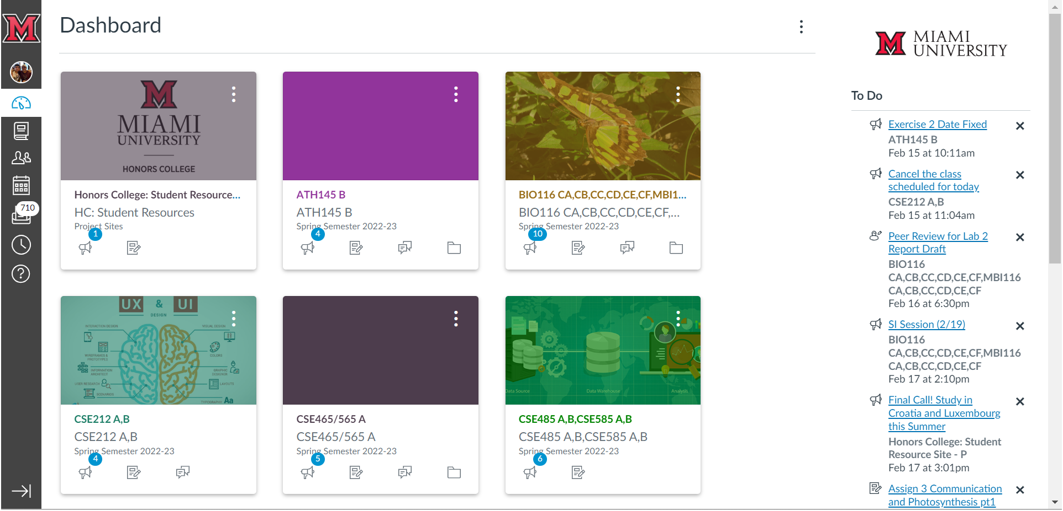
Notes:
I won't go into too much detail on how Canvas works, since you've all worked with it before, but one of the things I'd like to point out is that there are two different views of the main dashboard. This is what the main dashboard of Canvas looks like while in card view -- however, there is also the option to see it in list view, if you click the three dots in the top right corner.

Slide 4
Description of the system and its users
Notes:
These two views function in completely different ways, rather than displaying the same information in two different formats. (go into more detail).

Slide 5
Users - Two contrasting personas
Name: Lauren Smith Age: 22
Occupation: Student; a senior Computer Science major.
Background: Originally from a suburb of Chicago; enjoys watching movies and playing board games.
Key goals with Canvas: Lauren is very familiar with Canvas and has a lot of technical knowledge. Her main frustrations are that some tasks are inefficient, like checking grades and due dates.

Slide 6
Users - Two contrasting personas
Name: John Doe Age: 18
Occupation: Student; a first year nutrition major.
Background: Oxford local; enjoys cooking, hiking, and playing racquetball. Slightly colorblind.
Key goals with Canvas: John has never used Canvas before and doesn't have a lot of computer skills, so it's important that the application is intuitive and easy to use.

Slide 7
Users - User journey example
 | Before | During |  |  | After
Phases | Log in | Check Grades for all courses | Check incomplete Assignments | Access “Modules” tab | Log out
Events and Activities | John enters his credentials, then approves the 2FA Duo Push | John selects each course, then navigates to the grades tab | John selects each course, then navigates to the assignments tab | John scrolls through the course tabs for a while, then clicks modules | John presses the log out button under the account tab
Touch points | Miami CAS page | The dashboard of Canvas | The dashboard of Canvas | The dashboard of Canvas | The dashboard of Canvas
Pain points | Auth error, page freeze | Grades scattered among many courses, had to check manually | No centralized place to see what assignments are due | The location of “modules” tab different for each course | Log out button hard to find
Channels | Online, on Canvas page | Online, on Canvas page | Online, on Canvas page | Online, on Canvas page | Online, on Canvas page

Slide 8
Work re-engineering – Use-case scenario
The first task we will focus on is accessing the grade of an individual assignment.
Our user, John Doe, is a freshman who is new to Canvas. John would like to check his grade on an assignment called Homework 5 in his CSE 212 class.

Slide 9
Work re-engineering – Use-case scenario
John starts out by logging into Canvas, and is now at the dashboard.
John sees CSE 212 in the cards on the top of the page. He clicks the grade bubble and goes to the “Grades” tab.
He finds the assignment he is looking for and reviews his grade. The entire task took John about half a minute to complete.

Slide 10
Essential use case
User’s Purpose | System responsibility
Log in to Canvas | Validate user credentials
Complete MFA request | Validate MFA request, open dashboard
Select a course | Open the course home page
Select the grades tab | Open the grades page
Select assignment to review | Open the assignment
Close webpage | Sign out

Slide 11
Concrete Use Case - Checking assignment grade
(slide 1 of 2)
User’s Action | System response
Student enters credentials into the login screen and clicks log in | System checks the credentials and sends a MFA request to the student's mobile device
Student approves of the MFA request on a mobile device | System verifies MFA and brings the student to the dashboard page

Slide 12
Concrete Use Case - Checking assignment grade (2/2)
User’s Action | System response
Student selects a course by clicking on a card in the card view | System opens the course’s home page
Student selects the grades tab that is pinned to the top of the gray list on the left of the screen | System opens the grades page with the grade of every assignment in that course sorted by due date (by default)
Student searches for and clicks on desired assignment to review it | System opens the assignment and displays its information in full detail, including grade, assignment name, and rubric

Slide 13
Task Object –
Assignment
Attributes | Actions
Assignment name Description Type of submission (quiz, text file, video, etc.) Due date Available dates (dates that the assignment opens and closes) Grade Rubric Comments Score details Group or individual assignment | View Add Edit (due date, title, description, etc.) Delete Save Submit Resubmit Add comment Reopen submissions (after assignment is closed) Input grade Add rubric comments Edit grade

Slide 14
Student Course
Attributes | Actions
Login Name Name recording Password Phone number Pronouns Contact Biography Links Profile picture University/Institution Enrolled courses | View Add Edit Delete Save
Attributes | Actions
Course name Instructor Students enrolled Tabs included Assignments Announcements Discussion posts Syllabus | View Add Edit Delete Save Enroll student Unenroll student

Slide 15
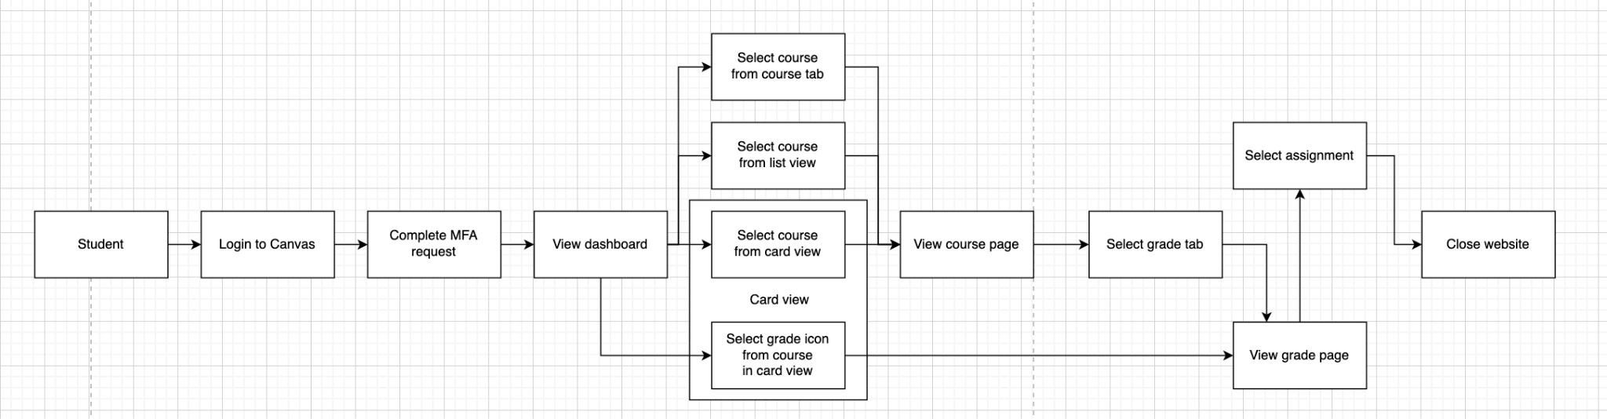
Content Diagram
Notes:
This is our content diagram, it's hard to see so we'll break it into multiple slides (zoomed in)

Slide 18
Investigation & Analysis - Design Principles
Simplicity - Remove dashboard title, History and Groups icons, button to show all course grades, button to navigate between views.
Structure - Combine list and card view, move the Today and Notifications buttons to the center of the screen above the list view.
Notes:
To increase simplicity, we removed the dashboard title at the top of the page, the History and Groups icons on the sidebar, and removed the buttons to show all course grades or navigate between views.
For structure, we kept the design organized and sensible. We combined the list and card view on the dashboard, while also moved the Today and Notifications buttons to the center of the screen above the list view.

Slide 19
Investigation & Analysis - Design Principles
Consistency - Pin the six most important tabs to the top of course view, so they appear in the same place for every course
Tolerance - Change the To Do list to auto-dismiss old assignments, so the user won't have to do it manually
Notes:
To improve consistency, we decided to pin the six most important tabs to the top, so that they appear in the same place regardless of which course is selected.
In terms of tolerance, a student is already prevented from doing most risky actions on the site, so the main "mistake" a student might make is to miss the deadline for an assignment. To prevent this, we changed the To Do list to auto-dismiss old assignments, so the user will not have remember to manually do this.

Slide 20
Interaction styles, elements, and devices
The interaction style of Canvas is standard for a website, with distinct pages that show different information and link to different locations of the site.
This overall style has not been adjusted by the redesign, but we did try to reduce the number of different pages a user needs to visit to accomplish common tasks.
Notes:
Abby

Slide 21
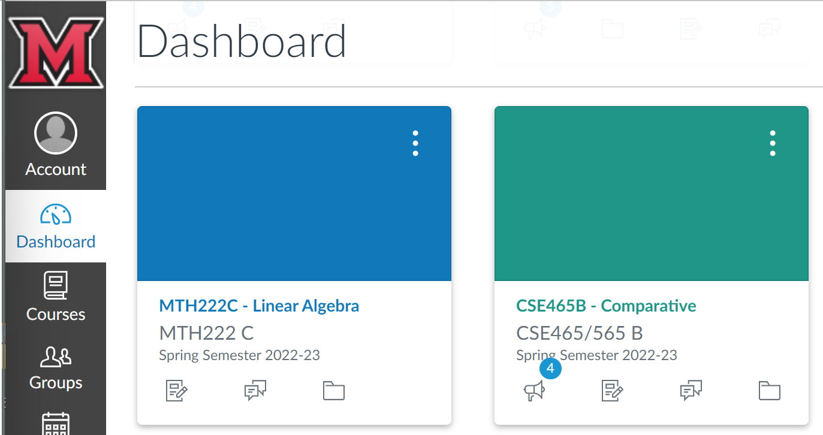
Interaction elements
Interaction elements include text, color, image, and sound.
For the most part, these haven't changed.
Notes:
Abby - The biggest use of color is on the dashboard, where a color is assigned to each course. Users can easily change these colors, allowing them to match the colors to their own personal associations. For example, one student might associate math with the blue, and science with the green. They can more easily recognize a course if they are allowed to change the colors to match. Additionally, in List View, it is much easier to focus on one course at a time by looking at only the assignments of the relevant color. Although we combined List and Card view, we decided to retain this color-coding feature due to its versatility.
We made a minor change in color and text by darkening and bolding the text for the six most pertinent tabs in the course view. Here, color is used for grouping, indicating that these six tabs are special and have been pinned to the top of the list for each course. The blue tabs below are subject to the instructor's discretion, and may vary between courses.

Slide 22
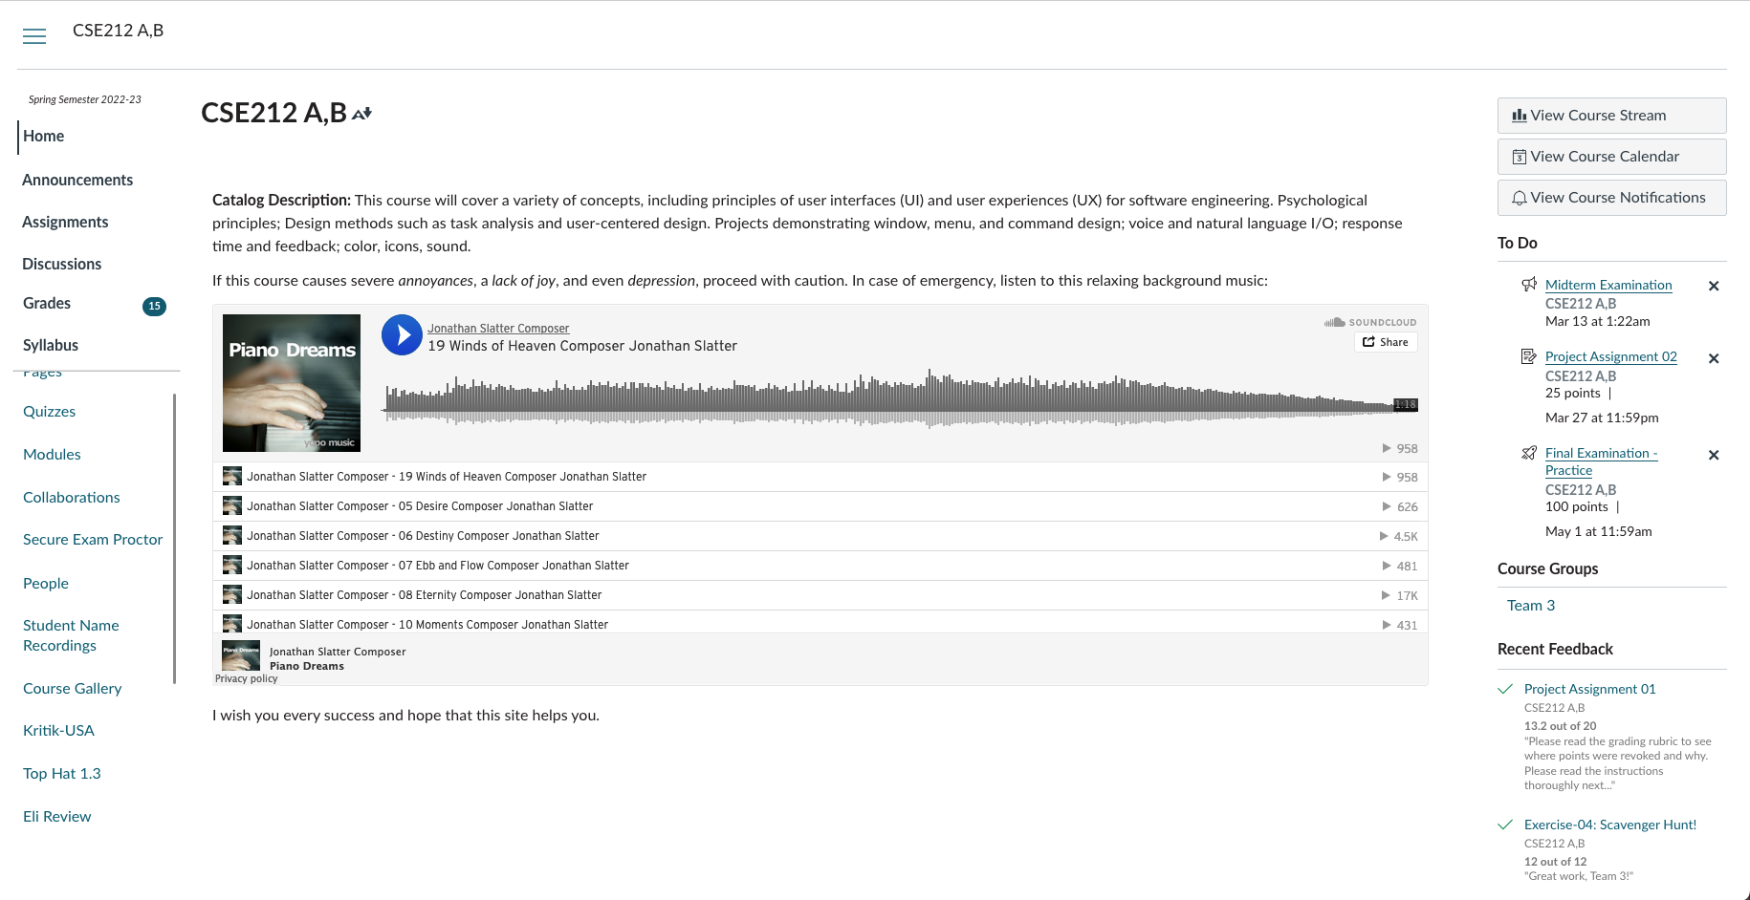
Interaction elements
Previously, the links to all of the pages in course view were identical. We pinned the most important tabs to the top, and used a darker, bold text to differentiate them from the other links.
Notes:
We did make a slight adjustment for color and text…

Slide 23
Interaction devices
For our redesign, we chose to focus on computers only, whether desktop or laptop.
Keyboards and mouse, possible touchscreen
Anything with internet access can use Canvas, but there is a separate UI for the mobile site, so it would have to be redesigned separately.
Notes:
Canvas should be usable by anyone with basic equipment. The interaction devices chosen are generally the simplest and most common types of devices, so that more advanced or complex equipment does not become a barrier to use.

Slide 24
Prototypes
Low-fidelity:
Gives a visual of the anticipated design
Includes dashboard and course view
High-fidelity:
Allows for a user to navigate the system
Allows for better user feedback

Slide 25
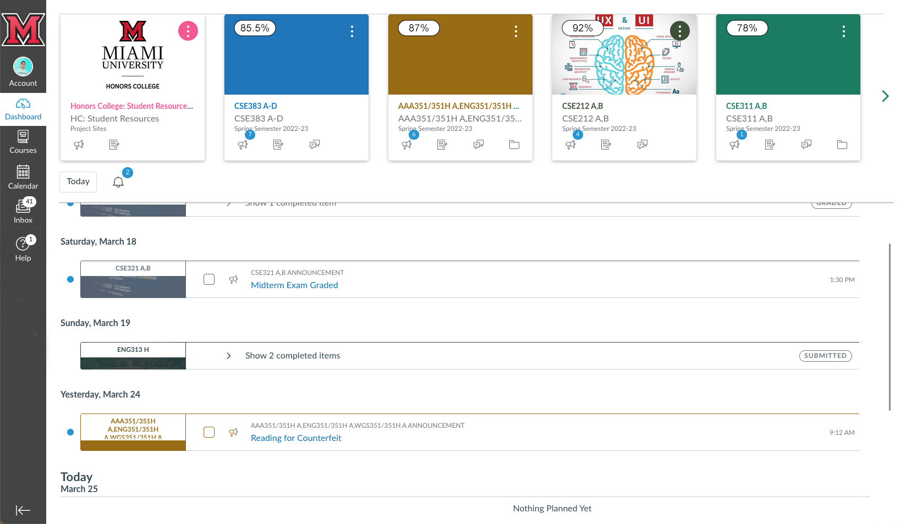
Notes:
The sidebar menu is decluttered to show only essential options.
Grades are now shown in the cards for all the courses, in line with the behaviour of the app.
Course cards are pinned to the top to combine card view and list view.
Card view scrolls horizontally
List view shows at the bottom and can be scrolled up and down.

Slide 26
Notes:
The six most important sidebar items are pinned, boldened, and fixed in order for better predictability.
The rest of the menu items scroll to the bottom.

Slide 27
Demo of Interactive Prototype
https://www.figma.com/file/DHilV6VQ7sY0aYsbOrwoQJ/CSE212-Prototype?node-id=0%3A1&t=7u2uSAnWokxiJc62-1

Slide 28
Evaluation - User Observation
For our user observation, we recruited 6 participants who volunteered to interact with our prototype, at a time and location that worked for them.
All participants were students who had experience with the old Canvas site. A possible limitation is that our sample did not include a student who has never used Canvas before.
Notes:
.. since that would be difficult to find this time of year. (Assignment 3, Q2 - Abby)

Slide 29
Evaluation - User Observation
After a brief introduction, ask the participant to complete the following tasks. Time it and take notes.
Check your overall grade for three courses.
Check for assignments that have upcoming deadlines.
Find the modules page for CSE 212.
Notes:
After a brief introduction, ask the participant to complete the following tasks. Wait until the participant has completed one task before presenting them with the next one. Time each task and take notes on the participant's thoughts and actions.
- Check your overall grade for three courses.
- Check for assignments that have upcoming deadlines.
- Find the modules page for CSE 212.
These tasks were chosen because they relate to the features of Canvas we changed, and they're also frequently performed by the student. The first task checks whether the student will notice the new grade bubble over each course on the dashboard. The second task checks whether the student will use the list view at the bottom of the dash. The third task checks the student's response to the most important tabs being pinned to the top of the course view.

Slide 30
Evaluation - User Observation
After that, provide the participant with the following statements, asking them to rate their agreement.
The website is intuitive and easy to use.
The website is an improvement over the current Canvas site.
The website has addressed some of my complaints with the current Canvas site.
Notes:
After each task has been completed, provide the participant with the following statements, asking them to rate their agreement, from "Strongly Agree" to "Strongly Disagree" (Likert Scale).

Slide 31
Evaluation - User Observation
Finally, ask some more open-ended questions.
How did each of those tasks go?
What motivated your choices and your thought process?
Was it easy to figure out what to do?
Was there anything that confused you or didn't seem intuitive?

Slide 32
Evaluation - User Observation
Did the redesign address your complaints?
Are there any improvements you'd still like to see?
Overall, did you like the new interface?
Do you have any other comments?
This helps us gain more qualitative feedback from the user.

Slide 33
Evaluation - User Observation
Our user observation was overall very successful.
Things we learned about our interface:
Participants usually noticed the grades bubble, but didn't realize it could be clicked to take them to the grades tab.
It could be more obvious that the course view at the top of the screen scrolls horizontally

Slide 34
Evaluation - User Observation
Some users completed the tasks but didn't fully grasp how the redesigned interface was different -- next time, we could use more in-depth tasks.
In the list view, users would prefer explicit indication of which assignments are incomplete.
Apart from these changes, participants were generally very satisfied with the redesign.

Slide 35
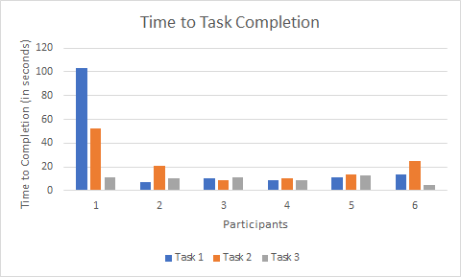
Evaluation - User Observation Results

Slide 36
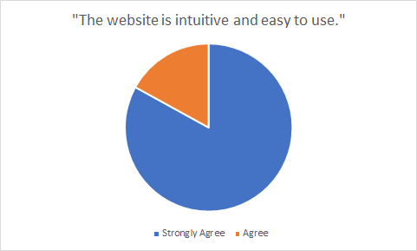
Evaluation - User Observation Results

Slide 37
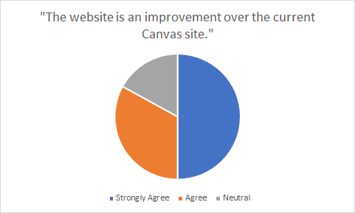
Evaluation - User Observation Results

Slide 38
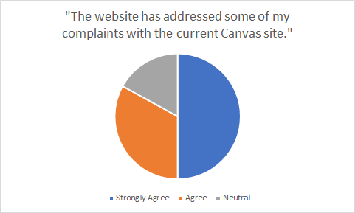
Evaluation - User Observation Results

Slide 39
Evaluation - Heuristic Evaluation
Viable Metrics to evaluate the design:
Visibility
User Control/Freedom
Error prevention
Recognition
Flexibility/Efﬁciency
Aesthetic Design
Match System/Real World

Slide 40
Evaluation - Heuristic Evaluation
Nonviable Metrics to evaluate the design:
Help users recognize, diagnose, and recover from errors
Help and documentation

Slide 41
Lessons learned
Challenges in completing the project:
Understanding what each assignment question was asking for
Staying under word count
Finding meeting times that worked for everyone
Favorite experience in completing the project:
Learning new Canvas features
Seeing users interact with our new design
Notes:
Anyone can add to this

