Slide 1
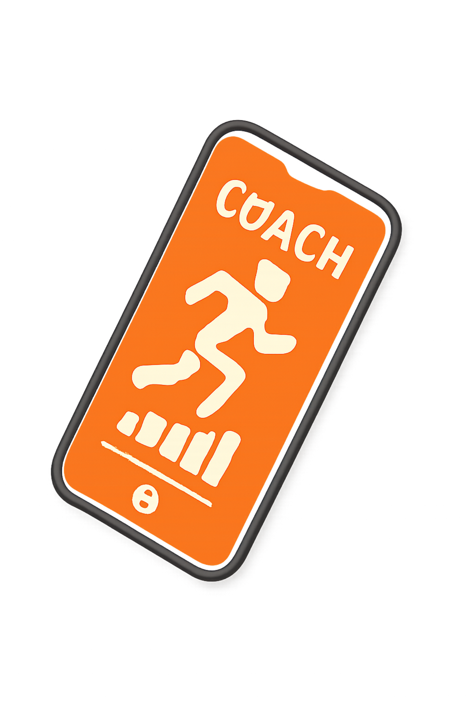
PocketCoach
AI: The Personal Trainer in Your Pocket
Team: Error404
Members: Sarmeeka N, Sanjay K

Slide 2
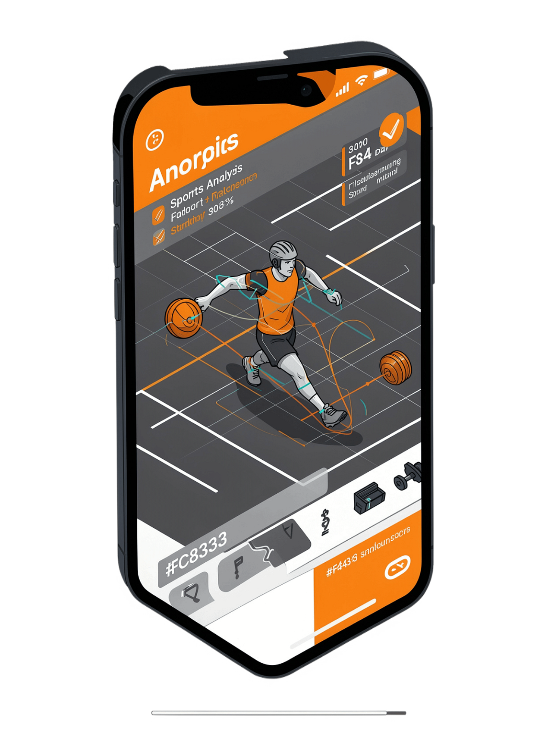

SLIDE 2: WHAT IS POCKETCOACH
The Personal Trainer in Your Pocket
The Vision
Democratizing elite sports coaching through AI.
Tagline
"Professional feedback for every athlete, anywhere."

Slide 3
SLIDE 3: THE PROBLEM
The Gap in Solo Training
The Privilege Divide
The Result
Multi-million dollar coaching staffs track micro-flaws for pros.
Slow progress, poor mechanics, and higher risk of injury from bad habits.
The Everyday Struggle
Everyday players and kids training alone have zero real-time guidance on form.

Slide 4
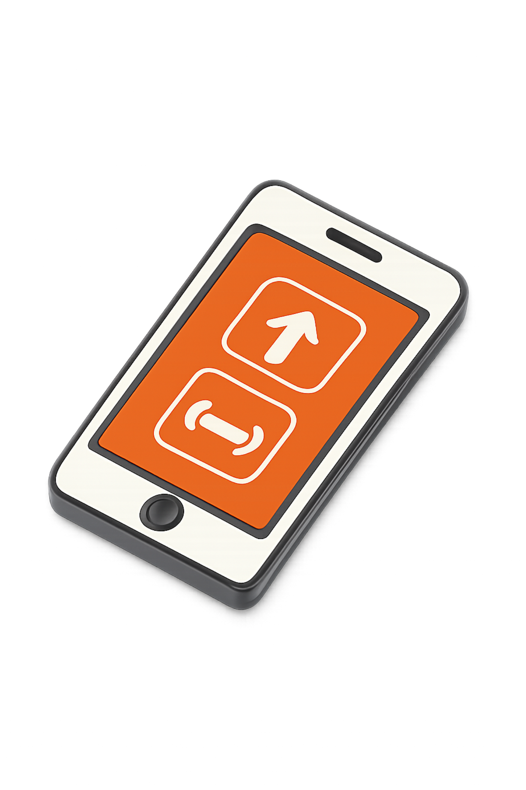
SLIDE 4: THE SOLUTION & FLEXIBILITY
Introducing PocketCoach AI
Choose Your Track
Upload a 30-second training video for instant AI breakdown, or manually log daily gym/fitness drills.
Precision Angle Correction
Spots mechanical flaws and compares your joint angles (e.g., 70degree vs 90degree target) to fix form instantly.

Slide 5




SLIDE 5: CORE FEATURES (THE MVP)
Built for Impact: MVP Scope
Video Capture or Manual Log
AI Form Analysis Engine
Flexible entry for any workout routine.
Detects posture flaws and gives a clear "Form Score out of 100."
Dynamic Drill Generator
Gamified Progress Tracker
Creates a tailored 15-minute routine with targeted micro-drills.
Tracks schedules, streaks, and points to keep users motivated.

Slide 6





SLIDE 6: THE TECH STACK (POWERED BY GOOGLE)
High-Tech & Zero-Cost Architecture
Frontend / UI
Computer Vision
Flutter or Next.js (Cross-platform and responsive video handling).
MediaPipe (Open-source, real-time skeletal body/joint tracking).
AI Reasoning
Backend & Storage
Gemini API / Google AI Studio (Translates movement data into customized coaching plans).
Firebase Spark Plan (Free tier for secure video storage and profile history).

