Slide 1


Automated Smart Gate Pass and Identity Verification System for Secure Campus Access
Geethanjali College of Engineering and Technology (Autonomous)
Accredited by NAAC with A⁺ Grade; B.Tech. CSE, EEE, ECE accredited by NBA
Sy. No: 33 & 34, Cheeryal (V), Keesara (M), Medchal District, Telangana – 501301
Department of Cse- Data Science
Under the Guidance of
Dr. B. Venkateswarlu
Associate Professor
Batch No: 10
Presented by :
23R11A67G1 – K. Sathwika
23R11A67G6 – N. Sathyasri
23R11A67H9 – S. Navya

Slide 2
INTRODUCTION
Traditional gate pass systems in educational institutions are manual, paper-based, and dependent on handwritten approvals.
This process creates delays, administrative overhead, and limited visibility into request status.
Physical documents can be misplaced, duplicated, or manipulated, reducing reliability and accountability.
The proposed system replaces this workflow with a centralized digital platform integrated with identity verification.

Slide 3
DOMAIN
Smart campus security and access control system.
Web-based workflow automation integrated with facial recognition.
Combines request handling, approval management, and biometric verification.
Artificial Intelligence and Deep Learning
Machine Learning
Computer Vision
Full-Stack Web Development

Slide 4
TECHNOLOGIES USED
Front-end: React.js
Backend: Node.js
Database: MongoDB
Language: Python
Face Recognition: VGG-Face, OpenCV
Dev Tools: VS Code

Slide 5
PROBLEM STATEMENT
Current gate pass systems in colleges are mostly manual and paper-based. These systems suffer from
Lack of real-time tracking
Time-consuming approval process
Risk of document loss or forgery
No secure identity verification
Difficulty in maintaining records
As a result, unauthorized exits and security breaches can occur. Therefore, there is a need for an automated and secure gate pass management system.

Slide 6
ABSTRACT
This project (Automated Smart Gate Pass and Identity Verification System for Secure Campus Access) is a web-based, role-based gate pass management platform designed to digitize and automate the student gate pass process in educational institutions. The system allows students to submit gate pass requests online, enables HODs to approve or reject requests, and allows security personnel to verify student identity using facial recognition before granting exit. The project uses technologies such as React.js, Node.js, MongoDB, Python, and VGG Face to provide a secure and centralized platform that enhances campus security, reduces paperwork, and improves operational efficiency.

Slide 7
OBJECTIVES
To automate the gate pass request and approval process.
To provide role-based access for Students, HODs, and Security Guards.
To verify student identity using facial recognition technology.
To prevent unauthorized exits from the campus.
To maintain a centralized digital database of gate pass records.
To reduce paperwork and administrative workload.
To improve campus security, transparency, and efficiency.

Slide 8
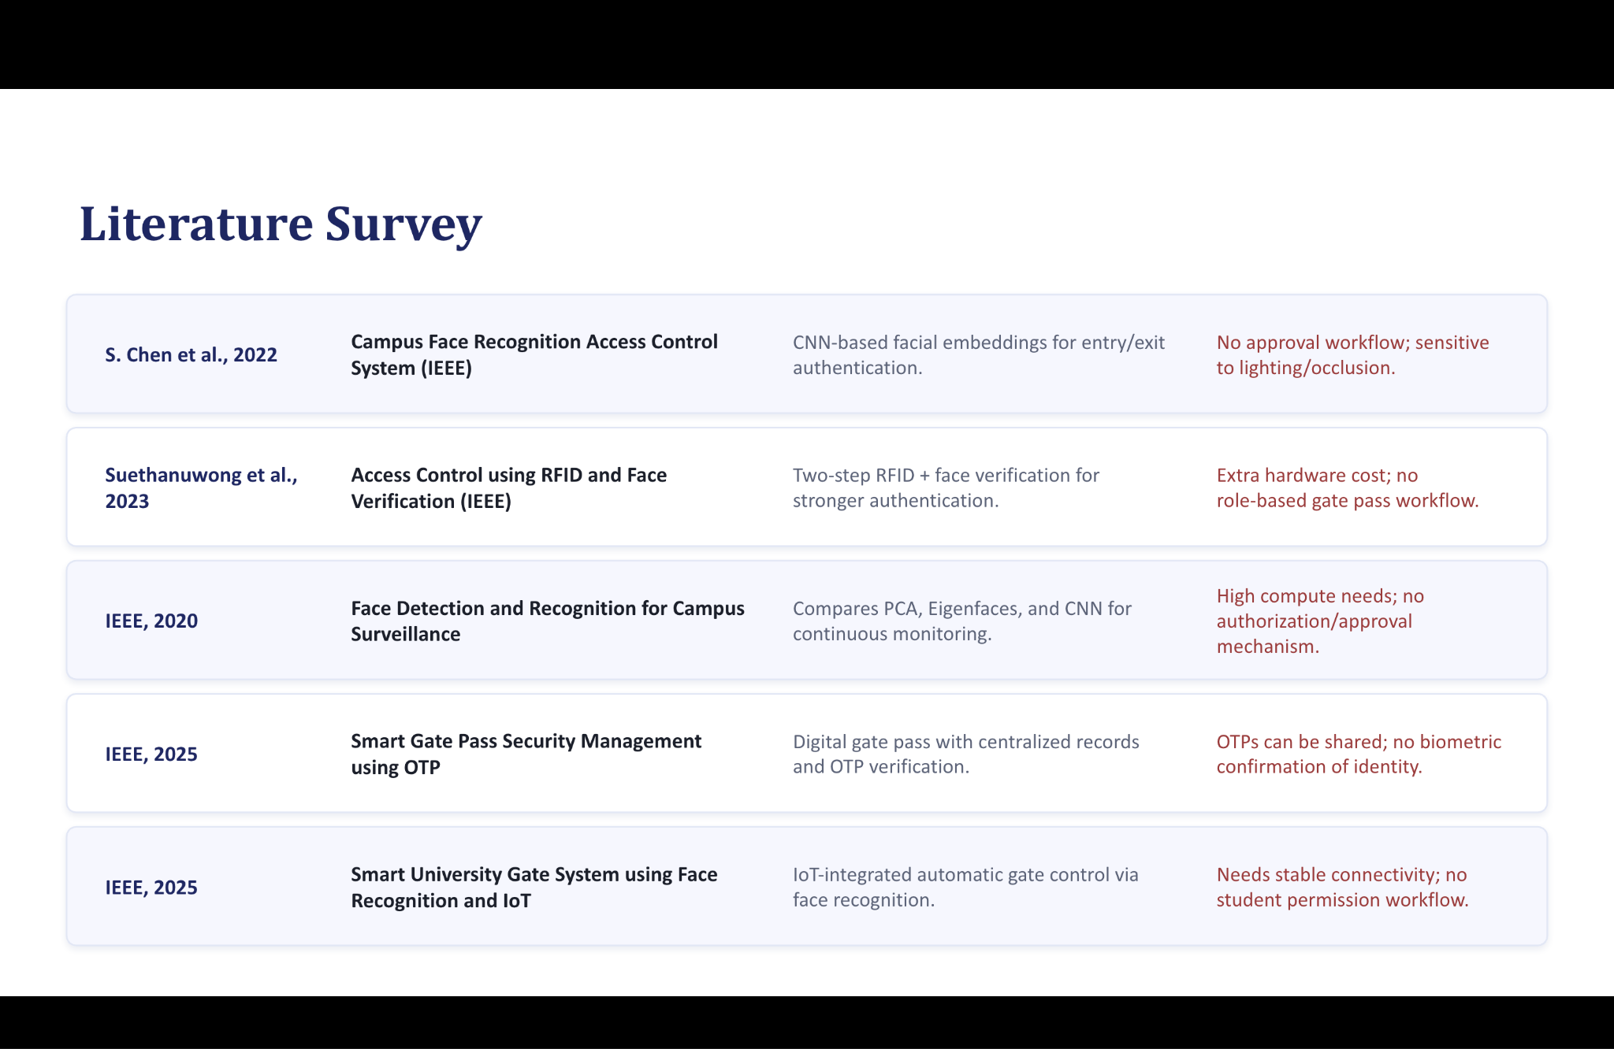
LITERATURE SURVEY

Slide 9
EXISTING SYSTEM
CNN-based facial embeddings for entry/exit authentication.
Two-step RFID + face verification for stronger authentication.
Compares PCA, Eigenfaces, and CNN for continuous monitoring.
Digital gate pass with centralized records and OTP verification.
IoT-integrated automatic gate control via face recognition.

Slide 10
PROPOSED SYSTEM
Fully digital, role-based web platform for all stakeholders
Real-time status updates and SMS alerts to HOD
VGG-Face facial recognition confirms identity at exit
Centralized MongoDB database with complete audit trail
Automated approval workflow with JWT-secured sessions

Slide 11
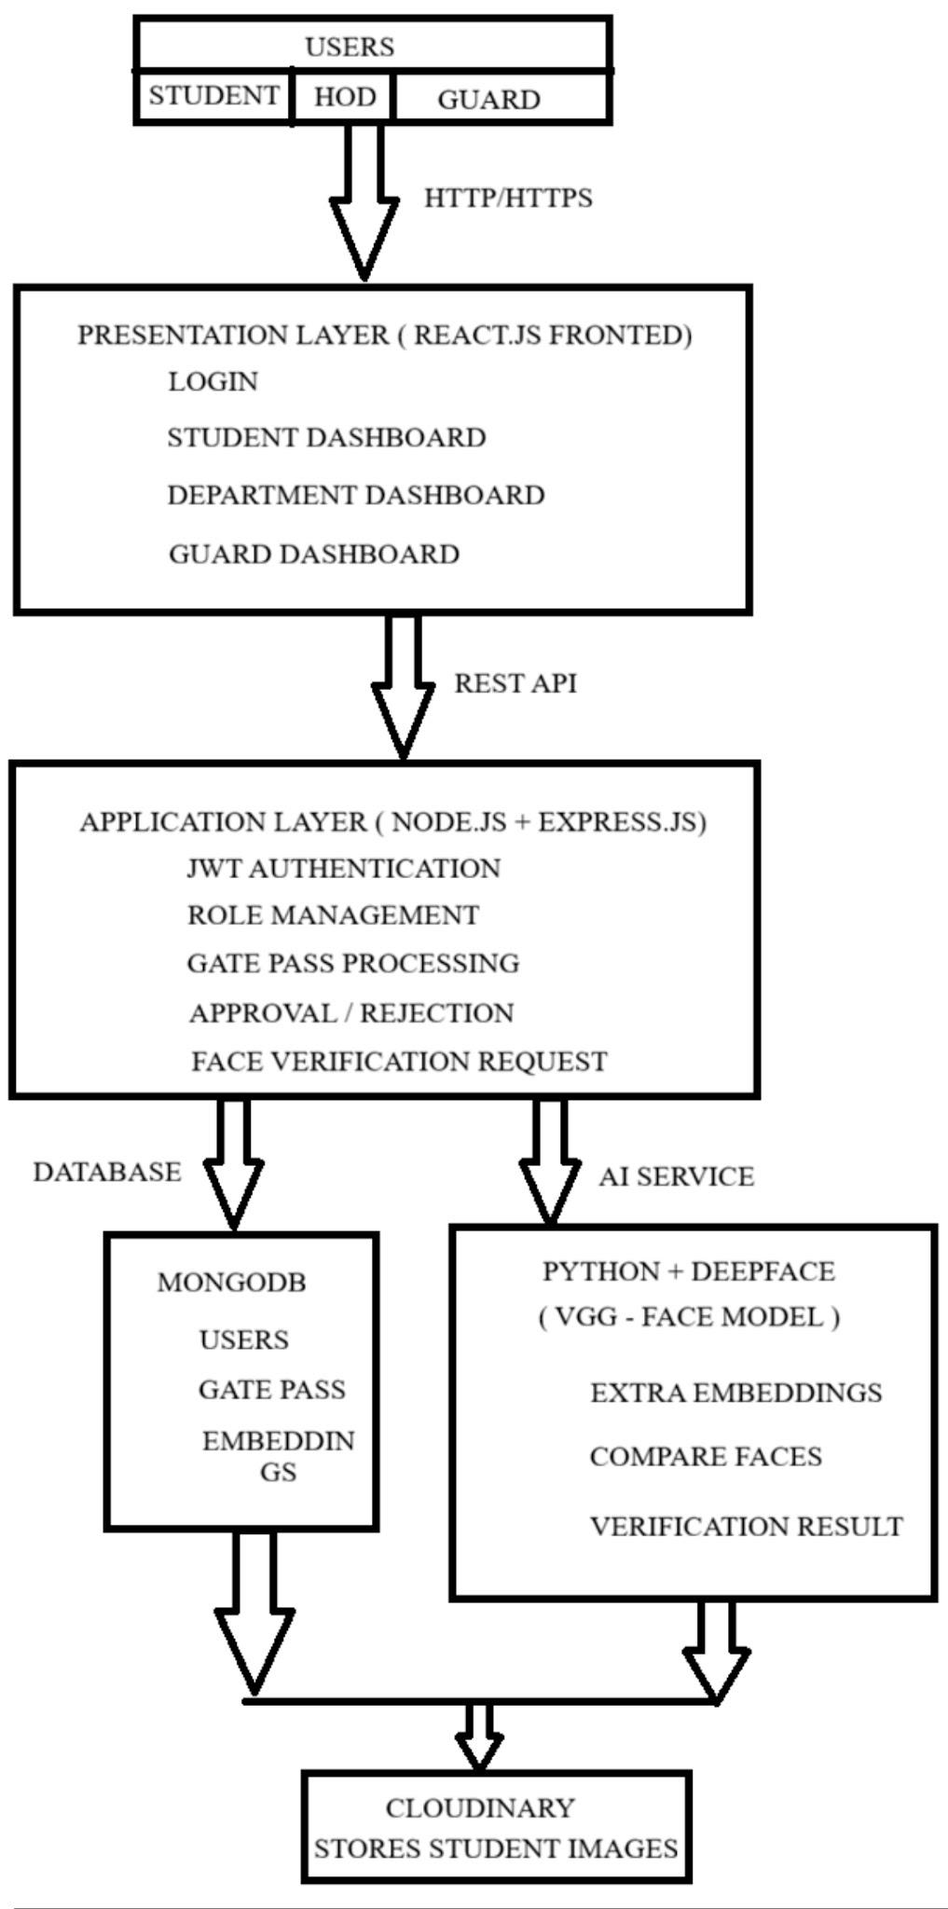
DESIGN
SYSTEM ARCHITECTURE

Slide 12
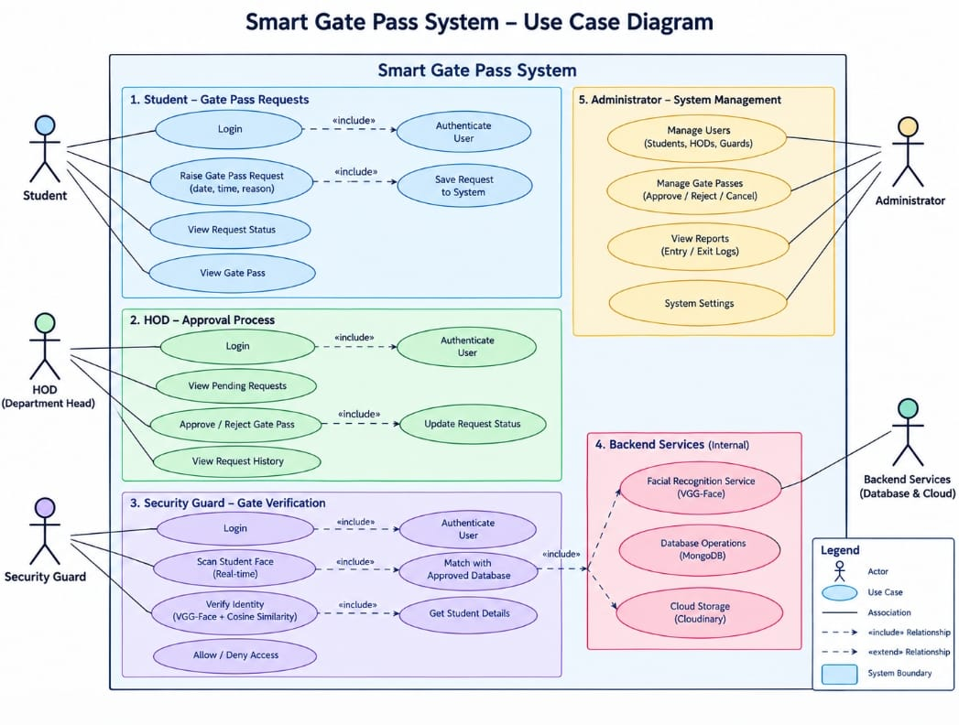
USE CASE DIAGRAM

Slide 13
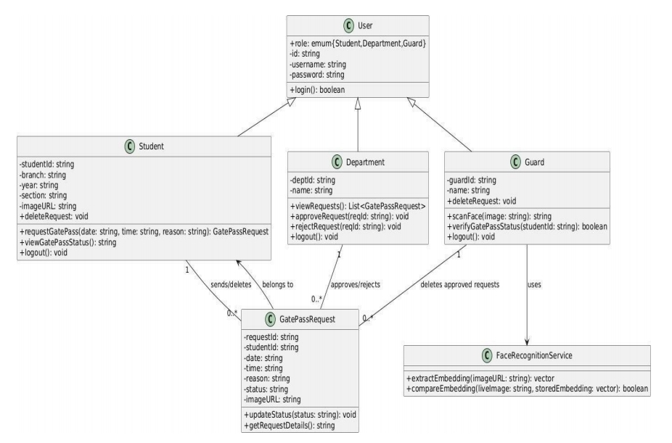
CLASS DIAGRAM

Slide 14
MODULES
Student Module
Login
Apply Gate Pass
View Status
Delete Pending Request
HOD Module
View Requests
Approve
Reject
View Student History
Security Module
View Approved Requests
Scan Face
Allow/Deny Exit
Mark Left Campus
Admin Module
Manage users
Monitor system

Slide 15
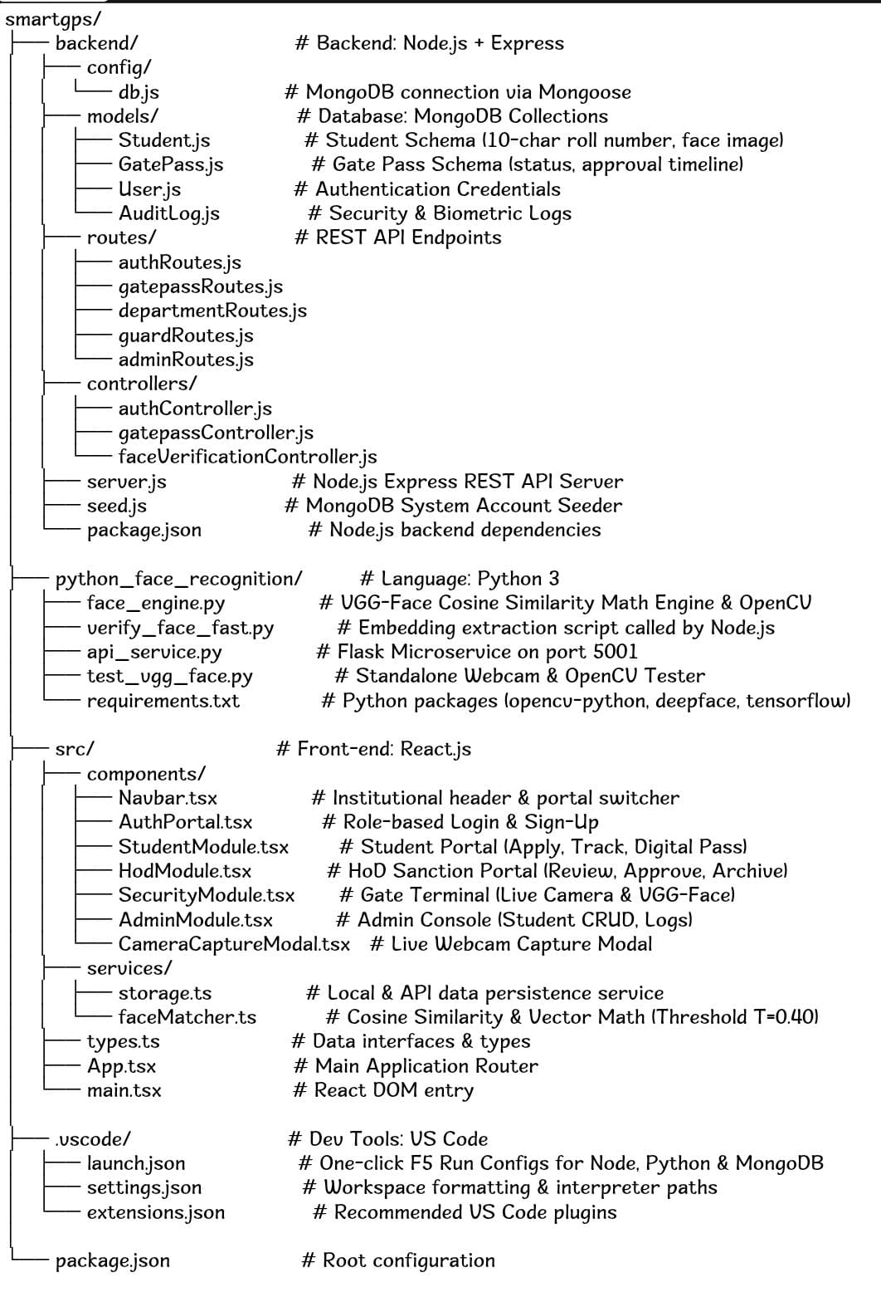
FILE STRUCTURE:

Slide 16
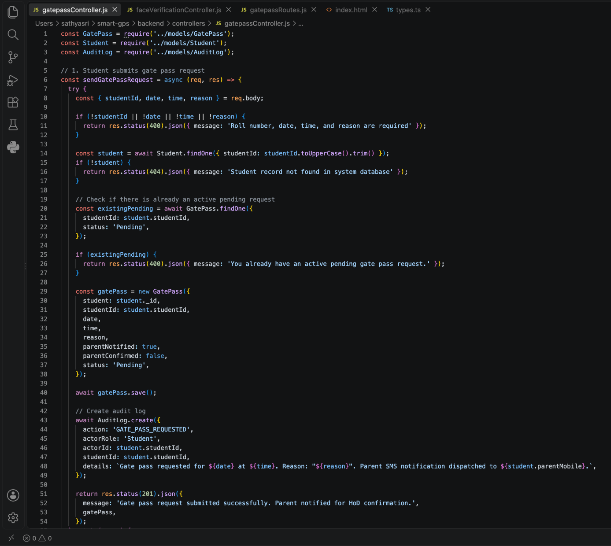
CODING
SNIPPETS:

Slide 17
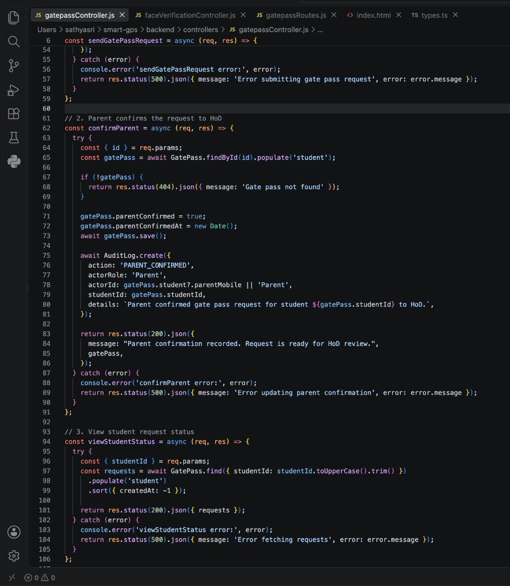
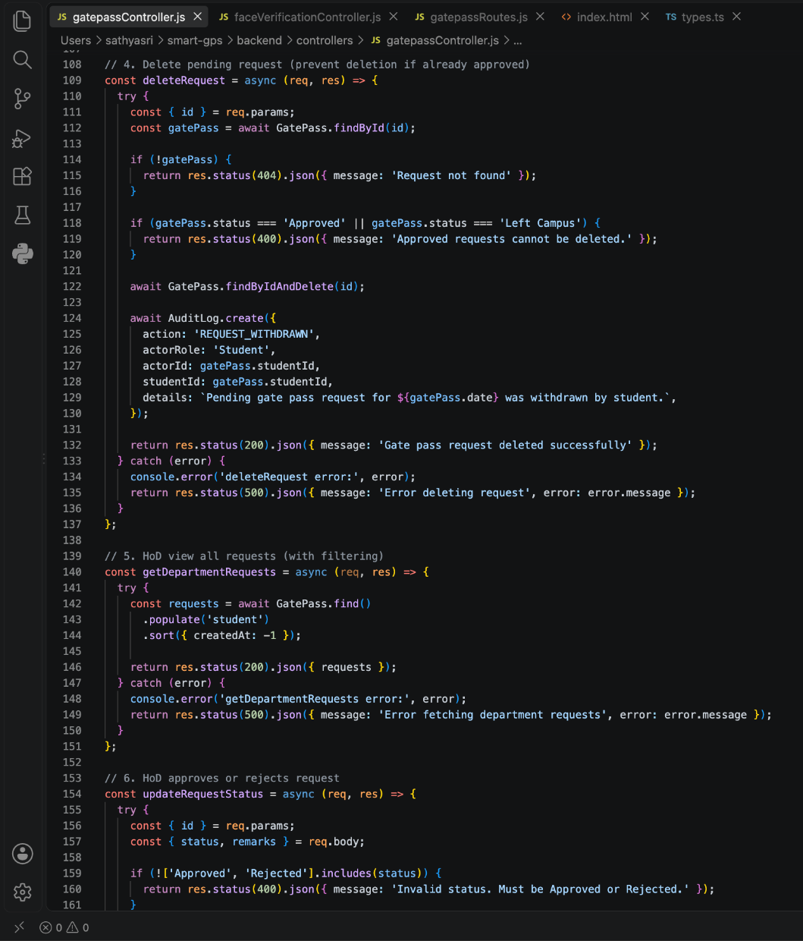

Slide 18
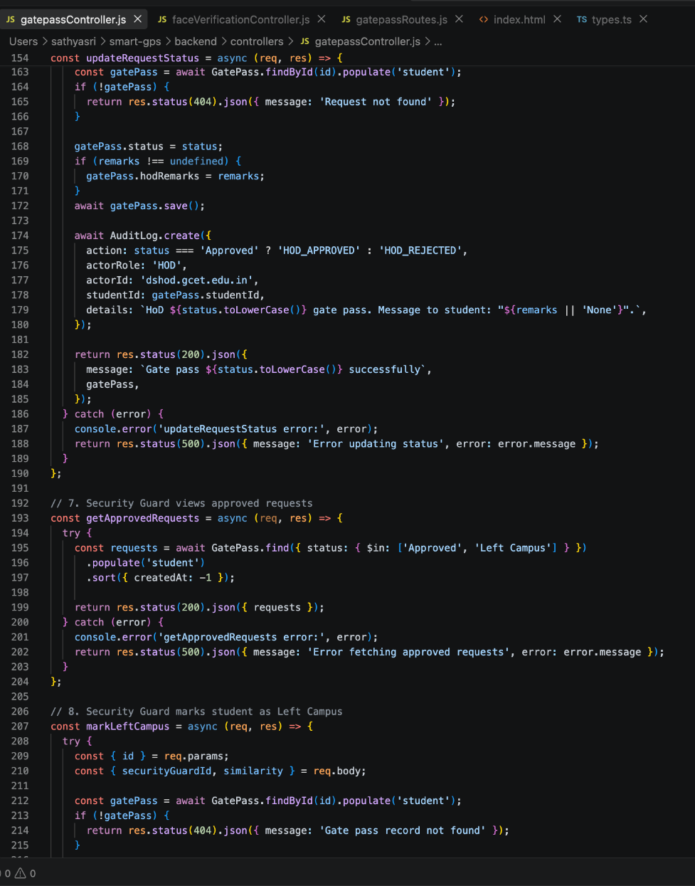
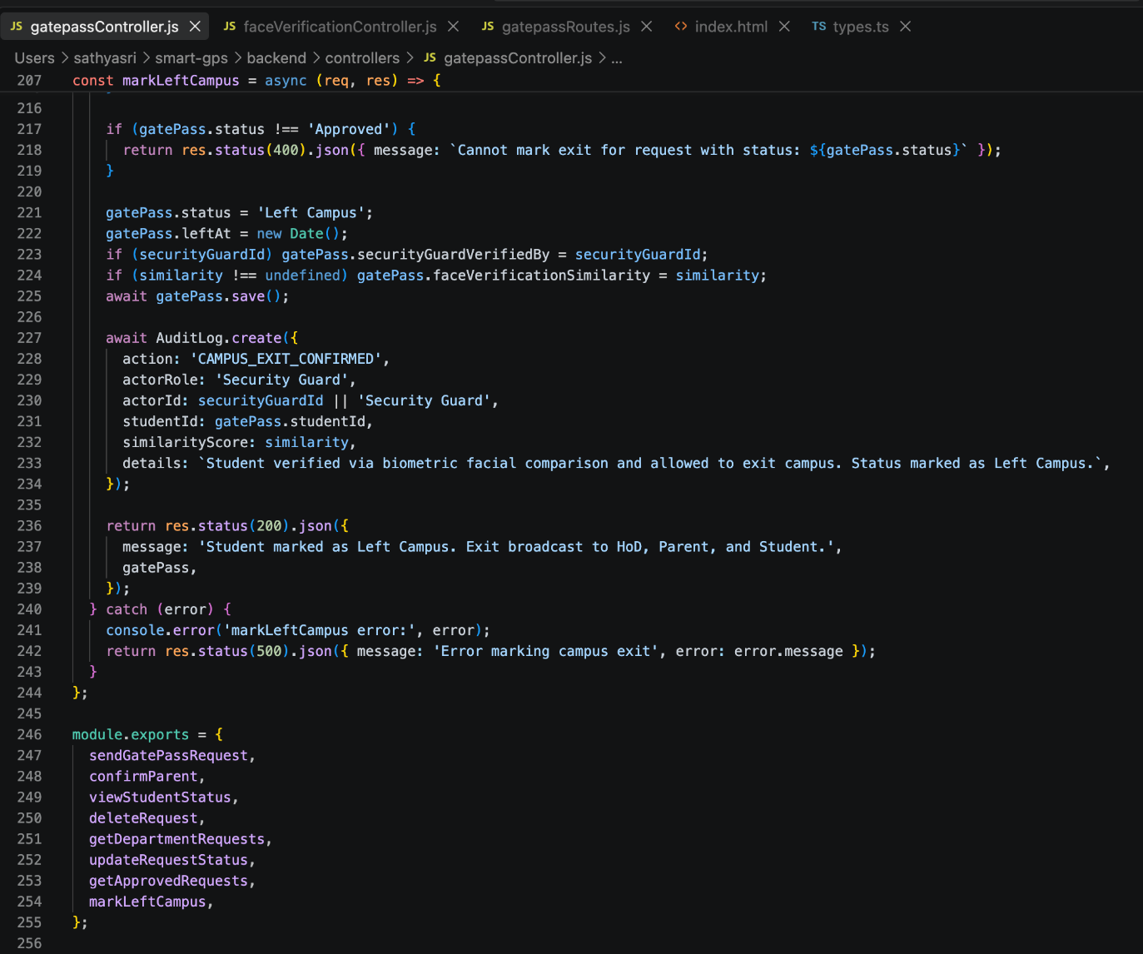

Slide 19
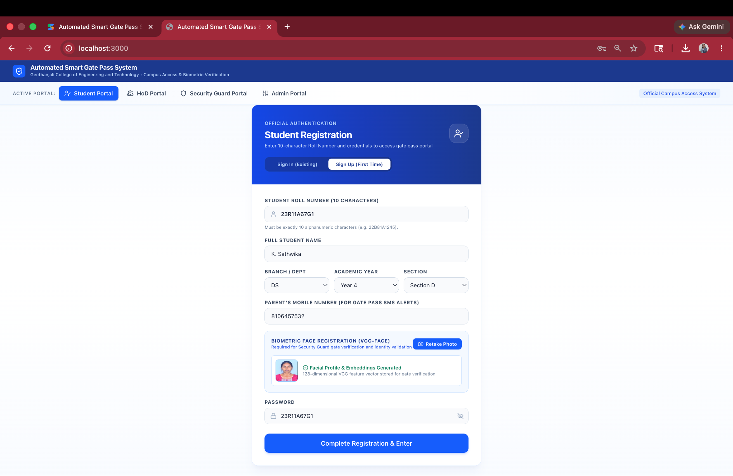
OUTPUT SCREENS:

Slide 20
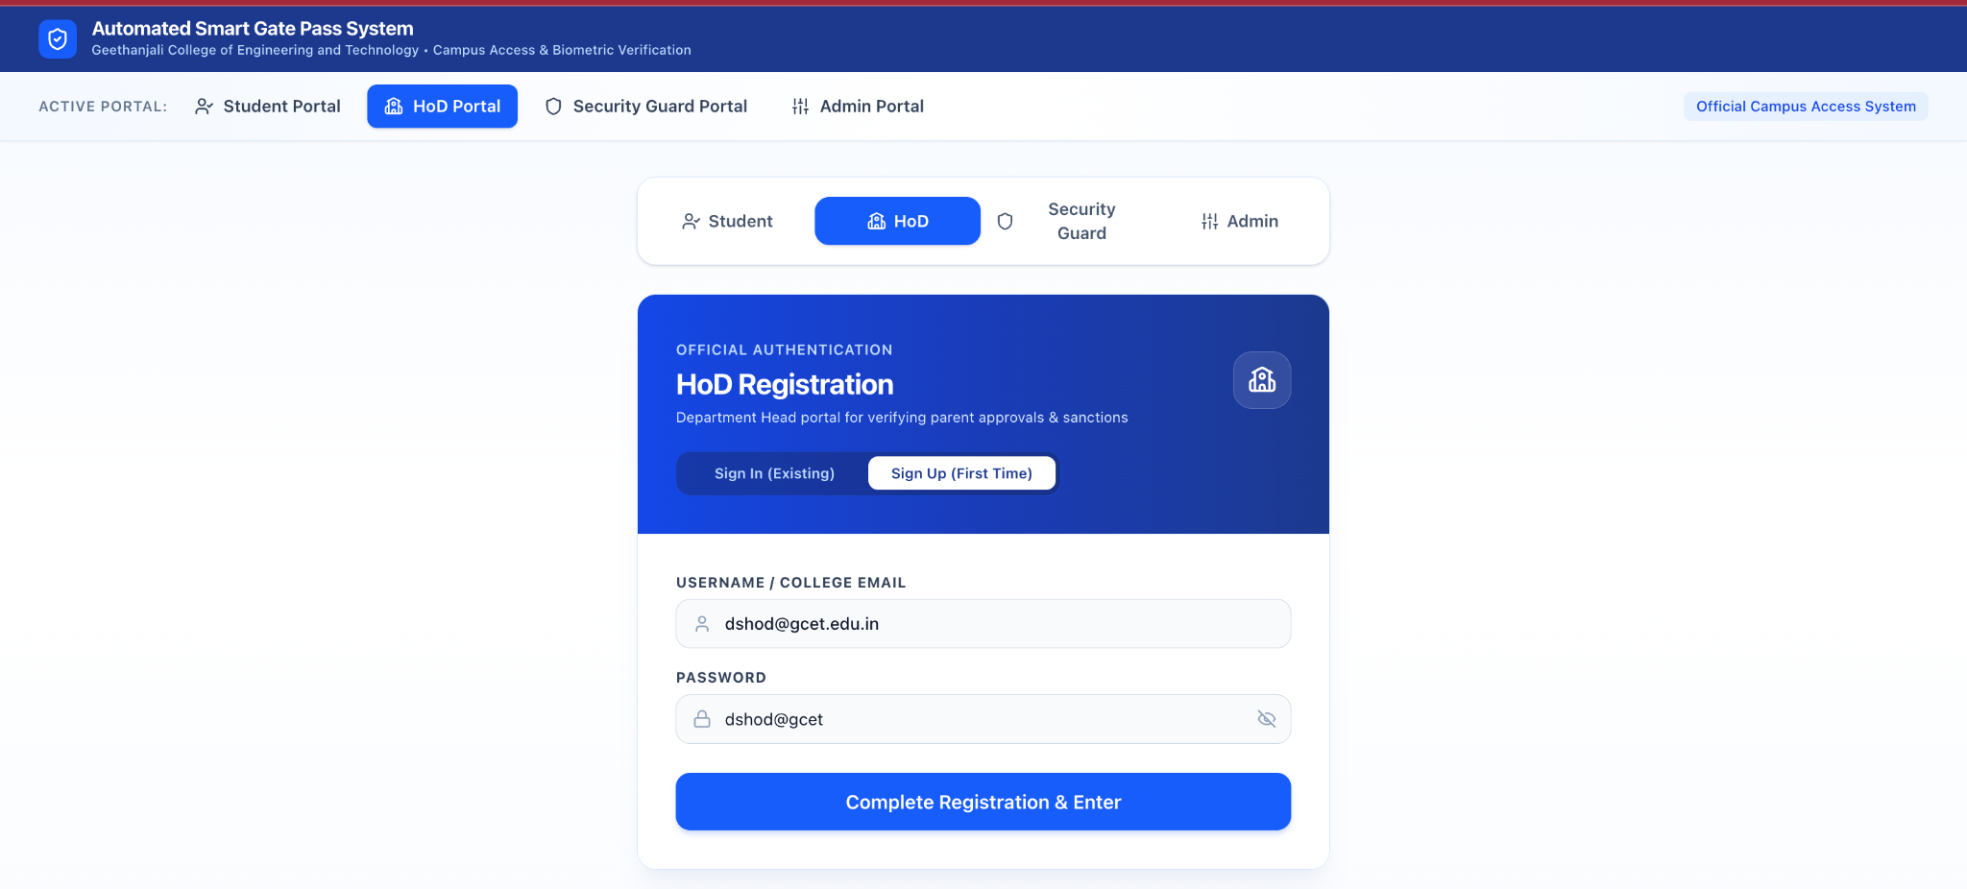
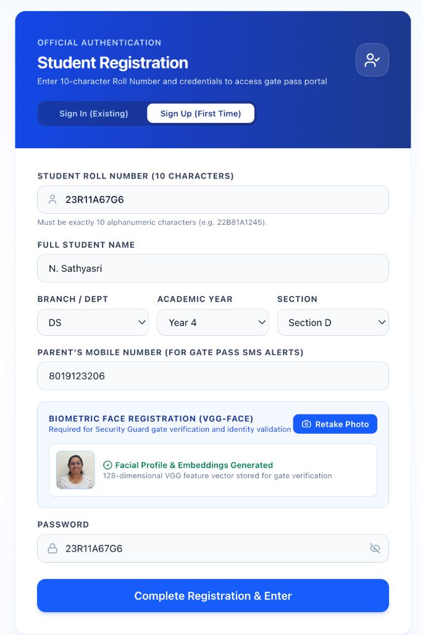
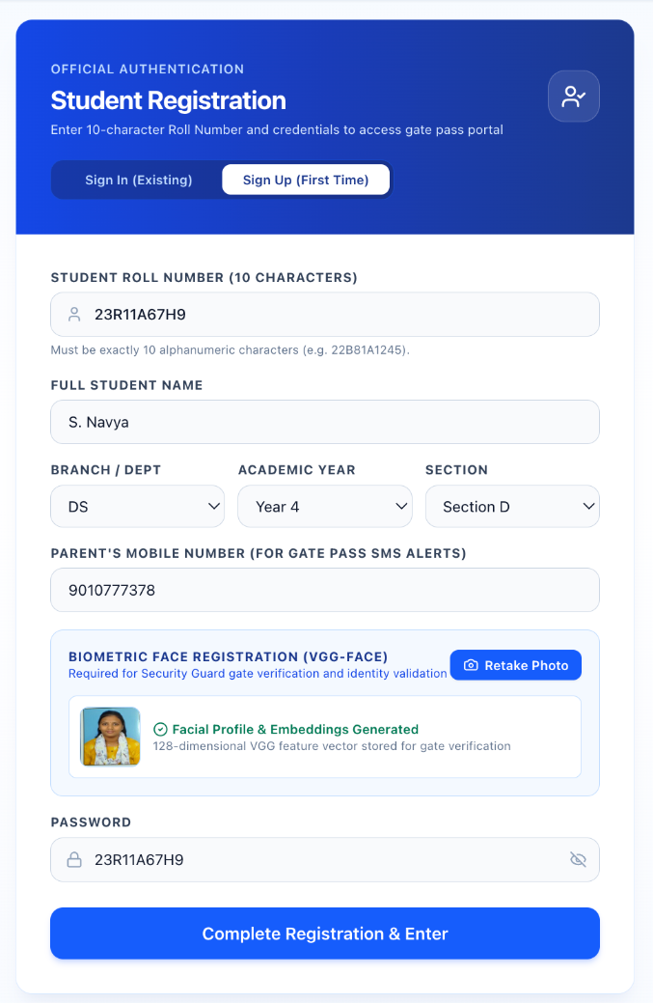
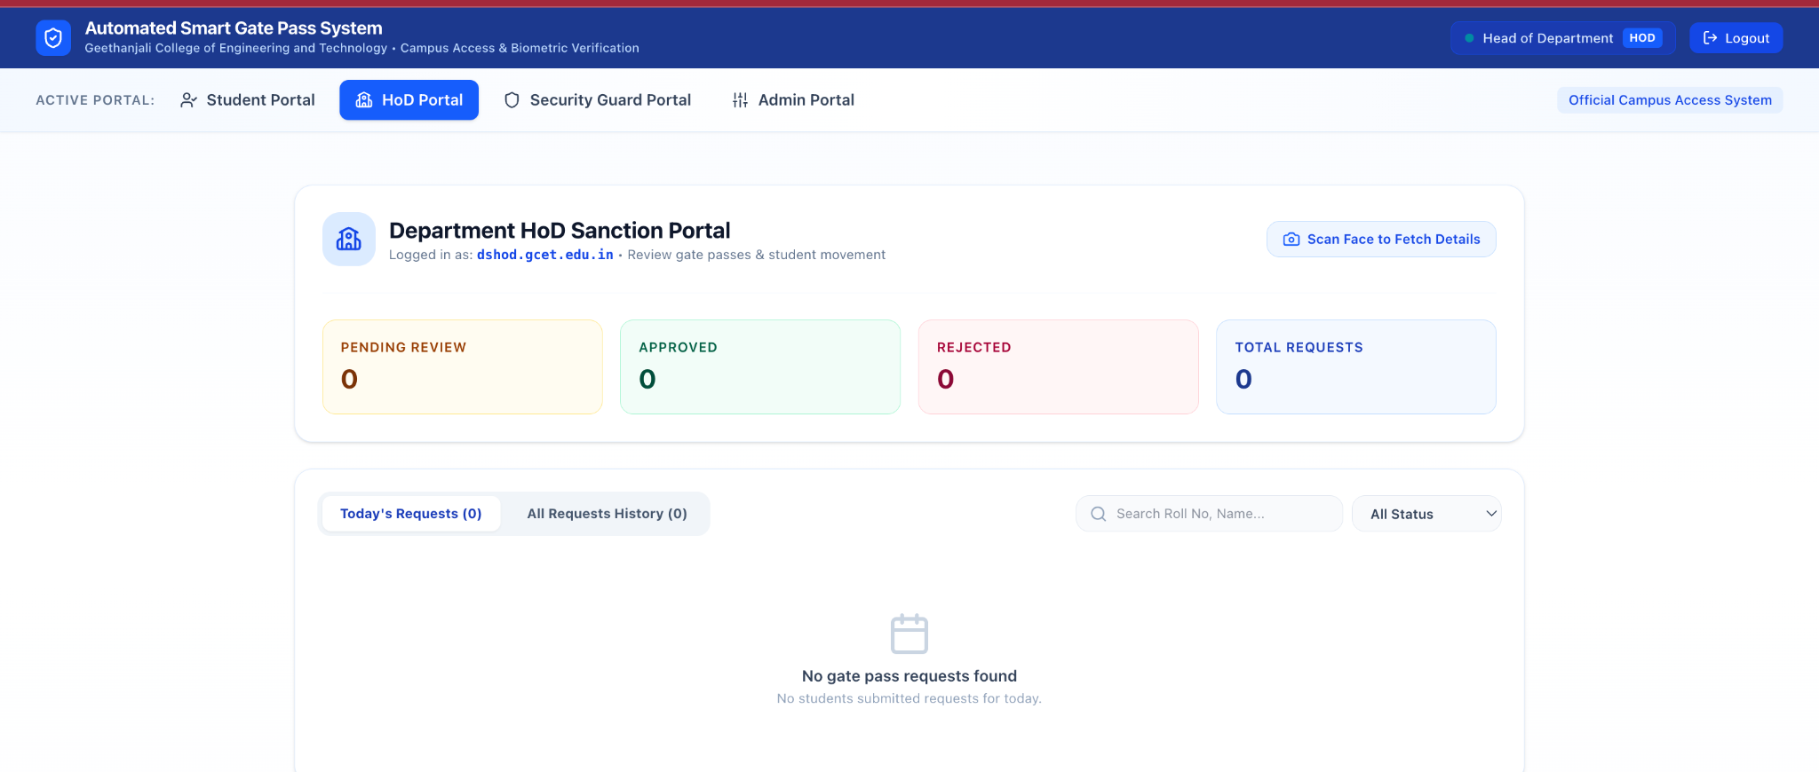

Slide 21
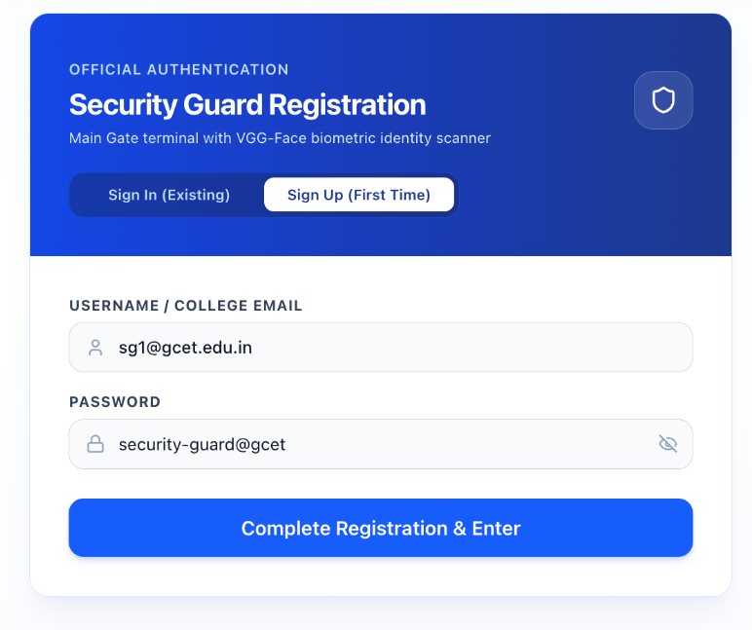
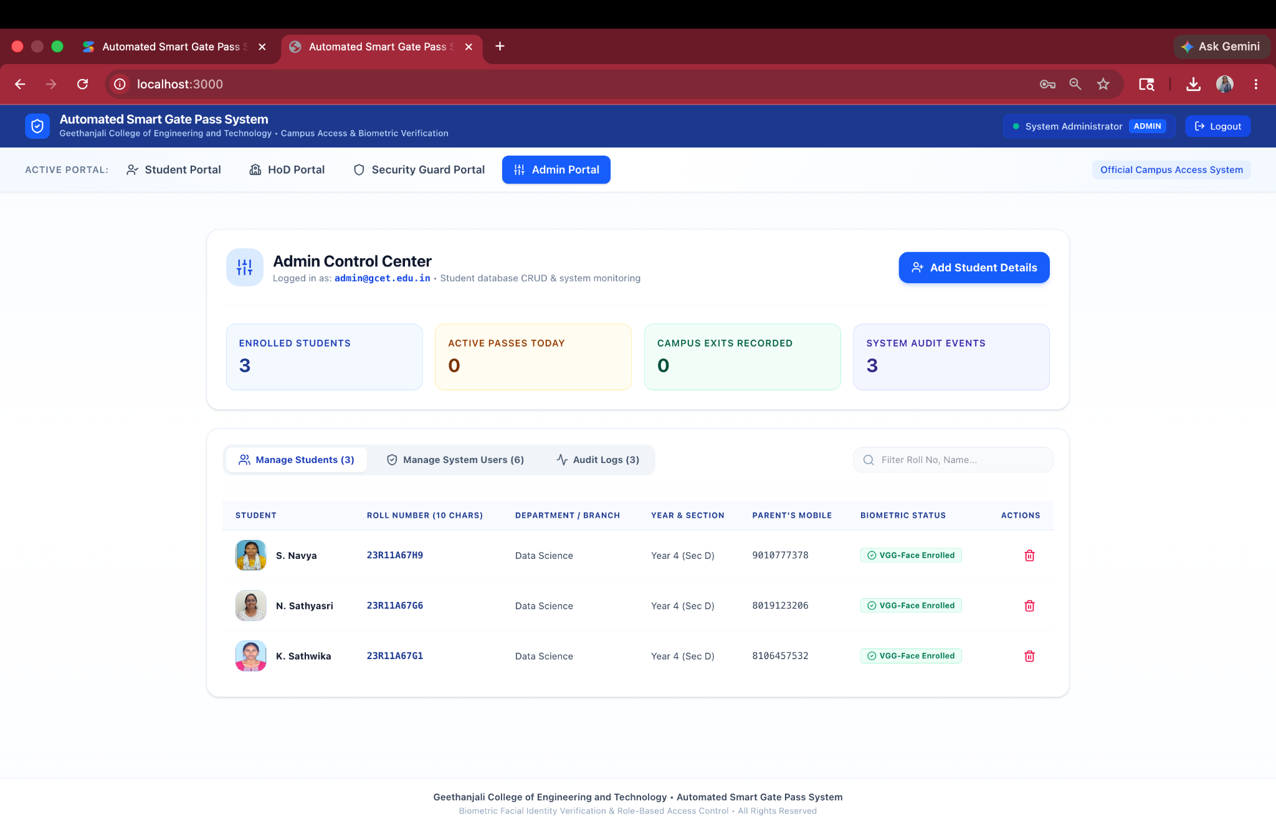
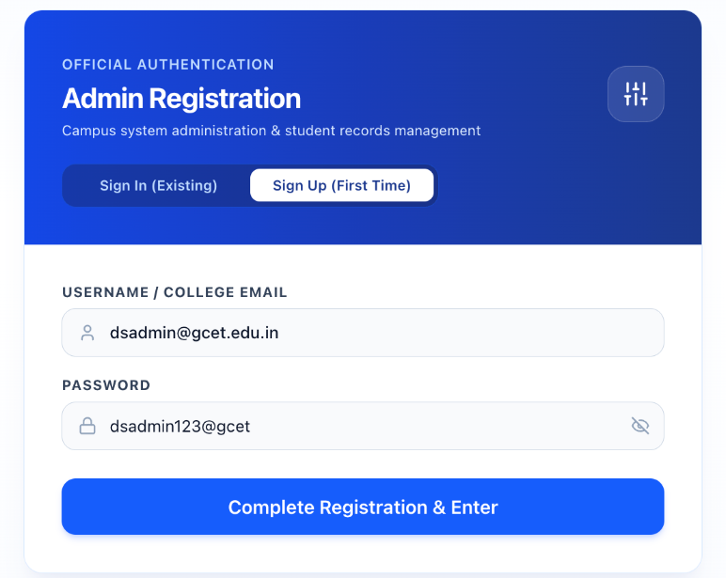

Slide 22
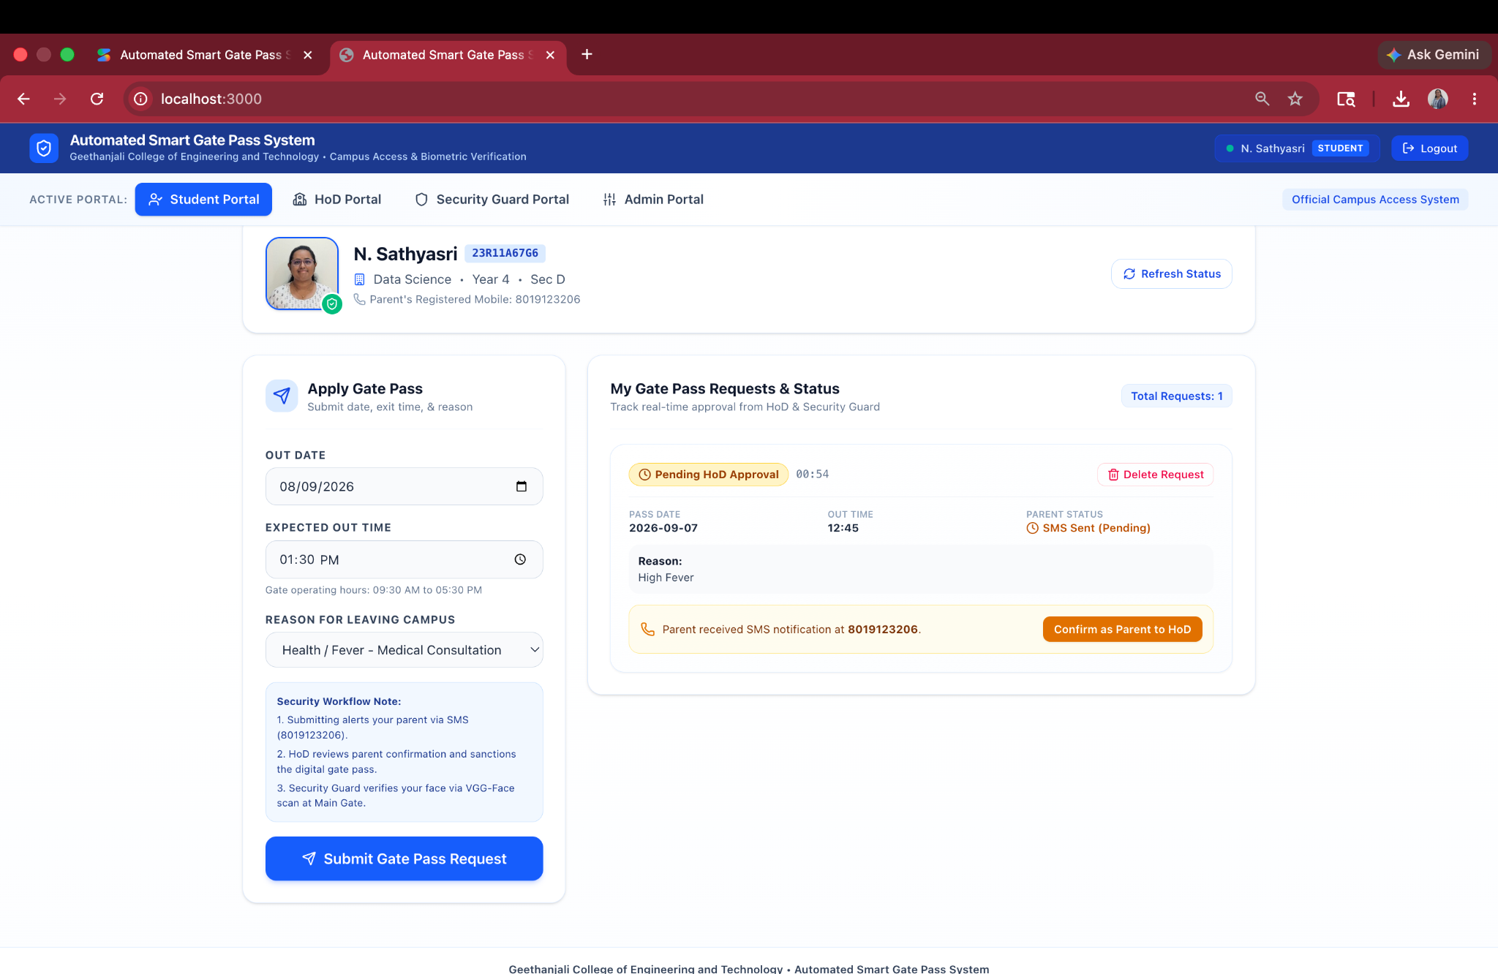
TEST CASE:

Slide 23
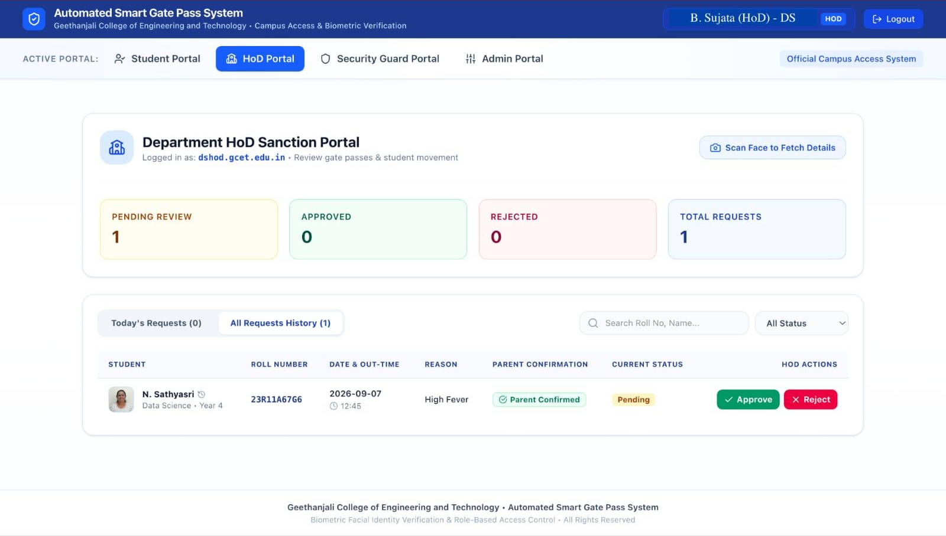
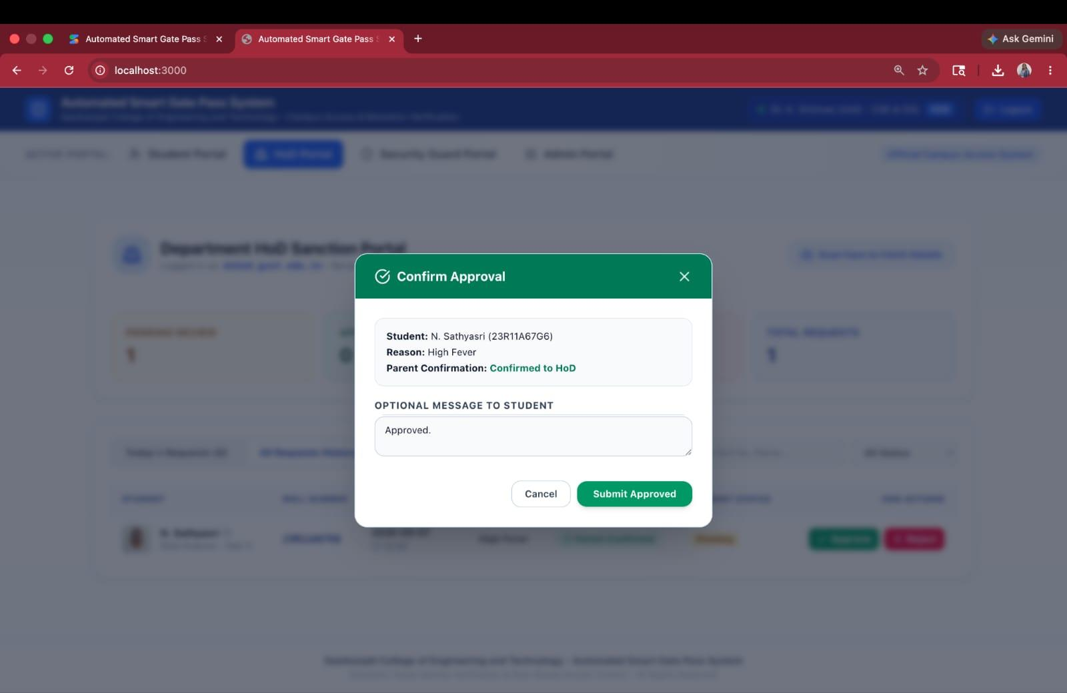

Slide 24
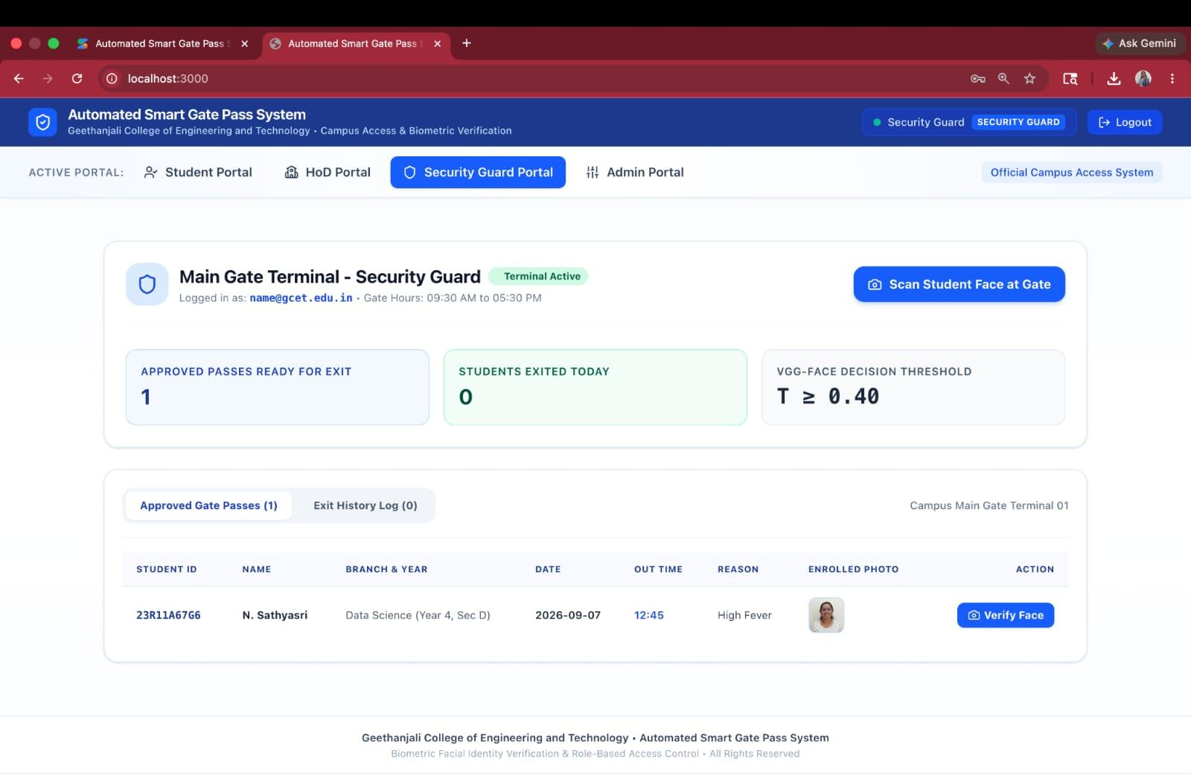
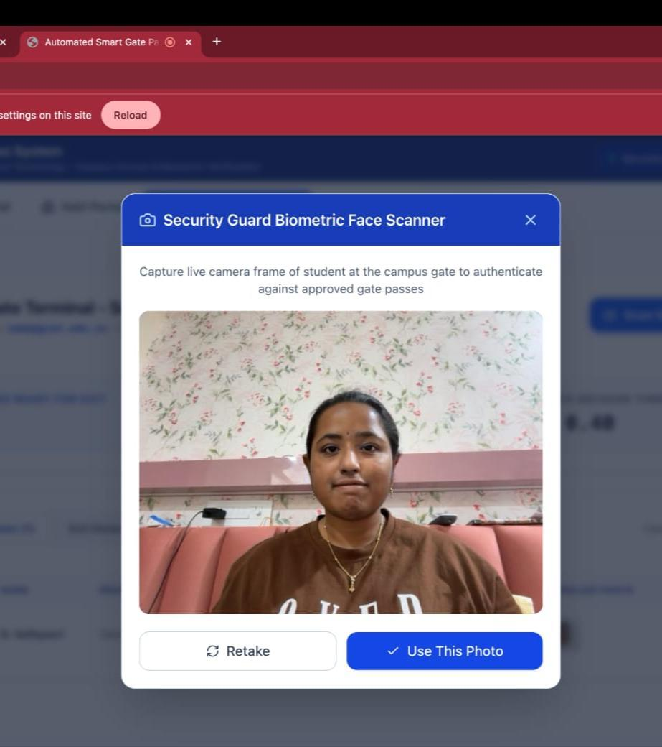

Slide 25
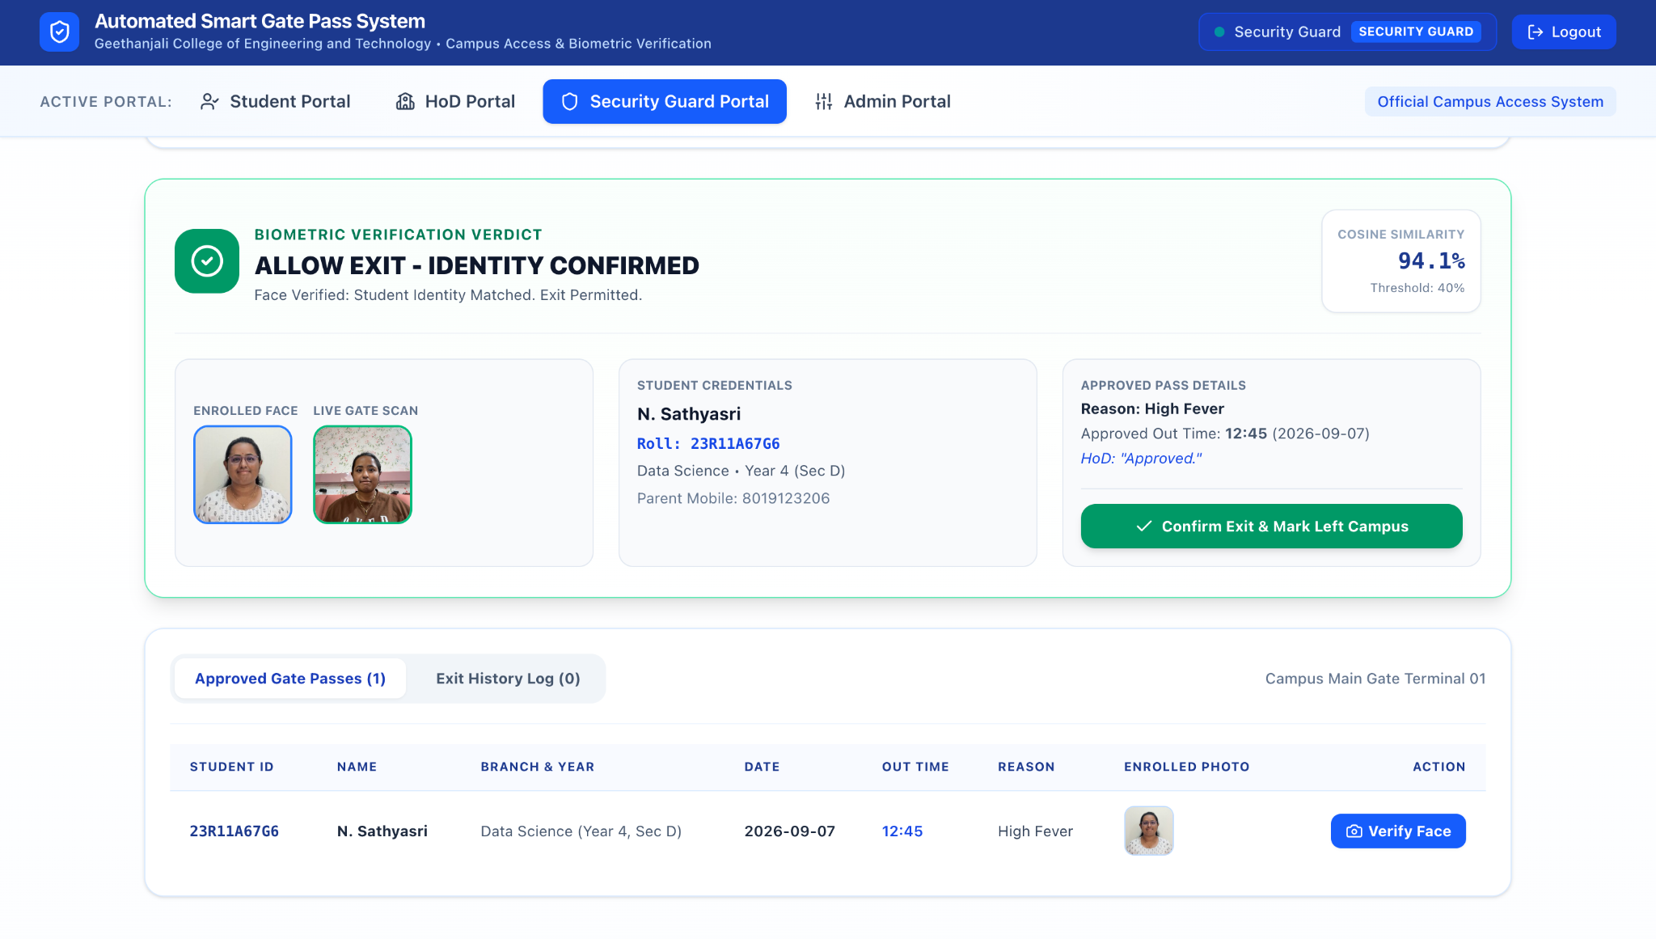
TEST RESULT:

Slide 26
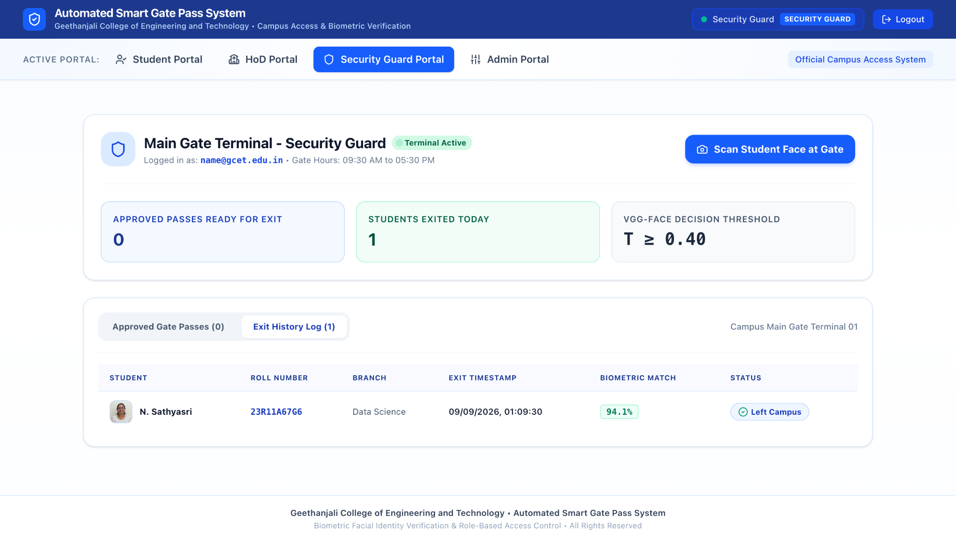

Slide 27
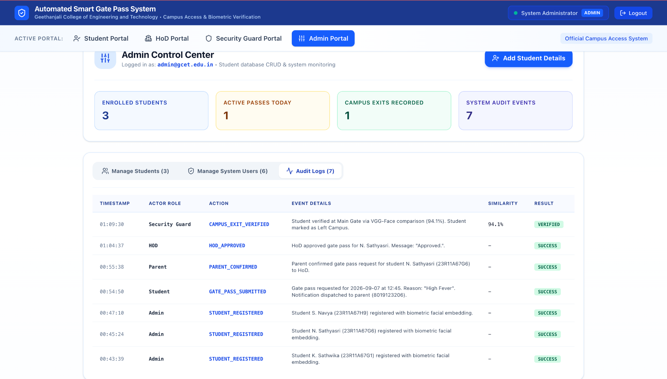

Slide 28
CONCLUSION
The Next-Gen Smart Pass System provides a secure and efficient solution for campus gate pass management. It automates the traditional paper-based gate pass process through a web-based application. Facial recognition using the VGG-Face model ensures accurate student identity verification. The system reduces paperwork, saves time, and minimizes human errors. Role-based access control enhances security for students, HODs, and security guards. A centralized database stores all gate pass records for easy tracking and management. Overall, the project improves campus security, transparency, and administrative efficiency.

Slide 29
FUTURE SCOPE
Real-time SMS, WhatsApp, or email notifications for gate-pass approval and status updates.
Linking the system with CCTV or live feed recognition to automate face detection without manual photo uploads.
Integration with college ERP/attendance systems for centralized management.
Exploring faster and more lightweight facial recognition models such as Face Net or MobileFaceNet for quicker processing and improved scalability.

Slide 30
BIBLIOGRAPHY
O. M. Parkhi, A. Vedaldi, and A. Zisserman, “Deep Face Recognition,” BMVC, 2015. Used as a reference for deep-learning-based facial recognition and face representation, which supports the identity verification component of the system.
G. Bradski, “The OpenCV Library,” Dr. Dobb’s Journal of Software Tools, 2000. Provides reference material for computer vision and image processing, which are relevant to capturing and processing facial images.
F. Chollet, Deep Learning with Python, 2nd ed., Manning Publications, 2021. Supports the deep-learning concepts used in the project's facial recognition component.
M. Grinberg, Flask Web Development: Developing Web Applications with Python, 2nd ed., O’Reilly Media, 2018. Provides reference for web application development, user interaction, authentication, and server-side processing.
K. Chodorow, MongoDB: The Definitive Guide, 3rd ed., O’Reilly Media, 2019. Provides reference for database management and storage of student details, gate-pass requests, approval status, verification data, and exit records.

Slide 31
APPENDIX
User Registration and Authentication – Details of student registration and login.
Gate Pass Request – Details of submitting an exit gate-pass request.
Gate Pass Approval/Rejection – Parent confirmation and HOD approval/rejection process.
Gate Pass Status & Records – Approved/rejected status and entry/exit record management.
Database & Testing Details – Database structure, sample records, test cases, and validation results.

Slide 32
PAPER PUBLICATION
Paper Tittle: Automated Smart Gate Pass and Identity Verification System For Secure Campus Access
Publication
Journal , Open access
Published on 1st October, 2026 version V1
DOI & Licence: 10.5281/zendo.23080432
Authors : K. Sathwika , N. Sathyasri , S. Navya
https://doi.org/10.5281/Zenodo.23080432

Slide 33
Thank You

