Slide 1
E T L Day-1 – Introduction
Cyrus Lentin

Slide 2
E T L
E T L
Is Short For Extract Transform Load,
Functions (Activities) That Are Combined Into One Tool
Used To Pull Data Out Of One Source And Place It Into Another Source
Extract Is The Process Of Reading Data From A Source
Transform Is The Process Of Converting The Extracted Data From Its Previous Form Into The Form It Needs To Be In The Target Source.
Load Is The Process Of Writing The Data Into The Target Database
Etl Is Used To Migrate Data From One Database To Another, To Form Data Marts And Data Warehouses And Also To Convert Databases From One Format Or Type To Another.

Slide 3
ETL Process
Extract
Data From Different Source (SAP, ERP, Other Operational Systems)
Is Converted Into One Consolidated Format
Which Is Ready For Transformation Processing
Transform
Applying Business Rules (So-called Derivations, E.G., Calculating New Measures And Dimensions)
Cleaning (E.G., Mapping NULL To 0 Or "Male" To "M" And "Female" To "F" Etc.)
Filtering (E.G., Selecting Only Certain Columns To Load)
Splitting A Column Into Multiple Columns And/Or Merging Multiple Columns To One
Joining Together Data From Multiple Sources (E.G., Lookup, Merge)
Transposing Rows And Columns
Applying Any Kind Of Simple Or Complex Data Validation
Load
Loading The Data Into A Data Warehouse Or Data Repository
Making Data Ready For Reporting Applications

Slide 4
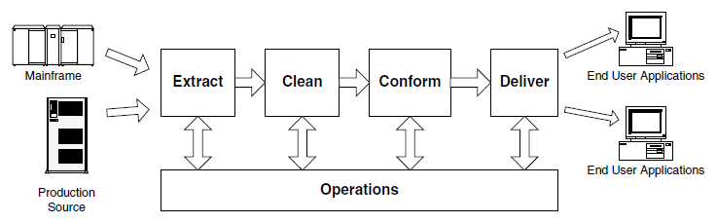
Data Flow Thread

Slide 5

Planning & Design Thread
Requirements / Realities
Architecture
Implementation
Test / Release

Slide 6
Planning & Design – Requirements
Business Needs
Compliance
Data Profiling
Security
Data Integration
Data Latency
End User Delivery Interfaces
Available Skills
Legacy Licenses

Slide 7
Planning & Design – Architecture
Hand-coded Versus ETL Vendor Tool
Batch Versus Streaming Data Flow
Horizontal Versus Vertical Task Dependency
Scheduler Automation
Exception Handling
Quality Handling
Recovery And Restart
Metadata
Security

Slide 8
Planning & Design – System Implementation
Hardware
Software
Coding practices
Documentation Practices
Quality Checks

Slide 9
Planning & Design – Test & Release
Development Systems
Test Systems
Production Systems
Handoff Procedures
Update Propagation Approach
System Snapshoting And Rollback Procedures
Performance Tuning

Slide 10
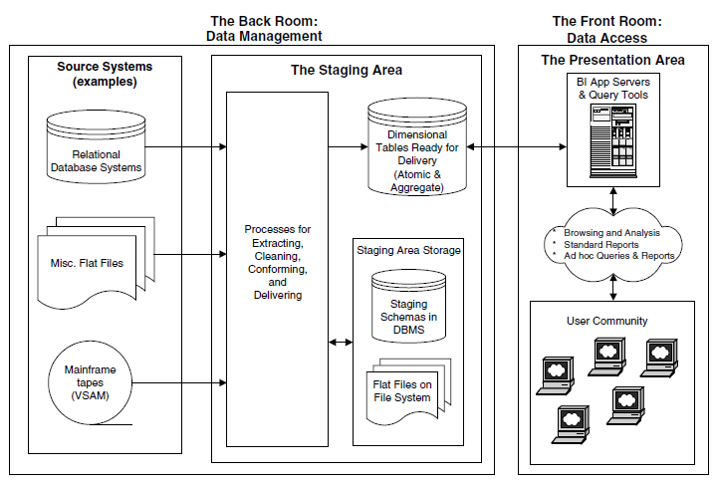
Data Management / Data Access

Slide 11
Why Segregation
Providing Detailed Security At A Row, Column, Or Applications Level
Building Query Performance-enhancing Indexes And Aggregations
Providing Continuous Up-time Under Service-level Agreements
Guaranteeing That All Data Sets Are Consistent With Each Other

Slide 12
Data Management / Staging (Back Room)
Staging describes discrete steps in the back room.
Staging almost always implies a temporary or permanent physical snapshot of data.
Four staging steps found in almost every data warehouse,
Extract
Clean
Conform
Deliver

Slide 13
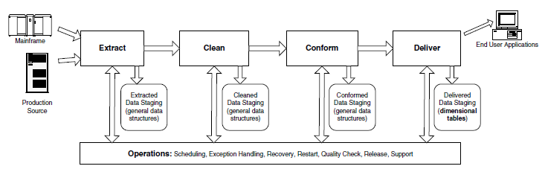
Staging – Block Diagram

Slide 14
Extract
The Raw Data Coming From The Source Systems Is Usually Written Directly To Disk. Some Minimal Restructuring Happens Before Significant Content Transformation Takes Place
Data From Structured Source Systems (IMS Databases, Or XML Data Sets) Often Is Written To Flat Files Or Relational Tables In This Step
This Allows The Original Extract To Be As Simple And As Fast As Possible And Allows Greater Flexibility To Restart The Extract If There Is An Interruption
Initially Captured Data Can Then Be Read Multiple Times As Necessary To Support The Succeeding Steps
In Some Cases, Initially Captured Data Is Discarded After The Cleaning Step Is Completed, And In Other Cases Data Is Kept As A Long-term Archival Backup
The Initially Captured Data May Also Be Saved For At Least One Capture Cycle So That The Differences Between Successive Extracts Can Be Computed

Slide 15
Clean
In Most Cases, The Level Of Data Quality Acceptable For The Source Systems Is Different From The Quality Required By The Data Warehouse.
Data Quality Processing May Involve Many Discrete Steps, Including
Checking For Valid Values Ensuring Data Consistency Across Values
Removing Duplicates
Checking Whether Complex Business Rules And Procedures Have Been Enforced
The Results Of The Data-cleaning Step Are Often Saved Semi-Permanently Because The Transformations Required Are Difficult And Irreversible.
Is The Cleaned Data Fed Back To The Sources Systems To Improve Their Data And Reduce The Need To Process The Same Data Problems Again
Even If The Cleaned Data Cannot Be Physically Fed Back To The Source Systems, The Data Exceptions Should Be Reported To Build A Case For Improvements

Slide 16
Conform
Data Conformation Is Required Whenever Two Or More Data Sources Are Merged In The Data Warehouse.
Separate Data Sources Cannot Be Queried Together Unless Some Or All Of The Textual Labels In These Sources Have Been Made Identical And Unless Similar Numeric Measures Have Been Mathematically Rationalized So That Differences And Ratios Between These Measures Make Sense.
Data Conformation Is A Significant Step That Is More Than Simple Data Cleaning.
Data Conformation Requires An Enterprise-wide Agreement To Use Standardized Domains And Measures.

Slide 17
Deliver
The Whole Point Of The Back Room Is To Make The Data Ready For Querying.
The Final And Crucial Back-room Step Is Physically Structuring The Data Into A Set Of Simple, Symmetric Schemas Known As Dimensional Models, Or Equivalently, Star Schemas.
These Schemas Significantly Reduce Query Times And Simplify Application Development.
Dimensional Schemas Are Required By Many Query Tools, And These Schemas Are A Necessary Basis For Constructing OLAP Machines

Slide 18
Stage Or Not To Stage
ETL Architect's Decision To Store Data In A Physical Staging Area Versus Processing It In Memory.
Determine The Right Balance Between Physical Input And Output (I/O) And In-memory Processing.
Determining Whether To Stage Your Data Or Not Depends On Two Conflicting Objectives:
Getting The Data From The Originating Source To The Ultimate Target As Fast As Possible
Having The Ability To Recover From Failure Without Restarting From The Beginning Of The Process
The Decision To Stage Data Varies Depending On Your Environment And Business Requirements.
Following Reasons Must Be Considered For Staging Data Before It Is Loaded Into The Data Warehouse:
Recoverability
Backup
Auditing
Staging Area Types:
Persistent – History To Staging Files Are Maintained
Transient – Staging Files Are Deleted After Delivery

Slide 19
Stage Rules
The Data-staging Area Must Be Owned By The ETL Team.
Users Are Not Allowed In The Staging Area For Any Reason.
Reports Cannot Access Data From The Staging Area.
Only Etl Processes Can Write To And Read From The Staging Area.
ETL Team Owns The Data-staging Area.
ETL Architect Designs The Tables & Decides Whether A Table Belongs In The Database Or Flatfile
The ETL Architect Must Supply Processing & Data Storage Requirement to OS-Admin / DBA
OS-Admin / DBA creates the required database / allocates required space and hands over to ETL Team

Slide 20
Data Access (Front Room)
Indexing dimensional tables in the presentation area for query performance
Choosing front-end tools, including query tools, report writers, and dashboards
Writing SQL to solve end user queries
Data-mining techniques
Forecasting, behavior scoring, and calculating allocations
Security on the tables and applications accessible by end users
Metadata supporting end user tools
End user training and documentation

Slide 21
Data Warehouse
The aim of the data warehouse is to publish the organization’s data assets to most effectively support decision making.
The key word in this mission statement is publish. The success of a data warehouse begins and ends with its end users.
Since the data warehouse is a decision support system, our main criterion of success is whether the data warehouse effectively contributes to the most important decision-making processes in the organization.
A data warehouse is a system that extracts, cleans, conforms, and delivers source data into a dimensional data store and then supports and implements querying and analysis for the purpose of decision making.
A Data Warehouse Is NOT Product | Language | Project | Data Model | Transaction System

Slide 22
ETL Mission
All ETL System Must:
Deliver Data Most Effectively To End User Tools
Add Value To Data In The Cleaning And Conforming Steps
Protect And Document The Lineage Of Data
Four Keys Steps:
Extracting Data From The Original Sources
Quality Assuring And Cleaning Data
Conforming The Labels And Measures In The Data To Achieve Consistency Across The Original Sources
Delivering Data In A Physical Format That Can Be Used By Query Tools, Report Writers, And Dashboards.

