Slide 1
E T L Day-2 – Data Structures
Cyrus Lentin

Slide 2
Data Structures
Flat Files
XML Files
Relational Tables

Slide 3
Flat Files
Data Is Stored In Columns And Rows Within A File On Your File System To Emulate A Database Table
Data Stored In Standard Manner Known As American Standard Code For Information Interchange (ASCII).
ASCII Flat Files Can Be Processed / Manipulated By ETL Tools Or Scripting Languages Very Fast!
Advantages
No Overhead To Maintain Metadata About The Data Being Processed
Processes Like Sorting, Merging, Deleting, Replacing, And Data-migration Functions Are Very Fast
Many Utility Programs Are Dedicated To Text-file Manipulation.
Disadvantage
Meta Data Not In-Built
Formatting Not In-Built
Best Suited For
Staging Source Data For Safekeeping And Recovery
Sorting Data
Filtering
Aggregation
Referencing Source Data

Slide 4
Flat Files – Types
Fixed Width Files
All Rows Have Same Width
All Fields (Columns) In The Rows Also Have The Same Width
No Field Level Delimiter Required
Row Level Delimiter Is \n or \r\n
Sample Tim M 5014510/21/1978 Sara F 6518011/23/1965
Delimited Files
Rows Have Variable Width
Fields (Columns) Also Have Variable Width
Field Level Delimiter Required; generally , for .csv
Row Level Delimiter Is \n or \r\n
Qualifier Character Is Required
Sample Tim, M, 50, 145, 10/21/1978 Sara, F, 65, 180, 11/23/1965

Slide 5
XML Files
XML is a for data communication or data exchange / not generally used for persistent staging in ETL
XML is very common format for both input to and output from the ETL system
XML takes the form of plain text documents containing both data and metadata but no formatting info
XML metadata consists of tags unambiguously identifying each item in an XML document.
XML has capability for declaring hierarchical structures, such as complex forms with nested fields.
For instance, an invoice coded in XML contains sequences such as: <Customer Name = "Bob" Address= "123 Main Street" City= "Philadelphia" />
Advantages
Meta Data In-Built
Processes Like Sorting, Merging, Deleting, Replacing, And Data-migration Functions Are Possible
Disadvantage
Overheads To Store & Read Meta DATA (huge in large-volume data transfer)
Formatting Not In-Built
Best Suited For
XML defines a universal language for data sharing
Links
http://www.w3schools.com/xml/xml_whatis.asp

Slide 6
JSON Files
JSON is a for data communication or data exchange / not generally used for persistent staging in ETL
JSON is very common format for both input to and output from the ETL system
JSON takes the form of plain text files containing both data and metadata but no formatting info
JSON Files consists key:value pair; the unambiguously identifying each item a document.
For instance, an invoice coded in XML contains sequences such as:
{ "employee": {"name":"sonoo","salary":56000, "married":true} }
Advantages
Meta Data In-built
Better Mix Of Flat File & XML Capability
Disadvantage
Overheads To Store & Read Meta DATA
Formatting Not In-Built
Best Suited For
JSON Format is designed to work with Java Script and is best suited for data transfer over HTTP
Links
http://www.w3schools.com/js/js_json_intro.asp
http://www.jsoneditoronline.org/

Slide 7
Relational Tables
Staging Data Can Optionally Be Stored Within The Confines Of A Relational DBMS
Using Database Tables Is Most Appropriate Especially When You Don’t Have A Dedicated ETL Tool
Advantages
Apparent Metadata
Relational Abilities
Open Repository
DBA Support
SQL Interface
Disadvantage
RDBMS Overheads
Dedicated Support
Best Suited For
Creating Persistent Data For Other ETL Processes When Data Is Already In RDBMS
Links
https://en.wikipedia.org/wiki/Relational_database_management_system
https://www.tutorialspoint.com/sql/sql-rdbms-concepts.htm

Slide 8
Data Structure Consideration
RDBMS Tables
Transaction Model
Dimensional Model
Independent
Normalization
Required
Not Required
Heterogeneous Data
Relational
Non Relational
Impact Analysis
New Requirement
Change Request
Metadata Capture
Data Lineage
Business Definitions
Technical Definitions
Process Metadata

Slide 9
Fact Tables
Fact Table Consists Of The Measurements, Metrics Or Facts Of A Business Process
Fact Table Is Located At The Center Of A Star Schema Or A Snowflake Schema Surrounded By Dimension Tables
Where Multiple Fact Tables Are Used, These Are Arranged As A Fact Constellation Schema
A Fact Table Typically Has Two Types Of Columns:
Those That Contain Facts
Those That Are A Foreign Key To Dimension Tables
Fact Tables Contain The Content Of The Data Warehouse And Store Different Types Of Measures Like Additive, Non Additive, And Semi Additive Measures

Slide 10
Dimension Table
A Dimension Table Is One Of The Set Of Companion Tables To A Fact Table.
Dimension Tables Contain Descriptive Attributes (Or Fields) That Are Typically Textual Fields (Or Discrete Numbers That Behave Like Text).
These Fields Are Designed To Serve Two Critical Purposes:
Query Constraining And/Or Filtering
Query Result Set Labeling.
Dimension Fields Should Be:
Verbose (Labels Consisting Of Full Words)
Descriptive
Complete (Having No Missing Values)
Discretely Valued (Having Only One Value Per Dimension Table Row)
Quality Assured (Having No Misspellings Or Impossible Values)

Slide 11
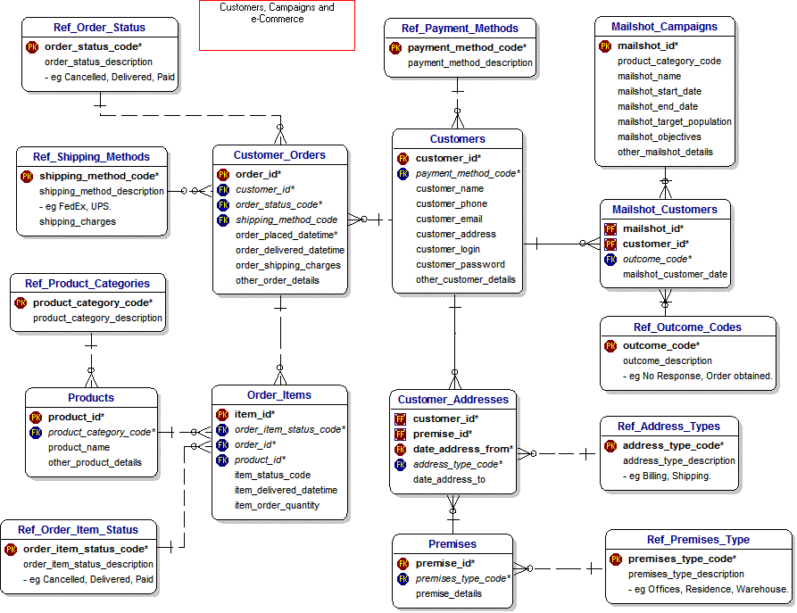
Snowflake Schema – Typical RDBMS Architecture

Slide 12
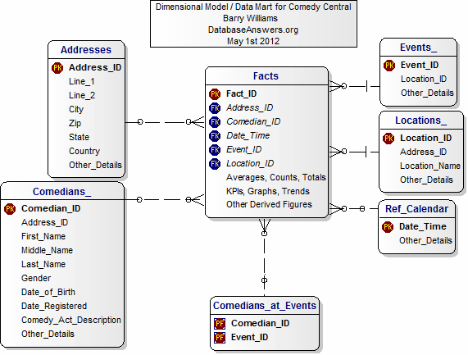
Star Schema – Typical BI-Tool Architecture

Slide 13
Star Schema v/s Snowflake Schema Comparison – Typical BI-Tool Architecture
 | Star Schema | Snowflake Schema
Ease of maintenance | Has redundant data and hence difficult to maintain / change | No redundancy, so snowflake schemas are easier to maintain and change
Ease of Use | Less query complexity and easy to understand | More complex queries and hence difficult to understand
Query Performance | Less number of foreign keys and hence shorter query execution time (faster) | More foreign keys and hence longer query execution time (slower)
Type of Data Warehouse | Good for DataMart’s with simple relationships (1:1 or 1:many) | Good to use for data warehouse with complex relationships (many:many)
Joins | Less Joins | Higher number of Joins
Normalization / DeNormalization | Both Dimension and Fact Tables are in De-Normalized form | Dimension Tables are in Normalized Fact Tables Are De-Normalized

Slide 14
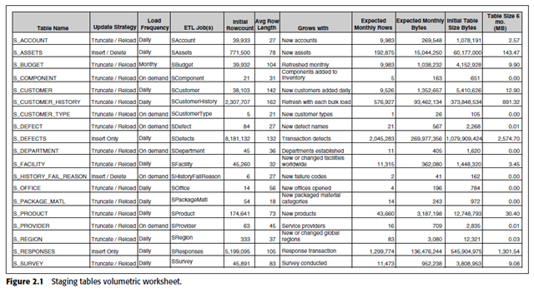
Staging Tables Volumetric Worksheet

Slide 15
Staging Tables Volumetric Worksheet - Information
Table Name
Load Frequency
ETL Job
Average Row Length
GrowsWith
Expected Monthly Rows
Initial Table Size
Table Size 6 Months

